Slide 1
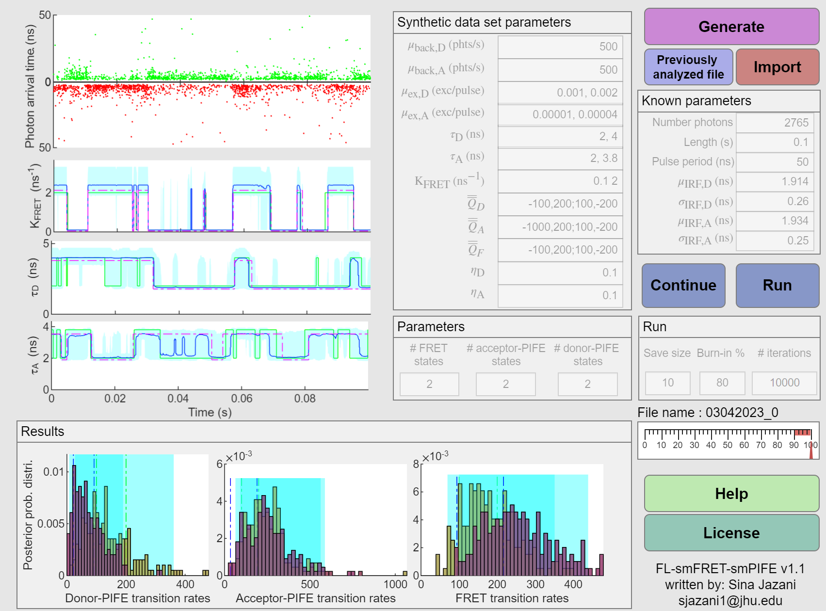
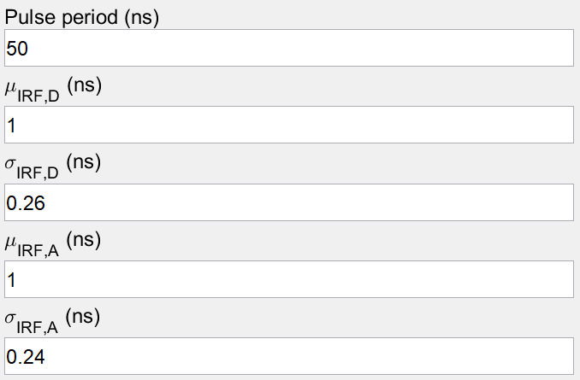
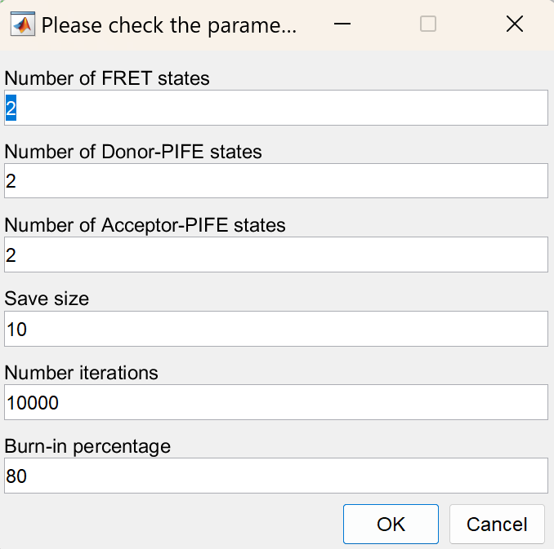
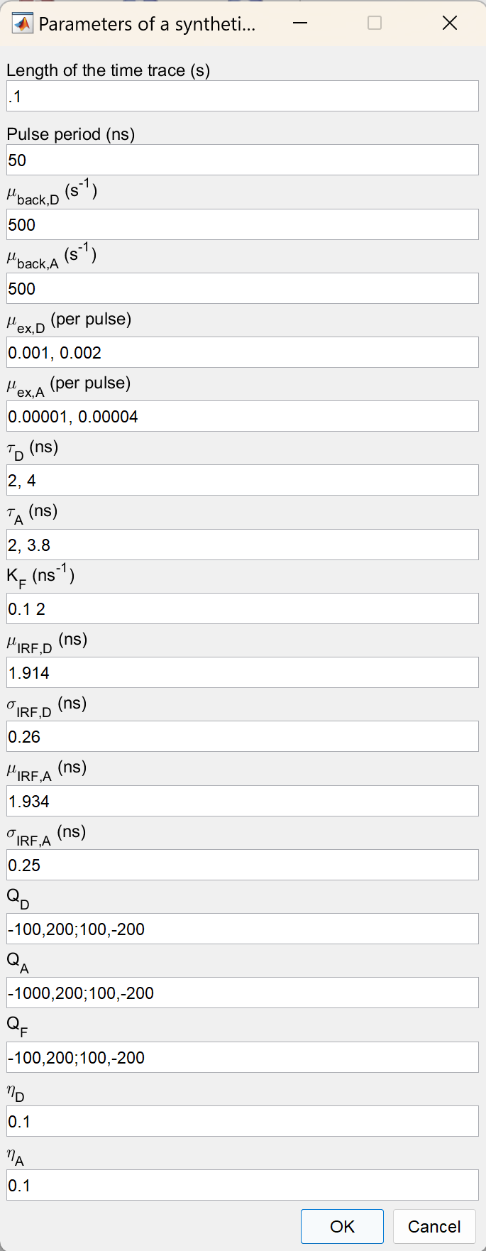
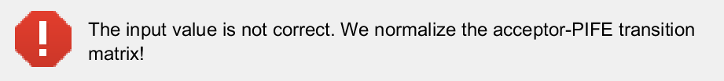

1
2: In the case of importing a trace, the user can press this key and a new window (22) will ask about the parameters and the file. The imported file can be in ‘.mat’ or ‘.txt’ file.
The order of the data should be a matrix with 3 rows (micro-times (ns), macro-times (s), channel index (1 or 2) ). The imported parameters will appear in parameter list 9. The imported time trace will be shown in plot 12.
*Note: Importing traces requires known parameters of IRF for both donor and acceptor channels, and the pulse period.
12
3
2
1
8
9
22: The new pop-up windows can be edited in order to generate the trace of interest. The parameters are:
Pulse period (ns)
Mean value of the donor IRF
Standard deviation of the donor IRF
Mean value of the acceptor IRF
Standard deviation of the acceptor IRF
2
13
22
3
14
5
4
4
5
15
10
11
3: This button can be useful in the case that the user want to visualize, analyze or reanalyze the previously generated, imported or analyzed data sets. It allows the user to select the file of interest and continue the analysis.
20
4: After generating or importing the time trace, the “Run” key will be available. Pressing this key leads to a pop-up window (23) asking for parameters listed in lists 10 and 11. All keys will disable while the program is running and gauge 19 will show the progress of the algorithm. After finishing the analysis, the results will show in plots 13, 14, 15, 16, 17 and 18. Also, the “continue” will be available for extra analysis.
19
6
1
16
17
18
7
23: The new pop-up windows can be edited in order to generate the trace of interest. The parameters are:
Maximum number of FRET states (For the analysis)
Maximum number of donor-PIFE states (For the analysis)
Maximum number of acceptor-PIFE states (For the analysis)
Period of saving the sampled parameter
Number of iteration for sampling the parameters
Burn-in percentage in order to remove the beginning part of the samples.
2
23
3
1: In the case of synthetic data, the user can generate time traces by clicking on the “Generate” key. Pressing this key automatically disables the rest of the app and a new pop-up window (21) will ask about the parameters that the user wants to use. These parameters will be shown in parameter lists 8 and 9. The generated time trace will be shown in plot 12. Also, the ground truth of the trajectories will be shown in plots 13, 14, and 15.
*Note: Parameters of the priors are fixed! These parameters are set in a way to make sure the effect of the prior is negligible compared to the likelihood.
4
5
21
6
21: The new pop-up windows can be edited in order to generate the trace of interest. The parameters are:
Length of the time trace (s)
Pulse period (ns)
Background rate collected in donor channel
Background rate collected in acceptor channel
Excitation rate of the donor per pulse
Excitation rate of the acceptor per pulse
Donor lifetimes
Acceptor lifetimes
FRET energy transfer rates
Mean value of the donor IRF
Standard deviation of the donor IRF
Mean value of the acceptor IRF
Standard deviation of the acceptor IRF
Donor-PIFE state transition matrix
Acceptor-PIFE state transition matrix
FRET state transition matrix
Cross-talk from donor to acceptor channel [0,1]
Cross-talk from acceptor to donor channel [0,1]
10
1
5: The “Continue” key will be available after the “Run” key. This key will allow the user to run the algorithm for larger iterations. After pressing this key, a pop-up window will ask the user about the number of extra iterations. While the algorithm is running the progress of the algorithm will be shown in gauge 19. After finishing the analysis, the results will show in plots 13, 14, 15, 16, 17 and 18. Also, the “continue” will be available for extra analysis.
6: The “Help” key will open the help pdf (this document).
7: The “License” key will open the license document.
8, 9, 10, 11: These are the list of the parameters that the data is generated or input by the user.
12,13,14,15,16, 17, 18: These are the plots related to the illustration of the time trace and the results of the algorithm.
19: This gauge shows the progress of the algorithm.
20: In all case the name of the file will be asked in order to save the sampled parameters. This will be done by a new pop-up window (24), which is editable and prename the file based on the data.
11
2
12
3
13
4
14
5
15
6
16
7
17
8
18
9
22
23
22: In the case that the transition matrices are not well normalized, this error will notify you that we normalize the matrices before generating the data.

