Slide 1
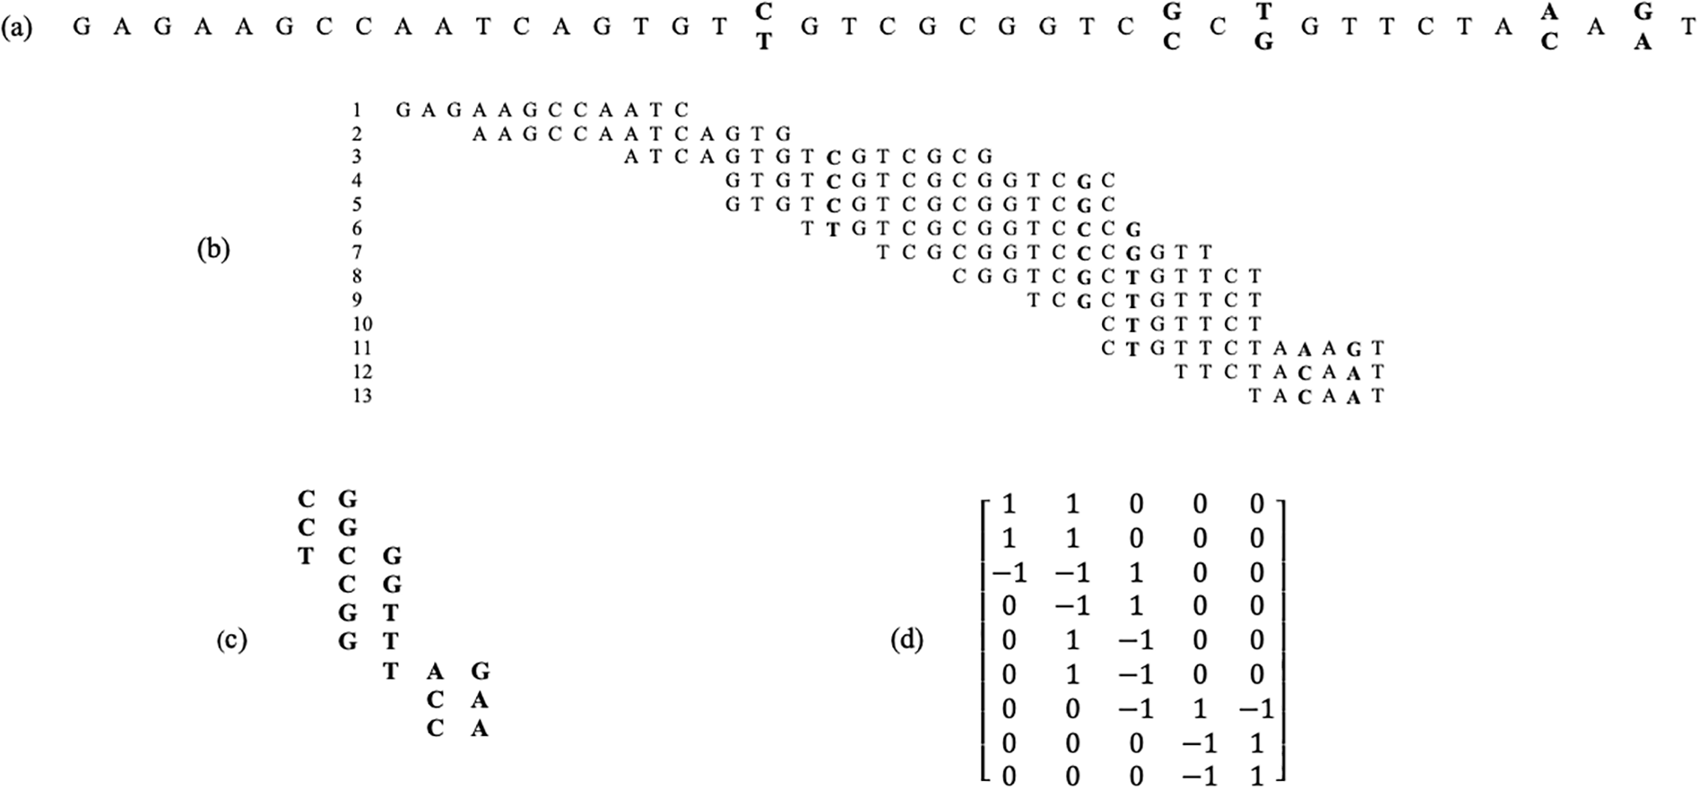
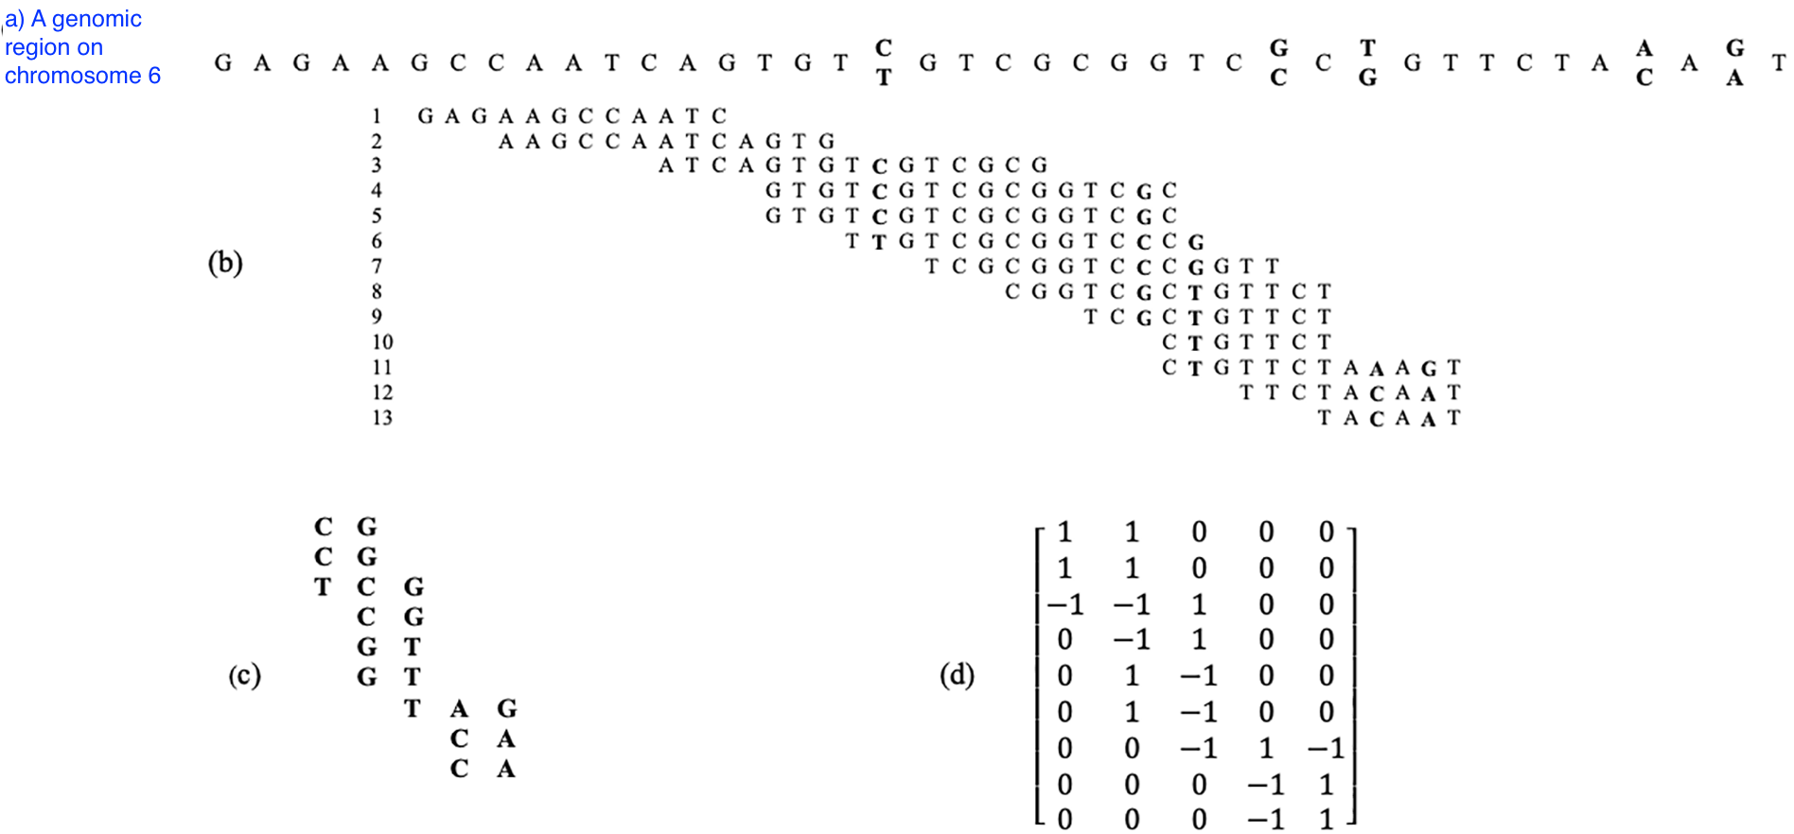
Reference genome
Sequencing reads aligned to reference
Modeling reads
Extracting variations
Haplotype estimation

Slide 2
