Slide 1
Post-COVID Wealth Landscape
Analyzing post-COVID billionaire trends to identify growth-driving sectors and strategies
Amanda Sinamane
Data Analyst | Analytics Engineer

Slide 2

Document Outline
Introduction
Project Overview
Tools & Workflow
Data-driven Insights
Context-specific Insights: South Africa
Recommendations
Reflections & Conclusion

Slide 3

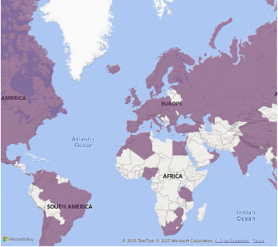
Project Overview
This project analyzes the 2020–2024 Forbes Billionaires list to explore how global wealth evolved in the wake of COVID-19.
The dataset comes from the Forbes Billionaires Evolution (1997–2024) collection on Kaggle, which tracks billionaire net worths annually.
By examining net worth, demographics, and industry trends, the goal was to uncover which types of billionaires contributed to economic recovery — and how countries might foster these growth sectors.

Slide 4
Project Overview What types of billionaires drove global economic growth post-covid, and how can countries foster these industries?
Core Objectives:
Clean and model raw data using SQL Server
Analyze global billionaire trends and compare with South Africa
Use EDA to uncover economic insights and patterns
Build an interactive Power BI dashboard to visualize findings

Slide 5




Tools & Workflow Data was cleaned and modeled using SQL Server views, then visualized in Power BI using a star-schema design.
Cleaned raw data using Python (Pandas + Wikidata API) and SQL
Used TRY_CAST, ROW_NUMBER(), LAG(), and window functions to transform multi-year date
Ensured data integrity through record counts, duplicate checks, and cross-year validation
Modeled data in POWER BI, using slicers and charts to explore time-based trends

Slide 6
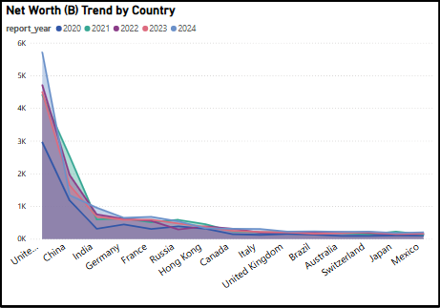
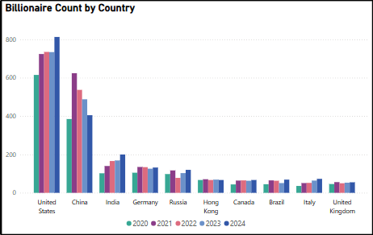
Data-driven Insights Global Trends in Wealth & Count

Slide 7
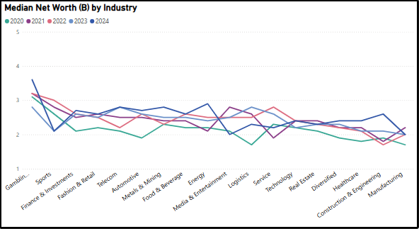
Data-driven Insights Industries & Median Wealth

Slide 8
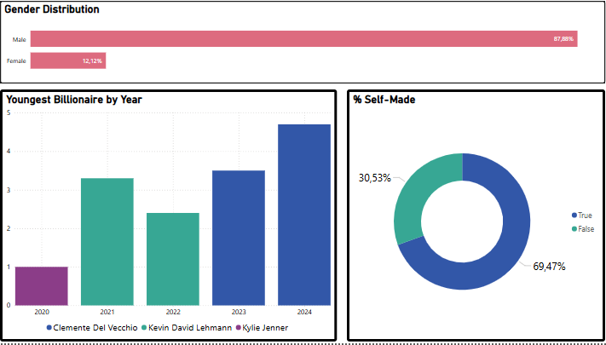
Global Billionaire Trends Demographics & Notable Changes

Slide 9
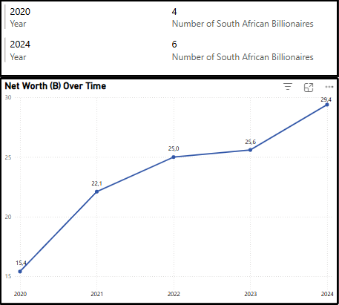
Data-driven Insights South African context
South Africa’s billionaire count rose from 4 to 6 between 2020 and 2024.
Net worth increased from $15.4B to $29.4B, despite a small billionaire population
Industries represented: Mining, Retail, Media, and Finance
However, wealth remains highly concentrated, highlighting a lack of broad participation

Slide 10
Recommendations Based on Global Trends
Strategies governments and stakeholders can adopt to stimulate economic growth:
Support high-growth countries: Incentivize sectors like tech, pharma, and fintech in India, China, and the U.S.
Double down on high-net-worth industries: Finance & Investments, Technology, and Manufacturing
Expand participation: Create female founder accelerators and youth innovation hubs
South Africa: Incentivize scalable entrepreneurship beyond traditional sectors
👉 Full breakdown of insights + recommendations: [Link to GitHub or Notion]

Slide 11
Reflections and & Conclusions This project used data from Forbes (2020–2024) to explore billionaire-led economic trends and shifts post-COVID.
What I uncovered:
What I gained:
A rise in self-made billionaires, especially among women and youth
Continued gender gaps in wealth accumulation
Dominance of Finance, Tech, and Manufacturing in billionaire wealth creation
Strengthened SQL and backend modeling skills
Experience working with multi-year, real-world datasets
A deeper appreciation for how data cleaning enables meaningful analysis

Slide 12
THANK YOU
LET’S Talk:

