Slide 1
Quickdex Architectural Design

Slide 2
Preferred Architectural Style
Abstract Data Type

Slide 3
Preferred Architectural Style
Abstract Data Type

Slide 4
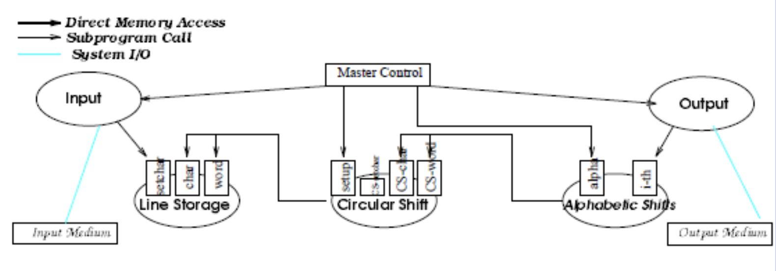
[1]

Slide 5
This diagram gave us PTSD!
So let’s redraw it!
[1]

Slide 6
This diagram gave us PTSD!
So let’s redraw it!
[1]

Slide 7
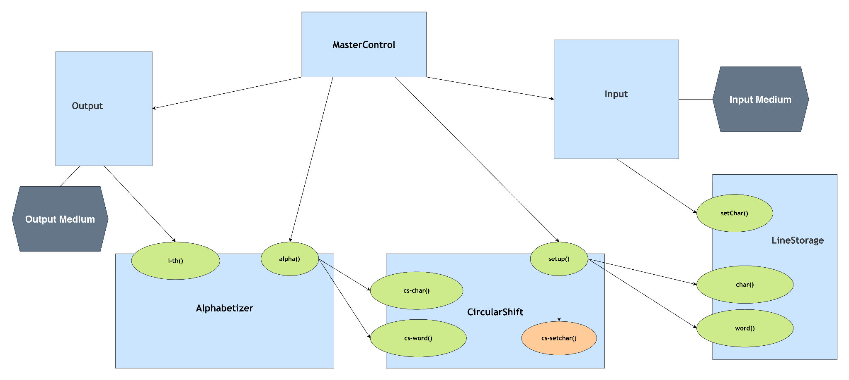
ADT Architectural Diagram by Shaw and Garlan

Slide 8
Problems with the diagram
Unclear operation names
  Operations like Char, Word, Alpha, and i-th were too vague.
Mixed responsibilities
  Input, processing, and output tasks were not clearly separated.
Poor encapsulation
  Internal processing was exposed instead of being hidden behind public interfaces.
Unclear module interfaces
  It was not obvious what data each module receives and returns.
Weak separation of business logic
  Shift generation and alphabetization were not clearly isolated from data access.

Slide 9
Problem: Operation names were vague

Slide 10

Fix: Replace them with descriptive names

Slide 11
Problem: Reading and storing Input were not clearly separated

Slide 12
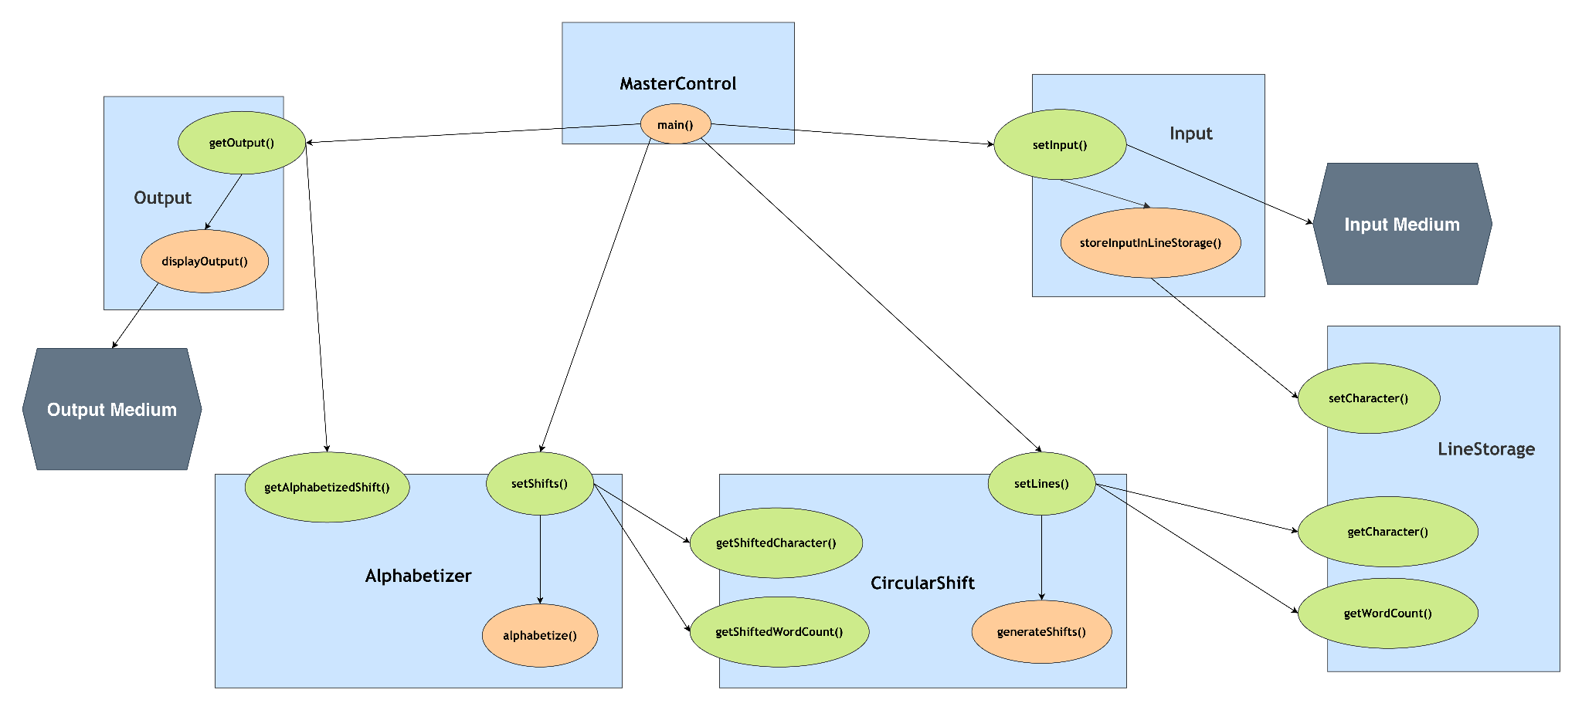
Fix: Reading and storing Input are separated

Slide 13
Problem: Input, processing, and retrieval
were not clearly separated in Alphabetizer

Slide 14
Fix: Separate input, processing, and retrieval in Alphabetizer

Slide 15
Problem: Retrieving and displaying the result were mixed

Slide 16
Fix: Retrieving and displaying the result are separated

Slide 17
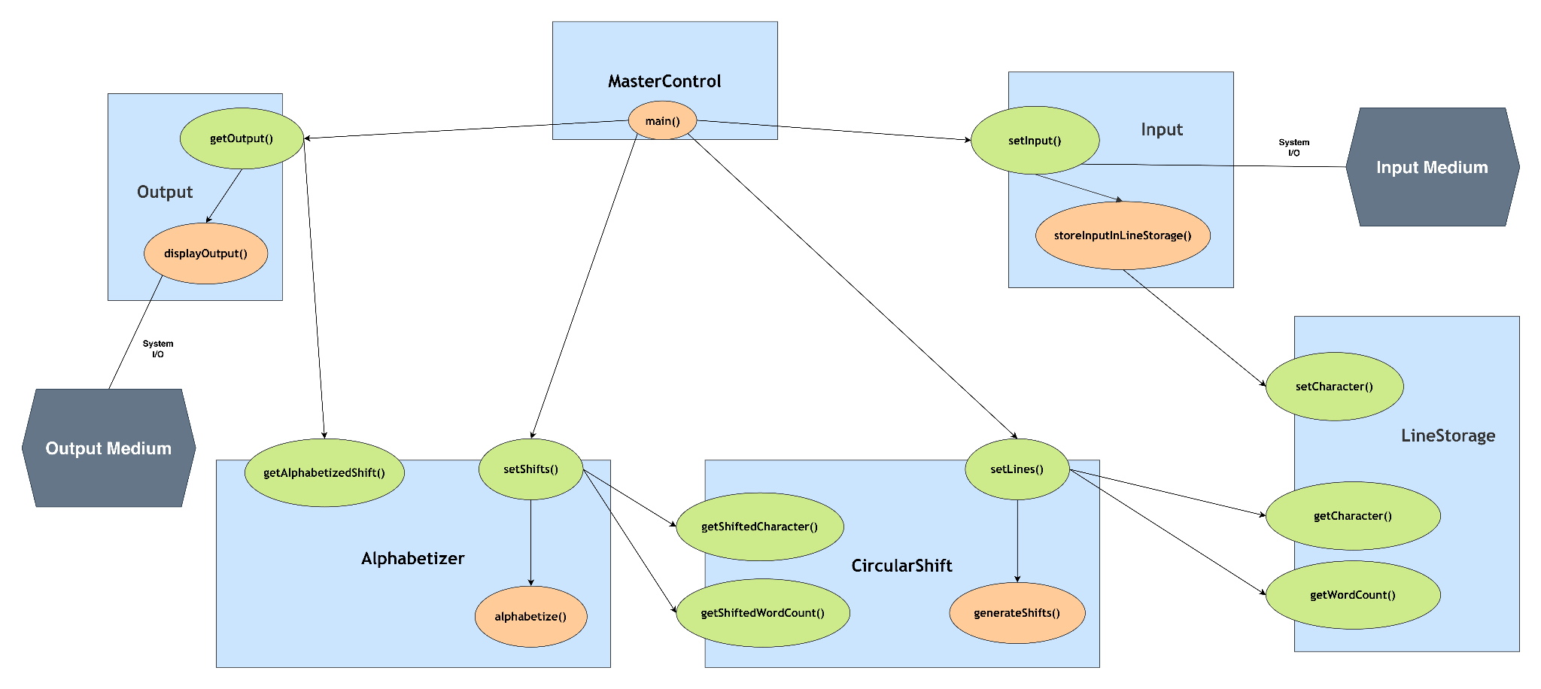

Slide 18
We have defined the Architectural Style
And also the Components and Connectors
Now we need to define the Constraints

Slide 19
We have defined the Architectural Style
And also the Components and Connectors
Now we need to define the Constraints

Slide 20
We have defined the Architectural Style
And also the Components and Connectors
Now we need to define the Constraints

Slide 21
Constraints
Incremental Processing
  Processing must happen one line at a time.
Incremental Merge
  Must retain previous alphabetized shifts and merge them with the current line's shifts.
Output Timing
  Output keeps updating based on incremental processing
Information Hiding
  Each component exposes (public) only the operations required by other components.

Slide 22
Now we talk about the most important part

Slide 23
RATIONALE

Slide 24
Architectural Rationale - Modifiability of Algorithms
These processing algorithms are isolated within their components.
Thus, algorithm changes have minimal impact on other components.

Slide 25
Architectural Rationale - Modifiability of Algorithms
These processing algorithms are isolated within their components.
Thus, algorithm changes have minimal impact on other components.

Slide 26
Architectural Rationale - Modifiability of Data
Data representation is hidden behind component operations.
Changes to how lines, characters, or shifts are stored (e.g., type of array, compressed/uncompressed) do not require changes to clients.
Supports alternative storage representations.

Slide 27
Architectural Rationale - Enhanceability
New components can be added for additional functionality.
  Noise word elimination will be added in phase 2.
Existing components can be extended without exposing their internal processing algorithms.
New enhancements require minimal changes to other components.

Slide 28
Architectural Rationale - Reusability
Components have focused responsibilities:
  Input — input acquisition
  LineStorage — data storage
  CircularShift — shift generation
  Alphabetizer — global sorting
  Output — presentation
Components make fewer assumptions about other components.

Slide 29
Architectural Rationale - Performance
Space
  Alphabetizer must retain previously alphabetized shifts for global ordering.
    Shift storage can therefore grow with the total number of circular shifts.
  Different components need individual copies of data.
  Nowadays, memory is relatively abundant, making this space cost less significant.
Response Time
  Data copying in different components cost time.
  Incremental processing saves time by using RAM instead of hard drives.
  Incremental sorting (merge sort) avoids re-sorting the entire collection after every line.

Slide 30
Thus, we chose
Abstract Data Type Architecture

Slide 32
Thank You

Slide 33
References
[1] Shaw, M., & Garlan, D. (1996). Software architecture (Vol. 101). Englewood Cliffs: prentice Hall.

