Slide 1
Short-term water demand forecasting tool
b-watersmart.eu

Slide 2
Introduction
Motivation
Growing peak loads due to increasingly extreme weather (e.g. droughts)
Risk of local water shortages
Water demand forecasts help anticipate peak loads and enable water distribution in an efficient manner.
Forecasts often only exist on a very high level (e. g. for the whole network or single DMAs).
Complex network structures make the identification of the individual water consumption of households, industrial and agricultural users difficult and thus, the provision of water demand forecasts for smaller supply areas difficult.
Short-term water demand forecasting tool
Developed in the scope of the B-WaterSmart project
Generates 24-hour water demand forecasts based on smart meter data
Different spatial resolutions (e.g. per household or group of households)
Produces a better knowledge base that helps manage the water supply system efficiently and sustainably

Slide 3
A scenario of use
Scenario of use (from B-WaterSmart)
Collaboration with East Frisia LL
Peak water consumption during evening hours highly increased in the city of Löhne since 2018
The complexity of the network does not allow for monitoring water discharge from one reservoir to a single customer or small district
Install smart meters to identify customer (group) responsible for increased peak consumption
Use tool to adapt tank level management based on the data to increase efficiency and sustainability
Remarks
As of 2023, the installed smart meters are still collecting data and the tool has not been fully applied to this use case
We explored if the tool could be applied to households that don’t have any smart meters installed, but that was not possible due to a lack of high quality socio-economic data and a proper evaluation approach

Slide 4
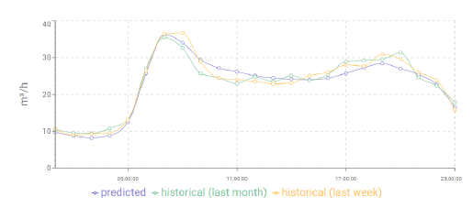
How to use the tool (high level overview)
Collect data
Smart meter installation
Measurement of water consumption (or flow) over a period of at least 1 year (preferably 3 years)
Optionally, capture any additional data that the tool should take into account (e.g. weather)
Install the tool
Connect data streams to tool
Use the tool‘s optional UI or build a custom UI in your own existing platform
Alternatively, use the tool headless (i.e. without UI)
Generate value
Create water demand forecasts manually or automatically
Take action based on forecasts manually or automatically

Slide 5
Forecast Generation
Algorithms
Machine learning = using past experience (data) to learn to solve a task
Six available machine learning algorithms to choose from based on
Available computational resources (some algorithms require GPUs)
What gives the best result for the given data
Variety of algorithms that have different strengths
Statistical
Arima, Triple Exponential Smoothing, Prophet
Efficient and effective for data with strong seasonal trends
Deep Learning / Neural Network based
N-Beats, Temporal Fusion Transformer
Inefficient, but highest potential to learn complex patterns
Classical machine learning
XGBoost
Both efficient and high potential to learn complex patterns
For most cases, offers the best trade-off between computation time and results

Slide 6
Bayesian Optimization and HyperBand (BOHB)
Hyperparameter optimization
For every algorithm, hyperparameters have to be chosen that affect the end result
The user may not know what a hyperparameter does
Commonly, the choice is not obvious and needs to be found empirically (trial and error)
Solution: let the tool find the best hyperparameters („hyperparameter optimization“)
But what if model training takes very long? Cannot test every possible set of hyperparameters
Bayesian Optimization and HyperBand (BOHB)
State-of-the-art hyperparameter optimization algorithm
Both efficient and effective
Finds very good sets of hyperparameters with a limited computing budget
Example by analogy
A cook has a kitchen full of ingredients (hyperparameters)
He can combine the ingredients to create a myriad of different dishes (forecasting models)
Wants to find the most delicious dish
The cook selects 8 recipes based on an educated guess from experience (Bayesian Optimization)
The 8 recipes enter a competition to find the best one (HyperBand)

Slide 7








Bayesian Optimization and HyperBand (BOHB)
Round 1 – Cook every recipe in 1/8th of the time (i.e. none rises to its full potential)

Slide 8
Bayesian Optimization and HyperBand (BOHB)
Round 1 – Cook every recipe in 1/8th of the time (i.e. none rises to its full potential)
Eliminate half of the recipes and keep the best

Slide 9
Bayesian Optimization and HyperBand (BOHB)
Round 1 – Cook every recipe in 1/8th of the time (i.e. none rises to its full potential)
Eliminate half of the recipes and keep the best
Round 2 – Cook every recipe again, but double the effort (i.e. spend 1/4th of the time)
Repeat until one recipe remains

Slide 10
Bayesian Optimization and HyperBand (BOHB)
Round 1 – Cook every recipe in 1/8th of the time (i.e. none rises to its full potential)
Eliminate half of the recipes and keep the best
Round 2 – Cook every recipe again, but double the effort (i.e. spend 1/4th of the time)
Repeat until one recipe remains

Slide 11
Bayesian Optimization and HyperBand (BOHB)
Round 1 – Cook every recipe in 1/8th of the time (i.e. none rises to its full potential)
Eliminate half of the recipes and keep the best
Round 2 – Cook every recipe again, but double the effort (i.e. spend 1/4th of the time)
Repeat until one recipe remains
We have spent the time to cook 3 full dishes, but explored 8 recipes (works with more recipes, too)
Similar (although not equivalent) to how BOHB finds the best model hyperparameters

Slide 12
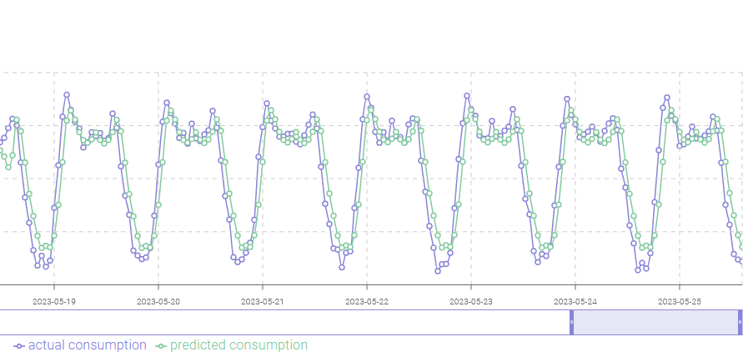
Model Evaluation
How does the user know if a model is good?
Model evaluation
Split into a train and test dataset
Train model only on train dataset
Compute error metrics on test dataset
Visualize predictions on test dataset for interpretability
Train the final model on the full dataset
Train a model on the train data for evaluation
70% train data
30% test data
Train a final model on all data for actual use

Slide 13
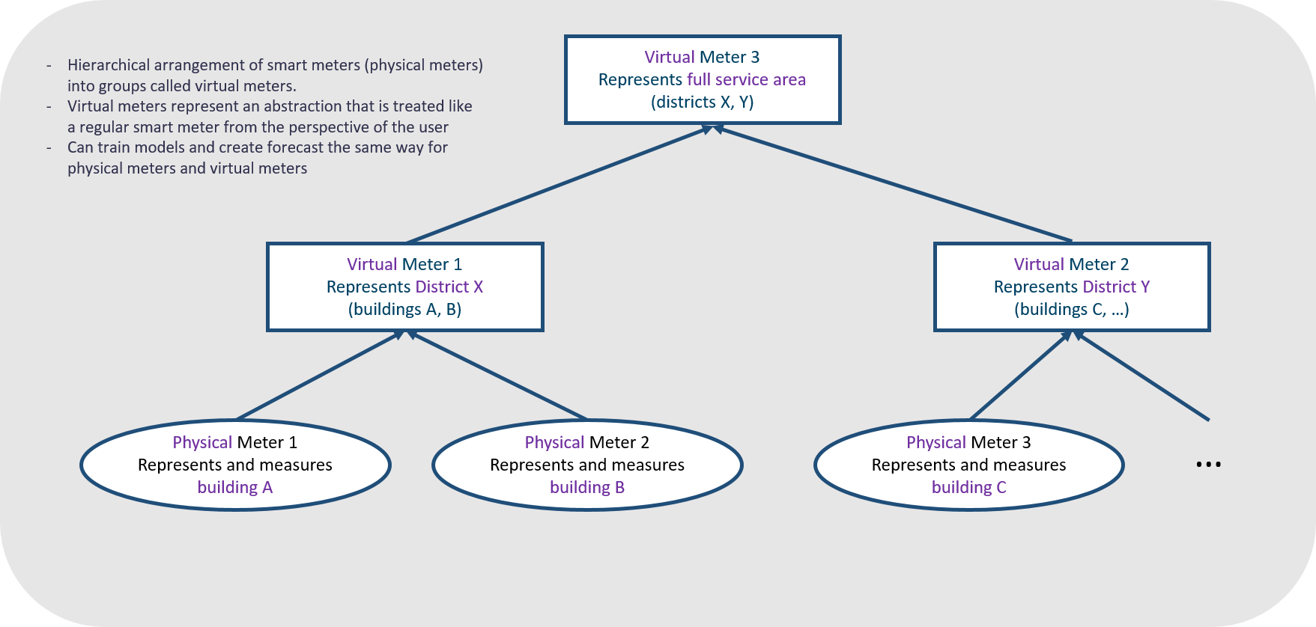
Spatial Resolution
Spatial resolution
Forecasts for different spatial resolutions possible
The smallest spatial resolution is a forecast per smart meter
A smart meter can represent a household or a district
Smart meters can be aggreated to represent larger areas
A forecast can be generated for a smart meter or a group of smart meters („virtual meter“)
In the case of a group of smart meters, the individual consumption is aggregated to a single time series and a single model is trained (training a model for every smart meter is too computationally demanding)

Slide 14
Forecast Generation
Data
Only water consumption time series data is required to use the tool
Optionally, additional data can be used if it provides valuable information
Usually weather data like temperature, precipitation, etc…
But any kind of data is possible, e.g.
if a certain local event currently takes place
dynamic information from an industrial or agricultural client
The tool defines interfaces through which this data can be connected

Slide 15
Interoperability
FiWare
Open-source platform developed as part of an EU project
Provides interoperability standards for developing a smart digital infrastructure (smart city)
Short-term water demand forecasting tool
FiWare-compliant
Possible to give external organisations access to generated forecasts
For consistency and security reasons, they cannot train models themselves but only access forecasts
Others can build services on top of water demand forecasts (and other organisation‘s data / services)

Slide 16
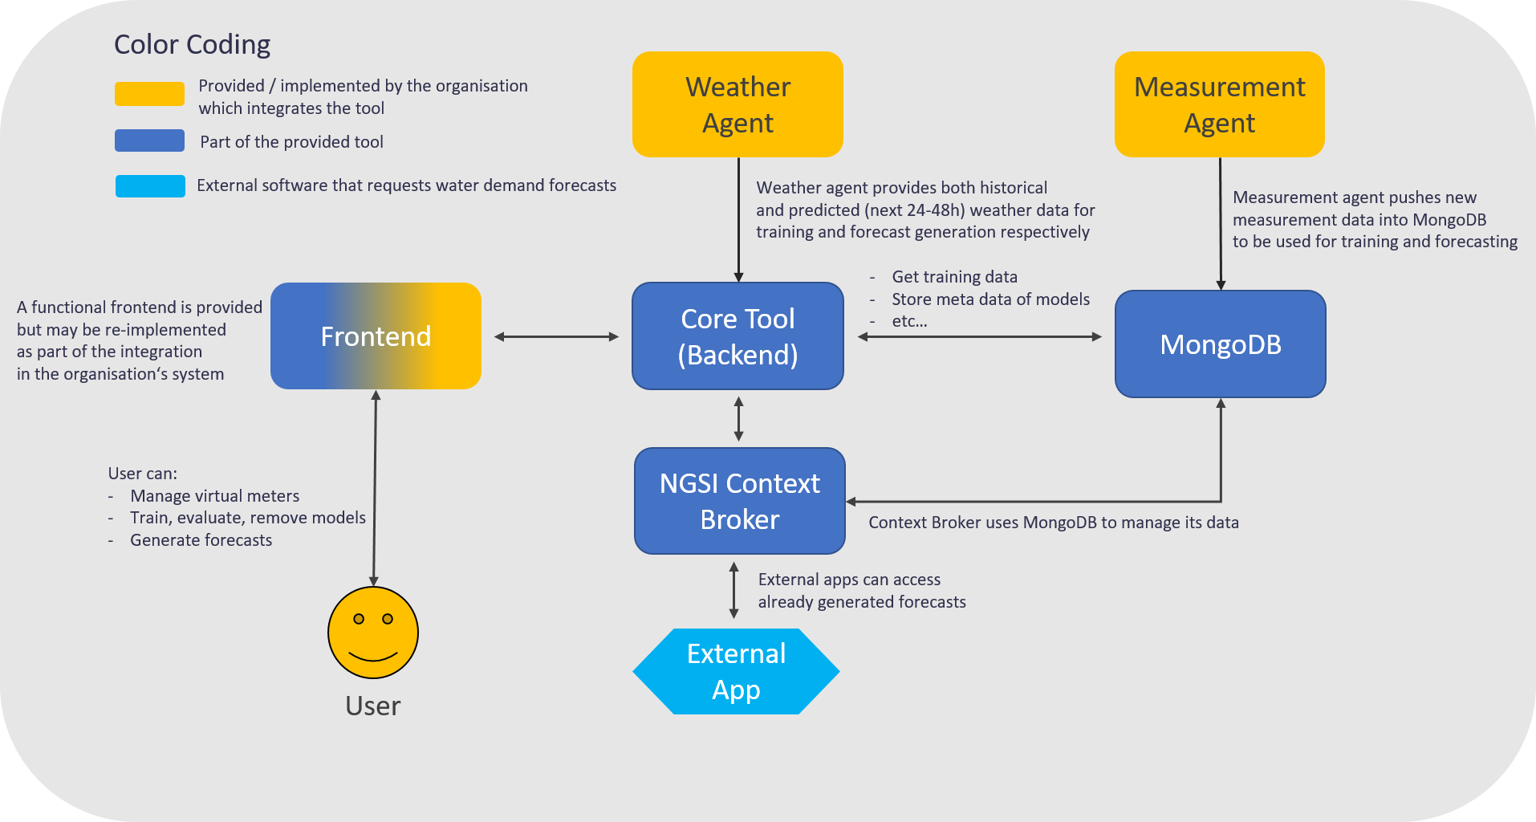
Tool Architecture

Slide 17
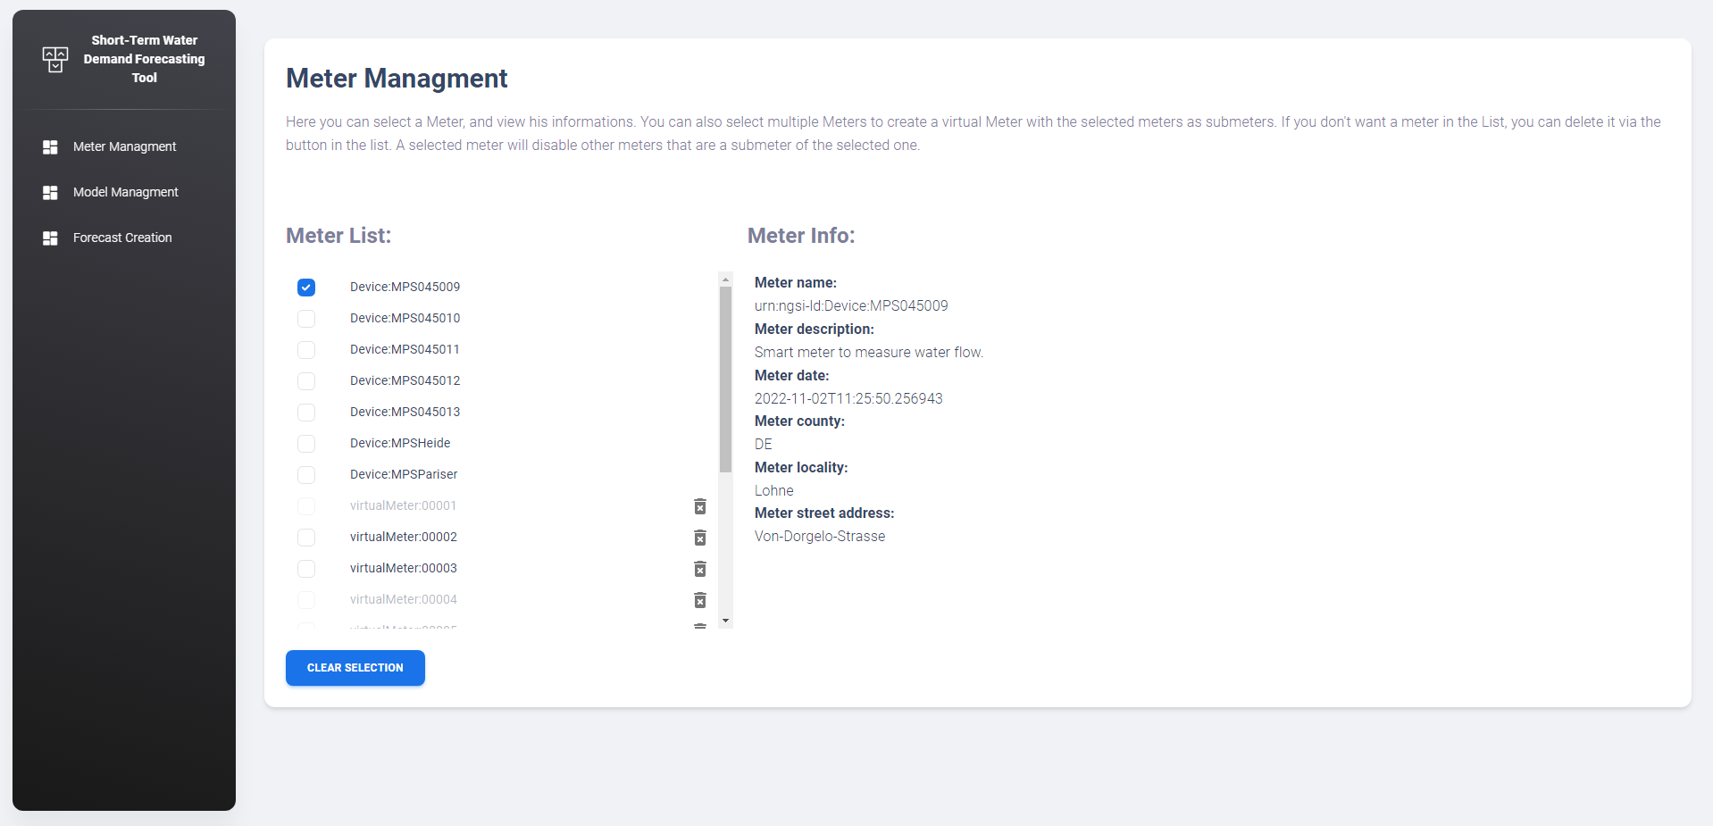
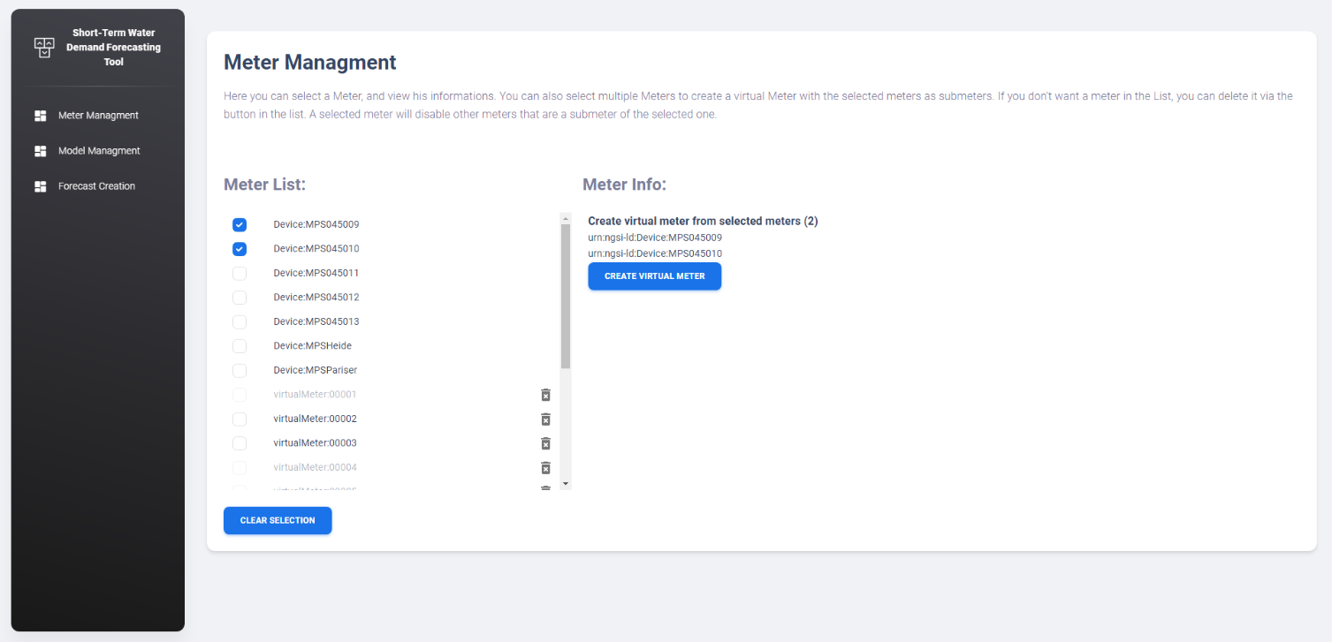
Workflow I – Managing groups of meters (virtual meters)
Create or delete groups of smart meters (virtual meters)

Slide 18
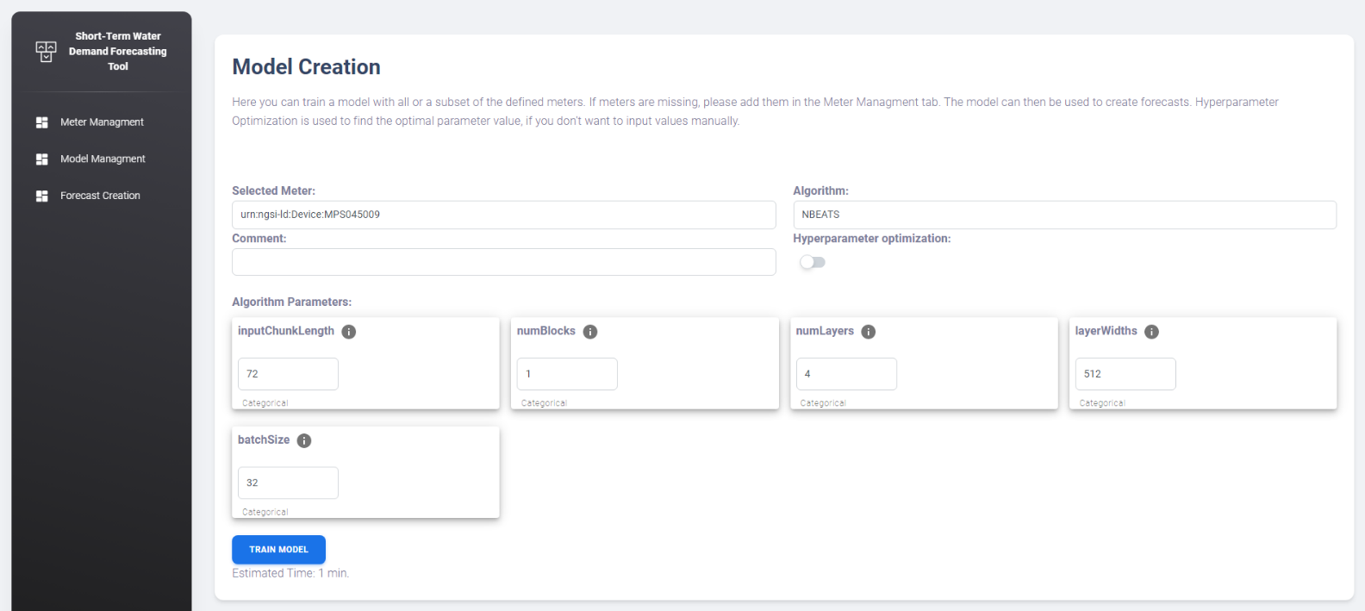
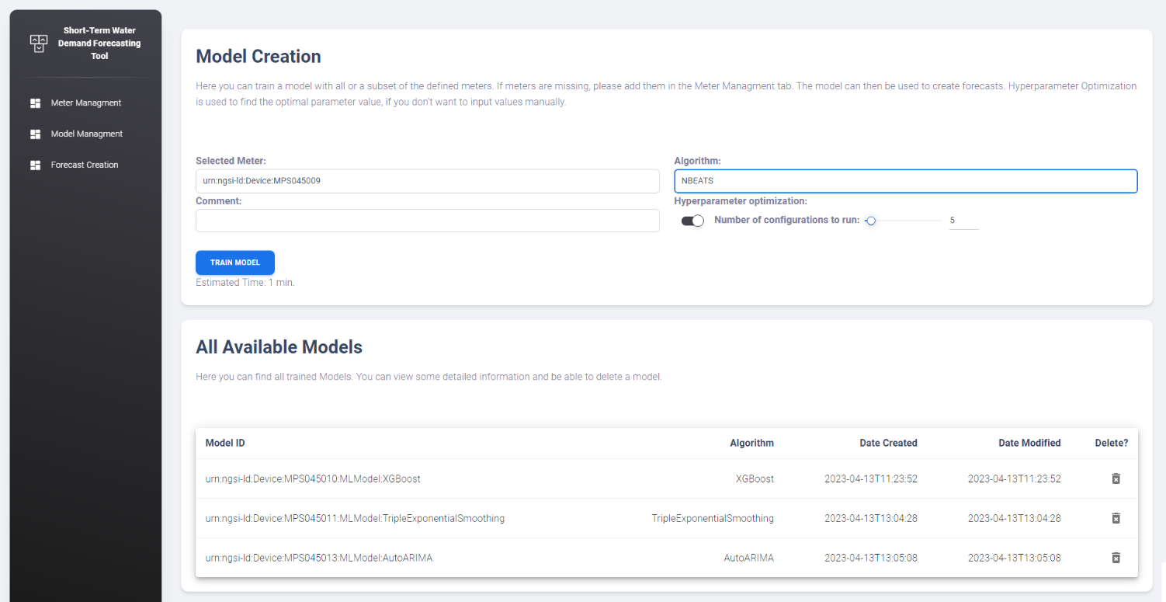
Workflow II – Training a Model
Select meter and algorithm
Select hyperparameters (top image)
Alternatively, select hyperparameters automatically based on multiple test runs (bottom image)

Slide 19
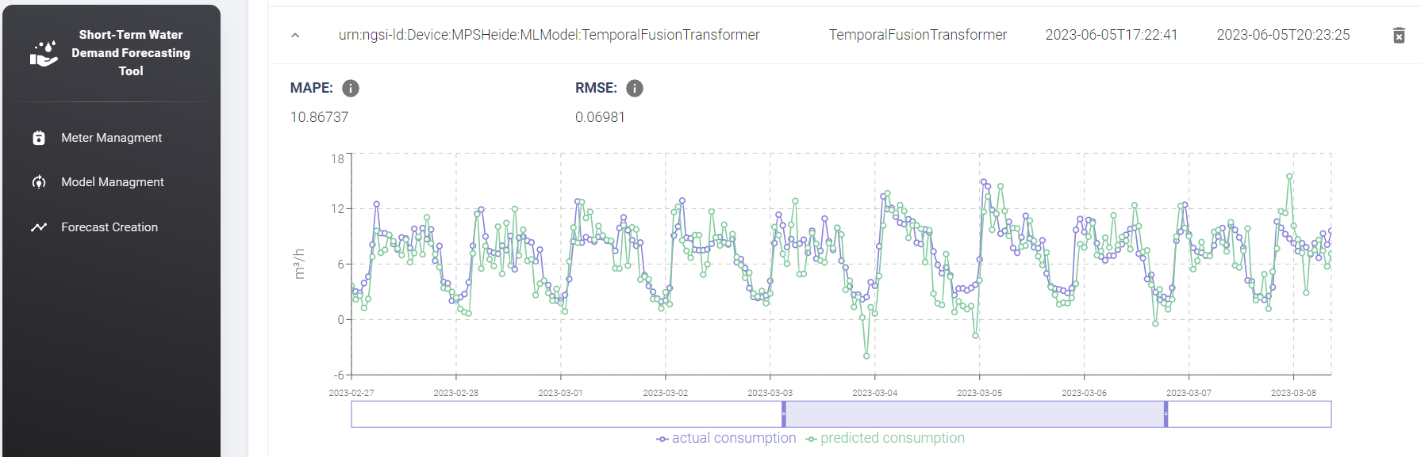
Workflow III – Check Model Evaluation
15-30% of the data is used for evaluation before training the model on the whole dataset
Users can plausibility check the predictions of the model on this evaluation dataset

Slide 20
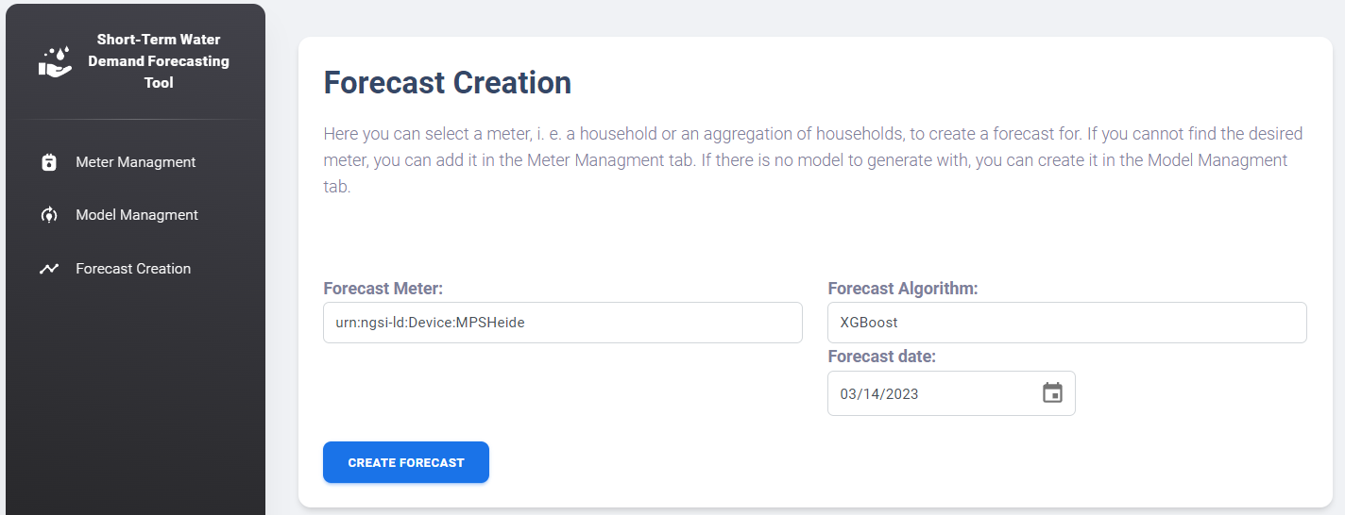
Workflow IV – Query the Model
Select date for which to generate a forecast for

Slide 21
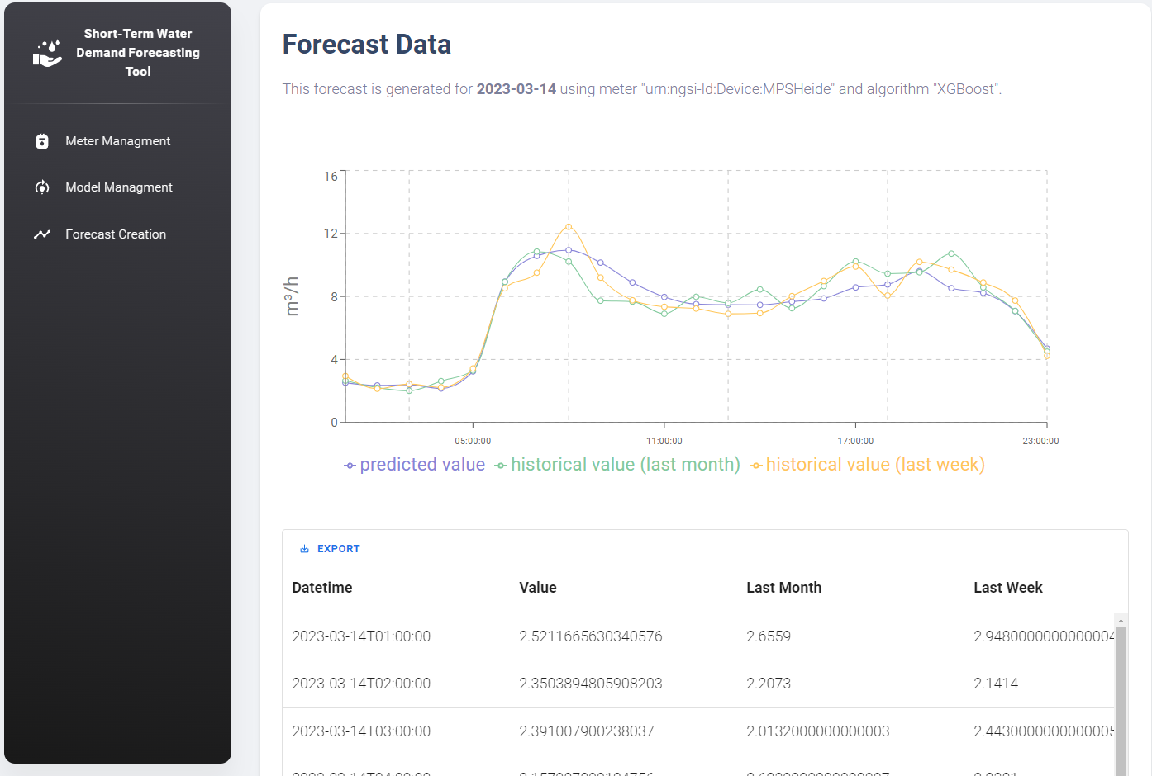
Workflow IV – Query the Model
Compare predicted consumption to historical consumption of the same weekday of the last week or month
All of the steps shown can also be done without any UI

Slide 22
Final Remarks
As of 2023, this tool is not available as a Software-as-a-Service
It is an open-source tool that has to be deployed and maintained by the organisation that wants to use it
More info
https://mp.watereurope.eu/d/Product/58
https://github.com/iwwtech/bws-short-term-forecasting
https://github.com/iwwtech/bws-short-term-forecasting-ui

