Slide 1
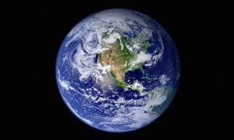
World Happiness Project

Slide 2
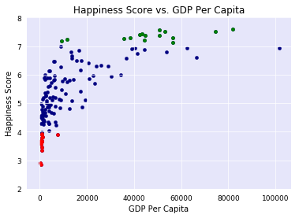
Spain
HS:6.3 GDPPC:$25K
0.73
Luxemburg
HS:6.9
GDPPC:$111K
USA
HS:7.1 GDPPC:$56K
Brundi
HS:2.9 GDPPC:$300

Slide 3
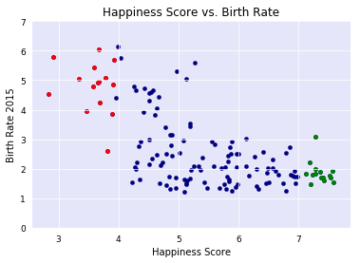
Chad
BR:6 HS:3.6
Zambia
BR:5 HS:5.1
Armenia
BR:1.6 HS:4.3
Switzerland
BR:1.5 HS:7.6

