Slide 1

World Happiness Project

Slide 2

Team Members:
Sinan Cengiz
Ricardo Tirado
Kan Ming
Tiffany Kao

Slide 3

Project Description/Outline:
We have a data set from 2015 to 2017 which contains happiness scores of countries. We will examine the data set and answer following questions then put our finding in our final presentation to make it more visually understandable for consumers to help their decision-making process.

Slide 4
Research Questions to Answer:
Question 1 - Which region of the world has higher mean happiness score then other regions?
Question 2 - Is there any correlation between GDP per capita and happiness score?
Question 3 - Does countries has higher level freedom, also has higher happiness score? Relationship between freedom level and happiness level?
Question 4 - Does people have higher happiness level, also has higher life expectancy?

Slide 5
Research Questions to Answer:
Question 5 - Does being more happy make people to have more babies or not. If there a correlation between happiness and fertility rate what is the direction?
Question 6 - Does Form of government influence the level of happiness?
Question 7 -
Question 8 -

Slide 6
Data Sets to be Used in the Project
Happiness scores by country from https://www.kaggle.com/unsdsn/world-happiness
GDP Per Capita by Country Data : World Bank open data sources : http://databank.worldbank.org/data/reports.aspx?
Fertility Rate Per Woman Data : World Bank open data sources : http://databank.worldbank.org/data/reports.aspx?

Slide 7
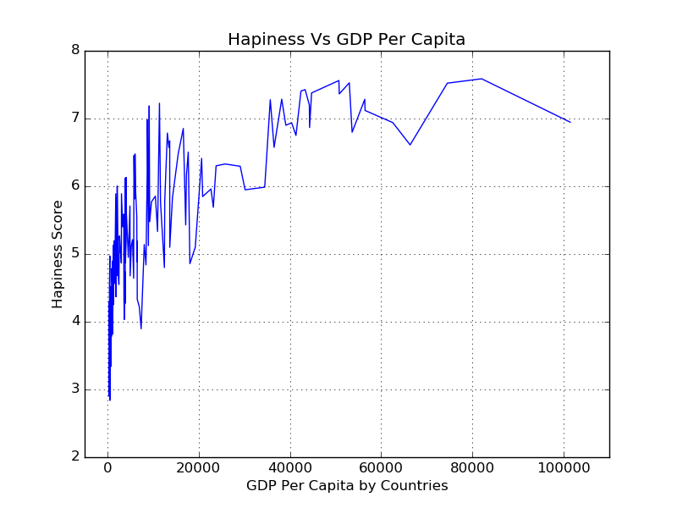
Question 2 – Happiness Score and GDP Per Capita
Correlation Analysis
Spain
HS:6.3 GDPPC:$25K
Pearson r correlation coefficient =
0.73
According to results of our analysis we can state that there is a strong positive relationship between Happiness Score and GDP Per Capita of a country
Luxemburg
HS:6.9
GDPPC:$111K
USA
HS:7.1 GDPPC:$56K
Regression Analysis Result
Observations 137
R Square 0.530437094
Significance F 6.46E-24
P-value 6.46E-24
Coefficients 0.0000437763
Each 10K = 0.437763 HS
Each 30K = 1.313289 HS
Brundi
HS:2.9 GDPPC:$300

Slide 8
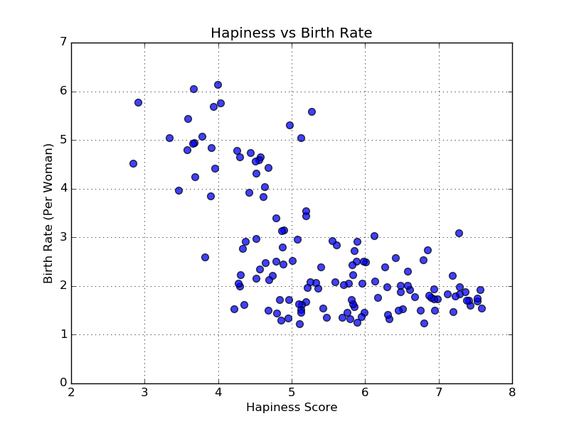
Question 3 – Birth Rate and Happiness Score
Correlation Analysis Birth Rate
Pearson r correlation coefficient =
-0.32
Chad
BR:6 HS:3.6
Zambia
BR:5 HS:5.1
According to results of our analysis we can state that there is a weak-medium negative relationship between Happiness Score and Birth Rate of a country
Regression Analysis Result
Observations 137
R Square 0.41558496
Significance F 1.88791E-17
P-value 1.88791E-17
Coefficients -0.726368483
Armenia
BR:1.6 HS:4.3
Switzerland
BR:1.5 HS:7.6

