Slide 1

World Happiness Project

Slide 2

Team Members:
Sinan Cengiz
Ricardo Tirado
Kan Ming
Tiffany Kao

Slide 3

Project Description/Outline:
We have a data set from 2015 to 2017 which contains happiness scores of countries. We will examine the data set and answer following questions than put our finding in our final presentation to make it more visually understandable for consumers to help their decision-making process.

Slide 4
Research Questions to Answer:
Question 1 - Which region of the world has higher mean happiness score then other regions?
Question 2 - Is there any correlation between GDP per capita and happiness score?
Question 3 - Does countries has higher level freedom, also has higher happiness score? Relationship between freedom level and happiness level?
Question 4 - Does people have higher happiness level, also has higher life expectancy?

Slide 5
Research Questions to Answer:
Question 5 - Does being more happy make people to have more babies or not. If there a correlation between happiness and fertility rate what is the direction?
Question 6 - Does less trust in government lead to higher levels of terrorism?
Question 7 -
Question 8 –

Slide 6
Data Sets to be Used in the Project
Happiness scores by country from https://www.kaggle.com/unsdsn/world-happiness
GDP Per Capita by Country Data : World Bank open data sources : http://databank.worldbank.org/data/reports.aspx?
Fertility Rate Per Woman Data : World Bank open data sources : http://databank.worldbank.org/data/reports.aspx?

Slide 7
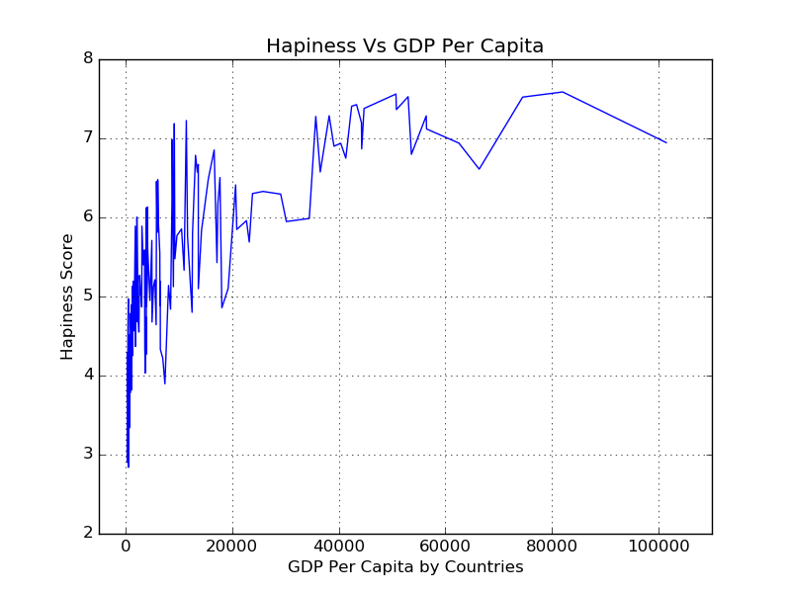

Slide 8
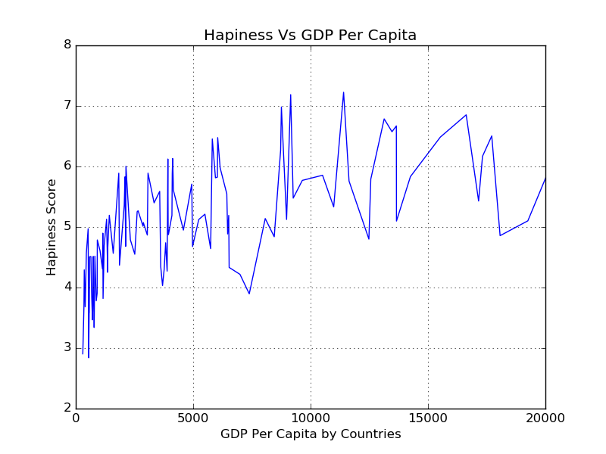

Slide 9
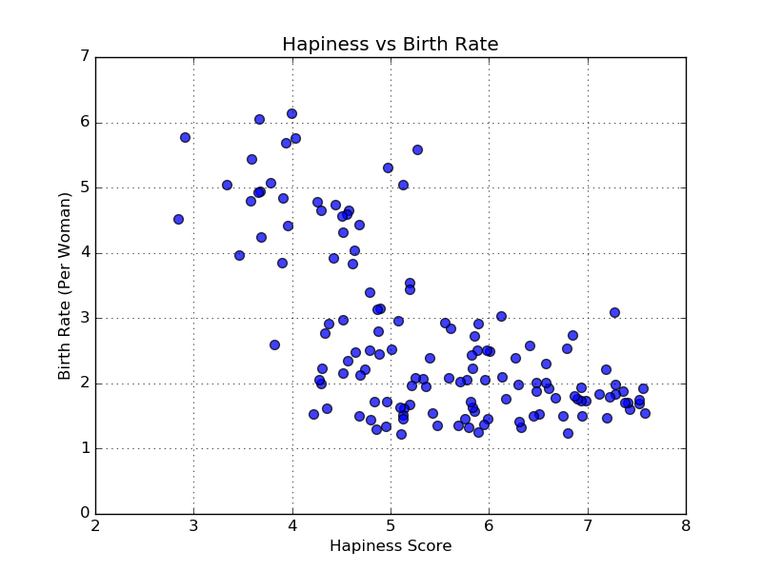

Slide 10
Correlation Test
Pearson r correlation: Pearson r correlation is the most widely used correlation statistic to measure the degree of the relationship. For example, in the stock market, if we want to measure how two stocks are related to each other, Pearson r correlation is used to measure the degree of relationship between the two.
Correlation coefficients between 0.10 and 0.29 represent a small association or relationship,
Correlation coefficients between 0.30 and 0.49 represent a medium association or relationship,
Correlation coefficients of 0.50 and above represent a large association or relationship.

Slide 11
Correlation Test Result for Happiness – GDP Per Capita
Happiness - GDP Per Capita
r (Pearson r correlation coefficient) =
0.73372
According to results of our analysis we can state that there is a strong positive relationship between GDP Per Capita and Happiness Score of a country

Slide 12
Correlation Test Result for Happiness – Birth Rate
Happiness - GDP Per Capita
r (Pearson r correlation coefficient) =
-0.32519
According to results of our analysis we can state that there is a medium negative relationship between Birth Rate and Happiness Score of a country

Slide 13

Regression Analysis
Regression analysis generates an equation to describe the statistical relationship between one or more predictor variables and the response variable.

Slide 14
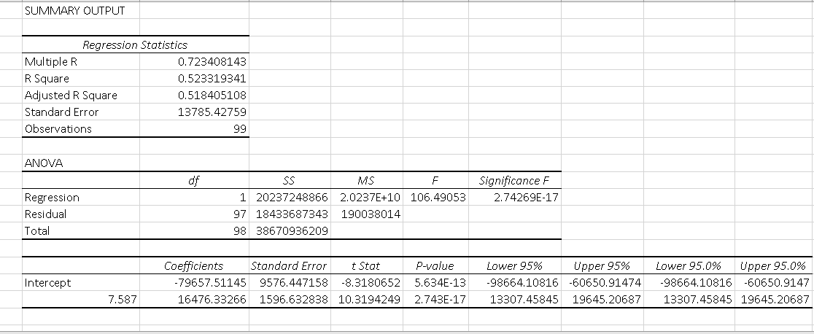
Regration Analysis Happiness – GDP Per Capita

Slide 15
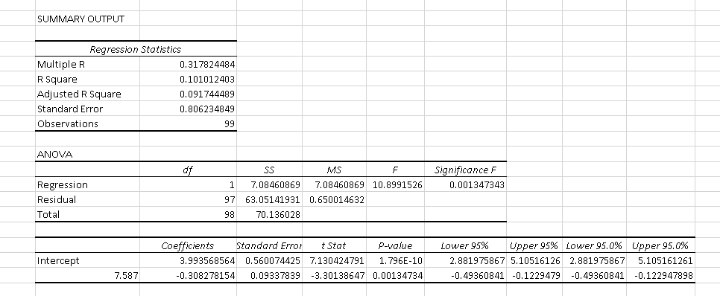
Regression Analysis Hapiness – Birth Rate

Slide 16
R Square
R Square equals 0.962, which is a very good fit. 96% of the variation in Quantity Sold is explained by the independent variables Price and Advertising. The closer to 1, the better the regression line (read on) fits the data.

