Slide 1

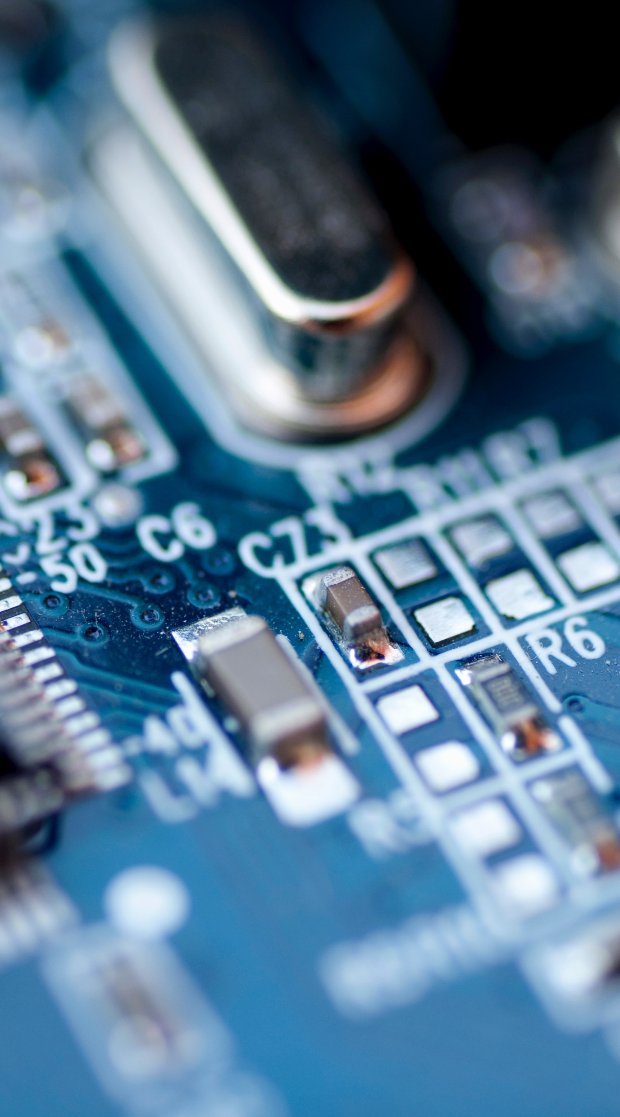


Accelerator Workshops - AI
ITU 13.05.2026
Egemen Erkan ÖĞÜTÇÜ
Business Development Manager

Slide 2

Hardware
Hardware
Temp&Hum (SHT40)
MCU (A34G43ARL2N)
Wifi&BLE
(ESP32-C3-MINI)
UART
I2C
Acc (LISDE12)
ADC
Analog Microphone (MP23ABS1)
Serial Wire
Debugger (A-LINK)

Slide 3
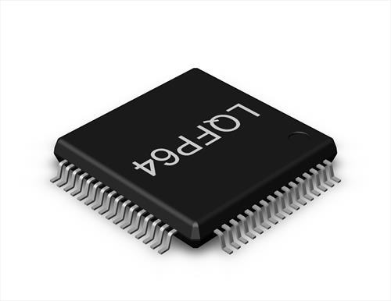

STM32U575CGT6
A34G43ARL2N
High performance with FPU (Floating-Point Unit) Arm Cortex-M4F MCU
The operating frequency is up to 200 MHz
2 Mbyte of Flash memory
LQFP-64 package
Motor PWM, RNG, Comparator
Operating Voltage: 2.7 V to 5.5 V

Slide 4
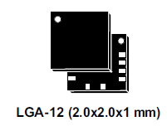
ISM330ISN (Acc + Gyro)
LISDE12 (Acc)
Ultra-low-power, high performance, three-axis linear accelerometer
Embedded temperature sensor
Ultra-low-power consumption down to 2uA
Industrial robots, Asset tracking, Anomaly detection and condition monitoring, Event detection in alarms and smart homes, gesture recognition for personal health

Slide 5
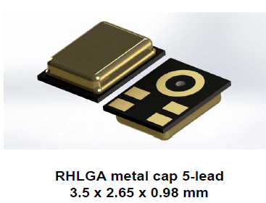
IMP34DT05 (Digital Mic)
MP23ABS1 (Analog Mic)
High performance MEMS audio sensor: Single-ended analog bottom-port microphone
Built with a capacitive sensing element and an IC interface
High signal-to-noise ratio
Enhanced RF immunity
Vibration monitoring, Audio-activated functions, Predictive maintenance, Anti-theft systems

Slide 6
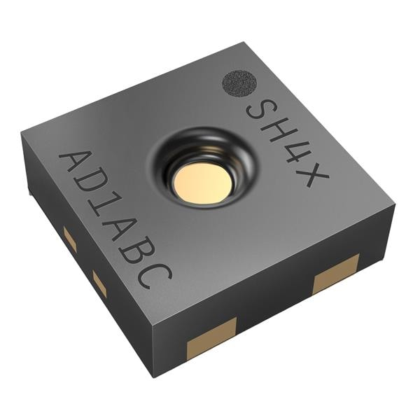
SHT40 (Temp + Hum)
SHT40 (Temp + Hum)
4 th Generation, High-Accuracy, Ultra-Low-Power, 16-bit Relative Humidity and Temperature Sensor
I2C Interface with communication speeds up to 1 MHz
Very fast start-up and measurement time
Typical accuracy of ±1.8 %RH and ±0.2 °C
1.5 x 1.5 mm DFN-4 package

Slide 7
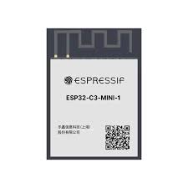
ESP32-C3-MINI (Wifi&BLE Module)
ESP32-C3-MINI (Wifi&BLE Module)
32-bit RISC-V single-core processor, up to 160 MHz
4 MB embedded flash
Supports 20 MHz, 40 MHz bandwidth in 2.4 GHz band
Bluetooth LE: Bluetooth 5, Bluetooth mesh
Speed: 125 Kbps, 500 Kbps, 1 Mbps, 2 Mbps
GPIO, SPI, UART, I2C, I2S, remote control peripheral, LED PWM controller, general DMA controller,USB Serial/JTAG controller, temperature sensor, SAR ADC, general-purpose timers, watchdog timers

Slide 8
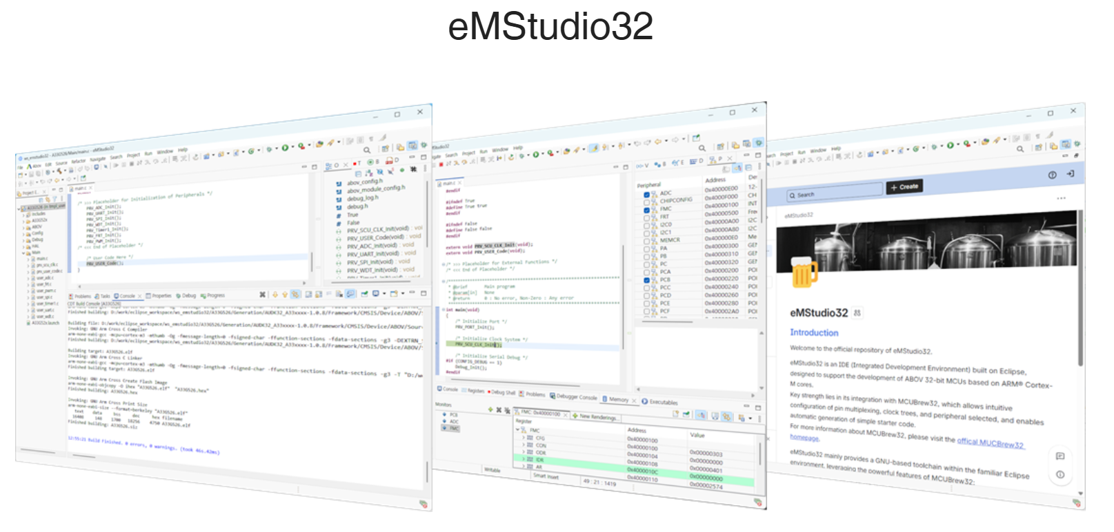



Software
Software
For MCU part
For AI/ML part

Slide 9
Hands-on Steps
1. Collecting the sensor data
2. Controlling the sensor data using wi-fi module via MQTT protocol
3. Using Tiremo®Intelligence to create ML models
4. Using Tiremo®Intelligence to deploy ML models

Slide 10
Time for some hands-on!

