Slide 1
Reimplementation of ”A CNN-BıLSTM-AM Method for Stock Price Prediction”[1]
Mahssa Nassiri
Huseyin Sinan Havus
[1] Lu, Wenjie, et al. ”A CNN-BiLSTM-AM method for stock price prediction.” Neural Computing and Applications 33.10 (2021): 4741- 4753.

Slide 2
Introduction
The stock market is a key driver of economic growth, providing companies with capital and investors with opportunities for wealth generation.
Predicting stock prices is challenging due to factors like policies, global events and market sentiment; therefore traditional methods struggle to capture the market complexity.
To address these challenges, a study proposing the CNN-BiLSTM-AM architecture was found and reimplemented in this research.

Slide 3
MODEL OVERVIEW
.
CNN-BiLSTM-AM to predict the stock closing price of the next day. The model consists of convolutional neural networks (CNN), bi-directional long short-term memory (BiLSTM) and attention mechanism (AM).
CNN
Extracts features from stock data.
BiLSTM
Addresses RNN limitations (gradient issues) and captures stock time series interdependencies.
AM
Enhances accuracy by weighing past data's influence on future stock prices.

Slide 4
Related work
Early stock prediction relied on linear models (e.g., autoregression, moving averages), limited by noise and nonlinearity. [1]
Nonlinear approaches like vector autoregression, error correction models, and Kalman filters were introduced to improve performance.
Machine learning methods (e.g., SVM, neural networks, hybrid models) gained popularity for better accuracy. [2] [3]
Deep learning led to major advances:
CNNs used for time-series prediction. [4]
BiLSTM applied to S&P 500 with strong results. [5]
These studies showed that neural networks with convolution and attention are effective for capturing complex patterns in financial data.
[1] Dunea, Daniel, and Stefania Iordache. ”TIME SERIES ANALYSIS OF AIR POLLUTANTS RECORDED FROM ROMANIAN EMEP STATIONS AT MOUNTAIN SITES.” Environmental Engineering Man- agement Journal (EEMJ) 14.11 (2015).
[2] White, Halbert. ”Economic prediction using neural networks: The case of IBM daily stock returns.” ICNN. Vol. 2. 1988.
[3] Li, Jing, Shuxiao Pan, and Lei Huang. ”A machine learning based method for customer behavior prediction.” Tehnicˇki vjesnik 26.6 (2019): 1670-1676.
[4] Hu, Y. ”Stock market timing model based on convolutional neural network–a case study of Shanghai composite index.” Finance Economy 4 (2018): 71-74.
[5] Zeng, An, and Wenjun Nie. ” LSTM (Stock Recommendation System Based on Deep Bidirectional LSTM).” 46.10 (2019): 84-89.

Slide 5
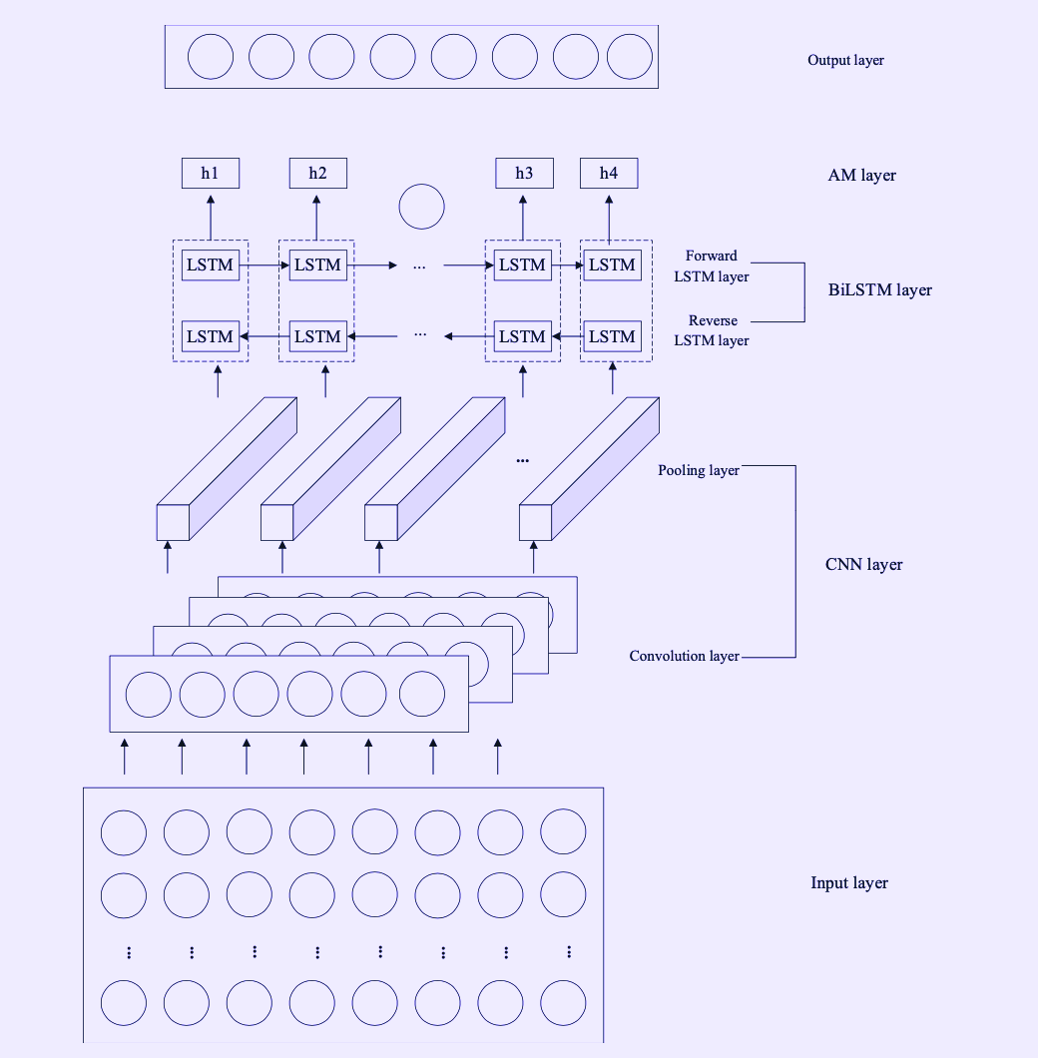
CNN-Bilstm-aM ARCHITECTURE
[1] Lu, Wenjie, et al. ”A CNN-BiLSTM-AM method for stock price prediction.” Neural Computing and Applications 33.10 (2021): 4741- 4753.

Slide 6
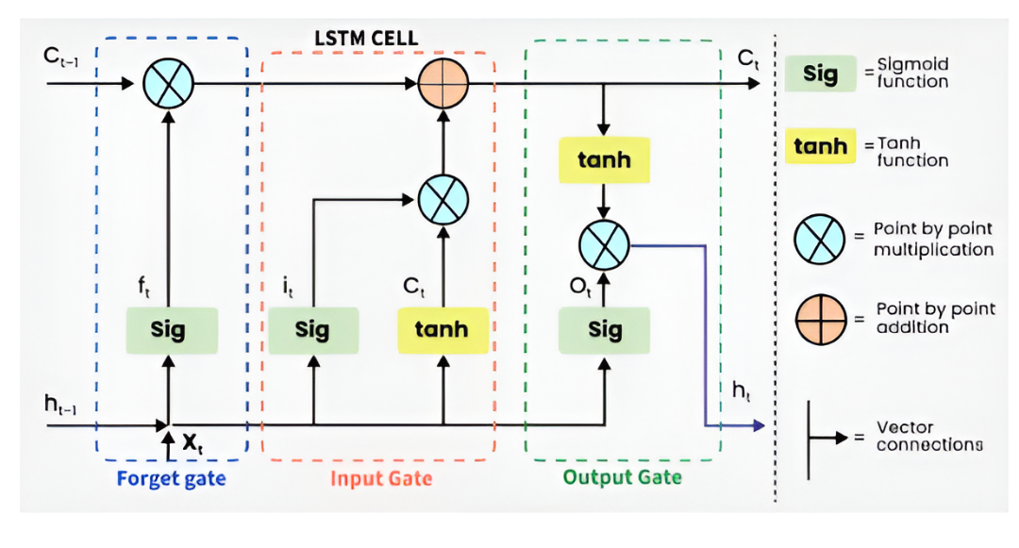
lstm ARCHITECTURE
[1] Lu, Wenjie, et al. ”A CNN-BiLSTM-AM method for stock price prediction.” Neural Computing and Applications 33.10 (2021): 4741- 4753.

Slide 7
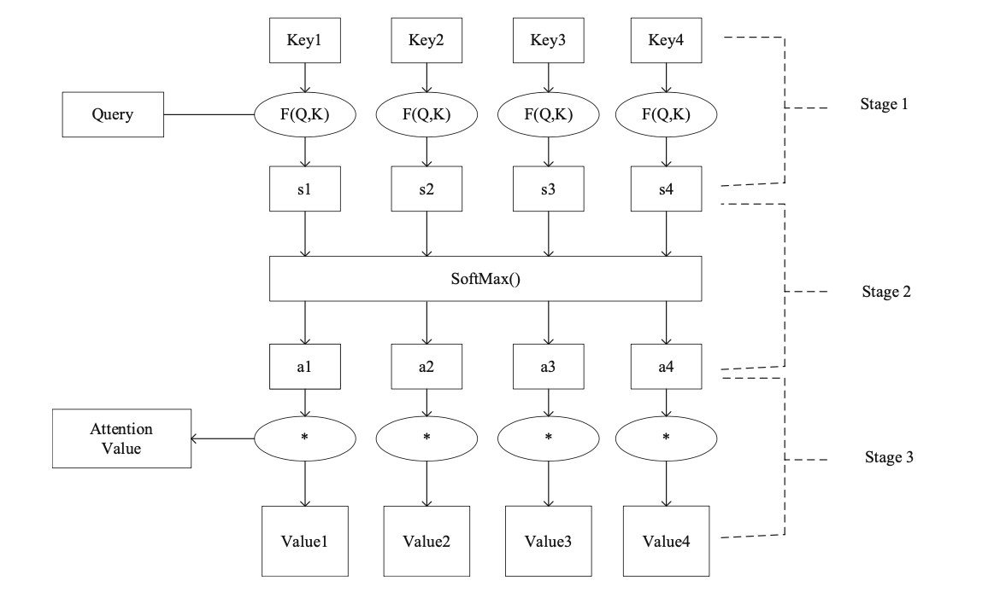
aM ARCHITECTURE
[1] Lu, Wenjie, et al. ”A CNN-BiLSTM-AM method for stock price prediction.” Neural Computing and Applications 33.10 (2021): 4741- 4753.

Slide 8
TRAINING PROCESS
Parameters | Value
Convolution layer filters | 64
Convolution layer kernel size | 1
Convolution layer activation function | RELU
Convolution layer padding | Same
Pooling layer pool size | 1
Pooling layer padding | Same
Pooling layer activation function | RELU
Number of hidden units in BiLSTM layer | 64
Input Data
Input Data Standardization
Network Initialization
CNN Layer Calculation
BiLSTM Layer Calculation
AM Layer Calculation
Output Layer Calculation
Error Calculation
Yes
Judge whether or not the end condition of the prediction process is satisfied
No
Backpropagation

Slide 9
TRAINING PROCESS
Parameters | Value
Epoch | 100
Loss function | MAE
Optimizer | Adam
Batch size | 64
Time step | 5
Learning rate | 0.001

Slide 10
DATA
The data used in this experiment was fetched from the National Stock Exchange (NSE) of India.
The stock data for Infosys (INFY) was considered, covering the period from November 3, 1994 to April 24, 2025.
A total of 7,083 trading days were used, with 6,083 days allocated for training and the remaining 1,000 trading days used for testing.
Date | Opening Price | Highest Price | Lowest Price | Closing Price | Volume | Turnover | Ups and Downs | Change
1994-11-03 | 451.0 | 451.2 | 443.4 | 450.0 | 400.0 | 180100.0 | -0.221 | 0.000
1994-11-04 | 475.0 | 484.3 | 460.3 | 460.6 | 100.0 | 47500.0 | 0.000 | 5.555
1994-11-05 | 445.0 | 455.4 | 442.3 | 448.0 | 100.0 | 44500.0 | -1.250 | -6.315
1994-11-06 | 445.0 | 445.0 | 443.1 | 445.0 | 100.0 | 89000.0 | 0.000 | 0.000
1994-11-07 | 446.0 | 446.0 | 423.1 | 441.0 | 200.0 | 44500.0 | -1.431 | 1.355

Slide 11
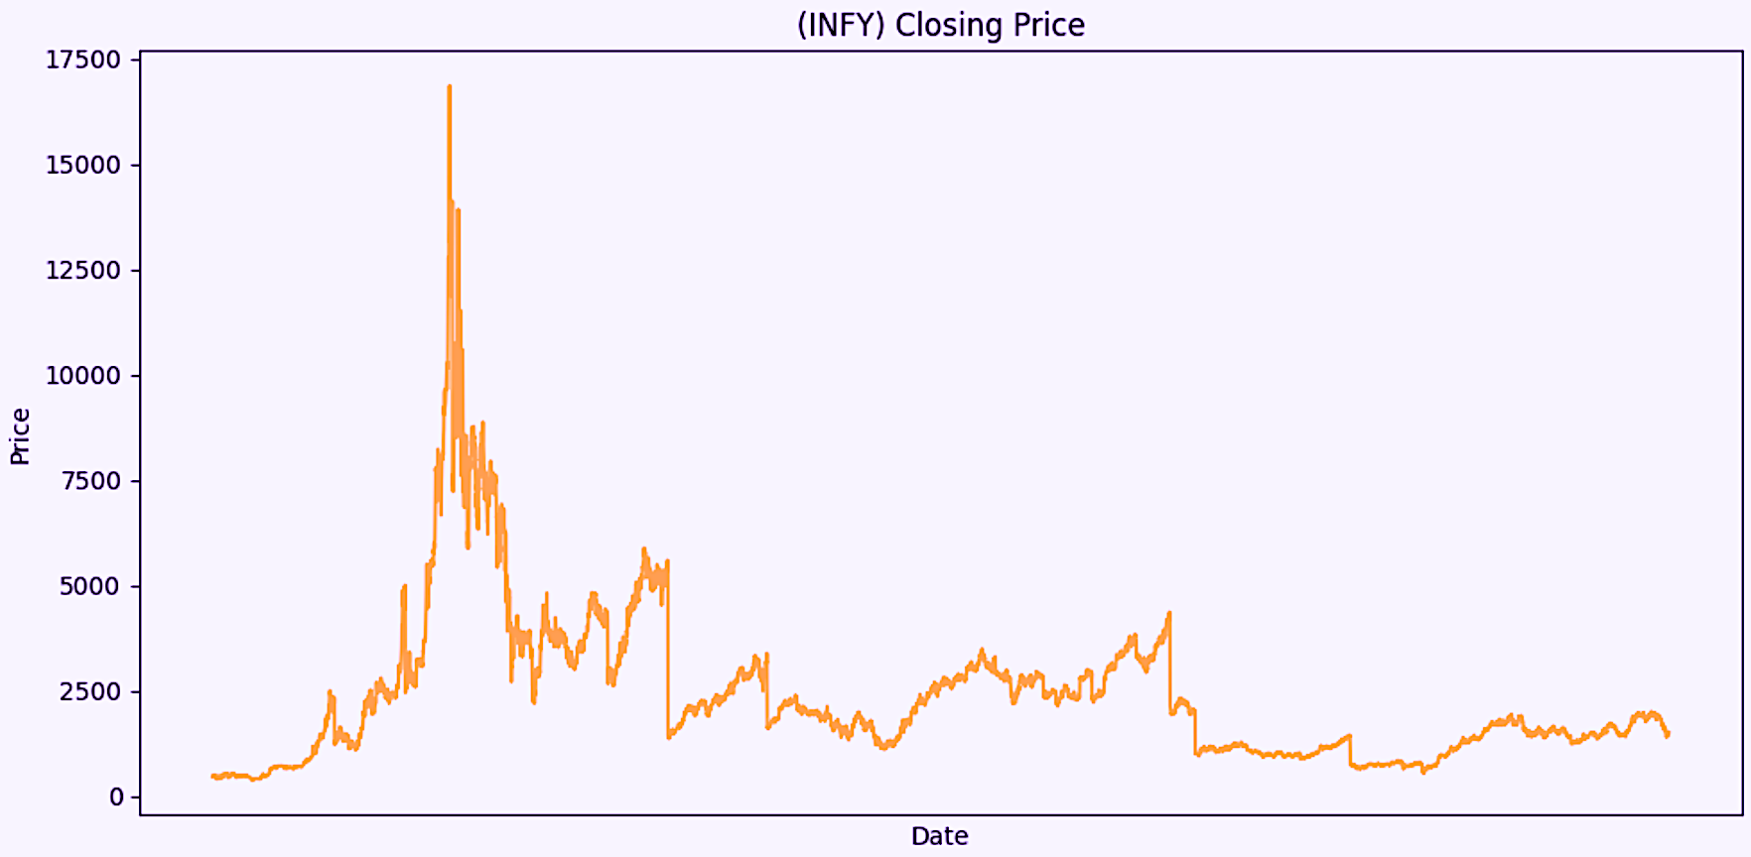
DATA
[1] National Stock Exchange of India (NSE), www.nseindia.com, accessed on 24 April 2025.

Slide 12
EVALUATION METRICS
Mean Absolute Error (MAE)
Root Mean Square Error (RMSE)
R-Squared Error (R²)

Slide 13
PREDICTION PROCESS
Input Data
Input Data Standardization
Prediction
Data Standardization Restoration
Output Result

Slide 14
RESULTS
Model | MAE | RMSE | R²
MLP | 47.7402 | 82.6017 | 0.8033
CNN | 30.5819 | 42.3451 | 0.9483
RNN | 42.4742 | 64.3114 | 0.8888
LSTM | 25.8196 | 40.5924 | 0.9525
BiLSTM | 25.7535 | 38.0903 | 0.9581
CNN-LSTM | 26.0955 | 44.4272 | 0.9431
CNN-BiLSTM | 26.7014 | 39.4487 | 0.9551
BiLSTM-AM | 24.5657 | 33.7425 | 0.9672
CNN-BiLSTM-AM | 23.7901 | 32.8739 | 0.9688

Slide 15
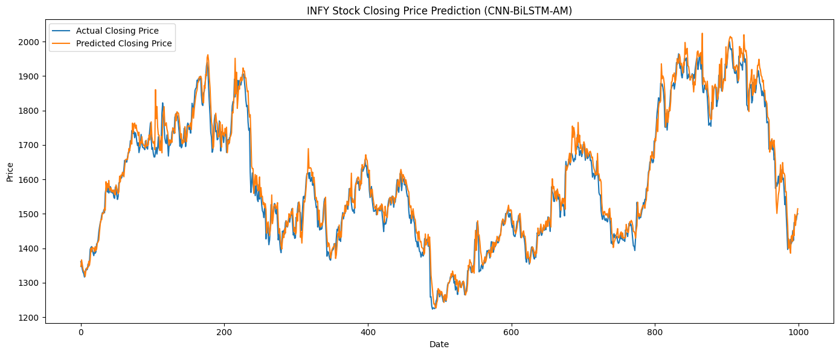
RESULTS (CNN-BiLSTM-AM)
MAE : 23.7901
RMSE : 32.8739
R² : 0.9688

Slide 16
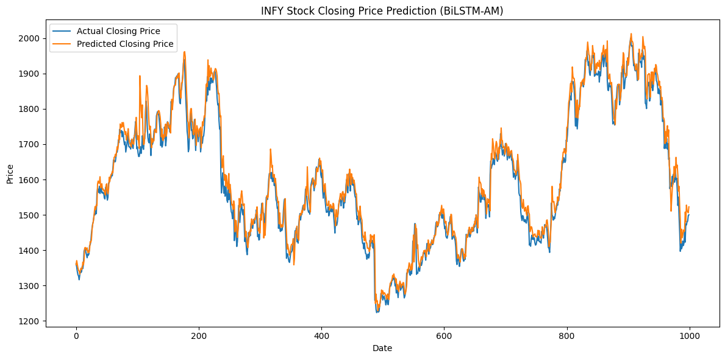
RESULTS (BiLSTM-AM)
MAE : 24.5657
RMSE : 33.7425
R² : 0.9672

Slide 17
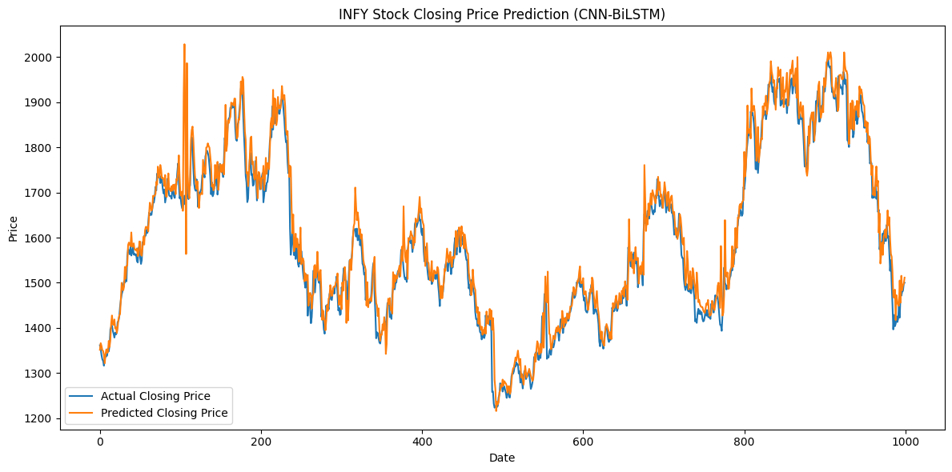
RESULTS (CNN-BiLSTM)
MAE : 26.7014
RMSE : 39.4487
R² : 0.9551

Slide 18
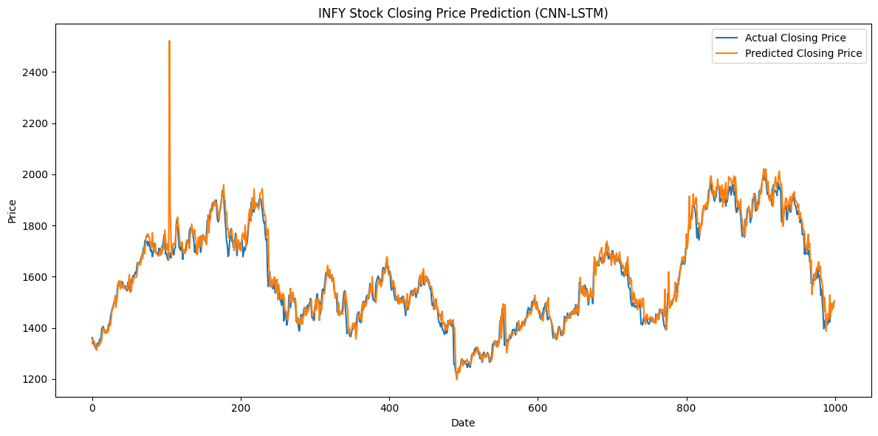
RESULTS (CNN-LSTM)
MAE : 26.0955
RMSE : 44.4272
R² : 0.9431

Slide 19
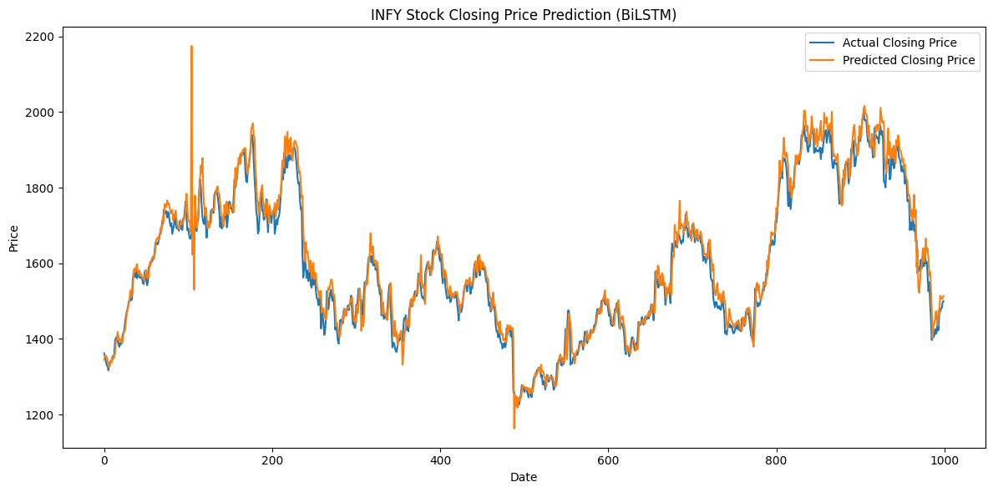
RESULTS (BiLSTM)
MAE : 25.7535
RMSE : 38.0903
R² : 0.9581

Slide 20
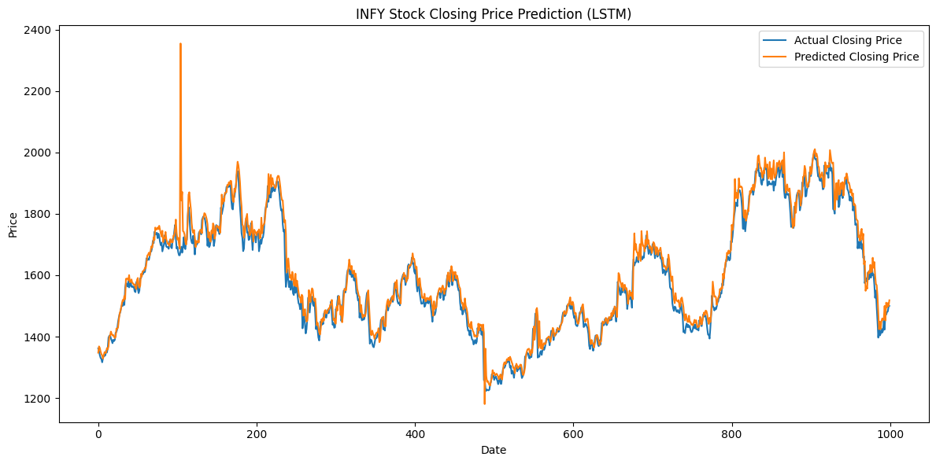
RESULTS (LSTM)
MAE : 25.8196
RMSE : 40.5924
R² : 0.9525

Slide 21
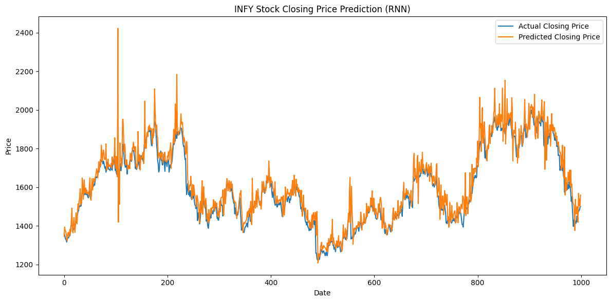
RESULTS (RNN)
MAE : 42.4742
RMSE : 64.3114
R² : 0.8888

Slide 22
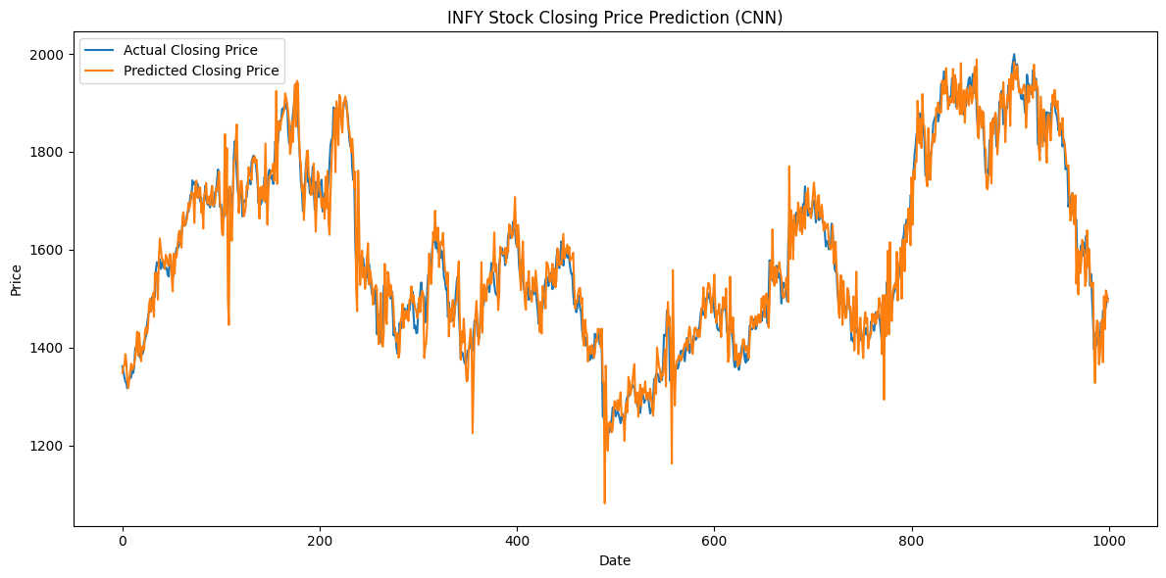
RESULTS (CNN)
MAE : 30.5819
RMSE : 42.3451
R² : 0.9483

Slide 23
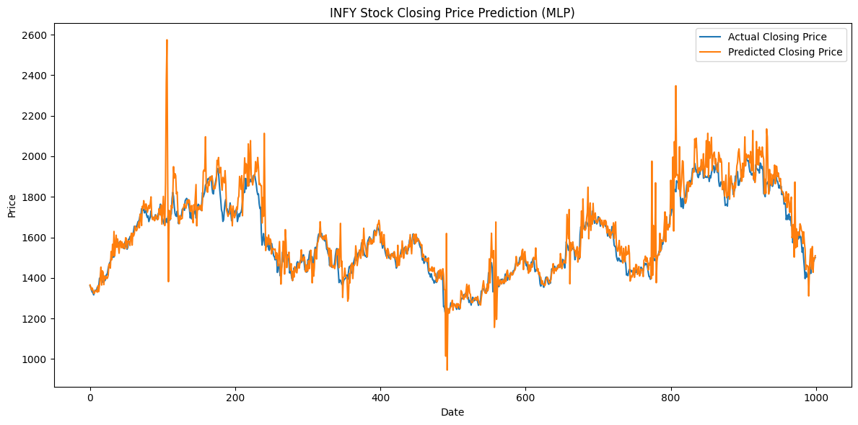
RESULTS (MLP)
MAE : 47.7402
RMSE : 82.6017
R² : 0.8033

Slide 24
HYPERPARAMETER TUNING
Experiment Description | Configuration | MAE | RMSE | R²
More CNN filters | Number of filters = 128 | 22.1031 | 30.1031 | 0.9736
Larger kernel size | Kernel size = 3 | 24.5857 | 37.9640 | 0.9585
More LSTM units | Number of units = 128 | 21.7605 | 35.4400 | 0.9638
With dropout | Dropout rate = 0.2 | 30.8255 | 40.9564 | 0.9426
Larger batch size | Batch size = 128 | 21.3441 | 35.5936 | 0.9635
Smaller learning rate | Learning rate = 0.005 | 22.7100 | 31.9436 | 0.9706
Base model | - | 23.7901 | 32.8739 | 0.9688

Slide 25
CONCLUSION
Designed a hybrid deep learning model combining CNN, BiLSTM, and Attention Mechanism to forecast next-day closing prices for Infosys (INFY).
Hybrid models significantly reduced generalization error compared to standalone models.
Our model outperformed all baseline models (MLP, CNN, RNN, LSTM, BiLSTM, CNN-LSTM, BiLSTM-AM), achieving the lowest error rates and highest R² score across all metrics.

Slide 26
FUTURE EXTENSION
Apply model to other time series domains (e.g., commodities, climate, seismic data).
Integrate explainability tools for financial analyst interpretation.

Slide 27
THANK YOU

