Slide 1
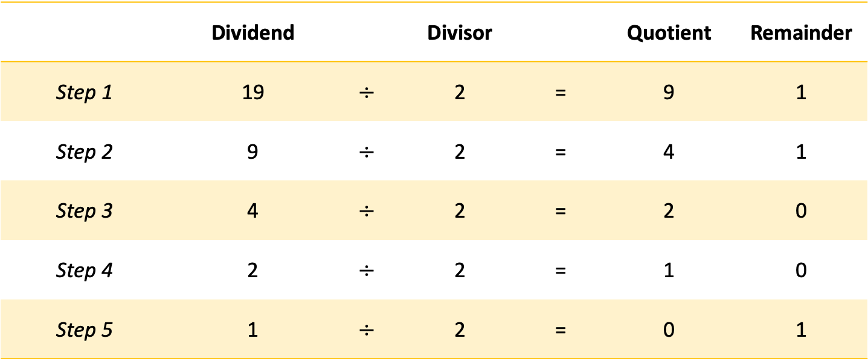
 | Dividend |  | Divisor |  | Quotient | Remainder
Step 1 | 19 | $$÷$$ | 2 | = | 9 | 1
Step 2 | 9 | $$÷$$ | 2 | = | 4 | 1
Step 3 | 4 | $$÷$$ | 2 | = | 2 | 0
Step 4 | 2 | $$÷$$ | 2 | = | 1 | 0
Step 5 | 1 | $$÷$$ | 2 | = | 0 | 1
The result:
Continue until quotient is zero
1 | 0 | 0 | 1 | 1

