Slide 1



.net aspire
by Sinan Nar

Slide 2
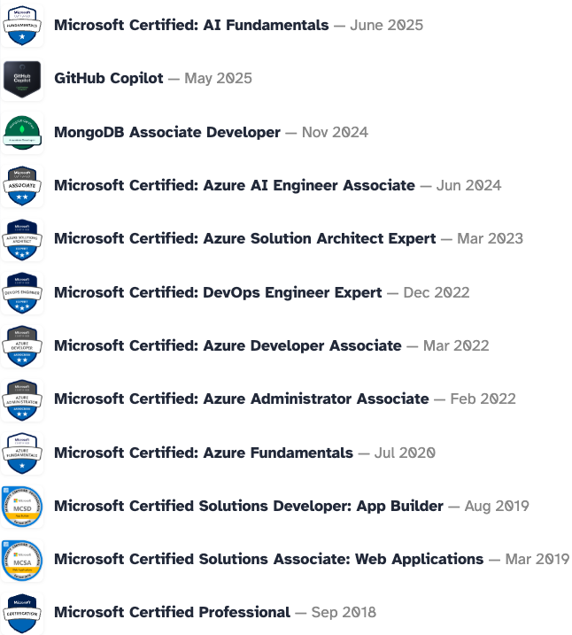
who am I
software engineer
consultant
have 8+ yrs exp
certification nerd
have 3 rabbits

Slide 3

repo

