Slide 1
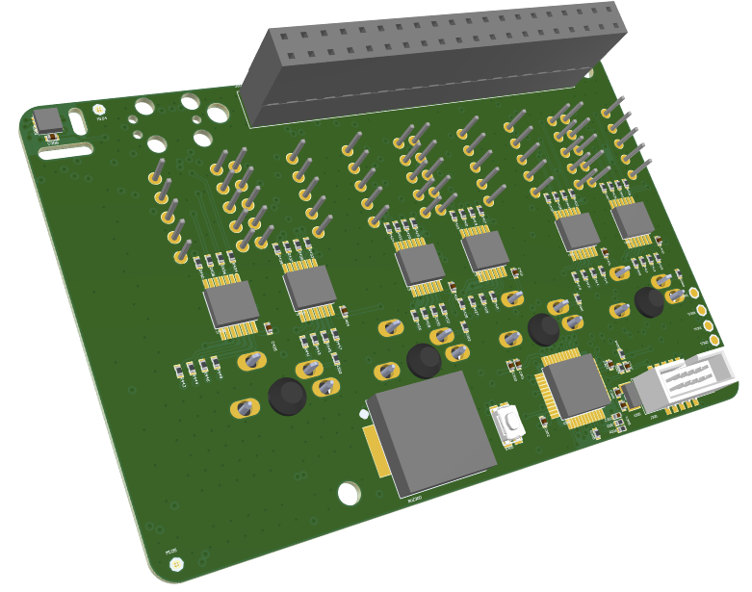
Raspberry Pi
Connector
Temperature
Humidity
Sensor
Button
7 Segment
Programming
Interface
Shift
Register
Microcontroller
Buzzer

Slide 2
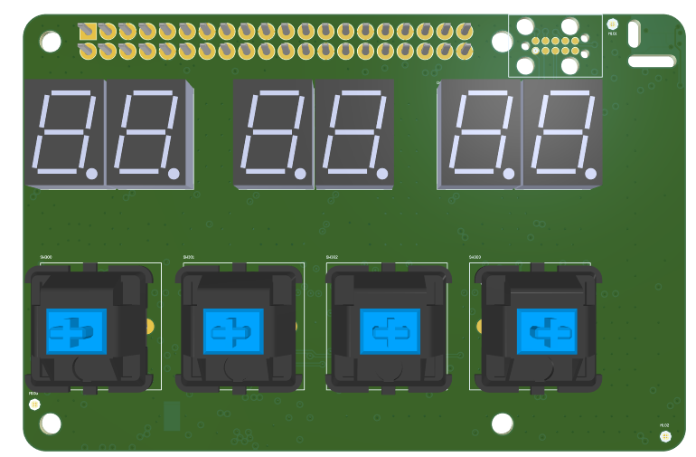
Programming
Interface
7 Segment
Button

Slide 3
Designator | Quantity | Comment | Supplier | Supplier Part Number | Manufacturer | Manufacturer Part Number | Unit Price @ 100 CHF | Total Price @ 100 CHF
BUZ300 | 1 | AST1240MLTRQ | DigiKey | 458-1094-1-ND | Mallory Sonalert Products Inc. | AST1240MLTRQ | 1.175 | 1.175
C300 | 1 | CL05A106MP8NUB8 | Digi-Key | 1276-6830-1-ND | Samsung Electro-Mechanics | CL05A106MP8NUB8 | 0.1 | 0.1
C301-C308, C400-C405 | 12 | GRM155R62A104KE14D | Digi-Key | 490-10458-1-ND | Murata Electronics | GRM155R62A104KE14D | 0.01 | 0.12
C305, C306 | 2 | CC0402BRNPO9BN9R0 | Digi-Key | 311-1629-1-ND | Yageo | CC0402BRNPO9BN9R0 | 0.01 | 0.02
D400-D405 | 6 | INND-TS40RCB | Digi-Key | 1830-1155-ND | Inolux | INND-TS40RCB | 0.32 | 1.92
J300 | 1 | 3220-10-0300-00 | Digi-Key | 1175-1629-ND | CNC Tech | 3220-10-0300-00 | 0.47 | 0.47
J500 | 1 | ESW-120-23-T-D | Digi-Key | 2031-ESW-120-23-T-D-ND | Samtec Inc. | ESW-120-23-T-D | 4.12 | 4.12
R300-R307, R400 | 9 | RMCF0402FT4K70 | Digi-Key | RMCF0402FT4K70CT-ND | Stackpole Electronics Inc | RMCF0402FT4K70 | 0.01 | 0.09
R401-R448 | 48 | RMCF0402FT470R | Digi-Key | 738-RMCF0402FT470RCT-ND | Stackpole Electronics Inc | RMCF0402FT470R | 0.01 | 0.48
S300 | 1 | KMR211GLFS | Digi-Key | 401-1426-1-ND | C&K Components | KMR211GLFS | 0.36 | 0.36
SW300-SW303 | 4 | MX1A-E1NW | Digi-Key | CH197-ND | Cherry Americas LLC | MX1A-E1NW | 1.05 | 4.2
U300 | 1 | STM32L010C6T6 | Digi-Key | 497-19662-ND | STMicroelectronics | STM32L010C6T6 | 0.923 | 0.923
U301 | 1 | SHT31-DIS-B | Digi-Key | 1649-1011-1-ND | Sensirion | SHT31-DIS-B | 2.74 | 2.74
U400-U405 | 6 | SN74HCS264PWR | Digi-Key | 296-SN74HCS264PWRCT-ND | Texas Instruments | SN74HCS264PWR | 0.1 | 0.6
X300 | 1 | ABS07-32.768KHZ-6-T | Digi-Key | 535-11898-1-ND | Abracon LLC | ABS07-32.768KHZ-6-T | 0.47 | 0.47
PCB | 1 |  | JLCPCB | pi_clock | JLCPCB | pi_clock | 2.67 | 2.67
 |  |  |  |  |  |  | Total | 20.46

