Slide 1
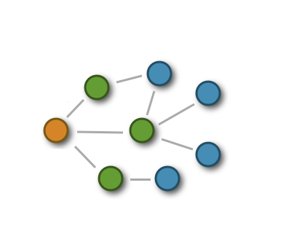



Clock Synchronization in Distributed Systems
Kasım Sinan YILDIRIM
ICAST 2010
May 25-26, 2010
Ege University, Izmir, Turkey
Ege University
Department of Computer Engineering
Izmir, TURKEY

Slide 2
Outline
Introduction
The System Model
The Lower Bound
Conclusion

Slide 3
Introduction
A distributed system consists of a collection of distinct processes (called nodes) which are spatially separated and which communicate with one another by exchanging messages.
The clocks of the nodes
  tick at different rates,
  drift apart,
  may not remain always synchronized although they might be synchronized when they start.

Slide 4
The Clock Synchronization Problem
Clock synchronization is the process of ensuring that physically distributed processors have a common notion of time.
Clock synchronization algorithms are based on
  exchanging clock information among the nodes
  eliminate the effects of non-determinism in
    message delay
    data processing time.

Slide 5
The System Model - I
The Clock Model
  The Physical Clock
    Clocks are perfect (do not drift)
  The Logical Clock
The Communication Model
  Communication Network
    Nodes
    Edges
    Message Delay
    Uncertainty

Slide 6
The System Model - II
The System Of Nodes With Clocks
  Events
  History
  Execution
    History for each node
    Admissable executions
      All message delays within
The Formal Clock Synchronization Problem
  The Algorithm terminates at time
  At time

Slide 7
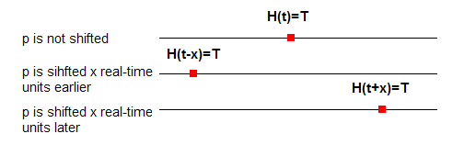
The Lower Bound - I
Shifting
We have two processors p and q.
We will create two indistinguishable executions and show that the clock synchronization algorithm must achieve the same precision.

Slide 8
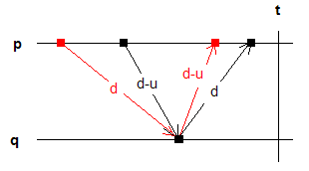
The Lower Bound - II
Equivalent executions
The worst-case clock synchronization error

Slide 9
Conclusion
We presented the lower bound techniques used for proving the worst-case achievable synchronization in a network with two processors.
Lundelius and Lynch improved this lower bound for a fully connected network with n processors.
Biaz and Welch proved that for any communication network, the best achievable synchronization error is a function of the diameter of the network.

Slide 10

Thank you...
Questions?

