Slide 1


Adaptive Control-Based Clock Synchronization in Wireless Sensor Networks
Kasım Sinan YILDIRIM*, Ruggero CARLI⁺, Luca SCHENATO⁺
* Department of Computer Engineering, Ege University, İzmir, TURKEY
+ Department of Information Engineering, University of Padova, Padova, ITALY
European Control Conference (ECC’15), Linz, Austria
July 17, 2015

Slide 2
Outline
The Problem
Need for Synchronization
Proposed Solution
Control Theory
Results
Experiments
&
Discussion
Wireless Sensor Networks
Average Consensus
Challenges
Existing Solutions

Slide 3
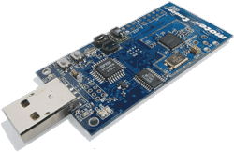
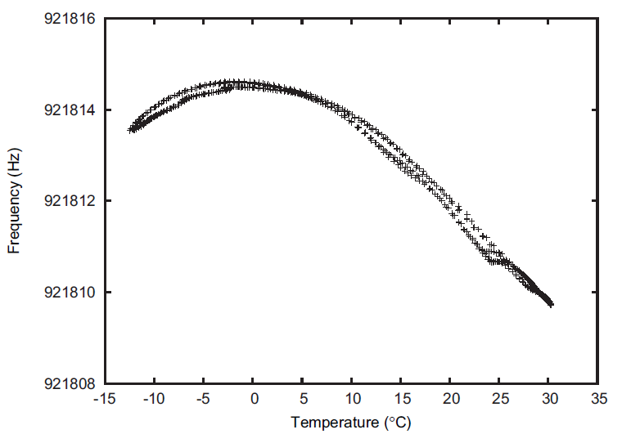
Wireless Sensor Networks
Hardware clock (built-in clock)
Counter register
Clocked with external crystal
32kHz, 7.37 MHz nominal rate
Read-only
Clock drift
Deviation from the nominal rate
30-100 parts per million (ppm)
dependent on environmental factors such as:
temperature, power supply, aging...
[Sommer et al. 2009]

Slide 4
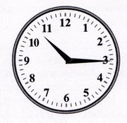
Need for Synchronization
Assigning global timestamps
sensed data and events
Coordinated actions
Duty-cycling of the nodes for energy efficient operation
Low-power, TDMA-based MAC layer
Applications
Localization via time-of-flight measurements
Tracking of moving objects

Slide 5
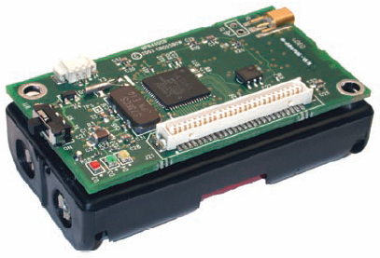
Time Synchronization
Communicate
Exchange current time information periodically
Hardware clock value
Compute
Calculate a logical clock
Software function
represents the global time
Challenge
Measurement errors
Message delay
Deterministic and non-deterministic components
Frequency
t
Expected delay
Jitter
timestamp
0-100 ms
0-500 ms
1-10 ms
Send
Access
Transmission
timestamp
Reception
Receive
0-100 ms
t

Slide 6

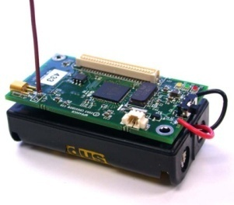
Pairwise Synchronization in Practice
Master – Slave Synchronization
Collect (H_{u},H_{r}) timestamp pairs periodically
Employ least-squares regression
H_{r}
Reference Node r
Slave Node u
Linear relationship: H_{r}(t)=α+βH_{u}(t)
clock offset
H_{u}
relative clock rate
Beacon interval B

Slide 7
Least-Squares with Two Pairs
Measurement errors
Slope:
Poor multi-hop performance scalability
Measurement errors
Error contributed by
the transmission delays
Error contributed by
the transmission delays
Measurement errors
Measurement errors
Intercept:
Errors enter non-linearly to the equations!
The effect of various error sources appear as multiplicative noise!

Slide 8


Time Synchronization as a Control Problem
e(t+B)
Speed difference
input
e(t)
time

Slide 9



Proportional Control
steady state error
P
control instants
Compensates only initial offset differences

Slide 10
Proportional-Integral Control
PI
control instants
Compensates both offset and clock speed differences

Slide 11
PISync Algorithm - Pairwise Synchronization
Reference Clock Estimate
No need to store received timestamps!
No regression table!
Very simple arithmetic operations!
Offset
Speed
Local time passed since update
Update Rule
Receive <H_{r}(t_{up})> at time t_{up} from r
Calculate Error
Update Offset
Update Speed
Convergence Conditions
Optimal Convergence Rate
Not the smallest steady-state error!
Integral gain should be adjusted adaptively!

Slide 12
PISync Algorithm – Error Dynamics
For k_{P}=1, PISync algorithm becomes
Error contributed by
the transmission delays
Measurement errors
Error contributed by
the transmission delays
Scalable multi-hop performance
Measurement errors
Errors enter linearly to the equations!
The effect of various error sources appear as additive noise!

Slide 13
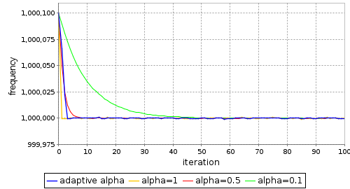
PISync - Integral Gain Adaptation
As k_{I} gets smaller, we obtain smaller steady-state
error but longer convergence time!
Maximum frequency
error
Adaptation Rule
If e(h) > e_{max} then k_{I} = 0 (turn-off integrator)
Else if k_{I} = k_{I}*
Else if e(h)e(h-1)>0 then k_{I} = max{2k_{I},k_{I}*}
Else k_{I} = k_{I}/3
Gradually increase or decrease according to the successive error signs
Inspired from [Yildirim and Gurcan et al. 2014]

Slide 14
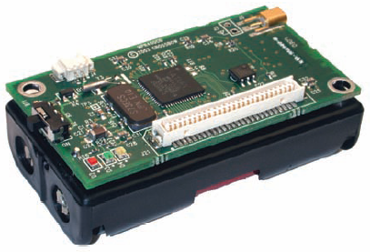

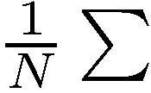
PI control + Average Consensus
PI
Clocks from neighboring nodes
No special reference node!
Nodes synchronize directly to their neighbors!

Slide 15
Testbed
Testbed setup
20 MICAz sensor nodes
FTSP (Flooding Time Synchronization Protocol [Marotti et al. 2004]) and PISync implemented in TinyOS 2.1
Network topology
Line and grid topologies
Parameters
Communication frequency: B=30 seconds
Regression table of size 8 for FTSP
f_{nom}= 1 MHz
k_{P}=1 and 0 < k_{I} < 2/(Bf_{nom})

Slide 16
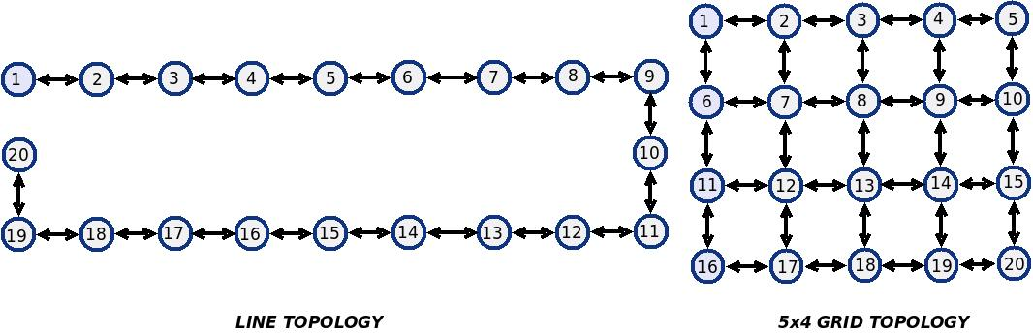
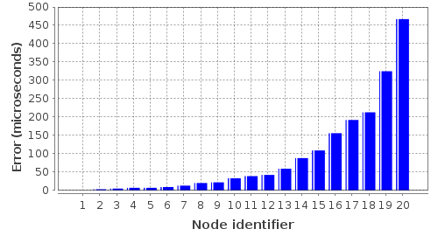
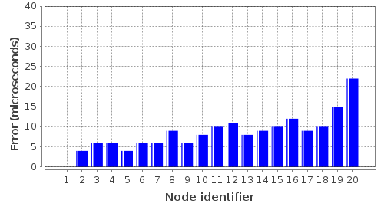
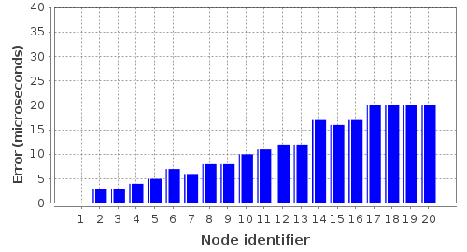
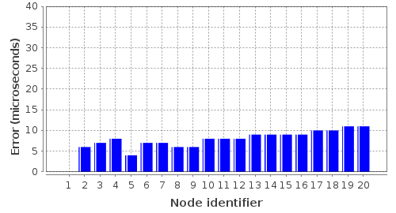
FTSP vs PISync
Completely blind operation!
No need to store neighbors time information explicitly!
Suitable for mobile networks!
Robust to packet losses
Very simple arithmetic operations
No need to store time information explicitly!
Scalable!
FTSP
FTSP
FloodPISync
AvgPISync

Slide 17
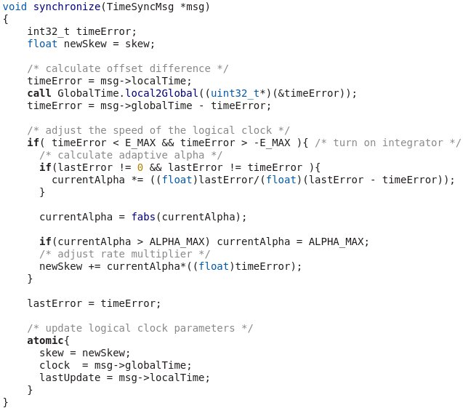
PISync Complexity
20 times better performance!
50 times fewer operations!
4 times less RAM requirements!
Low power consumption!
Very easy to implement & code
 | FTSP | PISync
Error | ≈0.5 ms | 20 microseconds
RAM | 52 bytes | 16 bytes
ROM | 18000 bytes | 15432 bytes
CPU | 5.5 ms | 145 microseconds
FTSP
Just 15 Lines of TinyOS code!

Slide 18
Conclusions
We considered time synchronization as a control problem
We solved this problem with a very simple and practical technique
Proportional-Integral Controller
We introduced a new time synchronization protocol
PISync
We observed
Better performance scalability
Less resource consumption
Lower CPU and main memory overhead
Lower power consumption
Notes:
Motivate why clock synch is important

Slide 19
Future Research Directions
Performance evaluation on real mobile networks
Implementation & evaluation of time-synchronized MAC layer
Adaptive receiving window
Evaluation of power consumption
Other algorithmic techniques?
Better steady-state error & convergence
Even lower resource requirements?

Slide 20
Thank YOU!
Any Questions?

