Slide 1
Arithmetic/Logical Unit (ALU)
Digital Computer Design

Slide 2
Arithmetic Circuits
Arithmetic circuits are the central building blocks of computers.
Computers and digital logic perform many arithmetic functions:
addition, subtraction, comparisons, shifts, multiplication and division

Slide 3
1-Bit Adders

Slide 4
Multibit Adders - Carry Propagate Adders (CPAs)
An N-bit adder sums two N-bit inputs A and B, and a carry in C_{in} to produce an N-bit result S and a carry out C_{out}.
Multibit adder is commonly called a carry propagate adder (CPA)
because the carry out of one bit propagates into the next bit.

Slide 5
CPAs: Ripple-Carry Adder
Chain together N full adders.
The C_{out} of one stage acts as the C_{in} of the next stage
The ripple-carry adder is slow when N is large.
For an 32-bit adder, S₃₁ depends on C₃₀, which depends on C₂₉, which depends on C₂₈, and so forth all the way back to C_{in}.

Slide 6
CPAs: Ripple-Carry Adder
The fundamental reason that large ripple-carry adders are slow is that the carry signals must propagate through every bit in the adder.
tripple = Nt_{FA}
where t_{FA} is the delay of a 1-bit full adder

Slide 7
Subtracter
Subtraction is almost as easy:
flip the sign of the second number, then add.
Flipping the sign of a two’ s complement number is done by inverting the bits and adding 1.

Slide 8
Comparator: Equality
A comparator determines whether two binary numbers are equal or if one is greater or less than the other.

Slide 9
Comparator: Less Than
Compute A − B and looking at the sign (most significant bit) of the result.
If the result is negative (i.e., the sign bit is 1), then A is less than B. Otherwise A is greater than or equal to B.
This comparator, however, functions incorrectly upon overflow.
Sign bit

Slide 10
Arithmetic/Logical Unit
ALU is one of the main components in the microprocessor.

Slide 11
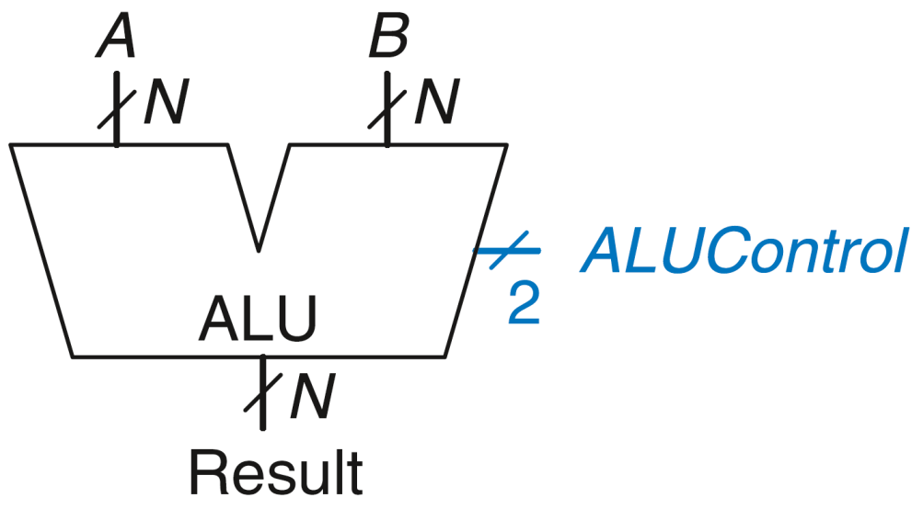
ALU: Arithmetic/Logical Unit
An Arithmetic/Logical Unit (ALU ) combines a variety of mathematical and logical operations into a single unit.
The ALU forms the heart of most computer systems.
ALUControl_{1:0} | Function
00 | Add
01 | Subtract
10 | AND
11 | OR
The ALU receives a 2-bit control signal ALUControl that specifies which function to perform.

Slide 12
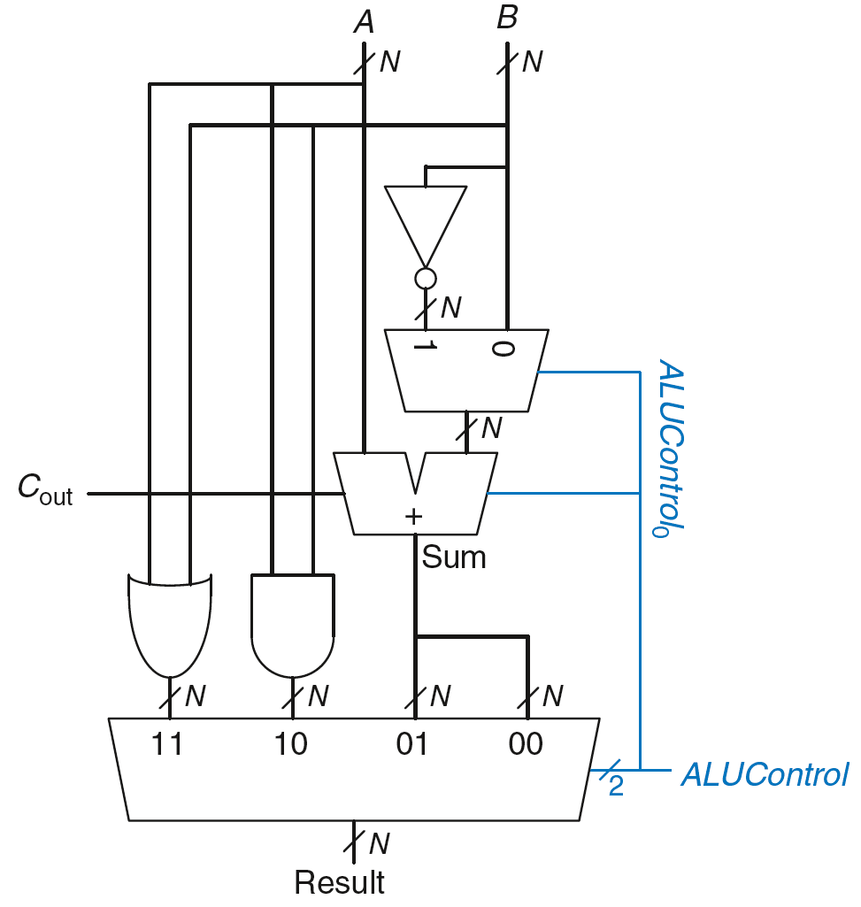
ALU Implementation
ALUControl_{1:0} | Function
00 | Add
01 | Subtract
10 | AND
11 | OR

Slide 13
ALU Implementation
ALUControl_{1:0} | Function
00 | Add
01 | Subtract
10 | AND
11 | OR
Example: Perform A OR B
ALUControl_{1:0} = 11
Mux selects output of OR gate as Result Result = A OR B

Slide 14
ALU Implementation
ALUControl_{1:0} | Function
00 | Add
01 | Subtract
10 | AND
11 | OR
Example: Perform A + B
ALUControl_{1:0} = 00
C_{in} to adder = 0
2nd input to adder is B
Mux selects Sum as Result
Result = A + B

Slide 15
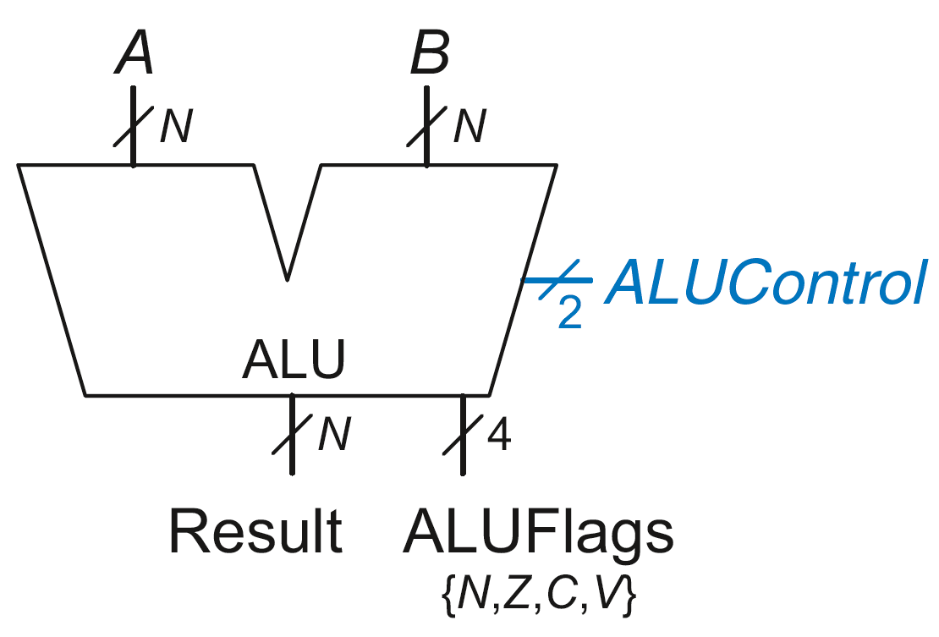
ALU with Status Flags
Flag | Description
N | Result is Negative
Z | Result is Zero
C | Adder produces Carry out
V | Adder oVerflowed
Some ALUs produce extra outputs, called flags, that indicate information about the ALU output.

Slide 16
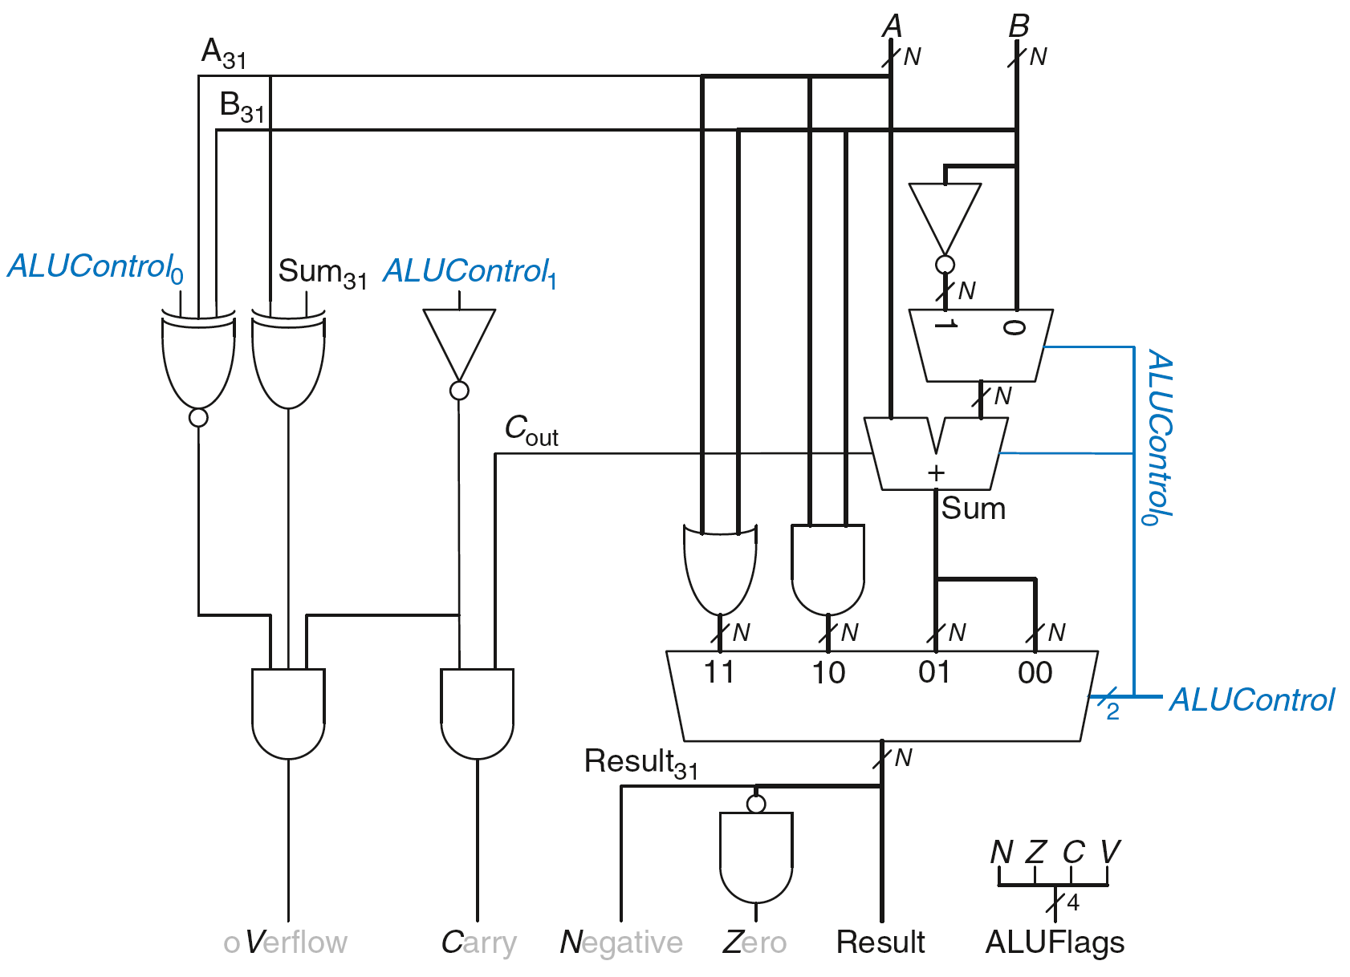
ALU with Status Flags

Slide 17
ALU with Status Flags: Negative
N = 1 if:
Result is negative
So, N is connected to most significant bit of Result

Slide 18
ALU with Status Flags: Zero
Z = 1 if:
all of the bits of Result are 0

Slide 19
ALU with Status Flags: Carry
C = 1 if:
C_{out} of Adder is 1 AND
ALU is adding or subtracting (ALUControl is 00 or 01)

Slide 20
ALU with Status Flags: oVerflow
V = 1 if:
The addition of 2 same-signed numbers produces a result with the opposite sign. (the result is too big to fit in the available digits.)

Slide 21
ALU with Status Flags: oVerflow
V = 1 if:
ALU is performing addition or subtraction
(ALUControl₁ = 0)

Slide 22
ALU with Status Flags: oVerflow
V = 1 if:
ALU is performing addition or subtraction
(ALUControl₁ = 0)
AND
A and Sum have opposite signs

Slide 23
ALU with Status Flags: oVerflow
V = 1 if:
ALU is performing addition or subtraction
(ALUControl₁ = 0)
AND
A and Sum have opposite signs
AND
A and B have same signs upon addition (ALUControl₀ = 0)
OR
A and B have different signs upon subtraction
(ALUControl₀ = 1)

Slide 24
Shifters/Rotators
Shifters and rotators move bits and multiply or divide by powers of 2.
As the name implies, a shifter shifts a binary number left or right by a specified number of positions.
Logical shifter: shifts value to left or right and fills empty spaces with 0’s
Ex: 11001 >> 2 = 00110
Ex: 11001 << 2 = 00100

Slide 25
Shifters/Rotators
Arithmetic shifter: right shift, fills empty spaces with the old most significant bit (msb)
Ex: 11001 >>> 2 = 11110
Ex: 11001 <<< 2 = 00100
Rotator: rotates bits in a circle, such that bits shifted off one end are shifted into the other end
Ex: 11001 ROR 2 = 01110
Ex: 11001 ROL 2 = 00111

Slide 26
Example: Logical Shift Right Implementation
An N-bit shifter can be built from N N:1 multiplexers.
The input is shifted by 0 to N−1 bits, depending on the value of the log₂N-bit select lines.
Depending on the value of the 2-bit shift amount shamt_{1:0}, the output Y receives the input A shifted by 0 to 3 bits.
0 (Ground)

Slide 27
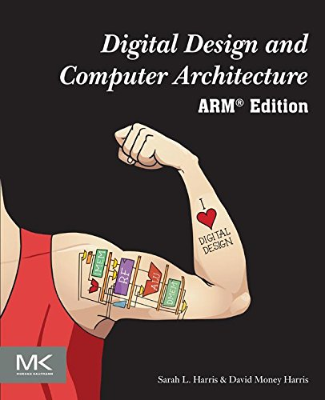
Further Reading
You can read Chapter 5 of your book
From Section 5.1 to 5.2.5

