Slide 1
Instruction Encoding
Digital Computer Design

Slide 2
How to Encode Instructions?
Assembly language is convenient for humans to read.
However, digital circuits understand only 1’ s and 0’ s.
A program written in assembly language is to a representation using only 1’ s and 0’ s
called Machine Language.
ARM uses a single instruction format
32-bit instructions
Variable-length instructions are avoided
would add complexity.

Slide 3
Design Principle 4
ARM defines three main instruction formats:
(1) Data-processing
(2) Memory
(3) Branch
Simpler decoder hardware
Number of instruction formats kept small
smaller is faster

Slide 4
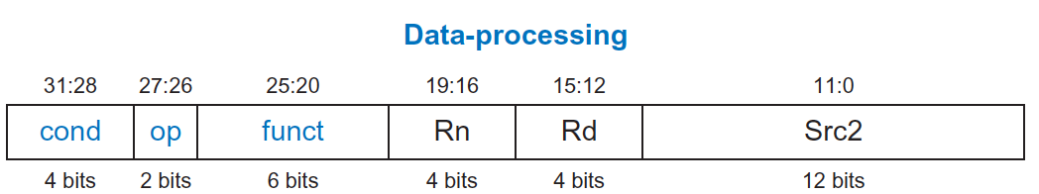
Data-processing Instruction Format
The 32-bit instruction has six fields:
Operands:
Rn: first source register
Src2: second source – register or immediate
Rd: destination register
Control fields:
cond: specifies conditional execution
op: the operation code or opcode
funct: the function to perform

Slide 5
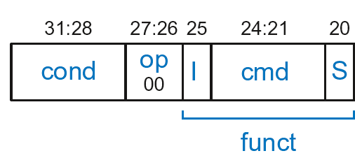
Data-processing Control Fields
cond =1110₂ for unconditional execution
op = 00₂ for data-processing (DP) instructions
funct is composed of cmd, I-bit, and S-bit
cmd: specifies the specific data-processing instruction. For example,
cmd = 0100₂ for ADD
cmd = 0010₂ for SUB
I-bit
I = 0: Src2 is a register
I = 1: Src2 is an immediate
S-bit: 1 if sets condition flags
S = 0: SUB R0, R5, R7
S = 1: ADDS R8, R2, R4 or CMP R3, #10

Slide 6
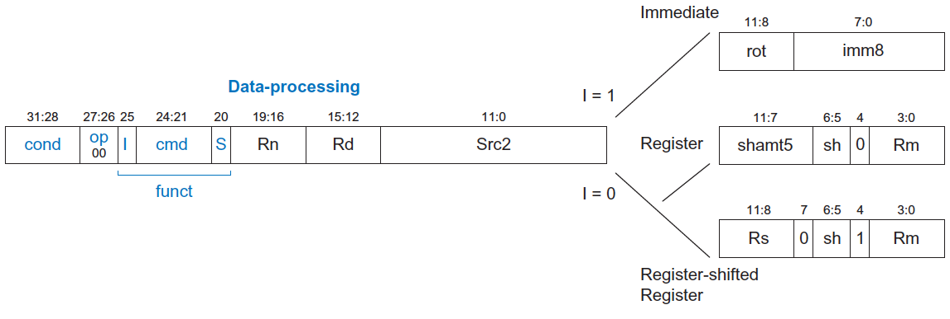
Data-processing Src2 Variations
Three variations of Src2 encoding allow the second source operand to be
Immediate
Register
Register-shifted register

Slide 7
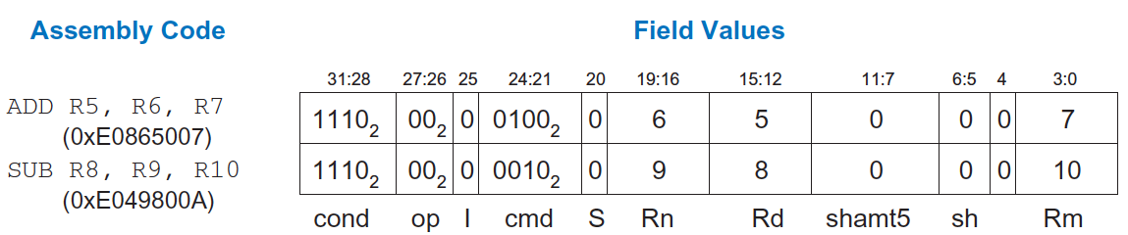
Data-processing instructions with three register operands
cond = 1110₂ (14) for unconditional execution
op = 00₂ (0) for data-processing instructions
cmd = 0100₂ (4) for ADD and 0010₂ (4) for SUB
Src2 is a register so I = 0

Slide 8
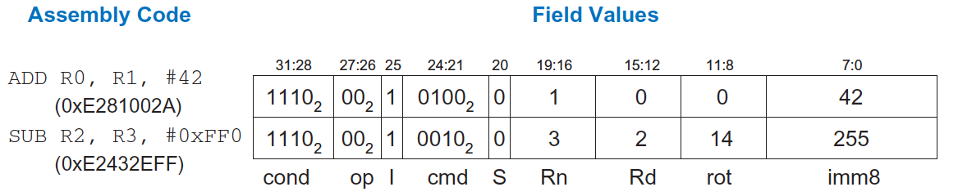
Data-processing instructions with an immediate and two register operands
The immediate of the ADD instruction (42) can be encoded in 8 bits, so no rotation is needed (imm8=42, rot=0)
However, the immediate of SUB R2, R3, 0xFF0 cannot be encoded directly using the 8 bits of imm8 . Instead, imm8 is 255 (0xFF), and it is rotated right by 28 bits (rot = 14).
The right rotation by 28 bits is equivalent to a left rotation by 32− 28 = 4 bits.

Slide 9
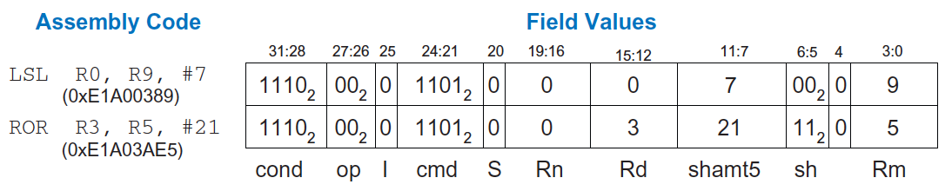
Shift instructions with immediate shift amounts
cmd: field is 13 (1101₂) for all shift instruction
Rm: the second source operand
shamt5: the amount Rm is shifted
sh: the type of shift
Shift Type | sh
LSL | 00₂
LSR | 01₂
ASR | 10₂
ROR | 11₂

Slide 10
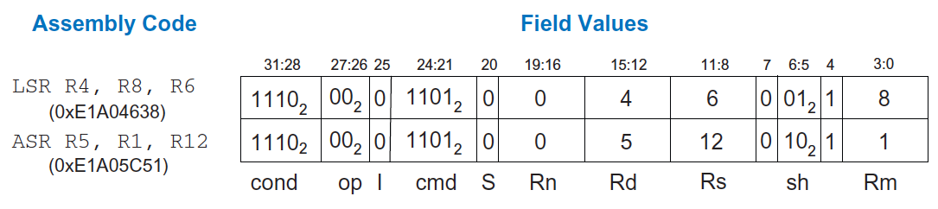
Shift instructions with register shift amounts
This instruction uses the register-shifted register addressing mode, where one register (Rm) is shifted by the amount held in a second register (Rs).

Slide 11
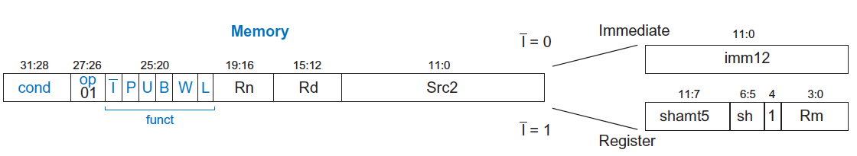
Memory Instruction Format
Encodes: LDR, STR, LDRB, STRB
op = 01₂
Rn = base register
Rd = destination (load), source (store)
Src2 = offset: immediate or register (optionally shifted)
funct = I (immediate bar), P (preindex), U (add), B (byte), W (writeback), L (load)

Slide 12
Memory Format funct Encodings
Type of Operation
Indexing Mode
L | B | Instruction
0 | 0 | STR
0 | 1 | STRB
1 | 0 | LDR
1 | 1 | LDRB
P | W | Indexing Mode
0 | 1 | Not supported
0 | 0 | Postindex
1 | 0 | Offset
1 | 1 | Preindex
Add/Subtract Immediate/Register Offset
Value | I | U
0 | Immediate offset in Src2 | Subtract offset from base
1 | Register offset in Src2 | Add offset to base

Slide 13
Indexing Modes
Mode | Address | Base Reg. Update
Offset | Base register ± Offset | No change
Preindex | Base register ± Offset | Base register ± Offset
Postindex | Base register | Base register ± Offset
Examples
Offset: LDR R1, [R2, #4] ; R1 = mem[R2+4]
Preindex: LDR R3, [R5, #16]! ; R3 = mem[R5+16]
; R5 = R5 + 16
Postindex: LDR R8, [R1], #8 ; R8 = mem[R1]
; R1 = R1 + 8

Slide 14
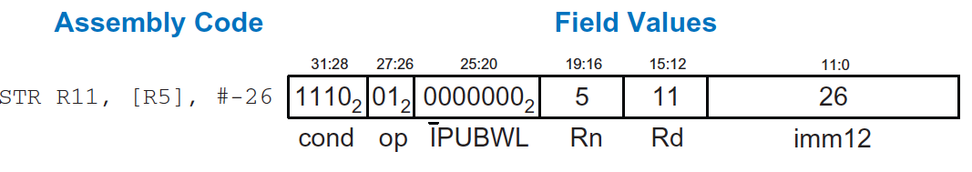
Memory Instruction Example
Operation: mem[R5] <= R11; R5 = R5 - 26
cond = 1110₂ (14) for unconditional execution
op = 01₂ (1) for memory instruction
funct = 0000000₂ (0)
I = 0 (immediate offset), P = 0 (postindex),
U = 0 (subtract), B = 0 (store word), W = 0 (postindex),
L = 0 (store)
Rd = 11, Rn = 5, imm12 = 26

Slide 15
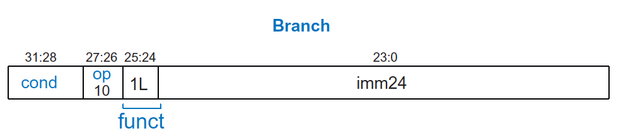
Branch Instruction Format
Encodes B and BL
op = 10₂
imm24: 24-bit immediate
funct = 1L₂: L = 1 for BL, L = 0 for B

Slide 16
Encoding Branch Target Address
Branch Target Address (BTA): The branch target address (BTA) is the address of the next instruction to execute if the branch is taken.
imm24 encodes BTA
imm24 = # of words BTA is away from PC+8

Slide 17
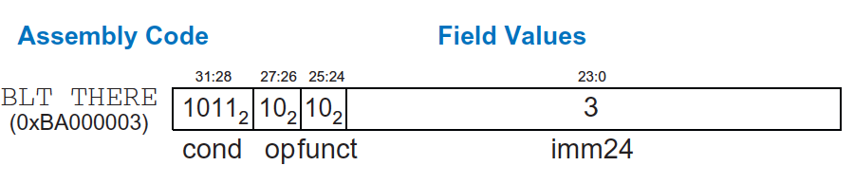
Branch Instruction: Example 1
ARM assembly code
0xA0 BLT THERE
0xA4 ADD R0, R1, R2
0xA8 SUB R0, R0, R9
0xAC ADD SP, SP, #8
0xB0 MOV PC, LR
0xB4 THERE SUB R0, R0, #1
0xB8 BL TEST
PC
PC = 0xA0
PC + 8 = 0xA8
THERE label is 3 instructions past PC+8
So, imm24 = 3
PC+8
BTA

Slide 18
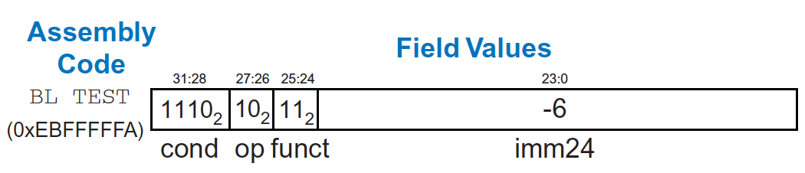
Branch Instruction: Example 2
ARM assembly code
0x8040 TEST LDRB R5, [R0, R3]
0x8044 STRB R5, [R1, R3]
0x8048 ADD R3, R3, #1
0x8044 MOV PC, LR
0x8050 BL TEST
0x8054 LDR R3, [R1], #4
0x8058 SUB R4, R3, #9
BTA
PC = 0x8050
PC + 8 = 0x8058
TEST label is 6 instructions before PC+8
So, imm24 = -6
PC
PC+8

Slide 19
Review: Condition Mnemonics
cond | Mnemonic | Name | CondEx
0000 | EQ | Equal
0001 | NE | Not equal
0010 | CS / HS | Carry set / Unsigned higher or same
0011 | CC / LO | Carry clear / Unsigned lower
0100 | MI | Minus / Negative
0101 | PL | Plus / Positive of zero
0110 | VS | Overflow / Overflow set
0111 | VC | No overflow / Overflow clear
1000 | HI | Unsigned higher
1001 | LS | Unsigned lower or same
1010 | GE | Signed greater than or equal
1011 | LT | Signed less than
1100 | GT | Signed greater than
1101 | LE | Signed less than or equal
1110 | AL (or none) | Always / unconditional | ignored

Slide 20
Conditional Execution: Machine Code

Slide 21
Interpreting Machine Code
Start with op: tells how to parse rest
op = 00 (Data-processing)
op = 01 (Memory)
op = 10 (Branch)
I-bit: tells how to parse Src2
Data-processing instructions:
If I-bit is 0, bit 4 determines if Src2 is a register (bit 4 = 0) or a register-shifted register (bit 4 = 1)
Memory instructions:
Examine funct bits for indexing mode, instruction, and add or subtract offset

Slide 22
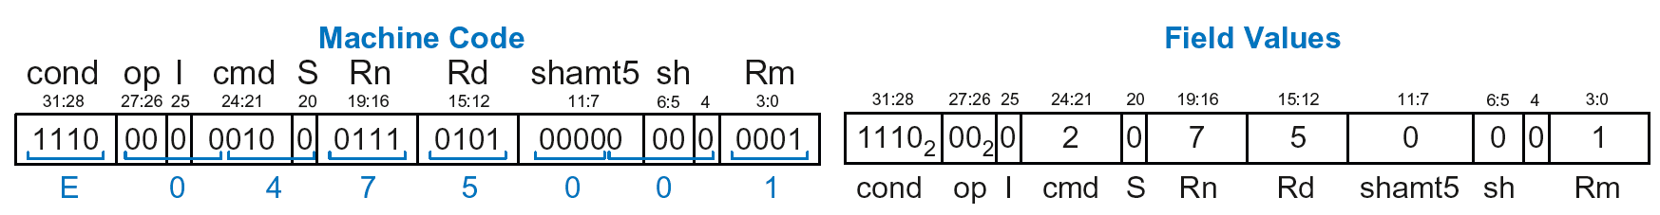
Interpreting Machine Code: Example 1
0xE0475001
Start with op: 00₂, so data-processing instruction
I-bit: 0, so Src2 is a register
bit 4: 0, so Src2 is a register (optionally shifted by shamt5)
cmd: 0010₂ (2), so SUB
Rn=7, Rd=5, Rm=1, shamt5 = 0, sh = 0
So, instruction is: SUB R5,R7,R1

Slide 23
Interpreting Machine Code: Example 2
0xE5949010
Start with op: 01₂, so memory instruction
funct: B=0, L=1, so LDR; P=1, W=0, so offset indexing; I=0, so immediate offset, U=1, so add offset
Rn=4, Rd=9, imm12 = 16
So, instruction is: LDR R9,[R4,#16]

Slide 24
Power of the Stored Program
32-bit instructions & data stored in memory
Sequence of instructions: only difference between two applications
To run a new program:
No rewiring required
Simply store new program in memory
Program Execution:
Processor fetches (reads) instructions from memory in sequence
Processor performs the specified operation

Slide 25
The Stored Program
Program Counter (PC): keeps track of current instruction

Slide 26
Up Next
How to implement the ARM Instruction Set Architecture in Hardware?
Microarchitecture

Slide 27
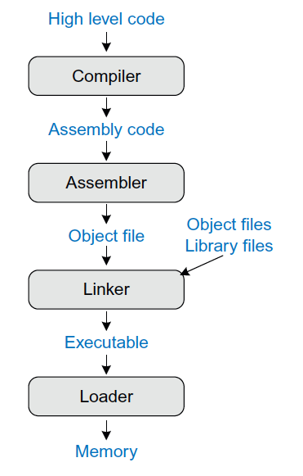
Steps for translating and starting a program

Slide 28
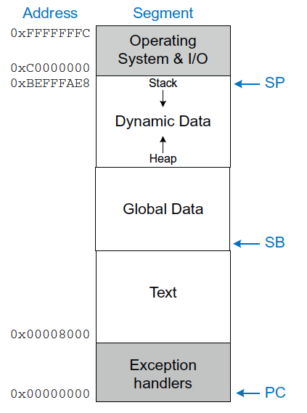
Memory MAP
The ARM architecture divides the address space into five parts or segments:
the text segment
stores the machine language program
global data segment
global variables that
dynamic data segment
the stack and the heap (dynamically allocated and deallocated)
and segments for exception handlers, the operating system (OS) and input/output (I/O).

Slide 29
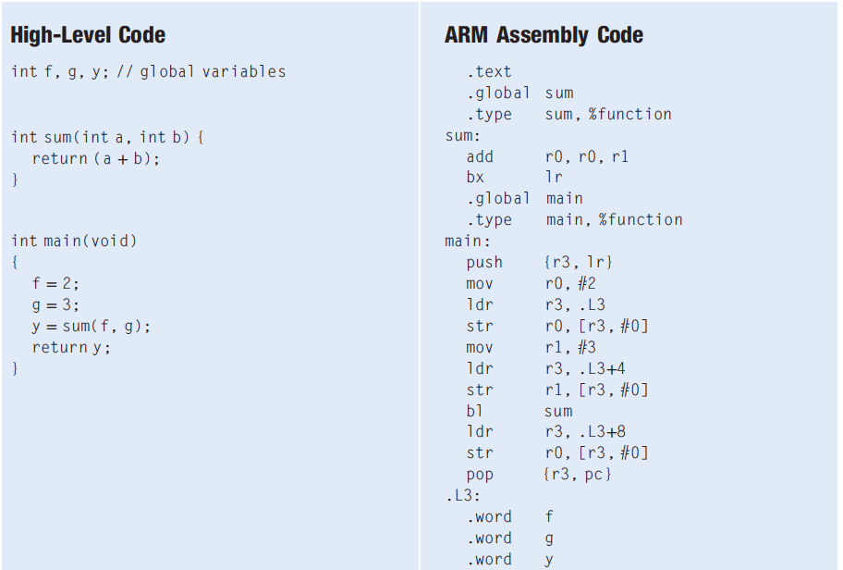
Compiling a High-Level Program

Slide 30

Further Reading
You can read Chapter 6 of your book
Section 6.4

