Slide 1
HDLs and SystemVerilog
Digital Computer Design

Slide 2
Logic Arrays
Gates can be organized into regular arrays.
If the connections are made programmable, these logic arrays can be configured to perform any function without the user having to connect wires in specific ways.
Software tools allow users to map logic designs onto these arrays.
Two types of logic arrays:
programmable logic arrays (PLAs)
field programmable gate arrays (FPGAs)

Slide 3
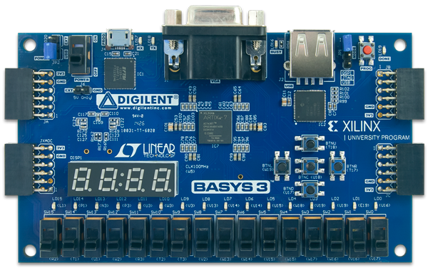
A FPGA Board

Slide 4
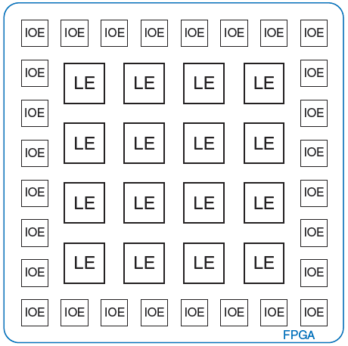
FPGA: Field Programmable Gate Array
FPGA is a reconfigurable substrate
Reconfigurable functions
Reconfigurable interconnection of functions
Reconfigurable input/output (IO)
FPGAs fill the gap between software and hardware
Achieves higher performance than software
Maintains more flexibility than hardware

Slide 5
LE: Logic Element
Composed of:
LUTs (lookup tables): perform combinational logic
Flip-flops: perform sequential logic
Multiplexers: connect LUTs and flip-flops

Slide 6
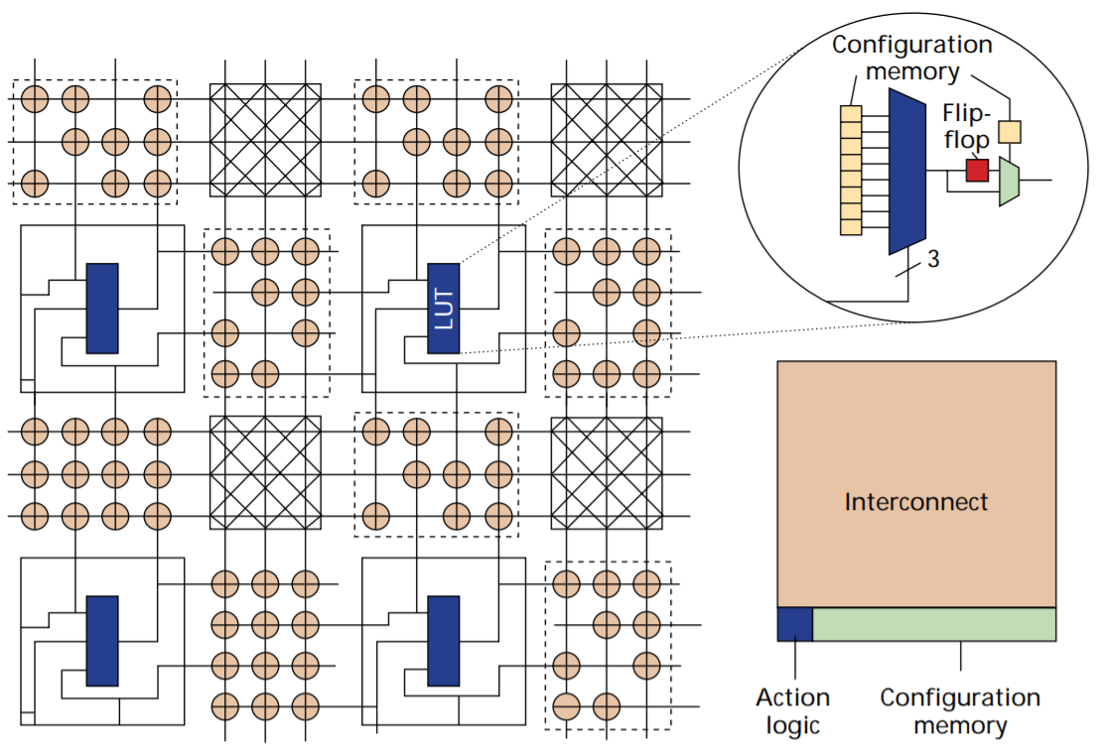
FPGA Architecture - Looking Inside an FPGA
Two main building blocks:
Look-Up Tables (LUT) and Switches

Slide 7
How Do We Program LUTs?
3-bit input LUT (3-LUT)
Data Input
000
3-LUT can implement any 3-bit input function
001
010
011
output (1 bit)
100
Multiplexer (Mux): Selects one of the data input corresponding to select input
101
110
111
Select Input
3
input (3 bits)

Slide 8
An Example of Programming a LUT
Let’s implement a function that outputs ‘1’ when there are more than one ‘1’ in select inputs
Data Input
000
0
001
0
Configuration Memory
010
0
011
1
output (1 bit)
100
0
101
1
110
1
111
1
3
input (3 bits)

Slide 9
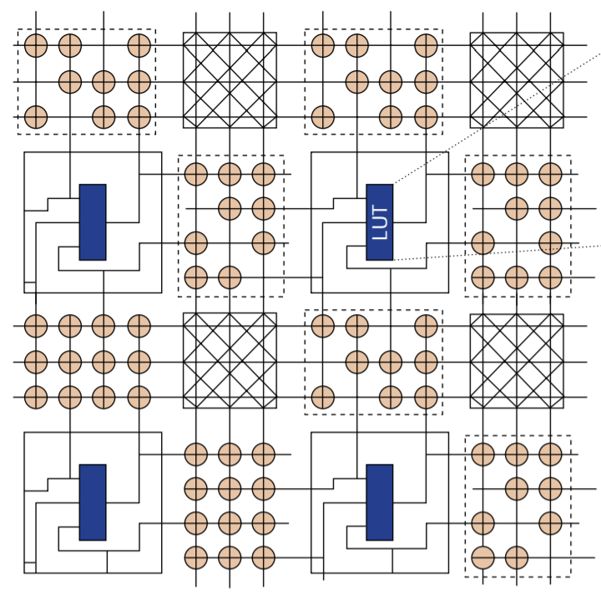
How to Implement Complex Functions?
FPGAs are composed of a large number of LUTs and switches
FPGA Chip

Slide 10
Advantages & Disadvantages of FPGAs
Advantages
Low development cost
Short time to market
Reconfigurable in the field
Reusability
An algorithm can be implemented directly in hardware
No ISA, high specialization
Disadvantages
Not as fast and power efficient as application specific hardware
Reconfigurability adds significant area overhead

Slide 11
Computer-Aided Design (CAD) Tools
FPGAs have many resources (e.g., LUTs, switches)
They are hard to program manually
How can we
represent a high-level functional description of our hardware circuit using the FPGA resources?
select the resources to map our circuit to?
optimally configure the interconnect between the selected resources?
generate a final configuration file to properly configure an FPGA?

Slide 12
FPGA Design Flow
Problem Definition
Your task!
Hardware Description Language (HDL)
Verilog, VHDL
Logic Synthesis
Xilinx Vivado
Placement and Routing
Bitstream Generation
Programming the FPGA

Slide 13
Hardware description language (HDL)
Specifies logic function only
Computer-aided design (CAD) tool produces or synthesizes the optimized gates
Think of the hardware the HDL should produce!
Most commercial designs built using HDLs
Two leading HDLs:
SystemVerilog
developed in 1984 by Gateway Design Automation
IEEE standard (1364) in 1995
Extended in 2005 (IEEE STD 1800-2009)
VHDL 2008
Developed in 1981 by the Department of Defense
IEEE standard (1076) in 1987
Updated in 2008 (IEEE STD 1076-2008)

Slide 14
HDL to Gates
Simulation
Inputs applied to circuit
Outputs checked for correctness
Millions of dollars saved by debugging in simulation instead of hardware
Synthesis
Transforms HDL code into a netlist describing the hardware (i.e., a list of gates and the wires connecting them)

Slide 15
SystemVerilog Modules
A block of hardware with inputs and outputs is called a module.
Two types of Modules:
Behavioral: describe what a module does
Structural: describe how it is built from simpler modules

Slide 16
Behavioral SystemVerilog
module/endmodule: required to begin/end module
example: name of the module
Operators:
~: NOT
&: AND
|: OR
module example(input logic a, b, c,
output logic y);
assign y = ~a & ~b & ~c | a & ~b & ~c | a & ~b & c;
endmodule

Slide 17
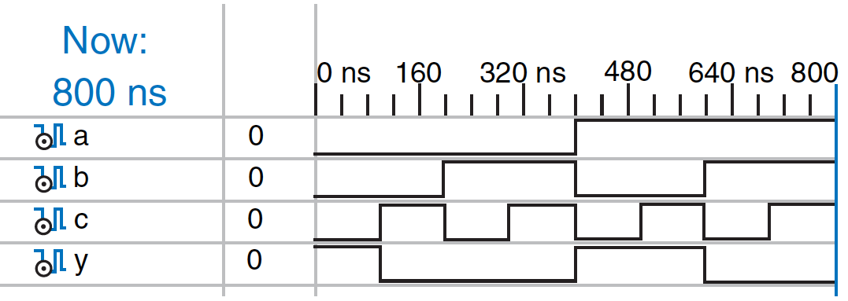
HDL Simulation
module example(input logic a, b, c,
output logic y);
assign y = ~a & ~b & ~c | a & ~b & ~c | a & ~b & c;
endmodule
Inputs applied to circuit, Outputs checked for correctness

Slide 18
HDL Synthesis
module example(input logic a, b, c,
output logic y);
assign y = ~a & ~b & ~c | a & ~b & ~c | a & ~b & c;
endmodule
Transforms HDL code into a netlist describing the hardware (i.e., a list of gates and the wires connecting them)

Slide 19

Further Reading
You can read Chapter 4 of your book.

