Slide 1
Microarchitecture
Digital Computer Design

Slide 2
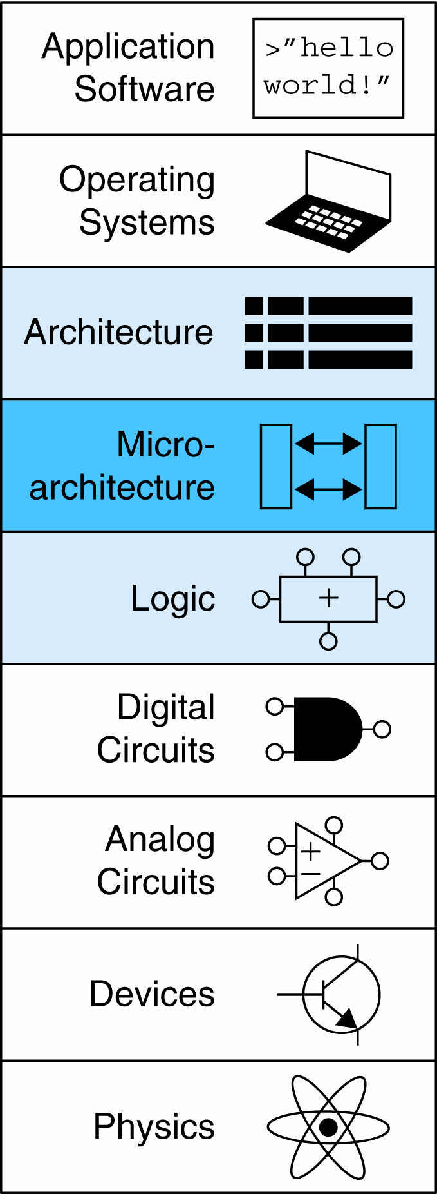
Introduction
Microarchitecture: how to implement an architecture in hardware
Processor:
Datapath: operates on words of data. It contains structures such as memories, registers, ALUs, and multiplexers.
Control: receives the current instruction from the datapath and tells the datapath how to execute that instruction.

Slide 3
Single-Cycle Processor
Executes instructions in a single cycle
Datapath: state elements with combinational logic that can execute the various instructions
Control signals: determine which specific instruction is performed by the datapath at any given time.
The control unit: contains combinational logic that generates the appropriate control signals based on the current instruction.
Fetch -> Decode -> Execute

Slide 4
ARM Architectural State Elements

Slide 5
ARM Architectural State Elements
PC points to the current instruction.
Its input, PC′, indicates the address of the next instruction.
The instruction memory has a single read port.
takes a 32-bit instruction address input, A
reads the 32-bit data (i.e., instruction) from that address onto the read data output, RD.
The data memory has a single read/write port.
If its write enable, WE, is asserted, then it writes data WD into address A on the rising edge of the clock.
If its write enable is 0, then it reads address A onto RD.

Slide 6
ARM Processor
Consider subset of ARM instructions:
Data-processing instructions:
ADD, SUB, AND, ORR
with register and immediate Src2, but no shifts
Memory instructions:
LDR, STR
with positive immediate offset
Branch instructions:
B

Slide 7
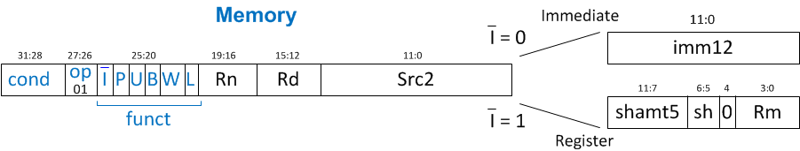
Single-Cycle ARM Processor
Example: LDR R1, [R2, #5]
LDR Rd, [Rn, imm12]

Slide 8
Single-Cycle Datapath: LDR fetch
STEP 1: Fetch instruction

Slide 9
Single-Cycle Datapath: LDR Reg Read
STEP 2: Read source operands from Register File
LDR Rd, [Rn, imm12]

Slide 10
Single-Cycle Datapath: LDR Immed.
STEP 3: Extend the immediate
LDR Rd, [Rn, imm12]

Slide 11
Single-Cycle Datapath: LDR Address
STEP 4: Compute the memory address
LDR Rd, [Rn, imm12]

Slide 12
Single-Cycle Datapath: LDR Mem Read
STEP 5: Read data from memory and write it back to register file
LDR Rd, [Rn, imm12]

Slide 13
Single-Cycle Datapath: PC Increment
STEP 6: Determine address of next instruction

Slide 14
Single-Cycle Datapath: Access to PC
PC can be source/destination of instruction
Source: R15 must be available in Register File
in the ARM architecture, reading register R15 returns PC + 8.
Destination: Be able to write result to PC

Slide 15
Single-Cycle Datapath: STR
Expand datapath to handle STR:
Write data in Rd to memory
STR Rd, [Rn, imm12]

Slide 16
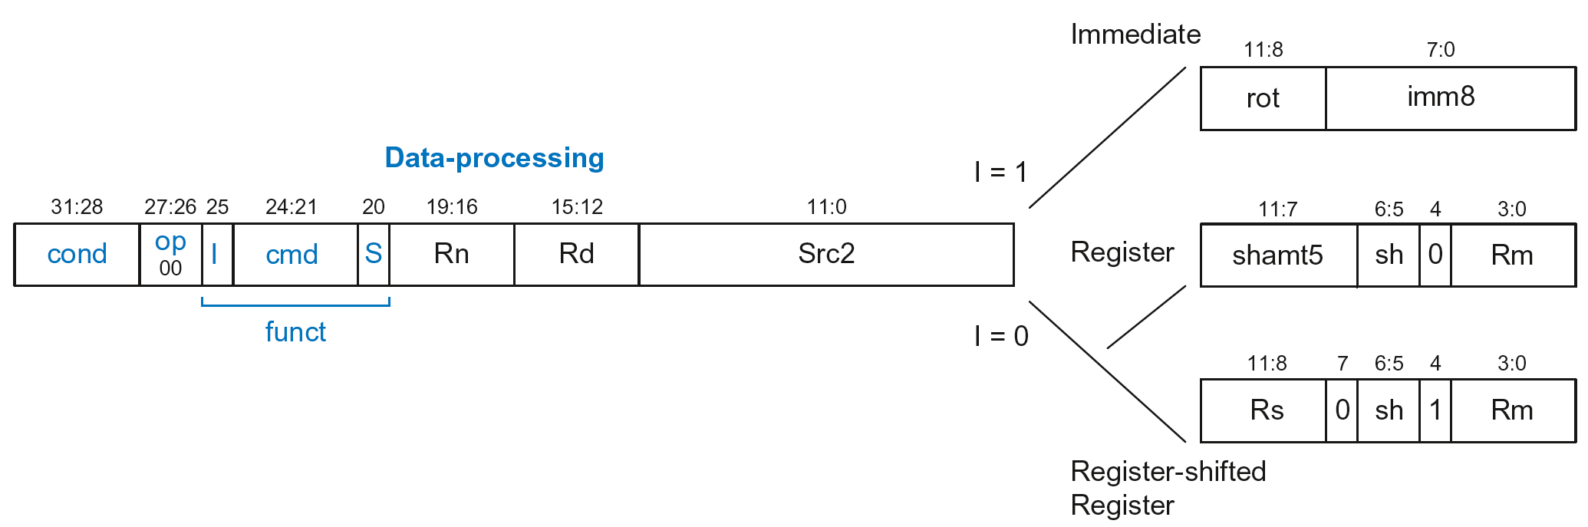
Single-Cycle Datapath: Data-processing
With immediate Src2:
Read from Rn and Imm8 (ImmSrc chooses the zero-extended Imm8 instead of Imm12)
Write ALUResult to register file
Write to Rd
ADD Rd, Rn, imm8

Slide 17
Single-Cycle Datapath: Data-processing
With immediate Src2:
Read from Rn and Imm8 (ImmSrc chooses the zero-extended Imm8 instead of Imm12)
Write ALUResult to register file
Write to Rd
ADD Rd, Rn, imm8

Slide 18
Single-Cycle Datapath: Data-processing
With register Src2:
Read from Rn and Rm (instead of Imm8)
Write ALUResult to register file
Write to Rd
ADD Rd, Rn, Rm

Slide 19
Single-Cycle Datapath: Data-processing
With register Src2:
Read from Rn and Rm (instead of Imm8)
Write ALUResult to register file
Write to Rd
ADD Rd, Rn, Rm

Slide 20
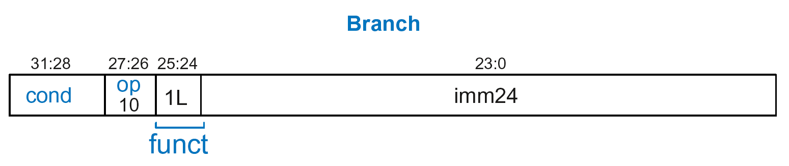
Single-Cycle Datapath: B
Calculate branch target address:
BTA = (ExtImm) + (PC + 8)
ExtImm = Imm24 << 2 and sign-extended
B Label

Slide 21
Single-Cycle Datapath: ExtImm
ImmSrc_{1:0} | ExtImm | Description
00 | {24’b0, Instr_{7:0}} | Zero-extended imm8
01 | {20’b0, Instr_{11:0}} | Zero-extended imm12
10 | {6{Instr₂₃}, Instr_{23:0}} | Sign-extended imm24

Slide 22
Single-Cycle ARM Processor

Slide 23
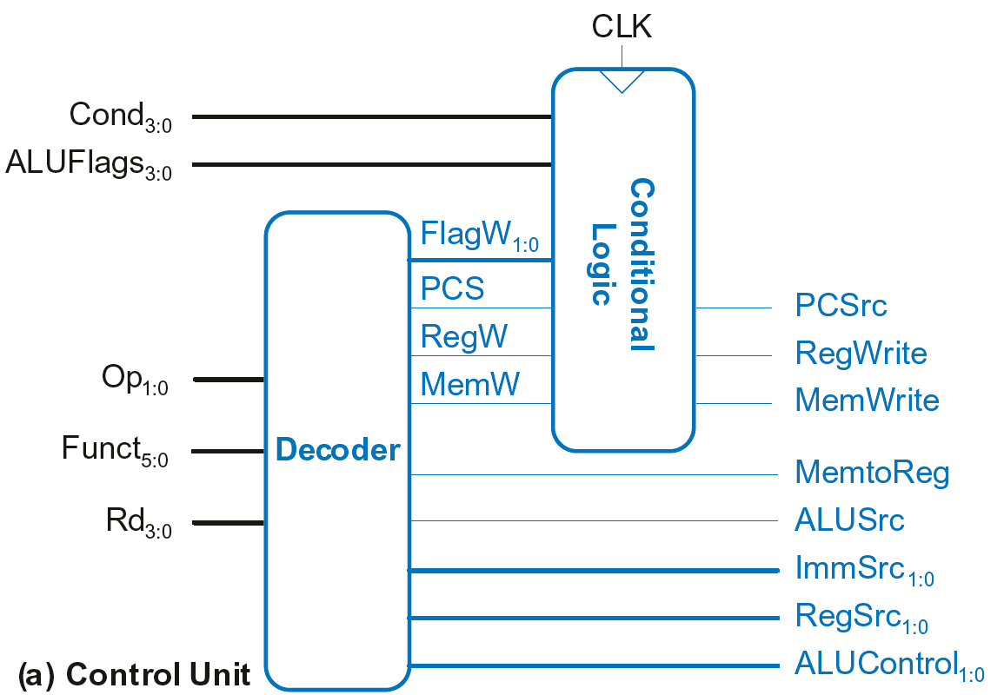
Single-Cycle Control

Slide 24
Single-Cycle Control
These signals change the state (PC, RF, Memory)
If instruction shouldn’t execute, forced to 0
Sent through
Conditional Logic
first, then to
datapath
Sent directly
to datapath

Slide 25
Single-Cycle Control
FlagW_{1:0}: Flag Write signal, asserted when ALUFlags should be saved (i.e., on instruction with S=1)
ADD, SUB update all flags (NZCV)
AND, ORR only update NZ flags
So, two bits needed:
FlagW₁ = 1: NZ saved (ALUFlags_{3:2} saved)
FlagW₀ = 1: CV saved (ALUFlags_{1:0} saved)

Slide 26
Single-Cycle Control: Decoder

Slide 27
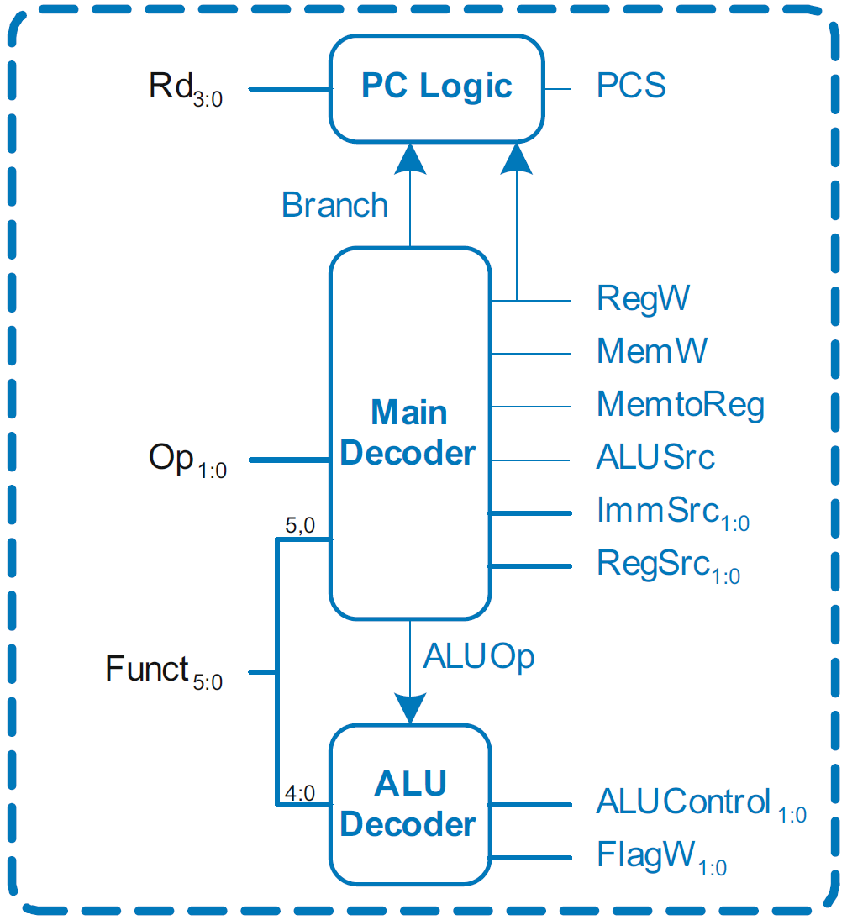
Single-Cycle Control: Decoder
Submodules:
Main Decoder
ALU Decoder
PC Logic

Slide 28
Single-Cycle Control: Decoder
Submodules:
Main Decoder
ALU Decoder
PC Logic

Slide 29
Control Unit: Main Decoder
Op | Funct₅ | Funct₀ | Type | Branch | MemtoReg | MemW | ALUSrc | ImmSrc | RegW | RegSrc | ALUOp
00 | 0 | X | DP Reg | 0 | 0 | 0 | 0 | XX | 1 | 00 | 1
00 | 1 | X | DP Imm | 0 | 0 | 0 | 1 | 00 | 1 | X0 | 1
01 | X | 0 | STR | 0 | X | 1 | 1 | 01 | 0 | 10 | 0
01 | X | 1 | LDR | 0 | 1 | 0 | 1 | 01 | 1 | X0 | 0
11 | X | X | B | 1 | 0 | 0 | 1 | 10 | 0 | X1 | 0

Slide 30
Single-Cycle Control: Decoder
Submodules:
Main Decoder
ALU Decoder
PC Logic

Slide 31
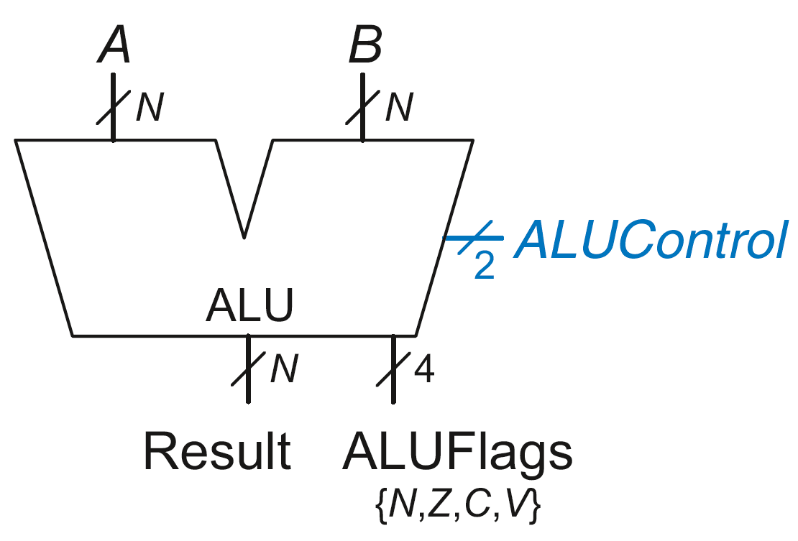
Review: ALU
ALUControl_{1:0} | Function
00 | Add
01 | Subtract
10 | AND
11 | OR

Slide 32
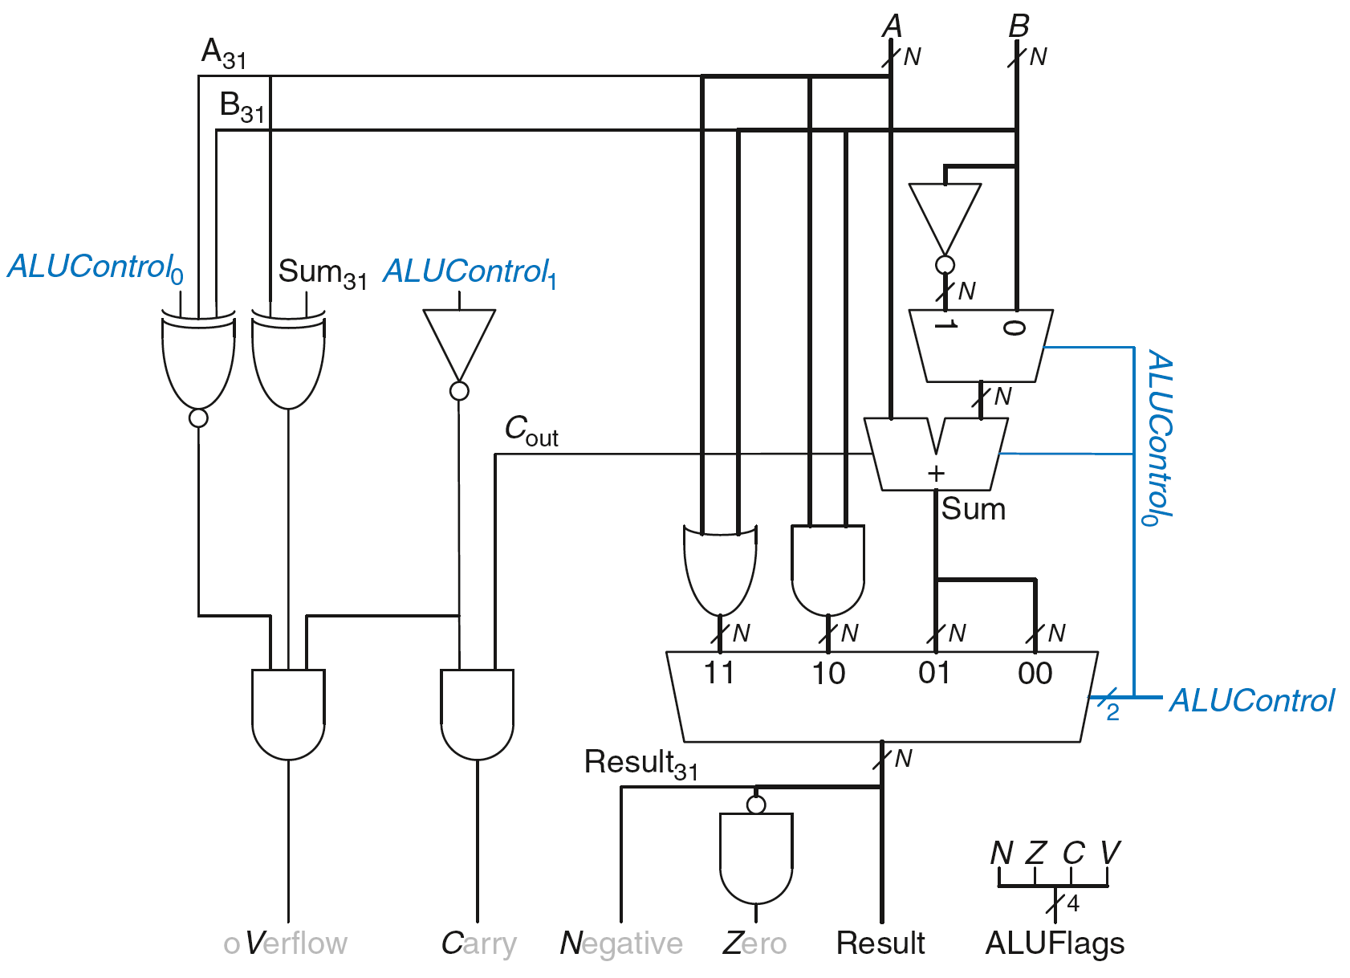
Review: ALU

Slide 33
Control Unit: ALU Decoder
ALUOp | Funct_{4:1} (cmd) | Funct₀ (S) | Type | ALUControl_{1:0} | FlagW_{1:0}
0 | X | X | Not DP | 00 | 00
1 | 0100 | 0 | ADD | 00 | 00
 |  | 1 |  |  | 11
 | 0010 | 0 | SUB | 01 | 00
 |  | 1 |  |  | 11
 | 0000 | 0 | AND | 10 | 00
 |  | 1 |  |  | 10
 | 1100 | 0 | ORR | 11 | 00
 |  | 1 |  |  | 10
FlagW₁ = 1: NZ (Flags_{3:2}) should be saved
FlagW₀ = 1: CV (Flags_{1:0}) should be saved

Slide 34
Single-Cycle Control: Decoder
Submodules:
Main Decoder
ALU Decoder
PC Logic

Slide 35
Single-Cycle Control: PC Logic
PCS = 1 if PC is written by an instruction or branch (B):
PCS = ((Rd == 15) & RegW) | Branch
If instruction is executed: PCSrc = PCS
Else PCSrc = 0 (i.e., PC = PC + 4)

Slide 36
Single-Cycle Control: Cond. Logic

Slide 37
Conditional Logic
Function:
Check if instruction should execute (if not, force PCSrc, RegWrite, and MemWrite to 0)
Possibly update Status Register (Flags_{3:0})

Slide 38
Conditional Logic
Function:
Check if instruction should execute (if not, force PCSrc, RegWrite, and MemWrite to 0)
Possibly update Status Register (Flags_{3:0})

Slide 39
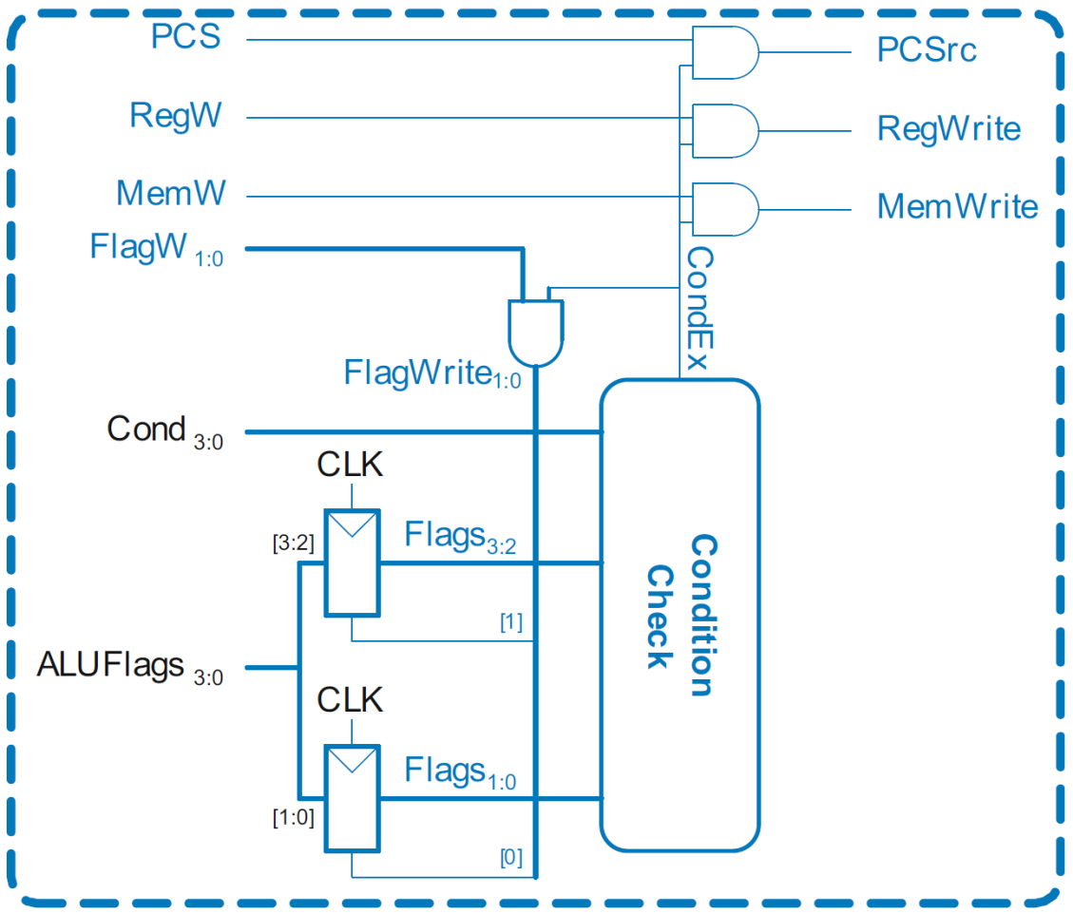
Conditional Logic: Conditional Execution
Flags_{3:0} is the status register
Depending on condition mnemonic (Cond_{3:0}) and condition flags (Flags_{3:0}) the instruction is executed (CondEx = 1)

Slide 40
Conditional Logic: Conditional Execution
Review: Condition Mnemonics
Cond_{3:0} | Mnemonic | Name | CondEx
0000 | EQ | Equal
0001 | NE | Not equal
0010 | CS / HS | Carry set / Unsigned higher or same
0011 | CC / LO | Carry clear / Unsigned lower
0100 | MI | Minus / Negative
0101 | PL | Plus / Positive of zero
0110 | VS | Overflow / Overflow set
0111 | VC | No overflow / Overflow clear
1000 | HI | Unsigned higher
1001 | LS | Unsigned lower or same
1010 | GE | Signed greater than or equal
1011 | LT | Signed less than
1100 | GT | Signed greater than
1101 | LE | Signed less than or equal
1110 | AL (or none) | Always / unconditional | ignored

Slide 41
Conditional Logic: Conditional Execution
Flags_{3:0} = NZCV
Example: AND R1, R2, R3
Cond_{3:0}=1110 (unconditional) => CondEx = 1

Slide 42
Conditional Logic: Conditional Execution
Flags_{3:0} = NZCV
Example: EOREQ R5, R6, R7
Cond_{3:0}=0000 (EQ): if Flags_{3:2}=0100 => CondEx = 1

Slide 43
Conditional Logic
Function:
Check if instruction should execute (if not, force PCSrc, RegWrite, and MemWrite to 0)
Possibly update Status Register (Flags_{3:0})

Slide 44
Conditional Logic: Update (Set) Flags
Flags_{3:0} = NZCV
Flags_{3:0} updated (with ALUFlags_{3:0}) if:
FlagW is 1 (i.e., the instruction’s S-bit is 1) AND
CondEx is 1 (the instruction should be executed)

Slide 45

Conditional Logic: Update (Set) Flags
Recall:
ADD, SUB update all Flags
AND, OR update NZ only
So Flags status register has two write enables: FlagW_{1:0}

Slide 46
Review: ALU Decoder
ALUOp | Funct_{4:1} (cmd) | Funct₀ (S) | Type | ALUControl_{1:0} | FlagW_{1:0}
0 | X | X | Not DP | 00 | 00
1 | 0100 | 0 | ADD | 00 | 00
 |  | 1 |  |  | 11
 | 0010 | 0 | SUB | 01 | 00
 |  | 1 |  |  | 11
 | 0000 | 0 | AND | 10 | 00
 |  | 1 |  |  | 10
 | 1100 | 0 | ORR | 11 | 00
 |  | 1 |  |  | 10
FlagW₁ = 1: NZ (Flags_{3:2}) should be saved
FlagW₀ = 1: CV (Flags_{1:0}) should be saved

Slide 47
Conditional Logic: Update (Set) Flags
All Flags updated
Example: SUBS R5, R6, R7
FlagW_{1:0} = 11 AND CondEx = 1 (unconditional) => FlagWrite_{1:0} = 11

Slide 48
Conditional Logic: Update (Set) Flags
Flags_{3:0} = NZCV
Only Flags_{3:2} updated
i.e., only NZ Flags updated
Example: ANDS R7, R1, R3
FlagW_{1:0} = 10 AND CondEx = 1 (unconditional) => FlagWrite_{1:0} = 10

Slide 49
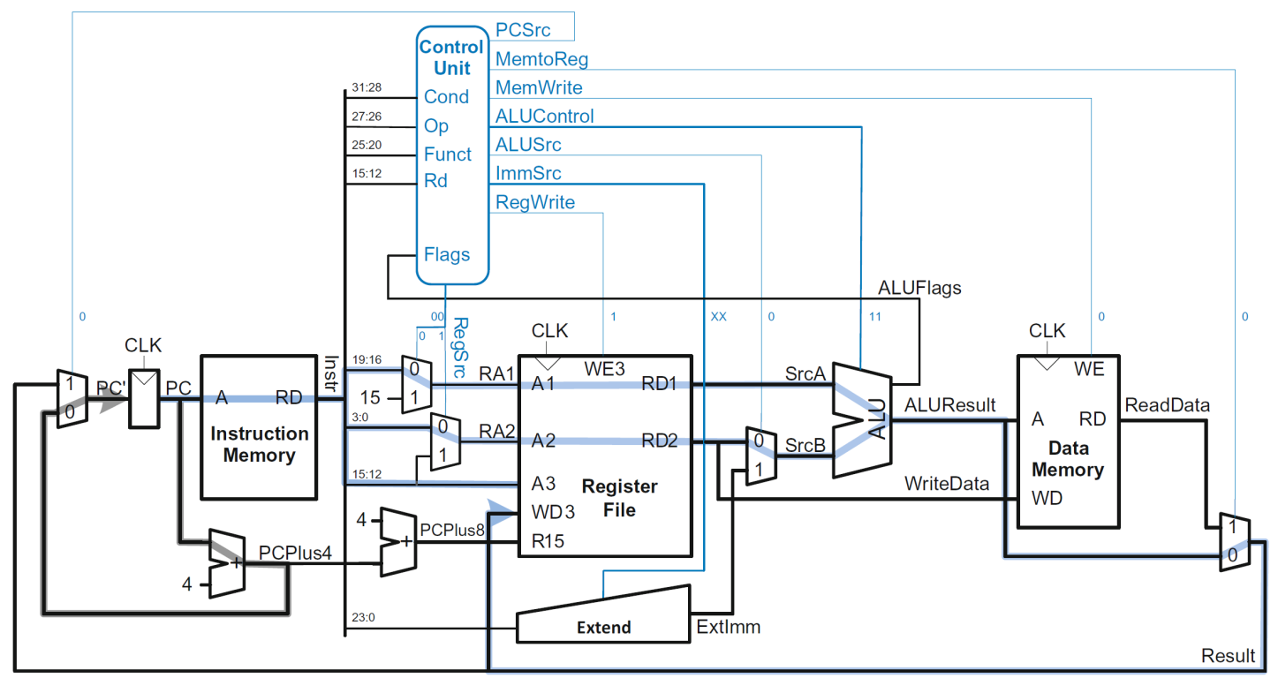
Example: ORR

Slide 50
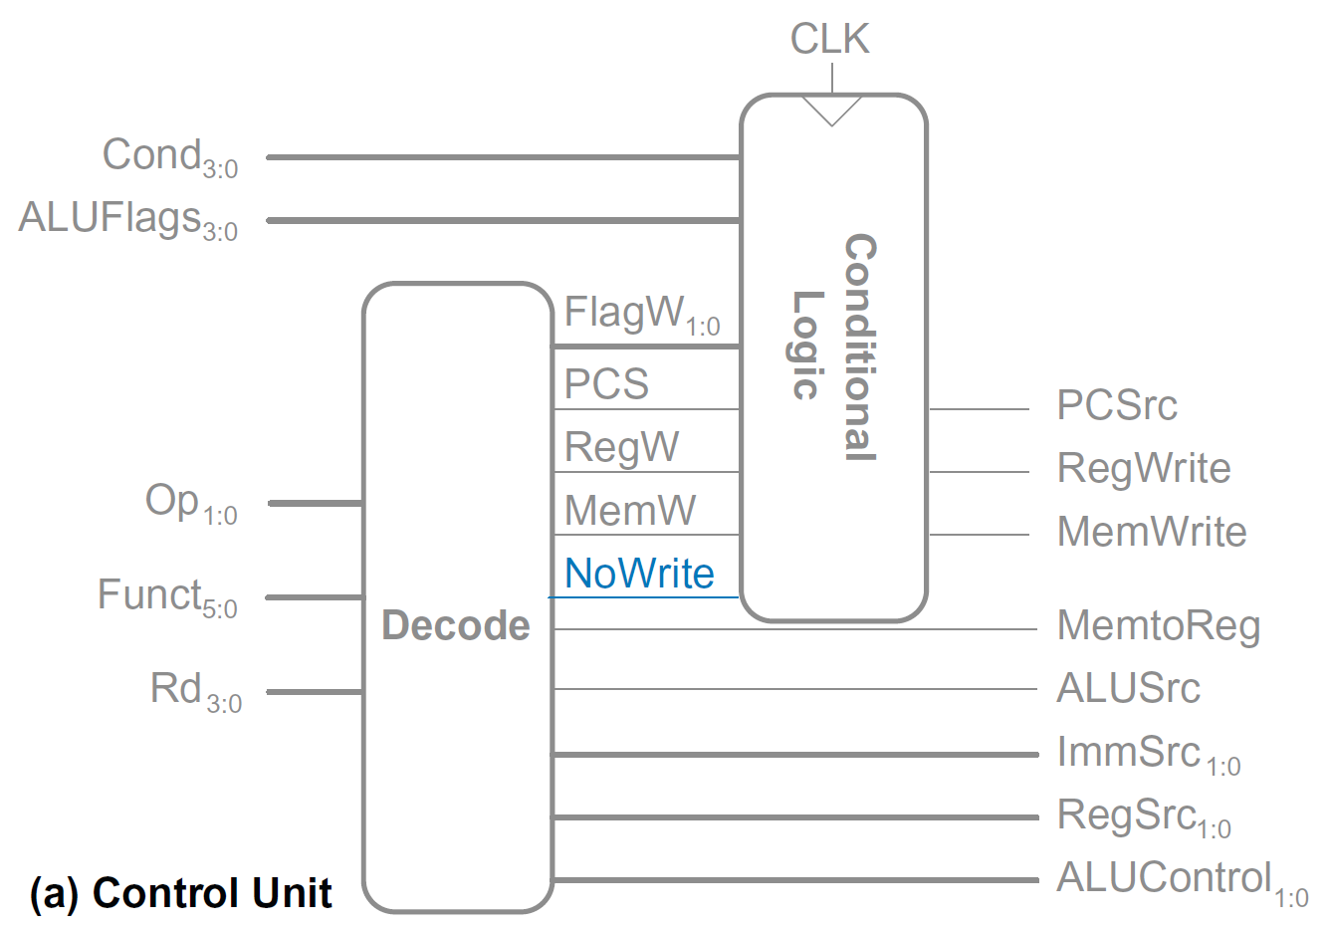
Extended Functionality: CMP

Slide 51
Extended Functionality: CMP
No change to datapath

Slide 52
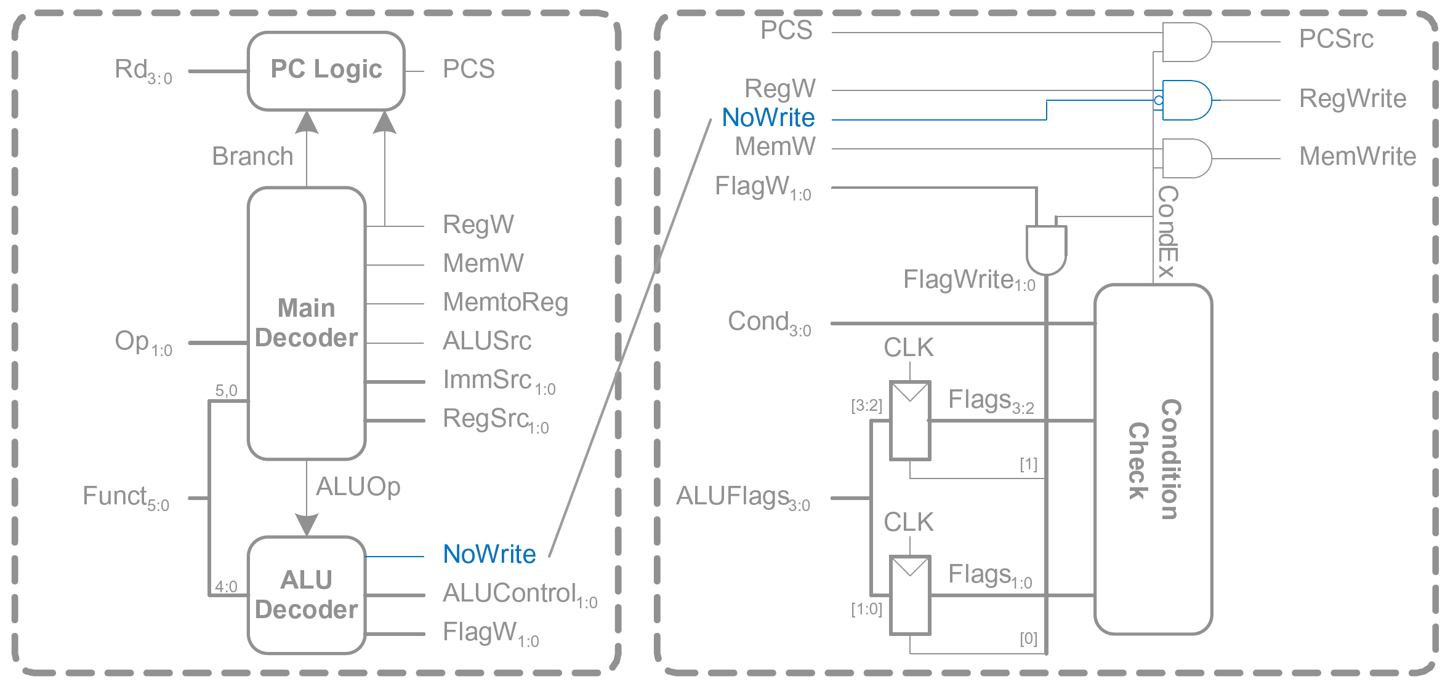
Extended Functionality: CMP

Slide 53
Extended Functionality: CMP
ALUOp | Funct_{4:1} (cmd) | Funct₀ (S) | Type | ALUControl_{1:0} | FlagW_{1:0} | NoWrite
0 | X | X | Not DP | 00 | 00 | 0
1 | 0100 | 0 | ADD | 00 | 00 | 0
 |  | 1 |  |  | 11 | 0
 | 0010 | 0 | SUB | 01 | 00 | 0
 |  | 1 |  |  | 11 | 0
 | 0000 | 0 | AND | 10 | 00 | 0
 |  | 1 |  |  | 10 | 0
 | 1100 | 0 | ORR | 11 | 00 | 0
 |  | 1 |  |  | 10 | 0
 | 1010 | 1 | CMP | 01 | 11 | 1

Slide 54
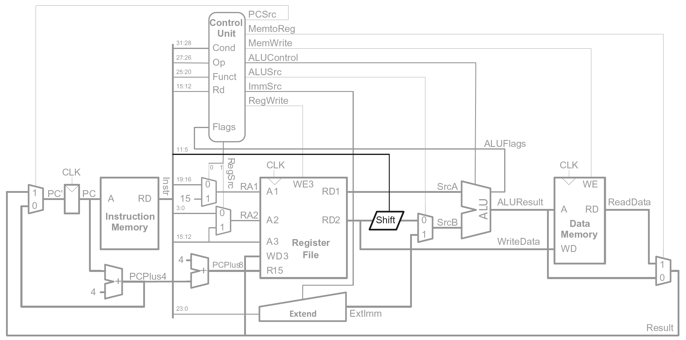
Extended Functionality: Shifted Register

Slide 55
Processor Performance
Program execution time
Execution Time = (#instructions)(cycles/instruction)(seconds/cycle)
# instructions x CPI x T_{C}
Definitions:
CPI: cycles per instruction (Cycles/instruction)
clock period: seconds/cycle
IPC: instructions per cycle (instructions/cycle)
Challenge is to satisfy constraints of:
Cost
Power
Performance

Slide 56
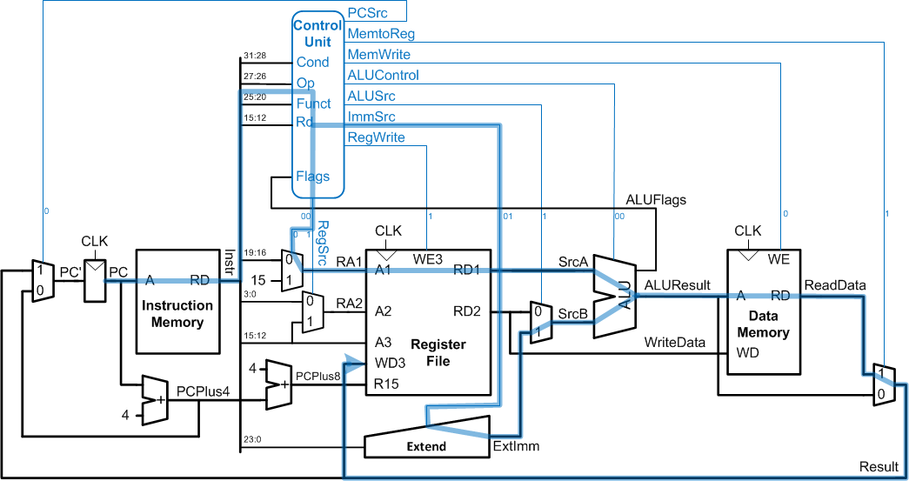
Single-Cycle Performance
T_{C} limited by critical path (LDR)

Slide 57
Single-Cycle Performance Example
Element | Parameter | Delay (ps)
Register clock-to-Q | t_{pcq_PC} | 40
Register setup | t_{setup} | 50
Multiplexer | t_{mux} | 25
ALU | t_{ALU} | 120
Decoder | t_{dec} | 70
Memory read | t_{mem} | 200
Register file read | t_{RFread} | 100
Register file setup | t_{RFsetup} | 60

Slide 58
Single-Cycle Performance Example
Element | Parameter | Delay (ps)
Register clock-to-Q | t_{pcq_PC} | 40
Register setup | t_{setup} | 50
Multiplexer | t_{mux} | 25
ALU | t_{ALU} | 120
Decoder | t_{dec} | 70
Memory read | t_{mem} | 200
Register file read | t_{RFread} | 100
Register file setup | t_{RFsetup} | 60
T_{c1} = t_{pcq_PC} + 2t_{mem} + t_{dec} + t_{RFread} + t_{ALU} + 2t_{mux} + t_{RFsetup}
= [50 + 2(200) + 70 + 100 + 120 + 2(25) + 60] ps
= 840 ps

Slide 59
Single-Cycle Performance Example
Program with 100 billion instructions:
Execution Time = # instructions x CPI x T_{C}
= (100 × 10⁹)(1)(840 × 10⁻¹² s)
= 84 seconds

Slide 60
Multicycle ARM Processor
Single-cycle:
+ simple
cycle time limited by longest instruction (LDR)
separate memories for instruction and data
3 adders/ALUs
Multicycle processor addresses these issues by breaking instruction into shorter steps
shorter instructions take fewer steps
can re-use hardware
cycle time is faster

Slide 61
Multicycle ARM Processor
Single-cycle:
+ simple
cycle time limited by longest instruction (LDR)
separate memories for instruction and data
3 adders/ALUs
Multicycle:
+ higher clock speed
+ simpler instructions run faster
+ reuse expensive hardware on multiple cycles
- sequencing overhead paid many times

Slide 62

Reading
Chapter 7
Sections 7.1, 7.2 and 7.3

