Slide 1
Architecture
Digital Computer Design

Slide 2
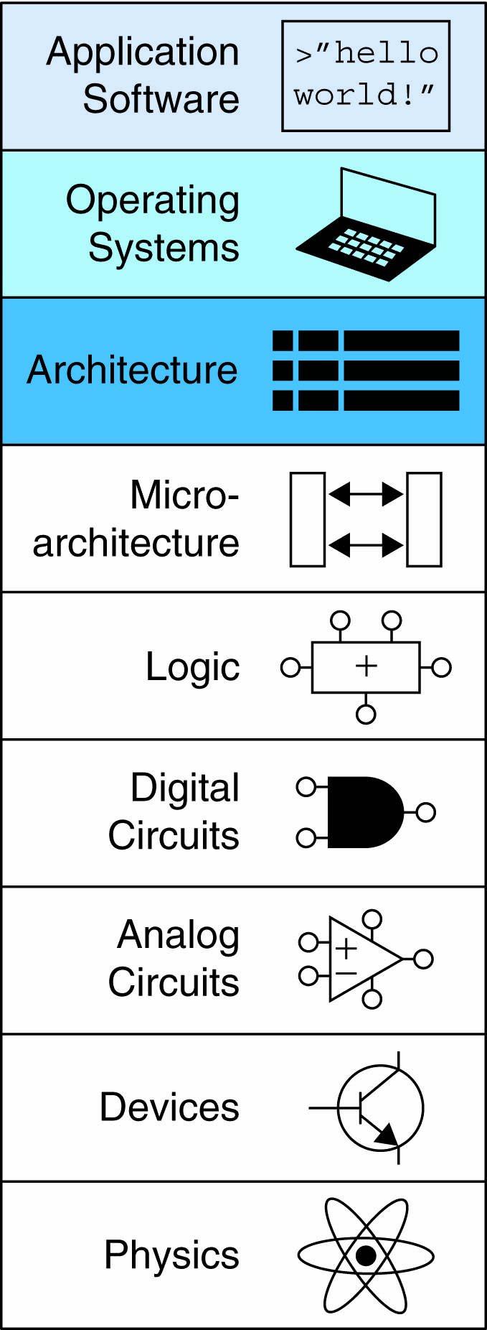
Architecture
The architecture is the programmer’s view of a computer.
It is defined by the
instruction set (language) and
operand locations (registers and memory).
Many different architectures exist, such as
ARM, x86, MIPS, SPARC, and PowerPC.

Slide 3
Understanding Computer Architecture
The first step in understanding any computer architecture is to learn its language:
The words in a computer’s language are called instructions.
The computer’s vocabulary is called the instruction set.
All programs running on a computer use the same instruction set.
All applications are eventually compiled into a series of simple instructions:
such as add, subtract, and branch.

Slide 4
Microarchitecture
A computer architecture does not define the underlying hardware implementation.
Registers, memories, ALUs, and other building blocks to form a microprocessor is called the microarchitecture.

Slide 5
Microarchitecture
Different microarchitectures may exist for a single architecture.
Intel and Advanced Micro Devices (AMD) both sell various microprocessors belonging to the same x86 architecture.
They all can run the same programs,
But they use different underlying hardware
Offer different trade-offs in performance, price, and power.
We will explore microarchitecture in the following weeks!

Slide 6
ARM Architecture
Developed in the 1980’s by Advanced RISC Machines – now called ARM Holdings
Almost all cell phones and tablets have multiple ARM processors
Over 75% of humans use products with an ARM processor
Used in servers, cameras, robots, cars, pinball machines, etc.

Slide 7
Machine Language
Computer hardware understands only 1’s and 0’s
Instructions are encoded as binary numbers in a format called machine language.
The ARM architecture represents each instruction as a 32-bit word.

Slide 8
Assembly Language
However, humans consider reading machine language to be tedious
We prefer to represent the instructions in a symbolic format called assembly language.
Each assembly language instruction specifies the operation to perform and the operands on which to operate

Slide 9
Instruction: Addition
C Code
a = b + c;
ARM Assembly Code
ADD a, b, c
ADD: mnemonic – indicates operation to perform
b, c: source operands
a: destination operand

Slide 10
Instruction: Subtraction
Similar to addition - only mnemonic changes
SUB: mnemonic
b, c: source operands
a: destination operand
C Code
a = b - c;
ARM assembly code
SUB a, b, c

Slide 11
Multiple Instructions
More complex code handled by multiple ARM instructions
C Code
a = b + c - d;
ARM assembly code
ADD t, b, c ; t = b + c
SUB a, t, d ; a = t - d

Slide 12
Operands
An instruction operates on operands .
The variables a, b, and c are all operands.
But computers operate on 1’ s and 0’ s, not variable names.
The instructions need a physical location from which to retrieve the binary data.
Operands can be stored in
Registers
Memory
Constants stored in the instruction itself (immediates).
SUB a, b, c

Slide 13
Registers and Memory

Slide 14
Operands: Registers
Instructions need to access operands quickly so that they can run fast.
But operands stored in memory take a long time to retrieve.
Therefore, most architectures specify a small number of registers that hold commonly used operands.
ARM has 16 registers
Registers are faster than memory
Each register is 32 bits
ARM is called a “32-bit architecture” because it operates on 32-bit data

Slide 15
ARM Register Set
Registers:
R before number, all capitals
Example: “R0” or “register zero” or “register R0”
Name | Use
R0 | Argument / return value / temporary variable
R1-R3 | Argument / temporary variables
R4-R11 | Saved variables
R12 | Temporary variable
R13 (SP) | Stack Pointer
R14 (LR) | Link Register
R15 (PC) | Program Counter

Slide 16
Instructions with Registers
Revisit ADD instruction
C Code
a = b + c
ARM Assembly Code
; R0 = a, R1 = b, R2 = c
ADD R0, R1, R2

Slide 17
Operands: Constants\Immediates
Many instructions can use constants or immediate operands
For example: ADD and SUB
Value is immediately available from instruction
C Code
a = a + 4;
b = a – 12;
ARM Assembly Code
; R0 = a, R1 = b
ADD R0, R0, #4
SUB R1, R0, #12

Slide 18
Generating Constants
Generating small constants using move (MOV):
Note: MOV can also use 2 registers: MOV R7,R9
C Code
//int: 32-bit signed word
int a = 23;
int b = 0x45;
ARM Assembly Code
; R0 = a, R1 = b
MOV R0, #23
MOV R1, #0x45

Slide 19
Operands: Memory
If registers were the only storage space for operands
Simple programs with no more than 15 variables.
However, data can also be stored in memory.
Whereas the register file is small and fast, memory is larger and slower.
For this reason, frequently used variables are kept in registers.
In the ARM architecture, instructions operate exclusively on registers
so data stored in memory must be moved to a register before it can be processed.

Slide 20
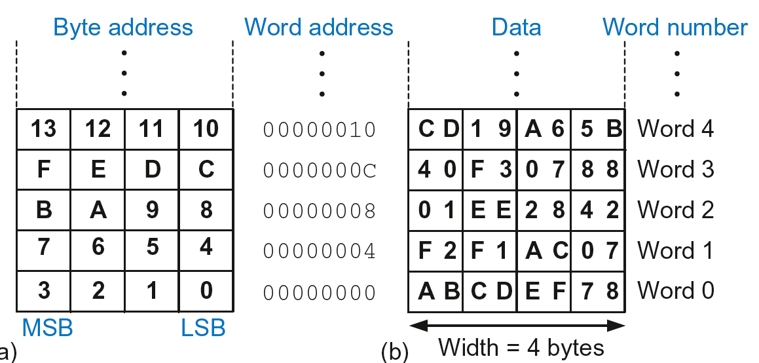
Byte-Addressable Memory
ARM uses a byte-addressable memory.
Each data byte has unique address
32-bit word = 4 bytes, so word address increments by 4

Slide 21
Reading Memory
Memory read called load
Mnemonic: load register (LDR)
Format:
LDR R0, [R1, #12]
Address calculation:
add base address (R1) to the offset (12)
address = (R1 + 12)
Result:
R0 holds the data at memory address (R1 + 12)
Any register may be used as base address.

Slide 22
Reading Memory
Example: Read a word of data at memory address 8 into R3
Address = (R2 + 8) = 8
R3 = 0x01EE2842 after load
ARM Assembly Code
MOV R2, #0
LDR R3, [R2, #8]

Slide 23
Writing Memory
Memory write are called stores
Mnemonic: store register (STR)
Example: Store the value held in R7 into memory word 21.
Memory address = 4 x 21 = 84 = 0x54
ARM assembly code
MOV R5, #0
STR R7, [R5, #0x54]

Slide 24
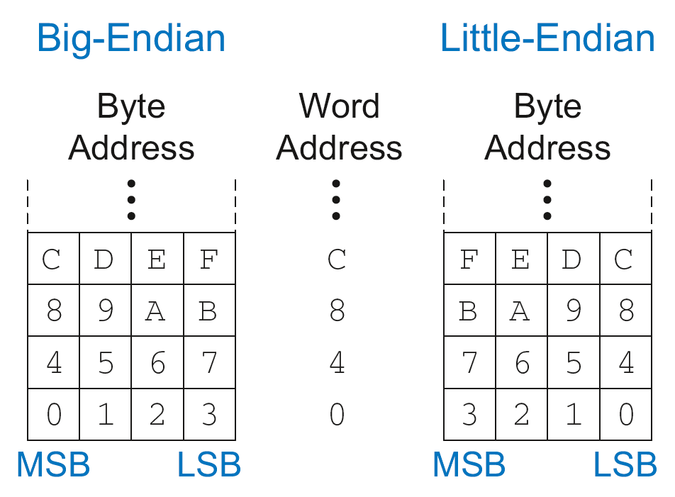
Recap: Accessing Memory
How to number bytes within a word?
Little-endian: byte numbers start at the little (least significant) end
Big-endian: byte numbers start at the big (most significant) end

Slide 25
Big-Endian & Little-Endian Example
Suppose R2 and R5 hold the values 8 and 0x23456789
After following code runs on big-endian system, what value is in R7?
In a little-endian system?
STR R5, [R2, #0]
LDRB R7, [R2, #1]
Big-endian: 0x00000045
Little-endian: 0x00000067

Slide 26
Programming
High-level languages
e.g., C, Java, Python:
Written at a more abstract level than assembly
Many high-level languages use common software constructs
such as arithmetic and logical operations
conditional execution, if/else statements
for and while loops
array indexing
function calls.

Slide 27
Data-processing Instructions
Logical operations
Shifts / rotate
Multiplication

Slide 28
Logical Instructions
These each operate bitwise on two sources and write the result to a destination register.
The first source is always a register and the second source is either an immediate or another register.
AND
ORR
EOR (XOR)
BIC (Bit Clear)
MVN (MoVe and NOT)

Slide 29
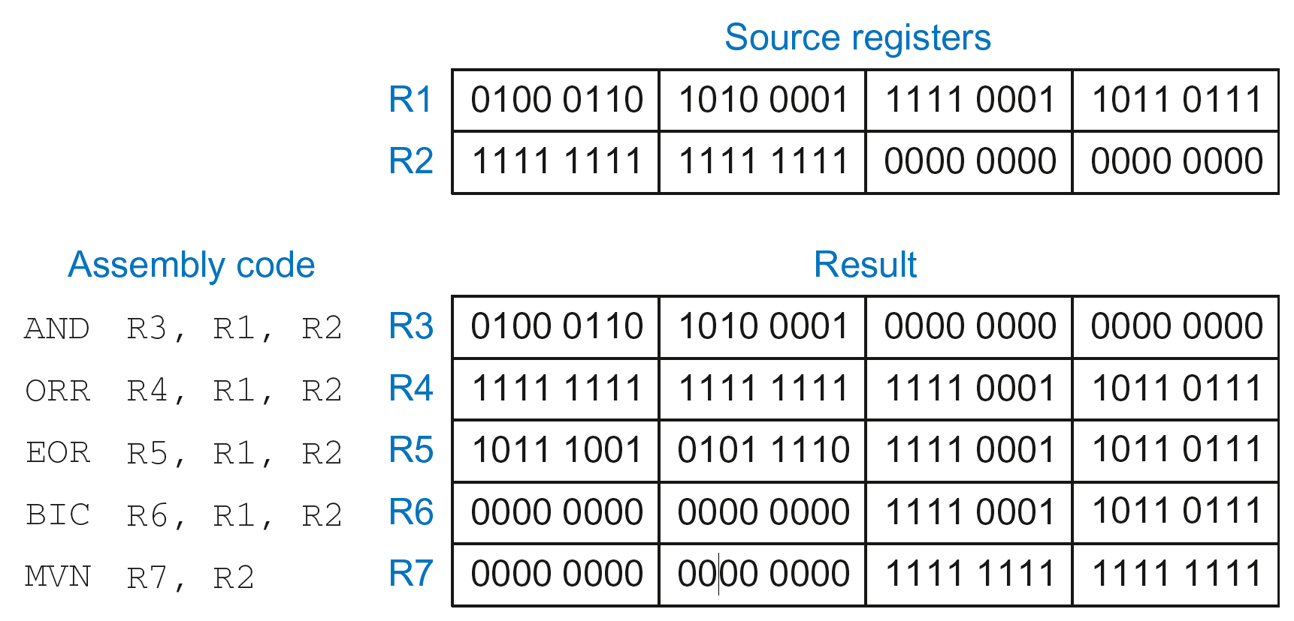
Logical Instructions: Examples

Slide 30
Logical Instructions: Uses
AND or BIC: useful for masking bits
Example: Masking all but the least significant byte of a value
0xF234012F AND 0x000000FF = 0x0000002F
0xF234012F BIC 0xFFFFFF00 = 0x0000002F
ORR: useful for combining bit fields
Example: Combine 0xF2340000 with 0x000012BC:
0xF2340000 ORR 0x000012BC = 0xF23412BC

Slide 31
Shift Instructions
LSL: logical shift left
Example: LSL R0, R7, #5 ; R0 = R7 << 5
LSR: logical shift right
Example: LSR R3, R2, #31 ; R3 = R2 >> 31
ASR: arithmetic shift right
Example: ASR R9, R11, R4 ; R9 = R11 >>> R4_{7:0}
ROR: rotate right
Example: ROR R8, R1, #3 ; R8 = R1 ROR 3

Slide 32
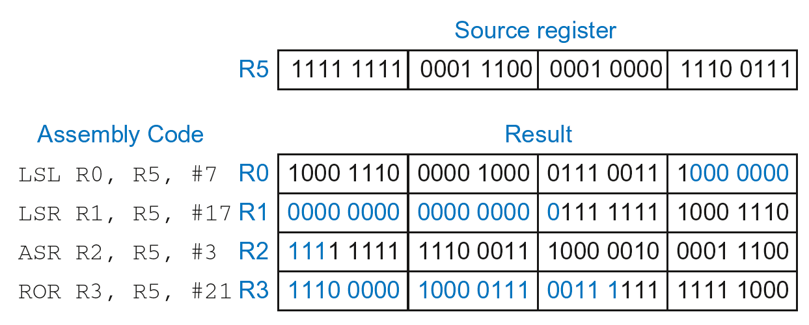
Shift Instructions: Example 1
Immediate shift amount (5-bit immediate)
Shift amount: 0-31

Slide 33
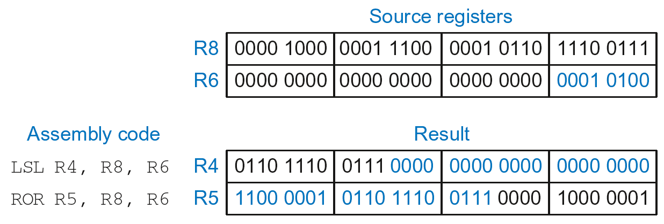
Shift Instructions: Example 2
Register shift amount (uses low 8 bits of register)
Shift amount: 0-255

Slide 34
Multiplication
MUL: 32 × 32 multiplication, 32-bit result
MUL R1, R2, R3
Result: R1 = (R2 x R3)_{31:0}
UMULL: Unsigned multiply long: 32 × 32 multiplication, 64-bit result
UMULL R1, R2, R3, R4
Result: {R1,R4} = R2 x R3 (R2, R3 unsigned)
SMULL: Signed multiply long: 32 × 32 multiplication, 64-bit result
SMULL R1, R2, R3, R4
Result: {R1,R4} = R2 x R3 (R2, R3 signed)

Slide 35
Conditional Execution
Don’t always want to execute code sequentially
For example:
if/else statements, while loops, etc.: only want to execute code if a condition is true
branching: jump to another portion of code if a condition is true
ARM includes condition flags that can be:
set by an instruction
used to conditionally execute an instruction

Slide 36
ARM Condition Flags
Flag | Name | Description
N | Negative | Instruction result is negative
Z | Zero | Instruction results in zero
C | Carry | Instruction causes an unsigned carry out
V | oVerflow | Instruction causes an overflow
Set by ALU
Held in Current Program Status Register (CPSR)

Slide 37
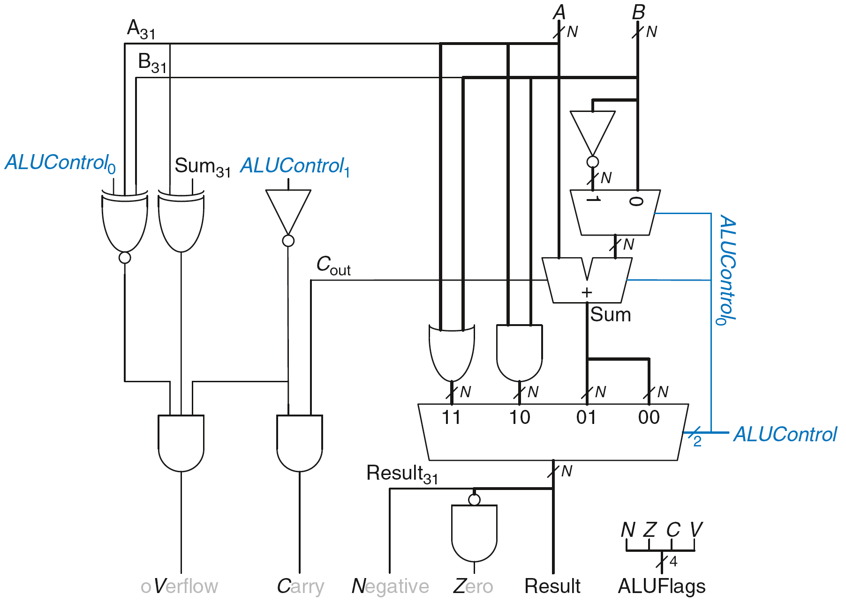
Review: ARM ALU

Slide 38
Review: ALU

Slide 39
Setting the Condition Flags: NZCV
Compare instruction: CMP
Example: CMP R5,R6
Performs: R5 - R6
Does not save result
Sets flags. If result:
Is 0, Z=1
Is negative, N=1
Causes a carry out, C=1
Causes a signed overflow, V=1

Slide 40
Condition Mnemonics
Instruction may be conditionally executed based on the condition flags
Condition of execution is encoded as a condition mnemonic appended to the instruction mnemonic
Example: CMP R1, R2
SUBNE R3, R5, R8
NE: condition mnemonic
SUB will only execute if R1 ≠ R2
(i.e., Z = 0)

Slide 41
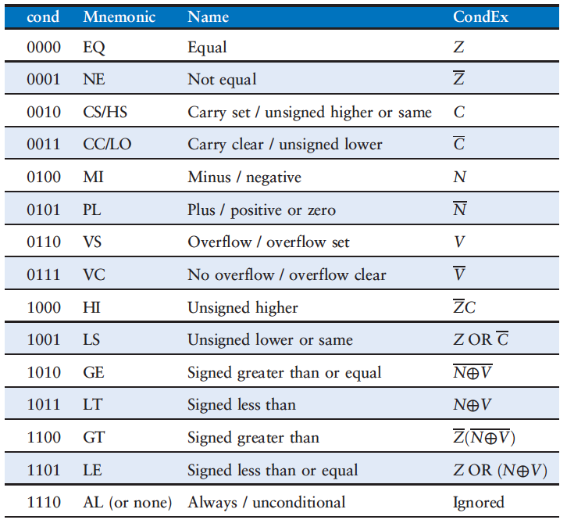
Condition Mnemonics

Slide 42
Conditional Execution
Example:
CMP R5, R9 ; performs R5-R9
; sets condition flags
SUBEQ R1, R2, R3 ; executes if R5==R9 (Z=1)
ORRMI R4, R0, R9 ; executes if R5-R9 is
; negative (N=1)
Suppose R5 = 17, R9 = 23:
CMP performs: 17 – 23 = -6 (Sets flags: N=1, Z=0, C=0, V=0)
SUBEQ doesn’t execute (they aren’t equal: Z=0)
ORRMI executes because the result was negative (N=1)

Slide 43
Branching
Branches enable out of sequence instruction execution
ARM use branch instructions to skip over sections of code or repeat code.
Types of branches:
Branch (B)
branches to another instruction
Branch and link (BL)
Both can be conditional or unconditional

Slide 44
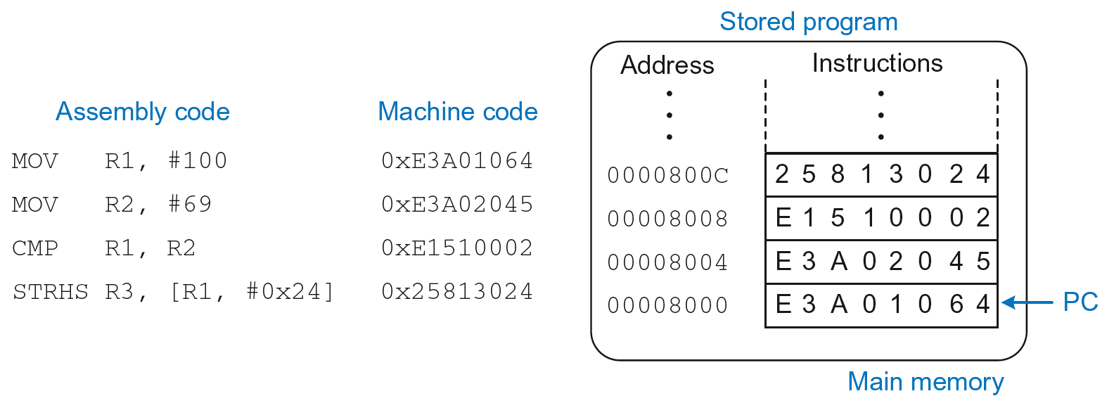
The Stored Program
A program usually executes in sequence, with the program counter (PC) incrementing by 4 after each instruction to point to the next instruction.
Recall that instructions are 4 bytes long and ARM is a byte-addressed architecture.
Branch instructions change the program counter.

Slide 45
Review: Stored Program

Slide 46
Unconditional Branching (B)
ARM assembly
MOV R2, #17 ; R2 = 17
B TARGET ; branch to target
ORR R1, R1, #0x4 ; not executed
TARGET
SUB R1, R1, #78 ; R1 = R1 + 78
Labels (like TARGET) indicate instruction location. Labels can’t be reserved words (like ADD, ORR, etc.)

Slide 47
Conditional Branching
ARM Assembly
MOV R0, #4 ; R0 = 4
ADD R1, R0, R0 ; R1 = R0+R0 = 8
CMP R0, R1 ; sets flags with R0-R1
BEQ THERE ; branch not taken (Z=0)
ORR R1, R1, #1 ; R1 = R1 OR R1 = 9
THERE
ADD R1, R1, 78 ; R1 = R1 + 78 = 87

Slide 48
if Statement
C Code
if (i == j)
f = g + h;
f = f – i;
ARM Assembly Code
;R0=f, R1=g, R2=h, R3=i, R4=j
CMP R3, R4 ; set flags with R3-R4
BNE L1 ; if i!=j, skip if block
ADD R0, R1, R2 ; f = g + h
L1
SUB R0, R0, R2 ; f = f - i
Assembly tests opposite case (i != j) of high-level code (i == j)

Slide 49
if/else Statement
C Code
if (i == j)
f = g + h;
else
f = f – i;
ARM Assembly Code
;R0=f, R1=g, R2=h, R3=i, R4=j
CMP R3, R4 ; set flags with R3-R4
BNE L1 ; if i!=j, skip if block
ADD R0, R1, R2 ; f = g + h
B L2 ; branch past else block
L1
SUB R0, R0, R2 ; f = f – i
L2

Slide 50
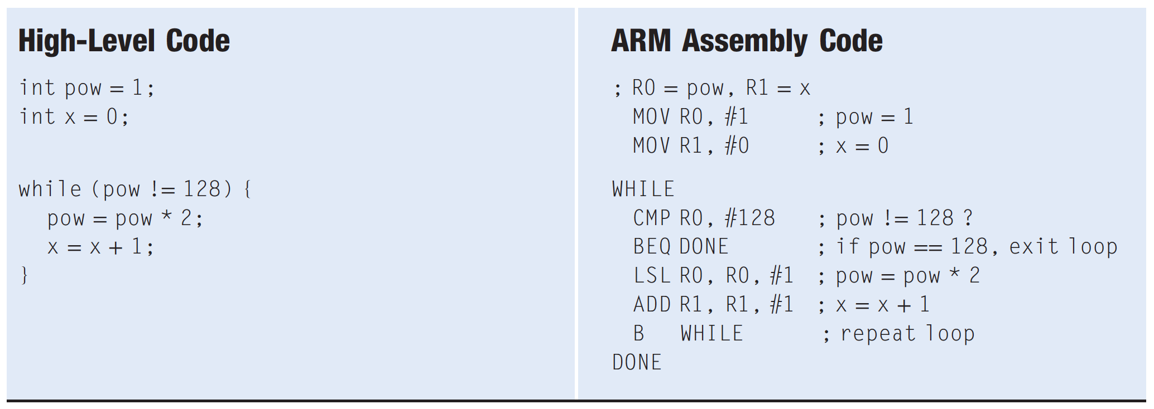
while Loops

Slide 51
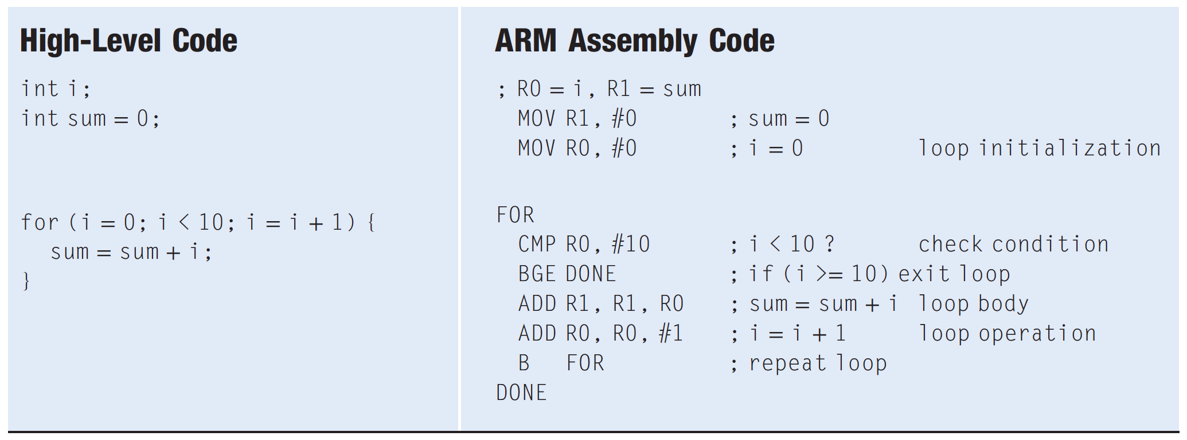
For Loops

Slide 52
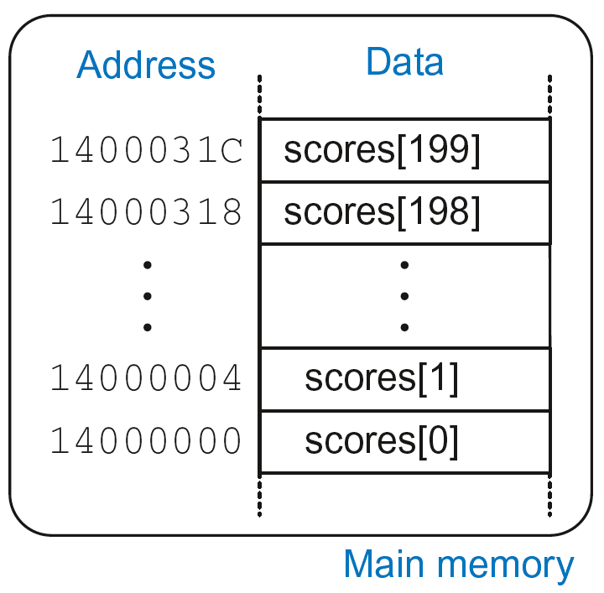
Arrays
Access large amounts of similar data
Index: access to each element
Size: number of elements
5-element array
Base address = 0x14000000 (address of first element, scores[0])
Array elements accessed relative to base address

Slide 53
Accessing Arrays
C Code
int array[5];
array[0] = array[0] * 8;
array[1] = array[1] * 8;
ARM Assembly Code
; R0 = array base address
MOV R0, #0x60000000 ; R0 = 0x60000000
LDR R1, [R0] ; R1 = array[0]
LSL R1, R1, 3 ; R1 = R1 << 3 = R1*8
STR R1, [R0] ; array[0] = R1
LDR R1, [R0, #4] ; R1 = array[1]
LSL R1, R1, 3 ; R1 = R1 << 3 = R1*8
STR R1, [R0, #4] ; array[1] = R1

Slide 54
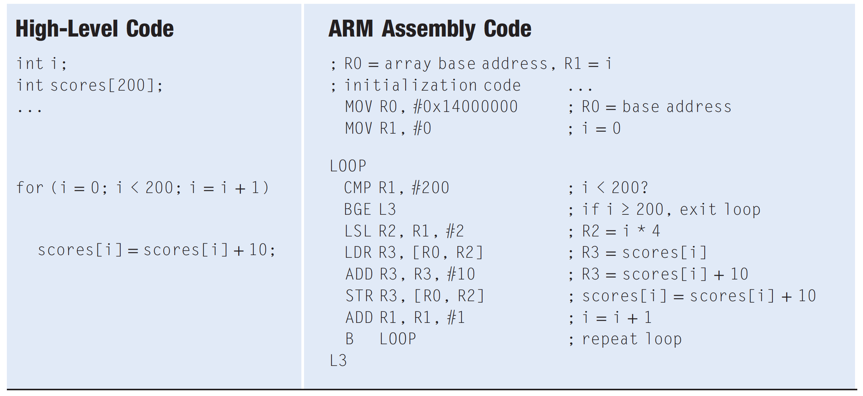
ACCESSING ARRAYS USING A FOR LOOP

Slide 55
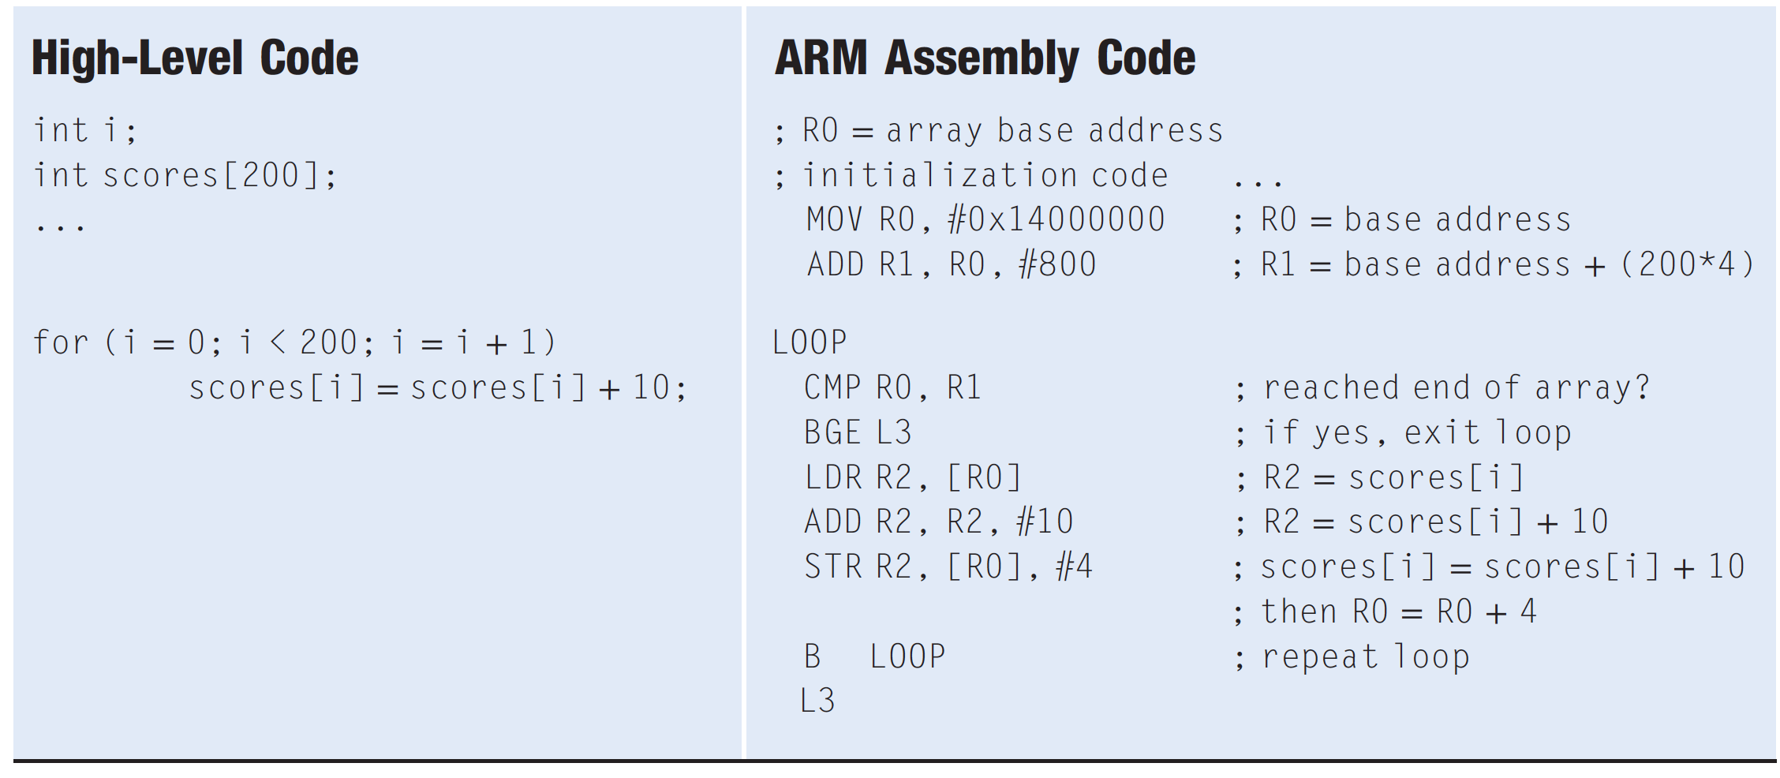
ACCESSING ARRAYS USING A FOR LOOP

Slide 56
Function Calls
Caller:
passes arguments to callee
jumps to callee
Callee:
performs the function
returns result to caller
returns to point of call
must not overwrite registers or memory needed by caller
C Code
void main()
{
int y;
y = sum(42, 7);
...
}
int sum(int a, int b)
{
return (a + b);
}

Slide 57
ARM Function Conventions
Call Function: branch and link
BL
it stores the return address of the next instruction in the link register (LR), and it branches to the target instruction.
Return from function: move the link register to PC: MOV PC, LR
Arguments: R0-R3
Return value: R0

Slide 58
Function Calls
C Code
int main() {
simple();
a = b + c;
}
void simple() {
return;
}
ARM Assembly Code
0x00000200 MAIN BL SIMPLE
0x00000204 ADD R4, R5, R6
...
0x00401020 SIMPLE MOV PC, LR
BL (branch and link)branches to SIMPLE
LR = PC + 4 = 0x00000204
MOV PC, LR makes PC = LR
(the next instruction executed is at 0x00000200)

Slide 59
Input Arguments and Return Value
ARM conventions:
Argument values: R0 - R3
Return value: R0

Slide 60
Input Arguments and Return Value
C Code
int main()
{
int y;
...
y = diffofsums(2, 3, 4, 5); // 4 arguments
...
}
int diffofsums(int f, int g, int h, int i)
{
int result;
result = (f + g) - (h + i);
return result; // return value
}

Slide 61
Input Arguments and Return Value
ARM Assembly Code
; R4 = y
MAIN
...
MOV R0, #2 ; argument 0 = 2
MOV R1, #3 ; argument 1 = 3
MOV R2, #4 ; argument 2 = 4
MOV R3, #5 ; argument 3 = 5
BL DIFFOFSUMS ; call function
MOV R4, R0 ; y = returned value
...
; R4 = result
DIFFOFSUMS
ADD R8, R0, R1 ; R8 = f + g
ADD R9, R2, R3 ; R9 = h + i
SUB R4, R8, R9 ; result = (f + g) - (h + i)
MOV R0, R4 ; put return value in R0
MOV PC, LR ; return to caller

Slide 62
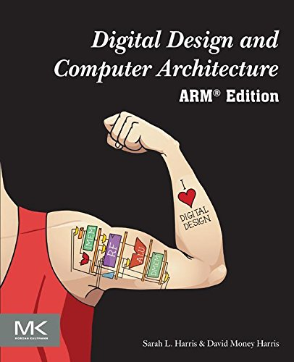
Further Reading
You can read Chapter 6 of your book
Till Section 6.4

