Slide 1
Counters, Shift Registers, Memory Arrays
Digital Computer Design

Slide 2
Counters
Increments on each clock edge
Used to cycle through numbers. For example,
000, 001, 010, 011, 100, 101, 110, 111, 000, 001…
Example uses:
Digital clock displays

Slide 3
Shift Registers
Shift a new bit in on each clock edge
Shift a bit out on each clock edge
Serial-to-parallel converter: converts serial input (S_{in}) to parallel output (Q_{0:N-1})
Symbol:
Implementation:

Slide 4
Shift Register with Parallel Load
When Load = 1, acts as a normal N-bit register
When Load = 0, acts as a shift register
Now can act as a serial-to-parallel converter (S_{in} to Q_{0:N-1}) or a parallel-to-serial converter (D_{0:N-1} to S_{out})

Slide 5
Memory Arrays
Efficiently store large amounts of data
3 common types:
Dynamic random access memory (DRAM)
Static random access memory (SRAM)
Read only memory (ROM)
M-bit data value read/written at each unique N-bit address

Slide 6
Memory Arrays
2-dimensional array of bit cells
Each bit cell stores one bit
N address bits and M data bits:
2^{N} rows and M columns
Depth: number of rows (number of words)
Width: number of columns (size of word)
Array size: depth × width = 2^{N} × M

Slide 7
Memory Array Example
2² × 3-bit array
Number of words: 4
Word size: 3-bits
For example, the 3-bit word stored at address 10 is 100

Slide 8
Memory Arrays
How many words? Word size?

Slide 9
Addressing Memory
Let’s implement a simple memory array with:
3-bit addressability & address space size of 2 (total of 6 bits)
1 Bit
D
Q
WE
6-Bit Memory Array
Bit₂
Bit₁
Bit₀
Addr(0)
Bit₂
Bit₁
Bit₀
Addr(1)
Notes:
Memory array

Slide 10
Reading from Memory
How can we select the address to read?
Because there are 2 addresses, address size is log(2)=1 bit
Notes:
How do we read from memory?

Slide 11
Reading from Memory
How can we select the address to read?
Because there are 2 addresses, address size is log(2)=1 bit
Addr[0]
Wordline
D[2]
D[1]
D[0]

Slide 12
Reading from Memory
How can we select the address to read?
Because there are 2 addresses, address size is log(2)=1 bit
Addr[0]
Wordline
Address Decoder
D[2]
D[1]
D[0]

Slide 13
Reading from Memory
How can we select the address to read?
Because there are 2 addresses, address size is log(2)=1 bit
Addr[0]
Wordline
Address Decoder
D[2]
D[1]
D[0]
Multiplexer

Slide 14
Writing to Memory
How can we select the address and write to it?
Notes:
How can we write to memory?

Slide 15
Writing to Memory
How can we select the address and write to it?
Input is indicated with D_{i}
Addr[0]
D_{i}[2]
D_{i}[1]
D_{i}[0]
WE

Slide 16
Putting it all Together
Enable reading and writing to a memory array
Addr[0]
D_{i}[2]
D_{i}[1]
D_{i}[0]
WE
D[2]
D[1]
D[0]
Notes:
Putting it all together...

Slide 17
A Bigger Memory Array
Addr[1:0]
D_{i}[2]
D_{i}[1]
D_{i}[0]
WE
D[2]
D[1]
D[0]
Notes:
A bigger memory array

Slide 18
A Bigger Memory Array
Addr[1:0]
D_{i}[2]
D_{i}[1]
D_{i}[0]
WE
Address Decoder
Multiplexer
D[2]
D[1]
D[0]

Slide 19
Multi-ported Memories
Multiported memories can access several addresses simultaneously
Example: 3-ported memory
2 read ports (A1/RD1, A2/RD2)
1 write port (A3/WD3, WE3 enables writing)
Register file: small multi-ported memory

Slide 20
Types of Memory
Memories are classified based on how they store bits in the bit cell.
Random access memory (RAM):
volatile: loses its data when power off
called random access memory because any data word is accessed with the same delay as any other.
e.g. main memory in computers
Read only memory (ROM):
nonvolatile: retains data when power off
e.g. flash memory in cameras

Slide 21
Types of RAM
DRAM (Dynamic random access memory)
SRAM (Static random access memory)
Differ in how they store data:
DRAM uses a capacitor
SRAM uses cross-coupled inverters

Slide 22
Dynamic Random Access Memory (DRAM)
Data bits stored on capacitor
When the capacitor is charged to V_{DD} the stored bit is 1
When it is discharged to GND the stored bit is 0
The transistor behaves as a switch
either connects or disconnects the capacitor from the bitline.

Slide 23
Dynamic Random Access Memory (DRAM)
Dynamic because the value needs to be refreshed (rewritten) periodically and after read:
Charge leakage from the capacitor degrades the value
Reading destroys the stored value
Data word must be restored (rewritten) after each read.

Slide 24
Static Random Access Memory (SRAM)
Static because stored bits do not need to be refreshed.
Unlike DRAM, if noise degrades the value of the stored bit, the cross-coupled inverters restore the value.
DRAM bit cell:
SRAM bit cell:

Slide 25
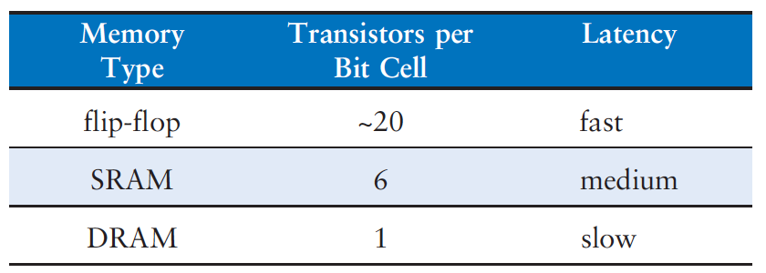
Area and Delay
The data bit stored in a flip-flop is available immediately at its output.
But flip-flops take at least 20 transistors to build.
DRAM latency is longer than that of SRAM
Because its bitline is not actively driven by a transistor.
DRAM must wait for charge to move (relatively) slowly from the capacitor to the bitline.

Slide 26
Read Only Memory ROM
Read only memory (ROM) stores a bit as the presence or absence of a transistor.
If the transistor is present, it pulls the bitline LOW.
If it is absent, the bitline remains HIGH.
The contents of the ROM bit are specified during manufacturing by the presence or absence of a transistor in each bit cell.

Slide 27
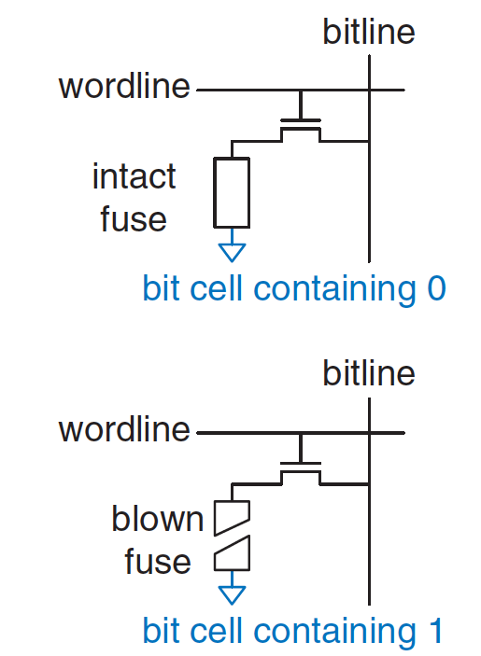
Read Only Memory ROM
A programmable ROM (PROM) places a transistor in every bit cell
but provides a way to connect or disconnect the transistor to ground.
A fuse-programmable ROM allows user programs to selectively blow fuses by applying a high voltage.

Slide 28
Read Only Memory ROM
Erasable PROMs (EPROMs) replace the transistor and fuse with a floating-gate transistor.
The floating gate is not physically attached to any other wires.
When suitable high voltages are applied, transistor is connects to the bitline to the wordline.
When the EPROM is exposed to intense ultraviolet (UV) light for about half an hour, the transistor is disconnected.
These actions are called programming and erasing, respectively.

Slide 29
Read Only Memory ROM: Dot Notation

Slide 30
Logic with Memory Arrays
Although they are used primarily for data storage, memory arrays can also perform combinational logic functions.
A 2^{N}-word x M-bit memory can perform any combinational function of N inputs and M outputs.
X = AB
Y = A + B
Z = A B

Slide 31
Logic with Memory Arrays
Called lookup tables (LUTs): look up output at each input combination (address)

Slide 32
Logic with Memory Arrays
Data₂ = A₁ xor A₀
Data₁ = A₁ + A₀
Data₀ = A₁A₀

Slide 33
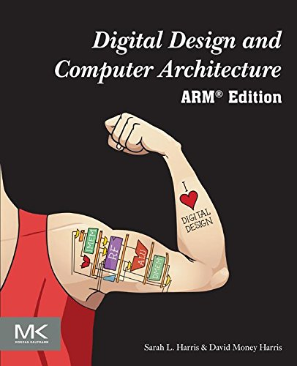
Further Reading
You can read Chapter 5 of your book
Sections 5.4 and 5.5

