Slide 1
Synchronous Sequential Circuit Design
Digital Computer Design

Slide 2
Races and Instability
Combinational logic
has no cyclic paths and no races
If inputs are applied to combinational logic, the outputs will always settle to the correct value within a propagation delay.
Sequential circuits with cyclic paths
If there is a cyclic path, undesirable races or unstable behavior might occur.

Slide 3
Example-1: Asynchronous Sequential Circuit
A problematic circuit: (no clock)
No inputs and 1-3 outputs
Astable circuit, oscillates
Period depends on inverter delay
It has a cyclic path: output fed back to input
The behavior of the asynchronous circuit depends on the gate delays.

Slide 4
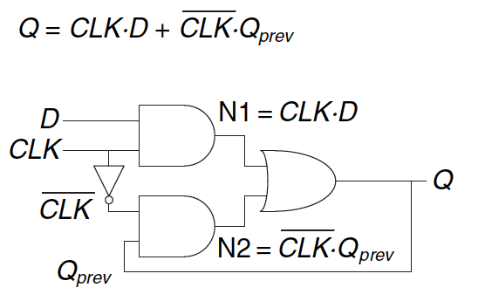
Example-2: Asynchronous Sequential Circuit
A problematic circuit (with clock):
Suppose CLK=D= 1.
Keeps Q=1.
Bur if the inverter delay is longer than that of the AND and OR gates:
When CLK becomes 0, Q becomes stuck at 0.

Slide 5
Synchronous Sequential Circuits
Breaks cyclic paths by inserting registers
Registers contain state of the system
All registers receive the same clock signal
Every cyclic path contains at least one register
State changes at clock edge: system synchronized to the clock
A flip-flop is the simplest synchronous sequential circuit.

Slide 6
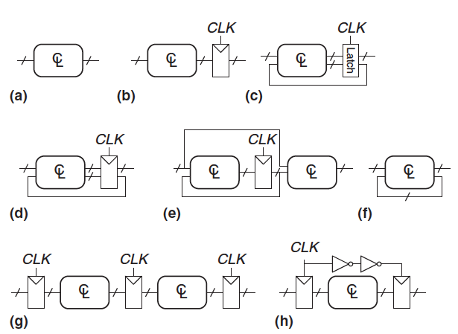
Circuit Examples
Which of the circuits are synchronous sequential circuits?
Sequential circuits that are not synchronous are asynchronous.

Slide 7
Synchronous Sequential Circuit Design
Synchronous sequential circuits can be drawn in FSM form.
A FSM consists of two blocks of combinational logic:
next state logic
output logic
Moore FSM: outputs depend only on current state
Mealy FSM: outputs depend on current state and inputs

Slide 8
Traffic Light Controller Design
Traffic sensors: T_{A}, T_{B} (TRUE when there’s traffic)
Lights: L_{A}, L_{B}

Slide 9
1- Determine Input and Output Signals
Traffic sensors: T_{A}, T_{B} (TRUE when there’s traffic)
Lights: L_{A}, L_{B}
Inputs: CLK, Reset, T_{A}, T_{B}
Outputs: L_{A}, L_{B}

Slide 10
2- Obtain State Transition Diagram
Moore FSM: outputs labeled in each state
States: Circles
Transitions: Arcs

Slide 11
2- Obtain State Transition Diagram
Moore FSM: outputs labeled in each state
States: Circles
Transitions: Arcs

Slide 12
3- From State Transition Diagram to State Transition Table
State Transition Table
Current State | Inputs |  | Next State
S | T_{A} | T_{B} | S'
S0 | 0 | X | S1
S0 | 1 | X | S0
S1 | X | X | S2
S2 | X | 0 | S3
S2 | X | 1 | S2
S3 | X | X | S0

Slide 13
4- State Encoding
The state transition diagram is abstract in that it uses states labeled S0, S1, S2, S3.
To build a real circuit, the states and outputs must be assigned binary encodings.
Each state is encoded with two bits: S_{1:0}
State | Encoding
S0 | 00
S1 | 01
S2 | 10
S3 | 11

Slide 14
5- Encoded State Transition Table
State Transition Table
Current State | Inputs |  | Next State
S | T_{A} | T_{B} | S'
S0 | 0 | X | S1
S0 | 1 | X | S0
S1 | X | X | S2
S2 | X | 0 | S3
S2 | X | 1 | S2
S3 | X | X | S0
Encoded State Transition Table
Current State |  | Inputs |  | Next State
S₁ | S₀ | T_{A} | T_{B} | S'₁ | S'₀
0 | 0 | 0 | X | 0 | 1
0 | 0 | 1 | X | 0 | 0
0 | 1 | X | X | 1 | 0
1 | 0 | X | 0 | 1 | 1
1 | 0 | X | 1 | 1 | 0
1 | 1 | X | X | 0 | 0
State | Encoding
S0 | 00
S1 | 01
S2 | 10
S3 | 11

Slide 15
6- Register (Flip-Flop) Input Equations (Next State Logic)
Current State |  | Inputs |  | Next State
S₁ | S₀ | T_{A} | T_{B} | S'₁ | S'₀
0 | 0 | 0 | X | 0 | 1
0 | 0 | 1 | X | 0 | 0
0 | 1 | X | X | 1 | 0
1 | 0 | X | 0 | 1 | 1
1 | 0 | X | 1 | 1 | 0
1 | 1 | X | X | 0 | 0
Flip-Flop (register) Input Equations:
S’₁ = (S₁ ∙ S₀) + (S₁ ∙ S₀ ∙ T_{B}) + (S₁ ∙ S₀ ∙ T_{B})
S’₀ = (S₁ ∙ S₀ ∙ T_{A}) + (S₁ ∙ S₀ ∙ T_{B})
The equations can also be simplified using Karnaugh maps:
S’₁ = S₁ xor S₀

Slide 16
Circuit Schematic: Next State Logic

Slide 17
Circuit Schematic: Next State Logic

Slide 18
7- Output Table and Output Equations (Output Logic)
Output | Encoding
green | 00
yellow | 01
red | 10
Output Table
Current State |  | Outputs
S₁ | S₀ | L_{A1} | L_{A0} | L_{B1} | L_{B0}
0 | 0 | 0 | 0 | 1 | 0
0 | 1 | 0 | 1 | 1 | 0
1 | 0 | 1 | 0 | 0 | 0
1 | 1 | 1 | 0 | 0 | 1
Output Equations:
L_{A1} = S₁
L_{A0} = S₁ ∙ S₀
L_{B1} = S₁
L_{B0} = S₁ ∙ S₀

Slide 19
Circuit Schematic: Output Logic

Slide 20
One-Hot State Encoding
Binary encoding:
i.e., for four states, 00, 01, 10, 11
K states only needs log₂K bits of state
One-hot encoding
One state bit per state
K states only needs K bits of state
Only one state bit HIGH at once
i.e., for 4 states, 0001, 0010, 0100, 1000
Requires more flip-flops
Often next state and output logic is simpler
State | Binary Encoding
S0 | 00
S1 | 01
S2 | 10
State | One Hot Encoding
 | S₂ | S₁ | S₀
S0 | 0 | 0 | 1
S1 | 0 | 1 | 0
S2 | 1 | 0 | 0

Slide 21
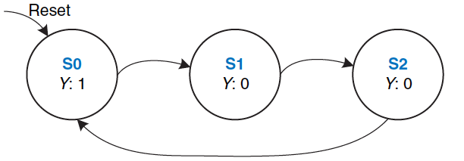
A divide-by-N Counter Design With One Hot State Encoding
The output Y is HIGH for one clock cycle out of every N.
Divide-by-3 counter
State Transition Table
Output Table
Current State | Next State
S0 | S1
S1 | S2
S2 | S0
Current State | Output
S0 | 1
S1 | 0
S2 | 0

Slide 22
State Table, Output Table, State Encoding
State | One Hot Encoding
 | S₂ | S₁ | S₀
S0 | 0 | 0 | 1
S1 | 0 | 1 | 0
S2 | 1 | 0 | 0
Current State |  |  | Next State
S₂ | S₁ | S₀ | S’₂ | S’₁ | S’₀
0 | 0 | 1 | 0 | 1 | 0
0 | 1 | 0 | 1 | 0 | 0
1 | 0 | 0 | 0 | 0 | 1
Current State |  |  | Output
S₂ | S₁ | S₀ | Y
0 | 0 | 1 | 1
0 | 1 | 0 | 0
1 | 0 | 0 | 0
Encoded State Table
Encoded Output Table
State Encoding

Slide 23
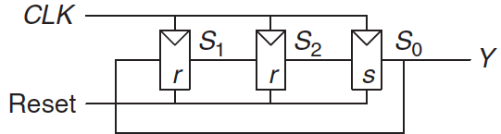
Register Input Equations and Output Equations
Current State |  |  | Next State
S₂ | S₁ | S₀ | S’₂ | S’₁ | S’₀
0 | 0 | 1 | 0 | 1 | 0
0 | 1 | 0 | 1 | 0 | 0
1 | 0 | 0 | 0 | 0 | 1
Current State |  |  | Output
S₂ | S₁ | S₀ | Y
0 | 0 | 1 | 1
0 | 1 | 0 | 0
1 | 0 | 0 | 0
Encoded State Table
Output Table
Flip-Flop (register) Input Equations:
Y=S₀
Output Equations:
S’₂=S₁
S’₁=S₀
S’₀=S
It is easy to derive boolean equations with One-Hot encoding.

Slide 24
Pattern Recognizer Design
A synchronous sequential circuit that recognizes the occurrence of 01 by observing a given sequence.
0010101000101010001010010001
Outputs 1 when the patter is found.
Design Steps:
Determine Input and Output Signals
Draw State Transition Diagram
State Transition Table
Encoded State Transition Table
Register Input Equations
Encoded Outputs
Output Equations
Draw Schematic

Slide 25
State Transition Diagrams

Slide 26
Moore State Transition and Output Tables
Current State | Input | Next State
S | A | S’
S0 | 0 | S1
S0 | 1 | S0
S1 | 0 | S1
S1 | 1 | S2
S2 | 0 | S1
S2 | 1 | S0
Current State | Output
S | Y
S0 | 0
S1 | 0
S2 | 1

Slide 27
State Transition and Output Tables with State Encoding
Current State |  | Input | Next State
S₁ | S₀ | A | S'₁ | S'₀
0 | 0 | 0 | 0 | 1
0 | 0 | 1 | 0 | 0
0 | 1 | 0 | 0 | 1
1 | 0 | 1 | 1 | 0
1 | 0 | 0 | 0 | 1
1 | 1 | 1 | 0 | 0
Current State |  | Output
S₁ | S₀ | Y
0 | 0 | 0
0 | 1 | 0
1 | 0 | 1

Slide 28
Register Input Equations and Output Equations
Current State |  | Input | Next State
S₁ | S₀ | A | S'₁ | S'₀
0 | 0 | 0 | 0 | 1
0 | 0 | 1 | 0 | 0
0 | 1 | 0 | 0 | 1
1 | 0 | 1 | 1 | 0
1 | 0 | 0 | 0 | 1
1 | 1 | 1 | 0 | 0
Current State |  | Output
S₁ | S₀ | Y
0 | 0 | 0
0 | 1 | 0
1 | 0 | 1
Y = S₁
S’₁ = S₀A
S’₀ = A

Slide 29
Mealy State Transition and Output Tables
Current State | Input | Next State | Output
S | A | S’ | Y
S0 | 0 | S1 | 0
S0 | 1 | S0 | 0
S1 | 0 | S1 | 0
S1 | 1 | S2 | 1

Slide 30
State Transition and Output Tables with State Encodings
Current State | Input | Next State | Output
S | A | S’ | Y
0 | 0 | 1 | 0
0 | 1 | 0 | 0
1 | 0 | 1 | 0
1 | 1 | 0 | 1

Slide 31
Register Input Equations and Output Equations
Current State | Input | Next State | Output
S | A | S’ | Y
0 | 0 | 1 | 0
0 | 1 | 0 | 0
1 | 0 | 1 | 0
1 | 1 | 0 | 1
S’₀ = A
Y = S₀ A

Slide 32
Circuit Schematic
Moore Machine
Mealy Machine

Slide 33

Further Reading
These slides are sufficient to understand the design of the synchronous sequential circuits.
You can read Chapter 3 of your book
Sections 3.2, 3.3, 3.5

