Slide 1
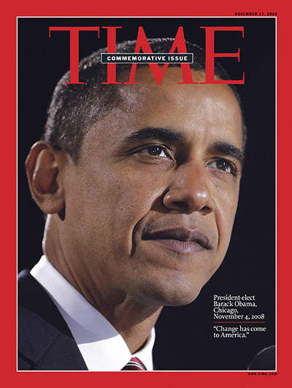
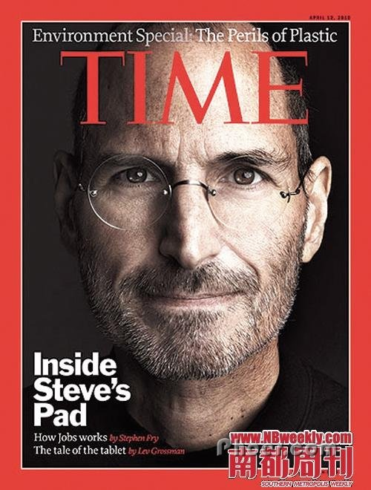
TIME

Slide 2
General Introduction
Time (trademarked in capitals as TIME) is an American weekly news magazine published in New York City.
Time is the world's largest circulation weekly news magazine with a readership of 25 million, of which 20 million are in the US.
Time is regarded as the “History Library” of the world and it includes columns of economy, education, politics, business, science, technology, health, sports, criticism, people etc.
The purpose of Time is to make people who are busy fully understand the world events.

Slide 3
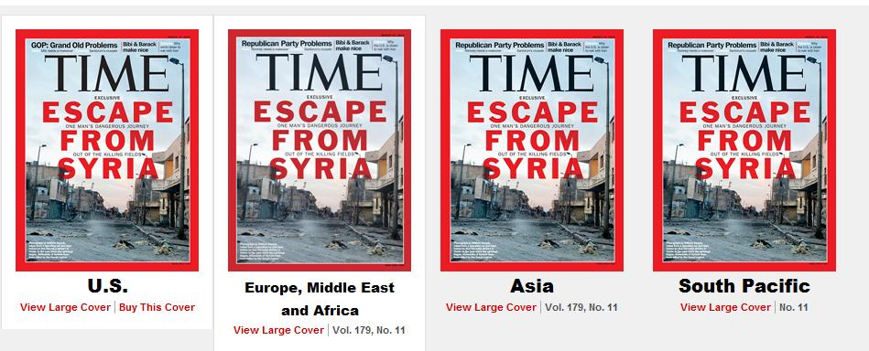
Editions
The US edition is in New York.
A European edition (Time Europe, formerly known as Time Atlantic) is published in London and also covers the Middle East, Africa and, since 2003, Latin America.
An Asian edition (Time Asia) is based in Hong Kong.
The South Pacific edition, covering Australia, New Zealand and the Pacific Islands, is based in Sydney.
In December 2008, Time discontinued publishing a Canadian advertiser edition.

Slide 4
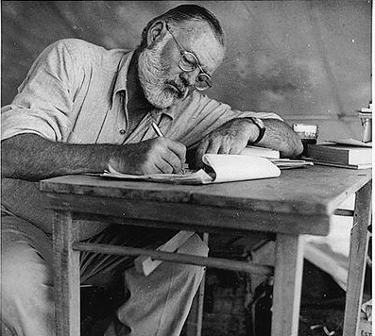
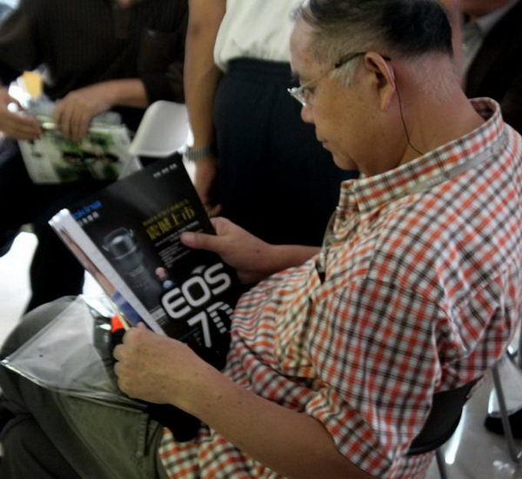
Time’s slogan
Time seems to be Written by someone and read by another.

Slide 5
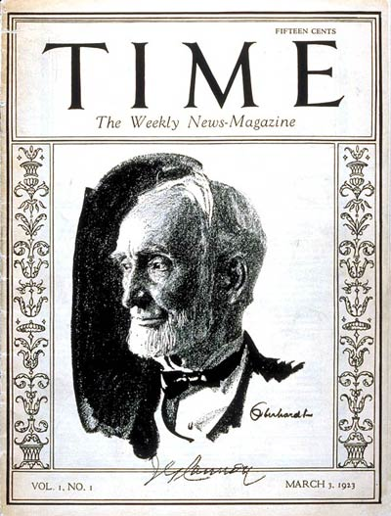
History
Time magazine was created in 1923 by Briton Hadden and Henry Luce, making it the first weekly news magazine in the United States.
The first issue of Time was published on March 3, 1923, featuring on its cover Joseph G. Cannon, the retired Speaker of the United States House of Representatives.

Slide 6
On Hadden's death in 1929, Luce became the dominant man at Time and a major figure in the history of 20th-century media.
By the time of Henry Luce's death in 1967, the Time Inc. stock which Luce owned was worth about US$109 million and yielded him a yearly dividend income of more than US$2.4 million.
Time became part of Time Warner in 1989, along with Warner Bros.
Since 2000, the magazine has been part of AOL Time Warner, which subsequently reverted to the name Time Warner in 2003.
In 2007, Time moved from a Monday subscription delivery to a schedule where the magazine goes on sale Fridays, and is delivered to subscribers on Saturday. The magazine actually began in 1923 with Friday publication.

Slide 7
General Introduction of the Content
Style
Classification
The Time initially possessed a distinctive writing style, making regular use of inverted sentences. The biggest feature is that it classifies and analyzes the events within a week ,with the background information. Time has always kept its constant style of classification and seldom changed for nearly 70 years since it had been founded.

Slide 8
It includes the column of
The letters from readers
Asian affairs
Business
Books
Music
Education
The science and technology
The United States

Slide 9
2. International
“Keeping a foothold on The United States and at the same time caring about the whole world” has always been a major feature of Time.
The information of Time come from the whole world. Taking the "World Outlook” as an example,which is reported on March 15th, 2002. The news are from the Middle East, France, Russia, Britain, Ireland, Afghanistan, Algeria, Pakistan, South Korea, India, the United States, Canada and other countries or regions.
With the publication of European edition, Asian edition and South Pacific edition,Time has become even more international.

Slide 10
3. Profundity and Authority
As a mainstream news-week, Time has become one of the most famous news publications in the world with its profound and authoritative writing style. It has advantages that can’t easily be imitated, replaced or surpassed by others, which is reflected in its style, content as well as workflow.
The authority of Time is fully reflected in its integrated capacities such as news gathering capacity, the capacity of analyzing and processing news as well as post-production capacity.
With charts, data, personal interviews and a lot of work behind the scenes, Time profoundly presents some well-worth reading news to the readers.

Slide 11
The Most Famous Column——The Person of the Year
Time’s most famous feature throughout its history has been the annual "Person of the Year" (formerly "Man of the Year") cover story, in which Time recognizes the individual or group of individuals who have had the biggest impact on news headlines over the past twelve months. The distinction is supposed to go to the person who, for good or ill, has most affected the course of the year; it is therefore not necessarily an honor or a reward.

Slide 12
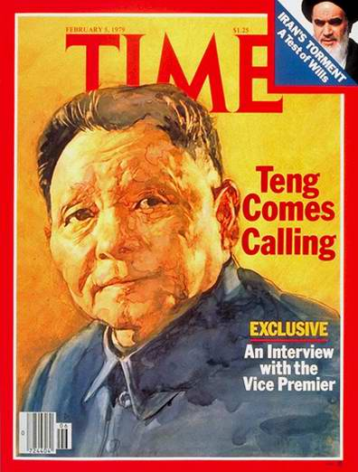
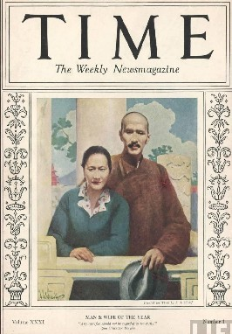
Famous Persons of the past Years
1937: Jiangjieshi and Songmeiling
This was the first time that Chinese people had been elected as Person of the Year.
1978 and 1985: Dengxiaoping

Slide 13
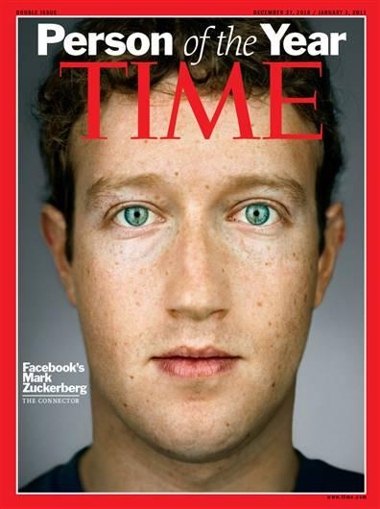
2008:Barack Obama
2010:Mark Zuckerburg
(The man who founded Face book)

Slide 14
Sometimes, The Person of the Year is some people, something or even a conception instead of a person. For example:
1950: American soldiers
1966: people under 25years old
1982: personal computers
1988: the endangered Earth
2006: You——Internet users
2011: The demonstrators

Slide 15
The influence of Time
Time is one of the three topicality weekly in America, which includes all kinds of current issues in the world.
With different editions published , Time has a large number of international readers all over the world.
Its circulation often ranks in the top few in the completion with other similar magazines.
The Time’s words ,which Time produces every year, has become the record of American’s language changes in some sense.

Slide 16
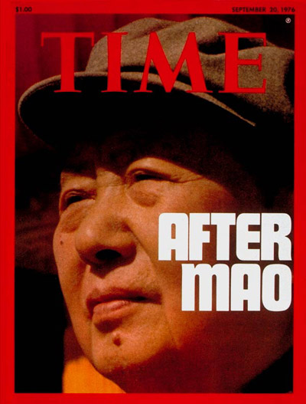
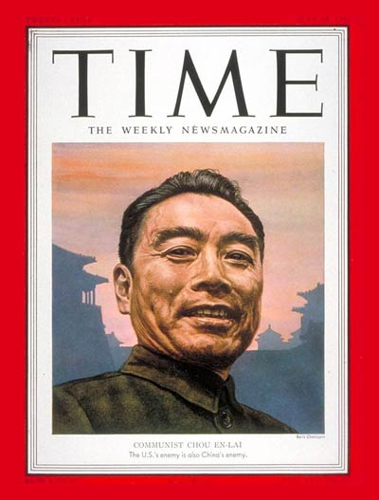
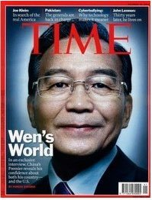
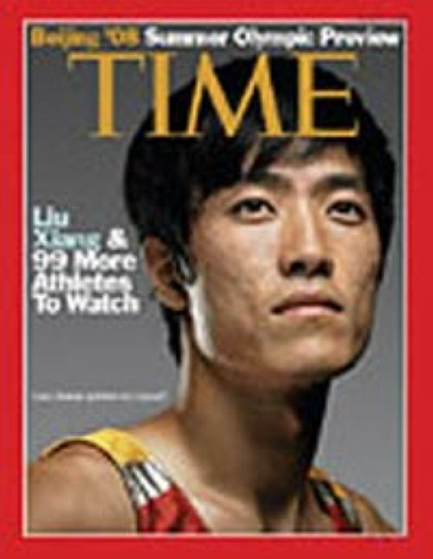
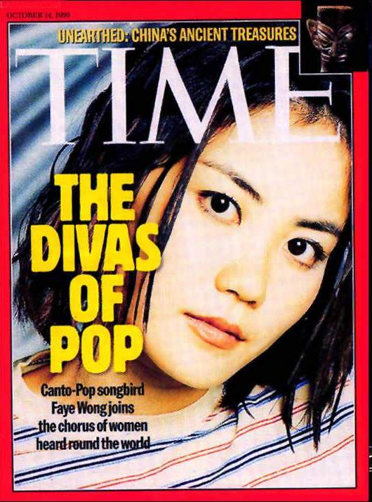
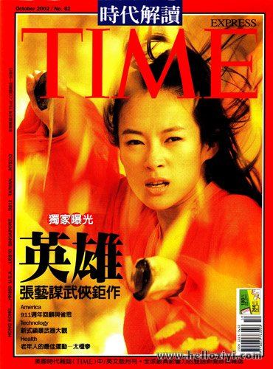

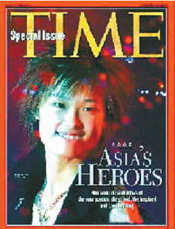
Famous Chinese people who have ever appeared in Time

Slide 17
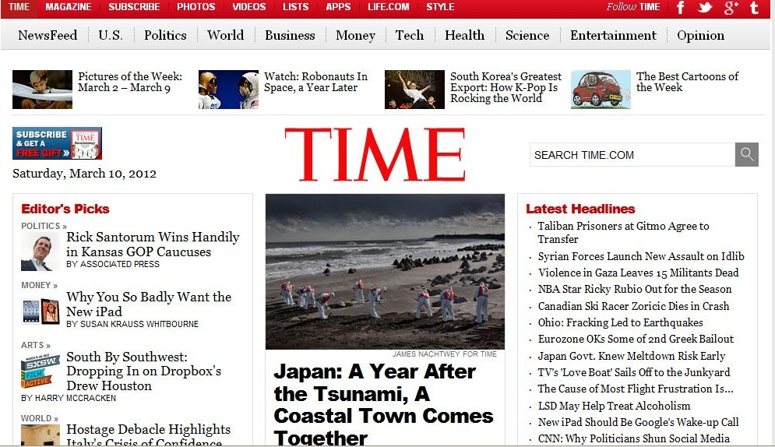

Slide 18
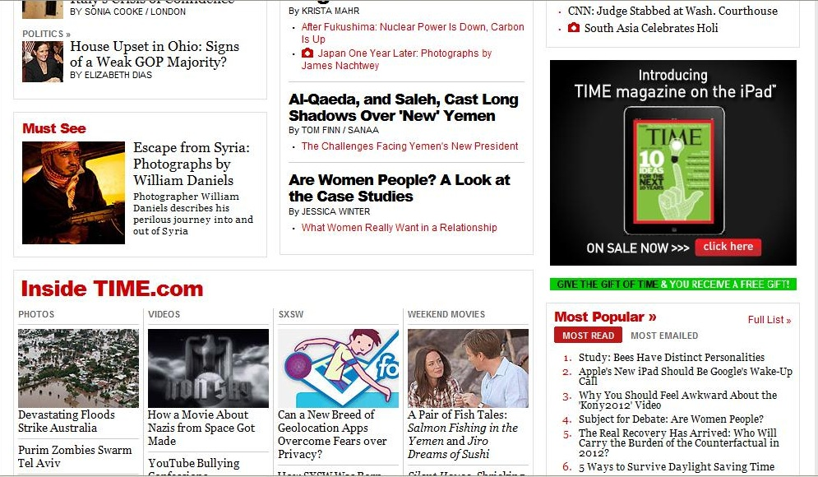

Slide 19
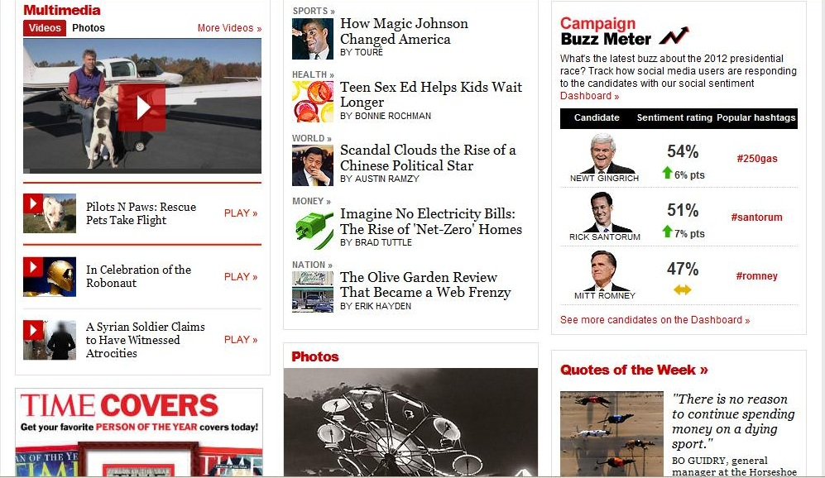

Slide 20
