Slide 1




Operation Increase Sales and Profit (OISP)
A Sales Data Analysis
For a Multinational Retail Company
by: Sina Tijani

Slide 2


Problem Statement
The multinational retail company want to embark on an operation to increase its sales and maximize their profits.
To do this, it wants to draw necessary insights from its sitting data before taking any actionable decision.

Slide 3


Objective
The project objectives are:
To analyze the 5-years sales data of the company to draw insights into the products, markets, profit and correlations between variables.
To make recommendations to management as to how they should embark their “Operation Increase Sales and Profit (OISP)” campaign.

Slide 4




The Project Stages
1. The 5 year dataset is from the retail company which can be obtained here superstore.csv. (2011, 2012, 2013, 2014, 2015)
2. Exploratory Data Analysis and Data Cleaning: The quality of the data was ensured by removing the Postal Code column which had missing values beyond acceptable range; the column was also not needed in this analysis. Also formatted the column heads and other entries to make it easier to work with. New columns were created to help with the analysis. They are day, month, year, discount amount, unit price, and selling price.
3. The dataset was grouped variously by market, profit, sales, product name, quantity, category, city, order id, order priority, and region.

Slide 5
Packages used
Packages
Numpy
Re
Pandas
Seaborn
Matplotlib

Slide 6
Findings

Slide 7

Sales and profit per market
01
MARKET | SALES | PROFIT
APAC | 3585744.13 | 436000.05
Africa | 783773.21 | 88871.63
Canada | 66928.17 | 17817.39
EMEA | 806161.31 | 43897.97
EU | 2938089.06 | 372829.74
LATAM | 2164605.17 | 221643.49
US | 2297200.86 | 286397.02
The sales and profit per market are grouped in the table.

Slide 8
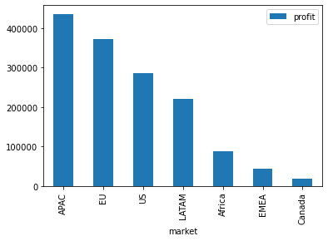
Most and least profitable market
02
The most profitable market is APAC
And the least profitable market is Canada

Slide 9
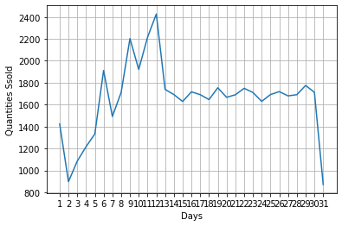
How to increase the sales for the products that are least bought
03
The company's peak days are from 6th to 21st of every month where huge quantities of items are bought across the store. While the quantities drops on Day 7, the trend shows it picks up on Day 8 and continues throughout to Day 12.
Since many customers shop around these 7 days (from 6th to 12th), several ads for the poor performing products can be placed strategically on the company's website to target them; on the homepage, on main product category navigation pages to get more views, at checkout pages, and more

Slide 10
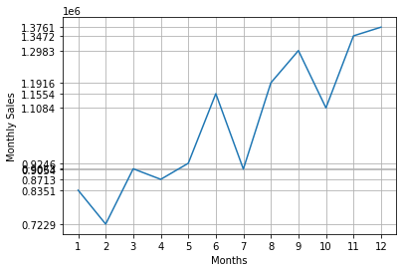
Months the company record more sales
04
The company records the most sales in December.
Then in November,
and in September.

Slide 11
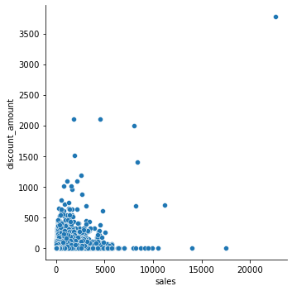
Correlation between discount and sale
05
0.30
Correlation Coefficient
Sales compared to discount amount has a correlation coefficient of 0.30. While it shows a positive correlation between the two, it is a weak correlation.

Slide 12
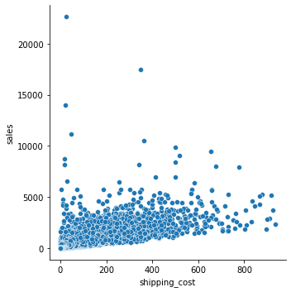
Shipping cost and sales correlation
06
0.77
Correlation Coefficient
From the graph and with a correlation coefficient of 0.77 between shipping cost and sales, there is a moderate positive relationship between them.

Slide 13
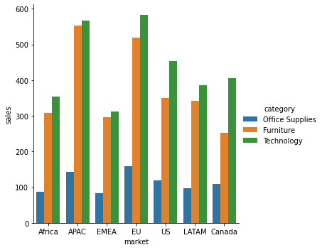
The dominant product category in each market
07
From the bar chart, in terms of sales,
1. Technology is dominant in APAC, Africa, EMEA, EU, and in the US.
2. Office Supplies is dominant in Canada
3. Furniture is dominant in LATAM.

Slide 14
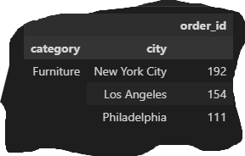
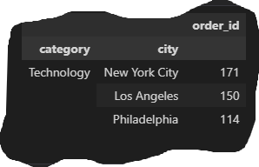
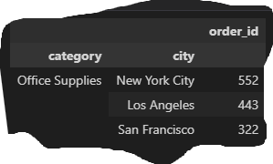
City with most orders for a given product category
08
The cut outs shows a snippet of a sorted list of city with the most orders for a product category.
New York City dominates all the 3,636 cities the company sells in for each product category.

Slide 15
Products making losses
09
product_name | loss
Cubify CubeX 3D Printer Double Head Print | -8879.97
Lexmark MX611dhe Monochrome Laser Printer | -4589.97
Motorola Smart Phone, Cordless | -4447.04
Cubify CubeX 3D Printer Triple Head Print | -3839.99
Bevis Round Table, Adjustable Height | -3649.89
Bevis Computer Table, Fully Assembled | -3509.56
Rogers Lockers, Blue | -2893.49
Chromcraft Bull-Nose Wood Oval Conference Tables & Bases | -2876.12
Bevis Wood Table, with Bottom Storage | -2782.59
The table shows a snippet of products making losses. They are the worse 10 products making the worst losses.
The total number of products in store for sales are 3,788.
The number of products making losses are 675.
Therefore 17% of the company’s products are making losses.
The entire data can be found here: products_making_losses.xlsx

Slide 16
Segment providing more profits
10
SEGMENT | PROFIT
Consumer | 749239.78
Corporate | 441208.33
Home Office | 277009.18
From the table, Consumer segment provides the most profit for the company

Slide 17
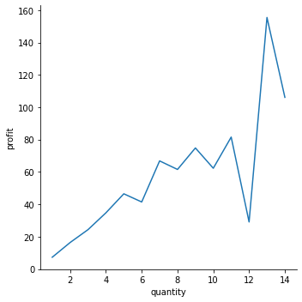
Correlation between quantity and profit
11
From the chart, it is evident that there is a strong positive correlation between quantity of products bought and profit. As customers buy more quantities of products, so as the profit gained grows.

Slide 18
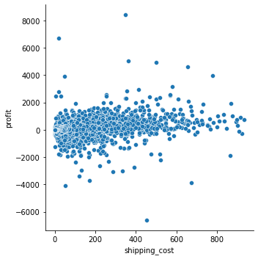
Correlation between shipping cost and profit
12
0.35
Correlation Coefficient
From the scatter plot and with a correlation coefficient of 0.35, there is a weak correlation between shipping cost and profit.

Slide 19
Order priority with more sales
13
ORDER PRIORITY | SALES
Medium | 7280892.37
High | 3807548.14
Critical | 986235.46
Low | 567825.93
The order priority that yields more sales is Medium

Slide 20
Average shipping cost to each region
14
REGION | SHIPPING COST
North Asia | 40.65
Central Asia | 38
Oceania | 34.59
Southeast Asia | 29.94
North | 27.48
Central | 26.71
East | 25.54
South | 25.35
West | 23.89
Caribbean | 21.06
Canada | 19.29
Africa | 19.22
EMEA | 17.57
The average shipping cost to each region is seen in the table. It has also been sorted to show from highest to lowest.

Slide 21
Product categories to be targeted to the different markets
15
category | APAC | Africa | Canada | EMEA | EU | LATAM | US
Furniture | 1343934.07 | 194650.64 | 10595.28 | 228620.74 | 779103.05 | 811970.62 | 741999.8
Office Supplies | 884319.83 | 266755.53 | 30034.08 | 276685.99 | 1046307.02 | 563920.73 | 719047.03
Technology | 1357490.23 | 322367.04 | 26298.81 | 300854.58 | 1112678.99 | 788713.82 | 836154.03

Slide 22
Recommendations
For the products making losses, the company should leverage on their peak days (6th to 12th every month) to upsell them to customers. These products should be strategically placed across the website to attract more views, clicks, and engagement.
The company should drop the top 20 products making losses and provide more products to its Consumer segment as more growth can be experienced in the segment. It already brings very healthy profit margins.

Slide 23
Thank You
By: Sina Tijani

