Slide 1
Iteration 2 summary + Iteration 3 suggestions

Slide 2
Summary
2 objectives to be maximized and 1 objective to be minimized.
1000 GPs created to map 7D composition space to the objective space.
Search space size: 13518 (6658 in iteration 2).
116 unique suggestions are obtained (139 in iteration 2).
No enthalpy measurements for 6 alloys.
No transformation strain measurements for 15 alloys.
Total of 22 out of 58 are excluded. (9 + 13)
Current Pareto Front
Hysteresis (min) | Enthalpy (max) | Transformation Strain (max) | MS
20.61 | 27.95 | 12.98 | 250.5
50.51 | 13.19 | 13.08 | 108.1
48.73 | 32.29 | 12.18 | 349.0
46.07 | 29.75 | 11.16 | 299.7
32.26 | 29.13 | 12.49 | 286.7
18.1 | 21.17 | 10.79 | 178.8
Iteration | HV | Pareto front size
1 | 1659.7 | 3
2 | 1686.0 | 4

Slide 3
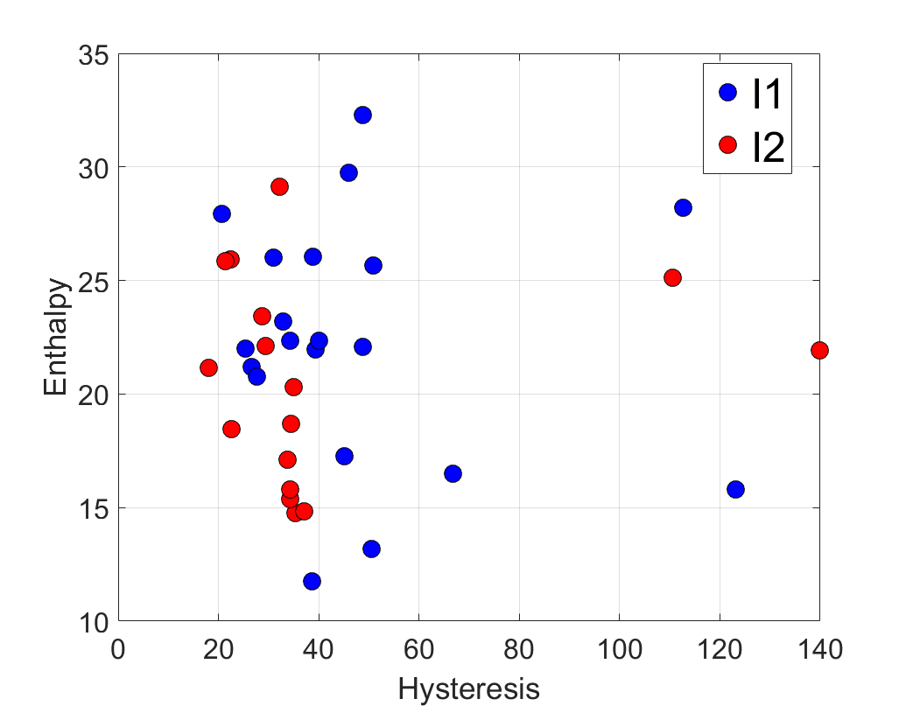
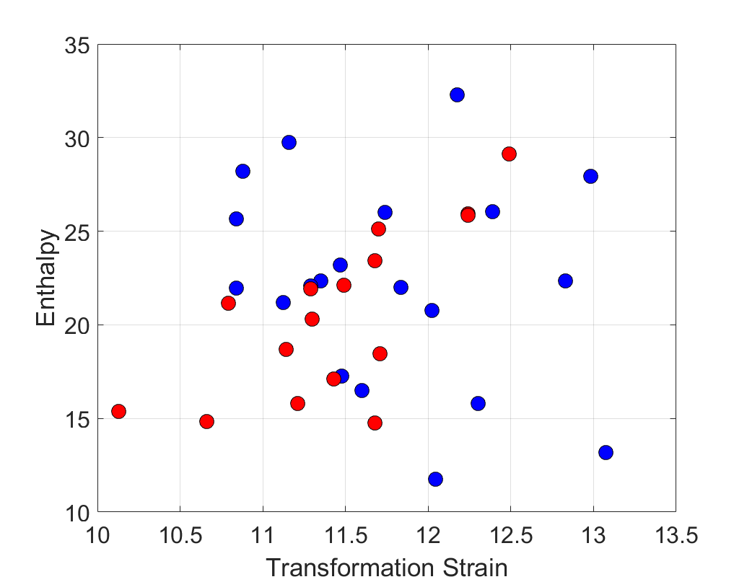
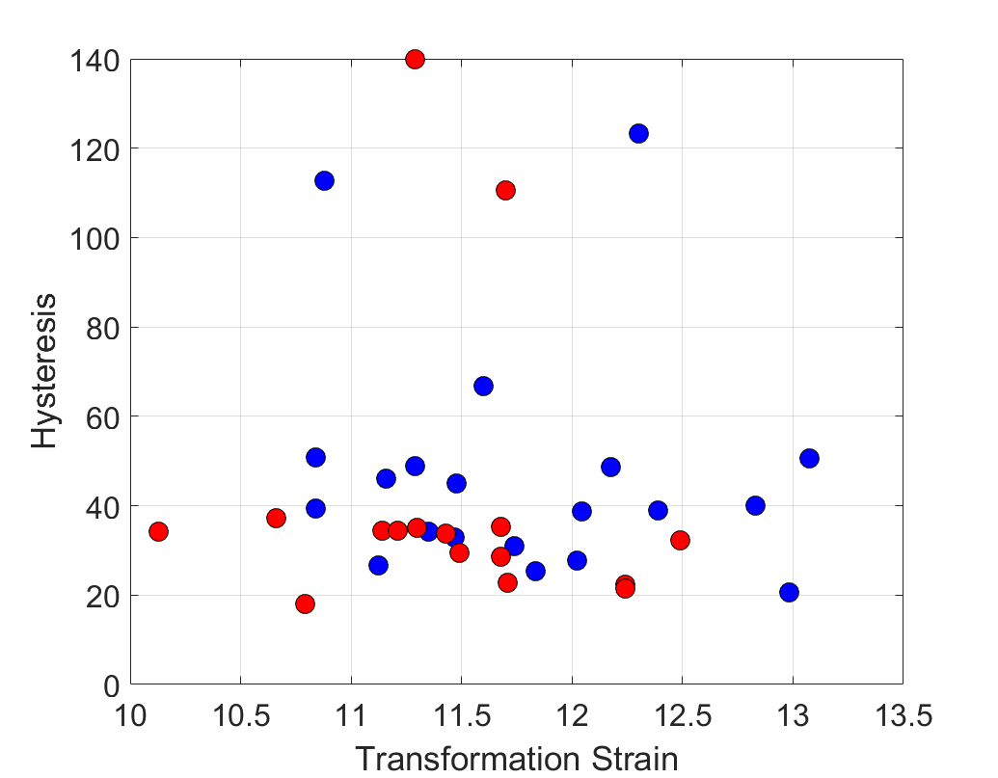
Summary (experimental results)

Slide 4
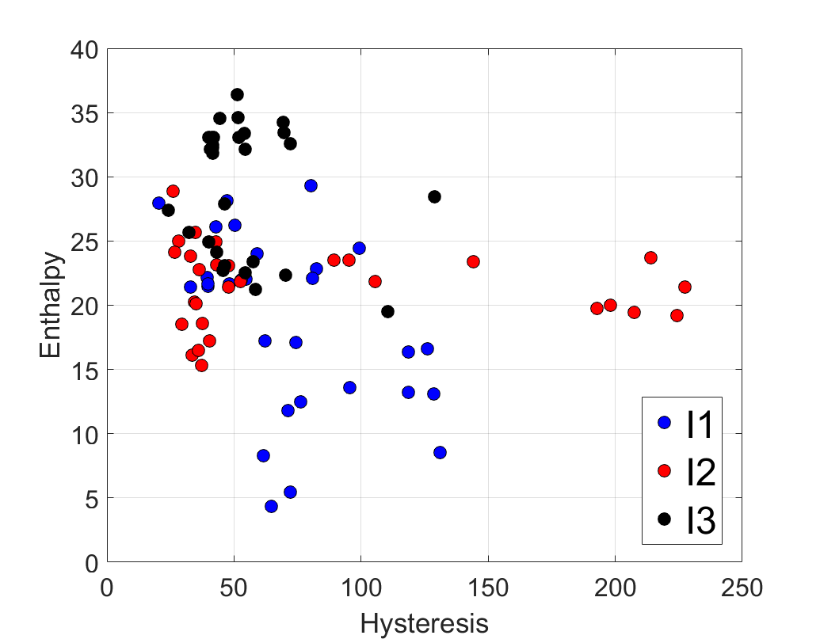
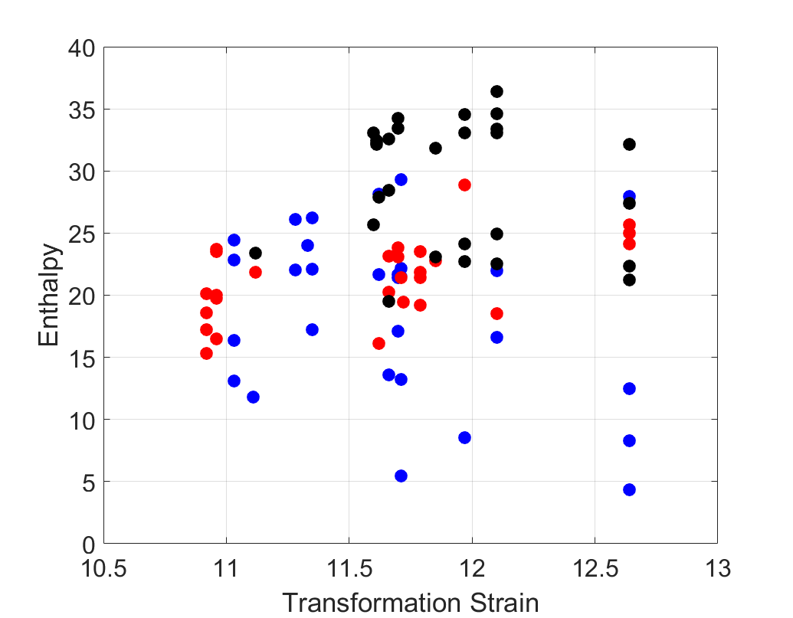
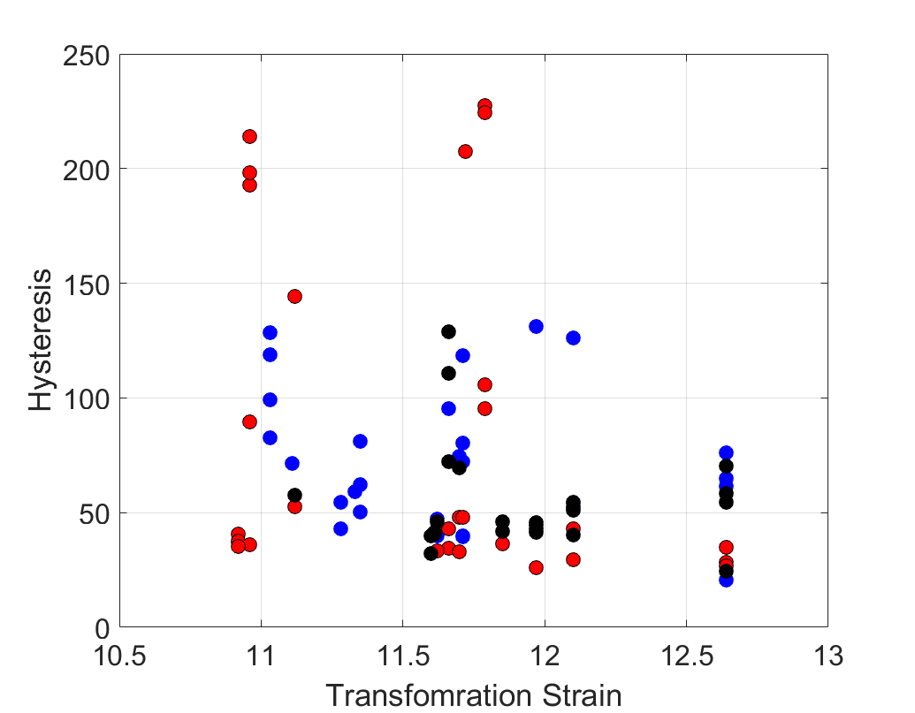
Summary (ML model predictions)

Slide 5
Iteration 3 Suggestions
Sample | Ni | Ti | Cu | Hf | Zr | Pd | Co
1 | 44 | 25 | 0 | 20 | 5 | 3 | 3
2 | 50 | 27 | 0 | 18 | 5 | 0 | 0
3 | 50 | 27 | 0 | 14 | 9 | 0 | 0
4 | 50 | 31 | 0 | 13 | 6 | 0 | 0
5 | 45 | 27 | 0 | 23 | 0 | 2 | 3
6 | 50 | 30 | 0 | 9 | 11 | 0 | 0
7 | 47 | 30 | 0 | 14 | 6 | 0 | 3
8 | 50 | 29 | 0 | 16 | 5 | 0 | 0
9 | 50 | 22 | 0 | 13 | 15 | 0 | 0
10 | 50 | 31 | 0 | 14 | 5 | 0 | 0
11 | 50 | 25 | 0 | 17 | 8 | 0 | 0
12 | 47 | 27 | 0 | 13 | 10 | 0 | 3
13 | 50 | 31 | 0 | 12 | 7 | 0 | 0
14 | 43.2 | 24.8 | 0 | 25 | 0 | 3 | 4
15 | 50 | 27 | 0 | 17 | 6 | 0 | 0
16 | 45 | 26 | 0 | 19 | 5 | 0 | 5
Sample | Ni | Ti | Cu | Hf | Zr | Pd | Co
17 | 50 | 29 | 0 | 13 | 8 | 0 | 0
18 | 48 | 26 | 0 | 15 | 9 | 0 | 2
19 | 42 | 23 | 5 | 14 | 13 | 0 | 3
20 | 50 | 25 | 0 | 15 | 10 | 0 | 0
21 | 43 | 20 | 0 | 20 | 10 | 4 | 3
22 | 46 | 28 | 0 | 22 | 0 | 2 | 2
23 | 50 | 25 | 0 | 18 | 7 | 0 | 0
24 | 50 | 27 | 0 | 15 | 8 | 0 | 0
25 | 50 | 27 | 0 | 16 | 7 | 0 | 0
26 | 47 | 29 | 0 | 9 | 12 | 0 | 3
27 | 45 | 26 | 0 | 19 | 5 | 3 | 2
28 | 50 | 30 | 0 | 15 | 5 | 0 | 0
29 | 50 | 29 | 0 | 14 | 7 | 0 | 0

