Slide 1
Factors Affecting House Values Houston Area from 2011 to 2017
Project Team: Housing Masters
Eva Okhankhuele Suleyman Incekara
Nguyen Nguyen Patrick Cardozo
Houston, September 11, 2019

Slide 2
Project Scope
Harris County- Texas (133 zip codes- 22 cities including Houston Area)
Focus on Houston Area (100 zip codes, divided into 5 regions: Inner Loop, Northeast, Southeast, Northwest, Southwest)
Time period: from 2011 to 2017

Slide 3
Project Scope
Inner Loop:
77002, 77003, 77004, 77005, 77006, 77007, 77008, 77009, 77010,
77011, 77012, 77019, 77020, 77021, 77023, 77025, 77026, 77027,77030, 77046, 77054, 77098
Northeast:
77013, 77015, 77016, 77022, 77028, 77032, 77037, 77039, 77044, 77049, 77050, 77060, 77073, 77076, 77078
Northwest:
77014, 77018, 77038, 77040, 77041, 77043, 77055, 77064, 77065, 77066, 77066, 770067, 77068, 77069, 77070, 77080, 77084, 77086, 77088, 77090, 77091, 77092, 77095
Southwest:
77024, 77031, 77035, 77036, 77042, 77045, 77053, 77056, 77057, 77063, 77071, 77072, 77074, 77077, 77079, 77080, 77081, 77082, 77083, 77085, 77094, 77094, 77096, 77099, 77237
Southeast:
77017, 77029, 77033, 77034, 77047, 77048, 77051, 77058, 77059, 77061, 77062, 77075, 77086, 77089, 77092

Slide 4
Project Scope
What are factors that affects housing’s values/prices in Houston?
Look for housing value’s trends and explanation

Slide 5
Project Scope
Dependent element: Housing’s value/prices asked (Nguyen)
Proposed independent factors:
1) Monthly housing cost (Nguyen)
2) Income (Patrick)
3) Population (Suleyman)
4) Time travel to work (Eva)

Slide 6
Methodology
1) Datasource: US Census- American 5 year Survey
2) Retrieve Data by zip codes- API requests
3) Create Dataframes- store results
4) Clean dataset- drop invalid figures, group by cities and regions, add new calculation columns
5) Plot charts- visualize correlations (if any)
6) Do hypothesis tests- test for statistical significance. Confirm correlations
7) Conclusions

Slide 7
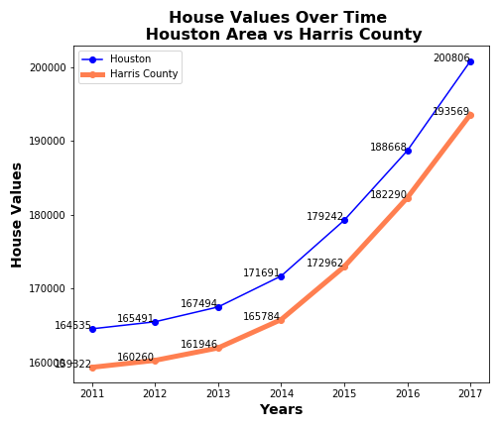
# Above average

Slide 8
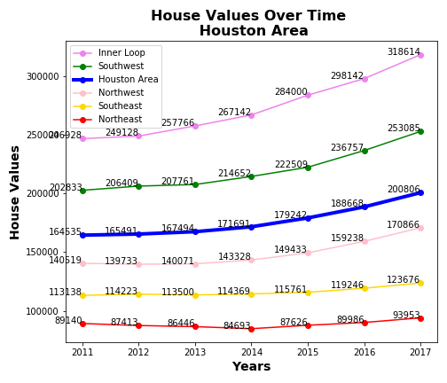
# Above average:
Innerloop, Southwest
# Below average:
Northwest,Southeast

Slide 9
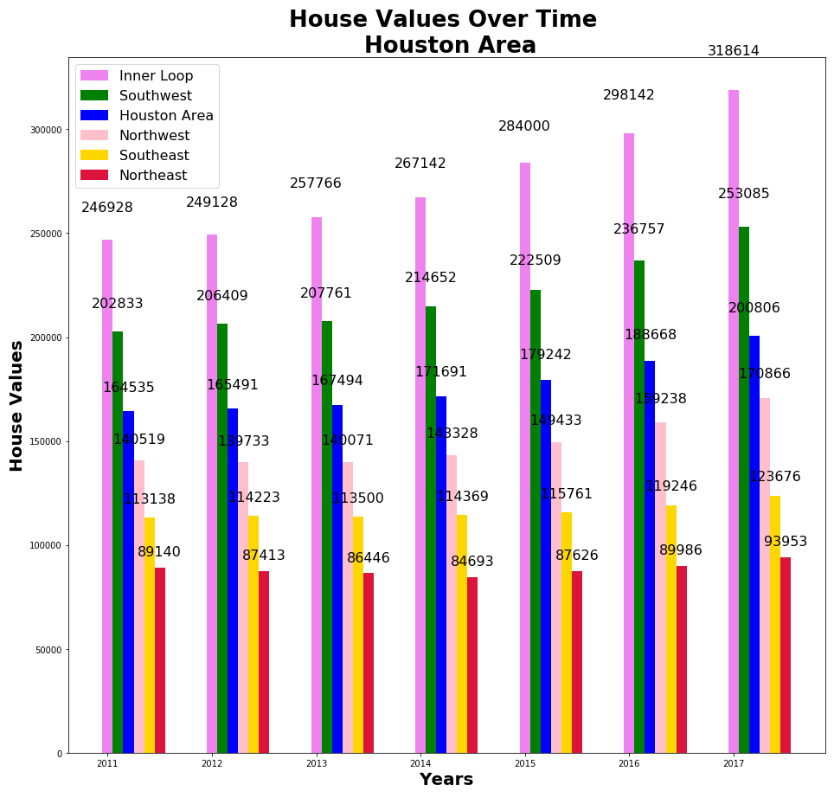
# The biggest increase in house values are seen in Inner Loop, Southwest, and Northwest

Slide 10
Factors affecting house value- Monthly housing cost

Slide 11
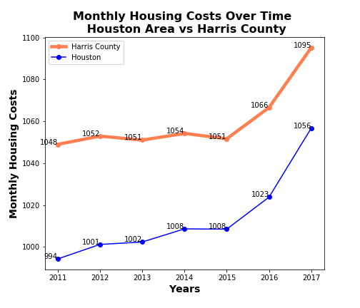
Factors affect housing’s value- Monthly housing cost

Slide 12
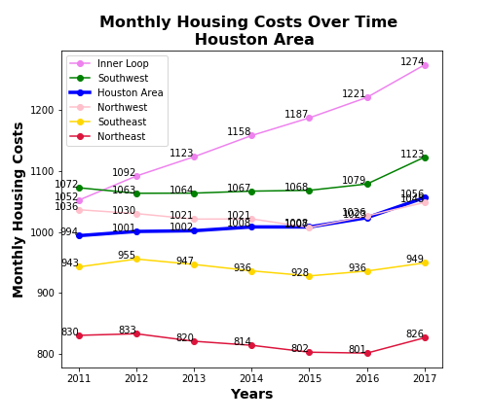
Factors affect housing’s value- Monthly housing cost

Slide 13
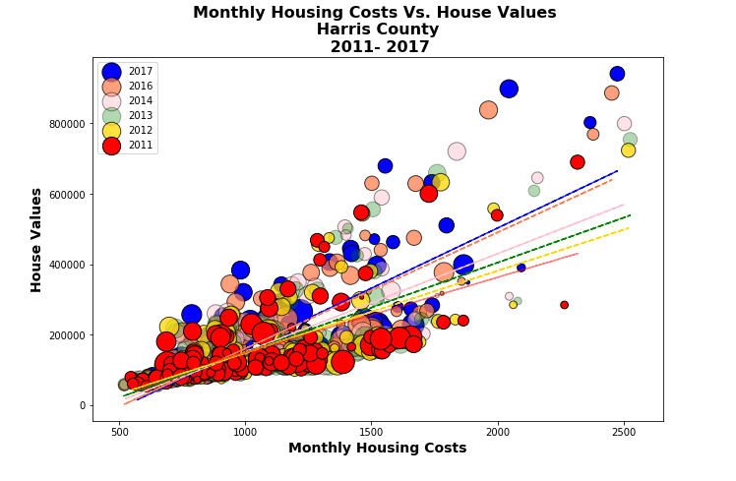
Factors affect housing’s value- Monthly housing
# Positive
Linear
Correlation
# Regression
Line change
In degree

Slide 14
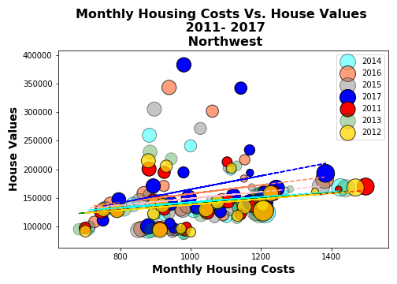
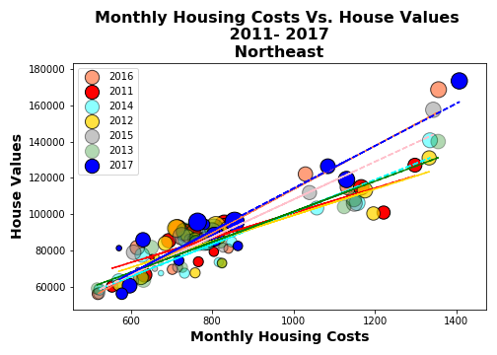
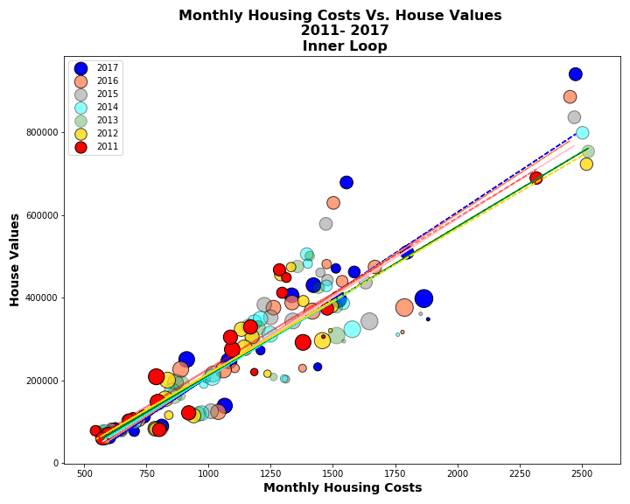
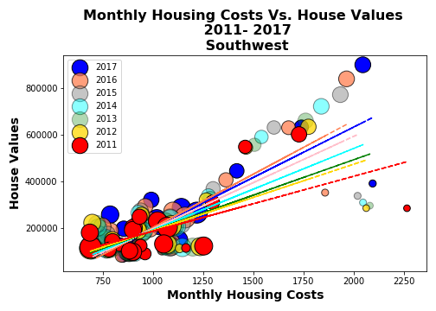
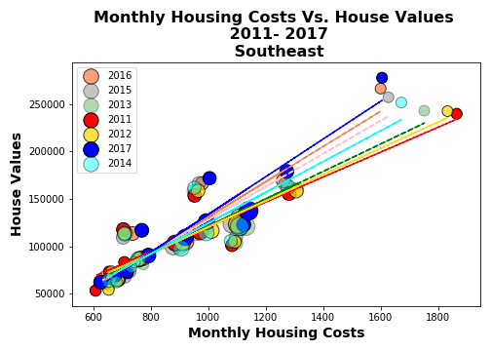

Slide 15
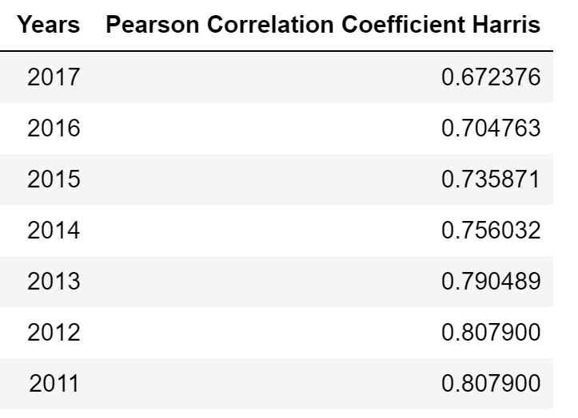
Pearson Correlation Coefficient- Monthly housing costs vs house values
Correlation r (-1, 1)
The relationship between two variables is generally
considered strong when their r value > 0.7
The correlation r measures the strength
of the linear relationship between
two quantitative variables
Confirmed positive correlation
Consideriably strong relationship
Degree of correlation’s strength declining over time

Slide 16
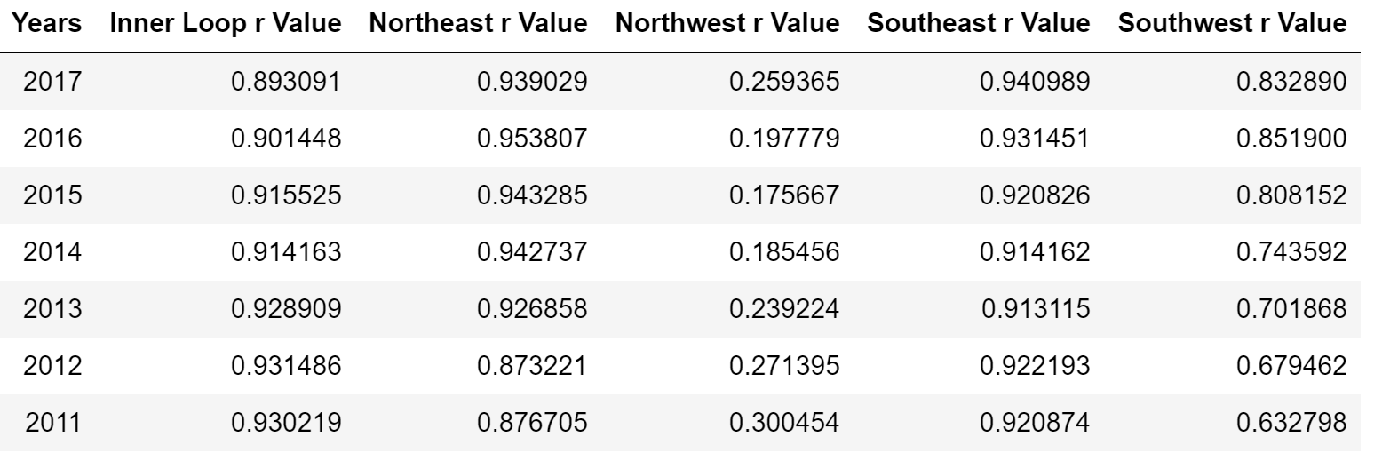
Pearson Correlation Coefficient- Monthly housing costs vs house values
Highly strong in most regions EXCEPT Northwest

Slide 17
Factors affecting house value - Income

Slide 18
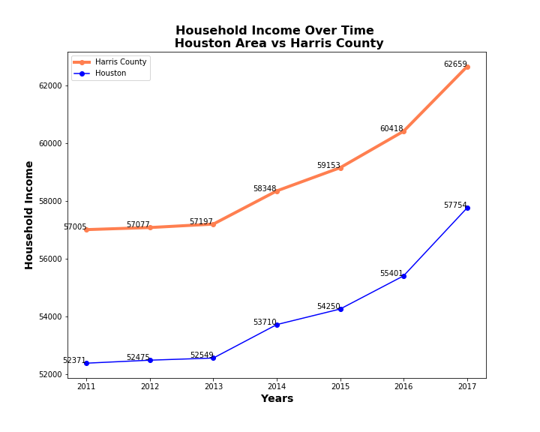
Factors affecting house value- Income
Houston Area:
Below average

Slide 19
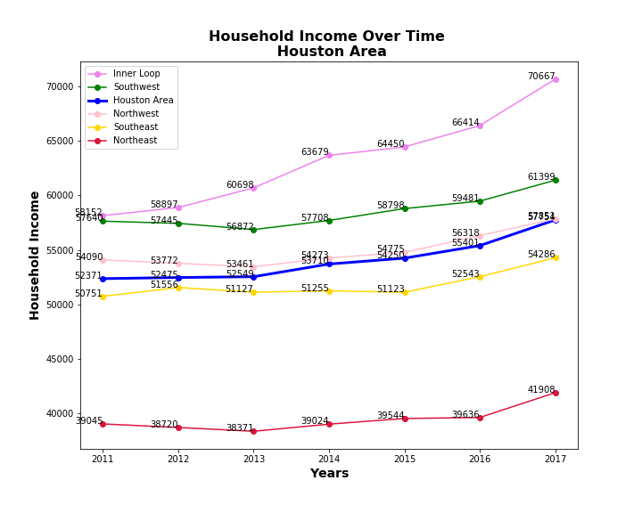
Factors affecting house value- Income
# Above average:
Inner loop, Southwest,
Northwest
# Below average:
Southeast, Northeast

Slide 20
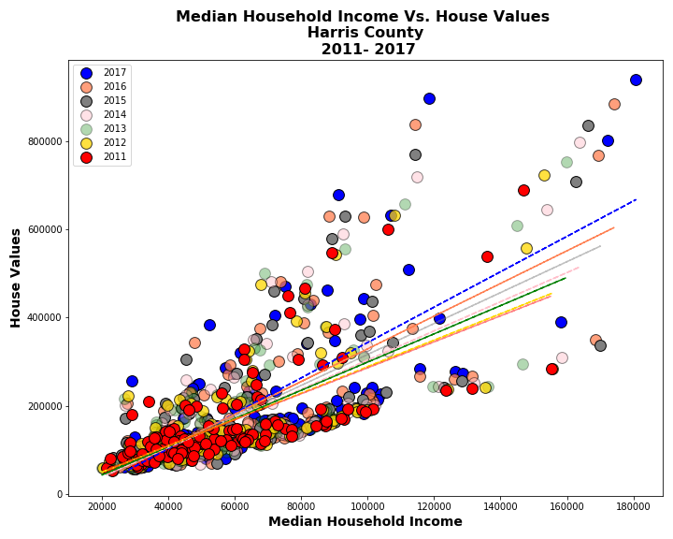
Factors affecting house value- Income
# Linear positive correlation
# Degree slightly changed
Over time
Chart

Slide 21
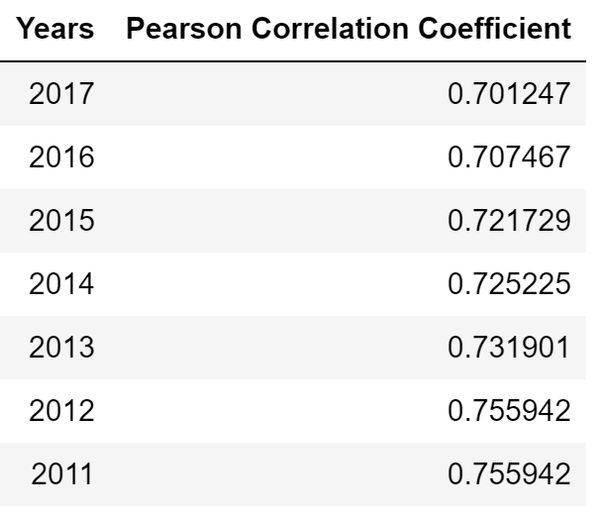
Person Correlation Coefficient Test- Factors affecting housing’s value- Income
# Strong positive correlation
# Degree of impact slightly declines over time, going stable for the last couple years

Slide 22
Factors affecting house value - Population

Slide 23
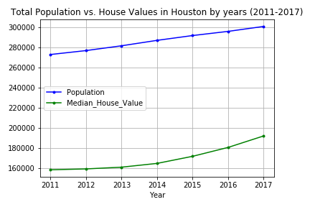
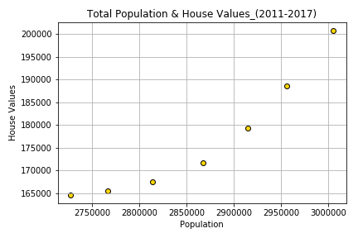
Factors affecting house value- Population
Figure 2: Comparison of population growth and increase in housing values (scatter plot).
Figure 1: Comparison of population growth and increase in housing values (Line plot).

Slide 24
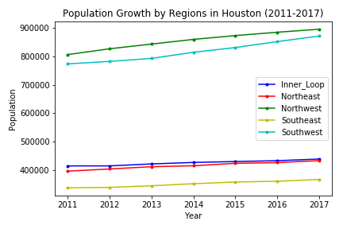
Factors affecting house value- Population
Figure 3: Population growth in five regions of Houston (2011-2017.

Slide 25
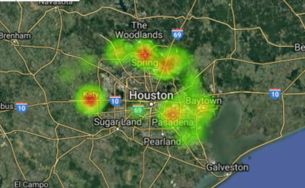
Factors affecting house value- Population
Figure 4: Google heat map of the cities in Houston based on population

Slide 26
Factors affecting house value- Population
Hypothesis development:
1- Hypothesis: There is a statistically meaningful relationship between population growth and house values in the selected regions of Houston because the both population and house values are increasing constantly.
2- Null hypothesis: Although there is an increase in population and house values, it does not indicates statistical significance between two variables.

Slide 27
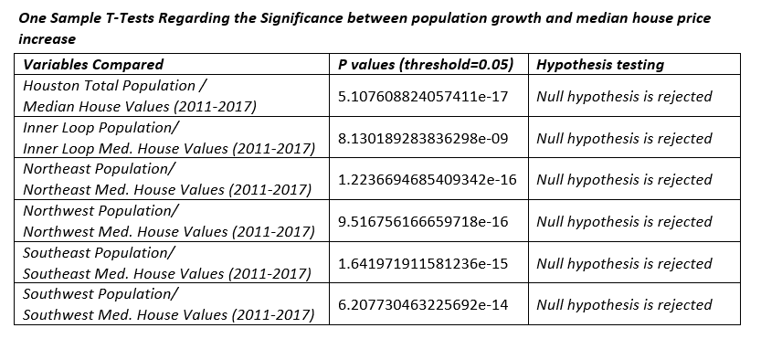
Factors affecting house value- Population
Figure 5: T-Test Scores and Hypothesis Testing:
“T-test scores indicate strong statistical significance between population growth and median house values at Houston and regions scale between 2011-2017”.

Slide 28
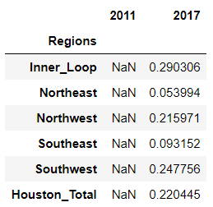
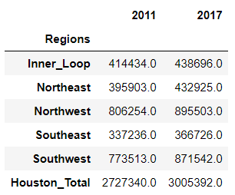
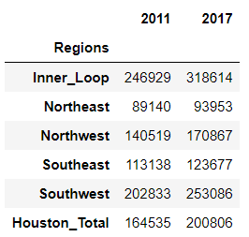
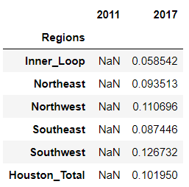
Factors affecting house value- Population
Figure 6: Percent Change_Population
Figure 7: Percent Change_Housing Values
Southwest, Northwest, Northeast
Inner Loop, Southwest, Northwest

Slide 29
Factors affect housing’s value - Time travel to work

Slide 30
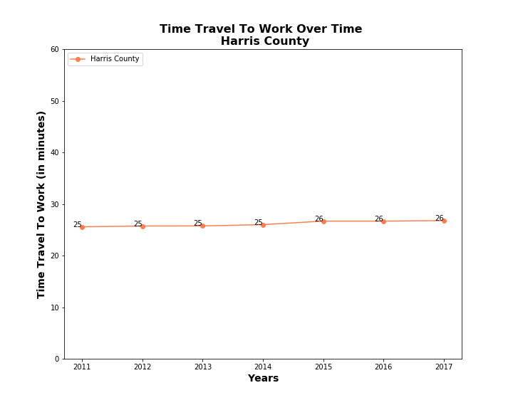
Factors affect housing’s value- Time travel

Slide 31
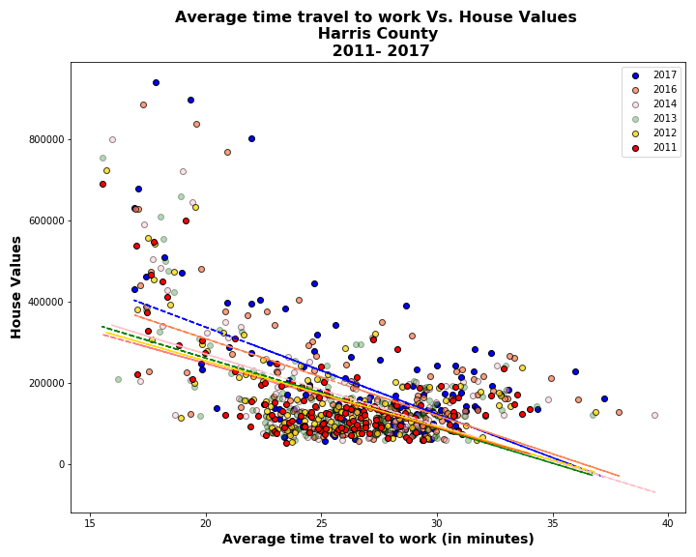
#Visualize: Linear negative
correlation
# Degree seems stable
Over time

Slide 32
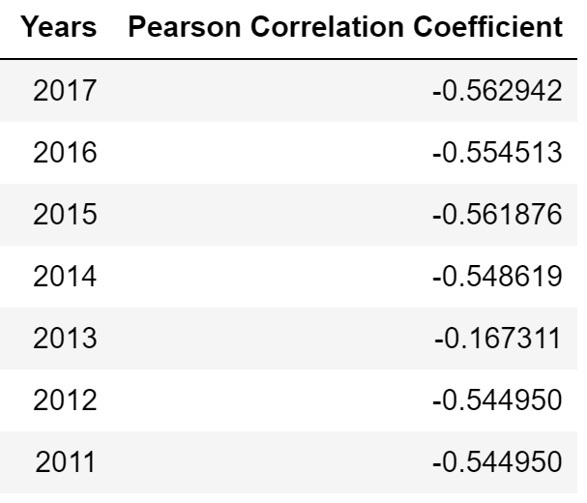
Correlation Coefficient: Time travel to work vs
House values
# Correlation: Somewhat weak
# Degree of the impact changing over times, decreasingly

Slide 33
Conclusions

Slide 34
Conclusions
House’s values in Houston Area are generally higher than average in Harris County. In which, Inner Loop and Southwest are most expensive
Monthly housing costs
in Houston Area is cheaper than average
positively affect house values, making a stronger impact in Houston Area. However, the strength of correlation declines over time.
One exception is Northwest region where the correlation is very weak
Household income
in Houston Area is generally below average compared to Harris County. However, Inner Loop has higher income and Southwest is about equal to Harris County average
strongly positively affects house values. The degree of impact seems stable over time

Slide 35
Conclusions
4) Population: strong statistical significance between population growth and median house values at Houston
5) Time travel to work weakly negatively affects house’s value. Degree of impact declines over time

Slide 36
Thank you for your attention!

