Slide 1
PrivacyLens AI: Session-Only Digital Privacy Intelligence & Content Exposure Analyzer
CAPSTONE PROJECT
Presented By:
  Student Name- Sinchan Sahoo
  College Name- University of Calcutta
  Department- B.Sc in Chemistry
  AICTE ID- STU684844a0d086b1749566624

Slide 2
OUTLINE
Problem Statement
Proposed System/Solution
System Development Approach
Algorithm & Deployment
Result
Conclusion
Future Scope
References

Slide 3
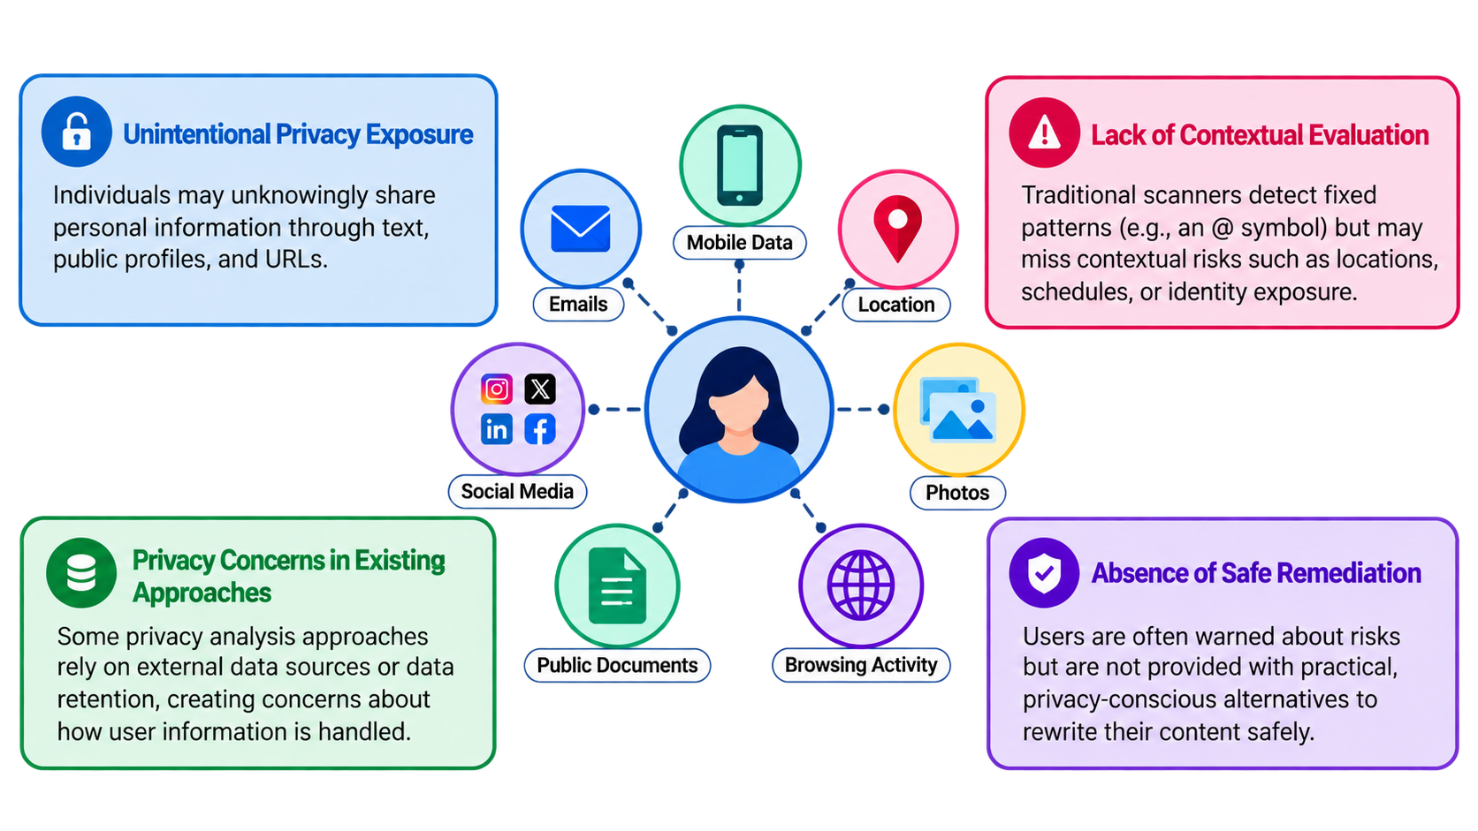
Problem Statement
People share personal information online without realizing the risks, while existing tools lack context and solutions.

Slide 4
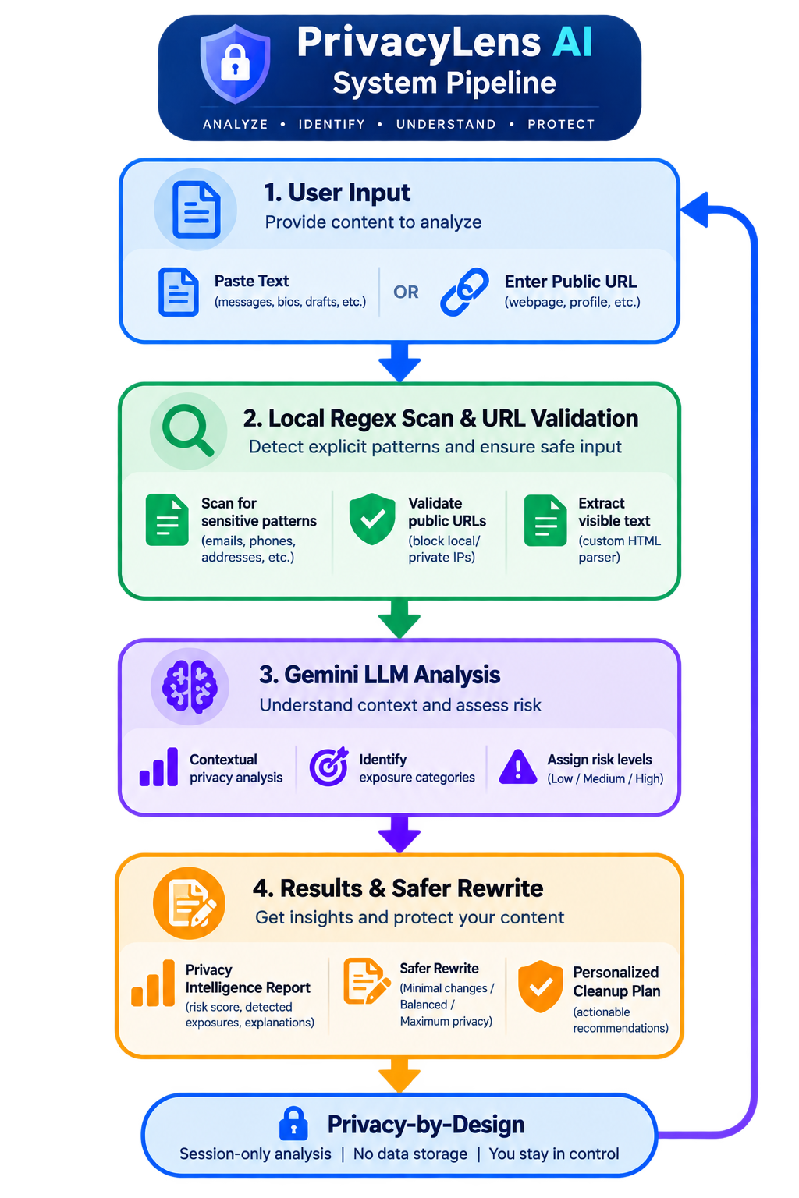
Proposed Solution
Dual-Engine Privacy Intelligence: Combines regex pattern detection with Gemini LLM analysis to identify both explicit personal data and contextual privacy risks.
Privacy-by-Design Architecture: Operates entirely in temporary session state (st.session_state) with zero database persistence, analyzing only user-provided content without indexing individuals.
Safe Public Web Content Pipeline: Validates URLs, blocks private IPs, and extracts readable text using a custom HTMLParser, ensuring users review the content before analysis begins.
Automated Remediation & Safer Rewriting: Provides targeted cleanup recommendations and generates privacy-conscious rewrites at three selectable levels (Minimal, Balanced, Maximum) to reduce exposure while preserving intent.

Slide 5
System Approach
System Requirements
Language: Python 3.x
API Requirement: Google Gemini API Key (stored in Streamlit secrets or environment variables)
Hardware: Standard CPU and RAM sufficient for web application hosting.
Libraries Required to Build the Model
Streamlit (streamlit): Used for the reactive web interface, UI styling, and managing temporary session state.
Google Generative AI (google.generativeai): Used for LLM-based privacy scoring, exposure categorization, and text rewriting.
Python Standard Library (Web & Networking): urllib.request, urllib.parse, socket, and ipaddress for secure public URL retrieval and IP validation.
Python Standard Library (Parsing & Processing): html.parser for extracting visible text, re (Regex) for local pattern detection, and json for parsing LLM outputs.

Slide 6
Algorithm & Deployment
Algorithm Selection
Hybrid Inspection Method: Utilizes deterministic Regular Expressions to guarantee the detection of explicit items (emails, phones, addresses) alongside a Generative AI prompt framework constrained to return structured JSON for contextual risk assessment.
Data Input
Accepts manual text input (e.g., drafts, messages) or public webpage URLs. HTML input is processed by a custom VisibleTextExtractor to strip <script>, <style>, and navigation boilerplate before analysis.
Analysis Process
The system executes local regex pattern matching first. If enabled, it then passes the sanitized text to the Gemini model using a strict ANALYSIS_PROMPT to extract exposure categories, severity (Low, Medium, High), and practical recommendations.
Risk scores are generated from detected privacy signals and contextual severity information, with the final score represented on a 0–100 scale.
Deployment
Deployed as a Streamlit web application capable of running locally or on cloud platforms, with session-based state management and secure API key configuration.

Slide 7
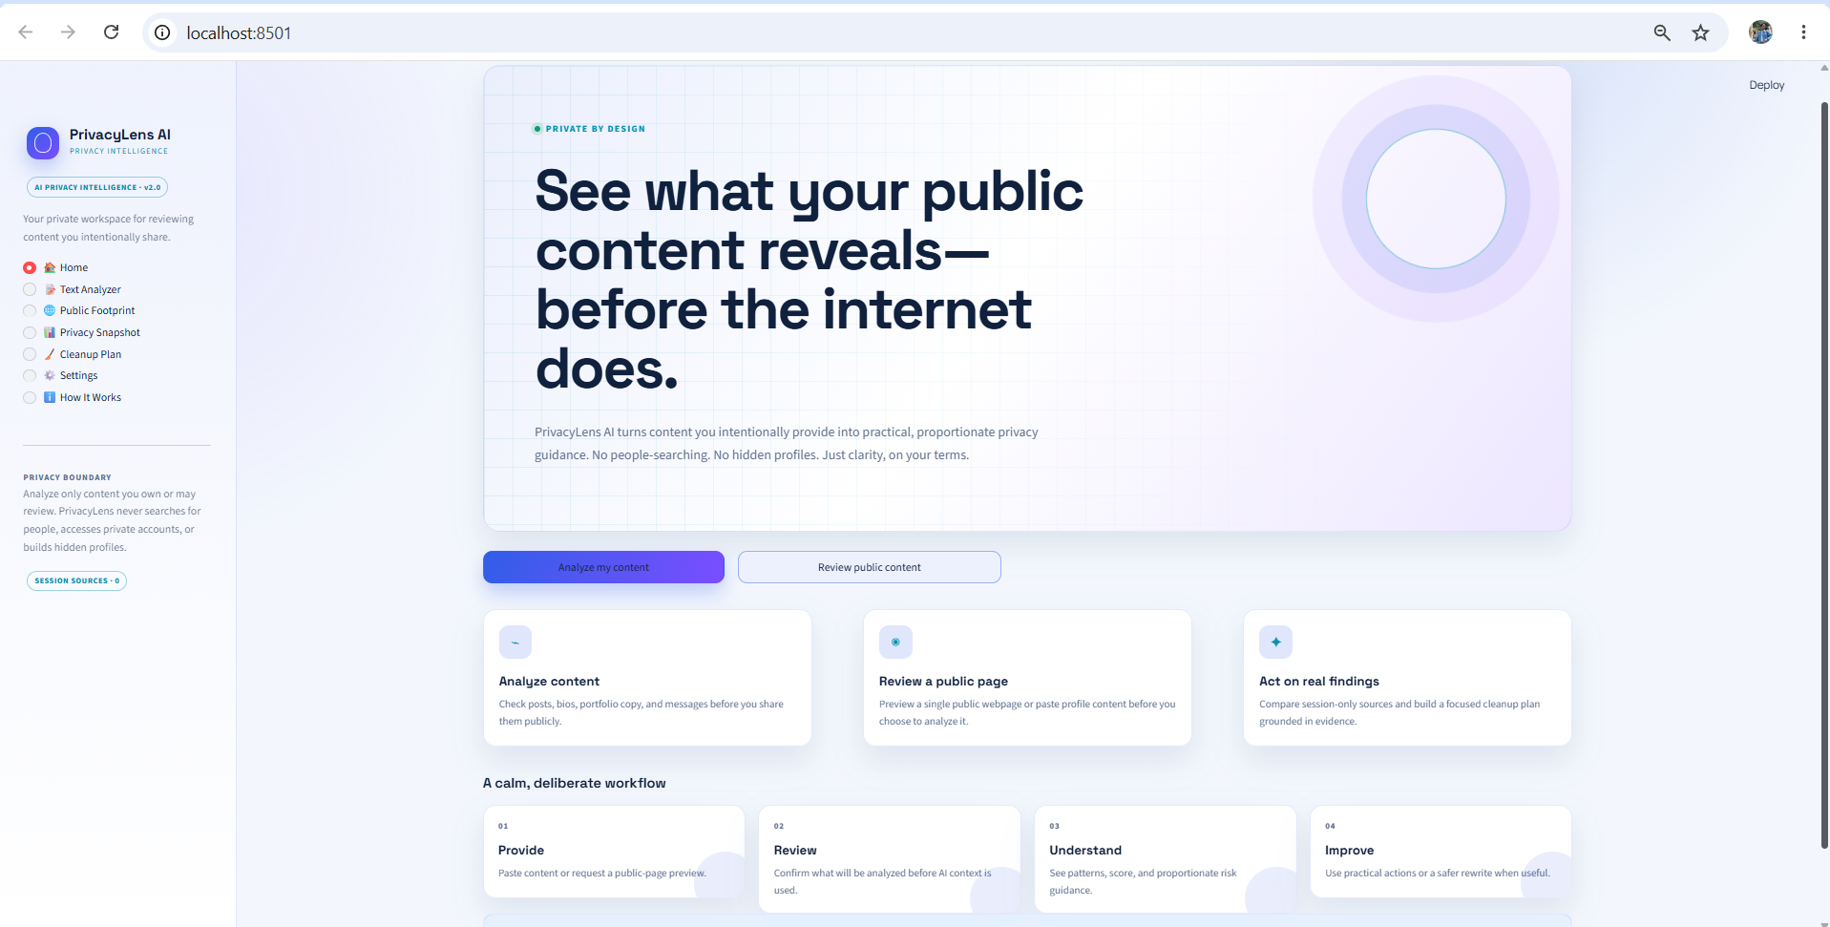
Result:PRIVACYLENS AI ANALYSIS
Overview of the PrivacyLens AI platform and its main privacy analysis features

Slide 8
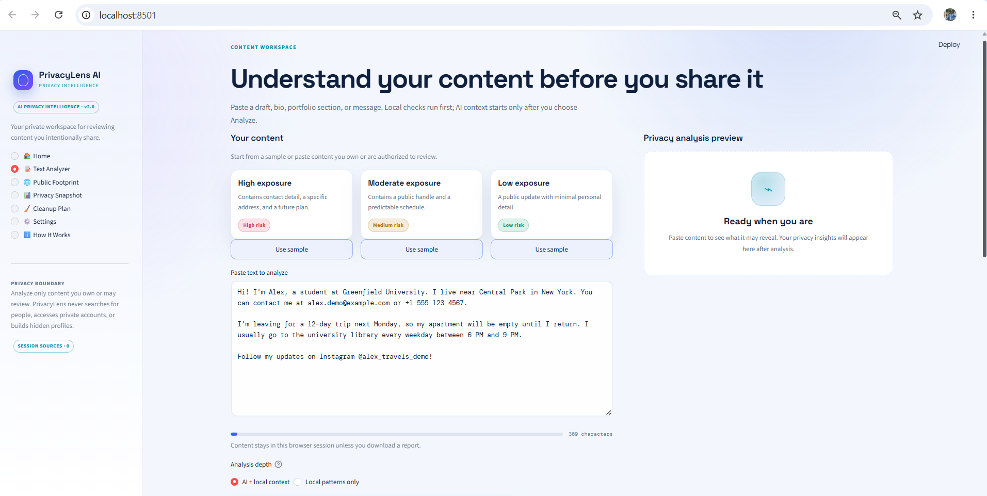
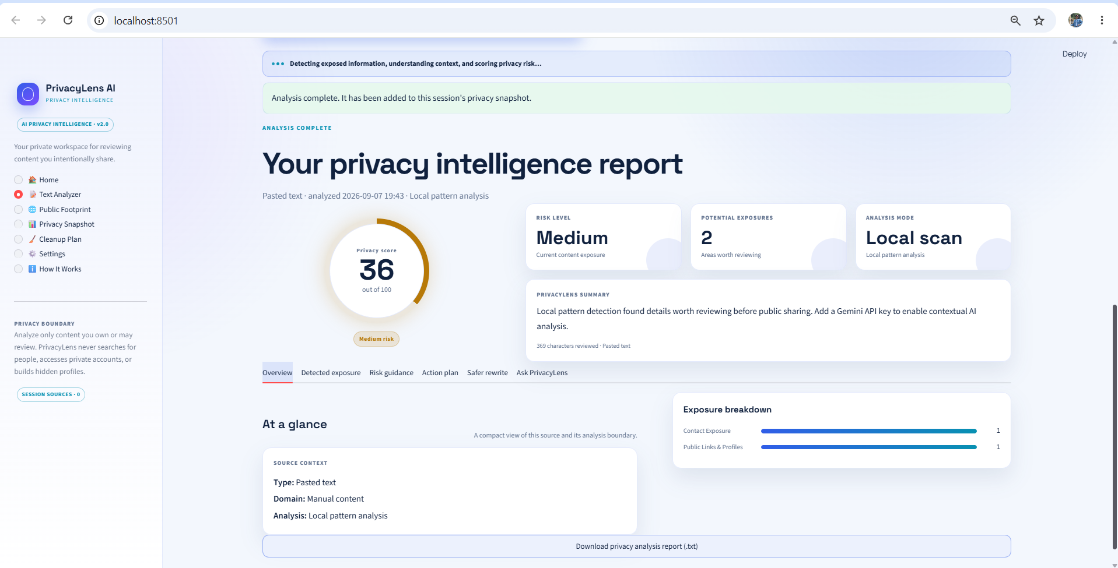
Result: TEXT PRIVACY ANALYSIS
Users can analyze their content before sharing it publicly and identify potential privacy exposures.

Slide 9
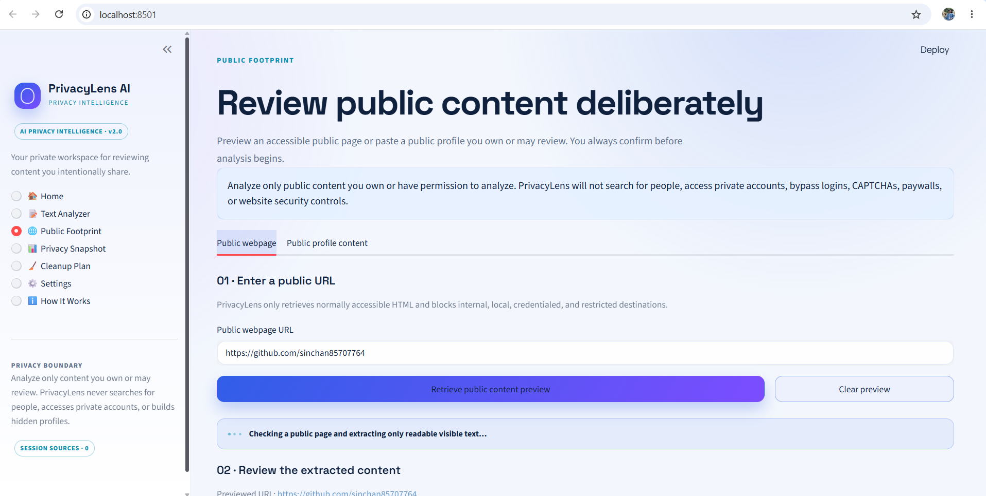
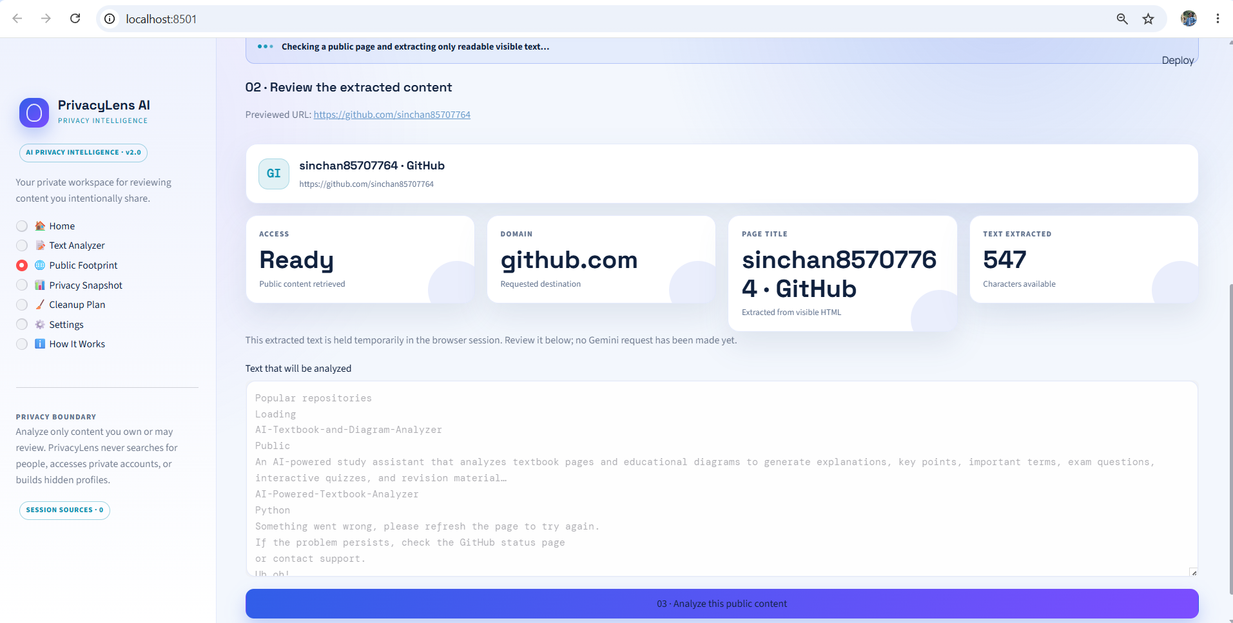
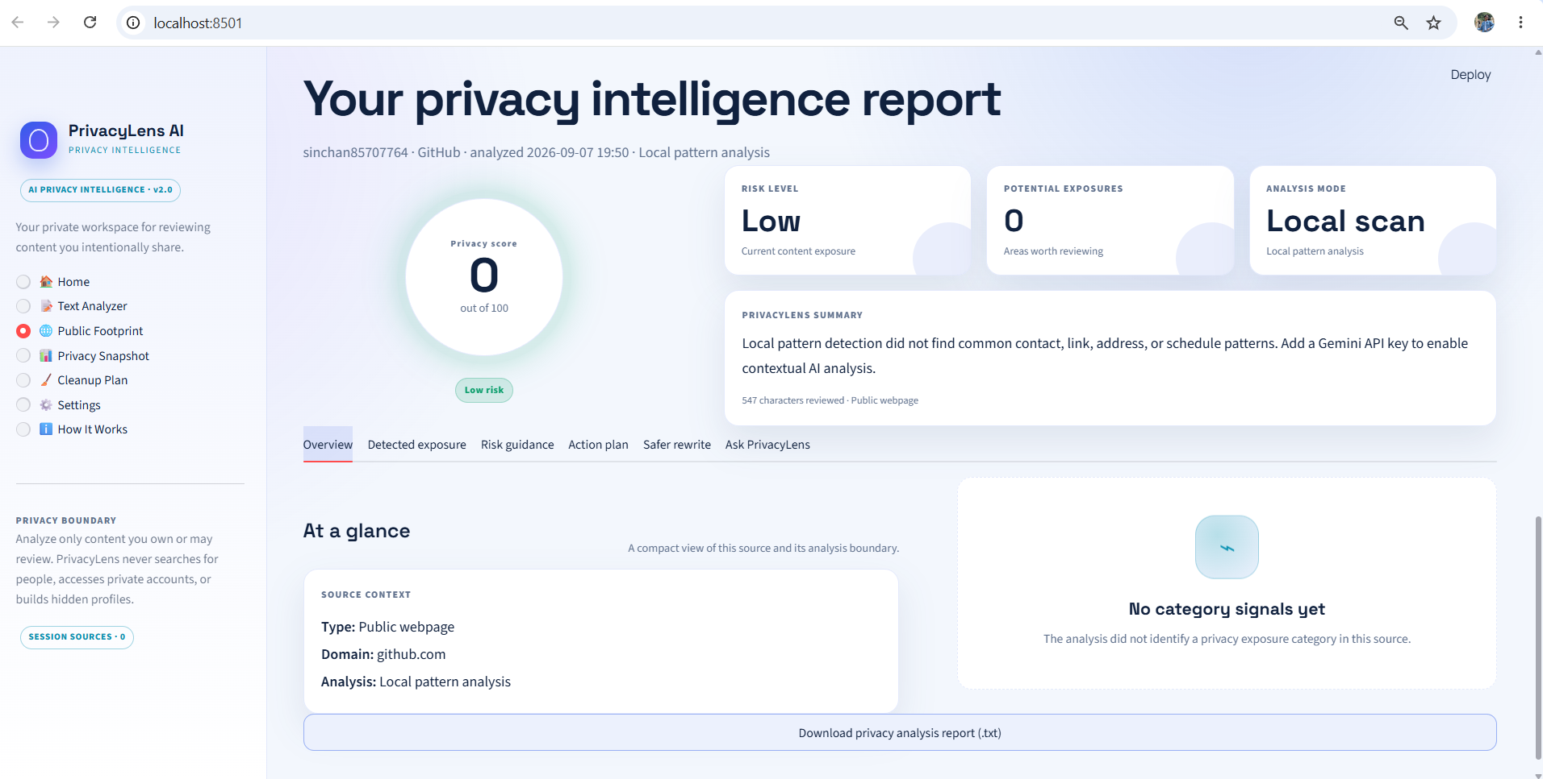
Result: PUBLIC FOOTPRINT ANALYSIS
PrivacyLens AI reviews accessible public content and analyzes it for potential privacy risks.

Slide 10
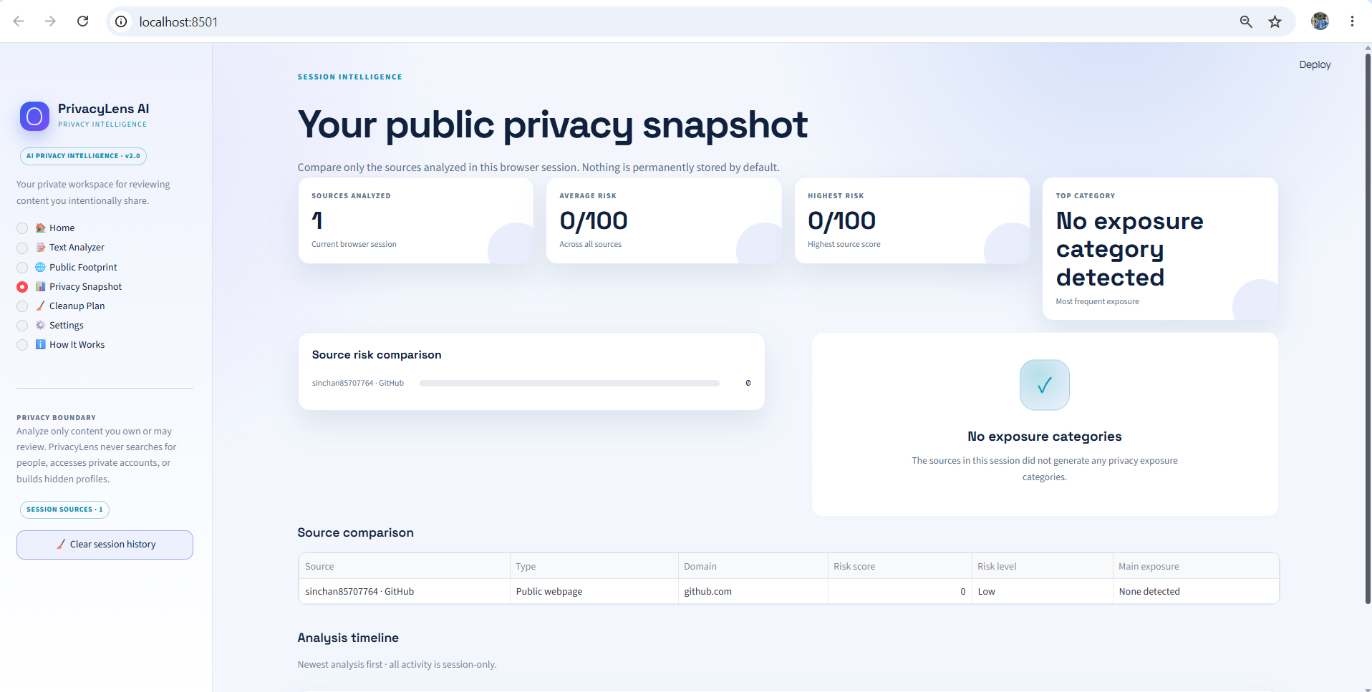
Result: PRIVACY SNAPSHOT
Provides a session-based overview and comparison of privacy risks across analyzed sources.

Slide 11
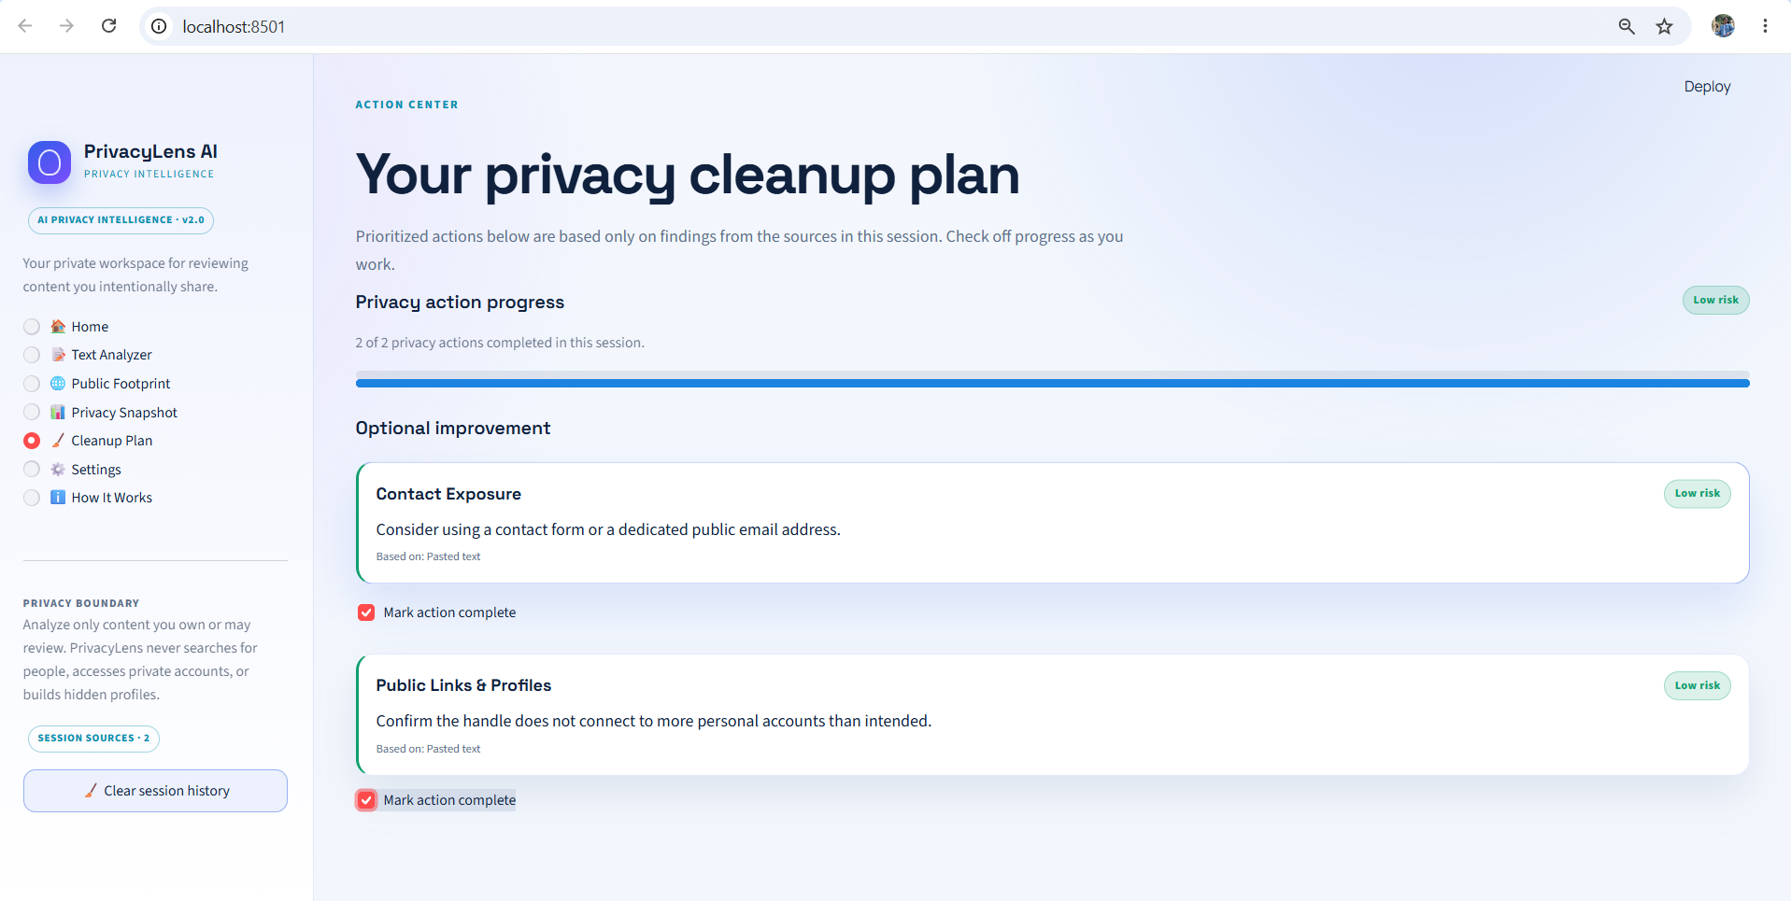
Result:PRIVACY CLEANUP PLAN
Provides practical actions and recommendations based on the identified privacy exposures.

Slide 12
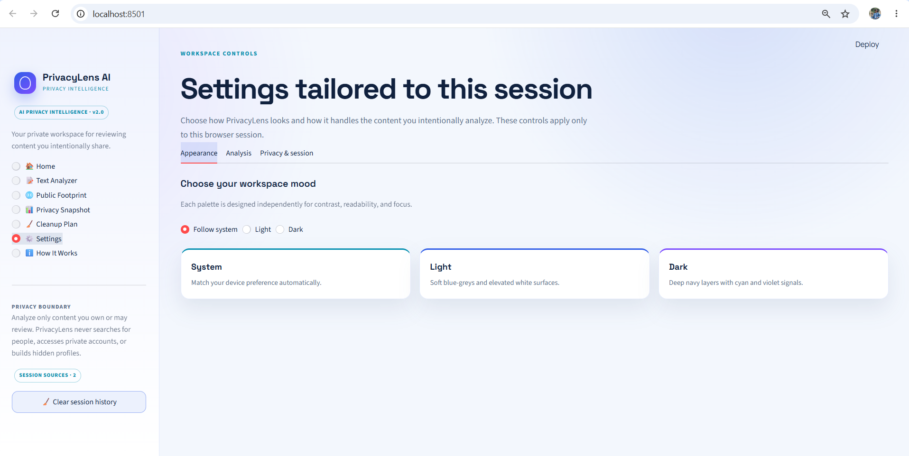
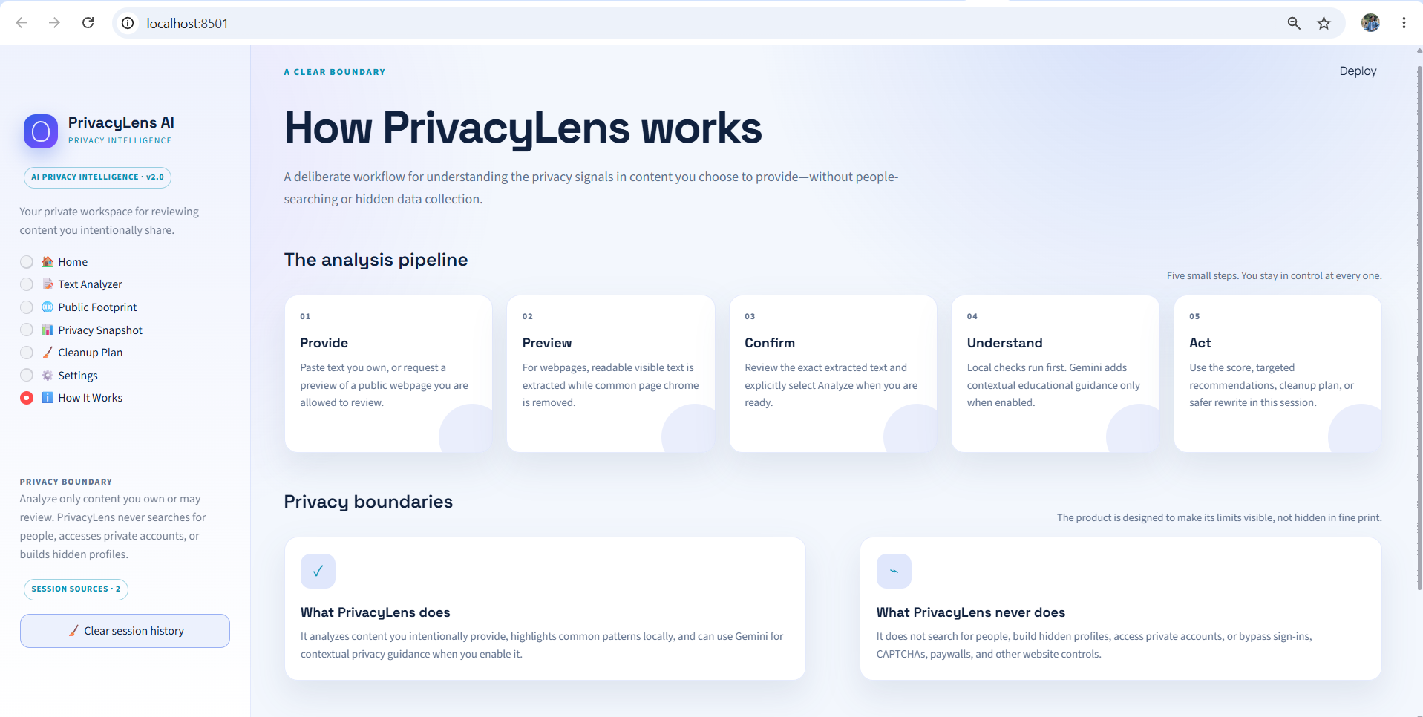
Result: SETTINGS & SYSTEM WORKFLOW
Allows workspace customization and explains the transparent privacy analysis workflow.

Slide 13
Conclusion
PrivacyLens AI successfully demonstrates that digital privacy tools can provide deep, contextual insights without sacrificing user data.
By combining standard local regex processing with constrained generative AI, the application helps identify explicit privacy signals and context-dependent exposure risks in user-provided text.
The custom HTML parsing and IP validation mechanisms prove highly effective at extracting public web content safely while helping prevent analysis of local, private, and internal network destinations.
The automated rewriting and dynamic remediation features successfully transition the tool from passive detection to active, practical privacy protection.

Slide 14
Future scope
Document Support: Expanding input capabilities to securely parse local PDF or DOCX files for offline regex analysis.
Expanded Pattern Recognition: Enhancing the local detection engine to flag regional financial identifiers, license plates, and standardized identification numbers.
Open-Source Local LLMs: Integrating lightweight, locally hosted language models (e.g., Llama 3 or Mistral via Ollama) to remove the reliance on the external Google Gemini API for offline users.
Browser Extension: Adapting the core analysis logic into a web extension to warn users before they submit sensitive text on social media or public forums.

Slide 15
References
Streamlit Documentation
Google Generative AI Python SDK (google.generativeai) Documentation
Python Standard Library Documentation
OWASP Foundation: Server-Side Request Forgery (SSRF) Prevention guidelines.

Slide 16
Deployment link / github link
GitHub Repository: https://github.com/sinchan85707764/PrivacyLens-AI.git
Streamlit Application: https://privacylens-ai-mdzp4p687cfsgf2stwspam.streamlit.app/
Project Technology: Python + Streamlit + Gemini AI

Slide 17
THANK YOU

