Slide 1
Depression Detection
Name: Yuxin Li
Date: May 8- May 15

Slide 2
Agenda
01
Comprehensive Summary of Clinical Diagnostic Scales
02
Bimodal Depression Recognition
2.1 Audio + Vision
2.2 Audio + Text
2.3 Vision + Text
03
Multimodal Depression Recognition
3.1 Audio + Text + Vision
04
Multimodal vs. Bimodal
05
LLM-based Depression Recognition
5.1 Newly Introduced Dataset
5.2 Overview
5.3 Insightful papers

Slide 3
1 Comprehensive Summary of Clinical Diagnostic Scales

Slide 4
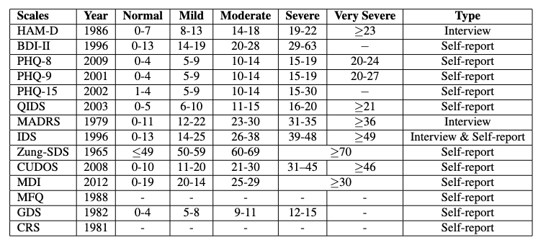
1. Comprehensive Summary of Clinical Diagnostic Scales
Table 1: Clinical depression diagnosis questionnaires and tools^{[1][27]}
HAM-D is the most widely used depression assessment scale in clinical diagnosis
High statistical correlation between the scores on the MADRS and the HAM-D. (Heo et al., 2017)
High statistical correlation between the scores on the CRS, HAM-D and BDI-II
The GDS is specially for older patients.
PHQ-8, PHQ-9 and BDI-II are the most popular scales in automatic depression recognition
[1] Wu, P., Wang, R., Lin, H., Zhang, F., Tu, J., & Sun, M. (2023). Automatic depression recognition by intelligent speech signal processing: A systematic survey. CAAI Transactions on Intelligence Technology, 8(3), 701-711.
[2] Hamilton, M.: The Hamilton rating scale for depression. In: Assessment of Depression, 143–152. Springer (1986)
[3] Beck, A.T., Steer, R.A., Brown, G.K.: Manual for Beck Depression Inventory‐II. Psychological Corporation, San Antonio (1996)
[4] Kroenke, K., et al.: The PHQ‐8 as a measure of current depression in the general population. J. Affect. Disorders. 114(1–3), 163–173 (2009)
[5] Kroenke, K., Spitzer, R.L., Williams, J.B.: The PHQ‐9: validity of a brief depression severity measure. J. Gen. Intern. Med. 16(9), 606–613 (2001)
[6] Kroenke, K., Spitzer, R.L., Williams, J.B.: The PHQ‐15: validity of a new measure for evaluating the severity of somatic symptoms. Psychosom. Med. 64(2), 258–266 (2002)
[7] Rush, A.J., et al.: The 16‐Item Quick Inventory of Depressive Symptomatology (QIDS), clinician rating (QIDS‐C), and self‐report (QIDS‐ SR): a psychometric evaluation in patients with chronic major depression. Biol. Psychiatr. 54(5), 573–583 (2003)
[8] Montgomery, S.A., Åsberg, M.A.R.I.E.: A new depression scale designed to be sensitive to change. Brit. J. Psychiat. 134(4), 382–389 (1979)
[9] Edition, F.: Diagnostic and statistical manual of mental disorders. Am Psychiatric Assoc. 21, 591–643 (2013)
[28] A. J. Rush, C. M. Gullion, M. R. Basco, R. B. Jarrett, M. H. Trivedi, The inventory of depressive symptomatology (ids): Psychometric properties, Psychological Medicine 26 (3) (1996) 477–486
[29[W. W. Zung, A self-rating depression scale, Archives of General Psychiatry 12 (1) (1965) 63–70.
[30] Yesavage JA, Brink TL, Rose TL, et al. Development and validation of a geriatric depression screening scale: a preliminary report. J Psychiatr Res. 1982-83;17(1):37-49. PMID 7183759
[44] Heo, M., Murphy, C. F. & Meyers, B. S. Relationship between the hamilton depression rating scale and the montgomery- åsberg depression rating scale in depressed elderly: a meta-analysis. The American Journal Geriatric Psychiatry 15, 899–905 (2007)
01
Notes:
HAM-D is the most widely used depression assessment scale in clinical diagnosis
High statistical correlation between the scores on the MADRS and the HAM-D.
The GDS is specially for older patients
The CRS was closely matching the information content and specific items of the HAM-D (high correlation).
The CRS may be a useful alternative to the BDI-II, with closer correspondence to the HAM-D.
Most of them access the symptoms of depression experienced over the past week

Slide 5
2 Bimodal Depression Recognition

Slide 6
2. Bimodal Depression Recognition
2.1 Audio + Vision
Early Fusion: integrating data at the beginning of the data processing pipeline
Fusion Strategy
Late Fusion: connect feature vectors after they have been independently processed.
No. | Papers | Dataset | Fusion Strategy | Model | Task | Results
1 | Guohou et al., 2020 | DAIC-WOZ | Early Fusion | RF | Regression | RMSE 5.28
2 | Ghosh et al., 2014 | DAIC-WOZ | Late Fusion | Maximum Entropy Model | Classification | F1 score 0.6315
3 | Yang et al., 2016 | DAIC-WOZ | Late Fusion | DT, SVR | Classification and Regression | F1 score 0.724 RMSE 9.106
4 | Jan et al., 2017 | AVEC 2013, AVEC 2014 | Late Fusion | PLS, LR | Regression | RMSE 7.43
5 | Dibeklioğlu et al., 2017 | Self-collected | Late Fusion | LR | Classification | Accuracy 78.67
6 | Alghowinem et al., 2017 | Black Dog | Late Fusion | SVM | Classification | Recall 86.7
7 | Ye et al., 2021 | Self-collected | Late Fusion | Att-TCN | Classification | F1 score 0.875
8 | Niu et al., 2020 | AVEC2013, AVEC2014 | Late Fusion | CNN, LSTM, Attention | Regression | RMSE 6.68
9 | Yoon et al., 2022 | D-Vlog | Late Fusion | Transformer-based | Classification | F1 score 0.635
Table 1: Comparison of Bimodal (Audio + Vision) Methods
Late fusion is more popular than early fusion
Decision models are still more on traditional ML models
Fewer articles in recent years
Diverse clinical datasets
[11] Ghosh, S., Chatterjee, M., & Morency, L. P. (2014, November). A multimodal context-based approach for distress assessment. In Proceedings of the 16th International Conference on Multimodal Interaction (pp. 240-246).
[12] Scherer, S., Stratou, G., & Morency, L. P. (2013, December). Audiovisual behavior descriptors for depression assessment. In Proceedings of the 15th ACM on International conference on multimodal interaction (pp. 135-140).
[13] Guohou, S., Lina, Z., & Dongsong, Z. (2020). What reveals about depression level? The role of multimodal features at the level of interview questions. Information & Management, 57(7), 103349.
[22] Yang, L., Jiang, D., He, L., Pei, E., Oveneke, M. C., & Sahli, H. (2016, October). Decision tree based depression classification from audio video and language information. In Proceedings of the 6th international workshop on audio/visual emotion challenge (pp. 89-96).
[24] Jan, A., Meng, H., Gaus, Y. F. B. A., & Zhang, F. (2017). Artificial intelligent system for automatic depression level analysis through visual and vocal expressions. IEEE Transactions on Cognitive and Developmental Systems, 10(3), 668-680.
[26] Dibeklioğlu, H., Hammal, Z., & Cohn, J. F. (2017). Dynamic multimodal measurement of depression severity using deep autoencoding. IEEE journal of biomedical and health informatics, 22(2), 525-536.
[27] Alghowinem, S., Goecke, R., Wagner, M., Epps, J., Hyett, M., Parker, G., & Breakspear, M. (2016). Multimodal depression detection: fusion analysis of paralinguistic, head pose and eye gaze behaviors. IEEE Transactions on Affective Computing, 9(4), 478-490.
[30] Ye, J., Yu, Y., Wang, Q., Li, W., Liang, H., Zheng, Y., & Fu, G. (2021). Multi-modal depression detection based on emotional audio and evaluation text. Journal of affective disorders, 295, 904-913.
[31] Yoon, J., Kang, C., Kim, S., & Han, J. (2022, June). D-vlog: Multimodal vlog dataset for depression detection. In Proceedings of the AAAI Conference on Artificial Intelligence (Vol. 36, No. 11, pp. 12226-12234).
02
Notes:
Early Fusion: integrating audio and vision data at the beginning of the data processing pipeline.
Late Fusion: connects feature vectors extracted from each modality after they have been independently processed.

Slide 7
2. Bimodal Depression Recognition
2.2 Audio + Text
Early Fusion: integrating data at the beginning of the data processing pipeline
Fusion Strategy
Late Fusion: connect feature vectors after they have been independently processed.
No. | Papers | Dataset | Fusion Strategy | Model | Task | Results
1 | Marriwala et al., 2023 | DAIC-WOZ | Late Fusion | LSTM | Classification | F1 score 0.78
2 | Toto et al., 2021 | DAIC-WOZ | Late Fusion | BiLSTM | Classification | F1 score 0.71
3 | AI et al., 2018 | DAIC-WOZ | Late Fusion | LSTM | Classification and Regression | F1 score 0.77 RMSE 4.97
4 | Lin et al., 2020 | DAIC-WOZ, AViD-Corpus | Late Fusion | LSTM | Classification and Regression | F1 score 0.85 RMSE 5.44
5 | Zhang et al., 2024 | DAIC-WOZ | Late Fusion | Llama-based | Classification | F1 score 0.833
6 | Lam et al., 2019 | DAIC-WOZ | Late Fusion | Transformer-based | Classification | F1 score 0.87
7 | Park et al., 2022 | DAIC-WOZ | Late Fusion | BERT-CNN and CNN-BiLSTM | Classification | -
8 | Guo et al., 2022 | DAIC-WOZ | Late Fusion | CNN | Classification | F1 score 0.647
9 | Guohou et al., 2020 | DAIC-WOZ | Early Fusion | SVR | Regression | RMSE 5.3
Table 2: Comparison of Bimodal (Audio + Text) Methods
Late Fusion is more popular than Early Fusion
DAIC-WOZ is the most wildly used dataset in Bimodal (Audio+Text)
[2] Marriwala, N., & Chaudhary, D. (2023). A hybrid model for depression detection using deep learning. Measurement: Sensors, 25, 100587.
[3] Toto, E., Tlachac, M. L., & Rundensteiner, E. A. (2021, October). Audibert: A deep transfer learning multimodal classification framework for depression screening. In Proceedings of the 30th ACM international conference on information & knowledge management (pp. 4145-4154).
[4] Al Hanai, T., Ghassemi, M. M., & Glass, J. R. (2018, September). Detecting Depression with Audio/Text Sequence Modeling of Interviews. In Interspeech (pp. 1716-1720).
[5] Lin, L., Chen, X., Shen, Y., & Zhang, L. (2020). Towards automatic depression detection: A BiLSTM/1D CNN-based model. Applied Sciences, 10(23), 8701.
[6] Zhang, X., Liu, H., Xu, K., Zhang, Q., Liu, D., Ahmed, B., & Epps, J. (2024). When LLMs Meets Acoustic Landmarks: An Efficient Approach to Integrate Speech into Large Language Models for Depression Detection. arXiv preprint arXiv:2402.13276.
[8] Lam, G., Dongyan, H., & Lin, W. (2019, May). Context-aware deep learning for multi-modal depression detection. In ICASSP 2019-2019 IEEE international conference on acoustics, speech and signal processing (ICASSP) (pp. 3946-3950). IEEE.
[9] Park, J., & Moon, N. (2022). Design and implementation of attention depression detection model based on multimodal analysis. Sustainability, 14(6), 3569.
[10] Guo, Y., Zhu, C., Hao, S., & Hong, R. (2022). A topic-attentive transformer-based model for multimodal depression detection. arXiv preprint arXiv:2206.13256.
[13] Guohou, S., Lina, Z., & Dongsong, Z. (2020). What reveals about depression level? The role of multimodal features at the level of interview questions. Information & Management, 57(7), 103349.
03

Slide 8
2. Bimodal Depression Recognition
2.3 Text + Vision
Early Fusion: integrating data at the beginning of the data processing pipeline
Fusion Strategy
Late Fusion: connect feature vectors after they have been independently processed.
Papers | Dataset | Fusion Strategy | Model | Task | Results
Morales et al., 2016 | AVEC 2014 | Late Fusion | SVR | Regression | RMSE 7.43
Guohou et al., 2020 | DAIC-WOZ | Early Fusion | RF | Regression | RMSE 5.24
Table 3: Comparison of Bimodal (Vision + Text) Methods
There are way less paper on T+V comparing to other two combinations
04
[13] Guohou, S., Lina, Z., & Dongsong, Z. (2020). What reveals about depression level? The role of multimodal features at the level of interview questions. Information & Management, 57(7), 103349.
[48] M.R. Morales, R. Levitan, Speech vs. Text: a comparative analysis of features for depression detection systems, In 2016 IEEE Spoken Language Technology Workshop (SLT), December, 2016, pp. 136–143.
Notes:
Early Fusion: integrating audio and vision data at the beginning of the data processing pipeline.
Late Fusion: connects feature vectors extracted from each modality after they have been independently processed.

Slide 9
3 Multimodal Depression Recognition

Slide 10
3. Multimodal Depression Recognition
3.1 Audio + Vision + Text
No | Papers | Dataset | Fusion Strategy | Model | Task | Results
1 | Ghosh et al., 2014 | DAIC-WOZ | Late Fusion | Maximum Entropy Model | Classification | F1 score 0.6751
2 | Guohou et al., 2020 | DAIC-WOZ | Early Fusion | SVR | Regression | RMSE 4.96
3 | Yang et al., 2017 | DAIC-WOZ | Late Fusion | Hybrid DCNN-DNN | Regression | RMSE 5.974
4 | Fang et al., 2023 | DAIC-WOZ | Late Fusion | LSTM | Classification | RMSE 3.68
5 | Wei et al., 2022 | DAIC-WOZ | Early Fusion | BiLSTM | Classification | F1 score 0.66
6 | Zhang et al., 2020 | BDC, E-DAIC | Early Fusion | Gaussian Mixture Model | Classification | F1 score 0.721
7 | Yang et al., 2024 | DAIC-WOZ | Early Fusion | Representation Learning | Classification | F1 score 0.805
8 | Qureshi et al., 2019 | DAIC-WOZ | Late Fusion | LSTM | Regression | RMSE 4.14
9 | Ray et al., 2019 | DAIC-WOZ, EDAIC | Late Fusion | BiLSTM | Regression | RMSE 4.14
10 | Pampouchidou et al., 2016 | DAIC-WOZ | Late Fusion | DT | Classification | F1 score 0.52
11 | Victor et al., 2019 | Self-collected | Late Fusion | LSTM | Classification, Regression | F1 score 0.711 RMSE 6.35
12 | Danner et al., 2024 | DAIC-WOZ | Late Fusion | ChatGPT-3.5 | Classification | F1 score 0.78
Table 4: Comparison of multimodal Methods
Late Fusion is more popular than Early Fusion
DAIC-WOZ is the most wildly used dataset in multimodal
Various deep learning like neural network, representation learning, transfer learning, etc
[14] Yang, L., Jiang, D., Xia, X., Pei, E., Oveneke, M. C., & Sahli, H. (2017, October). Multimodal measurement of depression using deep learning models. In Proceedings of the 7th annual workshop on audio/visual emotion challenge (pp. 53-59).
[15] Fang, M., Peng, S., Liang, Y., Hung, C. C., & Liu, S. (2023). A multimodal fusion model with multi-level attention mechanism for depression detection. Biomedical Signal Processing and Control, 82, 104561.
[16] Wei, P. C., Peng, K., Roitberg, A., Yang, K., Zhang, J., & Stiefelhagen, R. (2022, October). Multi-modal depression estimation based on sub-attentional fusion. In European Conference on Computer Vision (pp. 623-639). Cham: Springer Nature Switzerland
[17] Zhang, Z., Lin, W., Liu, M., & Mahmoud, M. (2020, November). Multimodal deep learning framework for mental disorder recognition. In 2020 15th IEEE International Conference on Automatic Face and Gesture Recognition (FG 2020) (pp. 344-350). IEEE.
[18] Yang, S., Cui, L., Wang, L., Wang, T., & You, J. (2024). Enhancing multimodal depression diagnosis through representation learning and knowledge transfer. Heliyon.
[19] Qureshi, S. A., Hasanuzzaman, M., Saha, S., & Dias, G. (2019). The Verbal and Non Verbal Signals of Depression--Combining Acoustics, Text and Visuals for Estimating Depression Level. arXiv preprint arXiv:1904.07656.
[20] Ray, A., Kumar, S., Reddy, R., Mukherjee, P., & Garg, R. (2019, October). Multi-level attention network using text, audio and video for depression prediction. In Proceedings of the 9th international on audio/visual emotion challenge and workshop (pp. 81-88).
[21] Pampouchidou, A., Simantiraki, O., Fazlollahi, A., Pediaditis, M., Manousos, D., Roniotis, A., ... & Tsiknakis, M. (2016, October). Depression assessment by fusing high and low level features from audio, video, and text. In Proceedings of the 6th International Workshop on Audio/Visual Emotion Challenge (pp. 27-34).
[23] Victor, E., Aghajan, Z. M., Sewart, A. R., & Christian, R. (2019). Detecting depression using a framework combining deep multimodal neural networks with a purpose-built automated evaluation. Psychological assessment, 31(8), 1019.
[25] Niu, M., Tao, J., Liu, B., Huang, J., & Lian, Z. (2020). Multimodal spatiotemporal representation for automatic depression level detection. IEEE transactions on affective computing, 14(1), 294-307.
05

Slide 11
3. Multimodal Depression Recognition
3.1 Audio + Vision + Text
No | Papers | Model | Results
5 | Wei et al., 2022 | BiLSTM | 0.66
7 | Yang et al., 2024 | Representation Learning | 0.805
Table 4: Comparison of multimodal Methods
Late Fusion is more popular than Early Fusion
DAIC-WOZ is the most wildly used dataset in multimodal
Various deep learning like neural network, representation learning, transfer learning, etc
[14] Yang, L., Jiang, D., Xia, X., Pei, E., Oveneke, M. C., & Sahli, H. (2017, October). Multimodal measurement of depression using deep learning models. In Proceedings of the 7th annual workshop on audio/visual emotion challenge (pp. 53-59).
[15] Fang, M., Peng, S., Liang, Y., Hung, C. C., & Liu, S. (2023). A multimodal fusion model with multi-level attention mechanism for depression detection. Biomedical Signal Processing and Control, 82, 104561.
[16] Wei, P. C., Peng, K., Roitberg, A., Yang, K., Zhang, J., & Stiefelhagen, R. (2022, October). Multi-modal depression estimation based on sub-attentional fusion. In European Conference on Computer Vision (pp. 623-639). Cham: Springer Nature Switzerland
[17] Zhang, Z., Lin, W., Liu, M., & Mahmoud, M. (2020, November). Multimodal deep learning framework for mental disorder recognition. In 2020 15th IEEE International Conference on Automatic Face and Gesture Recognition (FG 2020) (pp. 344-350). IEEE.
[18] Yang, S., Cui, L., Wang, L., Wang, T., & You, J. (2024). Enhancing multimodal depression diagnosis through representation learning and knowledge transfer. Heliyon.
[19] Qureshi, S. A., Hasanuzzaman, M., Saha, S., & Dias, G. (2019). The Verbal and Non Verbal Signals of Depression--Combining Acoustics, Text and Visuals for Estimating Depression Level. arXiv preprint arXiv:1904.07656.
[20] Ray, A., Kumar, S., Reddy, R., Mukherjee, P., & Garg, R. (2019, October). Multi-level attention network using text, audio and video for depression prediction. In Proceedings of the 9th international on audio/visual emotion challenge and workshop (pp. 81-88).
[21] Pampouchidou, A., Simantiraki, O., Fazlollahi, A., Pediaditis, M., Manousos, D., Roniotis, A., ... & Tsiknakis, M. (2016, October). Depression assessment by fusing high and low level features from audio, video, and text. In Proceedings of the 6th International Workshop on Audio/Visual Emotion Challenge (pp. 27-34).
[23] Victor, E., Aghajan, Z. M., Sewart, A. R., & Christian, R. (2019). Detecting depression using a framework combining deep multimodal neural networks with a purpose-built automated evaluation. Psychological assessment, 31(8), 1019.
[25] Niu, M., Tao, J., Liu, B., Huang, J., & Lian, Z. (2020). Multimodal spatiotemporal representation for automatic depression level detection. IEEE transactions on affective computing, 14(1), 294-307.
05

Slide 12
4 Multimodal vs. Bimodal

Slide 13
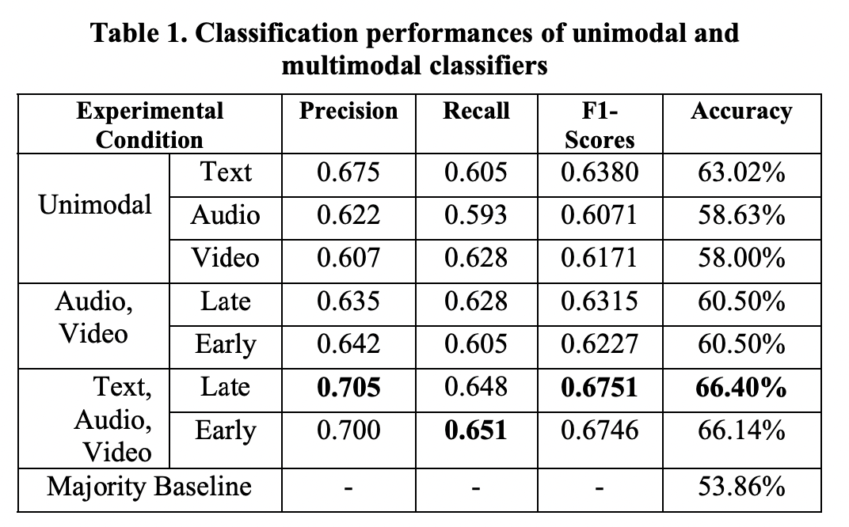
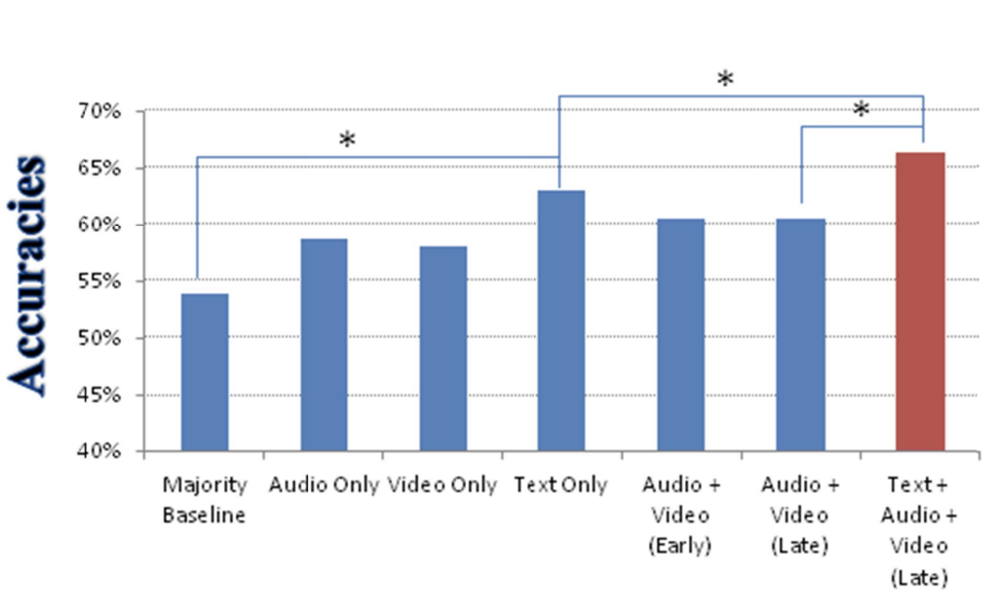
4. Multimodal vs. Bimodal
4.1 A multimodal context-based approach for distress assessment.^{[11]}
Multimodal method outperforms bimodal method
Analyzed the performance of late and early fusion using the same classifier - late fusion to be more effective
06
[11] Ghosh, S., Chatterjee, M., & Morency, L. P. (2014, November). A multimodal context-based approach for distress assessment. In Proceedings of the 16th International Conference on Multimodal Interaction (pp. 240-246).

Slide 14
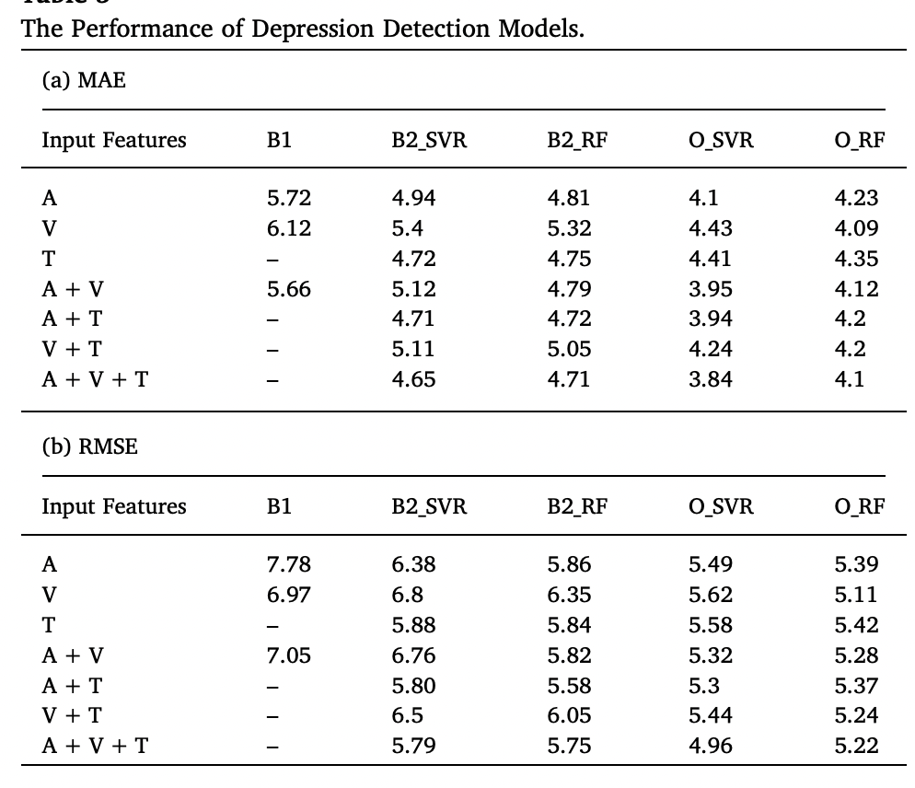
4. Multimodal vs. Bimodal
4.2 What reveals about depression level? The role of multimodal features at the level of interview questions.^{[13]}
Multimodal method outperforms bimodal method
07
[13] Guohou, S., Lina, Z., & Dongsong, Z. (2020). What reveals about depression level? The role of multimodal features at the level of interview questions. Information & Management, 57(7), 103349.

Slide 15
5 LLMs-based Depression Recognition

Slide 16
5. LLMs-based Depression Recognition
5.1 Newly introduced datasets
KID Dataset
Modality: audio
Diagnostic Scale: GRID-HAMD-17 (an upgraded version of the Hamilton Depression Rating Scale)
Time duration: approximately lasted on average 15 minutes
Interview conducted: online by the Private University of Applied Sciences Göttingen.
No online access
08

Slide 17
5. LLMs-based Depression Recognition
5.2 Overview
 | Model (Authors) | Compared Models | Domain | Data Source
1 | MentalBERT | BERT, RoBERTa, BioBERT, ClinicalBERT | Social Media | Reddit (Text)
2 | MentalRoBERTa
3 | MentaLLaMA | BERT, RoBERTa, MentalBERT, MentalRoBERTa, Llama, ChatGPT | Social Media | Reddit, Twitter, SMS (Text)
4 | Chat-Diagnose system (GPT3-based) | MTAL, GRU+VGC_COMMA, MTAN, SetTransformer, Time2Vex Trasnformer, BERT, PTDD | Social Media | Twitter & Weibo (Text)
5 | Mental-Alpaca | Alpaca, Alpaca-LoRA, FLAN-T5, GPT-3.5, GPT-4 | Social Media | Reddit, Twitter, SMS (Text)
6 | Mental-FLAN-T5
7 | DORIS (GPT-3-based) | TF-IDF+XGBoost, HAN, Mood2Content, BERT, FastText, gte-small, MentalRoBERTa, ChatGPT, MentalLLama | Social Media | SWDD Dataset (Text)[31]
8 | Zhang et al., 2024 (Llama-based) | SOTA[23] | Clinical Interview | DAIC-WOZ (Text + speech landmark)
9 | Arcan et al., 2024 | XGBoost, GPT-3.5, Llama-1, Llama-2, Distil-RoBERT | Clinical Interview | DAIC-WOZ(Text)
10 | Ohse et al., 2024 | BERT, GPT-3.5, GPT-4, and Llama2 13b | Clinical Interview | KID dataset (Text)
11 | Agrawal et al., 2024 | GPT-4, Llama 2, and Gemini | Clinical Interview | RMHD and DAIC-WOZ
12 | Hadzic et al., 2024 | BERT, GPT-3.5 and GPT-4 | Clinical Interview | DAIC-WOZ, Simulated, KID dataset
13 | Sadeghi et al., 2023 | GPT 3.5 Turbo | Clinical Interview | E-DAIC
14 | Danner et al., 2024 | BERT, GPT-3.5 and GPT-4 | Clinical Interview | DAIC-WOZ
Table 4: comparison of LLMs-based Methods in Depression Detection
09
[27] Yang, K., Zhang, T., Kuang, Z., Xie, Q., & Ananiadou, S. (2023). Mentalllama: Interpretable mental health analysis on social media with large language models. arXiv preprint arXiv:2309.13567.
[28] Ji, S., Zhang, T., Ansari, L., Fu, J., Tiwari, P., & Cambria, E. (2021). Mentalbert: Publicly available pretrained language models for mental healthcare. arXiv preprint arXiv:2110.15621.
[29] Lan, X., Cheng, Y., Sheng, L., Gao, C., & Li, Y. (2024). Depression Detection on Social Media with Large Language Models. arXiv preprint arXiv:2403.10750.
[30] Arcan, M., Niland, P. D., & Delahunty, F. (2024). An Assessment on Comprehending Mental Health through Large Language Models. arXiv preprint arXiv:2401.04592.
[31] Yicheng Cai, Haizhou Wang, Huali Ye, Yanwen Jin, and Wei Gao. Depression detection on online social network with multivariate time series feature of user depressive symptoms. Expert Systems with Applications, 217:119538, 2023.
[32] Xu, X., Yao, B., Dong, Y., Gabriel, S., Yu, H., Hendler, J., ... & Wang, D. (2024). Mental-LLM: Leveraging Large Language Models for Mental Health Prediction via Online Text Data. Proceedings of the ACM on Interactive, Mobile, Wearable and Ubiquitous Technologies, 8(1), 1-32.

Slide 18
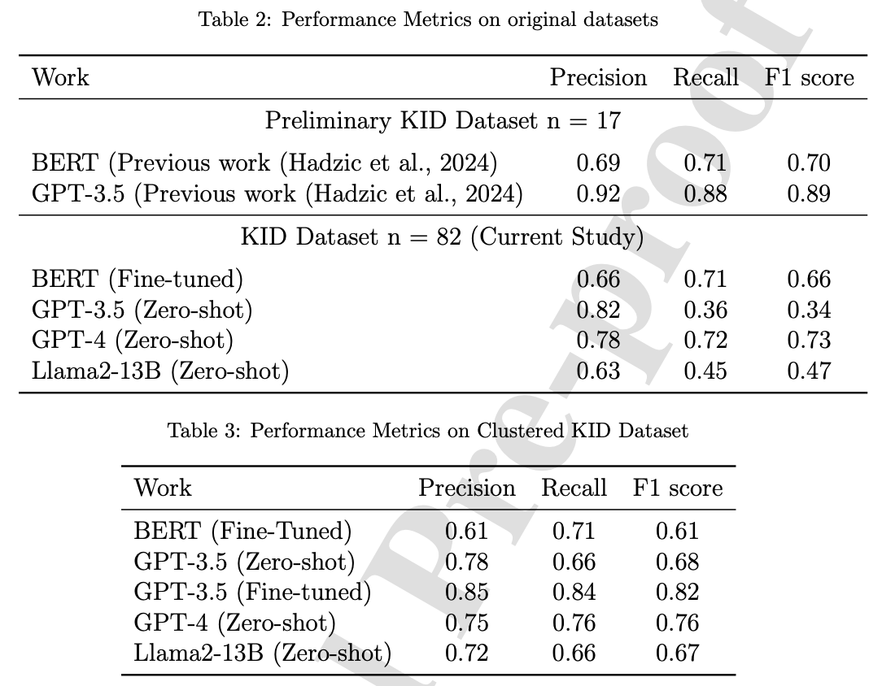
5. LLMs-based Depression Recognition
5.2 Zero-shot strike: Testing the generalisation capabilities of out-of-the-box LLM models for depression detection: Exploring the Potential of LLMs for Depression Detection in Clinical Data ^{[35]}
Highlights
Dataset: KID dataset – self-collected (PHQ 8)
Models compared: BERT, GPT-3.5, GPT-4, and Llama2 13b
Various approaches explored: Zero-shot testing, fine-tuning, and novel cluster idea
Zero-shot GPT-4 and Fine-tuned GPT-3.5 exhibited superior performance.
Llama2 13b as an open-source model showcases significant potential.
08
[35] Ohse, J., Hadžić, B., Mohammed, P., Peperkorn, N., Danner, M., Yorita, A., ... & Shiban, Y. (2024). Zero-shot strike: Testing the generalisation capabilities of out-of-the-box LLM models for depression detection. Computer Speech & Language, 101663.

Slide 19
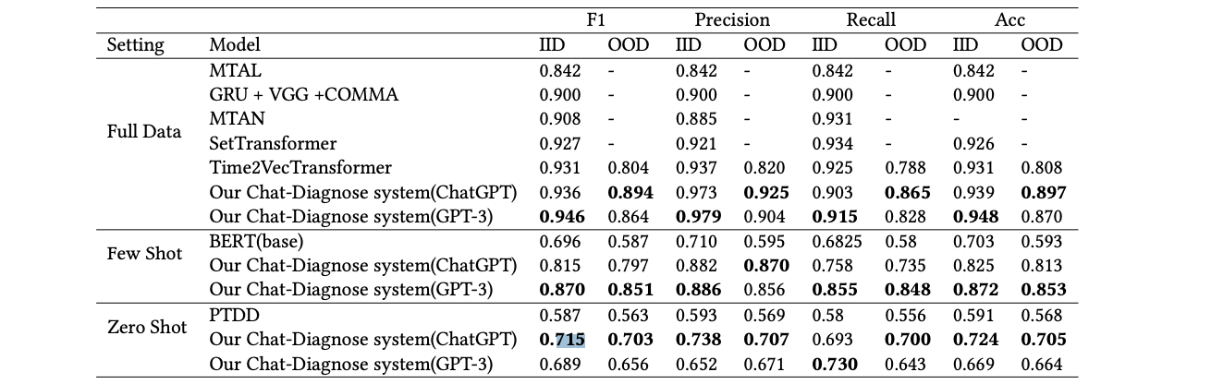
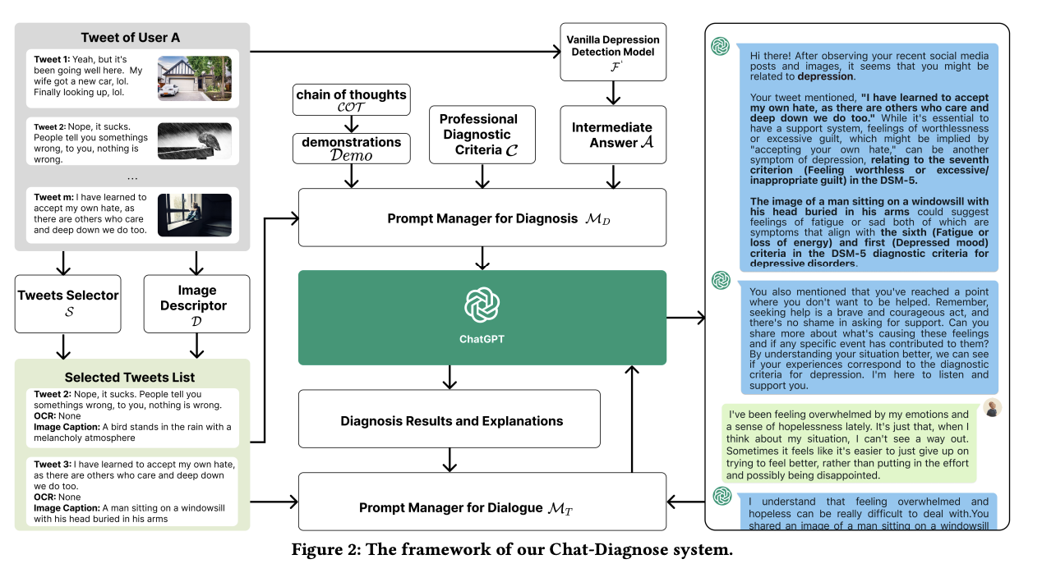
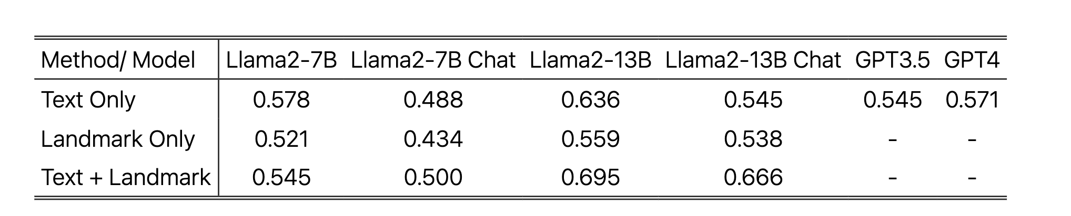
4. LLMs-based Depression Recognition
4.2 Depression Detection on Social Media with LLMs
(1) Chat-Diagnose system^{[25]}
Results using social media in ChatGPT:
Model: ChatGPT, GPT3
Modalities: Text
Dataset: Twitter & Weibo
Table 7: Experiment Results^{[25]}
Results using DAIC-WOZ in ChatGPT^{[24]}
Table 5: F1-scores for the different LLM models^{[24]}
Figure 4: The framework of the Chat-Diagnose system^{[25]}
Social media data outperforms the DAIC-WOZ dataset in ChatGPT
06
[25] Qin, W., Chen, Z., Wang, L., Lan, Y., Ren, W., & Hong, R. (2023). Read, diagnose and chat: Towards explainable and interactive LLMs-augmented depression detection in social media. arXiv preprint ar

Slide 20
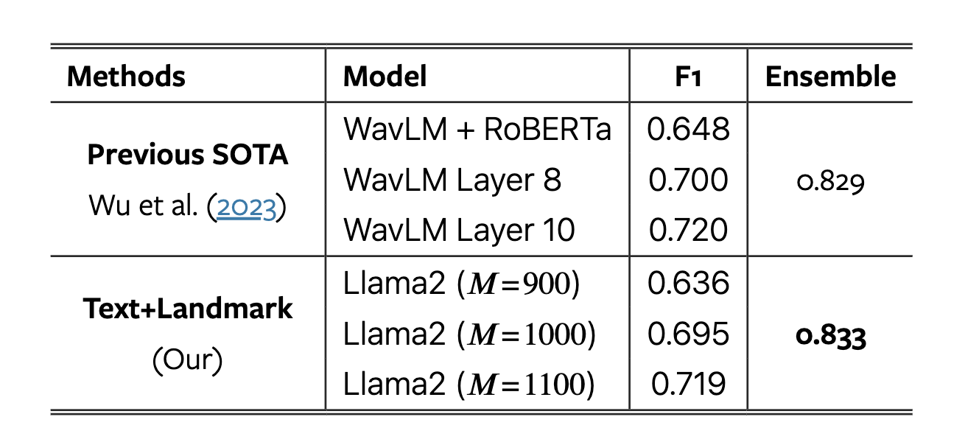
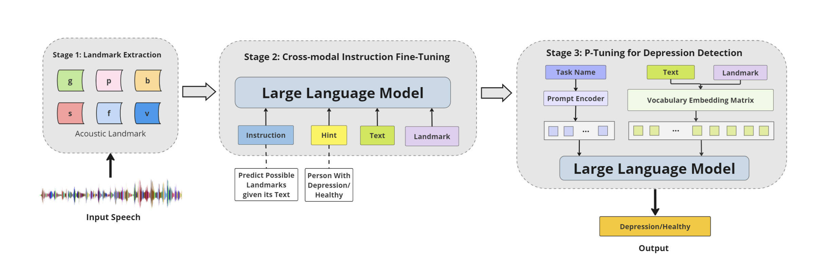
5. LLMs-based Depression Recognition
5.1 When LLMs Meets Acoustic Landmarks: An Efficient Approach to Integrate Speech into Large Language Models for Depression Detection
(1) Text + Speech landmark in Llama^{[24]}
Results:
Model: Llama 2-7b, Llama 2-13b
Modalities: Text + Speech landmark
Data Augmentation: Sub-dialogue shuffling
Dataset: DAIC-WOZ
Table 5: F1-scores for the different LLM models^{[24]}
Table 6: Comparision with SOTA^{[24]}
Ensembled voting can catch up with SOTA
Potential idea: Pass MFCC codebook into Llama 2
Figure 3: Overview of LLM-Landmark Depression Pipeline^{[24]}
05
[24] Zhang, X., Liu, H., Xu, K., Zhang, Q., Liu, D., Ahmed, B., & Epps, J. (2024). When LLMs Meets Acoustic Landmarks: An Efficient Approach to Integrate Speech into Large Language Models for Depression Detection. arXiv preprint arXiv:2402.13276.
Notes:
Possible direction: 用codebook改进
LLMs are more in text-based and social media
Xiangyu got it with audio banchmark

Slide 21
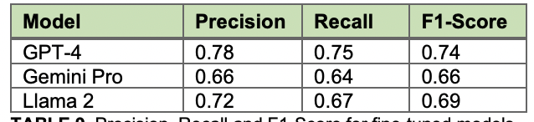
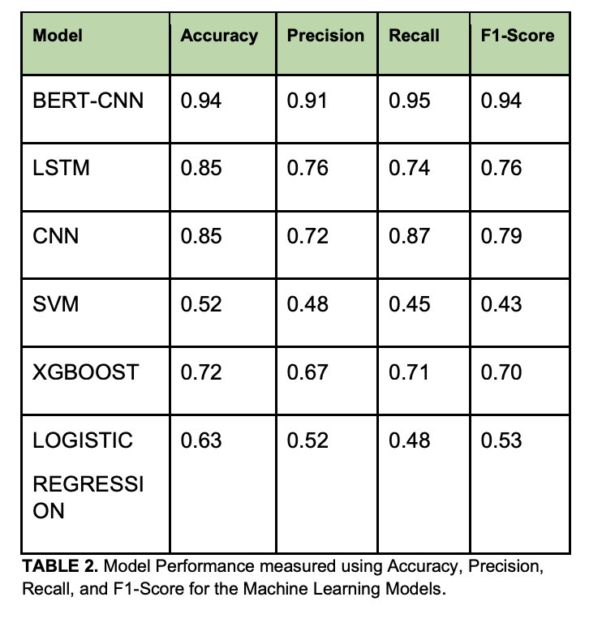
5. LLMs-based Depression Recognition
5.3 Illuminate: A novel approach for depression detection with explainable analysis and proactive therapy using prompt engineering. ^{[36]}
Highlights:
Dataset: RMHD and DAIC-WOZ
Compared models: GPT-4, Llama 2, and Gemini
Each fine-tuned using specially engineered prompts
Use a few-shot prompting methodology
Outperforms traditional ML methods, but lower than DL methods
GPT-4 has the best performance
10
[36] Agrawal, A. (2024). Illuminate: A novel approach for depression detection with explainable analysis and proactive therapy using prompt engineering. arXiv preprint arXiv:2402.05127.

Slide 22
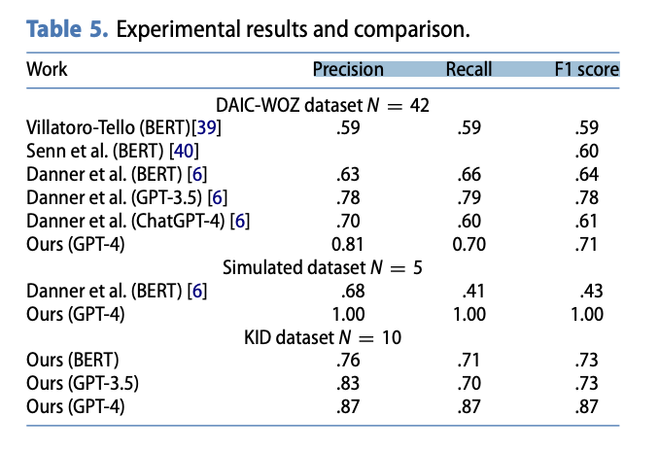
5. LLMs-based Depression Recognition
5.4 Enhancing early depression detection with AI: a comparative use of NLP models. ^{[37]}
Highlights:
Dataset: DAIC-WOZ, Simulated, KID dataset
Compared models: BERT, GPT-3.5 and GPT-4
GPT-4 outperforms both BERT and GPT-3.5 models, even without previous fine-tuning
10
[37] Hadzic, B., Mohammed, P., Danner, M., Ohse, J., Zhang, Y., Shiban, Y., & Rätsch, M. (2024). Enhancing early depression detection with AI: a comparative use of NLP models. SICE Journal of Control, Measurement, and System Integration, 17(1), 135-143.

Slide 23
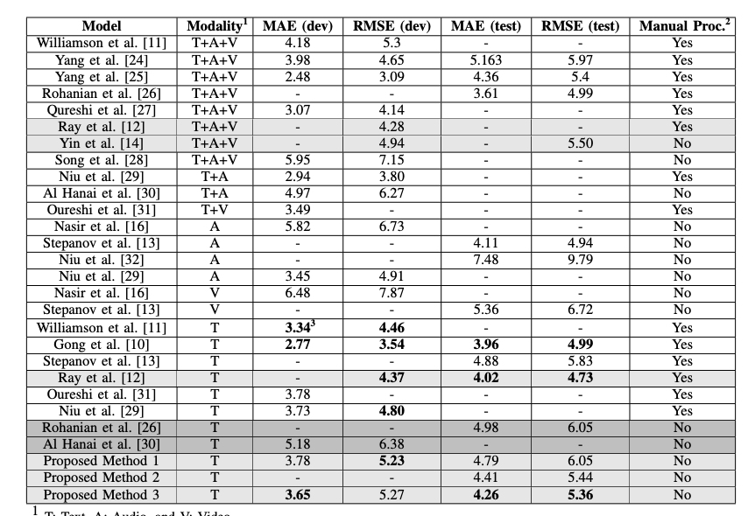
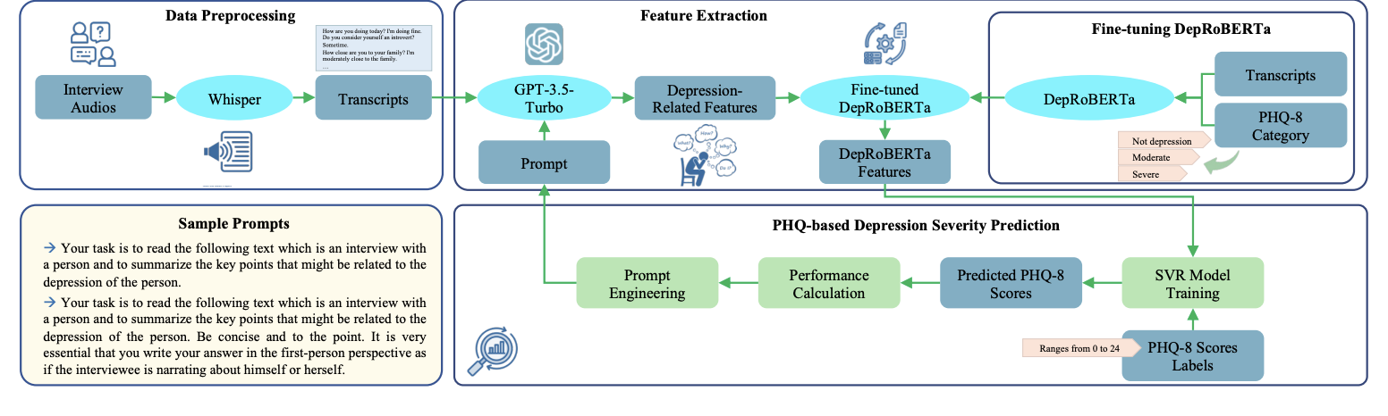
5. LLMs-based Depression Recognition
5.4 Exploring the Capabilities of a Language Model-Only Approach for Depression Detection in Text Data. ^{[38]}
Highlights:
Dataset: E-DAIC
LLM model: GPT 3.5 Turbo
Proposed method 1: not to fine-tune the DepRoBERTa model
Proposed method 2: performed finetuning of the DepRoBERTa model on the entire train set and dev set.
Proposed method 3: optimized the prompt used in method 1 and 2
11
[38] Sadeghi, M., Egger, B., Agahi, R., Richer, R., Capito, K., Rupp, L. H., ... & Eskofier, B. M. (2023, October). Exploring the Capabilities of a Language Model-Only Approach for Depression Detection in Text Data. In 2023 IEEE EMBS International Conference on Biomedical and Health Informatics (BHI) (pp. 1-5). IEEE.

Slide 24
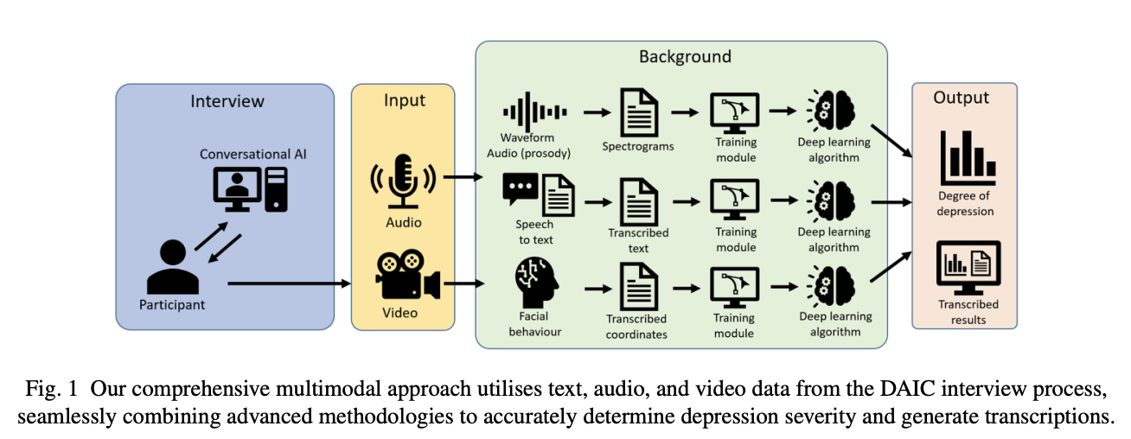
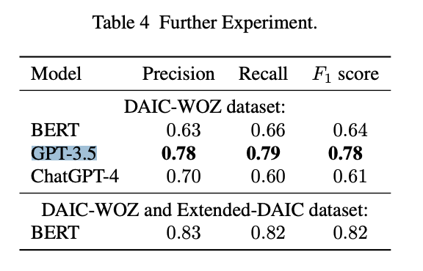
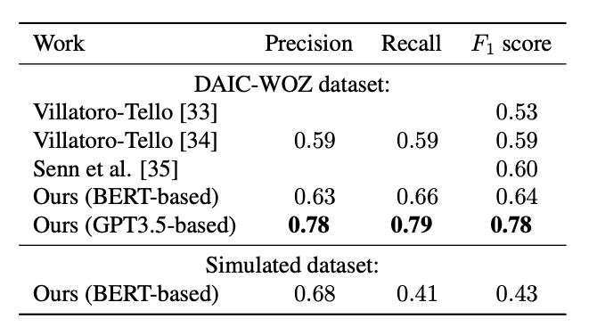
5. LLMs-based Depression Recognition
5.5 Advancing Mental Health Diagnostics: GPT-Based Method for Depression Detection.^{[39]}
Highlights:
Dataset: DAIC-WOZ
Compared models: BERT, GPT-3.5 and GPT-4
GPT-3.5 has the best performance
12
[39] Danner, M., Hadzic, B., Gerhardt, S., Ludwig, S., Uslu, I., Shao, P., ... & Ratsch, M. (2023, September). Advancing Mental Health Diagnostics: GPT-Based Method for Depression Detection. In 2023 62nd Annual Conference of the Society of Instrument and Control Engineers (SICE) (pp. 1290-1296). IEEE.

Slide 25
Plan for next week
01
Review paper writing on LLM-based Methods
02
Start literature review on Transformer-based Methods
03
Keep working on code evaluation on LLMs

Slide 26
Thank you!

