Slide 1
Depression Detection
Name: Yuxin Li
Date: April 24 - May 8

Slide 2
Agenda
01
Compare Different Spatiotemporal Information Modelling Methods in Visual Modality
02
Attention Mechanism in Visual Modality
2.1 Methods without using Spatiotemporal Information Modelling
2.2 Methods using Spatiotemporal Information Modelling -- Attention
2.3 Methods using Spatiotemporal Information Modelling -- Channel-based + Attention
03
Hybrid Feature Extraction Approach in Visual Modality
04
Bimodal (Audio + Vision) Approaches using DAIC-WOZ
05
Plan for Next Week

Slide 3
Overview of Visual Feature Extraction
Local Binary Patterns (LBP), Local Phase Quantization (LPQ), Motion History Histograms (MHH), Space-Time Interest Points (STIP) algorithm
Appearance-based
Face landmarks
Local Models method (CLM), Active Shape Models (ASM), Active Appearance Models (AAMs), 3D Landmark Model Matching, Elastic Bunch Graph Matching (EBFM), Landmark Distribution Model (LDM), Landmark Motion Magnitude (LMM)
Face
AUs
Handcrafted
Mouth and Eyes
(1)
Body
STIP, Divergence-Curl-Shear (DCS)
Without Spatiotemporal information modeling
Pretrained CNN
Feature Extraction
(2)
End-to-End
Attention Module
DNN-based
C3D
(3)
Spatiotemporal information modeling
2D-CNN
Attention Module
Hybrid Approach
(Handcrafted + DNN-based)
Channel-based methods
Attention Module
01
Fig 1: Overview of Visual Feature Extraction
[1] Ashraf, A., Gunawan, T. S., Rahman, F. D. A., Kartiwi, M., & Ismail, N. (2020, September). A summarization of the visual depression databases for depression detection. In 2020 6th International Conference on Wireless and Telematics (ICWT) (pp. 1-6). IEEE.
[2] Pampouchidou, A., Simos, P. G., Marias, K., Meriaudeau, F., Yang, F., Pediaditis, M., & Tsiknakis, M. (2017). Automatic assessment of depression based on visual cues: A systematic review. IEEE Transactions on Affective Computing, 10(4), 445-470.
.

Slide 4
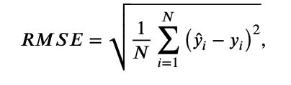
1. Comparison of Spatiotemporal Information Modelling Methods
1.1 C3D, 2D CNN and Channel-based
 | Author(s) | Year | Spatiotemporal information Modeling | Model | RMSE
1 | Zhou et al.^{[3]} | 2021 | / | ResNet-50 + Attention | 8.43
2 | Zhou et al^{[8]} | 2018 | 2D CNN | CNN-based | 8.28
Table 1: Zhou et al.’s work
Fig 1 & 2: The significance of using spatiotemporal information modeling
Fig 2: C3D outperforms 2D CNN
Fig 3: Channel-based outperforms C3D
 | Author(s) | Year | Spatiotemporal information Modelling | Model | RMSE
1 | Melo et al. | 2019 | / | CNN | 8.31
2 | Melo et al. | 2019 | / | ResNet-50 | 8.25
3 | Melo et al. | 2020 | 2D CNN | CNN | 7.97
4 | Melo et al. | 2020 | C3D | CNN | 7.61
5 | Melo et al. | 2021 | C3D | Maximization-Differentiation Network (MDN) | 7.65
Channel-based > C3D > 2D CNN
Table 2: Melo et al.’s work
 | Author(s) | Year | Spatiotemporal information Modeling | Model | RMSE
1 | Niu et al. | 2020 | C3D | RNN | 8.31
2 | Niu et al.^{[6]} | 2022 | Channel-based | CNN | 7.79
3 | Niu et al. ^{[6]} | 2022 | Channel-based | CNN | 7.49
Table 3: Niu et al.’s work
02
[3] Zhou, X., Huang, P., Liu, H., & Niu, S. (2019). Learning content‐adaptive feature pooling for facial depression recognition in videos. Electronics Letters, 55(11), 648-650.
[6] Niu, M., Zhao, Z., Tao, J., Li, Y., & Schuller, B. W. (2022). Dual attention and element recalibration networks for automatic depression level prediction. IEEE Transactions on Affective Computing, 14(3), 1954-1965.
[7] Niu, M., He, L., Li, Y., & Liu, B. (2022). Depressioner: facial dynamic representation for automatic depression level prediction. Expert Systems with Applications, 204, 117512.
[8] X. Zhou, K. Jin, Y. Shang, and G. Guo, “Visually interpretable representation learning for depression recognition from facial images,” IEEE Trans. on Affective Computing, pp. 1–12, 2018.
Notes:
写在文章里 不做ppt

Slide 5
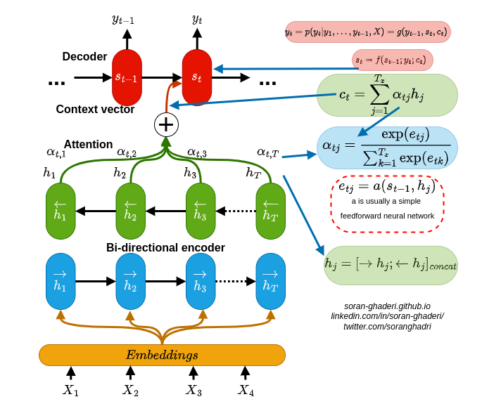
2. Attention Mechanism in Visual Modality
An attention mechanism is an Encoder-Decoder kind of neural network architecture that allows the model to focus on specific sections of the input while executing a task.
03
Image source: https://towardsdatascience.com/rethinking-thinking-how-do-attention-mechanisms-actually-work-a6f67d313f99?gi=223e68061924

Slide 6
Overview of Visual Feature Extraction
Local Binary Patterns (LBP), Local Phase Quantization (LPQ), Motion History Histograms (MHH), Space-Time Interest Points (STIP) algorithm
Appearance-based
Face landmarks
Local Models method (CLM), Active Shape Models (ASM), Active Appearance Models (AAMs), 3D Landmark Model Matching, Elastic Bunch Graph Matching (EBFM), Landmark Distribution Model (LDM), Landmark Motion Magnitude (LMM)
Face
AUs
Handcrafted
Mouth and Eyes
(1)
Body
STIP, Divergence-Curl-Shear (DCS)
Without Spatiotemporal information modeling
Pretrained CNN
Feature Extraction
(2)
End-to-End
Attention Module
DNN-based
C3D
(3)
Spatiotemporal information modeling
2D-CNN
Attention Module
Hybrid Approach
(Handcrafted + DNN-based)
Channel-based methods
Attention Module
04
Fig 1: Overview of Visual Feature Extraction
[1] Ashraf, A., Gunawan, T. S., Rahman, F. D. A., Kartiwi, M., & Ismail, N. (2020, September). A summarization of the visual depression databases for depression detection. In 2020 6th International Conference on Wireless and Telematics (ICWT) (pp. 1-6). IEEE.
[2] Pampouchidou, A., Simos, P. G., Marias, K., Meriaudeau, F., Yang, F., Pediaditis, M., & Tsiknakis, M. (2017). Automatic assessment of depression based on visual cues: A systematic review. IEEE Transactions on Affective Computing, 10(4), 445-470.
.

Slide 7
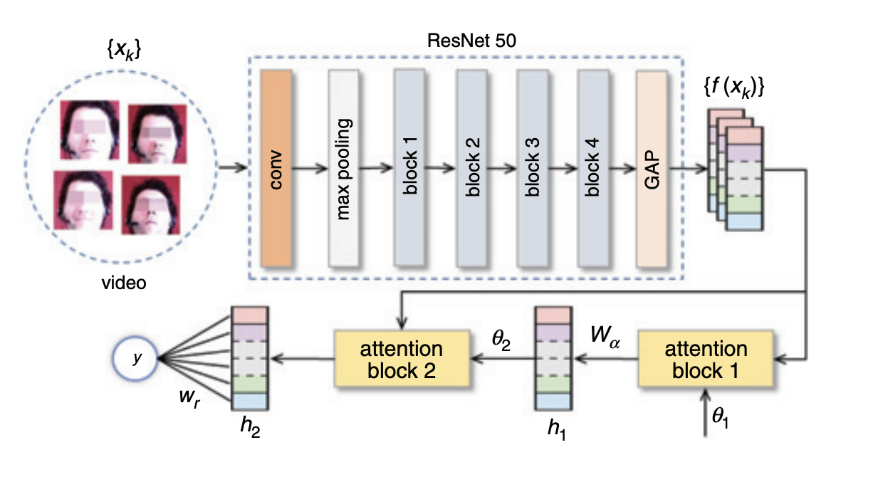
2. Attention Mechanism in Visual Modality
2.1 Methods without using Spatiotemporal Information Modelling
(1) DAN^{[3]}:
 | Author(s) | Year | Model | Datasets | RMSE
1 | Kang et al. | 2017 | Pre-trained CNN | AVEC 2014 | 9.43
2 | Melo et al. | 2019 | CNN |  | 8.31
3 | Melo et al. | 2019 | ResNet-50 |  | 8.25
4 | Zhou et al.^{[3]} | 2019 | ResNet-50 + Attention |  | 8.43
Fig 2: Architecture of DAN^{[3]}
Table 4: Comparison with methods without attention mechanism
05
[3] Zhou, X., Huang, P., Liu, H., & Niu, S. (2019). Learning content‐adaptive feature pooling for facial depression recognition in videos. Electronics Letters, 55(11), 648-650.
[4] Liu, Z., Yuan, X., Li, Y., Shangguan, Z., Zhou, L., & Hu, B. (2023). PRA-Net: Part-and-Relation Attention Network for depression recognition from facial expression. Computers in Biology and Medicine, 157, 106589.
Notes:
which consists of three modules: feature pre-extractor, part partition and part-and-relation (PR) attention. The feature pre-extractor is to obtain mid-level features and consists of shallow convolution layers of Resnet. Then, the part partition is designed to process the mid-level feature maps to acquire local and global information. Specifically, the feature map is divided into 𝑛 + 1 part feature maps: 𝑛 local feature maps and a copy of the original feature maps. They are fed into the 𝑛 + 1 branch networks for further extraction of high-level features.
The weights of input features are computed by part attention and are refined by relation attention.
Part attention is applied to assign rough weights to part features and compute weighted features

Slide 8
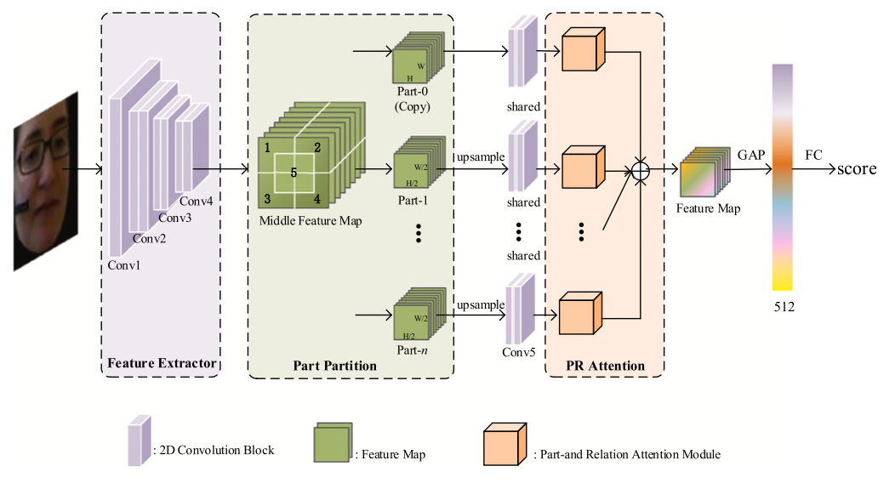
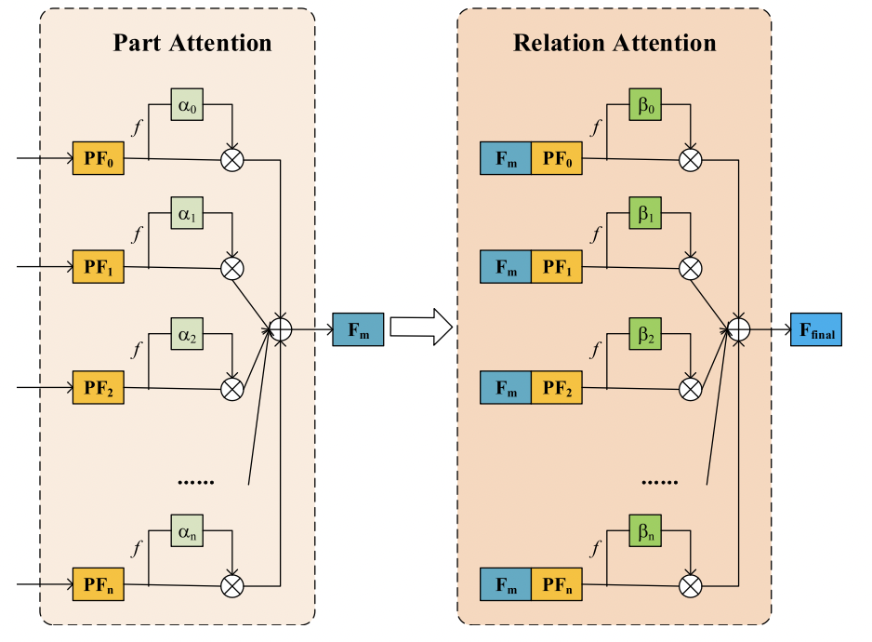
2. Attention Mechanism in Visual Modality
2.1 Methods without using Spatiotemporal Information Modelling
(1) DAN^{[3]}:
 | Author(s) | Year | Model | Datasets | RMSE
1 | Kang et al. | 2017 | Pre-trained CNN | AVEC 2014 | 9.43
2 | Melo et al. | 2019 | CNN |  | 8.31
3 | Melo et al. | 2019 | ResNet-50 |  | 8.25
4 | Zhou et al.^{[3]} | 2019 | ResNet-50 + Attention |  | 8.43
5 | Liu et al.^{[4]} | 2023 | Resnet18+Attention |  | 7.59
Fig 2: Architecture of DAN^{[3]}
(2) PRA-Net^{[4]}:
Table 4: Comparison with methods without attention mechanism
06
Fig 3: Architecture of PRA-Net^{[4]}
[3] Zhou, X., Huang, P., Liu, H., & Niu, S. (2019). Learning content‐adaptive feature pooling for facial depression recognition in videos. Electronics Letters, 55(11), 648-650.
[4] Liu, Z., Yuan, X., Li, Y., Shangguan, Z., Zhou, L., & Hu, B. (2023). PRA-Net: Part-and-Relation Attention Network for depression recognition from facial expression. Computers in Biology and Medicine, 157, 106589.
Notes:
which consists of three modules: feature pre-extractor, part partition and part-and-relation (PR) attention. The feature pre-extractor is to obtain mid-level features and consists of shallow convolution layers of Resnet. Then, the part partition is designed to process the mid-level feature maps to acquire local and global information. Specifically, the feature map is divided into 𝑛 + 1 part feature maps: 𝑛 local feature maps and a copy of the original feature maps. They are fed into the 𝑛 + 1 branch networks for further extraction of high-level features.
The weights of input features are computed by part attention and are refined by relation attention.
Part attention is applied to assign rough weights to part features and compute weighted features

Slide 9
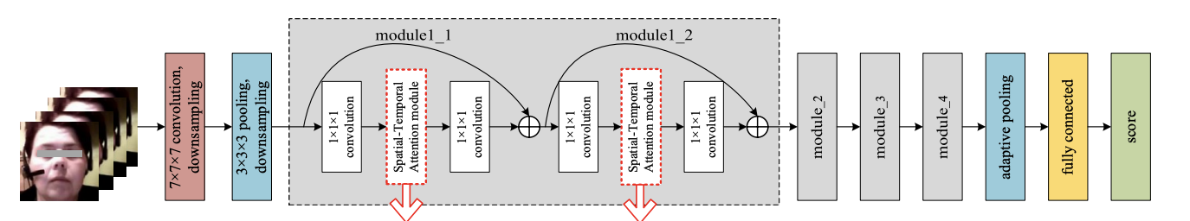
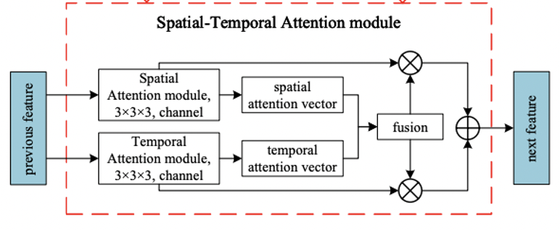
2. Attention Mechanism in Visual Modality
2.2 Methods using Spatiotemporal Information Modelling -- Attention
(3) STA-DRN^{[5]}
 | Author(s) | Year | Spatiotemporal information Modeling | Model | RMSE
1 | Zhou et al. | 2019 | / | ResNet-50 + Attention | 8.43
2 | Liu et al. | 2023 | / | Resnet18+Attention | 7.59
3 | Pan et al^{[5]} | 2024 | CNN+Attention | ResNet | 7.55
Table 5: Comparison with methods without spatiotemporal information modeling on AVEC 2014
 | Author(s) | Year | Spatiotemporal Information Modeling | Model | RMSE
1 | AI et al. | 2018 | C3D | RNN | 9.28
2 | Melo et al. | 2020 |  | CNN | 7.61
3 | Zhou et al. | 2020 |  | DCNN | 8.25
4 | Niu et al. | 2020 |  | RNN | 8.31
5 | Melo et al. | 2021 |  | MDN | 7.65
6 | Xu et al. | 2021 |  | GNN | 7.57
7 | He et al. | 2022 |  | CNN | 8.30
8 | Chen et al. | 2021 | 2D CNN | CNN | 8.13
9 | Melo et al. | 2020 |  | CNN | 7.97
10 | Uddin et al. | 2020 |  | BiLSTM | 8.93
11 | Pan et al^{[5]} | 2024 | CNN+Attention | ResNet | 7.55
Fig 4: Spatial-Temporal Attention Network for Depression Recognition from Facial Videos^{[5]}
Future work: incorporates not only video data but also audio, electroencephalogram (EEG), and magnetic resonance imaging (MRI)
Table 6: Comparison with methods using spatiotemporal information modeling on AVEC 2014
07
[5] Pan, Y., Shang, Y., Liu, T., Shao, Z., Guo, G., Ding, H., & Hu, Q. (2024). Spatial–temporal attention network for depression recognition from facial videos. Expert Systems with Applications, 237, 121410.
Table: Comparison with previous vision-based methods on AVEC 2013 and AVEC 2014
Notes:
Apart from C3D, 2D CNN, Channel-based Spatiotemporal information modeling. Recently, papers are using Spatial-Temporal Attention Module to extract features. Specifically, by assigning adaptive weights and fusing the spatial and temporal features, thereby enhancing the ability to capture both global and local information.

Slide 10
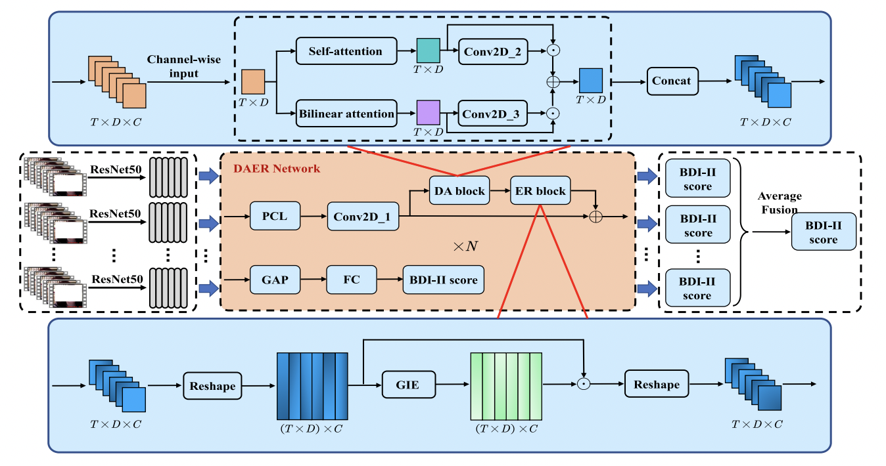
2. Attention Mechanism in Visual Modality
2.3 Methods using Spatiotemporal Information Modelling – Channel-based + Attention
(4) DEAR^{[6]}
DA Block: Extract The temporal information
Table 7: Comparison with different Spatiotemporal information Modeling methods in AVEC 2024
 | Author(s) | Year | Spatiotemporal information Modeling | Model | RMSE
1 | AI et al. | 2018 | C3D | RNN | 9.28
2 | Melo et al. | 2020 |  | CNN | 7.61
3 | Zhou et al. | 2020 |  | DCNN | 8.25
4 | Niu et al. | 2020 |  | RNN | 8.31
5 | Melo et al. | 2021 |  | MDN | 7.65
6 | Xu et al. | 2021 |  | GNN | 7.57
7 | He et al. | 2022 |  | CNN | 8.30
8 | Chen et al. | 2021 | 2D CNN | CNN | 8.13
9 | Melo et al. | 2020 |  | CNN | 7.97
10 | Uddin et al. | 2020 |  | BiLSTM | 8.93
11 | Pan et al | 2024 | Attention | ResNet | 7.55
12 | Niu et al.^{[6]} | 2022 | Channel-based + Attention | CNN | 7.79
ER Block: improve the representation ability of network
Fig 5: Architecture of DEAR^{[6]}
08
[6] Niu, M., Zhao, Z., Tao, J., Li, Y., & Schuller, B. W. (2022). Dual attention and element recalibration networks for automatic depression level prediction. IEEE Transactions on Affective Computing, 14(3), 1954-1965.
[7] Niu, M., He, L., Li, Y., & Liu, B. (2022). Depressioner: facial dynamic representation for automatic depression level prediction. Expert Systems with Applications, 204, 117512.
Notes:
DA Block: Extract The temporal information from each channel of the tensor using the self-attention
ER Block: improve the representation ability of network by recalibrating elements of the input tensor.
Depressioner: Graph Convolution Embedding (GCE) block and MultiScale Vectorization (MSV) block. The GCE block treats each channel as a node in the graph and constructs the corresponding adjacency matrix. Furthermore, the GCE block adopts the graph convolution operation to examine the relationship among channels to take advantage of each channel and highlight useful elements. The MSV block combines the dilated convolution and attention mechanism to process each channel to extract the multi-scale representation of depression cues along temporal dimension. Moreover, it aggregates these representations into the vectorization result of tensor along channel dimension

Slide 11
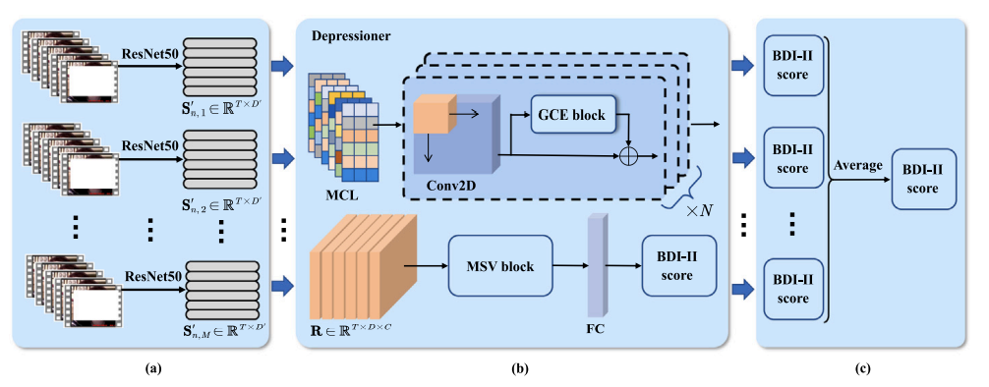
2. Attention Mechanism in Visual Modality
2.3 Methods using Spatiotemporal Information Modelling – Channel-based + Attention
(4) DEAR^{[6]}
DA Block: Extract The temporal information
Table 7: Comparison with different Spatiotemporal information Modeling methods in AVEC 2024
 | Author(s) | Year | Spatiotemporal information Modeling | Model | RMSE
1 | AI et al. | 2018 | C3D | RNN | 9.28
2 | Melo et al. | 2020 |  | CNN | 7.61
3 | Zhou et al. | 2020 |  | DCNN | 8.25
4 | Niu et al. | 2020 |  | RNN | 8.31
5 | Melo et al. | 2021 |  | MDN | 7.65
6 | Xu et al. | 2021 |  | GNN | 7.57
7 | He et al. | 2022 |  | CNN | 8.30
8 | Chen et al. | 2021 | 2D CNN | CNN | 8.13
9 | Melo et al. | 2020 |  | CNN | 7.97
10 | Uddin et al. | 2020 |  | BiLSTM | 8.93
11 | Pan et al | 2024 | Attention | ResNet | 7.55
12 | Niu et al.^{[6]} | 2022 | Channel-based + Attention | CNN | 7.79
13 | Niu et al.^{[7]} | 2022 |  | CNN | 7.49
ER Block: improve the representation ability of network
(5) Depressioner^{[7]}
Graph Convolution Embedding (GCE)
MultiScale Vectorization (MSV)
09
[6] Niu, M., Zhao, Z., Tao, J., Li, Y., & Schuller, B. W. (2022). Dual attention and element recalibration networks for automatic depression level prediction. IEEE Transactions on Affective Computing, 14(3), 1954-1965.
[7] Niu, M., He, L., Li, Y., & Liu, B. (2022). Depressioner: facial dynamic representation for automatic depression level prediction. Expert Systems with Applications, 204, 117512.
Notes:
DA Block: Extract The temporal information from each channel of the tensor using the self-attention
ER Block: improve the representation ability of network by recalibrating elements of the input tensor.
Depressioner: Graph Convolution Embedding (GCE) block and MultiScale Vectorization (MSV) block. The GCE block treats each channel as a node in the graph and constructs the corresponding adjacency matrix. Furthermore, the GCE block adopts the graph convolution operation to examine the relationship among channels to take advantage of each channel and highlight useful elements. The MSV block combines the dilated convolution and attention mechanism to process each channel to extract the multi-scale representation of depression cues along temporal dimension. Moreover, it aggregates these representations into the vectorization result of tensor along channel dimension

Slide 12
Overview of Visual Feature Extraction
Local Binary Patterns (LBP), Local Phase Quantization (LPQ), Motion History Histograms (MHH), Space-Time Interest Points (STIP) algorithm
Appearance-based
Face landmarks
Local Models method (CLM), Active Shape Models (ASM), Active Appearance Models (AAMs), 3D Landmark Model Matching, Elastic Bunch Graph Matching (EBFM), Landmark Distribution Model (LDM), Landmark Motion Magnitude (LMM)
Face
AUs
Handcrafted
Mouth and Eyes
(1)
Body
STIP, Divergence-Curl-Shear (DCS)
C3D
Feature Extraction
(2)
Spatiotemporal information modeling
2D-CNN
DNN-based
Channel-based methods
Attention Module
Without Spatiotemporal information modeling
Attention Module
(3)
Pretrained CNN
Hybrid Approach
(Handcrafted + DNN-based)
End-to-End
Attention Module
10
Fig 1: Overview of Visual Feature Extraction
[1] Ashraf, A., Gunawan, T. S., Rahman, F. D. A., Kartiwi, M., & Ismail, N. (2020, September). A summarization of the visual depression databases for depression detection. In 2020 6th International Conference on Wireless and Telematics (ICWT) (pp. 1-6). IEEE.
[2] Pampouchidou, A., Simos, P. G., Marias, K., Meriaudeau, F., Yang, F., Pediaditis, M., & Tsiknakis, M. (2017). Automatic assessment of depression based on visual cues: A systematic review. IEEE Transactions on Affective Computing, 10(4), 445-470.
.

Slide 13
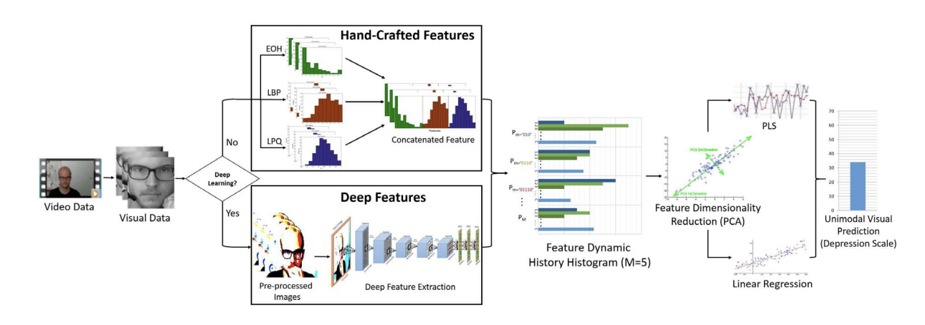
3. Hybrid Feature Extraction Approach in Visual Modality
Fig 7: Architecture of Hybrid Feature Extraction Approach^{[8]}
 | Author | Feature Extraction | Spatiotemporal information Modeling | Model | RMSE
1 | Jan et al., 2017^{[8]} | Hybrid | / | Pre-trained CNN +PLS | 7.43
2 | Niu et al., 2022^{[7]} | DNN-based | Channel-based + Attention | CNN | 7.49
3 | Li et al., 2024 ^{[9]} | Handcrafted | Attention | CNN | 7.90
Hybrid Approach outperform the DNN-based approach in regression task in AVEC 2014
Table 7: Comparison with the state-of-art in DNN-based visual feature extraction
11
[8] Jan, A., Meng, H., Gaus, Y. F. B. A., & Zhang, F. (2017). Artificial intelligent system for automatic depression level analysis through visual and vocal expressions. IEEE Transactions on Cognitive and Developmental Systems, 10(3), 668-680.
[9] Li, X., Yi, X., Lu, L., Wang, H., Zheng, Y., Han, M., & Wang, Q. (2024). TSFFM: Depression detection based on latent association of facial and body expressions. Computers in Biology and Medicine, 168, 107805.
Notes:
Last week I introduced Hand

Slide 14
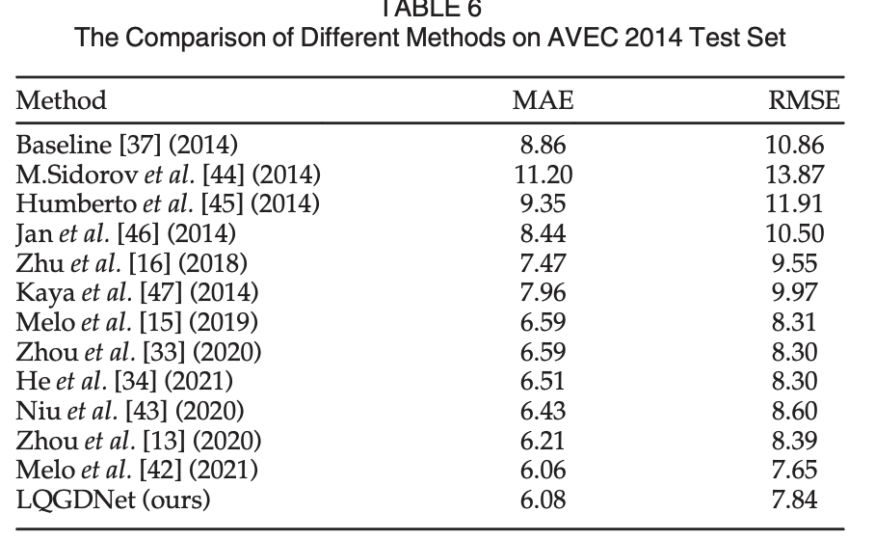
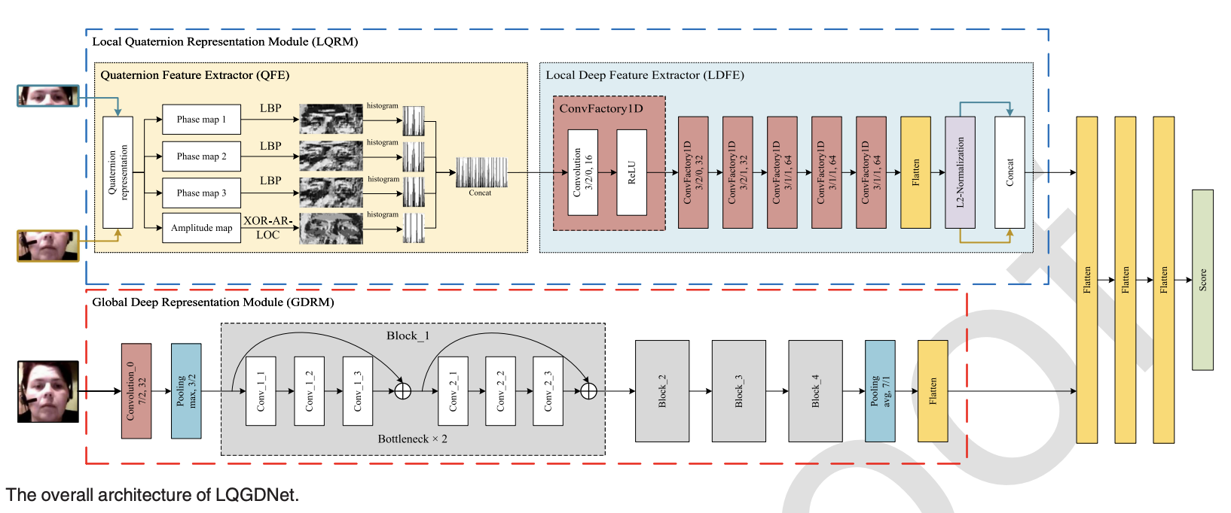
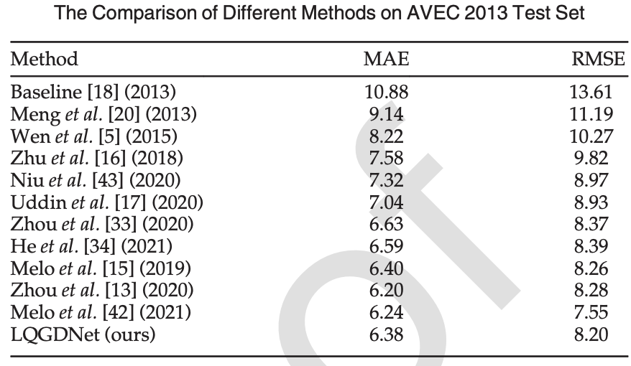
3. Hybrid Feature Extraction Approach in Visual Modality
LQGDNet: A Local Quaternion and Global Deep Network for Facial Depression Recognition
12
[10] Shang, Y., Pan, Y., Jiang, X., Shao, Z., Guo, G., Liu, T., & Ding, H. (2021). LQGDNet: A local quaternion and global deep network for facial depression recognition. IEEE Transactions on Affective Computing, 14(3), 2557-2563.

Slide 15
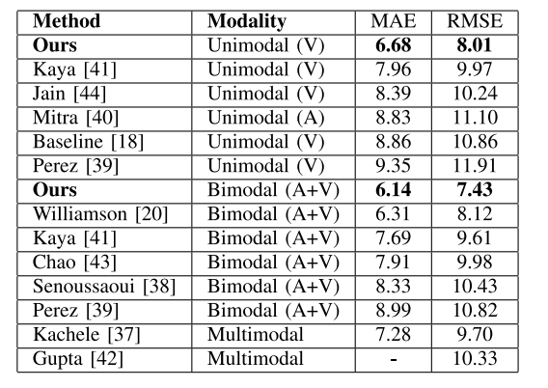
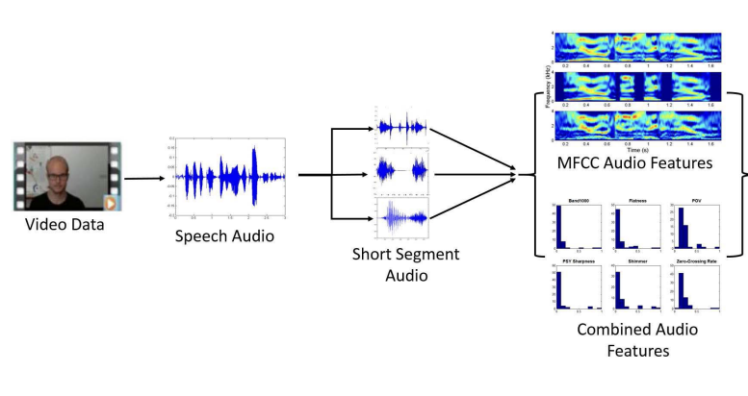
5. Bimodal (Audio + Vision) Approach using DAIC-WOZ
Results:
BDI-II
Scores
[41] H. Kaya, F. Çilli, and A. A. Salah, “Ensemble CCA for continuous emotion prediction,” in Proc. 4th ACM Int. Workshop Audio/Vis. Emotion Challenge (AVEC), Orlando, FL, USA, 2013, pp. 19–26.
[40] V. Mitra et al., “The SRI AVEC-2014 evaluation system,” in Proc. ACM Int. Conf. Multimedia, Orlando, FL, USA, 2014, pp. 93–101.
[44] V. Jain, J. L. Crowley, A. K. Dey, and A. Lux, “Depression estimation using audiovisual features and Fisher vector encoding,” in Proc. 4th ACM Int. Workshop Audio/Vis. Emotion Challenge (AVEC), Orlando, FL, USA, 2014, pp. 87–91.
[18] M. F. Valstar et al., “AVEC 2014: 3D dimensional affect and depression recognition challenge,” in Proc. Int. Conf. ACM Multimedia Audio/Vis. Emotion Challenge Workshop, Orlando, FL, USA, 2014, pp. 3–10.
[39] H. Pérez Espinosa et al., “Fusing affective dimensions and audio-visual features from segmented video for depression recognition: INAOEBUAP’s participation at AVEC’14 challenge,” in Proc. 4th Int. Workshop Audio/Vis. Emotion Challenge (AVEC), Orlando, FL, USA, 2014, pp. 49–55.
[20] J. R. Williamson, T. F. Quatieri, B. S. Helfer, G. Ciccarelli, and D. D. Mehta, “Vocal and facial biomarkers of depression based on motor incoordination and timing,” in Proc. 4th ACM Int. Workshop Audio/Vis. Emotion Challenge (AVEC), Orlando, FL, USA, 2013, pp. 41–47.
[43] L. Chao, J. Tao, M. Yang, and Y. Li, “Multi task sequence learning for depression scale prediction from video,” in Proc. Int. Conf. Affective Comput. Intell. Interact. (ACII), Xi’an, China, 2015, pp. 526–531.
[38] M. Senoussaoui, M. Sarria-Paja, J. F. Santos, and T. H. Falk, “Model fusion for multimodal depression classification and level detection,” in Proc. 4th Int. Workshop Audio/Vis. Emotion Challenge, Orlando, FL, USA, 2014, pp. 57–63.
[37] M. Kächele, M. Schels, and F. Schwenker, “Inferring depression and affect from application dependent meta knowledge,” in Proc. 4th Int. Workshop Audio/Vis. Emotion Challenge (AVEC), Orlando, FL, USA, 2014, pp. 41–48.
[42] R. Gupta et al., “Multimodal prediction of affective dimensions and depression in human–computer interactions categories and subject descriptors,” in Proc. 4th ACM Int. Workshop Audio/Vis. Emotion Challenge (AVEC), Orlando, FL, USA, 2014, pp. 33–40.
[8] Jan, A., Meng, H., Gaus, Y. F. B. A., & Zhang, F. (2017). Artificial intelligent system for automatic depression level analysis through visual and vocal expressions. IEEE Transactions on Cognitive and Developmental Systems, 10(3), 668-680.
01
Notes:
Last week I introduced Hand

Slide 16
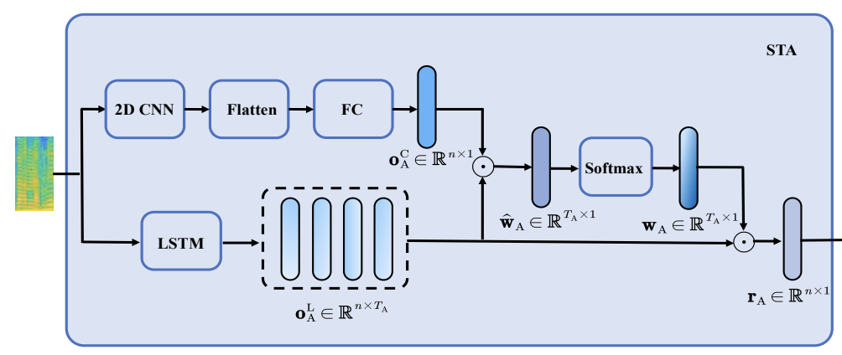
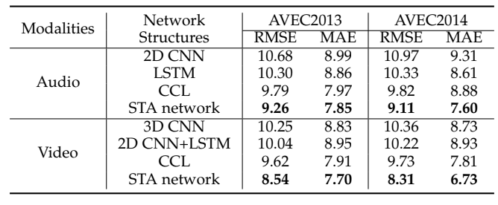
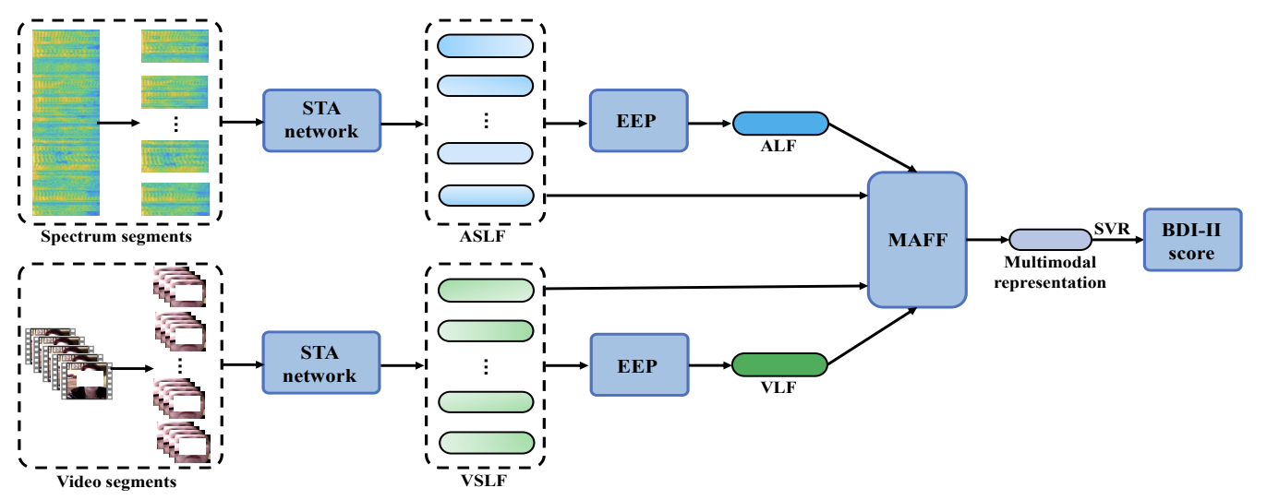
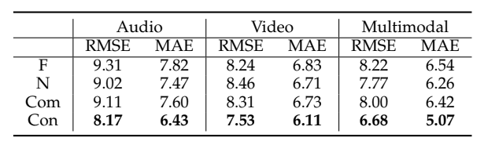
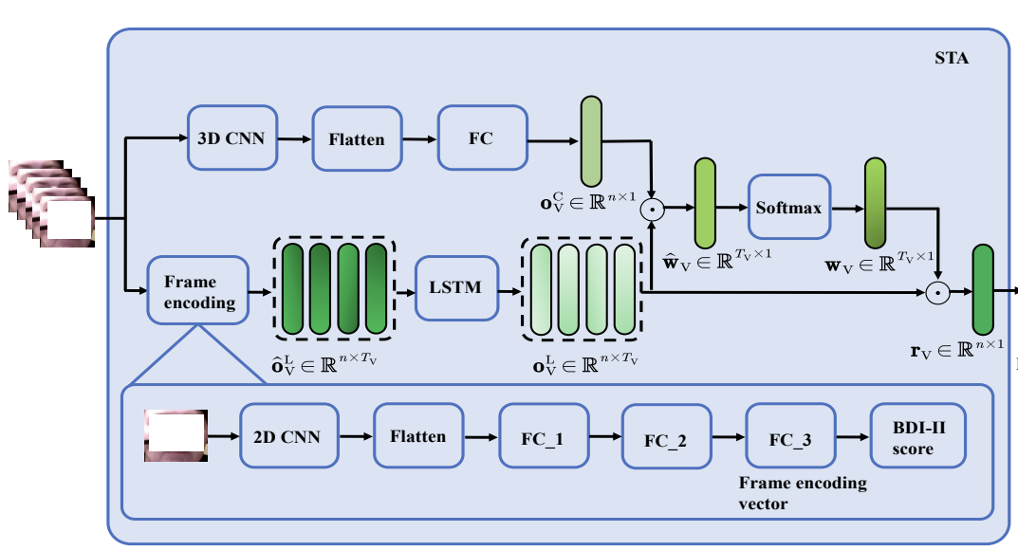
5. Bimodal (Audio + Vision) Approach using DAIC-WOZ
Author(s) | Year | Model | Modalities | RMSE
Niu et al. | 2020 | STA | V+A | 6.68
Jan et al. | 2017 | Pre-trained CNN +PLS | V+A | 7.43
02
[8] Jan, A., Meng, H., Gaus, Y. F. B. A., & Zhang, F. (2017). Artificial intelligent system for automatic depression level analysis through visual and vocal expressions. IEEE Transactions on Cognitive and Developmental Systems, 10(3), 668-680.
[9] Niu, M., Tao, J., Liu, B., Huang, J., & Lian, Z. (2020). Multimodal spatiotemporal representation for automatic depression level detection. IEEE transactions on affective computing, 14(1), 294-307.

Slide 17
5. Bimodal (Audio + Vision)
(1) Classification
Author(s) | Year | Model | Modalities | Datasets | Result
Alghowinem et al. | 2016 | SVM | Visual and Audio | BlackDog | Rec 0.883
Alghowinem et al. | 2016 | SVM | Visual | BlackDog | Rec 0.783
Author(s) | Year | Model | Modalities | Datasets | Result
Dibeklioğlu et al. | 2017 | Stacked Denoising Autoencoders (SDA) | Visual and Audio | Pittsburgh | Acc 0.787
Dibeklioğlu et al. | 2017 | SDA | Visual | Pittsburgh | Acc 0.726
(1) Regression
Author(s) | Year | Model | Modalities | Datasets | Result
Niu et al. | 2020 | STA | Visual and Audio | AVEC 2014 | RMSE 6.68
Niu et al. | 2020 | STA | Visual | AVEC 2014 | RMSE 7.53
Niu et al. | 2020 | STA | Audio | AVEC 2014 | RMSE 8.17
03
S. Alghowinem, et al., “Multimodal depression detection: Fusion analysis of paralinguistic, head pose and eye gaze behaviors,” IEEE Trans. Affect. Comput., 2016, doi: 10.1109/TAFFC.2016.2634527.
H. Dibeklioglu, Z. Hammal, and J. F. Cohn, “Dynamic multimodal measurement of depression severity using deep autoencoding,” IEEE J. Biomed. Health Informat., 2017, doi: 10.1109/JBHI.2017.2676878.

Slide 18
Plan for next week
01
Literature review and writing on Feature Fusion Section
Including bimodal (A+V; A+T) and multimodal (A+V+T)
02
Evaluate LLMs in DAICWOZ dataset
(
03
)
Literature review and writing on LLMs

Slide 19
Thank you!

