Slide 1
Automated Depression Recognition: A Multi-modal Deep Learning Framework to recognize depression from audio and text
Name: Yuxin Li
Date: April 5- April 17

Slide 2
Agenda
01
Depression Diagnostic Scales
02
Audio-based Depression Detection
2.1 Methods summary in ML/DL methods
2.2 The State-of-Art in DAIC-WOZ
03
LLMs-based Methods in Depression Detection
04
Other possible modalities
4.1 Smartphone usage features
4.2 Physiological Signals
Notes:
Added 20 good papers that I read before , especially, in audio and multimodal. I also added a few in text-based method and have some interesting findings.
Also, I added 10 LLMs based paper I read this week and also have some findings to share

Slide 3
1 Depression Diagnostic Scales

Slide 4
1. Depression Diagnostic Scales
 | Scales | Year | Normal | Mild | Moderate | Severe | Very severe | Types
1 | HAM-D^{[2]} | 1986 | 0-7 | 8-13 | 14-18 | 19-22 | >=23 | Interview
2 | BDI-II^{[3]} | 1996 | 0-13 | 14-19 | 20-28 | 29-63 | - | Self-Report
3 | PHQ-8^{[4]} | 2009 | 0-4 | 5-9 | 10-14 | 15-19 | 20-24 | Self-Report
4 | PHQ-9^{[5]} | 2001 | 0-4 | 5-9 | 10-14 | 15-19 | 20-27 | Self-Report
5 | PHQ-15^{[6]} | 2002 | 1-4 | 5-9 | 10-14 | 15-30 | - | Self-Report
6 | QIDS^{[7]} | 2003 | 0-5 | 6-10 | 11-15 | 16-20 | >=21 | Self-Report
7 | MADRS^{[8]} | 1979 | 0-11 | 12-22 | 23-30 | 31-35 | >=36 | Interview
8 | DSM-V^{[9]} | 2013 | - | - | 11-15 | 16-20 | >=21 | Diagnostic manual
9 | IDS^{[28]} | 1996 | 0-13 | 14-25 | 26-38 | 39-48 | >=49 | Interview and self-report
10 | Zung-SDS^{[29]} | 1965 | <=49 | 50-59 | 60-69 | >=70 |  | Self-report
Table 1: Clinical depression diagnosis questionnaires and tools^{[1][27]}
[1] Wu, P., Wang, R., Lin, H., Zhang, F., Tu, J., & Sun, M. (2023). Automatic depression recognition by intelligent speech signal processing: A systematic survey. CAAI Transactions on Intelligence Technology, 8(3), 701-711.
[2] Hamilton, M.: The Hamilton rating scale for depression. In: Assessment of Depression, 143–152. Springer (1986)
[3] Beck, A.T., Steer, R.A., Brown, G.K.: Manual for Beck Depression Inventory‐II. Psychological Corporation, San Antonio (1996)
[4] Kroenke, K., et al.: The PHQ‐8 as a measure of current depression in the general population. J. Affect. Disorders. 114(1–3), 163–173 (2009)
[5] Kroenke, K., Spitzer, R.L., Williams, J.B.: The PHQ‐9: validity of a brief depression severity measure. J. Gen. Intern. Med. 16(9), 606–613 (2001)
[6] Kroenke, K., Spitzer, R.L., Williams, J.B.: The PHQ‐15: validity of a new measure for evaluating the severity of somatic symptoms. Psychosom. Med. 64(2), 258–266 (2002)
[7] Rush, A.J., et al.: The 16‐Item Quick Inventory of Depressive Symptomatology (QIDS), clinician rating (QIDS‐C), and self‐report (QIDS‐ SR): a psychometric evaluation in patients with chronic major depression. Biol. Psychiatr. 54(5), 573–583 (2003)
[8] Montgomery, S.A., Åsberg, M.A.R.I.E.: A new depression scale designed to be sensitive to change. Brit. J. Psychiat. 134(4), 382–389 (1979)
[9] Edition, F.: Diagnostic and statistical manual of mental disorders. Am Psychiatric Assoc. 21, 591–643 (2013)
[27] He, L., Niu, M., Tiwari, P., Marttinen, P., Su, R., Jiang, J., ... & Dang, W. (2022). Deep learning for depression recognition with audiovisual cues: A review. Information Fusion, 80, 56-86.
[28] A. J. Rush, C. M. Gullion, M. R. Basco, R. B. Jarrett, M. H. Trivedi, The inventory of depressive symptomatology (ids): Psychometric properties, Psychological Medicine 26 (3) (1996) 477–486
[29[W. W. Zung, A self-rating depression scale, Archives of General Psychiatry 12 (1) (1965) 63–70.
01
Notes:
The conversion between these scales is challenging

Slide 5
2. Audio-based Depression Detection

Slide 6
2. Audio-based Depression Detection
2.1 Methods Summary in ML/DL models
Statistical features
Raw speech signal ^{[15]}
Cepstral features
Zero frequency filtered signal ^{[15]}
Prosodic features
Audio Segmentation
Handcrafted feature-based
[17]
Voice quality features
Linear prediction residual signal ^{[15]}
Spectral features
Low pass filtered speech signal ^{[15]}
Signal Processing
TEO-based features
Homomorphically filtered voice source signal ^{[15]}
Self-supervised Learning
Noise Injection ^{[16] [14]}
Feature Extraction
DNN-based
Supervised Learning^{[23]}
Pitch Augmentation ^{[16] [14]}
Handcrafted feature + DNN-based
Shift Augmenter ^{[14]}
Data Augmentation
ML/DL models
Transfer Learning^{[14][23]}
Speed Augmenter ^{[14]}
Subsegmental modelling^{[15]}
Length of filters in convolutional layer
Test Time Augmentation (TTA) ^{[18]}
Segmental modelling^{[15]}
Sub-dialogue shuffling^{[23][24]}
Vowels and Consonants Separation ^{[16]}
Classification/Regression
Class Balancing
Other Pre-processing
Random Sampling
SMOTE Analysis
02
[14] Rejaibi, E., Komaty, A., Meriaudeau, F., Agrebi, S., & Othmani, A. (2022). MFCC-based recurrent neural network for automatic clinical depression recognition and assessment from speech. Biomedical Signal Processing and Control, 71, 103107.
[15] Dubagunta, S. P., Vlasenko, B., & Doss, M. M. (2019, May). Learning voice source related information for depression detection. In ICASSP 2019-2019 IEEE International Conference on Acoustics, Speech and Signal Processing (ICASSP) (pp. 6525-6529). IEEE.
[16] Muzammel, M., Salam, H., Hoffmann, Y., Chetouani, M., & Othmani, A. (2020). AudVowelConsNet: A phoneme-level based deep CNN architecture for clinical depression diagnosis. Machine Learning with Applications, 2, 100005.
[17] Othmani, A., Kadoch, D., Bentounes, K., Rejaibi, E., Alfred, R., & Hadid, A. (2021). Towards robust deep neural networks for affect and depression recognition from speech. In Pattern Recognition. ICPR International Workshops and Challenges: Virtual Event, January 10–15, 2021, Proceedings, Part II (pp. 5-19). Springer International Publishing.
[18] Chlasta, K., Wołk, K., & Krejtz, I. (2019). Automated speech-based screening of depression using deep convolutional neural networks. Procedia Computer Science, 164, 618-628.

Slide 7
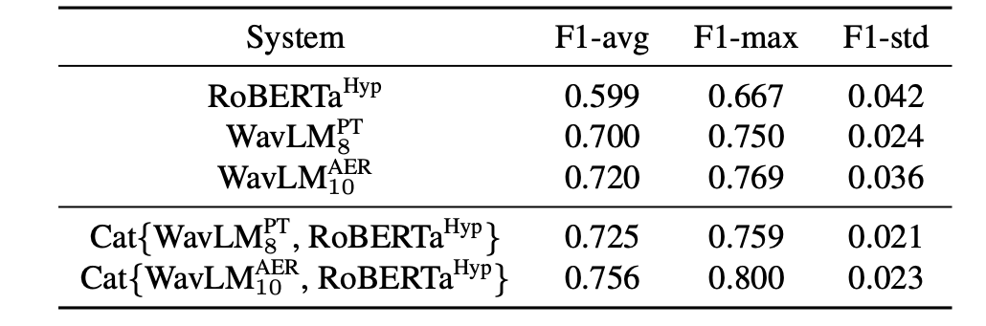
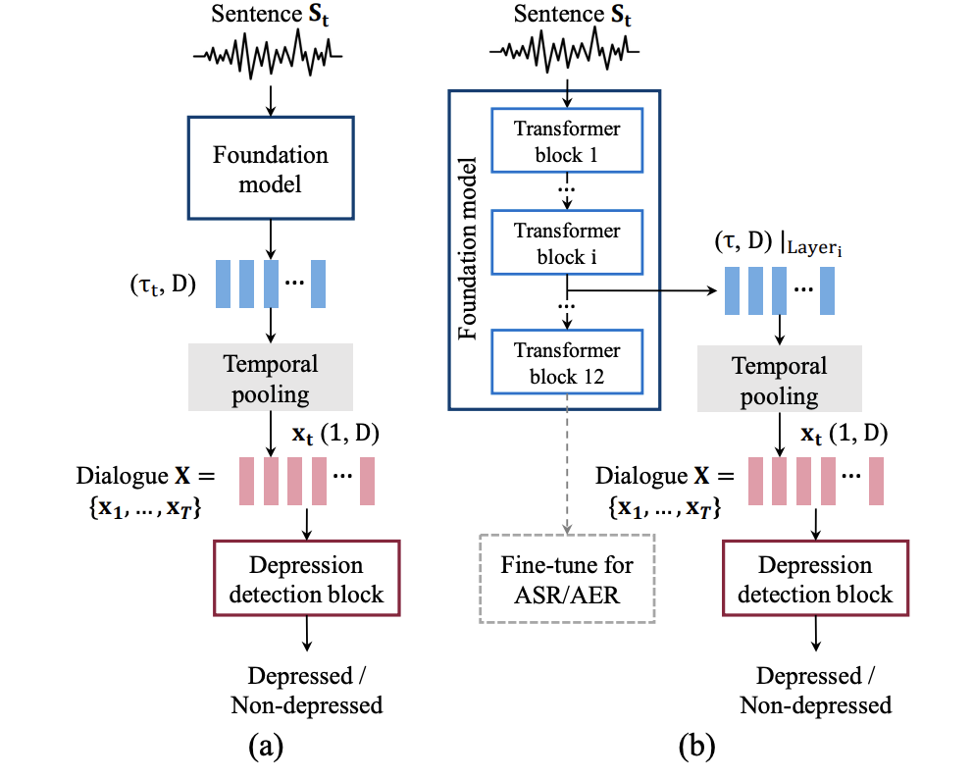
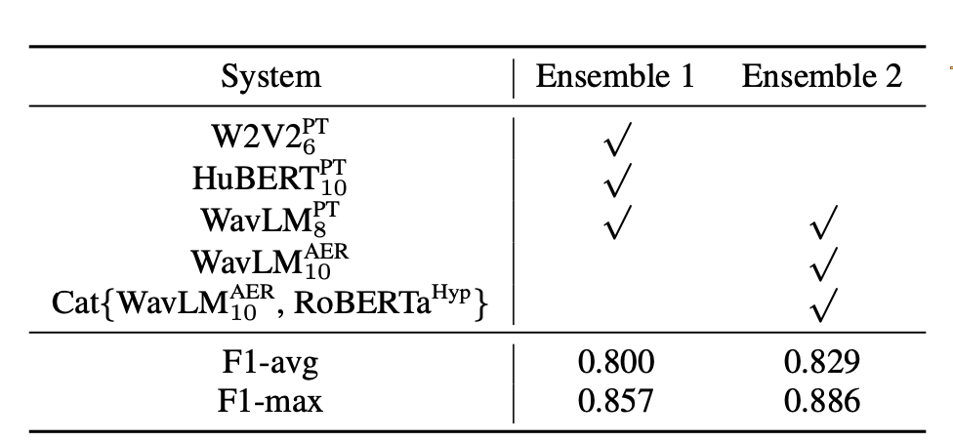
2. Audio-based Depression Detection
2.2 The State-of-Art in DAIC-WOZ -- SOTA^{[23]}
Main method: Transfer Learning
Model: W2V2, HuBERT2 , and WavLM3, RoBERTa
Data Augmentation: Sub-dialogue shuffling
Dataset: DAIC-WOZ
Results:
Table 2: Result of combining different speech and text foundation models^{[23]}
Table 3: Ensemble of foundation models^{[23]}
03
Figure 2: (a) Model structure (b) The block-wise analysis framework^{[23]}
[23] Wen Wu, Chao Zhang, and Philip C Woodland. 2023.Self-supervised representations in speech-based depression detection.In ICASSP 2023-2023 IEEE International Conference on Acoustics, Speech and Signal Processing (ICASSP), pages 1–5. IEEE.
Notes:
Sub-dialogue shuffling involves sampling a sub-dialogue from each complete dialogue, where and represent the randomly selected start and end utterance indexes, respectively.
(From ASR or AER to ADD - pre-trained models and self-supervised learning of the representation.)

Slide 8
3. LLMs-based Methods in Depression Detection

Slide 9
3. LLMs-based Methods in Depression Detection
 | Model | Baseline | Domain | Data Source | Reference | Highlight
1 | MentalBERT | BERT, RoBERTa, BioBERT, ClinicalBERT | Social Media | Reddit (Text) | Ji et al., 2021[Link] | -
2 | MentalRoBERTa
3 | MentaLLaMA | BERT, RoBERTa, MentalBERT, MentalRoBERTa, Llama, ChatGPT | Social Media | Reddit, Twitter, SMS (Text) | Yang et al., 2023 [Link] | Outperforms 1, 2 Close to SOTA^{[23]}
4 | Chat-Diagnose system (GPT3-based) | MTAL, GRU+VGC_COMMA, MTAN, SetTransformer, Time2Vex Trasnformer, BERT, PTDD | Social Media | Twitter & Weibo (Text) | Qin et al., 2023 | -
5 | Mental-Alpaca | Alpaca, Alpaca-LoRA, FLAN-T5, GPT-3.5, GPT-4 | Social Media | Reddit, Twitter, SMS (Text) | Xu et al., 2024 | Outperforms 1,2 and 3
6 | Mental-FLAN-T5
7 | DORIS (GPT-3-based) | TF-IDF+XGBoost, HAN, Mood2Content, BERT, FastText, gte-small, MentalRoBERTa, ChatGPT, MentalLLama | Social Media | SWDD Dataset (Text)^{[31]} | Lan et al., 2024 | The state-of-art in LLMs in social media
8 | Zhang et al., 2024 (Llama-based) | SOTA^{[23]} | Clinical Interview | DAIC-WOZ (Text + speech landmark) | Zhang et al., 2024 | Integrated speech landmark Close to SOTA^{[23]}
9 | Arcan et al., 2024 | XGBoost, GPT-3.5, Llama-1, Llama-2, Distil-RoBERT | Clinical Interview | DAIC-WOZ(Text) | Arcan et al., 2024 | Assessed different base LLMs model
Table 4: comparison of LLMs-based Methods in Depression Detection
[27] Yang, K., Zhang, T., Kuang, Z., Xie, Q., & Ananiadou, S. (2023). Mentalllama: Interpretable mental health analysis on social media with large language models. arXiv preprint arXiv:2309.13567.
[28] Ji, S., Zhang, T., Ansari, L., Fu, J., Tiwari, P., & Cambria, E. (2021). Mentalbert: Publicly available pretrained language models for mental healthcare. arXiv preprint arXiv:2110.15621.
[29] Lan, X., Cheng, Y., Sheng, L., Gao, C., & Li, Y. (2024). Depression Detection on Social Media with Large Language Models. arXiv preprint arXiv:2403.10750.
[30] Arcan, M., Niland, P. D., & Delahunty, F. (2024). An Assessment on Comprehending Mental Health through Large Language Models. arXiv preprint arXiv:2401.04592.
[31] Yicheng Cai, Haizhou Wang, Huali Ye, Yanwen Jin, and Wei Gao. Depression detection on online social network with multivariate time series feature of user depressive symptoms. Expert Systems with Applications, 217:119538, 2023.
[32] Xu, X., Yao, B., Dong, Y., Gabriel, S., Yu, H., Hendler, J., ... & Wang, D. (2024). Mental-LLM: Leveraging Large Language Models for Mental Health Prediction via Online Text Data. Proceedings of the ACM on Interactive, Mobile, Wearable and Ubiquitous Technologies, 8(1), 1-32.
04

Slide 10
4. Other Possible Modalities

Slide 11
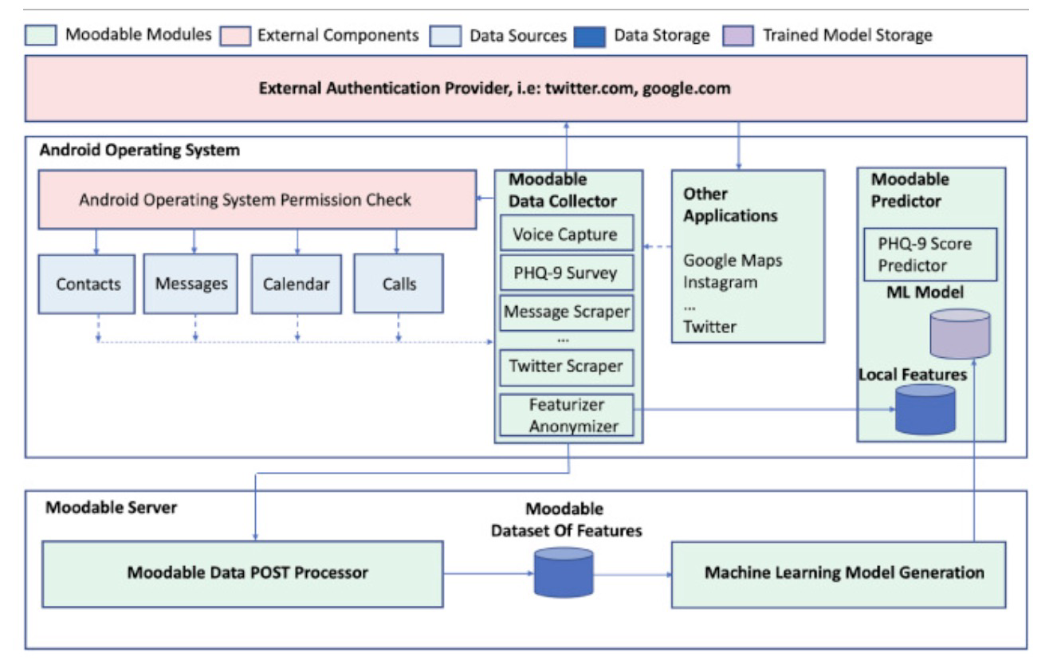
4. Other Possible Modalities
4.1 Integrating smartphone usage features^{[21]}:
Modalities:
Audio feature
Smartphone usage feature (location, browser history, call logs)
Social media features
Experiment Methods:
Audio + Smartphone
Audio + Social
Smartphone + Social
Ensemble
Data source: Collected from a self-created App
Figure 4: Model Archichecture^{[21]}
05
[21] Dogrucu, A., Perucic, A., Isaro, A., Ball, D., Toto, E., Rundensteiner, E. A., ... & Boudreaux, E. (2020). Moodable: On feasibility of instantaneous depression assessment using machine learning on voice samples with retrospectively harvested smartphone and social media data. Smart Health, 17, 100118.
Notes:
Handcrafted Features: Acoustic Low-Level Descriptors are extracted from the audio signal.
These predefined features are grouped into six main categories: the spectral features (Harmonic Model and Phase Distortion Mean etc.), the cepstral features ( (MFCC),.), the prosodic features etc.), and the voice quality features. A set of statistical features are also calculated (max, min, variance and standard deviation of features. Some researchers also propose the experimentation of the Teager Energy Operator (TEO) based features.
- different features and their combinations have similar accuracies (Zhang et al., 2021)

Slide 12
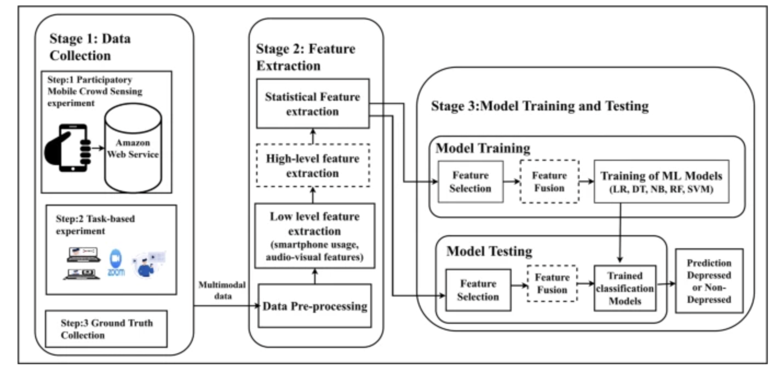
4. Other Possible Modalities
4.2 Fusing social media features, audio feature and video features^{[22]}:
Modalities:
Audio feature
Video feature
Social media features
Experiment Methods:
Audio+Video
Audio
Video
Ensemble
Data source: Collected from a self-created App
Figure 5: Model Archichecture^{[22]}
05
[22] Thati, R. P., Dhadwal, A. S., Kumar, P., & P, S. (2023). A novel multi-modal depression detection approach based on mobile crowd sensing and task-based mechanisms. Multimedia Tools and Applications, 82(4), 4787-4820.
Notes:
Handcrafted Features: Acoustic Low-Level Descriptors are extracted from the audio signal.
These predefined features are grouped into six main categories: the spectral features (Harmonic Model and Phase Distortion Mean etc.), the cepstral features ( (MFCC),.), the prosodic features etc.), and the voice quality features. A set of statistical features are also calculated (max, min, variance and standard deviation of features. Some researchers also propose the experimentation of the Teager Energy Operator (TEO) based features.
- different features and their combinations have similar accuracies (Zhang et al., 2021)

Slide 13
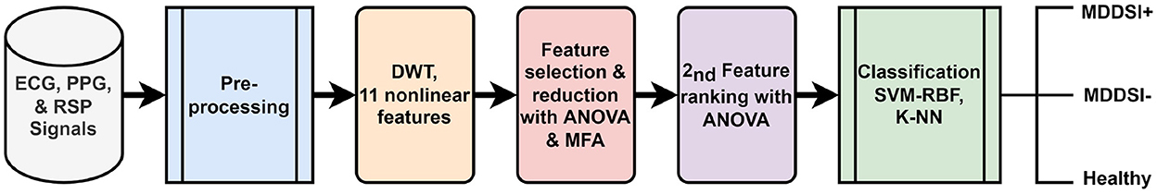
4. Other Possible Modalities
4.3 Physiological Signals:
sleep patterns
Electrocardiogram (ECG)
Wearable AI
heart rate
Respiratory signals (RSP)
activity level
(1) Physiological Signals
(2) Data Source
Etc…
Finger photoplethysmography (PPG)
Existing dataset
Depresjon Link
Electroencephalography (EEG)
Heart Rate Variability (HRV)
Figure 2. Physiological Signals^{[20]}
(3) Framework for the recognition of MDD from physiological signals
Figure 6. Block diagram of the framework for the recognition of MDD with SI from physiological signals. ^{[20]}
06
[20] Zitouni, M. S., Lih Oh, S., Vicnesh, J., Khandoker, A., & Acharya, U. R. (2022). Automated recognition of major depressive disorder from cardiovascular and respiratory physiological signals. Frontiers in Psychiatry, 13, 970993.
[26] Abd-Alrazaq, A., AlSaad, R., Shuweihdi, F., Ahmed, A., Aziz, S., & Sheikh, J. (2023). Systematic review and meta-analysis of performance of wearable artificial intelligence in detecting and predicting depression. NPJ Digital Medicine, 6(1), 84.
Notes:
问一下这个方向近期要不要深入？

Slide 14
Plan for next week
01
Literature Review Paper Writing
02
Continue work on the replication of EmoAudioNet
03
Replicate Xiangyu’s model (Llamas)

Slide 15
Thank you!

