Slide 1
Depression Detection
Name: Yuxin Li
Date: April 18- April 24

Slide 2
Agenda
01
Common Flow of Video-based Depression Detection
02
Visual Feature Extraction
2.1 Handcrafted Feature Performance
2.2 DNN-based feature extraction
2.3 DNN-based feature extraction performance
03
Discussion

Slide 3
1 Common Flow of Visual-based Depression Detection

Slide 4
1. Common Flow of Visual-based Depression Detection
Local Binary Patterns (LBP), Local Phase Quantization (LPQ), Motion History Histograms (MHH), Space-Time Interest Points (STIP) algorithm
Video Segmentation
Appearance-based
Illumination normalization
Face landmarks
Local Models method (CLM), Active Shape Models (ASM), Active Appearance Models (AAMs), 3D Landmark Model Matching, Elastic Bunch Graph Matching (EBFM), Landmark Distribution Model (LDM), Landmark Motion Magnitude (LMM)
Face
AUs
Registration and alignment
between the image sequences
Handcrafted
Mouth and Eyes
(1)
Body
STIP, Divergence-Curl-Shear (DCS)
Low-level visual descriptors
Face Detection
Feature Extraction
Dimensionality Reduction
Modal fusion
ML/DL Classifier
Fig 1: Common flow of visual-based depression detection
01
[1] Ashraf, A., Gunawan, T. S., Rahman, F. D. A., Kartiwi, M., & Ismail, N. (2020, September). A summarization of the visual depression databases for depression detection. In 2020 6th International Conference on Wireless and Telematics (ICWT) (pp. 1-6). IEEE.
[2] Pampouchidou, A., Simos, P. G., Marias, K., Meriaudeau, F., Yang, F., Pediaditis, M., & Tsiknakis, M. (2017). Automatic assessment of depression based on visual cues: A systematic review. IEEE Transactions on Affective Computing, 10(4), 445-470.
.

Slide 5
2 Visual Feature Extraction

Slide 6
2. Visual Feature Extraction
2.1 Handcrafted Feature Performance
Author(s) | Year | Classifier | Modalities | Datasets | Results
Scherer et al. | 2013 | SVM | Visual and Audio | DAIC-WOZ | Acc 0.897
Ghosh et al. | 2014 | Maximum Entropy Model (MaxEnt) | Visual and Audio | DAIC-WOZ | Acc 0.600
Yang et al. | 2016 | LR | Visual, Text and Audio | DAIC-WOZ | F1 0.857
Pampouchidou et al. | 2016 | RF | Visual, Text and Audio | DAIC-WOZ | F1 0.620
Guo et al. | 2022 | Temporal Dilated Convolutional Network (TDCN) | Visual | DAIC-WOZ | Acc 0.660
Alghowinem et al. | 2016 | SVM | Visual and Audio | BlackDog | Rec 0.883
Alghowinem et al. | 2016 | SVM | Visual | BlackDog | Rec 0.783
Dibeklioğlu et al. | 2017 | Stacked Denoising Autoencoders (SDA) | Visual and Audio | Pittsburgh | Acc 0.787
Dibeklioğlu et al. | 2015 | LR | Visual | Pittsburgh | Acc 0.845
Dibeklioğlu et al. | 2017 | SDA | Visual | Pittsburgh | Acc 0.726
Li et al. | 2024 | CNN+Attention | Visual | AVEC 2014 | RMSE 7.909
Li et al. | 2024 | CNN+Attention | Visual | Self-collected (HAMD) | Acc 0.896 F1 0.896
Table 1: Comparison of different handcrafted feature-based performance
02
Li, X., Yi, X., Lu, L., Wang, H., Zheng, Y., Han, M., & Wang, Q. (2024). TSFFM: Depression detection based on latent association of facial and body expressions. Computers in Biology and Medicine, 168, 107805.

Slide 7
2. Visual Feature Extraction
Local Binary Patterns (LBP), Local Phase Quantization (LPQ), Motion History Histograms (MHH), Space-Time Interest Points (STIP) algorithm
Video Segmentation
Appearance-based
Illumination normalization
Face landmarks
Local Models method (CLM), Active Shape Models (ASM), Active Appearance Models (AAMs), 3D Landmark Model Matching, Elastic Bunch Graph Matching (EBFM), Landmark Distribution Model (LDM), Landmark Motion Magnitude (LMM)
Face
AUs
Registration and alignment
between the image sequences
Handcrafted
Mouth and Eyes
(1)
Body
STIP, Divergence-Curl-Shear (DCS)
Low-level visual descriptors
Face Detection
C3D
Feature Extraction
High-level visual representation
(2)
2D-CNN
Spatiotemporal information modelling
Dimensionality Reduction
DNN-based
Channel-based methods
Sequential DNN
Modal fusion
Others
ML/DL Classifier
Fig 2: Common flow of visual-based depression detection
03
[1] Ashraf, A., Gunawan, T. S., Rahman, F. D. A., Kartiwi, M., & Ismail, N. (2020, September). A summarization of the visual depression databases for depression detection. In 2020 6th International Conference on Wireless and Telematics (ICWT) (pp. 1-6). IEEE.
[2] Pampouchidou, A., Simos, P. G., Marias, K., Meriaudeau, F., Yang, F., Pediaditis, M., & Tsiknakis, M. (2017). Automatic assessment of depression based on visual cues: A systematic review. IEEE Transactions on Affective Computing, 10(4), 445-470.
.

Slide 8
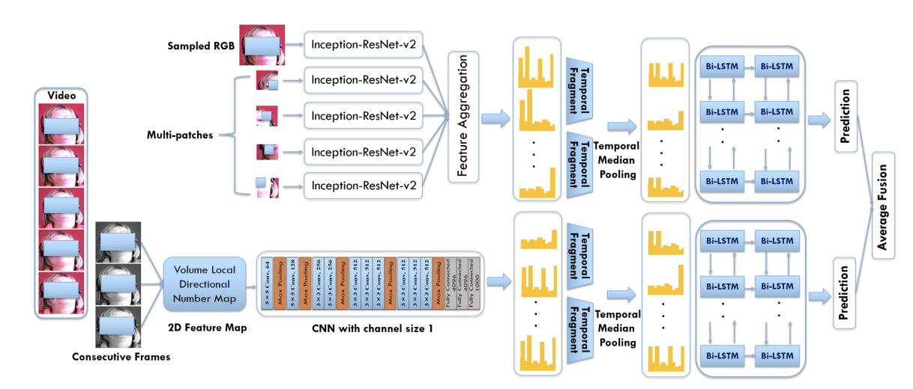
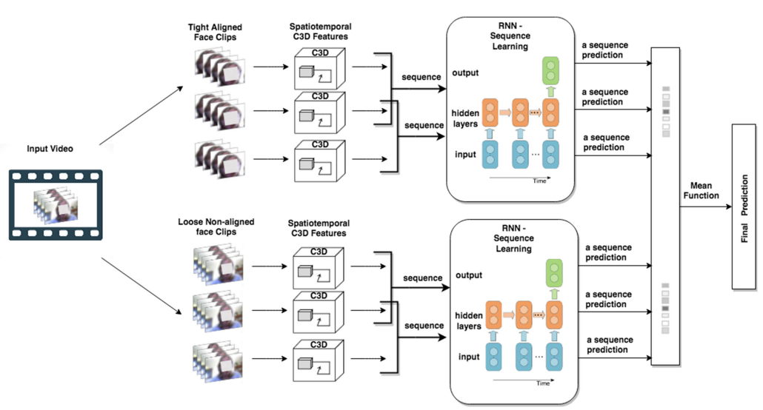
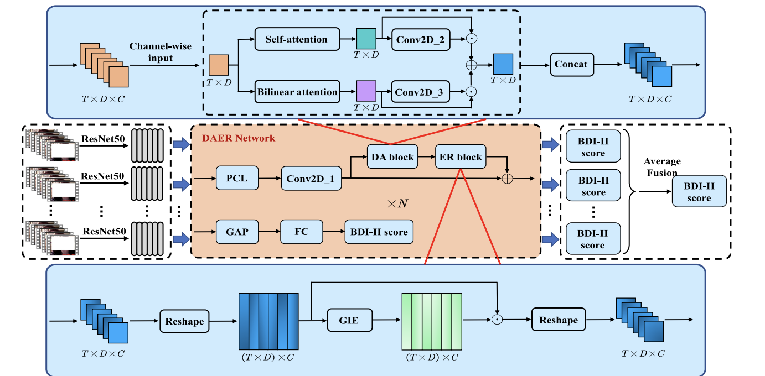
2. Visual Feature Extraction
2.2 DNN-based feature extraction
(2) 2D CNN
Sequential DNN
C3D
DNN-based
Spatiotemporal information modelling
2D-CNN
Channel-based methods
Others
Fig 3: Architecture of 2D CNN method (Melo et al., 2020)
(1) C3D
(3) Channel-based
04
Fig 2: Architecture of C3D method (AI et al., 2018)
Fig 4: Architecture of Channel method (Niu et al., 2022)

Slide 9
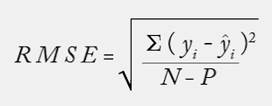
2. Visual Feature Extraction
2.3 DNN-based feature extraction performance
A: Audio; V: Visual
 | Author(s) | Year | Spatiotemporal information Modelling | Classifier | Mo. | Datasets | Results
1 | Kang et al. | 2017 | - | Deep Transformation Learning (DTL) | V | AVEC2014 | RMSE 9.43 MAE 7.74
2 | Jan et al. | 2017 | - | PLS and LR | A+V | AVEC 2014 | RMSE 8.28 MAE 6.20
3 | Zhu et al. | 2018 | - | DCNN | V | AVEC2013, 2014 | RMSE 9.82 MAE 7.58
4 | AI et al. | 2018 | C3D | RNN | V | AVEC2013, 2014 | RMSE 9.28 MAE 7.37
5 | Melo et al. | 2019 | - | CNN | V | AVEC2013, 2014 | RMSE 8.31 MAE 6.59
6 | Melo et al. | 2019 | - | ResNet-50 | V | AVEC2013, 2014 | RMSE 8.25 MAE 6.30
7 | Melo et al. | 2020 | C3D | CNN | V | AVEC2013, 2014 | RMSE 7.61 MAE 5.82
8 | Zhou et al. | 2019 | - | ResNet-50 | V | AVEC 2014 | RMSE 8.43 MAE 6.37
9 | Zhou et al. | 2020 | C3D | DCNN | V | AVEC2013, 2014 | RMSE 8.25 MAE 6.30
10 | Niu et al. | 2020 | C3D | RNN | V | AVEC2013, 2014 | RMSE 8.31 MAE 6.73
11 | Melo et al. | 2020 | 2D CNN | CNN | V | AVEC2013, 2014 | RMSE 7.97 MAE 5.96
12 | Uddin et al. | 2020 | 2D CNN | BiLSTM | V | AVEC2013, 2014 | RMSE 8.93 MAE 7.04
13 | Melo et al. | 2021 | C3D | Maximization-Differentiation Network (MDN) | V | AVEC2013, 2014 | RMSE 7.65 MAE 6.06
14 | Xu et al. | 2021 | C3D | Graph Neural Network (GNN) | V | AVEC2013, 2014 | RMSE 7.57 MAE 5.95
15 | Chen et al. | 2021 | 2D CNN | CNN | V | AVEC 2014 | RMSE 8.13 MAE 6.16
16 | He et al. | 2022 | C3D | CNN | V | AVEC2013, 2014 | RMSE 8.30 MAE 6.51
17 | Niu et al. | 2022 | Channel-based | CNN | V | AVEC2013, 2014 | RMSE 7.79 MAE 5.82
18 | Niu et al. | 2022 | Channel-based | CNN | V | AVEC2013, 2014 | RMSE 7.49 MAE 6.12
19 | Liu et al. | 2023 | - | Resnet18 | V | AVEC2013, 2014 | RMSE 7.59 MAE 6.08
C3D mean: 8.13
2D CNN mean: 8.34
Channel-based mean: 7.64
05
Table 2: Comparison of different DNN-based performance

Slide 10
3 Discussion

Slide 11
3. Discussion
Include physiological Signals in our literature review?
Overleaf compile time
Citation format
06

Slide 12
Reference
Ghosh, S., Chatterjee, M., & Morency, L. P. (2014, November). A multimodal context-based approach for distress assessment. In Proceedings of the 16th International Conference on Multimodal Interaction (pp. 240-246).
S. Scherer, G. Stratou, and L.-P. Morency, “Audiovisual behavior descriptors for depression assessment,” in Proc. 15th Int. Conf. Multimodal Interaction, 2013, pp. 135–140.
L. Yang, D. Jiang, L. He, E. Pei, M. C. Oveneke, and H. Sahli, “Decision tree based depression classification from audio video and language information,” in Proc. 6th Int. Workshop Audio/ Visual Emotion Challenge, 2016, pp. 89–96. [Online]. Available: http://doi.acm.org/10.1145/2988257.2988269
Pampouchidou, et al., “Depression assessment by fusing high and low level features from audio, video, and text,” in Proc. 6th Int. Workshop Audio/Visual Emotion Challenge, 2016, pp. 27–34. [Online]. Available: http://doi.acm.org/10.1145/2988257.2988266
S. Alghowinem, et al., “Multimodal depression detection: Fusion analysis of paralinguistic, head pose and eye gaze behaviors,” IEEE Trans. Affect. Comput., 2016, doi: 10.1109/TAFFC.2016.2634527.
H. Dibeklioglu, Z. Hammal, and J. F. Cohn, “Dynamic multimodal measurement of depression severity using deep autoencoding,” IEEE J. Biomed. Health Informat., 2017, doi: 10.1109/JBHI.2017.2676878.
H. Dibeklioglu, Z. Hammal, Y. Yang, and J. F. Cohn, “Multimodal detection of depression in clinical interviews,” in Proc. ACM Int. Conf. Multimodal Interaction, 2015, pp. 307–310.
Guo et al., 2022 \cite{Guo2022Visual} & Landmarks, AUs, Pose, Gaze & Temporal Dilated Convolutional Network (TDCN) & Visual & DAIC-WOZ & Acc 0.660\\
Al Jazaery, M., & Guo, G. (2018). Video-based depression level analysis by encoding deep spatiotemporal features. IEEE Transactions on Affective Computing, 12(1), 262-268.
de Melo, W. C., Granger, E., & Hadid, A. (2019, May). Combining global and local convolutional 3d networks for detecting depression from facial expressions. In 2019 14th ieee international conference on automatic face & gesture recognition (fg 2019) (pp. 1-8). IEEE.
Jan, H. Meng, Y. Gaus, and F. Zhang, “Artificial intelligent system for automatic depression level analysis through visual and vocal expressions,” IEEE Trans. Cogn. Develop. Syst., vol. 10, no. 3, pp. 668–680, Sep. 2018.
De Melo, W. C., Granger, E., & Hadid, A. (2019, September). Depression detection based on deep distribution learning. In 2019 IEEE international conference on image processing (ICIP) (pp. 4544-4548). IEEE.
X. Zhou, P. Huang, H. Liu, and S. Niu, “Learning content-adaptive feature pooling for facial depression recognition in videos,” Electron. Lett., vol. 55, no. 11, pp. 648–650, 2019.
de Melo, W. C., Granger, E., & Lopez, M. B. (2021). MDN: A deep maximization-differentiation network for spatio-temporal depression detection. IEEE transactions on affective computing, 14(1), 578-590.
Liu, Z., Yuan, X., Li, Y., Shangguan, Z., Zhou, L., & Hu, B. (2023). PRA-Net: Part-and-Relation Attention Network for depression recognition from facial expression. Computers in Biology and Medicine, 157, 106589.
De Melo, W. C., Granger, E., & Hadid, A. (2020). A deep multiscale spatiotemporal network for assessing depression from facial dynamics. IEEE transactions on affective computing, 13(3), 1581-1592.
Xu, J., Song, S., Kusumam, K., Gunes, H., & Valstar, M. (2021). Two-stage temporal modelling framework for video-based depression recognition using graph representation. arXiv preprint arXiv:2111.15266.
De Melo W.C., Granger E., Lopez M.B.
Encoding temporal information for automatic depression recognition from facial analysis
ICASSP 2020-2020 IEEE International Conference on Acoustics, Speech and Signal Processing, ICASSP, IEEE (2020), pp. 1080-1084
Uddin M.A., Joolee J.B., Lee Y.-K.
Depression level prediction using deep spatiotemporal features and multilayer bi-LSTM
IEEE Trans. Affect. Comput. (2020)
Niu, M., Zhao, Z., Tao, J., Li, Y., & Schuller, B. W. (2022). Dual attention and element recalibration networks for automatic depression level prediction. IEEE Transactions on Affective Computing.
Niu, M., He, L., Li, Y., & Liu, B. (2022). Depressioner: facial dynamic representation for automatic depression level prediction. Expert Systems with Applications, 204, 117512

Slide 13
Plan for next week
01
Continue literature review on video-based method and writing
02
Literature review on Transfer-Learning-based Method

Slide 14
Thank you!

