Slide 1
Presented by: Yuxin Li
Automated Depression Recognition: A Multi-modal Deep Learning Framework to recognize depression from audio and text
Notes:
Thank you, Danny. Hello everyone I am Yuxin, I’m very honored to have this chance to share my postgraduate research with you today. I was a postgraduate student in UCL KIDS and Danny was my supervisor on my master‘s thesis at that time, and now I am a research staff in Nanyang Technological University and going to pursue a phd from August 2024 and my future research topic will be an extension to my master’s research that I’m gonna share today. If you are interested in this topic or have any suggestions, feel free to reach out to me after this meeting.
So my research topic is Automated Depression Recognition: A multi-modal deep learning framework to recognize repression from audio and text.

Slide 2
CONTENTS
01
02
Introduction
Existing Research
Background
Challenges
Research Objective
Existing Classification Approaches
ML and DL Models
04
Methodology
03
Dataset
Techniques
Data Preparing
Deep Learning Architecture
The Comparison of Text and Audio Branch
Experiments
Training
Dataset used in my study
Existing Datasets
05
06
Results
Future Directions
Results
Future Work
Notes:
I will introduce this study in the following 6 parts. Starting from introduction, and a summary of existing research. Then I will introduce the dataset I used in my research and some existing datasets. Then I will introduce the methodology I employed including the experiment structure. Lastly, I will demonstrate the results and discuss the future directions

Slide 3
1. Introduction

Slide 4

1. INTRODUCTION
1.1 Major Depression Disorder (MDD)
It causes persistent feelings, hopelessness, and disinterest in activities.
Symptoms include feelings of worthlessness or guilt, trouble sleeping or concentrating, tiredness, and thoughts of suicide
The causes can be genetic, biological, psychological, or environmental ^{[1].}
01
[1] Kupfer, D. J., Frank, E., & Phillips, M. L. (2012). Major depressive disorder: new clinical, neurobiological, and treatment perspectives. The Lancet, 379(9820), 1045-1055.
Notes:
So the specific mental disease I am focusing on is Major depression Disorder. Which we call it MDD.
MDD causes persistent feelings, hopelessness, and disinterest in activities.
Symptoms include feelings of worthlessness or guilt, trouble sleeping or concentrating, tiredness, and thoughts of suicide
The causes can be genetic, biological, psychological, or environmental

Slide 5
1. INTRODUCTION
1.2 Challenges
Traditional diagnostics: Subjectivity, potential stigma, underreporting ^{[2]}.
Emotion expression in voice has individuals variance.
The same answer may have different meaning depending on the tone of voice.
Small scale and imbalanced datasets. (Major)
Need more automatic, non-invasive and multimodal approaches
02
[2] Epstein, R. M., Duberstein, P. R., Feldman, M. D., Rochlen, A. B., Bell, R. A., Kravitz, R. L., ... & Paterniti, D. A. (2010). “I didn’t know what was wrong:” how people with undiagnosed depression recognize, name and explain their distress. Journal of general internal medicine, 25, 954-961.
Notes:
There are a few challenges of the recognition of MDD.
The first challenge is from the traditional diagnostic having issues of subjectivity, potential stigma, and underreporting.
Secondly, the emotion expression in voice varies greatly between individuals, resulting in poor performance of pure audio-based depression classifiers.
Thirdly, the same answer to an interview question may have different meaning depending on the tone of voice may lead to inaccuracy of pure text-based depression classifiers.
And the most major challenge is the lack of labeled data available to machine learning researchers, and the available datasets have a small number of participants, most often under 100. This limits the effectiveness of being able to train deep learning models.
Therefore, these challenges highlight the need for more automatic, non-invasive and multimodal approaches.

Slide 6
1. INTRODUCTION
1.3 Research Objective
To detect depression by modeling audio and text information
Specifically：
Extract features from different modalities and deal with imbalanced classes
Propose a novel deep neural network that can embed text and audio features.
Enable feature-level fusion to concatenate features and make final predictions.
03
Notes:
The objective of this study is to detect depression by modeling audio and text information
Specifically：
First we need to extract features from different modalities and deal with imbalanced classes
Also, we aim to advance existing AI techniques to propose a deep neural network that can embed text and audio features.
Lastly, enable feature-level fusion to concatenate features and make final predictions.

Slide 7
2. Existing Research

Slide 8
UCL Department of Information Studies
2. EXISTING RESEARCH
2.1 Existing Classification approaches for Depression Recognition
Before 2016
2016-2018
2019
2020
2021
2022
2023
Audio,
Linear Regression
(Jayawardena et al. 2020)
Audio and Video, Transformer-based Model (Sun et al. 2021)
GLoVE, SenticNet,
LSTM with Attention
(Ansari et al. 2022)
BERT, DistilBERT
(Kabir et al. 2023)
Connect multiple modality by non-linear transforms (Socher et al. 2010)
Fuse low and high-level features (Pampouchidou et al. 2016, Nasir et al. 2016)
Audio, Video and Text, BiLSTM (Ray et al. 2019)
Audio and Text, BERT-CNN (Rodrigues 2019)
Resting state EEG,
Hybrid EEGNet
(Wan et al. 2020)
Audio,
CNN and LSTM (Harati et al. 2021)
Electronic health records; demographic and medical,
Stacked ensemble
(Ansari et al. 2022)
Correlations of formants and spectral information (Williamson et al. 2013)
Audio, Deep neural network (Ma et al. 2016)
Audio and Video, SVM (Kächele et al. 2015)
Audio, Video and Text, Bi-LSTM (Ray et al. 2019)
Audio,
Transformer (Sun et al. 2021)
Audio and video, capture temporal variations (Syed et al. 2017)
Audio and Video, LSTM-RNN (Chao et al. 2015)
CNN, BiLSTM and RNN with SoftMax (Rosa et al. 2019)
Audio,
Transformer (Zhang et al. 2021)
Topic modeling, multimodal Approach (Gong et al. 2017)
Bert,
CNN, BiGRU (Zogan et al. 2021)
Multi-modal, DNN, DCNN (Yang et al. 2017)
04
Audio and Text, LSTM (Al et al. 2018)
Notes:
Here, I list the existing classification algorithms for depression recognition
In the early years, before 2016, researchers tend to use feature engineering, such as by calculating the correlations of formants and spectral information in audio, and some people tried to connect multi modality by non-linear transforms.
Later, from 2016-2018, with the rise of machine learning, models like SVMs, and Random forests have been greatly used in the classification
From 2019 to 2021, Deep neural networks have also been proven to be suitable for depression recognition
And more recently, people are putting more and more attention in fusing different modalities, and large language models play a key role in increasing the accuracy.

Slide 9
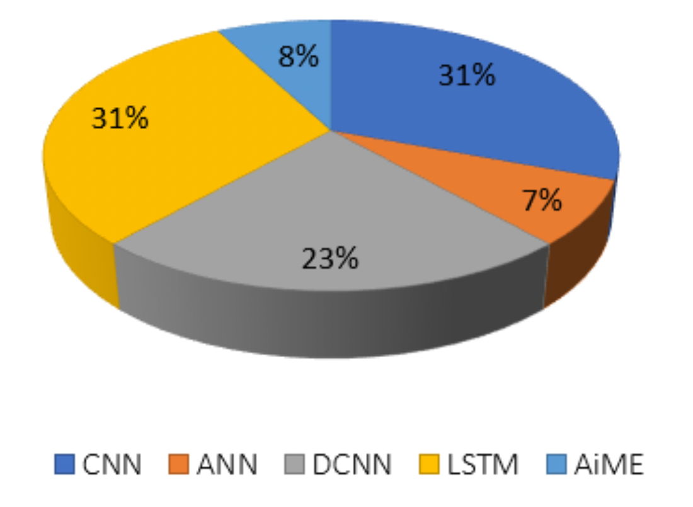
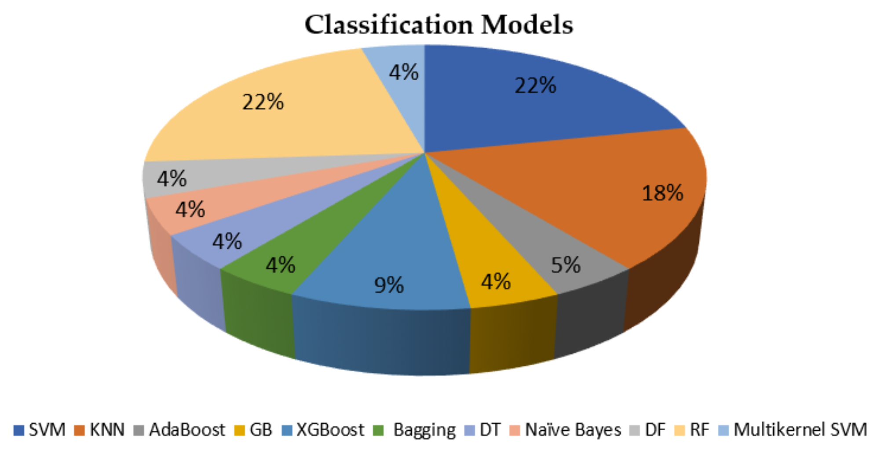
UCL Department of Information Studies
2. EXISTING RESEARCH
2.2 ML and DL Models used for Depression Recognition
Figure 1: Machine Learning Models Used in Depression Classification (Aleem et al., 2022)
Figure 2: Deep Learning Models Used in Depression Classification (Aleem et al., 2022)
05
Notes:
There are two pie charts from a review paper in 2022 that demonstrate the proportion of machine learning models and deep learning models used in depression recognition. Figure 1 shows the proportion of different machine learning models used in depression classification. SVMs and random forests are the most used classification algorithms.
Regarding deep learning methods shown in the right pie chart, CNNs and LSTMs are the most used neural networks.

Slide 10
3. Dataset
Notes:
Then, I will introduce the dataset used in my research

Slide 11
UCL Department of Information Studies
3. DATASETS
3.1 Existing Datasets:
 | Dataset | Modality | Numbers of subject | Number of clips | Label | Reference
1 | AVEC 2013 | Video/audio | 84 participants | 150 clips | Self-report survey (BDI-II) | [Dataset]
2 | AVEC 2014 | Video/audio | 84 participants | 300 clips | Self-report survey (BDI-II) | Valster et al. (2014)
3 | DAIC-WOZ | Video/audio/text | 189 participants | 189 clips | Self-report survey (PHQ-8) | Gratch et al. (2014)
4 | E-DAIC | Video/audio | 351 participants | 275 clips | Self-report survey (PHQ-8) | Ringeval et al. (2019)
5 | Facebook Depression Dataset | Text | / | / | Bag-of-words | /
6 | RSDD | Text | / | 116000 clips | Self-report survey | Yates et al. (2017)
7 | DEPTWEET | Text | / |  | Self-report survey (PHQ-9) | Kabir et al. (2023)
Table 2: Existing Datasets
06
Notes:
There are 7 commonly used datasets in depression detection
The first 2 datasets, AVEC 2013 and AVEC 2014, are the subset of Audio‐Visual Depression Language Corpus. AVEC 2014 is a subset of AVEC 2013,consisting of 300 videos, where duration of each video clip is shorter than the clip in AVEC 2013
And the third dataset, DAIC‐WOZ, is from the challenge AVEC 2016 and is the most popular dataset in multimodal approaches and audio-based approaches. It is conducted purely by a virtual agent - Ellie
So the difference between the first two datasets and Daic-Woz dataset is that the first two datasets are more broadly focused on depression recognition in a controlled environment, while DAIC-WOZ is specifically designed for depression analysis in a clinical interview setting.
The fourth dataset, E‐DAIC, is an extended version of DAIC‐WOZ which is conducted by a virtual agent and a human-being The dataset contains 351 samples and the participants’ data are marked with age, gender and PHQ‐8 score. More focused on emotion analysis than depression recognition
The last three datasets Facebook Depression Dataset, RSDD and DEEPTWEET are text-based datasets from social media.
Among them, DEEPTWEET is the most used dataset in text-based depression recognition, Facebook and RSDD is also very popular

Slide 12
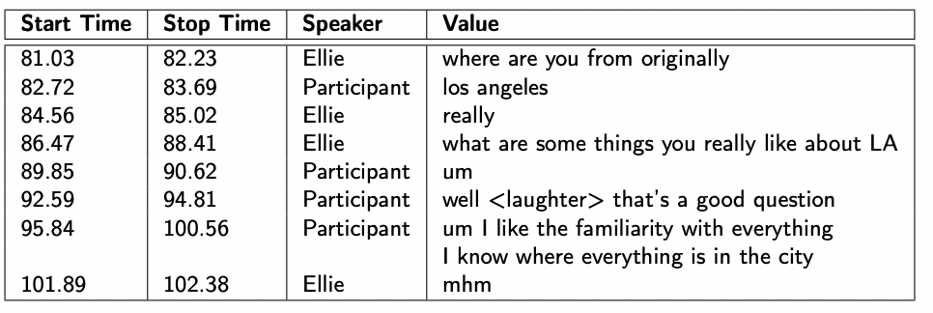
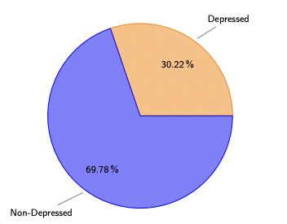
UCL Department of Information Studies
3. DATASETS
3.1 Sample of DAIC-WOZ:
Each participant has been labeled with 0 or 1 (PHQ8 Binary)
PHQ8_Binary | PHQ8_Score | Gender | PHQ8_NoInterest | PHQ8_Depressed | PHQ8_Sleep | PHQ8_Tired | PHQ8_Appetite | PHQ8_Failure | PHQ8_Concentrating | PHQ8_Moving
Transcript example:
Figure 3: Partition of depressed and non-depressed participants
Audio example:
07
Non-depressed sample:
Depressed sample:
Notes:
Here are some examples of this dataset.
Firstly, each participant has been labeled with 0 or 1, where 0 stands for non-depression and 1 stands for depression using PHQ-8. It’s the most popular authenticated way to determine if a person is depressed or not.
And the transcript sample in this dataset contains the start time, stop time, speaker of each sentence
The audio sample is here
However, this dataset is very imbalanced, we can see from figure 3 that the non-depression sample is more than 3 times than the depressed sample

Slide 13
4. Methodology
Notes:
And then the methodology applied in this research

Slide 14
UCL Department of Information Studies
4. Methodology
4.1 Techniques - Convolutional Neural Networks(CNNs)
Feature extraction
Local pattern recognition
Dimensionality reduction
a1*A1+b1*B1+c1*C1+a2*A2+b2*B2+c2*C2+a3*A3+b3*B3+c3*C3
Convolutional kernel
A1 | B1 | C1
A2 | B2 | C2
A3 | B3 | C3
a1 | b1 | c1 | d1 | e1 | f1
a2 | b2 | c2 | d2 | e2 | f2
a3 | b3 | c3 | d3 | e3 | f3
a4 | b4 | c4 | d4 | e4 | f4
a5 | b5 | c5 | d5 | e5 | f5
a6 | b6 | c6 | d6 | e6 | f6
0
Maxpooling layer
Flatten layer
Convolutional layer
Input
Figure 4: The Pipeline of CNN Layers
08
Notes:
Firstly, The convolutional neural networks (CNNs) layers are used for feature extraction, local pattern recognition and dimensionality reduction. It starts with a 2-dimensional input, which goes into convolutional layers. In the convolutional layer, (点)convolution kernels are used to produce a tensor of outputs. For example, the first grid of the output is calculated using this equation.(点)In this way, features can be extracted efficiently.
Then, each Conv1olutional layer is followed by a MaxPooling layer to downsample the data and further reduce its dimensionality. After that, flatten layers are used to convert the multi-dimensional feature map into a 1 dimensional sequence that can be passed into the LSTM model.

Slide 15




UCL Department of Information Studies
4. Methodology
4.1 Techniques - Bidirectional Long Short-Term Memory
Capture the temporal sequential behavior in the data
$$⨁$$
Sigmoid Function
$$σ_{0}$$
$$σ_{1}$$
$$σ_{2}$$
New sequence
Forwards
Backwards
token 1
token 2
token 3
09
Figure 5: The Pipeline of LSTM Layers
Notes:
Then there's the Bidirectional LSTM (BiLSTM) layer, which is used to capture the temporal sequential behavior in the data. here are our tokens,
the forward layer processes the sequence in the original order, capturing past context.
The backward layer processes the sequence in reverse, capturing future context. This process generates a new sequence.
Next, the output of the Bi-LSTM layer is passed through an Attention layer, which focuses on the more important and relevant information by assigning significance to different parts of the sequence.
$Sigma0$, $Sigma1$, $Sigma2$ stands for the weights, and a sigmoid function is used to output a 1 or a 0.

Slide 16
UCL Department of Information Studies
4. METHODOLOGY
4.2 Data Preparing
（1）Text Data
Obtaining raw transcripts
Text cleaning - NLTK stopwords and Word2Vec model
Embed each script into a 2-dimensional vector
Text annotation - Word2Vec model
Class-balancing – Upsampling
word
A sentence
H
i
0
0
Textual data
（2）Audio Data
Using extracted audio features by COVARAP (already existed in the DAIC-WOZ Dataset)
Class balancing - Upsampling
10
Notes:
The first step – Data preparing
For text data
We first obtain original raw transcript
And then clean the text by using NLTK stopwords and Word2Vec model
To process the scripts into our models sentence by sentence, scripts are embeded into a 2-dimensional vector, where each matrix represents a textual data, the rows of each matrix represent a sentence, and the columns of each row represent the words in the sentence.
The first dimensional size (the row) of this matrix is the max number of sentences of all samples, and the second dimensional size (the column) is the max words per sentence. So in this way, If the number of sentences in a given sample is less than the max number of the sentence of all samples, the remainder is filled with zeros, and if the number of words in a sentence is less than the max words per sentence, the remainder is also filled with zeros
And then annotate them using Word2Vec model
Class Balancing use upsampling
For Audio data:
Using extracted audio features by COVARAP (already existed in the DAIC-WOZ Dataset)
Class balancing - Upsampling

Slide 17
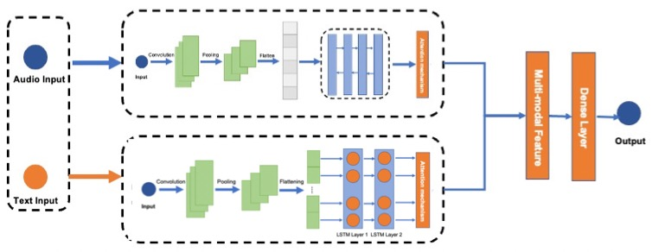
UCL Department of Information Studies
4. METHODOLOGY
4.3 Multi-modal Deep Learning Architecture:
Two inputs - text and audio.
Both branches consist of CNN layers, LSTM layers, and an attention layer to extract features.
Feature level fusion in the concatenate layer.
Integrating information and making the final prediction in a fully connected layer
Figure 6: The Structure of CLAM model
11
Notes:
The first step – Data preparing
For text data
We first obtain original raw transcript
And then clean the text by using NLTK stopwords and Word2Vec model
Embed script into a 3-dimensional vector, where each matrix represents a textual data, the rows of each matrix represent a sentence, and the columns of each row represent the words in the sentence. So it can be processed sentence by sentence
To achieve this,
A four dimensional array is constructed (s, ms, mw, d), where the first factor S is sample size, the second factor ms is the max number of sentences of all samples, the third factor mw is the max words per sentence, The last fator d is the dimensionality of the word vector).
So in this way, If the number of sentences in a given sample is less than the max number of the sentence of all samples, the remainder is filled with zeros, and if the number of words in a sentence is less than the max words per sentence, the remainder is also filled with zeros
For example, s = 57, ms = 250, mw = 20, d = 300
And then annotate them using Word2Vec model
Class Balancing use upsampling

Slide 18
UCL Department of Information Studies
4. METHODOLOGY
4.4 The Comparison of Text and Audio Branch
 | Text branch | Audio branch
CNN layers | 2-D Convolutional Layer 150 convolutional kernels Window size: (1,5) Input size: (250,20,300) Activation function: ReLU 2-D Max-pooling Layer | 1-D Convolutional Layer Convolutional kernels: 60, 30, 15 kernel size: 10, 5, 5 Input size: (40000,74) Activation function: ReLU 1-D Max-pooling Layer
LSTM layers | LSTM | BiLSTM
Table 3: The Comparison of Text and Audio Branch
12
Notes:
The first step – Data preparing
For text data
We first obtain original raw transcript
And then clean the text by using NLTK stopwords and Word2Vec model
Embed script into a 3-dimensional vector, where each matrix represents a textual data, the rows of each matrix represent a sentence, and the columns of each row represent the words in the sentence. So it can be processed sentence by sentence
To achieve this,
A four dimensional array is constructed (s, ms, mw, d), where the first factor S is sample size, the second factor ms is the max number of sentences of all samples, the third factor mw is the max words per sentence, The last fator d is the dimensionality of the word vector).
So in this way, If the number of sentences in a given sample is less than the max number of the sentence of all samples, the remainder is filled with zeros, and if the number of words in a sentence is less than the max words per sentence, the remainder is also filled with zeros
For example, s = 57, ms = 250, mw = 20, d = 300
And then annotate them using Word2Vec model
Class Balancing use upsampling

Slide 19
UCL Department of Information Studies
4. METHODOLOGY
4.5 Experiments
Conduct 7 experiments that use different combinations of text and audio embeddings for classification.
Exp 1 CNN model
Exp 2 BiLSTM model
Exp 3 CNN+BiLSTM+Attention
Text Embeddings
Data Preprocessing
Model Training
Model Testing
Evaluation
comparisons
Exp 4 CNN model
Exp 5 BiLSTM model
Exp 6 CNN+BiLSTM+Attention
Audio Embeddings
Hyperparameter Tuning
Exp 7 CNN+BiLSTM+Attention
Text and Audio Embeddings
Figure 7: The process of experiments
13
Notes:
Let’s look at the experiments, this study conducts 7 experiments that use different combinations of text and audio embeddings for classification.
For text embeddings, we tested 3 different models, only-CNN model, only-BiLSTM model and CNN, BiLSTM and Attention model.
For audio embeddings, we also tested these 3 models.
And for text and audio embeddings we tested the CNN, BiLSTM and Attention model.
The right flow chart demonstrate the process of each experiment, from Data processing and then hyperparameter tunning, model training, testing, evaluation and then comparision and analysis
And then I will break down the experiment steps.

Slide 20
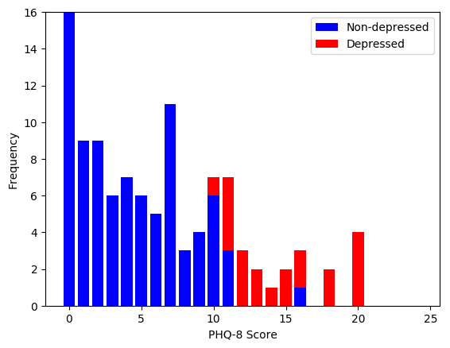
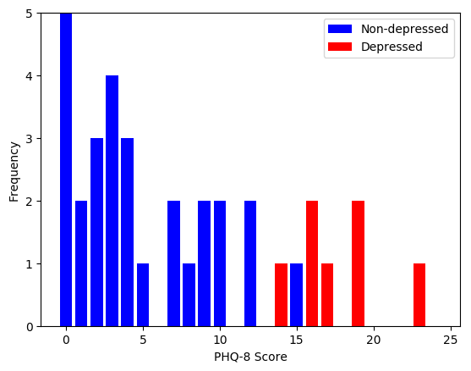
UCL Department of Information Studies
4. METHODOLOGY
4.6 Training
Dataset: DAIZ-WOZ dataset
Training : Testing : Validation = 57 : 25 : 18
10-folds cross validation
Binary cross entropy as the loss function
Adam optimizer with a learning rate of 0.001
Early stopping with a patience of 50 epochs
Training on an Intel Xeon Gold CPU and a Geforce RTX 2080Ti 11GB GPU took about 2.5 hours.
TensorFlow with Keras library (deep learning tools)
Figure 7: Train Set
Figure 8: Dev Set
14
Notes:
In the training step
The proportion of Training : Testing and Validation is 57%, 25% , 18% (Due to a lack of annotations for the test set, we use the development set for testing instead)
We use 10-folds cross validation to better evaluate the performance of our model
Binary cross entropy as the loss function
Adam optimizer with a learning rate of 0.001
Early stopping with a patience of 50 epochs
Training time is about 2.5 hours.
TensorFlow with Keras library (deep learning tools) to test the proposed solution

Slide 21
5. Results

Slide 22
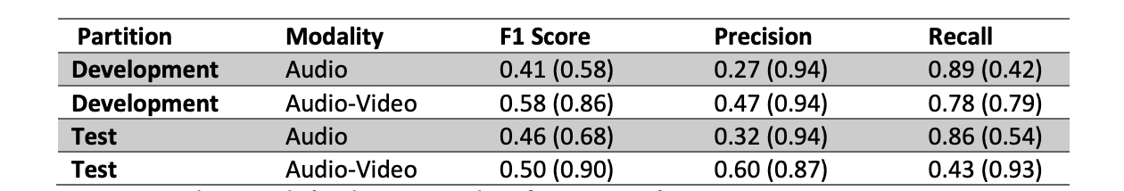
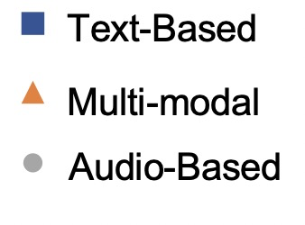
UCL Department of Information Studies
5. RESULTS
Model | Features | Rec. | Prec. | F1
Ma et al. (2016) | Text | 1 | .53 | .52
Williamson et al. (2016) | Audio | / | / | .50
Williamson et al. (2016) | Text | / | / | .76
Williamson et al. (2016)* | Text | / | / | .84
Alhanai et al., (2018) | Audio | .56 | .71 | .63
Alhanai et al., (2018) | Text | .57 | .67 | .80
Alhanai et al., (2018) | Text/Audio | .71 | .77 | .83
Lam et al., (2019) | Text/Audio/Video | / | / | .87
Lin et al., (2020) | Text/Audio | .92 | .73 | .81
Our Approach
CNN | Text | .40 | .78 | .53
BiLSTM | Text | .42 | .76 | .54
CNN+BiLSTM+Attention | Text | .45 | .80 | .58
CNN | Audio | .48 | .77 | .59
BiLSTM | Audio | .42 | .50 | .45
CNN+BiLSTM+Attention | Audio | .52 | .75 | .61
CNN+BiLSTM+Attention | Text/Audio | .60 | .82 | .69
Table 4: Baseline result for depression classification. Performances are measured (Valstar et al., 2016)
Salekin et al.,2018
Yalamanchili et al.,2020
Lam et al.,2019
Muzammel et al.,2020
Toto et al.,2021
Schultebraucks et al.,2020
Lin et al., 2020
Williamson et al.,2016
Lin et al.,2020
Othmani et al.,2021
Marriwala et al., 2023
Haque et al.,2018
Lin et al.,2020
Alhona et al.,2018
Lam et al., 2019
Muzammel et al.,2020
Marriwala et al.,2022
Pampouchidou et al.,2017
Gong et al.,2018
Huang et al.,2020
Wei et al.,2022
Alhana et al., 2018
Saidi et al.,2020
Othmani et al.,2021
Sardari et al., 2022
Lam et al.,2019
Zang et al.,2021
Nasir et al.,2016
Alhana et al.,2018
Wei et al., 2022
Wei et al., 2022
Sun et al., 2017
Ma et al.,2016
Figure 9: The State-of-Art Using DAIC-WOZ Dataset
15
Table 5: Evaluation Result for Each Experiment
Table 3: Experiments Results
Notes:
Table 4 at the top right is the baseline result from the AVEC 2016 Challenge. Performances are measured in F1 score, Precision and Recall
In table 5, We compared our methods with some baseline models using the same datasets
The figure on the right demonstrate the state-of-art using DAIC-WOZ dataset, The blue squres represent text-based approaches, the orange triangles represent multimodal methods and the grey circles represent the audio based approaches.
From this figure we can find an increasing trend and multimodal approaches have more advance performances and the performances of audio-based models are slightly higher than the text-based methods.
The proposed model achieved an F1-Score of 0.69 on the dataset which catched up with the state-of-art
in both text and audio modalities, the CNN+BiLSTM+Attention model outperforms the CNN-only and BiLSTM-only models in key performance metrics.

Slide 23
6. Future Direction
Notes:
And then the methodology applied in this research

Slide 24
UCL Department of Information Studies
6. FUTURE DIRECTION
Use LLMs to capture, and preserve important temporal details
Extracting audio features using the latest techniques
Spectral analysis of speech-related features
Integrating more modalities such as video
Building comprehensive and balanced benchmark datasets
16
Notes:
For the future direction of this study
Firstly, Use LLMs to capture, and preserve important temporal details
Secondly, Extracting audio features using the latest techniques
Thirdly, Spectral analysis of speech-related features
Thirdly, we could Integrate more modalities such as video - Explore the inclusion of visual data like body language and facial expressions to enrich the model's understanding of delicate human communication.
Then, build comprehensive and balanced Benchmark Datasets can ensure the dataset encompasses a variety of emotional states and contexts to provide a robust foundation for the model to learn from

Slide 25
Q&A

Slide 26
THANK YOU

