Slide 1
Depression Detection Weekly Report
Presented by: Yuxin Li (University College London)

Slide 2
Things done last week
01
02
Organize the code to GitHub
Dataset Comparison
GitHub Repo: https://github.com/LiYuxin44/Multimodal-Depression-Recognition
DAIC-WOZ vs E-DAIC
Datasets Demo
04
03
Audio Data preprocessing
Methodology
Data Preparing
Deep Learning Architecture
The Comparison of Text and Audio Branch
Issues encountered
Trying new preprocessing approach

Slide 3
2. Dataset Comparison
2.1 Difference between DAIC-WOZ and E-DAIC
 | DAIC-WOZ | E-DAIC
Type | Clinical interviews | Semi-clinical interview
Sample Size | 189 (IDs: [300,492]) | 219 (IDs: [300,492] and [600,718])
Training, Testing and Validation | All WoZ Scenarios | The training and development sets include a mix of WoZ and AI scenarios, the test set is only AI scenarios
Feature set | F0, VUV, NAQ, QOQ, H1H2, PSP, MDQ, peakSlope, Rd, Rd_conf, MCEP_0-24, HMPDM_0-24, HMPDD_0-12 | Bag-of-audio-words eGeMAPS, Bag-of-audio-words MFCCs, Densenet, extended Geneva Minimalistic Acoustic Parameter Set (eGeMaPS), MFCCs, VGG-16
Transcripts | Contains speaker’s information | Only contains the participants’ transcript
01

Slide 4
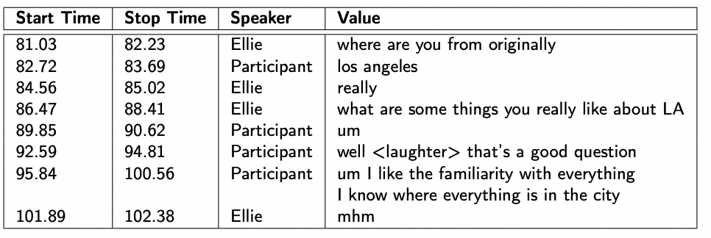
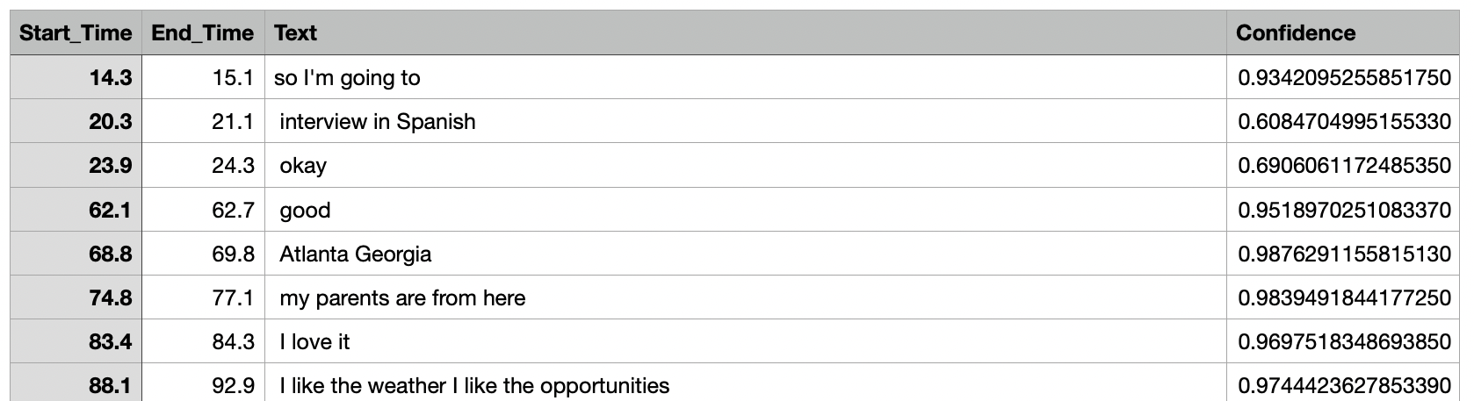
2. Dataset Comparison
2.2 Datasets Demo
Both datasets have been labeled with:
PHQ8_Binary | PHQ8_Score | Gender | PHQ8_NoInterest | PHQ8_Depressed | PHQ8_Sleep | PHQ8_Tired | PHQ8_Appetite | PHQ8_Failure | PHQ8_Concentrating | PHQ8_Moving
DAIC-WOZ Transcript example:
PHQ-8 | Depression Level
0 ~ 4 | Minimal Depression
5 ~ 9 | Mild Depression
10 ~ 14 | Moderate Depression
15 ~ 19 | Moderately Severe Depression
20 ~ 24 | Severe Depression
E-DAIC Transcript example:
02
Table 4: PHQ-8 Scores

Slide 5
3. METHODOLOGY
3.1 Data Preparing
word
A sentence
（1）Text Data
Obtaining raw transcripts
Text cleaning - NLTK stopwords and Word2Vec model
Embed each script into a 2-dimensional vector
A four-dimensional array: (s, ms, mw, d), where, s is sample size, ms is the max number of sentences of all samples, mw is the max number of words per sentence, and d is the dimensionality of the word vector)
For example, s = 57, ms = 250, mw = 20, d = 300
Text annotation - Word2Vec model
Class-balancing – Upsampling
Textual data
（2）Audio Data
Future improvement:
Extracting audio features using the latest techniques
Spectral analysis of speech-related features
Dimensional reduction for audio features
Class balancing
Using extracted audio features by COVARAP (already existed in the DAIC-WOZ Dataset)
Class balancing - Upsampling
03

Slide 6
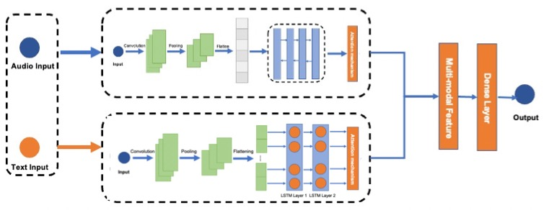
3. METHODOLOGY
3.2 Multi-modal Deep Learning Architecture:
Two inputs - text and audio.
Both branches consist of CNN layers, LSTM layers, and an attention layer to extract features.
Feature level fusion in the concatenate layer.
Integrating information and making the final prediction in a fully connected layer
Figure 6: The Structure of CLAM model
04

Slide 7
3. METHODOLOGY
3.3 The Comparison of Text and Audio Branch
 | Text branch | Audio branch
CNN layers | 2-D Convolutional Layer 150 convolutional kernels Window size: (1,5) Input size: (250,20,300) Activation function: ReLU 2-D Max-pooling Layer | 1-D Convolutional Layer Convolutional kernels: 60, 30, 15 kernel size: 10, 5, 5 Input size: (40000,74) Activation function: ReLU 1-D Max-pooling Layer
LSTM layers | LSTM | BiLSTM
Table 3: The Comparison of Text and Audio Branch
05

Slide 8

4. Audio Data Preprocessing
4.1 Remove Ellie’s Voice
def modify_audio_file(data, timings, sr, mode=False): timings = np.array(timings, float) samples = timings * sr samples = np.array(samples, int) pointer = 0 if mode: updated_audio = data[0:samples[0][1]] else: for i in samples: if pointer == 0: updated_audio = data[i[0]:i[1]] pointer += 1 else: updated_audio = np.hstack((updated_audio, data[i[0]:i[1]])) return updated_audio
Figure 7: DAIC-WOZ Transcript example
Figure 9: Code on removing audio
(https://github.com/adbailey1/daic_woz_process)
07
Start time
End time
Figure 8: Example of removing Ellie’s audio

Slide 9
Schedule for Next Week
01
Audio Feature Extraction Algorithm
08

