Slide 1
Automated Depression Recognition: A Multi-modal Deep Learning Framework to recognize depression from audio and text
Name: Yuxin Li

Slide 2
Agenda
01
Investigation of existing audio feature extraction approaches
1.1 Overview
1.2 Comparison of results in different audio feature extraction approaches
02
Replication of the state-of-art
2.1 Feature extraction implementation
2.2 Concatenate model

Slide 3
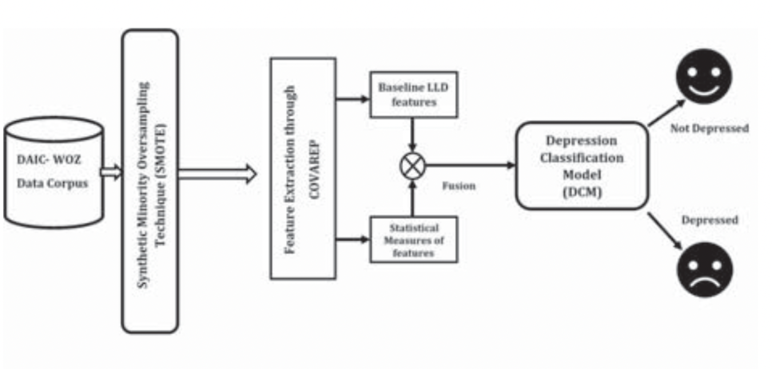
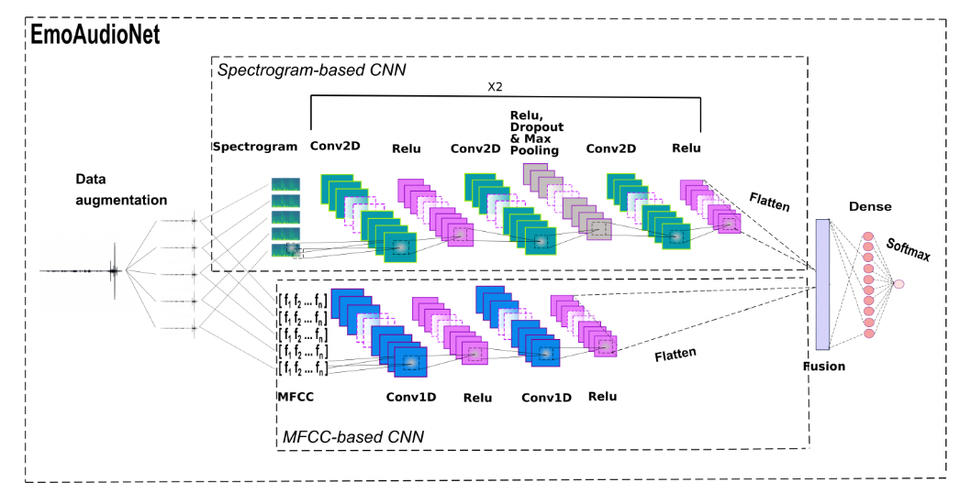
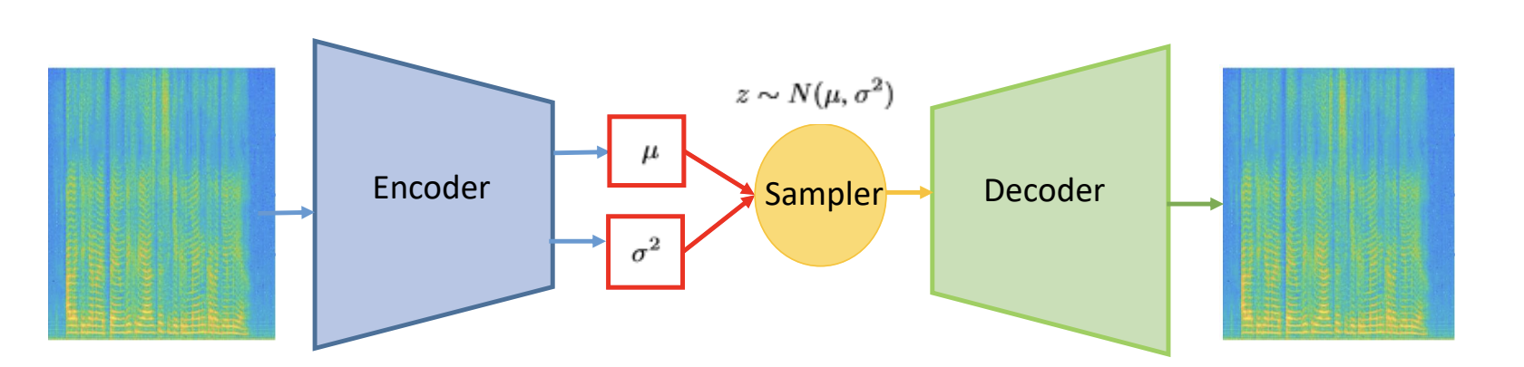
1. Audio Feature Extraction Approaches
1.1 Overview:
(1) Handcrafted Features-based: spectral features, cepstral features, prosodic features, voice quality features, statistical features, and Teager Energy Operator-based features (Othmani et al., 2021)
Feature Extraction
(2) Deep Neural Network(DNN)-based: Learn the abstract mathematical representation of informative patterns
(3) Handcrafted Features-based + DNN-based
(1) Handcrafted Features-based:
(3) Handcrafted Features-based + DNN-based:
Fig. 1: Architecture of Handcrafted Feature for Depression Detection (Yalamanchili et al., 2020)
(2) DNN-based:
Fig. 3: Architecture of DNN+Handcrafted features for Depression Detection (Othmani et al., 2021)
Code
01
Fig. 2: Architecture of DNN for Depression Detection (Garoufis et al. 2022)
Notes:
Handcrafted Features: Acoustic Low-Level Descriptors are extracted from the audio signal.
These predefined features are grouped into six main categories: the spectral features (Harmonic Model and Phase Distortion Mean etc.), the cepstral features ( (MFCC),.), the prosodic features etc.), and the voice quality features. A set of statistical features are also calculated (max, min, variance and standard deviation of features. Some researchers also propose the experimentation of the Teager Energy Operator (TEO) based features.
- different features and their combinations have similar accuracies (Zhang et al., 2021)

Slide 4
1. Audio Feature Extraction Approaches
1.2 Comparison of Results in Different Audio Feature Extraction Approaches:
Author(s) | Feature Extraction | Classifier | Modalities | Psychosis | Datasets | Results
Garoufis et al. 2022 | DNN-based |  | Audio | Schizophrenia | Self-collected data | ROC-AUC 0.7
Fu et al., 2021 |  |  | Audio | Schizophrenia | Self-collected data | Acc 98%
Amiriparian et al., 2019 |  |  | Audio | Bipolar Disorder | BD Dataset¹ | UAR 45.5%
Toto et al 2022 |  | - | Audio/Text | MDD | DAIC-WOZ | F1 Score 92%
Lam et al.2019 |  | - | Audio/Text | MDD | DAIC-WOZ | F1 Score 87%
Othmani et al., 2021 |  | - | Audio | MDD | RECOLA² | Arousal: Acc 75.65% Valence: Acc 73.81%
Alhanai et al. 2018 | Handcrafted-based | LSTM-RNN | Audio/Text | MDD | DAIC-WOZ | F1 Score 77%
Salekin et al., 2018 |  | NN2Vec + BLSTMMIL | Audio | MDD | DAIC-WOZ | F1 Score 85.4%
Yalamanchili et al., 2020 |  | SVM | Audio/Text/Video | MDD | DAIC-WOZ | F1 Score 84%
Othmani et al., 2021 |  | CNN | Audio | MDD | RECOLA | Arousal: Acc 70.23% Valence: Acc 71.12%
Othmani et al., 2021 | DNN-based+ Handcrafted¹ | CNN | Audio | MDD | RECOLA DAIC-WOZ | Arousal: Acc 89.30% Valence: Acc 91.44% F1 Score 82%
Zhang et al., 2021 |  | BLSTM | Audio | MDD | DAIC-WOZ | F1 Score 94%
Table 1: Comparison of results in different audio feature extraction methods
02
BD¹: This is one of the corpora used in the AVEC 2018 Challenge and includes both audio and video recordings taken from structured interviews conducted with 100 Turkish natives diagnosed with a form of BD (Ciftci et al. 2018)
RECOLA²: RECOLA dataset is a multimodal corpus of affective interactions in French. 46 subjects participated to data recordings. Only 23 audio recordings of 5 minutes of interaction are made publicly available and used in our experiments. Participants engaged in a remote discussion according to a survival task and six annotators measured emotion continuously on two dimensions: valence and arousal. (Ringeval et al.,2013)
Notes:
Deep Neural Network (DNN): do not extract predefined features from the data but allow the models to learn the abstract mathematical representation of informative patterns in speech without human knowledge in the loop. –
DNN overperforming the previous methods

Slide 5
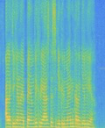
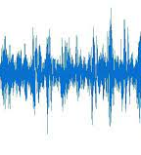
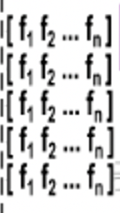
2. Replication of EmoAudioNet
2.1 Feature Extraction Implementation
Spectrograms
Spectral features
Raw audio file
Augmented audio files
MFCC features
Fig. 4: Feature Extraction Overview
Num. | Main Stages | Scope | Input | Output
1 | Data Augmentation | Noise augmentation and pitch augmentation of the original file | Raw audio file | Augmented audio files
2 | Spectrograms Generation | Generate a spectrogram for each audio file | Augmented audio files | Raw spectrograms
3 | Resize Spectrograms | Adjust the sizes of spectrograms | Raw spectrograms | Adjusted spectrograms
4 | Spectral Feature Extraction | Extraction of spectral features from spectrograms | Spectrograms | Spectral features
5 | MFCC Extraction | Extraction of MFCC feature from audio files | Augmented audio | MFCC features
03
Table 2: Main Stages of Feature Extraction

Slide 6
2. Replication of EmoAudioNet
2.2 Concatenate Model
Fig. 3: Architecture of DNN+Handcrafted features for Depression Detection (Othmani et al., 2021)
04
Notes:
(CONCATENATION) liyuxin@liyuxindeMacBook-Air AudioFeatureExtraction % python /Users/liyuxin/Documents/Depression_Recognition_Project/Audio_Project/AudioFeatureExtraction/Concatenate_Model.py

Slide 7
Plan for next week
01
Read 15+ latest papers on Depression Detection using LLMs
02
Try to replicate available research using LLMs on DAIC-WOZ

Slide 8
Thank you!

