Slide 1
Depression Detection Project
Presenter: Yuxin Li
Date: 5 June 2024

Slide 2
Agenda
01
Experiments on LLM model-based Depression Detection
1.1 LLM Model
1.2 Dataset
1.3 Experiment Methods
1.4 Results
02
Deal with Data Scarcity in Depression Detection
2.1 Sub-dialogue shuffling

Slide 3
1 Experiments on LLM model-based Depression Detection

Slide 4
1. Experiments on LLM model-based Depression Detection
1.1 Llama-2
An advanced open-source large language model developed by Meta
Support 20 languages
Two primary functionalities:
Version: Llama-2-7b, Llama-2-13b, Llama-2-70b
 | Text Completion | Chat Completion
Context Handling | to generate a continuation of a given prompt | To generate conversational responses in an interactive format
Use Cases | tasks requiring extended text generation from an initial prompt | interactive applications requiring back-and-forth communication
Interaction Style | one-time interaction based on a single prompt | continuous interaction
Table 1: Difference Between Text Completion and Chat Completion
01

Slide 5
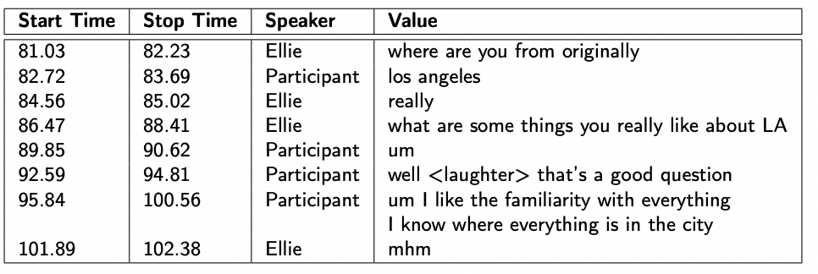
1. Experiments on LLM model-based Depression Detection
1.2 Dataset
DAIC-WOZ Dataset
Type: Clinical Interviews
Sample Size: 189
Each Patient is annotated with:
link
PHQ8_Binary | PHQ8_Score | Gender | PHQ8_NoInterest | PHQ8_Depressed | PHQ8_Sleep | PHQ8_Tired | PHQ8_Appetite | PHQ8_Failure | PHQ8_Concentrating | PHQ8_Moving
DAIC-WOZ Transcript example:
02

Slide 6


1. Experiments on LLM model-based Depression Detection
1.3 Experiments Method
PHQ 9 Scores
Data Preprocessing
Prompt Engineering
Diagnose
(Depression/No Depression)
Raw Transcripts
Preprocessed text
Llama-2 Model
03

Slide 7
1. Experiments on LLM model-based Depression Detection
1.3 Experiments Method
(1) Data Preprocessing
Remove Ellie’s transcript
Concatenate the sentences into a full paragraph
Example preprocessed transcripts:
Sure okay Los Angeles well that's a good question I like the familiarity with everything I know where everything is in the city That's all I can say right now So spread out so hard to get places Is there anything else My dream job I don't think there is a dream job for me No there isn't one I'm sort of unemployed right now So am I That's true I studied urban planning I think this school shooting thing and the NRA not wanting to budge on this gun control issue That's it I try to remove myself from that situation That's annoying me I've gotten better over the years Most of the time I just try to walk away or control my emotions in terms of just walking away Just watch TV now I would say my children being born…
04

Slide 8
1. Experiments on LLM model-based Depression Detection
1.3 Experiments Method
Aim of Experiments:
Is chat completion more suitable for the depression detection task than text completion?
Is the basic Llama 2 model capable of providing scores for each PHQ-9 question?
Will including the scoring instruction in the prompt improve the results?
Will Few-shot perform better than Zero-shot?
05

Slide 9
1. Experiments on LLM model-based Depression Detection
1.3 Experiments Method
(2) Prompt Engineering
Zero-shot
Version 1 & 2 Prompt:
No. | Llama 2 Functionality | Diagnose Scale | Prompt note
1 | Text Completion | PHQ 9 | Ask for PHQ 9 scores without scoring instruction
2 | Chat Completion | PHQ 9 | Ask for PHQ 9 scores without scoring instruction
3 | Chat Completion | PHQ 9 | Ask for PHQ 9 scores & provide scoring instruction
4 | Chat Completion | PHQ 9 | Only Ask for overall PHQ 9 score without scoring instruction
You are an experienced clinician specializing in mental health assessments. You have a patient's text record in front of you. Please determine whether the patient is experiencing Major Depressive Disorder (MDD) based on the criteria in PHQ 9 questions. Please predict the scores for each PHQ 9 question and predict an overall PHQ 9 score.
Patient Text Record:
{participant_text}
Your diagnosis is:
06

Slide 10
1. Experiments on LLM model-based Depression Detection
1.3 Experiments Method
(2) Prompt Engineering
Zero-shot
Version 3 Prompt:
No. | Llama 2 Functionality | Diagnose Scale | Prompt note
1 | Text Completion | PHQ 9 | Ask for PHQ 9 scores without scoring instruction
2 | Chat Completion | PHQ 9 | Ask for PHQ 9 scores without scoring instruction
3 | Chat Completion | PHQ 9 | Ask for PHQ 9 scores & provide scoring instruction
4 | Chat Completion | PHQ 9 | Only Ask for overall PHQ 9 score without scoring instruction
You are an experienced clinician specializing in mental health assessments. You have a patient's text record in front of you. Based on the text, predict scores from 0 to 3 for each of the 9 questions in the PHQ-9 questionnaire. Use the following scale for scoring:
- 0: Not at all
- 1: Several days
- 2: More than half the days
- 3: Nearly every day
Provide the overall PHQ score
Patient Text Record:
{participant_text}
Your diagnosis is:
07

Slide 11
1. Experiments on LLM model-based Depression Detection
1.3 Experiments Method
(2) Prompt Engineering
Zero-shot
Version 4 Prompt:
No. | Llama 2 Functionality | Diagnose Scale | Prompt note
1 | Text Completion | PHQ 9 | Ask for PHQ 9 scores without scoring instruction
2 | Chat Completion | PHQ 9 | Ask for PHQ 9 scores without scoring instruction
3 | Chat Completion | PHQ 9 | Ask for PHQ 9 scores & provide scoring instruction
4 | Chat Completion | PHQ 9 | Only Ask for overall PHQ 9 score without scoring instruction
You are an experienced clinician specializing in mental health assessments. You have a patient’s text record in front of you. Please determine whether the patient is experiencing Major Depressive Disorder (MDD) based on the criteria in PHQ-9 questions and predict an overall PHQ-9 score.
Patient Text Record:
{participant_text}
Your diagnosis is:
08

Slide 12
1. Experiments on LLM model-based Depression Detection
1.3 Experiments Method
(2) Prompt Engineering
Version 1 & 2 Prompt:
Few-shot
You are an experienced clinician specializing in mental health assessments. You have a patient’s text record in front of you. Please determine whether the patient is experiencing Major Depressive Disorder (MDD) based on the criteria in PHQ-9 questions and predict an overall PHQ-9 score. Here is an example: {example_diagnosis} Now, please evaluate the following patient's text record: Patient Text Record: {participant_text} Your diagnosis is:
No. | Llama 2 Functionality | Diagnose Scale | Example No.
1 | Text Completion | PHQ 9 | 1
2 | Chat Completion | PHQ 9 | 1
3 | Chat Completion | PHQ 9 | 2
4 | Chat Completion | PHQ 9 | 3
09

Slide 13
1. Experiments on LLM model-based Depression Detection
1.3 Experiments Method
(2) Prompt Engineering
Version 3 Prompt:
Few-shot
You are an experienced clinician specializing in mental health assessments. You have a patient’s text record in front of you. Please determine whether the patient is experiencing Major Depressive Disorder (MDD) based on the criteria in PHQ-9 questions and predict an overall PHQ-9 score. Example 1: {example_1}
Example 2: {example_2}
Now, please evaluate the following patient's text record: Patient Text Record: {participant_text} Your diagnosis is:
No. | Llama 2 Functionality | Diagnose Scale | Example No.
1 | Text Completion | PHQ 9 | 1
2 | Chat Completion | PHQ 9 | 1
3 | Chat Completion | PHQ 9 | 2
4 | Chat Completion | PHQ 9 | 3
10

Slide 14
1. Experiments on LLM model-based Depression Detection
1.3 Experiments Method
Version 4 Prompt:
(2) Prompt Engineering
You are an experienced clinician specializing in mental health assessments. You have a patient’s text record in front of you. Please determine whether the patient is experiencing Major Depressive Disorder (MDD) based on the criteria in PHQ-9 questions and predict an overall PHQ-9 score. Example 1: {example_1}
Example 2: {example_2}
Now, please evaluate the following patient's text record: Patient Text Record: {participant_text} Your diagnosis is:
Few-shot
No. | Llama 2 Functionality | Diagnose Scale | Example No.
1 | Text Completion | PHQ 9 | 1
2 | Chat Completion | PHQ 9 | 1
3 | Chat Completion | PHQ 9 | 2
11

Slide 15
1. Experiments on LLM model-based Depression Detection
1.3 Diagnose Results
Zero-shot
No | Llama 2 Functionality | Acc | Pre | Rec | F1 | Sample Size | Prompt Description
0 | Text Completion | 0.445 | 0.377 | 0.836 | 0.519 | 146 | Only ask for diagnose results (Depression/Non depression)
1 | Text Completion | 0.317 | 0.375 | 0.714 | 0.492 | 142 | Ask for PHQ 9 scores without scoring instruction
2 | Chat Completion | 0.292 | 0.316 | 0.969 | 0.477 | 106 | Ask for PHQ 9 scores without scoring instruction
3 | Chat Completion | 0.25 | 0.333 | 0.583 | 0.423 | 28 | Ask for PHQ 9 scores & provide scoring instruction
4 | Chat Completion | 0.414 | 0.456 | 0.953 | 0.617 | 99 | Only Ask for overall PHQ 9 score without scoring instruction
Chat completion is not more suitable for the depression detection task than text completion.
Only asking for overall scores performs better than individual scores for each of the 9 questions, but causes more sample loss.
Including the scoring instruction in the prompt will not improve the results.
12

Slide 16
1. Experiments on LLM model-based Depression Detection
1.3 Diagnose Results
Zero-shot
No | Llama 2 Functionality | Acc | Pre | Rec | F1 | Sample Size | Prompt Description
1 | Text Completion | 0.445 | 0.377 | 0.836 | 0.519 | 146 | Only ask for diagnose results (Depression/Non depression)
2 | Text Completion | 0.317 | 0.375 | 0.714 | 0.492 | 142 | Ask for PHQ 9 scores without scoring instruction
3 | Chat Completion | 0.292 | 0.316 | 0.969 | 0.477 | 106 | Ask for PHQ 9 scores without scoring instruction
4 | Chat Completion | 0.25 | 0.333 | 0.583 | 0.423 | 28 | Ask for PHQ 9 scores & provide scoring instruction
5 | Chat Completion | 0.414 | 0.456 | 0.953 | 0.617 | 99 | Only Ask for overall PHQ 9 score without scoring instruction
Few-shot
No | Llama 2 Functionality | Acc | Pre | Rec | F1 | Sample Size | Exa No. | Prompt Description
1 | Text Completion | 0.554 | 0.407 | 0.603 | 0.451 | 166 | 1 | Only ask for diagnose results (Depression/Non depression)
2 | Text Completion | 0.05 | 0.133 | 0.222 | 0.166 | 39 | 2
3 | Text Completion | 0.693 | 0.203 | 0.276 | 0.234 | 128 | 1 | Only Ask for overall PHQ 9 score without scoring instruction
4 | Chat Completion | 0.613 | 0.167 | 0.313 | 0.219 | 93 | 1 | Ask for PHQ 9 scores without scoring instruction
5 | Chat Completion | / | / | / | / | 5 | 2
Zero-shot performs better than Few-shot
Text Completion performs better than chat completion in few-shot
2 examples of few-shot causing steep decreasing
13

Slide 17
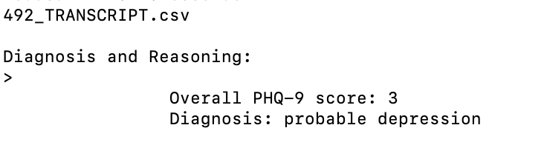
1. Experiments on LLM model-based Depression Detection
1.3 PHQ-9 Scores Results
Zero-shot
No | Llama 2 Functionality | Overall transcripts | Valid PHQ scores | Invalid PHQ scores | Prompt Description
1 | Text Completion | 189 | 46 | 143 | Ask for PHQ 9 scores without scoring instruction
2 | Chat Completion | 189 | 35 | 54 | Ask for PHQ 9 scores without scoring instruction
3 | Chat Completion | 189 | 9 | 180 | Ask for PHQ 9 scores & provide scoring instruction
4 | Chat Completion | 189 | 19 | 170 | Only Ask for overall PHQ 9 score without scoring instruction
Few-shot
No | Llama 2 Functionality | Overall transcripts | Valid PHQ scores | Invalid PHQ scores | Exa No. | Prompt Description
5 | Text Completion | 189 | 96 | 93 | 1 | Only Ask for overall PHQ 9 score without scoring instruction
6 | Chat Completion | 189 | 76 | 113 | 1
7 | Chat Completion | 189 | 3 | 186 | 2 | Only Ask for overall PHQ 9 score without scoring instruction
Most of them failed to generate PHQ scores
The wrong diagnosis result based on the PHQ score (DAIC-WOZ: PHQ >= 10 -- Major Depression Detection)
14

Slide 18
1. Experiments on LLM model-based Depression Detection
1.4 Summary
Chat completion is not more suitable for the depression detection task than text completion.
Long prompts may cause more sample loss
Most of them failed to generate PHQ scores
The wrong diagnosis result based on the PHQ score
15

Slide 19
2 Deal with Data Scarcity

Slide 20
2. Deal with Data Scarcity
2.1 Sub-Dialogue Shuffling
Definition: A technique where segments of dialogues are shuffled to create new training samples.
Purpose:
To generate more diverse dialogue scenarios.
To enhance the model’s ability to understand context
16

Slide 21
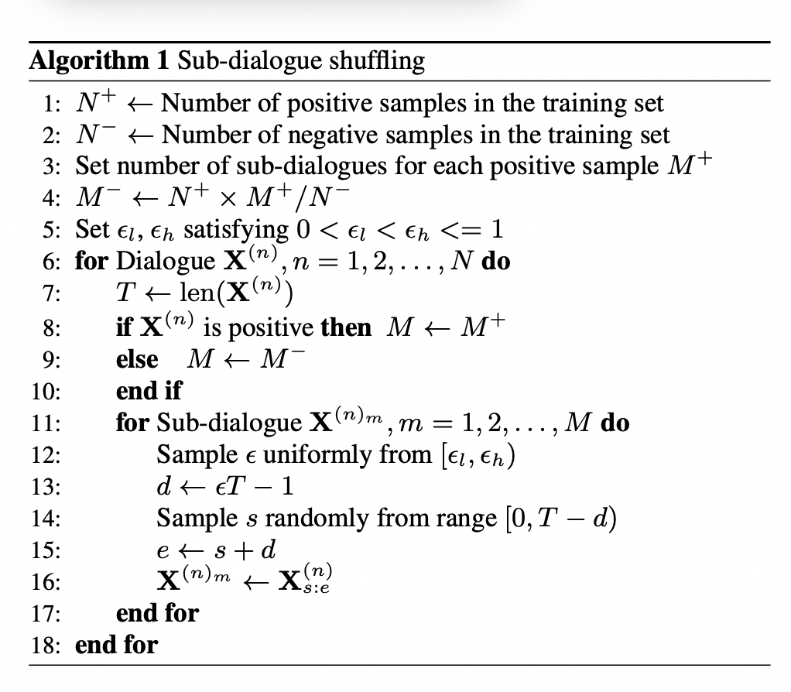
2. Deal with Data Scarcity
2.1 Sub-Dialogue Shuffling
Before:
Dialogue 1: (Positive)
"How are you today?"
"I'm doing well, thank you."
"That's great to hear!"
Dialogue 2: (Negative)
"I'm feeling very sad."
"I'm sorry to hear that."
"It's been a tough week."
After (Generated Sub-dialogues):
Sub-dialogue from Dialogue 1:
"How are you today?"
"I'm doing well, thank you."
Sub-dialogue from Dialogue 1:
"I'm doing well, thank you."
"That's great to hear!"
Sub-dialogue from Dialogue 2:
"I'm feeling very sad."
"I'm sorry to hear that."
Paper: Self-supervised representations in speech-based depression detection (Wu et al., 2023)
17

Slide 22
Plan for next week
01
Make recordings
Design code to transfer new recordings to the DAIC-woz format
02
03
Zero-shot on ChatGPT 4o
04
Fine-tune Llama 2
05
Experiment text with full dialogue
06
Experiment Sub-dialogue shuffling in my previous multimodal model

Slide 23
Thank you!

