Slide 1


VISVESVARAYA TECHNOLOGICAL UNIVERSITY JNANASANGAMA, BELAGAVI CAUVERY INSTITUTE OF TECHNOLOGY, MANDYA
Two Way Communication System for Deaf and Dumb People
PRESENTED BY UNDER THE GUIDANCE OF
SINCHANA (4CA22CS099) Prof. SAHANA G C
SOUNDARYA K S (4CA22CS102) (Dept of Computer Science)
THASHMITHA M H (4CA22CS109)
VARSHINI M U (4CA22CS113)

Slide 2
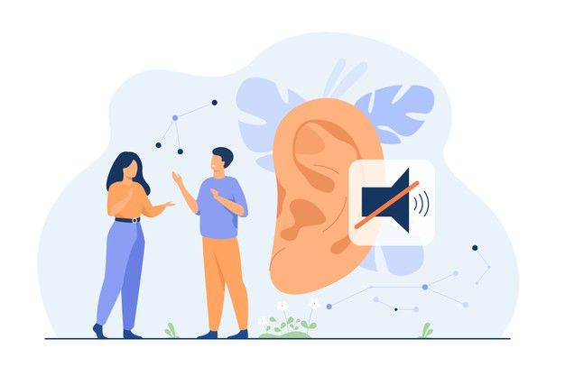
TWO WAY COMMUNICATION SYSTEM FOR DEAF AND DUMB PEOPLE

Slide 3
TABLE OF CONTENTS
INTRODUCTION
PROBLEM STATEMENT
OBJECTIVES
SOFTWARE AND HARDWARE REQUIREMENTS
LITERATURE REVIEW
MODULES
SYSTEM ARCHITECTURE
USE CASE DIAGRAMS
IMPLEMENTATION STEPS
SYSTEM TESTING
EXISTING SYSTEM
PROPOSED SYSTEM
SNAPSHOTS
APPLICATIONS
FUTURE ENHANCEMENT
CONCLUSION

Slide 4
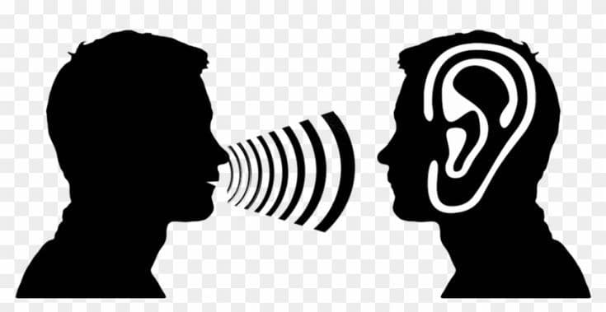
INTRODUCTION
AI-powered two-way communication bridge.
Converts speech ↔ sign language in real time.
Uses speech recognition, NLP, MediaPipe, and ANN.
Enables inclusive interaction for deaf users.

Slide 5
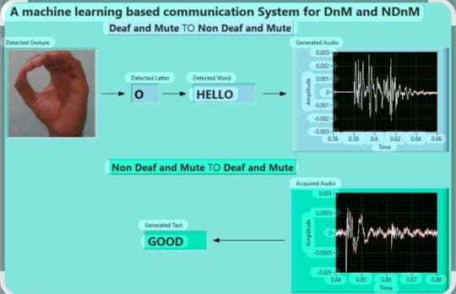
EXISTING SYSTEM
One-way translation only.
Limited sign vocabulary.
Requires costly hardware (gloves/sensors).
Not real-time and low accuracy.
Separate tools for speech and gesture.
Poor user experience in real scenarios

Slide 6
PROBLEM STATEMENT
Sign Language not widely understood.
Existing tools are one-directional.
Communication gaps in education, healthcare, workplaces.
Need for fast, low-cost, real-time translation.

Slide 7
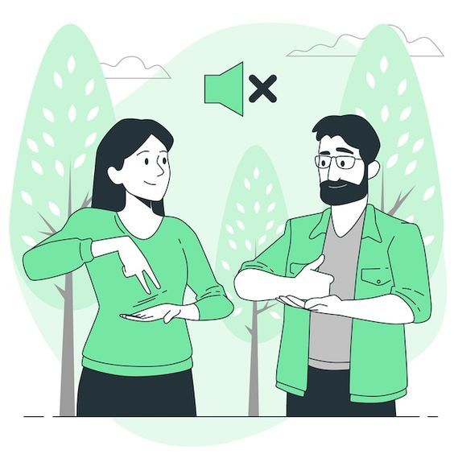
OBJECTIVE
Build bidirectional translation system.
Speech → Sign via STT + NLP.
Sign → Text via webcam + ANN.
Deliver real-time, user-friendly interface.

Slide 8
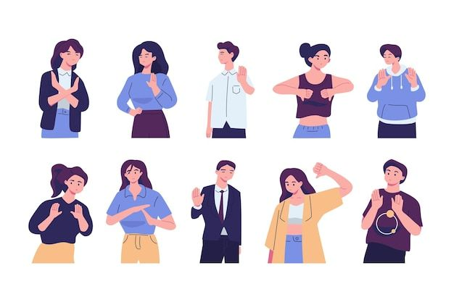
PROPOSED SYSTEM
Fully bidirectional: Speech ↔ Sign.
Real-time, high-accuracy processing.
MediaPipe + ANN for robust gesture recognition.
Low-cost setup: webcam + microphone.
One integrated, user-friendly platform.
Scalable for education, healthcare, workplaces.

Slide 9
LITERATURE SURVEY
PAPER TITLE | AUTHORS | OBJECTIVE | METHODOLOGY | ACCURACY
Sign Language Translation | R . Harini, R. Janani, S. Keerthana ,S . Madhubala, S. Venkatasubramanian (2020). | To develop a real time sign language translator using image processing and machine learning. | Used edge detection and segmentation for hand gesture extraction. Implemented SVM (Support Vector Machine)for gesture. | The mode F1-scoreo its ability t across all being bias particular Weighted
Sign Language Translator Using Deep Learning Techniques | S. Krishna murthi, I.M (2021) | To apply deep learning models (CNN and RNN) for sign language recognition . | Used CNN for feature extraction and LSTM for sequential gesture recognition . Data augmentation. | 89%accuracy

Slide 10
Real Time Sign Language Translation Systems : A | M. Papatsimouli et al. (2022) | To review real-time sign language translation | Analyzed vision-based(CNN, RNN)and sensor-based | The review signs with 88% in recovery.
System for Helping Disabled People | Mia, R. Hassan (2023) | sign language recognition system for mobile applications. | And SVM for classification. Integrated with mobile devices for real-time processing. | 85% accuracy
A Novel Machine Learning-Based Two-Way Communication System for Deaf and Mute. | M.I .Saleem ,A. Siddiqui, S. Noor , M.-A .Luque - Nieto, P. Otero (2023) | To develop a two way communication system for the deaf and mute community | Used CNN for static sign recognition and LSTM for sequential gesture classification. | this is between due to var gestures people.

Slide 11
SOFTWARE AND HARDWARE REQUIREMENTS
HARDWARE REQUIREMENT
SOFTWARE REQUIREMENT
Processor : Intel i3 3.30 GHz.
Hard Disk : 40 GB (min)
RAM : 4GB
Operating system : Windows 7 and above.
Coding Language : Python.
Framework : Django
Front End : HTML,CSS,JAVASCRIPT
Back End : MYSQL

Slide 12
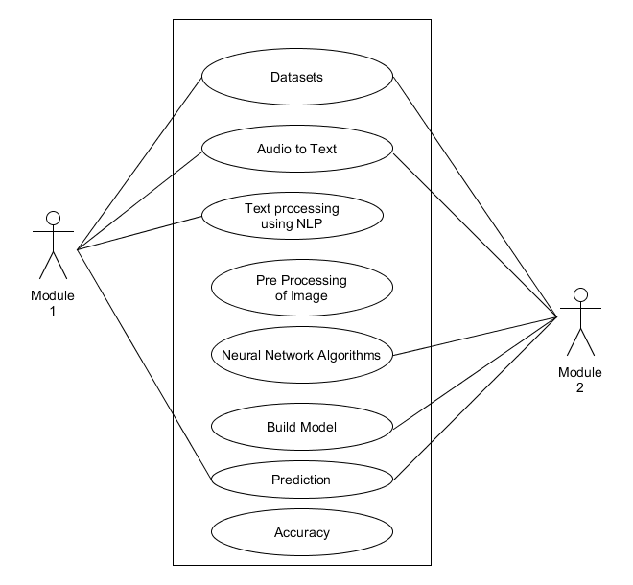
USE CASE DIAGRAM

Slide 13
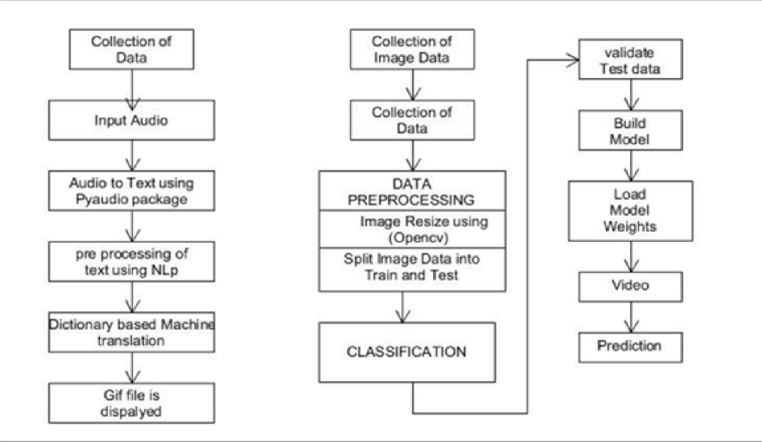
SYSTEM ARCHITECTURE

Slide 14
MODULES
Speech-to-Sign: Audio capture, STT, NLP, ASL animation.
Sign-to-Text: MediaPipe landmarks, ANN gesture recognition.
UI Module: Module switching, output display.

Slide 15
IMPLEMENTATIONS STEPS
Speech-to-Sign
Sign-to-Text
System Integration
Audio capture
Speech-to-text
NLP cleanup
Gesture mapping
ASL animation
Webcam input
Hand landmarks
ANN classification
Text output
Real-time processing
Lightweight models
Simple unified UI

Slide 16
SYSTEM TESTING
tests: STT ↔ NLP, MediaPipe ↔ ANN.
End-to-end validationUnit tests on NLP, preprocessing, mapping.
Integration.
Latency, accuracy, and robustness checks.

Slide 17
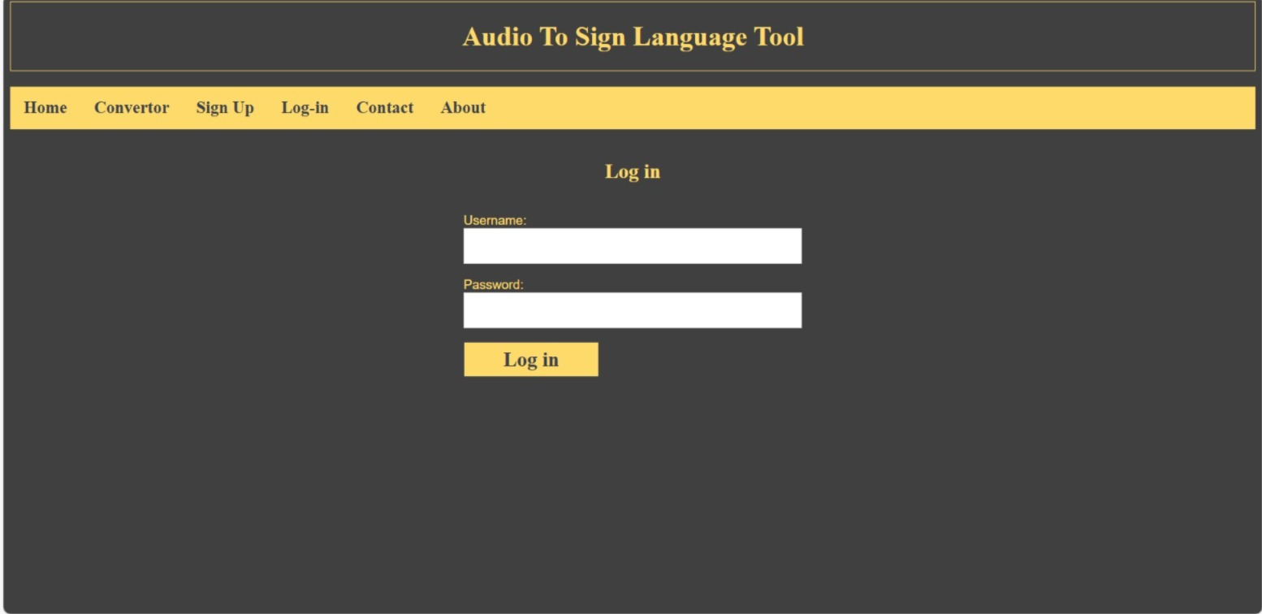
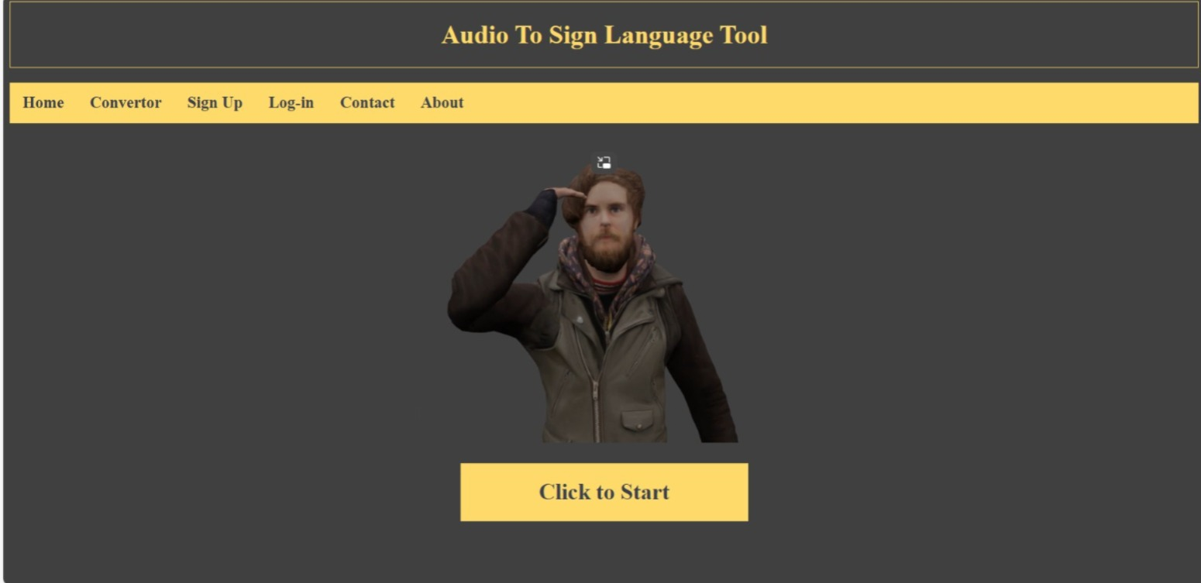
SNAPSHOTS
Login
Home

Slide 18
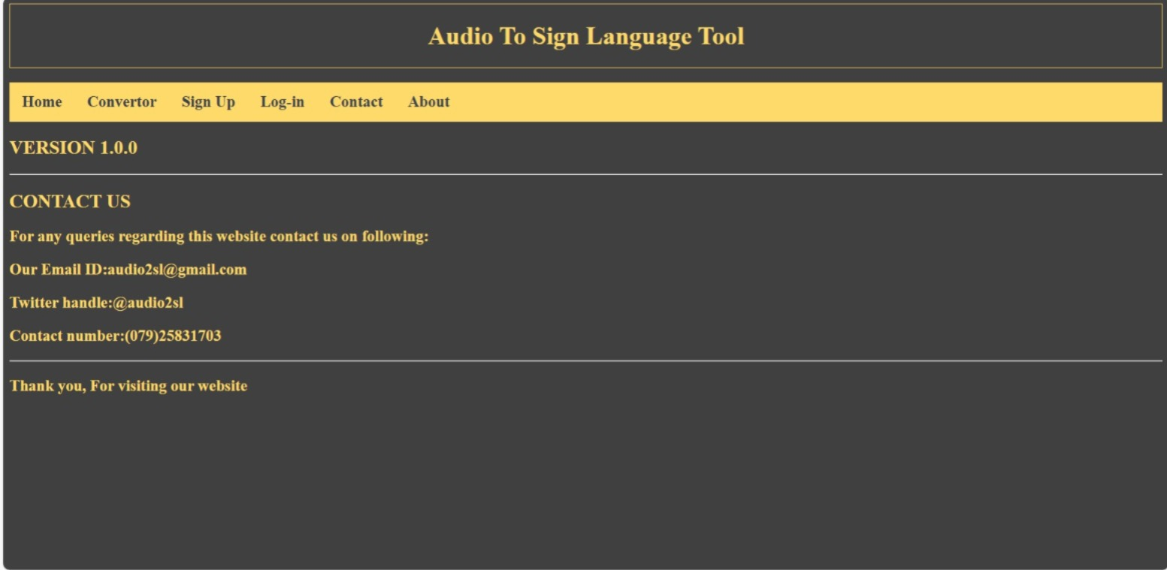
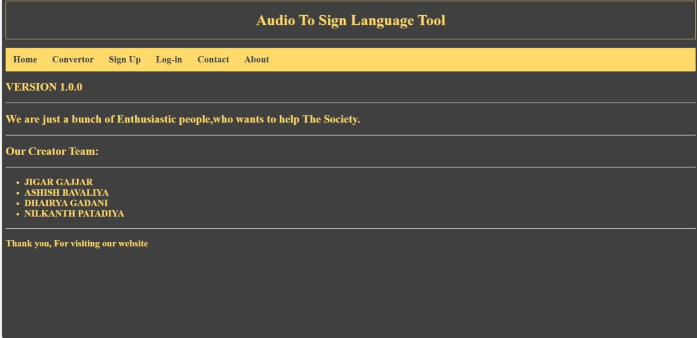
Page
Contact
About

Slide 19
APPLICATIONS
Classrooms & learning support
Hospitals & emergency communication
Public service kiosks
Workplaces & corporate accessibility
Personal assistive communication

Slide 20
CONCLUSION
Delivers a cost-efficient, real-time, and inclusive two-way communication system.
Bridges communication gaps using modern AI technologies.
Scalable platform with significant social impact potential.

Slide 21
FUTURE ENHANCEMENTS
Dynamic gesture recognition
Multi-language support (ISL, regional languages)
Mobile app integration
3D avatar-based sign animations

Slide 22
THANK YOU

