Slide 1
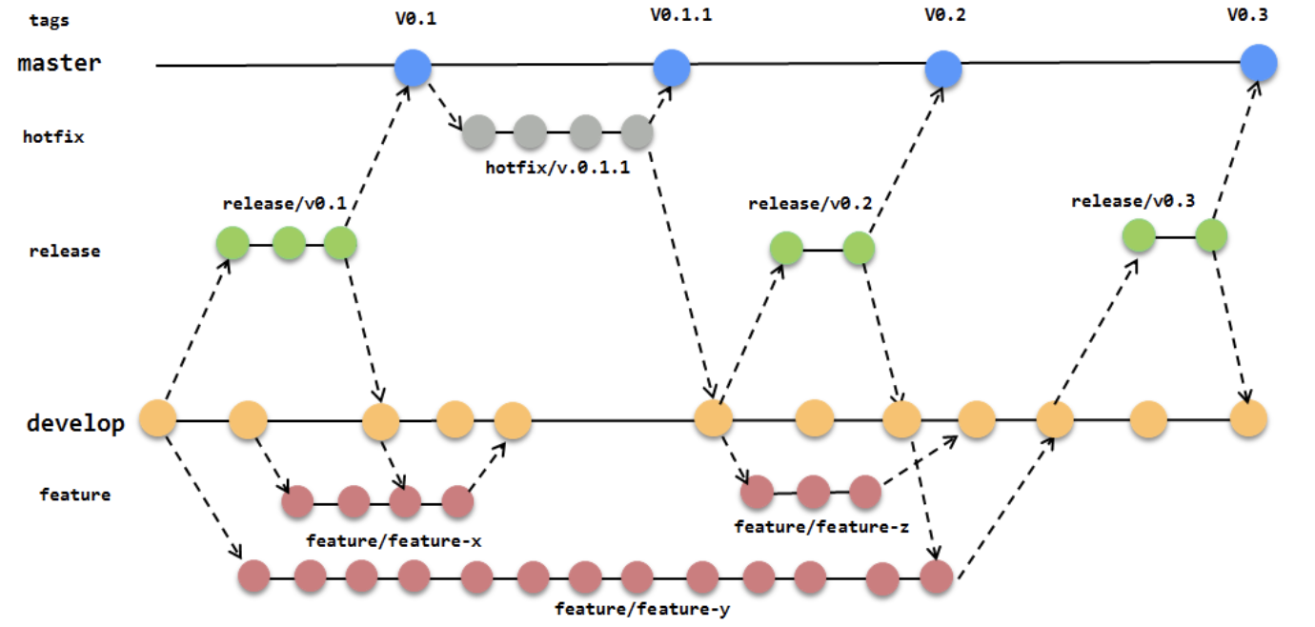
Branching & Release Workflow

Slide 2
Branching Strategy
There will be a 3 Branches. (develop, master, release candidate)
master
Will be a working copy that is on Production
Will be Tagged with a versions (e.g. V0.1, V0.1.1 etc.)
All Hotfixes will be worked on off “master”.
develop
Will be the branch for all feature development
All feature branches will be merged into develop.
This will be the source for the Release Candidate Branch.

Slide 3
Branching Strategy
Release Candidate
This will be the source for release to all High-Level Environments like (QA, Staging, Stress etc.).
There will be no modifications directly off the Release Candidate branch.
Features from develop branch will be merged into Release Candidate branch
Hotfixes will not be merged into any existing Release Candidate as they would be merged into develop and be a part of the next Release Candidate.

Slide 4
Hot Fixes Strategy
The Hotfixes will be branched off “master“.
Once fixed, they will be merged into “master” and “develop”
Once merged into “master” there will be versioning and the branch will be appropriately tagged.
Release Strategy
All Releases will be deployed from the Tagged version of “master” branch.
Docker Images for the Releases will be Tagged with same versions.

