Slide 1

Plant Disease Classification using Deep Learning

Slide 2
Plant Disease Classifier with TensorFlow
Early blight, late blight, and healthy potato plants represent distinct states of plant health, each influenced by environmental conditions and pathogen presence. Recognizing the symptoms associated with these conditions is essential for implementing effective disease management strategies. A plant disease classifier can play a pivotal role in early detection and mitigation efforts, aiding farmers in safeguarding potato crops and ensuring food security.
This project involves building a deep learning model using TensorFlow to classify plant diseases based on images.

Slide 3
Dataset Loading and Preprocessing
The PlantVillage dataset is loaded and preprocessed using TensorFlow's ImageDataGenerator.
Code Snippet:
# Loading and Preprocessing the Dataset
dataset = tf.keras.preprocessing.image_dataset_from_directory(
"PlantVillage",
seed=123,
shuffle=True,
image_size=(IMAGE_SIZE, IMAGE_SIZE),
batch_size=BATCH_SIZE
)

Slide 4
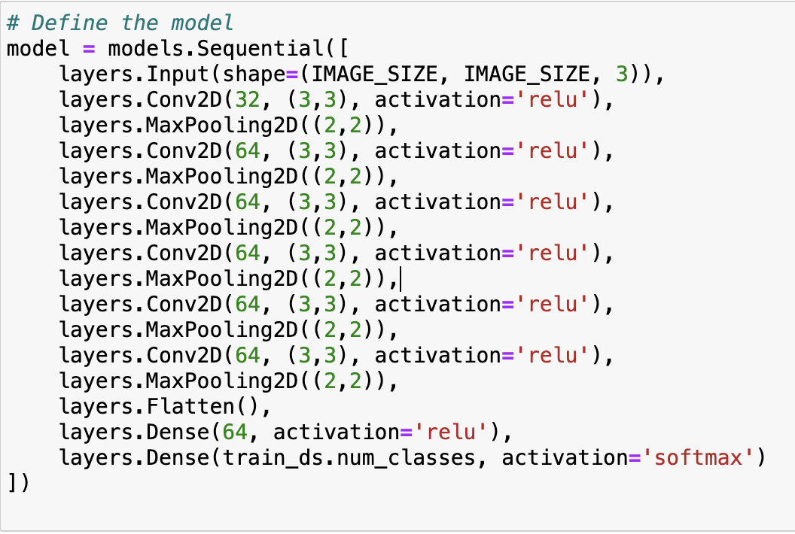
Model Architecture
The architecture of the convolutional neural network (CNN) model is defined using TensorFlow's Keras API.

Slide 5
Training the Model
Code snippet
The model is compiled and trained using the specified optimizer, loss function, and evaluation metrics.
It showcases the compilation of the model using the Adam optimizer and categorical cross-entropy loss function.
Additionally, key parameters such as the number of epochs, batch size, and validation data are highlighted.
It is an iterative process of model training and validation for achieving optimal performance.
# Compiling and Training the Model
model.compile(optimizer='adam',
loss='categorical_crossentropy',
metrics=['accuracy'])
history = model.fit(
train_ds,
epochs=EPOCHS,
batch_size=BATCH_SIZE,
verbose=1,
validation_data=val_ds
)

Slide 6
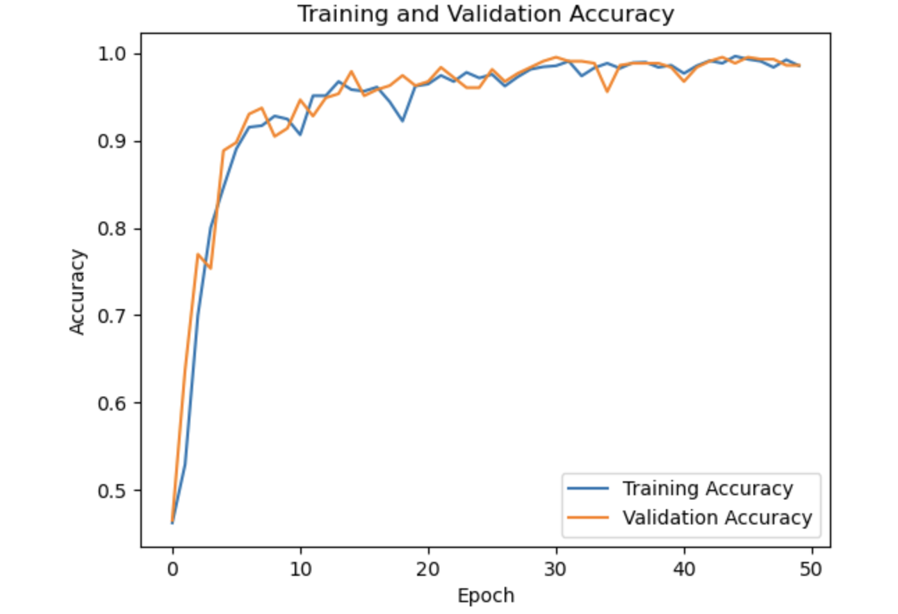
Model Evaluation - Accuracy

Slide 7
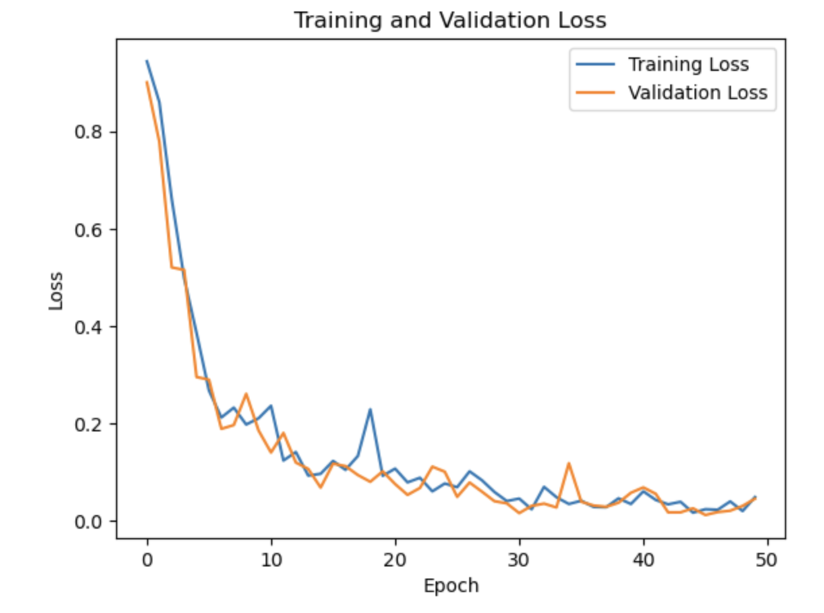
Model Evaluation - Loss

Slide 8
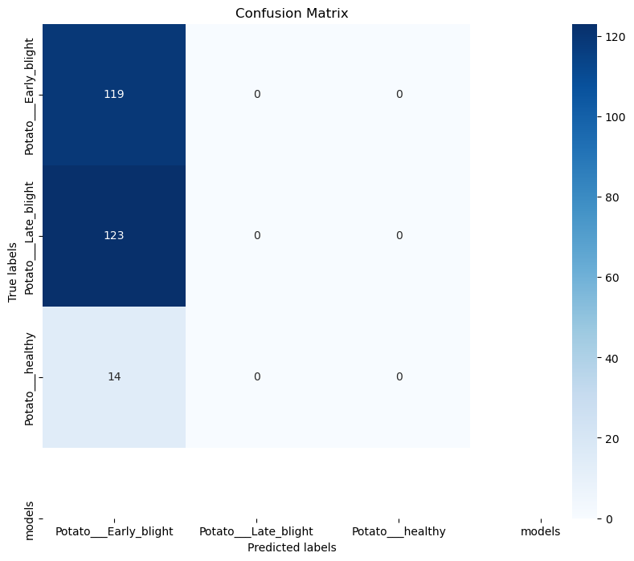
Model Evaluation - Confusion Matrix
The confusion matrix as a visual representation of the model's classification performance. The heatmap showcases the distribution of true and predicted labels across different classes, providing insights into the model's ability to correctly classify plant diseases. The slide highlights the utility of the confusion matrix in assessing the model's overall performance and identifying areas for improvement.

Slide 9
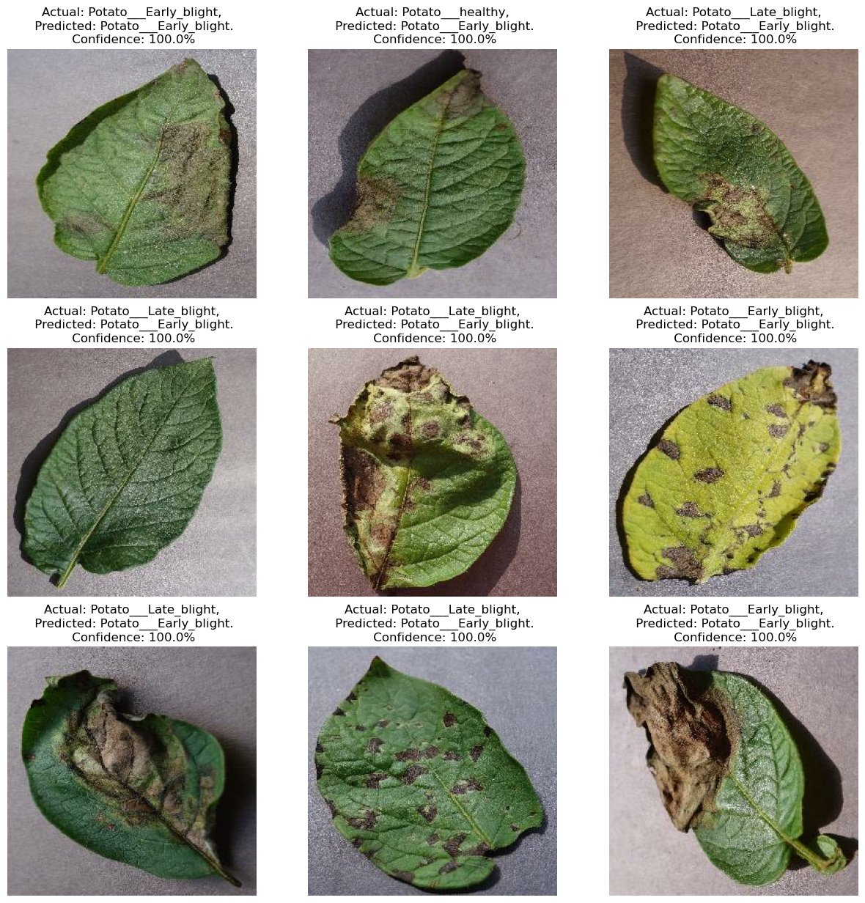
Prediction and confidence

Slide 10
Thank you!

