Slide 1

GOVERNMENT ENGINEERING COLLEGE, KUSHALNAGAR - 571234
DEPARTMENT OF ELECTRONICS AND COMMUNICATION ENGINEERING
MAIN PROJECT PRESENTATION on
“Tomato Plant Disease Detection using Image Processing”
Presented by,
Keerthana R 4GL21EC056
Gagana T V 4GL22EC402
Rakshitha M K 4GL22EC404
Sinchana 4GL22EC406
Under the guidance of,
Prof. SUSHMA.S B.E.,M.Tech
Assistant Professor
Dept. of E & C Engineering
Government Engineering College
Kushalnagara - 571 234

Slide 2
CONTENTS
Introduction
Objectives
Scope
Importance
Literature Survey
Methodology
Hardware Requirements
Software Requirements
Flowchart
Result
Advantages and applications
Conclusion

Slide 3
INTRODUCTION Background:
The primary occupation in India is agriculture. India ranks second in agriculture output worldwide. About 70% of the population relies on agriculture. Tomatoes hold a significant position among the various plants accounting for approximately 16% of the market share.
Food security remains threatened by a number of factors and one of those factors is Plant disease. Tomato diseases can severely reduce the quantity and quality of tomato crops leading to lower yields. In the developing world more than 80% of the agricultural production is generated by smallholder farmers and reports of yield loss than 50%due to pests and disease are common.

Slide 4
Objectives:
Train and optimize the MobileNetV2 convolutional neural network model for accurate classification of diseased and healthy tomato plants.
Provide real-time feedback for the farmers to take preventive measures.
Scope:
By leveraging machine learning technique, image processing enables early detection of various tomato plant disease such as early blight and late blight.
Importance:
Early and accurate detection of diseases allow farmers to take timely corrective measures preventing the spread of infections and minimizing crop losses.

Slide 5
Literature Survey:
Sl. No | Author | Year | Methadology | Limitations | Result
1. | Sagar Vital (Tomato plant disease detection using image processing). | 2017 | Image segmentation and Multi-class SVM algorithm. | It deals with binary system and can classify only two inputs. | Achieves accuracy of 93.75%.
2. | Lakshmana Rao (Precise detection of tomato leaf disease using deep learning). | 2021 | CNN & MobileNetV2 algorithms Deep learning model. | Limited imbalance dataset reduce model performance. Environmental noise can mislead models. | Achieves accuracy of 99.50%.

Slide 6
Methodology
Block diagram:
Data Base
Pre-processing
Build Training & Test- Database
Model Learning
Symptoms Identified & Disease Detection
Evaluation
Fig: Block diagram

Slide 7
HARDWARE COMPONENTS:
Laptop: A laptop with sufficient processing power and memory to run the machine learning model and interface software.
GPU (Graphics Processing Unit): A GPU is a specialized electronic circuit designed to quickly manipulate and alter memory to accelerate the creation of images on a display device.
Hard Disk Drive (HDD): Store large amounts of image data and feature extraction data.
Internet Connectivity: An internet connection is required for accessing cloud-based resources, uploading datasets, and deploying the system online.

Slide 8
SOFTWARE REQUIREMENT:
Operating System: The system should be compatible with popular operating systems such as Windows, macOS, and Linux.
Python Libraries: Required Python libraries include TensorFlow, Keras, Gradio, NumPy, and Pandas for machine learning, interface development, and data manipulation.
Deep Learning Frameworks: TensorFlow or TensorFlow-GPU and Keras for building, training, and deploying deep learning models.
IDE (Integrated Development Environment): Optional IDEs such as Jupyter Notebook or PyCharm for code development and experimentation.
Cloud Platform: Access to cloud-based platforms such as Google Colab for training machine learning models using GPU resources and deploying web interfaces.

Slide 9
Flow chart:
Start
Data collection
Pre-Process Image
Run Image through Mobile NetV2 Model
If
Symptoms ?
No
Yes
Identify Disease Type
Early Blight
(Brown spot)
Late Blight(Water soaked grayish-green spot))
Display Healthy Status
Send Disease Alert
Stop

Slide 10
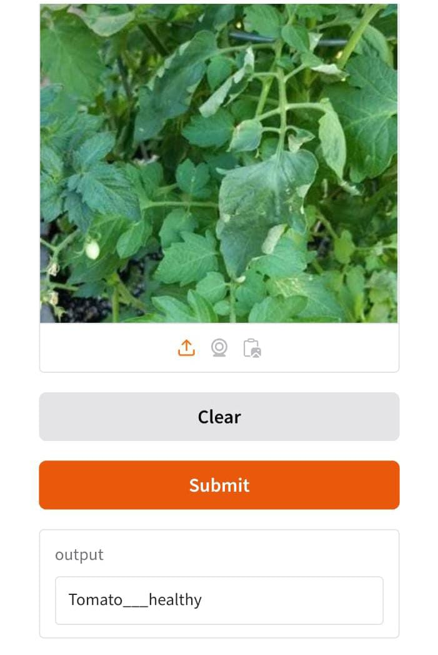
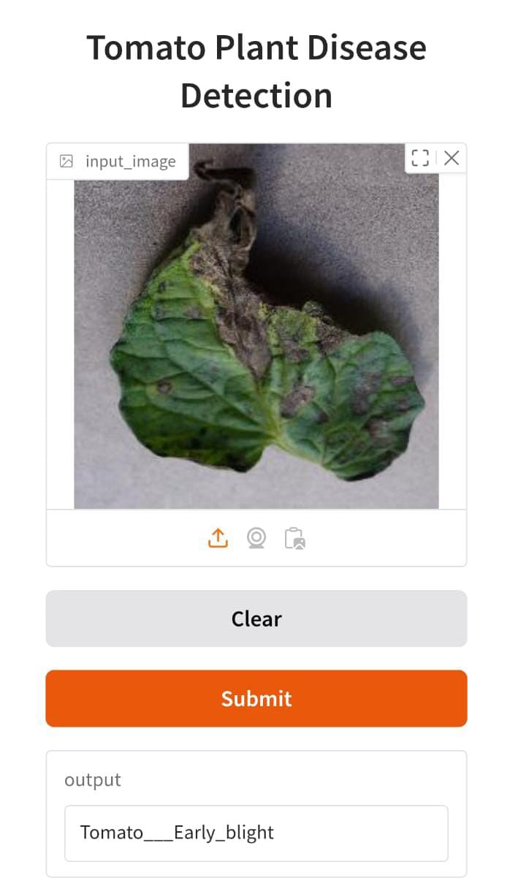
Result:

Slide 11
ADVANTAGES:
Early Detection: Image processing can identify symptoms of diseases at early stages enabling prompt intervention and reducing crop loss.
Non-invasive: It allows for disease detection without physically damaging the plants ensuring that their health and growth are not compromised.
Accuracy and precision: Automated image processing techniques can provide highly accurate and consistent detection reducing human error and subjectivity.
Cost-effective: Automated disease detection through image processing reduces the need for labour-intensive manual inspections saving costs for farmers especially on large-scale farms.

Slide 12
Limitations:
Image Resolution: Low-resolution images and poor quality images may decrease the accuracy in finding symptoms.
Limited Dataset Diversity: Most systems are trained on specific datasets which may not cover all possible variations of diseases plant species or environmental condition.

Slide 13
CONCLUSION:
The approach presented in this project for tomato plant disease detection using image processing, trained a deep learning model using a dataset of tomato leaf images which was collected from various sources. The trained model was able to accurately detect the presence of two common tomato leaf diseases namely early blight, late blight and healthy leaves. The proposed system is designed to provide an easy-to-use and efficient solution for detecting tomato leaf diseases. It uses a web interface page that allows end-users to upload images of tomato leaves and get real-time predictions on the presence of diseases. The result reported better classification accuracies for all the disease and percentage accuracy is 85%.

Slide 14
THANK YOU

