Slide 1
Name : Sinchana K
Roll no : 26150511
PART A
CPU(Processor):
• Model Name: 12th Gen Intel(R) Core(TM) i5-12450H
• Number of cores: 8
• Logical Processors: 12
RAM(Memory):
• Total RAM: 32 GB DDR4
• RAM Speed(MHz): 3200 MT/s
Storage(Disk):
• Disk Type(HDD/SSD): SSD(NVMe)
• Total Disk Size: 447GB
GPU(Graphics):
• GPU Name: NVIDIA GeForce RTX 2050
• Dedicated Memory(if any): 0.0/4.0GB

Slide 2
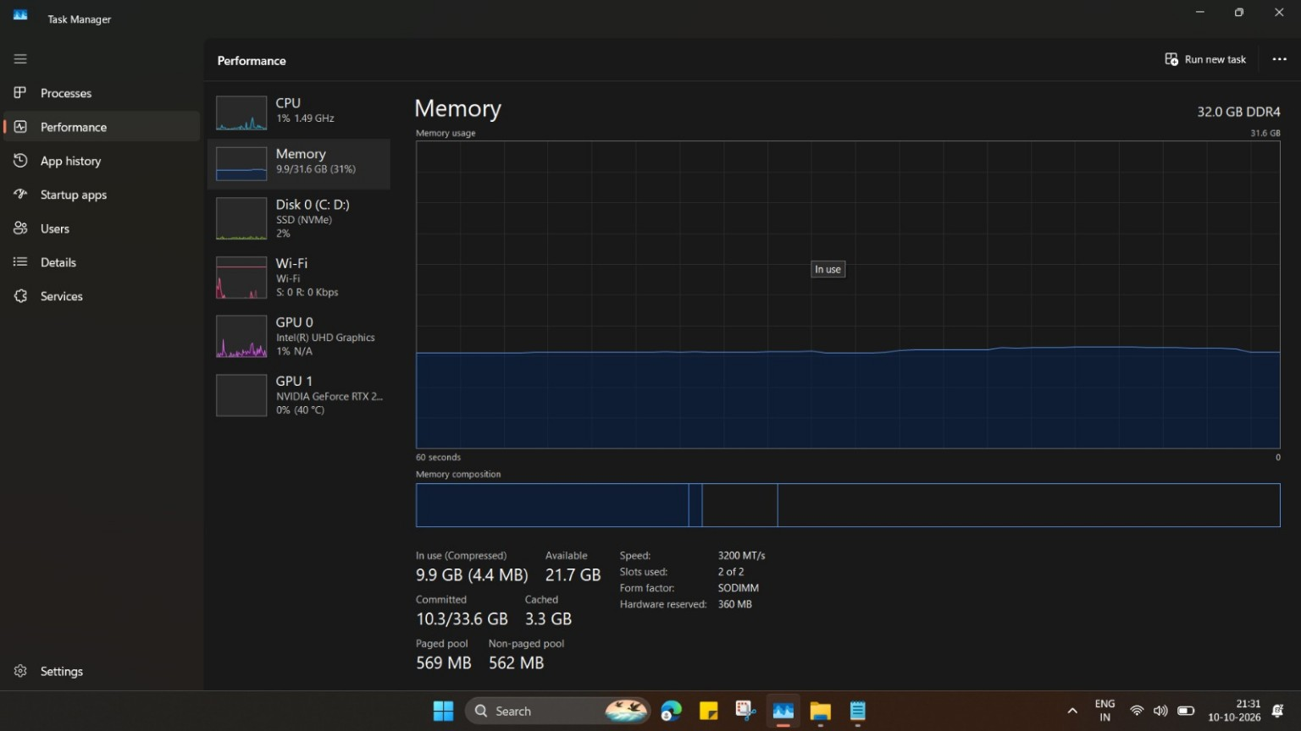

Slide 3
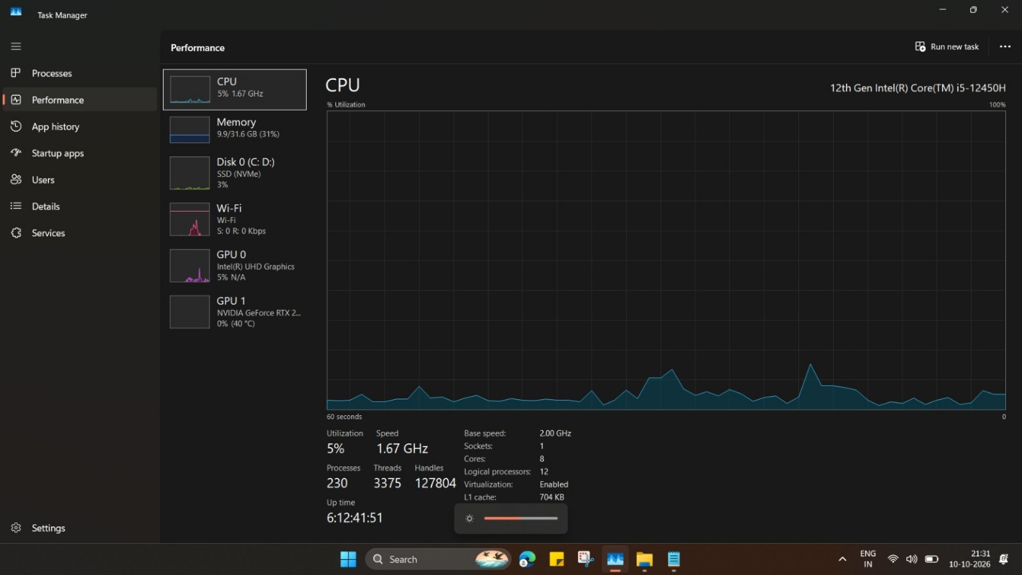

Slide 4
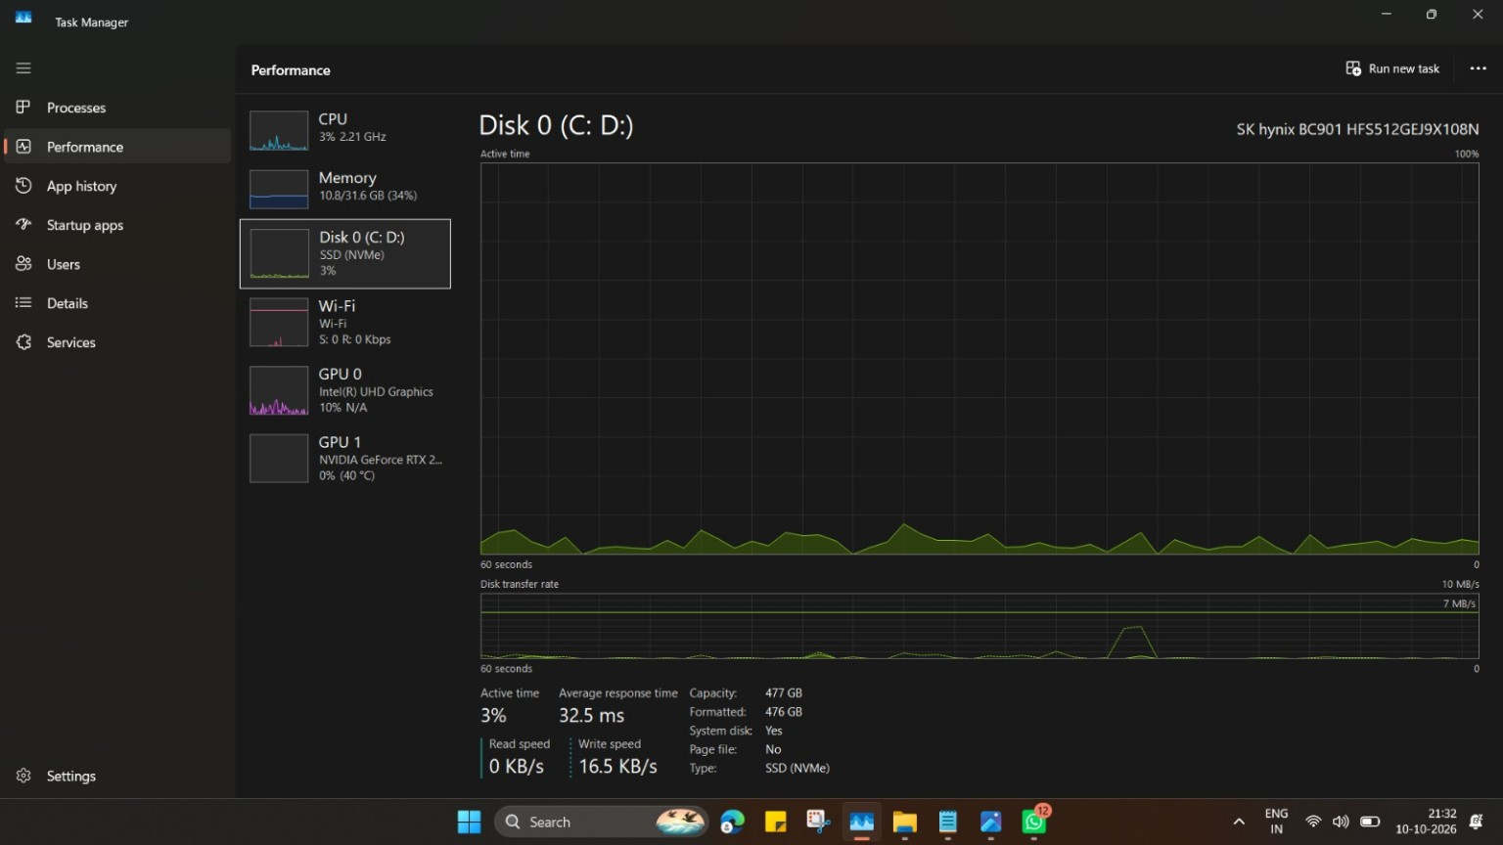

Slide 5
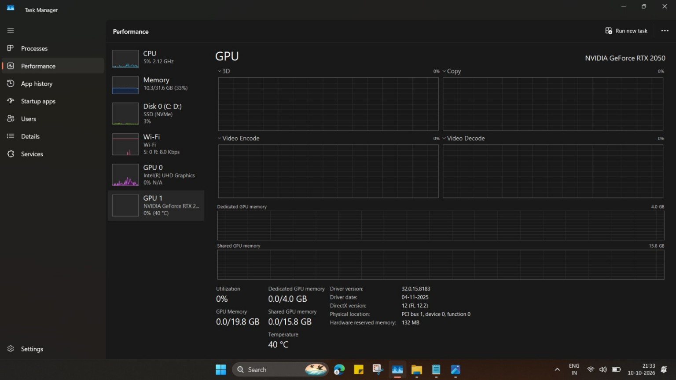

Slide 6
Name : Sinchana K
Roll no : 26150511
PART B
BIOS Version/Date: AMI F.18, 21-08-2024
OS Name: Microsoft Corporation
OS Version: 10.0.26200
OS Build: 26200
System Manufacture: HP
System Model: Victus by HP Gaming Laptop 15-fa1xxx

Slide 7
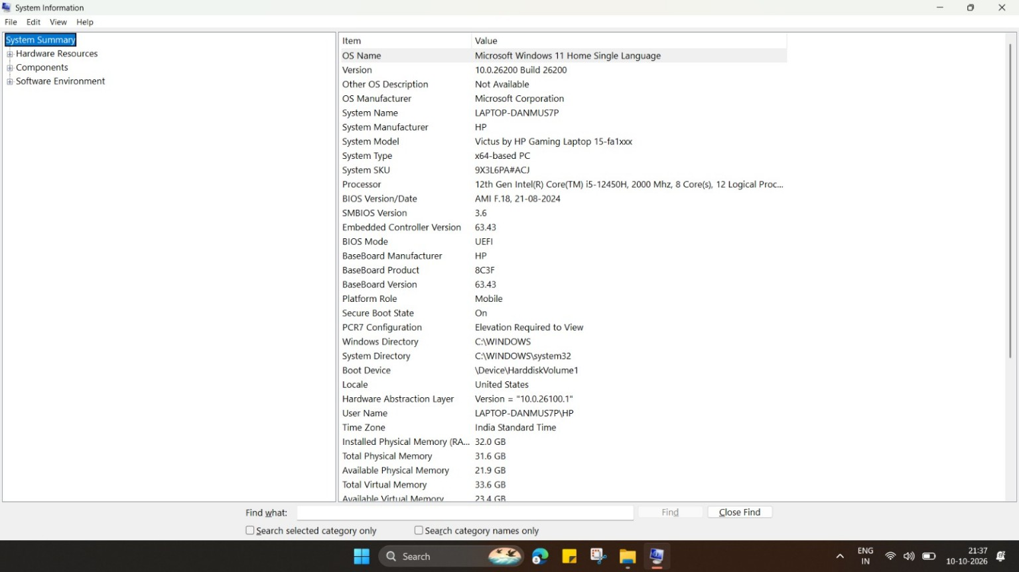
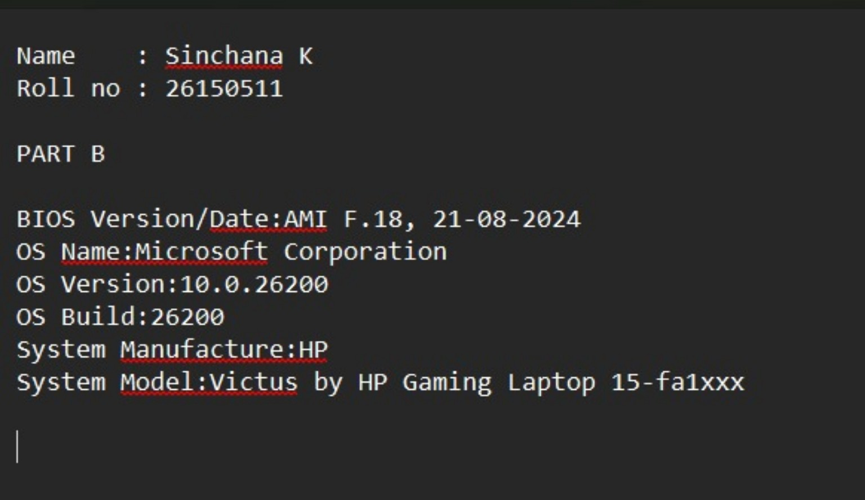

Slide 8
PART C
whoami
What it does: Shows your Windows username and domain
Example output: COMPUTER\YourUsername
Your output: laptop-danmus7p\hp
2. ipconfig
What it does: Shows your network configuration (IP address, gateway, DNS)
Look for: IPv4 Address
Your IP Address: 192.168.95.1
Your Default Gateway: fe80::8c93:68ff:fecf:6af5%7
3. dir
What it does: Lists all files and folders in current directory
Record 3 folders you see: documents, downloads, pictures
4. mkdir BCA_Test
What it does: Creates a new folder named "BCA_Test"
Verify by typing: dir
Did you see "BCA_Test" folder created? Yes/No

Slide 9
5. tasklist
What it does: Lists all running programs
Record 5 running processes: System Idle Process, System, Secure System,
Registry, smss.exe
6. systeminfo
What it does: Shows detailed Windows system information
Record your Processor: 1 Processor(s) Installed.
[01]: Intel64 Family 6 Model 154 Stepping 3 GenuineIntel ~2000 MHz
Record your Total Physical Memory: 32,409 MB

Slide 10
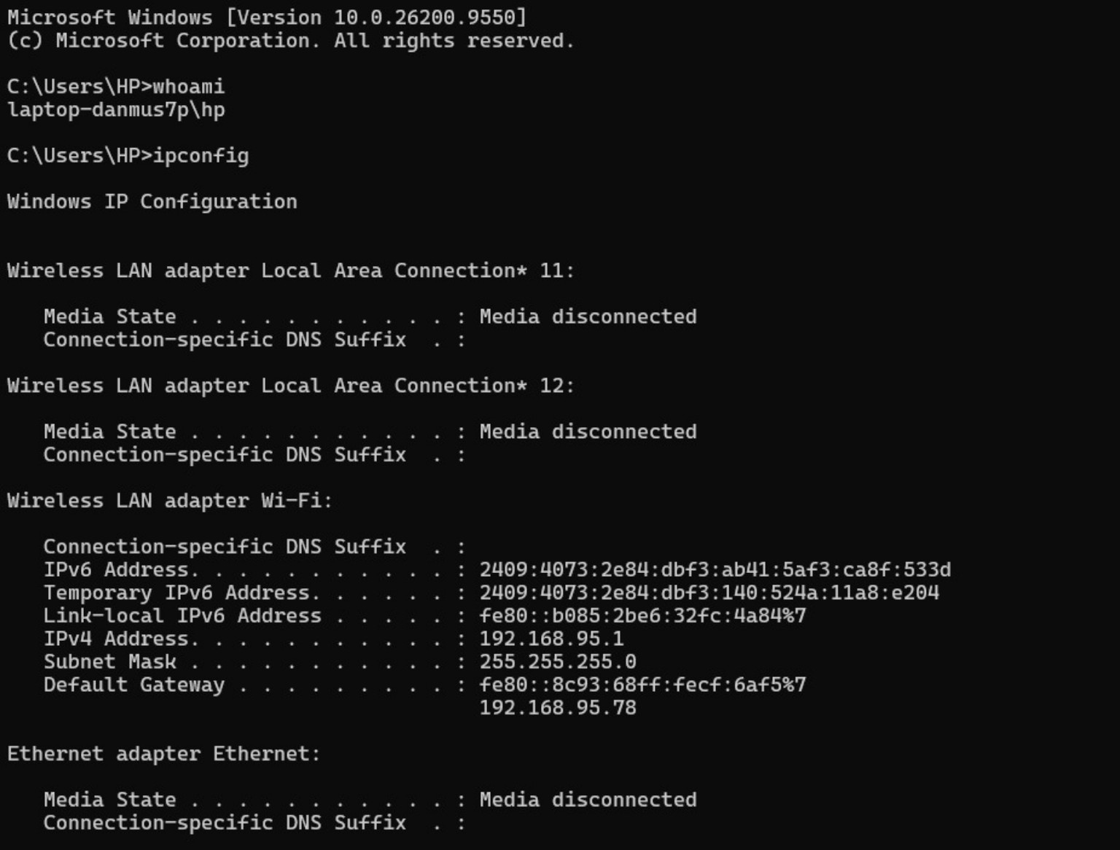

Slide 11
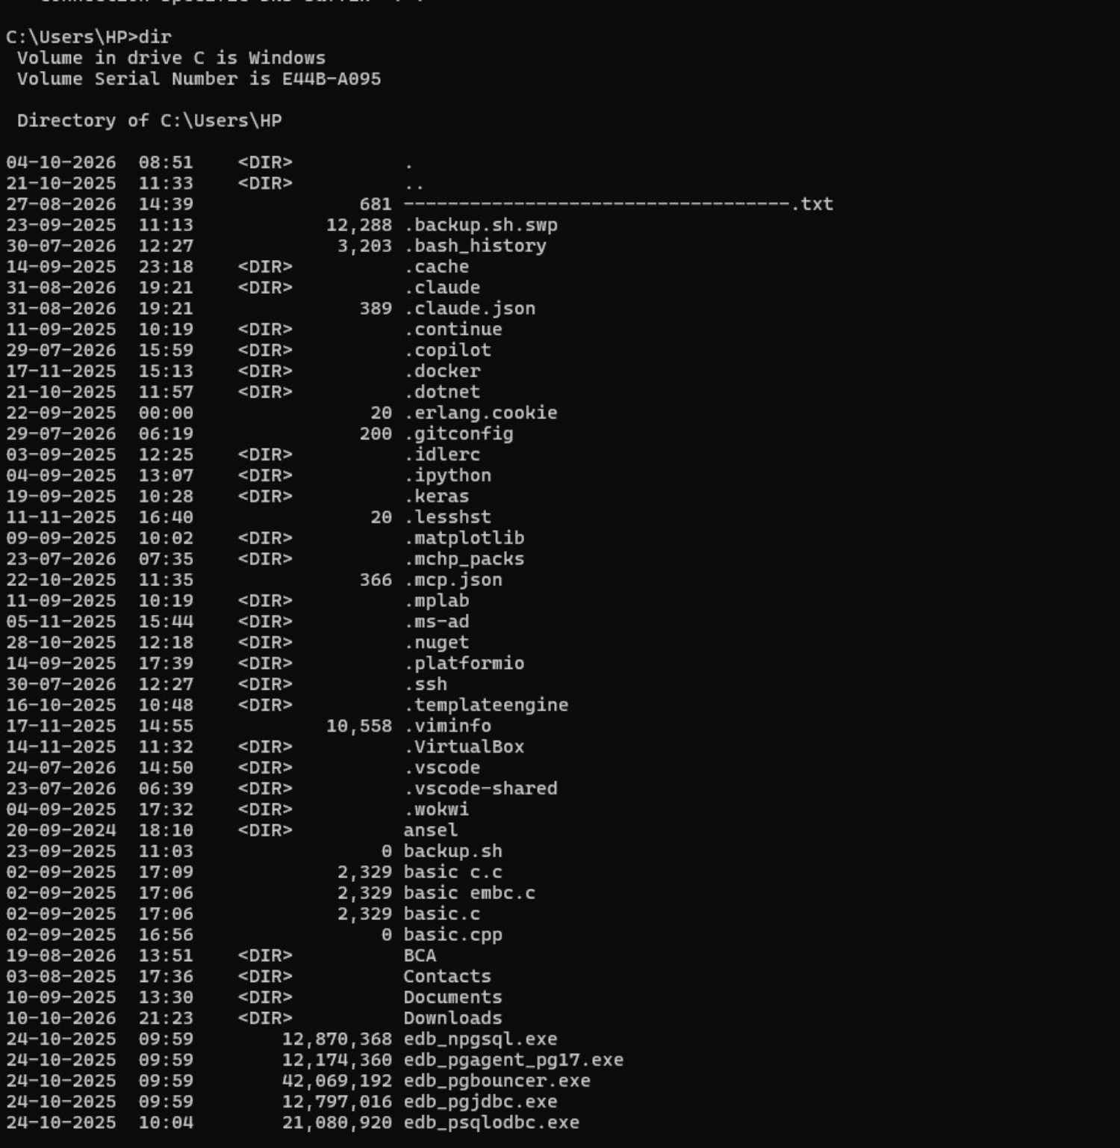

Slide 12
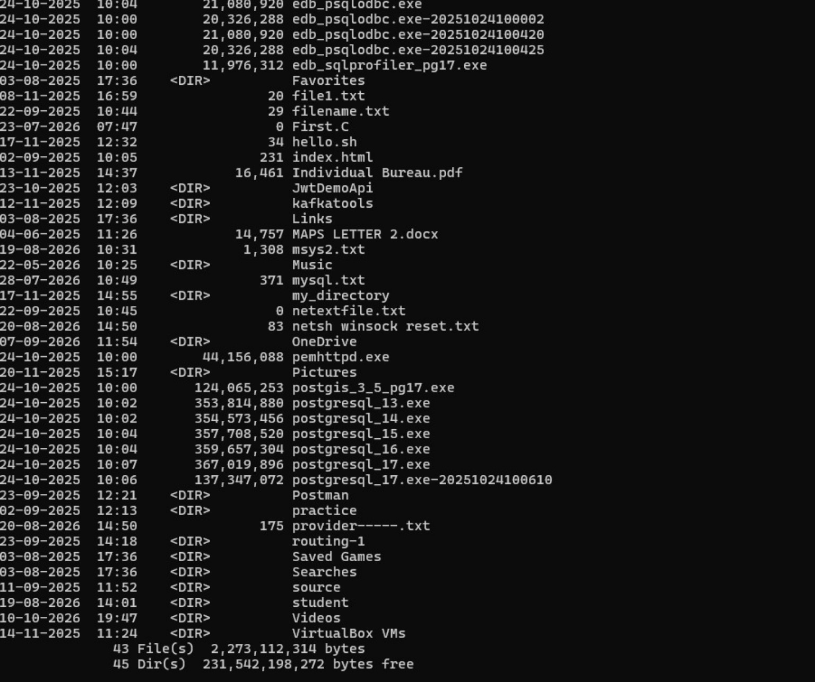

Slide 13
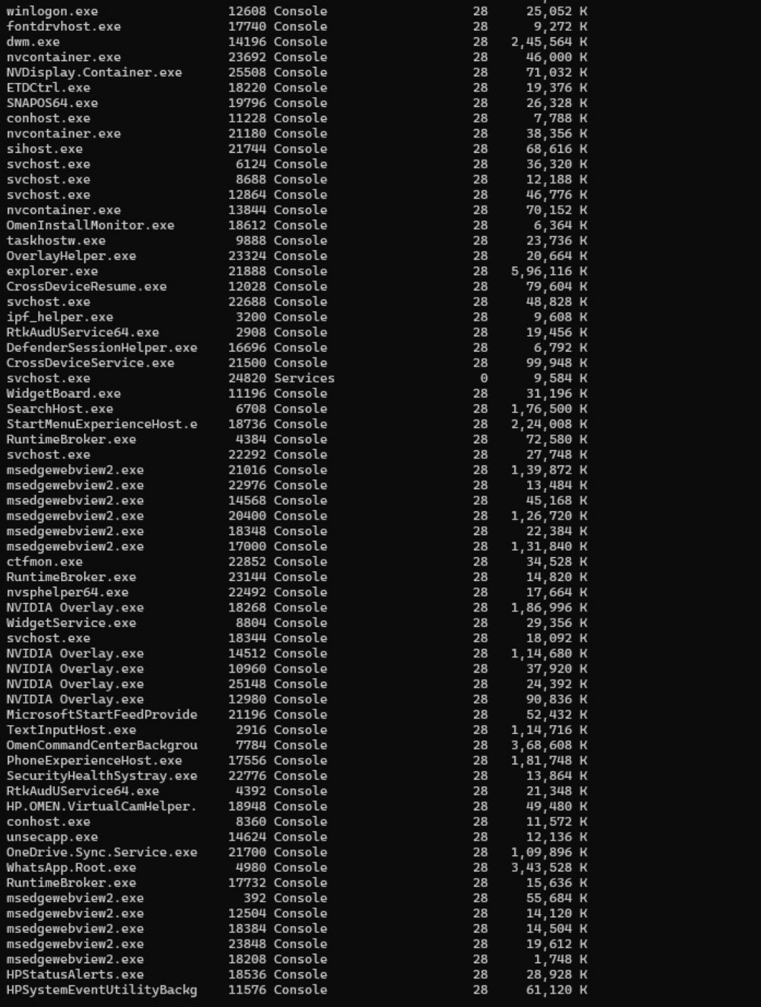

Slide 14
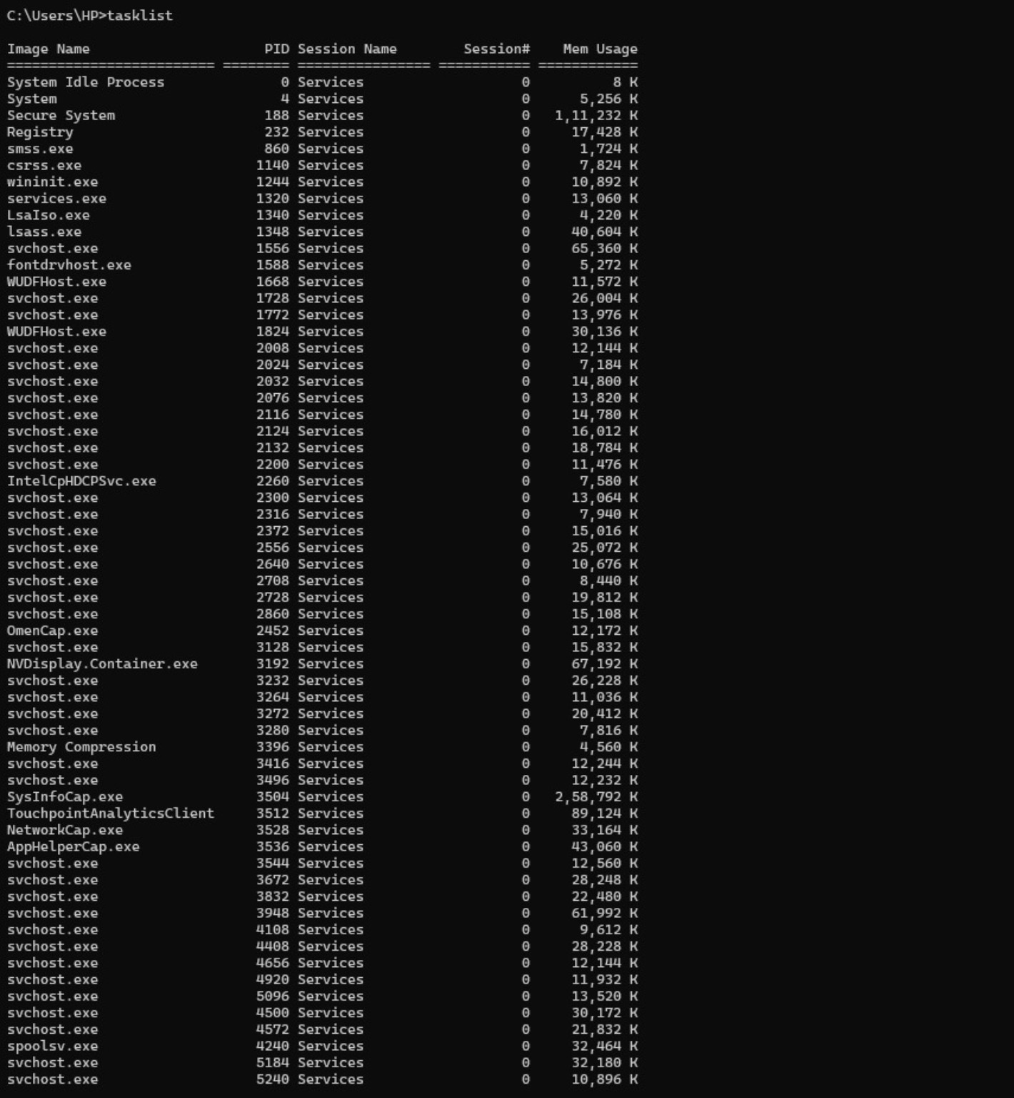

Slide 15
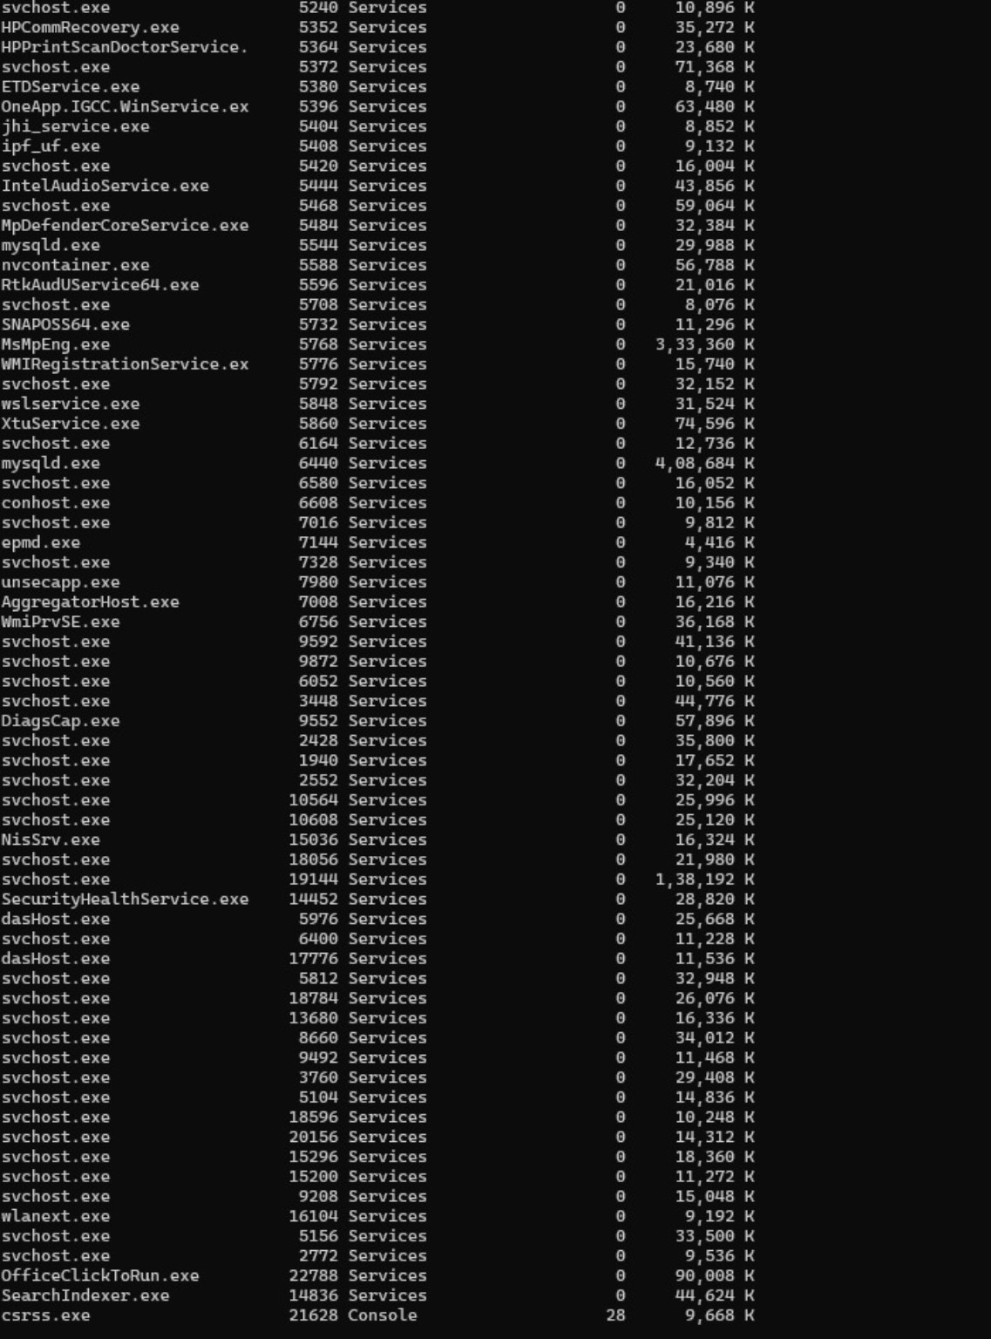

Slide 16
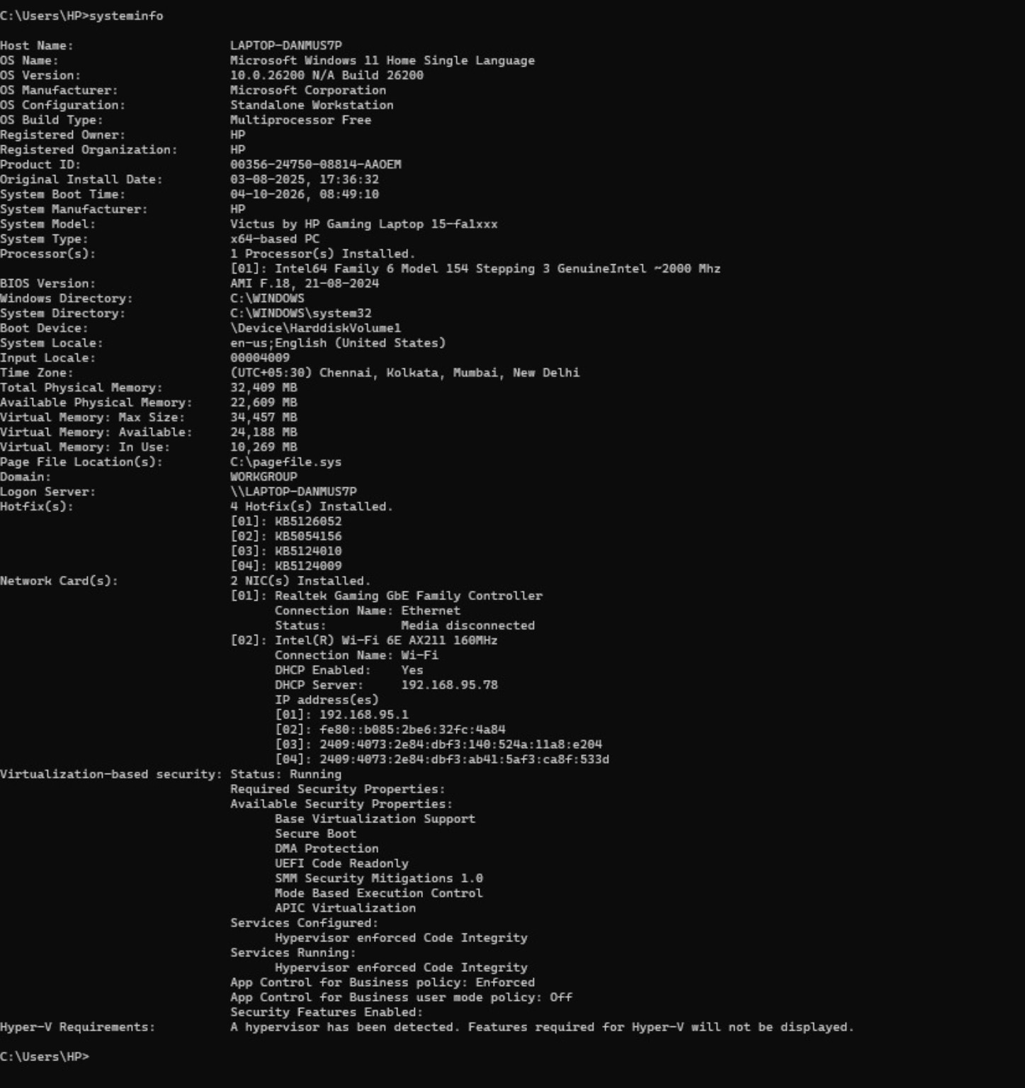

Slide 17
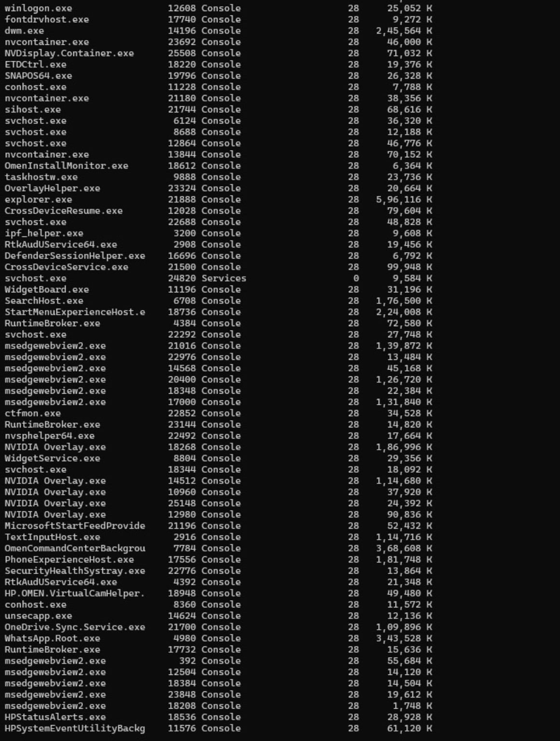

Slide 18
