Slide 1

BlinkIt Sales Dashboard Analysis
Presented by: Sinchana G

Slide 2

Objective
Understand sales performance
Analyze item which item types sell more
To check outlet size, and location performance
Support business decisions using data

Slide 3
Key Performance Metrics
Total Sales: $1.20M
Number of Items:
8523
Average Sales per Item:
$141
Average Rating:
3.9

Slide 4
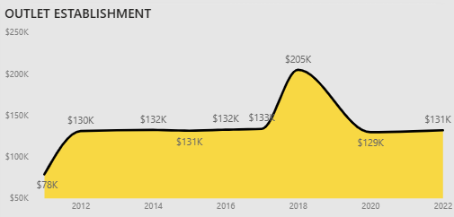
Sales Trade Over Time
Shows sales performance over the years
Identifies peak and low periods
Helps understand business growth over time

Slide 5

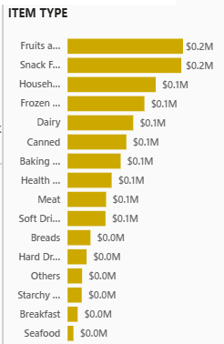
Item Type Performance
Shows which item categories make the highest sales
Snack foods and dairy have top performance
Useful for business focus on high demand categories

Slide 6
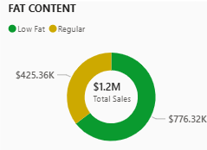
Fat Content Analysis
Comparison between Low Fat and Regular categories
Shows total sales contribution of each group

Slide 7
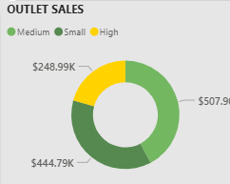
Outlet Size Analysis
Medium outlets show highest sales
Helps in planning new outlet openings

Slide 8
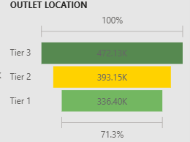
Outlet Location Analysis
Tier 3 contributes highest sales
Tier 2 Locations come next.
Tier 1 Locations contribute the least sales.
Helps identify high-performing regions

Slide 9
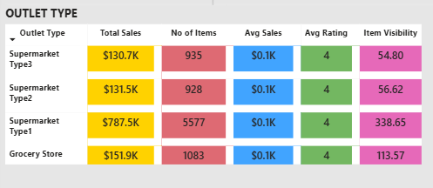
Summary Table Insights
Compares supermarkets and grocery stores
Shows Total sales, number of items, Average ratings, and visibility
Useful for strategic decisions

Slide 10

Conclusion
The dashboard helps us understand sales, outlets performance, and customer preferences clearly.
These insights can be used to improve sales, plan new outlets, enhance customer satisfaction, and support business decisions.

