Slide 1

INTRODUCTION TO WEB DEVELOPMENT
-KEY TECHNOLOGIES AND LANGUAGES

Slide 2
Web development encompasses the entire process of designing, constructing, and upkeeping websites. This multifaceted field includes tasks like crafting web designs, managing web content, programming interactive features, and overseeing databases. In essence, web development involves the creation of internet-based applications, specifically websites.
Frontend Development the part of a website where the user interacts directly is termed as front end. It is also referred to as the ‘client side’ of the application. It's responsible for creating the engaging, user-friendly elements that make a website or app not only visually appealing but also functional and intuitive.
Backend development constitutes the server-side of a website, the concealed portion not visible or directly interacted with by users. It's the engine behind the scenes, handling data storage, organization, and the intricate operations that ensure a website or application runs smoothly. In essence, the backend serves as the brainpower, orchestrating the data and functions that empower the user-facing frontend.

Slide 3
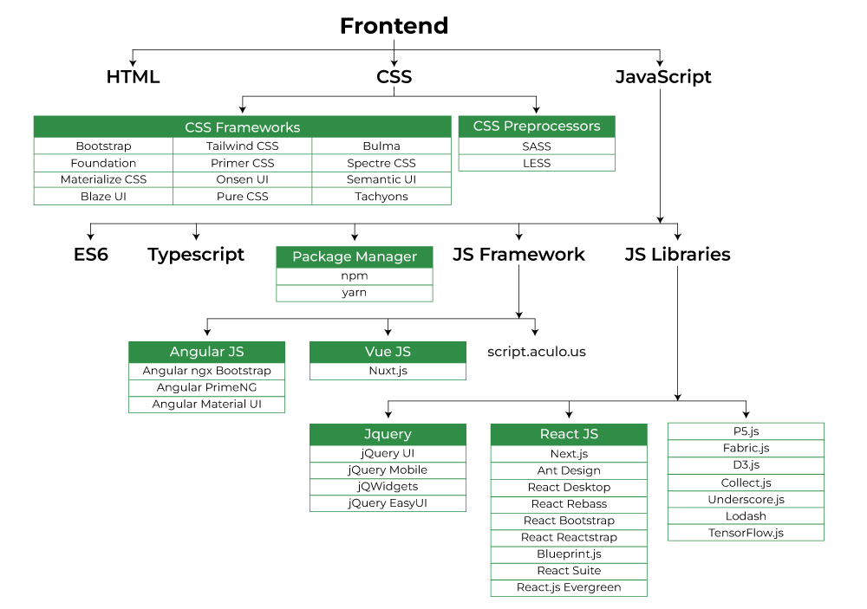

Slide 4
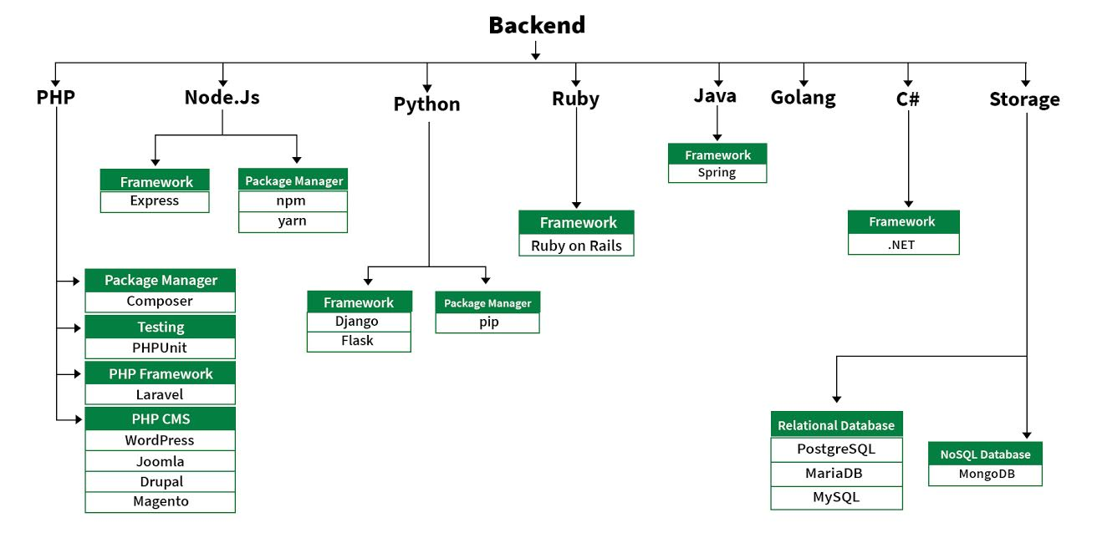

Slide 5
KEY TECHNOLOGIES AND LANGUAGES
1. HTML (Hypertext Markup Language): HTML is the foundation of web development. It's used to structure and present content on web pages. HTML elements define the structure of a webpage, such as headings, paragraphs, links, images, and more.
2. CSS (Cascading Style Sheets): CSS complements HTML by controlling the presentation and layout of web content. It allows developers to define styles, such as colors, fonts, spacing, and responsive designs, making websites visually appealing and consistent.
3. JavaScript: JavaScript is a versatile programming language used for creating dynamic and interactive web experiences. It powers features like form validation, animations, interactive menus, and AJAX requests for real-time updates without page reloads.

Slide 6
Backend Languages: Backend languages like Python, Ruby, PHP, Node.js, and Java handle server-side operations. They manage data, execute logic, and communicate with databases. These languages are crucial for building web applications with functionality beyond static web pages.
Python: Known for its readability and versatility, Python is widely used in web development, with frameworks like Django and Flask for building robust web applications.
Ruby: Ruby, often used in combination with the Ruby on Rails framework, emphasizes developer productivity and convention over configuration.
PHP: PHP is a server-side scripting language commonly used for web development. It powers popular content management systems (CMS) like WordPress.
Node.js: Node.js allows developers to use JavaScript on the server side, unifying the language used in both frontend and backend development

Slide 7
5. Frontend Frameworks: Frameworks like React, Angular, and Vue.js provide pre-built components and structures for building complex user interfaces. They enhance code reusability and maintainability.
React: Developed by Facebook, React is a popular library for building user interfaces. It follows a component-based architecture and is often used in single-page applications (SPAs).
Angular: Developed by Google, Angular is a comprehensive framework for building dynamic web applications. It includes tools for routing, forms, and state management.
Vue.js: Vue.js is a progressive JavaScript framework that is easy to integrate into existing projects and offers a flexible and approachable structure.
6. Databases: Databases are essential for storing and retrieving data in web applications. Popular database management systems include MySQL, PostgreSQL, MongoDB (NoSQL), and SQLite.
7. Version Control: Version control systems like Git are essential for collaborative development. They enable developers to track changes, collaborate on code, and manage different versions of a project.

