Slide 1
Diabetes prediction using Machine Learning
MS Sinchan
(4NM18EC085)
Department of Electronics and Communication Engineering
NMAM Institute of Technology, Nitte
Udupi, Karnataka 574110

Slide 2
Introduction
Diabetes is a disease whereby blood sugar (glucose) is not metabolized in the body. This increases the glucose in the blood to alarmingly high levels.
Diabetes is incurable; it has to be controlled.
Type1, Type2, Prediabetes and Gestational diabetes
Accurate screening and diagnosis of diabetes require more effective features.
Earlier diagnosis of Diabetes increases the chances of preventing it from becoming severe.

Slide 3
Introduction
Machine Learning is a concept which allows the machine to learn from examples and experience, and that too without being explicitly programmed.
Types of Machine Learning:
Supervised learning
Unsupervised learning
Reinforcement learning

Slide 4
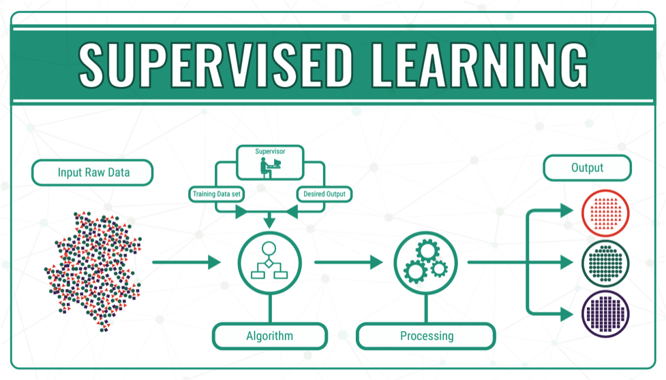
Supervised learning
In supervised learning, we use known or labeled data for the training data. Since the data is known, the learning is, therefore, supervised.

Slide 5
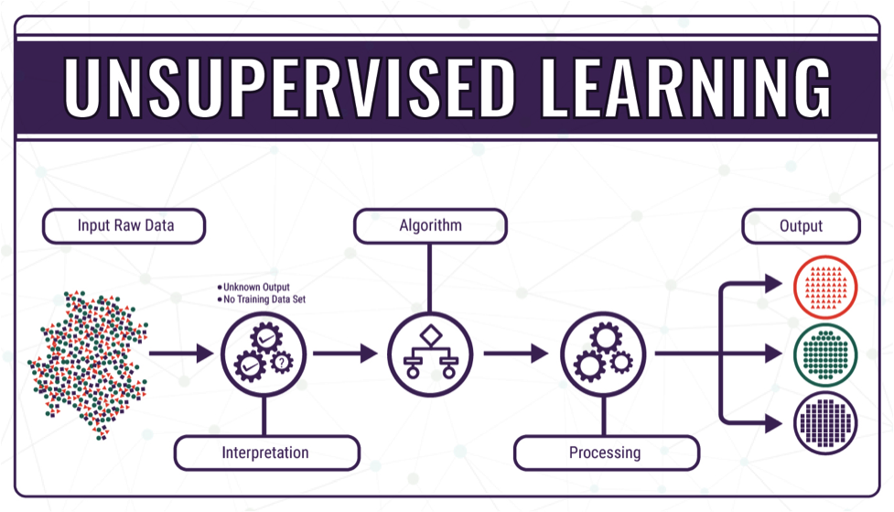
Unsupervised learning
In unsupervised learning, the training data is unknown and unlabeled - meaning that no one has looked at the data before.

Slide 6
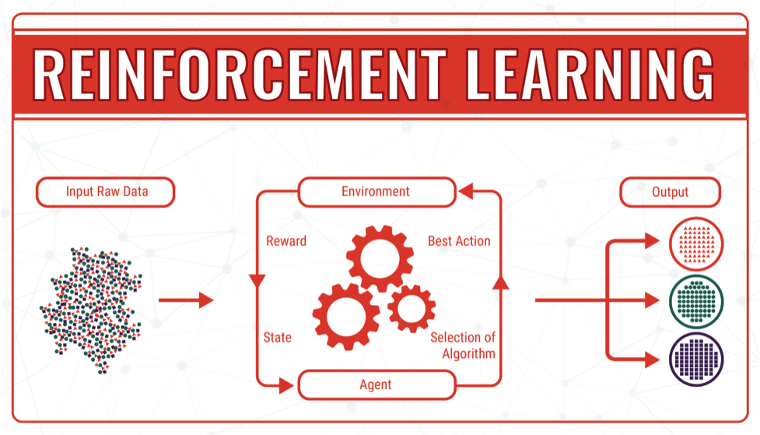
Reinforcement learning
In Reinforcement learning, the algorithm discovers data through a process of trial and error and then decides what action results in higher rewards. Three major components make up reinforcement learning: the agent, the environment, and the actions.

Slide 7
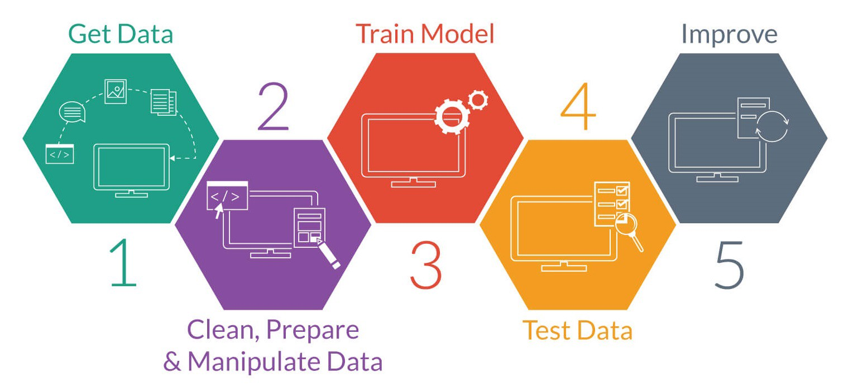
Methodology
Data Collection
Data Preparation
Choosing Model
Training Model
Evaluate the Model
Parameter Tuning
Make Predictions

Slide 8
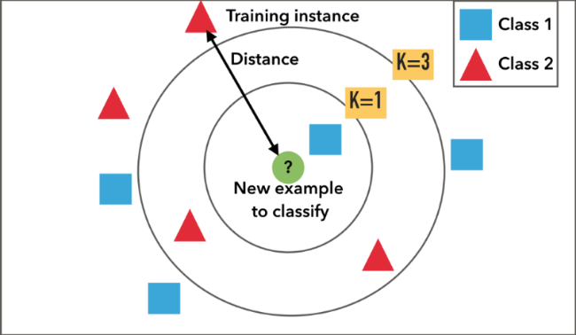
K-Nearest Neighbors algorithm
KNN algorithm is one of the simplest classification algorithms and it is one of the most used learning algorithms. KNN is a non-parametric, lazy learning algorithm. Its purpose is to use a database in which the data points are separated into several classes to predict the classification of a new sample point.

Slide 9

Decision tree
A decision tree is a decision support tool that uses a tree-like model of decisions and their possible consequences, including chance event outcomes, resource costs, and utility. It is one way to display an algorithm that only contains conditional control statements.

Slide 10
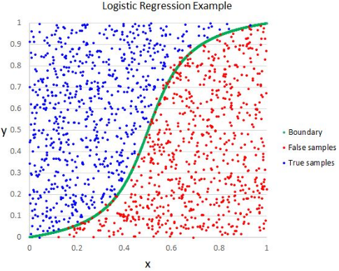
Logistic regression
Logistic regression is a supervised learning classification algorithm used to predict the probability of a target variable. It is one of the simplest ML algorithms that can be used for various classification problems such as spam detection, Diabetes prediction, cancer detection etc.

Slide 11

Support-vector machine
In machine learning, support-vector machines are supervised learning models with associated learning algorithms that analyze data for classification and regression analysis.

Slide 12
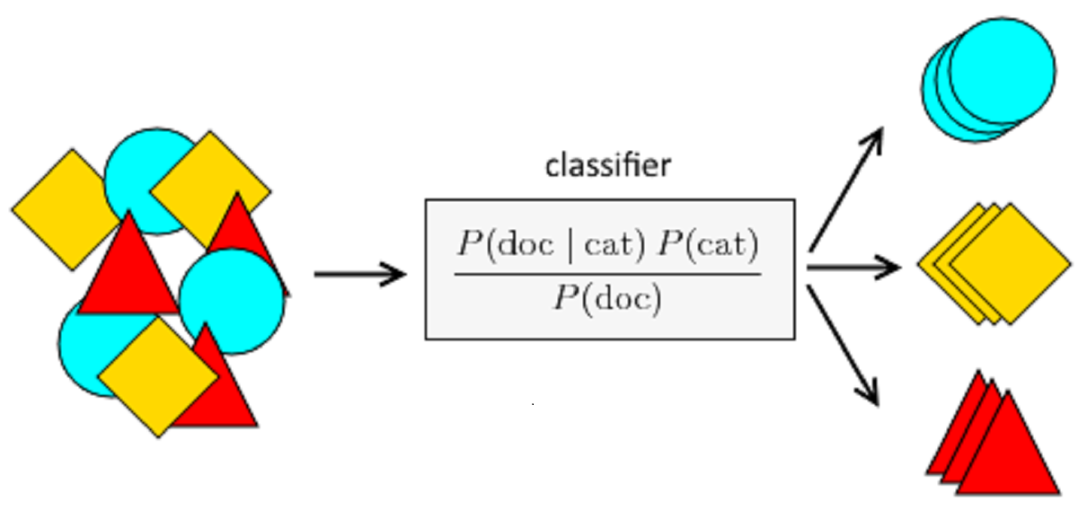
Naïve Bayes
Naïve Bayes is one of the fast and easy ML algorithms to predict a class of datasets. It can be used for Binary as well as Multi-class Classifications. It performs well in multi-class predictions as compared to the other Algorithms. It is the most popular choice for text classification problems.

Slide 13
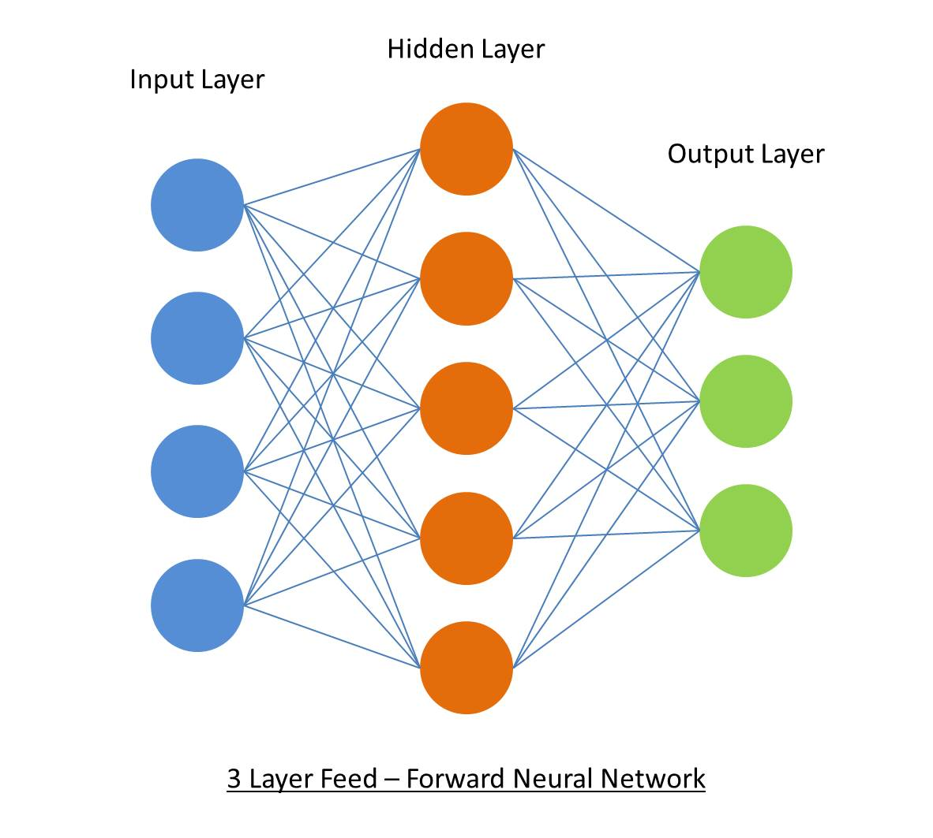
Artificial neural networks
Artificial neural networks, usually simply called neural networks, are computing systems vaguely inspired by the biological neural networks that constitute animal brains. An ANN is based on a collection of connected units or nodes called artificial neurons, which loosely model the neurons in a biological brain.

Slide 14
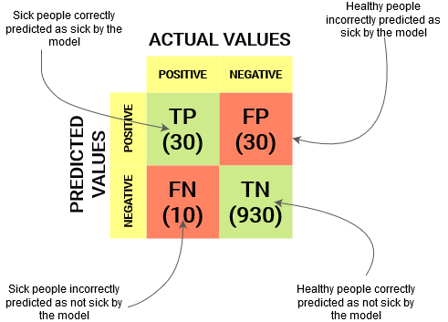
Confusion matrix
A confusion matrix is a table that is often used to describe the performance of a classification model (or "classifier") on a set of test data for which the true values are known.

Slide 15
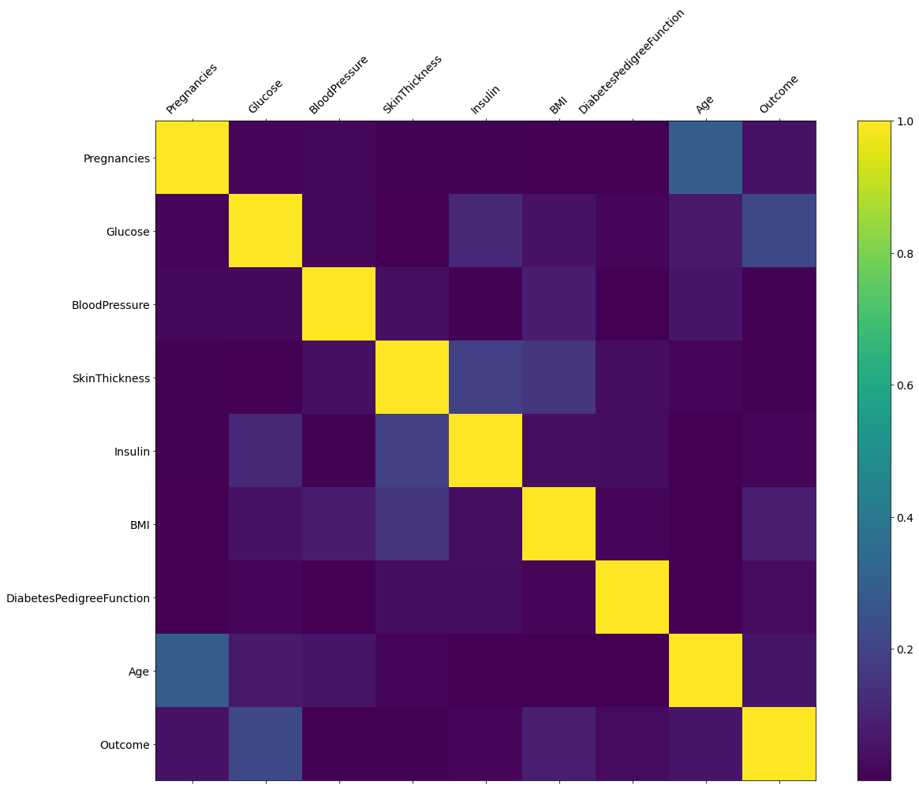
Results
Correlation is an indication about the changes between two variables. We can plot correlation matrix to show which variable is having a high or low correlation in respect to another variable.

Slide 16
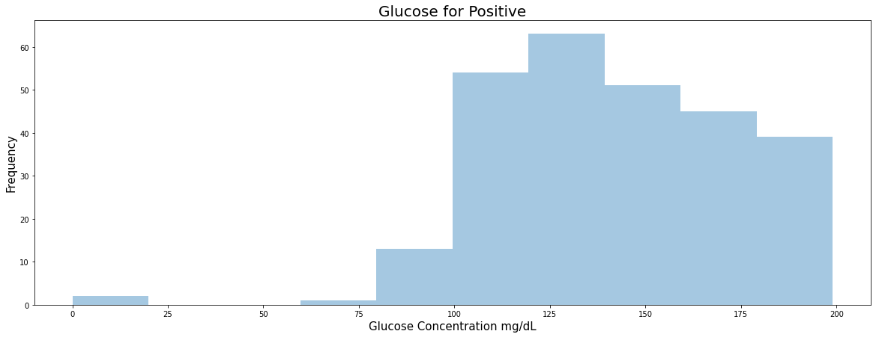
Glucose positive histogram
Results

Slide 17
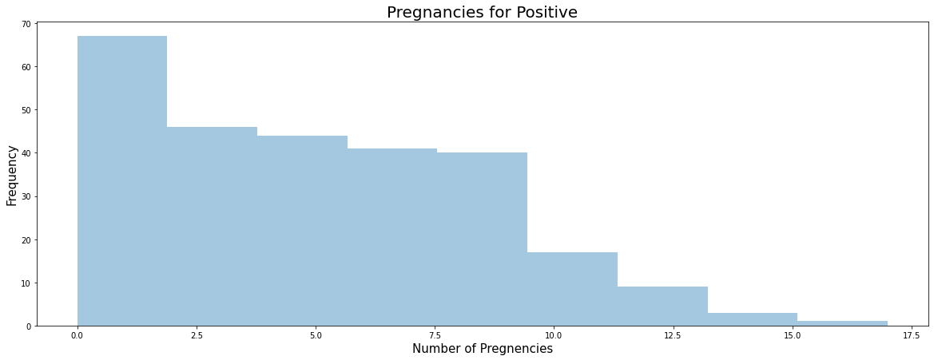
Pregnancies for positive histogram
Results

Slide 18
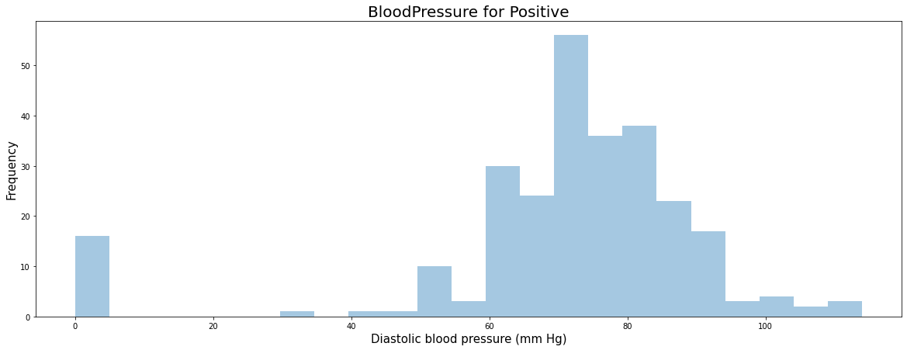
Blood Pressure positive histogram
Results

Slide 19
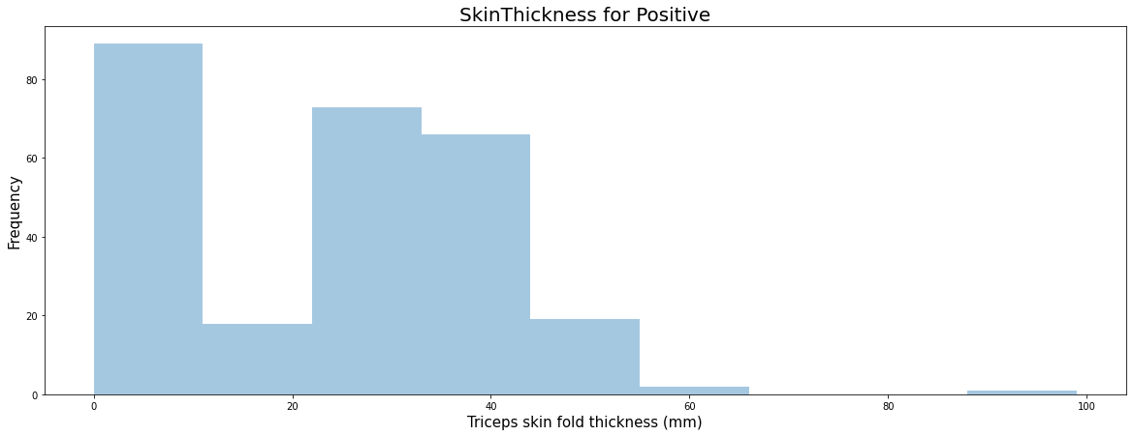
Skin Thickness positive histogram
Results

Slide 20
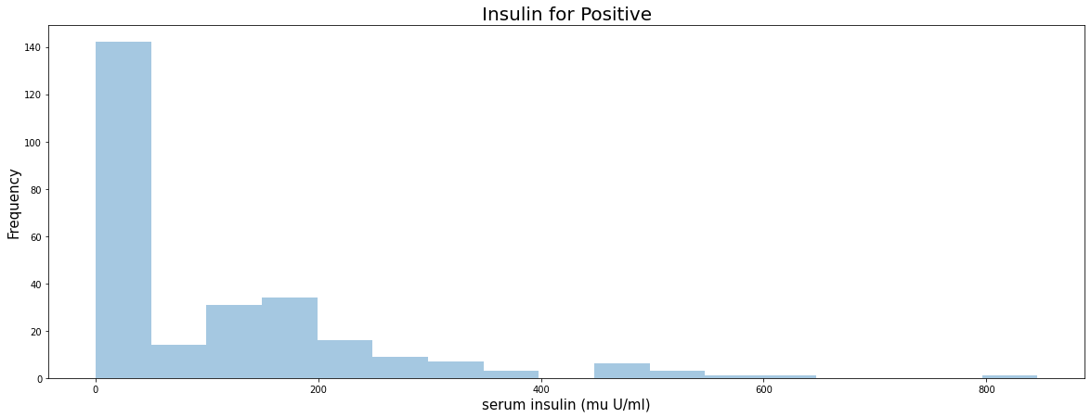
Insulin for positive histogram
Results

Slide 21
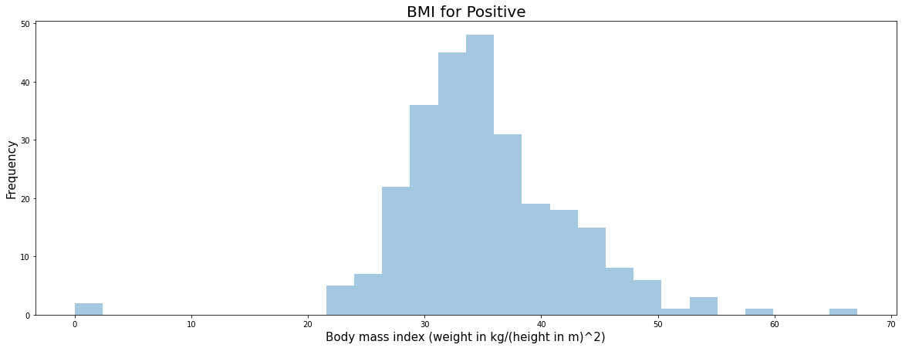
BMI for positive histogram
Results

Slide 22
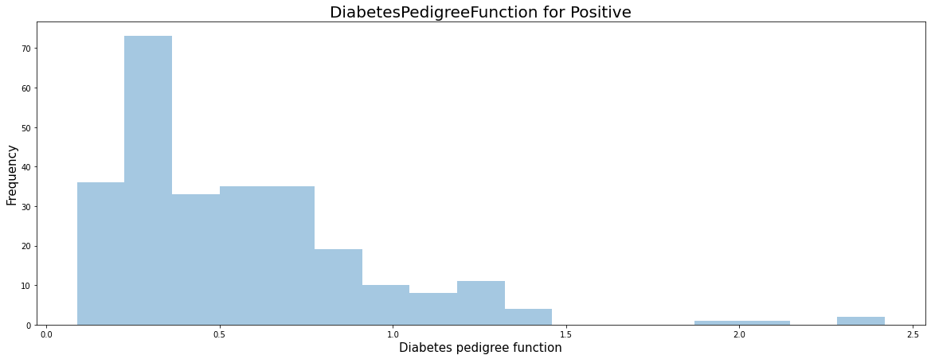
Diabetes pedigree function for positive histogram
Results

Slide 23
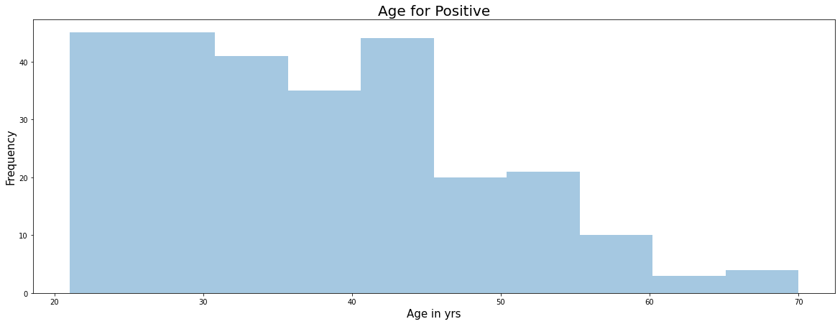
Age for positive histogram
Results

Slide 24
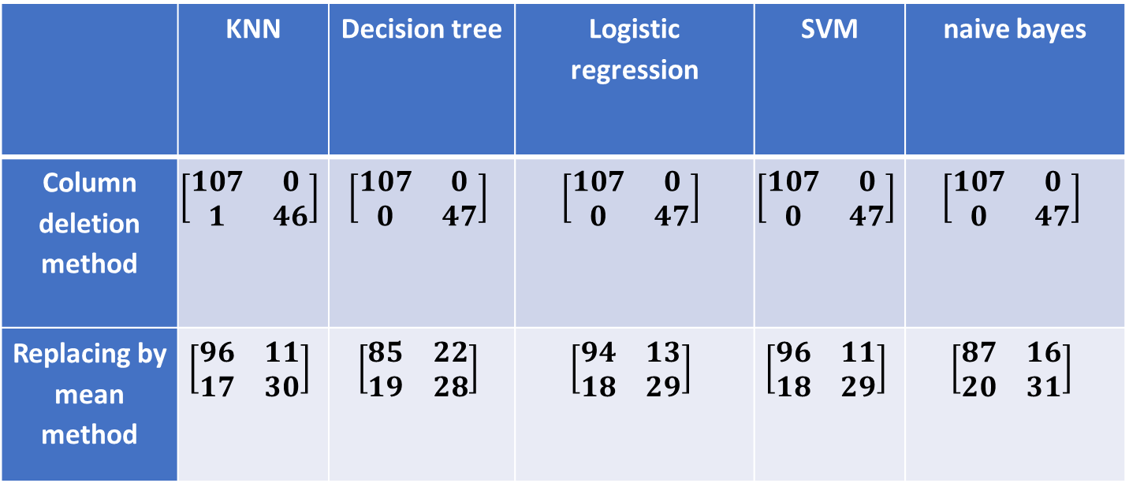
Confusion matrix for different algorithms
Results
 | KNN | Decision tree | Logistic regression | SVM | naive bayes
Column deletion method | $$\left[\begin{matrix}107 & 0 \\ 1 & 46\end{matrix}\right]$$ | $$\left[\begin{matrix}107 & 0 \\ 0 & 47\end{matrix}\right]$$ | $$\left[\begin{matrix}107 & 0 \\ 0 & 47\end{matrix}\right]$$ | $$\left[\begin{matrix}107 & 0 \\ 0 & 47\end{matrix}\right]$$ | $$\left[\begin{matrix}107 & 0 \\ 0 & 47\end{matrix}\right]$$
Replacing by mean method | $$\left[\begin{matrix}96 & 11 \\ 17 & 30\end{matrix}\right]$$ | $$\left[\begin{matrix}85 & 22 \\ 19 & 28\end{matrix}\right]$$ | $$\left[\begin{matrix}94 & 13 \\ 18 & 29\end{matrix}\right]$$ | $$\left[\begin{matrix}96 & 11 \\ 18 & 29\end{matrix}\right]$$ | $$\left[\begin{matrix}87 & 16 \\ 20 & 31\end{matrix}\right]$$

Slide 25
Accuracies for different algorithms
Results
 | KNN | Decision tree | Logistic regression | SVM | naive bayes | ANN
Column deletion method | 0.9935 | 1.0 | 1.0 | 1.0 | 1.0 | 0.9610
Replacing by mean method | 0.8182 | 0.7338 | 0.7987 | 0.8117 | 0.7662 | 0.8117

Slide 26
Conclusion
This project aims to predict the disease on the basis of the symptoms. The project is designed in such a way that the system takes symptoms from the user as input and predicts the probability of getting disease.
By the observation made, all the algorithms resulted in more than 73% of accuracy.
This model can be used with different datasets to predict different types of diseases.

