Slide 1

Phishing Site Detection
TECH PHOENIX

Slide 2
INTRODUCTION
Phishing site detection is a crucial cybersecurity practice aimed at identifying and preventing fraudulent websites designed to steal sensitive information, such as passwords and financial details.
Key indicators of phishing sites include suspicious URLs, poor website design, unsolicited information requests, and urgent messages. Effective detection helps protect personal data and prevent financial losses, making it essential for maintaining online security.

Slide 3


PROBLEM STATEMENT
The Cyber-attacks are growing faster than usual rate, it became evident that necessary steps should be taken in-order to get them under control. Among various cyber-attacks, Phishing websites is one of the popular and commonly used attack to steal users personal information and financial information by manipulating the website URL and IP addresses.
The main focus in this project is to implement the better model for detecting these phishing websites using ML libraries.

Slide 4


ABSTRACT
Phishing attacks are major cybersecurity threat which leads in providing sensitive information to different users over websites. It is required to have proper security , safety algorithms and good trust score to ensure safety of the information and upgrade the user interface in order to reduce the effects of phishing and maintain safety and security of information.

Slide 5
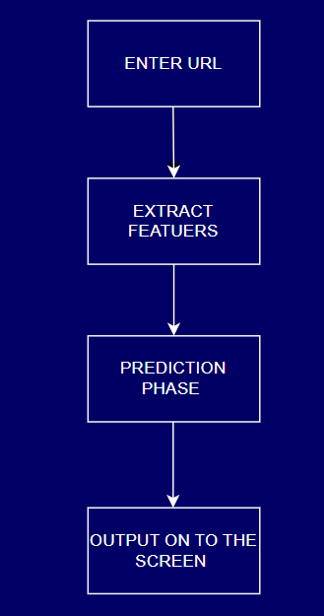
FLOWCHART

Slide 6
PREDICTION ANALYSIS
URL Analysis
SSL Certification
Domain Age
Page Content Analysis
Security Indicators

Slide 7
ML TOOLS
URL Validation and Formatting
WHOIS Data Retrieval
HTTP Header Inspection
URL Characteristics Analysis
Content Parsing
PhishTank Lookup
Certificate Details Retrieval

Slide 8

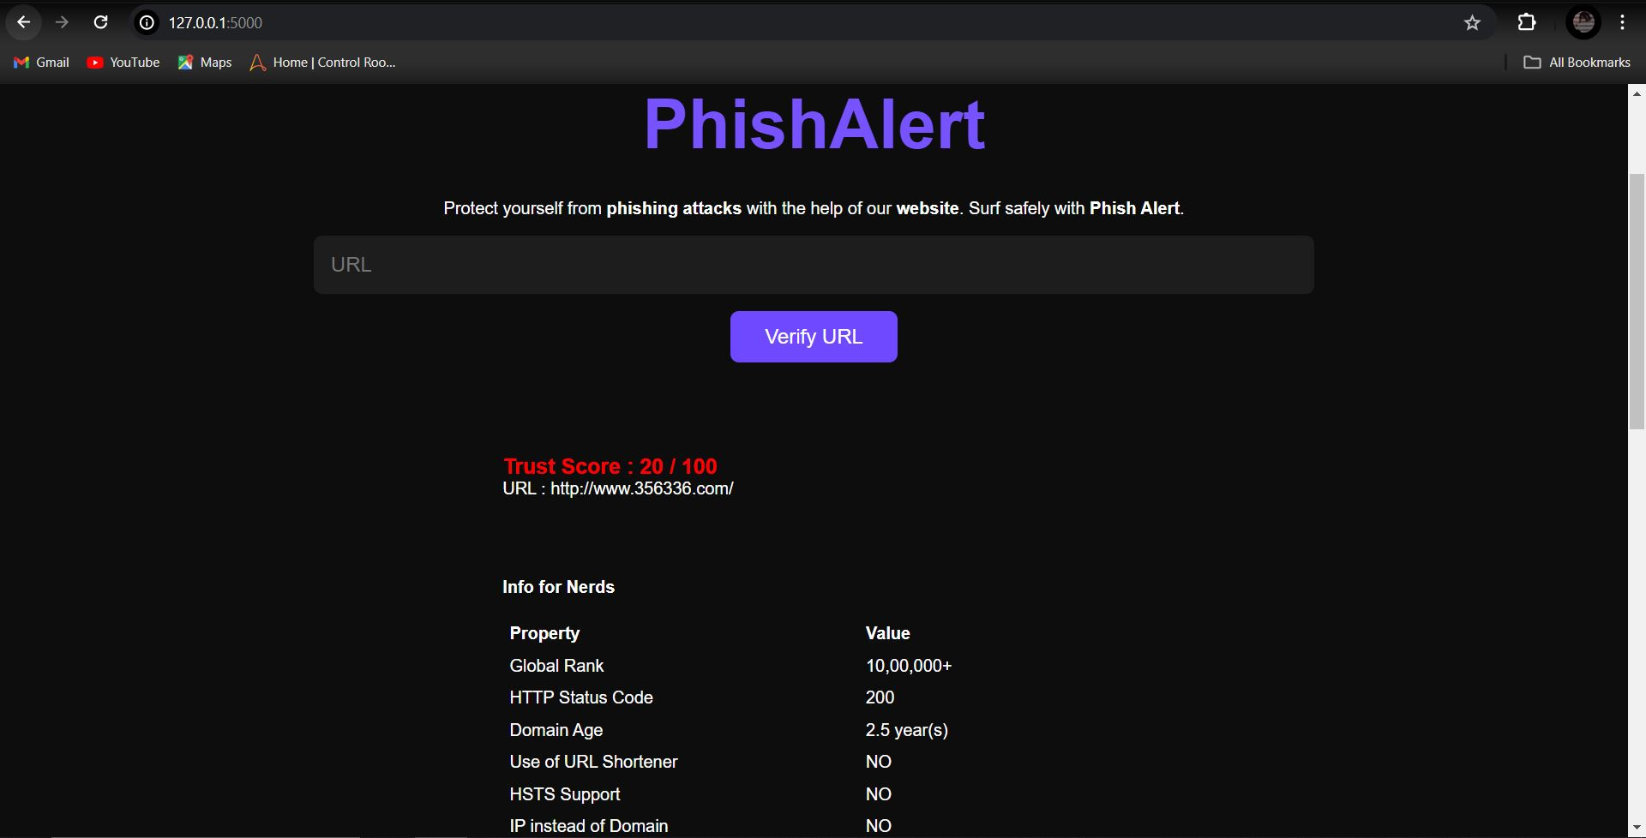
OUTPUT

Slide 9
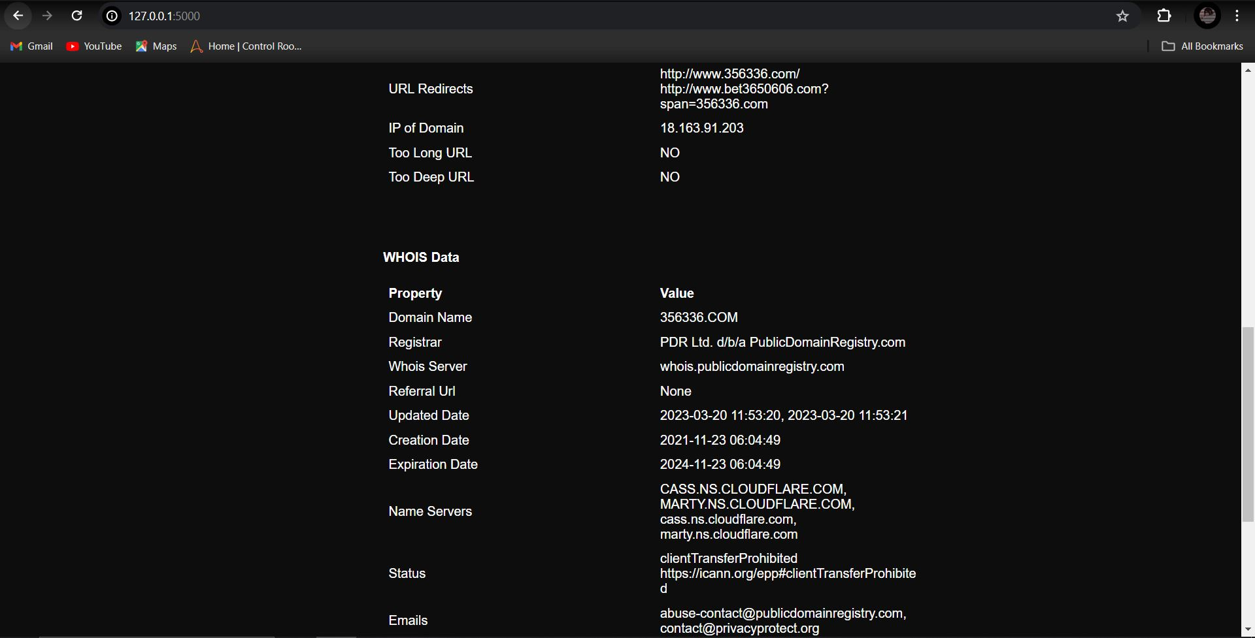
OUTPUT

Slide 10
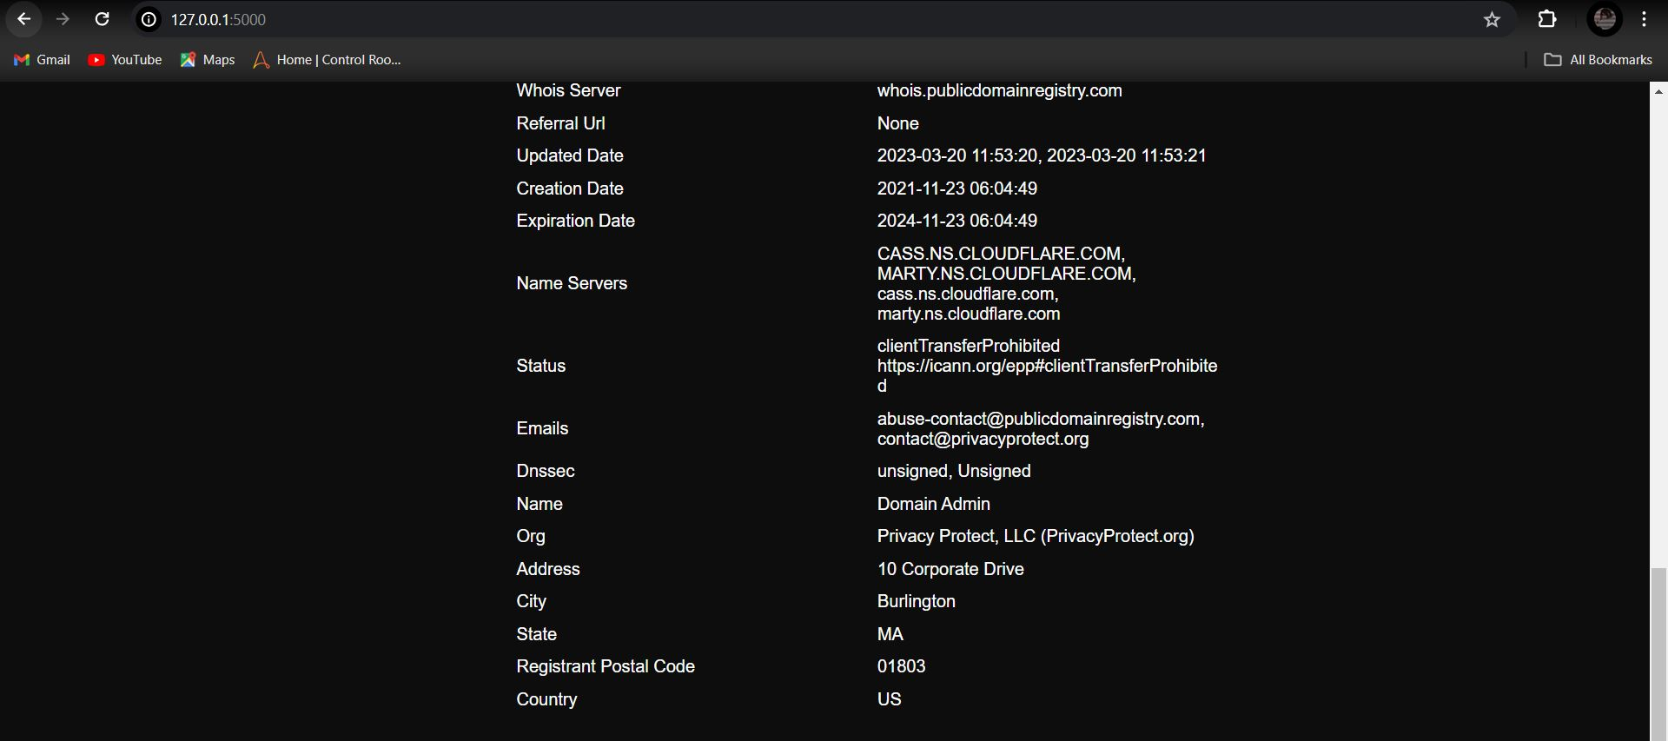
OUTPUT

Slide 11
CONCLUSION
Our phishing site detection project developed a robust and reliable system for identifying malicious websites.
Analysing various features such as URL structure, domain age, and website content, we were able to achieve high accuracy in distinguishing phishing sites from legitimate ones.

