Slide 1
The Use of MRI Data to Predict Dementia
ISYE-7406
Group 30
James Sinclair

Slide 2
Introduction
Open Access Series of Imaging Studies (OASIS) Project
provides a collection of magnetic resonance images (MRI) and related data
aim to facilitate future discoveries in basic and clinical neuroscience
Research Question
Can variables from the OASIS dataset be used to accurately predict a patient’s Clinical Dementia Rating (CDR)?

Slide 3
Dataset variables
CDR: Clinical Dementia Rating, scale 0-3
M.F: patient is either male or female
Age: age of patient
Educ: years of education of patient, 1-23
SES: Socioeconomic status, scale 1-5 (based on income)
MMSE: Mini Mental State Examination, 11-questions that test five areas of cognitive function: orientation, registration, attention and calculation, recall, and language, scored 0-30
eTIV: Estimated total intracranial volume, estimated from MRI images
nWBV: Normalized whole brain volume, allows for averaging data across subjects by establishing spatial correspondence between brains
ASF: Atlas scaling factor, factor used for normalizing WBV
Section: indicates whether the eTIV comes from a cross-sectional or longitudinal MRI image

Slide 4
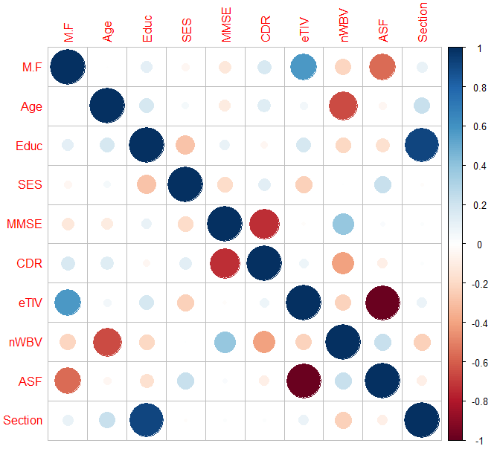
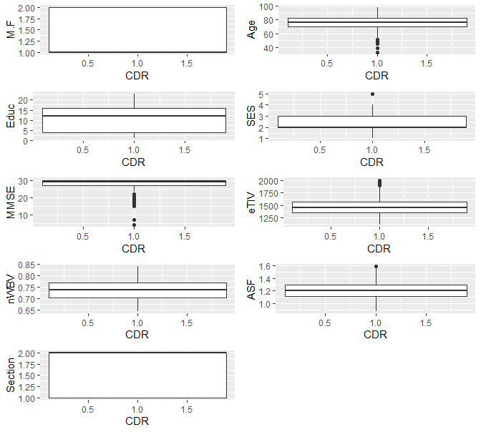
Data Overview
Patients with incomplete data removed
Patients from cross-sectional dataset and longitudinal dataset combined
570 rows of patients

Slide 5
Finding the lowest AIC score of the Multinomial Logistic Regression Model
Lowest AIC Score (507.24) Multinomial Model:
CDR ~ M.F + Age + Educ + MMSE + nWBV + ASF + Section
 | All Variables | No “Section” | No “ASF” | No “SES” | No “eTIV”
AIC Score | 661.985 | 516.8267 | 515.0185 | 507.2386 | 514.8518
Cont. No “SES” | + No “Educ” | + No “Section” | + No “ASF” | + No “Age”
AIC Score | 513.3635 | 509.3923 | 514.0185 | 523.686

Slide 6
Different Models Trained then Tested
Model (Using Lowest AIC Score Formula) | Multinomial Logistic Regression | KNN (k=11, chosen from 50 values tested) | LDA | Naïve Bayes
Test Error | 0.3070 | 0.2368 | 0.2807 | 0.3421
M.C. Test Error | 0.2509 | 0.2733 | 0.2774 | 0.2523
M.C. Test Variance | 0.0522 | 0.0558 | 0.0629 | 0.0569
Model (Starting with all variables) | LASSO | Ridge Regression | PCR | PLS
Test Error | 0.0852 | 0.0872 | 0.0865 | 0.0865
M.C. Test Error | 0.0653 | 0.0646 | 0.0659 | 0.0638
M.C. Test Variance | 0.0005 | 0.0005 | 0.0006 | 0.0005

Slide 7
Conclusions
Best performing models were LASSO and PLS
From LASSO, most important variables were
M.F
Age
MMSE
nWBV
Further studies should focus more on older aged patients of varying CDR
It would be interesting to see if other measurement based variables could contribute to predicting power

