Slide 1
[FRZII-PAY]
JAVA MINI PROJECT
A Java-based [console / desktop / web] application for [purpose]
SUBMITTED BY
GUIDED BY
INSTITUTE
[PRACHI SINDAL] ([Roll No])
[GEMINI]
[ADARSH COLLEGE OF PROFESSIONAL STUDIES]
[MANISH] ([Roll No])
[Designation, Department]
[Department] · [Session, e.g. 2026–27]
Notes:
Replace every [bracketed] text with your own details. Keep the project title short and clear (4–8 words). Introduce yourself and your team in about 20 seconds: names, guide, and what the project is. Total presentation time for this template: about 10–12 minutes.

Slide 2
Agenda
OVERVIEW
01
02
03
Introduction & Problem
Objectives & Scope
Existing vs Proposed System
04
05
06
Requirements & Tools
Design & Architecture
Implementation & Java Concepts
07
08
09
Output & Testing
Results & Challenges
Conclusion & Future Scope
02 · [FRZIII-PAY]
Notes:
Spend under 30 seconds here. Tell the audience the order of your talk. If your project has extra parts (for example a login module or reports), adjust these nine items to match your own flow.

Slide 3
Introduction
PART 1 · PROBLEM & GOALS
["A USER FRIENDLY DESKTOP GUI APPLICATION DESIGNED TO GENERATE OR CODE QUICKLY AND EFFICIENTLY]
[DEVELOPED UNDER FACULTY GUIDANCE]
[SMALL BUSINESS MAN,RESTURANTS,GENERAL USER]
[BUILD WITH JAVA (SWING/AWT) ,MODULAR OOPS ARCHITECTURE
AT A GLANCE
Project type
[DESKTOP GUI APPLICATION(JAVA SWING)]
Language
Java [JDK 17+]
Data storage
[JAVA SWING.QR SERVER API]
Users
[SMALL BUSINESSMAN · GENERAL PUBLIC]
03 · [FRZIII-PAY]
Notes:
Keep it simple: what the project is, why it matters, who uses it. Add one sentence on why you picked Java (portable, object-oriented, strong libraries). About 1 minute.

Slide 4
Problem Statement
PART 1 · PROBLEM & GOALS
[Describe the problem in 2–3 lines. Example: Manual record keeping in [domain] is slow, error-prone and difficult to search.]
PAIN POINT 1
PAIN POINT 2
PAIN POINT 3
[TIME CONSUMING MANUAL ENTRY]
[HIGH RISK OF INPUT ERROR ]
[LACK OF REAL LIFE PROOF&FIXED AMOUNT]
04 · [FRZII-PAY]
Notes:
This is the most important slide. State the problem clearly in your own words, then show 2–3 pain points people face today. Examiners often ask: what problem does your project solve? About 1 minute.

Slide 5
Objectives & Scope
PART 1 · PROBLEM & GOALS
OBJECTIVES
SCOPE
[GENERATE DYNAMIC UPI QR CODES USING PAYMENT DETAILS]
[SUPPORTS USERS:SMALL BUSINESS,AND GENERAL PUBLIC]
[DESIGNED A USER FRIENDLY JAVA APPLICATION TO GENERATE FAST AND ACCURATE QR CODE]
[Apply OOP concepts: classes, inheritance, polymorphism]
[IT IMPLIMENTS A TIME BOUND FOR PAYMENT]
[Build a simple, user-friendly interface]
[HANDLING INVALID INPUT AND FILE SAVING ERROR SMOOTHLY]
LIMITATIONS
[REQUIRES ACTIVE INTERNET CONNECTIVITY TO FETCH QR CODE]
[PAYMENT BE INVALID ONES WHEN TIMER FINISH]
05 · [FRZIII-PAY]
Notes:
Start every objective with an action verb: design, develop, implement, test. Keep to 4–5 objectives. Then state the scope (what the project covers) and honest limitations. Being clear about limitations impresses examiners. About 1 minute.

Slide 6

Existing vs Proposed System
PART 1 · PROBLEM & GOALS
BEFORE
AFTER
Existing System
Proposed System
[MANUAL UPI TYPING]
[NO TIME LIMITATION ON PAYMENT SESSION ]
[UNCLEAR PAYMENT CONFIGRATION FOR USER]
[NO DIGITAL RECEIPT EXPORT]
[AUTOMATED DYNAMIC QR CODE ]
[TIME BOUND TRANSACTION WITH COUNTDOWN TIMER]
[INSTANT "PAYMENT SUCCESSFUL" CONFIRMATION STATUS]
[INSTANT PAYMENT CONFIRMATION & RECIPT EXPORT
06 · [FRZIII-PAY]
Notes:
Compare how the work is done today with how your Java application does it. Keep both lists the same length so the comparison feels fair. About 1 minute.

Slide 7
System Requirements
PART 2 · TOOLS
Software
Hardware
Item | Requirement
Language | Java JDK [17 or above]
IDE | [Eclipse ]
OS | [Windows 10/11 ]
Item | Requirement
Processor | [Intel i3 or above]
RAM | [4 GB minimum]
Storage | [500 MB free space]
Display | [1366×768 or higher]
07 · [FRZII-PAY]
Notes:
List the software and hardware needed to build AND run your project. Use the exact versions you actually used (for example JDK 17, MySQL 8). About 30–45 seconds.

Slide 8






Technology Stack
PART 2 · TOOLS
LANGUAGE
IDE
DATABASE
Java [JDK 17]
[Eclipse ]
[QRSERVER API & FILE SYSTEM]
INTERFACE
VERSION CONTROL
TESTING
[JAVA Swing / AWT]
Git & GitHub
[ Manual testing]
08 · [FRZIII-PAY]
Notes:
Name every tool you actually used and say in one line why you chose it. Remove tiles you did not use and add new ones (for example Maven or Scene Builder). About 45 seconds.

Slide 9

System Architecture
PART 3 · DESIGN
User
UI Layer
Logic Layer
Data Layer
Storage
[PAYER]
[Java Swing GUI ]
[VALIDATION ENGINE &TIMER
[QR GENERATOR API]
[RECEIPT FILE EXPORT]
1 · INPUT
2 · PROCESS
3 · OUTPUT
[User Enter Receiver Name,UPI Id & Amount on Swing Form]
[Fetch Dynamic UPI QR code With 60s timer]
[Display active QR for payment ,verifies status&export Receipt]
09 · [FRZIII-PAY]
Notes:
Explain how data moves through your system from left to right. If your project is not layered like this, replace the boxes with your own block diagram. Be ready to explain every box. About 1.5 minutes.

Slide 10
Modules
PART 3 · DESIGN
MODULE 1
MODULE 2
[USER INTERFACE & BANK DETAIL INPUT]
[QR CODE GENERATOR ENGINE]
[TAKE BANK DETAIL FROM USER(NAME,ACCOUNT NO) AND AMOUNT]
[Encode UPI payment payload and fetch QR by API
MODULE 3
MODULE 4
[COUNTDOWN TIMER]
[PAYMENT VERIFICATION]
[RUNS COUNTDOWN TIMER TO SAVE TIME]
[SHOW "PAYMENT SUCCESSFUL"CONFIRMATION]
10 · [FARZIII-PAY
Notes:
Break the project into 3–5 modules. For each one, say what it does and name the main Java classes in it. If you have more modules, copy this slide. About 1.5 minutes.

Slide 11
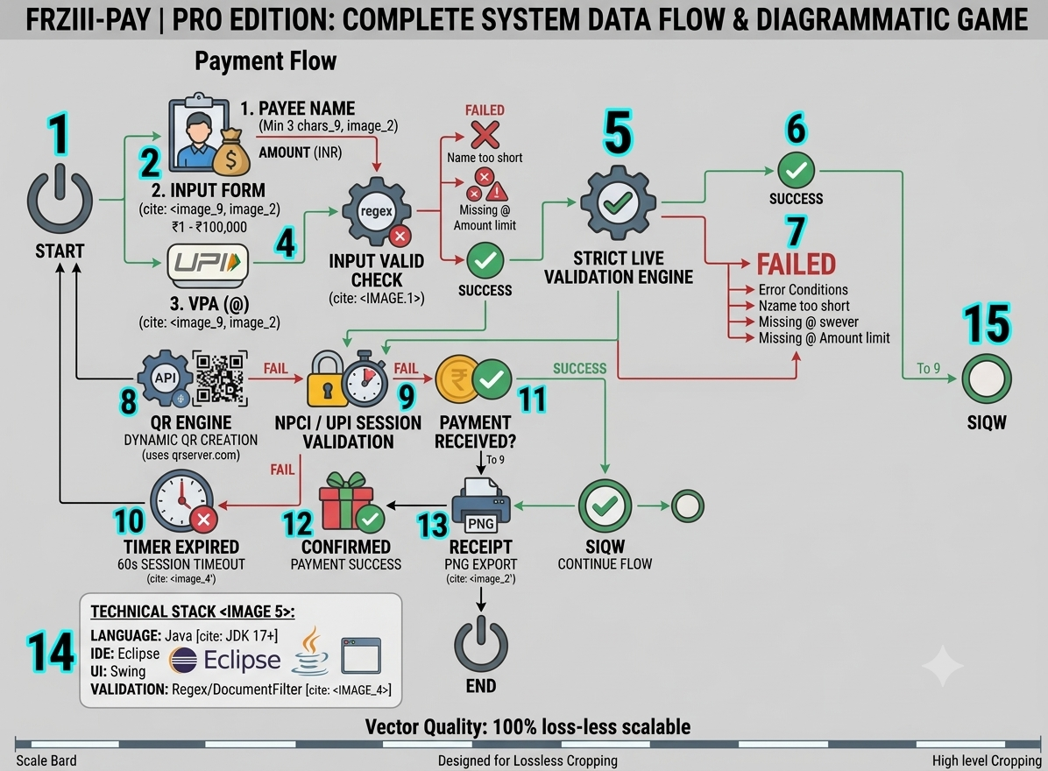
Flowchart & UML Diagrams
PART 3 · DESIGN
PICK WHAT FITS
Flowchart – Start App->Enter payee name->UPI id&amount->documentFilter validation->Generate QR Code->Start 60s timer->Confirm payment->Export Receipt->End
11 · [FARZII-PAY
Notes:
Paste a clear picture of your own diagram in the dashed box (draw it with draw.io, Lucidchart or by hand and scan it). Use at least a flowchart and one UML diagram. Explain it in 3–4 sentences, following the arrows. About 1.5 minutes.

Slide 12
Database Design
PART 3 · DESIGN
Table:[PAYMENT_TRANSACTION]
RELATIONSHIPS
Field | Type | Key
Transaction_id | INT | Primary
[bank_name] | VARCHAR(50) | –
[account_no] | VARCHAR(20) | -
[amount] | DECIMAL(10,2) | –
[DATA MODEL AND STORAGE
ONE SESSION MAPS TO TEMPORARY BANK NAME,ACCOUNT NO,TIME PEREMITER DURING RUNTIME].
12 · [FRZIII-PAY]
Notes:
Show your main tables with field names, data types and keys. Add one table per entity (copy this slide if you have several). If your project uses files or collections instead of a database, say that clearly and explain how data is saved and loaded. About 1 minute.

Slide 13
Java Concepts Used
PART 4 · BUILD
OOP
Collections
Exception Handling
File I/O
Classes, objects, payment payload data, encapsulation
[ Data structure/map ]
try, catch for invaild input and qr code generation
[ Read/write & save generated qr image]
JDBC
GUI
Packages & Interfaces
Multithreading
[stores transaction logs]
[Java Swing ]
[packages qr and interface (ActionListerner &DocumentListerner]
[timer task/tread for countdown time]
13 · [FARZIII-PAY]
Notes:
Keep only the concepts you really used and name the class where each one appears. Examiners love this slide because it proves you understand your own code. Delete tiles you did not use. About 1.5 minutes.

Slide 14
Implementation: Key Code
PART 4 · BUILD
public class BankQRApp extends JFrame {
public BankQRApp() {
setTitle("FRZIII-PAY | Pro Edition");
setSize(1020, 750);
setDefaultCloseOperation(JFrame.EXIT_ON_CLOSE);
setLocationRelativeTo(null);
}
public static void main(String[] args) {
SwingUtilities.invokeLater(() ->
new BankQRApp().setVisible(true)
);
}
}
EXPLAIN IT LIKE THIS
Say what the code does
Walk through the logic step by step
Name the Java concept used
14 · [FRZII-PAY]
Notes:
Show only the 8–15 most important lines, not the whole program. Good choices: the main class, the database connection, or the core logic. Copy this slide if you want to show more than one snippet. Use a large font so the back row can read it. About 2 minutes.

Slide 15
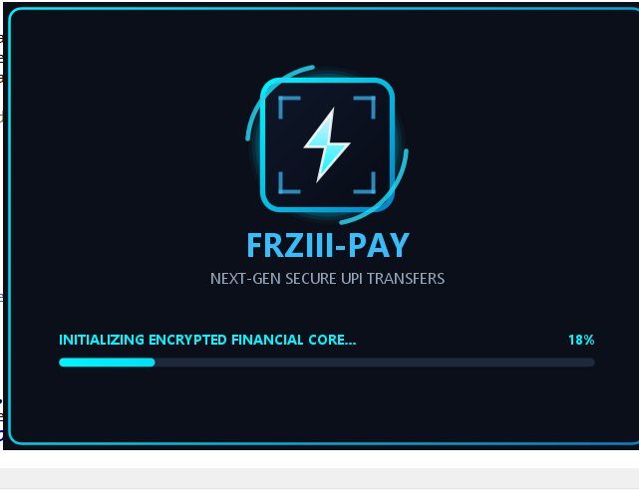
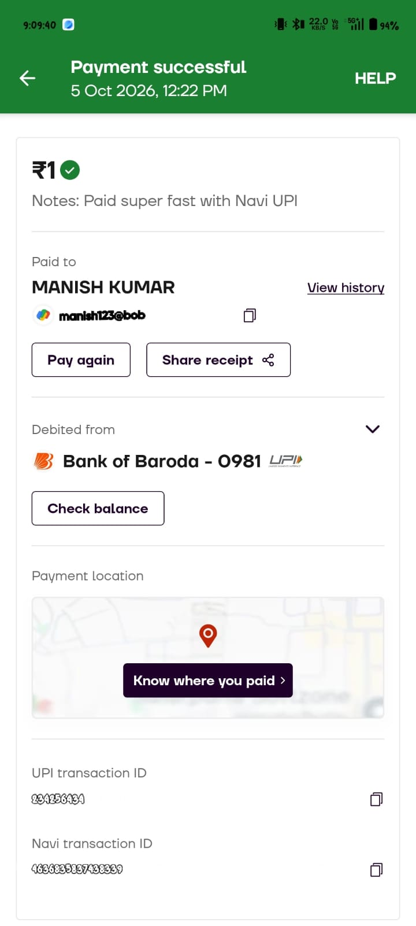
Output Screenshots
PART 4 · BUILD
1. Splash screen
2. Payment screen
3. Payment receipt
App launch with the encrypted core loading bar.
Receiver name, UPI ID and amount are validated, then a UPI QR is generated.
Success screen with receiver, bank and transaction ID.
15 · [FARZIII-PAY]
Notes:
Replace each dashed box with a real, clear screenshot of your running project. Show the main flow in order: start, main work, output. If possible, do a 1-minute live demo instead of, or after, this slide. About 2 minutes.

Slide 16
Testing
PART 4 · BUILD
Test ID | Input | Expected | Actual | Result
TC01 | [Valid name,UPI &amount] | [qr code generated & time starts] | [qr code generated & time starts] | Pass
TC02 | [Wrong password] | [Validation Error alert ] | [Validation Error alert] | Pass
TC03 | [timeout] | [Session Expired message] | [Session Expired message] | Pass
TC04 | [successful payment scan] | [show "payment successful"] | [show "payment successful"] | Pass
Testing types used: [Unit testing (JUnit)] · [Manual testing] · [Invalid input testing]
16 · [FARZIII-PAY]
Notes:
Show 4–6 test cases with real inputs and the real result. If a test failed and you fixed it, mention that: it shows honest testing. Say which testing types you used. About 1 minute.

Slide 17
Results & Advantages
PART 5 · WRAP-UP
[04]
[100%]
[04]
Modules completed
Test cases passed
Java classes created
Key advantages
[Faster and automated than manual back details sharing]
[Instant :"payment successfully "confirmation with digital Recipt]
[Simple and easy to use graphical interface]
17 · [FARZIII-PAY]
Notes:
Replace the placeholders with real numbers from your project (modules finished, share of tests passed, classes written). Then list 3 clear advantages. Do not claim anything you cannot show. About 1 minute.

Slide 18
Challenges & Solutions
PART 5 · WRAP-UP
Challenge | How it was solved
[Invalid or Empty user input] | [live validation]
[qr code generation error] | [used proper exception handling]
[GUI freeze during timer] | [used multithreading]
Key learning: [Learned making Java GUI application,manage time bound session using timer ]
18 · [FARZIII-PAY]
Notes:
Be honest about 3 real problems you faced and how you fixed them. This shows hands-on learning. End with one line on your biggest learning. About 1 minute.

Slide 19




Future Scope
PART 5 · WRAP-UP
[Add smart payment tracking ]
[cloud/real time bank API]
[e.g. Live transaction history & dowlnoad payment receipts ]
[live banking gateway for automated payment verification]
[Stronger security]
[Multi-user support]
[Secure user authentication login]
[allows multipal shop owner to generate their own qr ]
19 · [FAZIII PAY]
Notes:
Mention 3–4 realistic improvements. These should connect to the limitations you mentioned earlier. About 45 seconds.

Slide 20
Conclusion
PART 5 · WRAP-UP
WHAT I BUILT
WHAT I LEARNED
IMPACT
[Developed a secure UPI payment portal featuring live input validation,dynamic QR code generation,a 60 sec countdown session timer, and receipt export]
[fast,error free,secure,user friendly payment]
[java swing GUI design,oops,multithreading using swingWorker ,exception handling]
20 · [FRZIII-PAY]
Notes:
Connect back to the problem statement: you set out to solve it, and here is what you delivered. Do not add new information on this slide. About 45 seconds.

Slide 21
References
PART 5 · WRAP-UP
[Author, Book Title, Publisher, Year]
[Oracle, Java SE Documentation, docs.oracle.com/en/java/]
[Website or tutorial name, URL, date accessed]
[Research paper or project report, if any]
21 · [FARZIII-PAY]
Notes:
List every book, website or paper you used. Use one consistent format (for example IEEE or APA). Copying without credit counts as plagiarism, so add everything you referred to.

Slide 22
Thank You
Q & A
Questions are welcome
CONTACT
PROJECT CODE
[[Prachi Sindal] · [sindalprachi86@gmail.com]
[Manish], []
[GitHub repository link]
Notes:
Smile, thank the audience and the guide, and invite questions. Keep your code, diagrams and screenshots ready. Common viva questions: why Java, what is the main class, which OOP concepts did you use, how does the database connect, what are the limitations.

