Slide 1

Weekly
Goal Updates
8 June 2026
TEAM 1

Slide 2
R1 — Product Owner
25th MAY
+ Assigned to a team
+ Assigned roles to each members
+ Set up milestones
Timeline
26th May - 1 June 2026
collects data, runs the agents, queries four AI models, and commits a prediction to GitHub
31st May
+ Summarizing Works
+ Check the criterias
+ Send the Final report to Dr.Tan
Welcome to Team 1's Market Intelligence synthesis. I am presenting as the Product Owner alongside my co-PO, Georgi.
As required for the Product Owner role, I will first address our team's performance tracking: our calibration score from last week's sprint is currently Pending, as our QA Lead noted, because prediction and actuals weeks must align before scoring.
As outlined in our timeline, our sprint kicked off on May 25th with team formation and milestone planning. From May 26th up until today, May 31st, we executed a rigorous process of collecting data, running agents, and querying four distinct AI models.
8th June
+ Presentation about team works and what team have accomplished

Slide 3
R1 — Product Owner
Sprint Goal
Prediction File Committed
Exact SPX, NDX, and IWM ranges with associated confidence levels committed to the repository.
LLM Evidence Stored
All four raw LLM responses explicitly stored in the designated /evidence folder — no summaries, full logs only.
To create a clean, evidence-based market prediction process where every team member contributes clearly, all files are committed to GitHub, and the final prediction is supported by structured reasoning and human judgement.
This sprint goal was established collaboratively between the Scrum Master and Product Owner to ensure that every deliverable is traceable, reviewable, and grounded in documented analytical reasoning not assumption. The emphasis on GitHub commits guarantees a fully auditable project trail for all stakeholders.
What does "Done" look like for us this week? For this sprint to be considered completely done, our final prediction must be filed in GitHub specifying the market direction, percentage range, and our confidence level. Furthermore, our repository's evidence folder must be fully populated with the required data screenshots, raw LLM responses, our independent Human Score, the README update, and the official release tag.
My ultimate focus as Product Owner is to ensure the team does not merely complete tasks, but continuously improves the quality, clarity, and reliability of our prediction process as we prepare for our upcoming presentation on June 8th.
W3
Observations: this was easier week, but was still chaotic
Aiming: define clear communication protocol on Monday
Human Score Table Complete
Override justification written clearly alongside the completed Human Score table. Rationale must be traceable.
GitHub Release Tag Created
Official release tag successfully created and pushed to GitHub before class. Late tags do not satisfy this criterion.

Slide 4
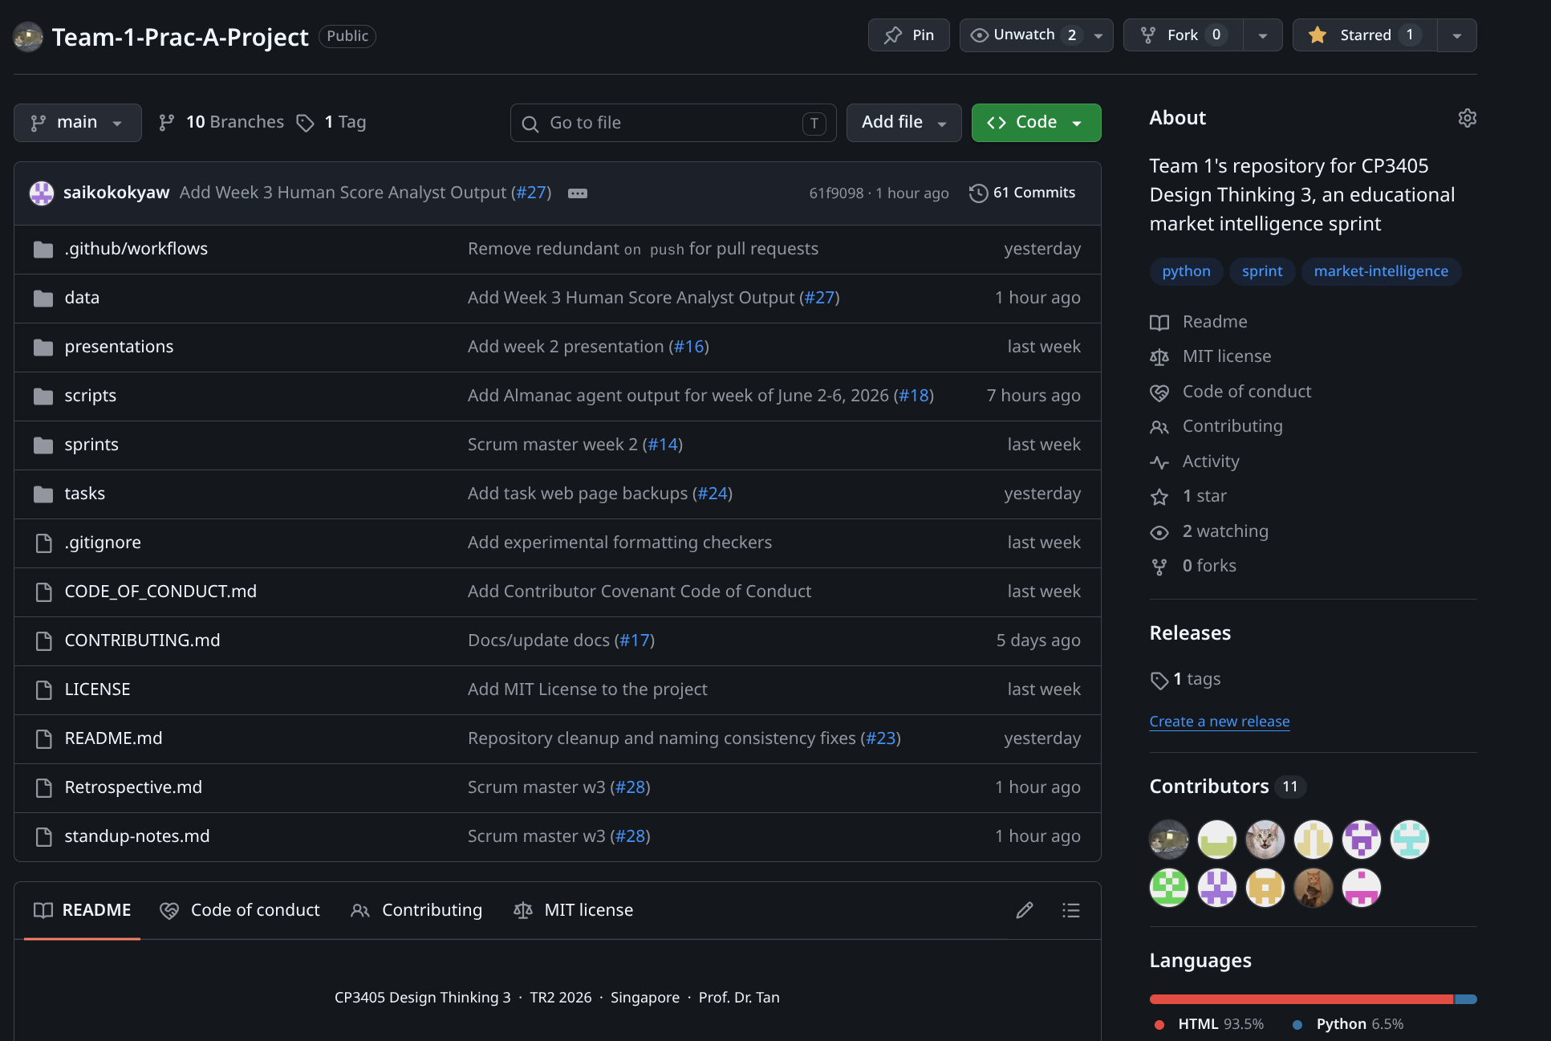
R1 — Product Owner
Evidence

Slide 5
Scrum master
Completed
Facilitated team communication and coordination.
Monitored sprint progress and tracked outstanding tasks.
Completed standup notes and sprint retrospective.
Supported team members with workflow guidance.
Updated and maintained Scrum documentation.
Key Challenges
Some team members were inactive.
Delayed progress updates from contributors.
Communication issues on Discord.
Role clarification was required for some members.
Lessons Learned
Clarify roles earlier.
Improve communication.
Raise blockers sooner.
Schedule regular check-ins.
Reflection
Good collaboration from active members.
Most deliverables completed successfully.
Earlier communication would improve future sprints.

Slide 6


Overview of Goals
1
2
3
UPGRADE CUSTOMER EXPANSION PROGRAM
IMPLEMENT NEW SYSTEM
ASSESS NEW SYSTEM AND PROGRAM
Install system and train users
Keep it updated and relevant
Identify areas for improvement
DONE
ONGOING

Slide 7
CP3405 DT3 · WEEK 3 · SPRINT REVIEW
R3 — Almanac Agent
ALMANAC BIAS
Bearish
Seasonal Patterns · June 2026
Confidence: MEDIUM
CYCLE CONTEXT
WEEK PATTERN (2–6 June)
SECTOR SIGNALS
2026 = Midterm Year
Q2–Q3 = The Weak Spot (still active)
Q4 2026 = Sweet Spot begins later
Holiday Pattern
Technology
Neutral
XLK
Mar–Jul window active
LONG
None this week
Banking
Early June Tendency
XLF
May–Jul headwind
SHORT
JUNE VITAL STATS
Summer doldrums building
Bearish
−2.1%
Gold/Sliver
XAU
Contradicts ATH
SHORT
Key Event — NFP Fri 5 Jun
Materials
S&P midterm year June avg
Dominant macro event
Watch
XLB
SHORT
May-Oct Window
June ranks #12 of 12 in midterm year — dead last
NET: Slight Bearish Lean — Midterm June Context Dominates
Energy
XLE
New-begins June
SHORT
INVALIDATION:
Cool NFP print on 5 June triggering Fed cut expectations → bias shifts Neutral-Bullish
ALMANAC THESIS:
June 2026 is the worst month of the year in a midterm cycle. Four sectors have active seasonal SHORT signals. Technology is the only seasonal bright spot.

Slide 8
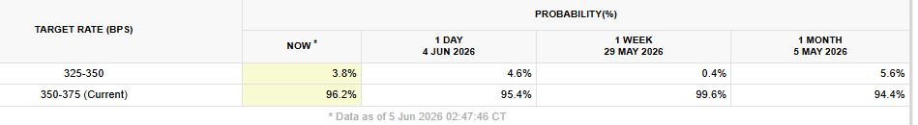
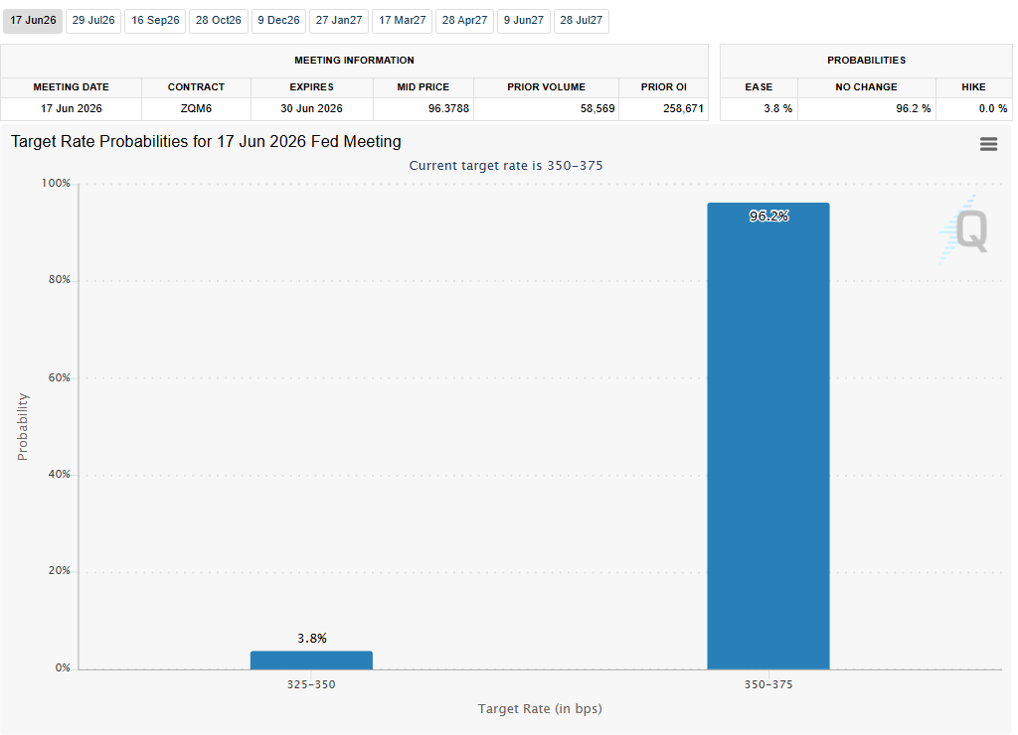
R4
FED & RATES (CME FedWatch + Treasury.gov)
Current Fed rate: 3.50%-3.75%
Next FOMC date: June 17, 2026. Hold probability: 96.2%. Cut probability: 3.8%. Direction vs last week: shifted dovish
Image: Data Tables and charts from CME Fedwatch tool
Notes:
The current Fed funds rate remains at 3.50% to 3.75%.
For the June 17 FOMC meeting, markets assign a 96.2% probability of no change and a 3.8% probability of a rate cut. Compared to last week, expectations became slightly more dovish.

Slide 9
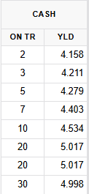
R4
FED & RATES (CME FedWatch + Treasury.gov)
2-year yield: 4.158% 10-year yield: 4.534% 30-year yield: 4.998%
Yield curve: normal. 10-year direction this week: rising
Implication: Rising 10-year yields are a headwind for growth stocks, REITs, and other long-duration assets
Image: Data Tables and charts from CME Fedwatch tool
Notes:
Treasury yields increased across the curve, with the 10-year yield rising to 4.534%. The yield curve remains normal, with longer-term yields higher than short-term yields.
Higher long-term yields can create headwinds for growth-oriented sectors such as technology and REITs because future cash flows are discounted at higher rates.

Slide 10
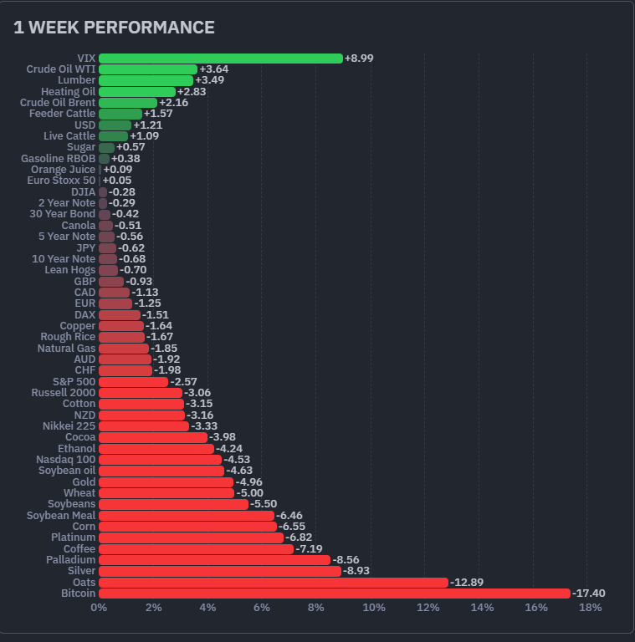
R4
COMMODITIES & DOLLAR (Finviz Futures 1W)
Crude Oil WTI (+3.64)
WTI Crude Oil
Last closed price: 90.25
weekly change +3.64%
direction: rising
Gold
Last closed price: 4353.9
weekly change -4.96%
direction: falling
DXY (Dollar)
weekly change +1.21%
direction: strengthening
Implication
Oil + Dollar + Yields rising mean:
tighter financial conditions
potential stagflation risk
USD (+1.09)
Gold (-4.96)
Image: 1 Week performance Bar Chart by finviz.com
Notes:
WTI crude oil rose 3.64% during the week, while the U.S. dollar strengthened by 1.21%.
Gold declined by 4.96%, reflecting pressure from higher yields and a stronger dollar.
The combination of rising oil prices, higher Treasury yields, and a stronger dollar suggests tighter financial conditions and increases concerns about inflation persistence. This creates a potential stagflation risk if economic growth slows while inflation remains elevated.

Slide 11
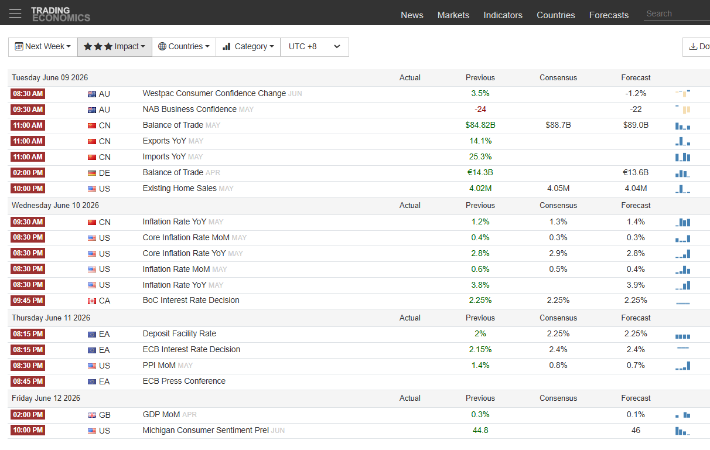
R4
WEEK-AHEAD CALENDAR (TradingEconomics)
Wednesday, June 10 — US Inflation YoY (May)
Expected: 3.9% (Previous: 3.8%)
Key inflation report of the week
Higher-than-expected inflation could reduce Fed cut expectations and pressure equities
Wednesday, June 10 — US Core CPI Inflation YoY (May)
Expected: 2.8% (Previous: 2.9%)
Closely watched by the Fed
A lower reading would support the disinflation narrative
Thursday, June 11 — ECB Interest Rate Decision
Expected: 2.40% (Previous: 2.15%)
Markets will focus on future policy guidance
Thursday, June 11 — US PPI MoM (May)
Expected: 0.8% (Previous: 1.4%)
Provides more insights into inflation trends
Image: Event calendar next week from tradingeconomics.com filtered to highest priorities
Notes:
The most important event this week is the U.S. CPI inflation report on June 10.
Headline CPI is expected to rise from 3.8% to 3.9%, while Core CPI is expected to decline slightly from 2.9% to 2.8%.
Markets will closely monitor these figures because inflation data will directly influence Fed rate expectations, Treasury yields, and equity market sentiment.
Additional key events include the ECB interest rate decision and the U.S. Producer Price Index report, both of which may provide further insight into inflation and monetary policy trends.

Slide 12
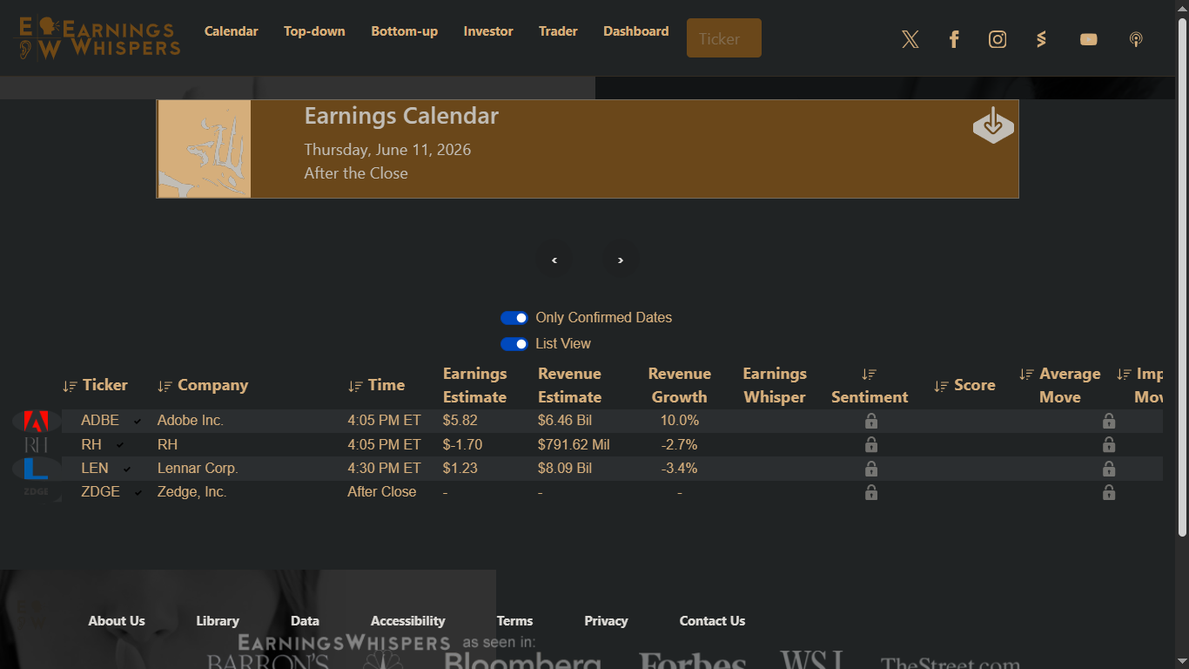
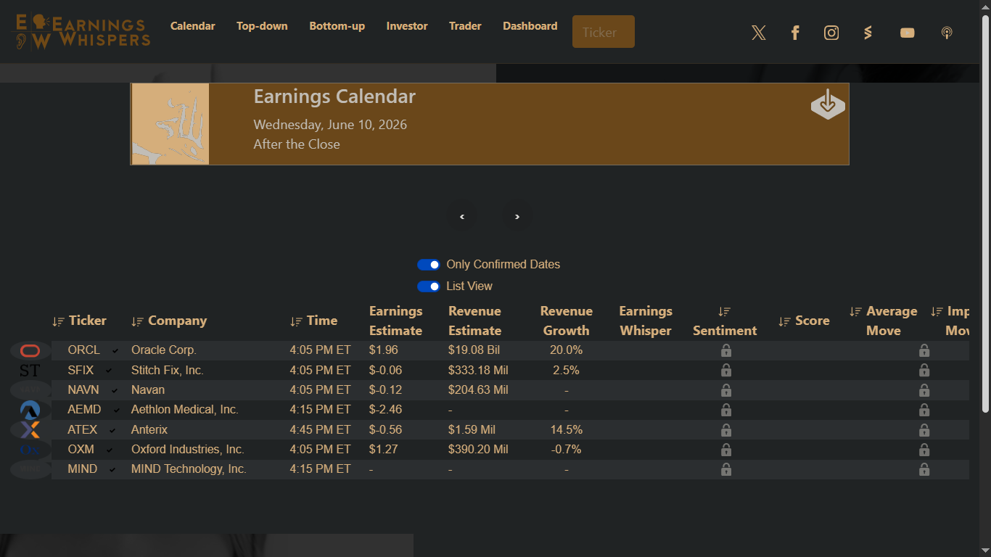
R4
KEY EARNINGS THIS WEEK (Earnings Whispers)
Oracle (ORCL) — June 10 (After Close)
Sector: XLK (Technology / Cloud)
Watch: Cloud growth, AI demand, and enterprise spending outlook
Adobe (ADBE) — June 11 (After Close)
Sector: XLK (Technology / Software)
Watch: AI monetization, Creative Cloud performance, and guidance
Lennar (LEN) — June 11 (After Close)
Sector: XHB (Homebuilders)
Watch: Housing demand, new-home orders, and mortgage-rate impact
Image: Earning prediction calendar by earningwhispers.com for 10 & 11 June
Notes:
Oracle and Adobe are the most significant earnings releases for the technology sector.
For Oracle, investors will focus on cloud growth, AI demand, and enterprise spending trends.
For Adobe, the focus will be on AI monetization, subscription growth, and forward guidance.
Lennar provides an important read-through on the U.S. housing market, particularly regarding home demand and the impact of mortgage rates.

Slide 13

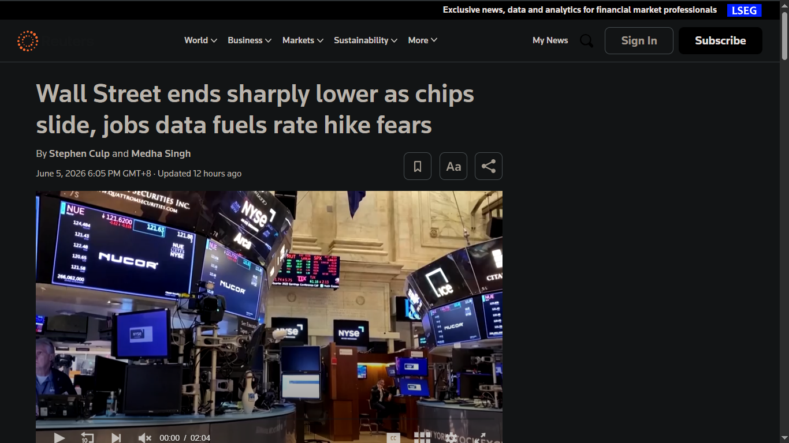

R4
CONFIRMED NEWS EVENTS (Reuters / AP)
Middle East Tensions Escalate (Reuters/AP)
US struck Iranian radar sites after drone activity near Gulf shipping routes
Potential support for oil prices and defense stocks
Increased geopolitical risk may weigh on market sentiment
Strong US Jobs Data Pressures Markets (Reuters)
Wall Street fell after stronger-than-expected employment data
Markets reduced expectations for future Fed rate cuts
Higher-for-longer rates support Treasury yields but pressure growth stocks
Image: News by Reuter.com
Image: News about Iran war by Apnews.com
Notes:
Geopolitical tensions increased after U.S. forces struck Iranian radar sites following Iranian drone activity near key Gulf shipping routes.
This development may support oil prices, defense stocks, and safe-haven assets while increasing overall market uncertainty.
In addition, stronger-than-expected U.S. jobs data reduced expectations for future Fed rate cuts and contributed to higher Treasury yields and weakness in technology stocks.
Conclusion
The overall macro bias is classified as Binary-risk.
The primary market driver this week is the U.S. CPI report. A higher-than-expected inflation reading would likely push yields and the dollar higher while pressuring equities. Conversely, a softer inflation reading could increase expectations for future Fed cuts and support risk assets.
Confidence is medium because several market indicators point toward tighter financial conditions, but the upcoming CPI release has the potential to significantly change market expectations.

Slide 14
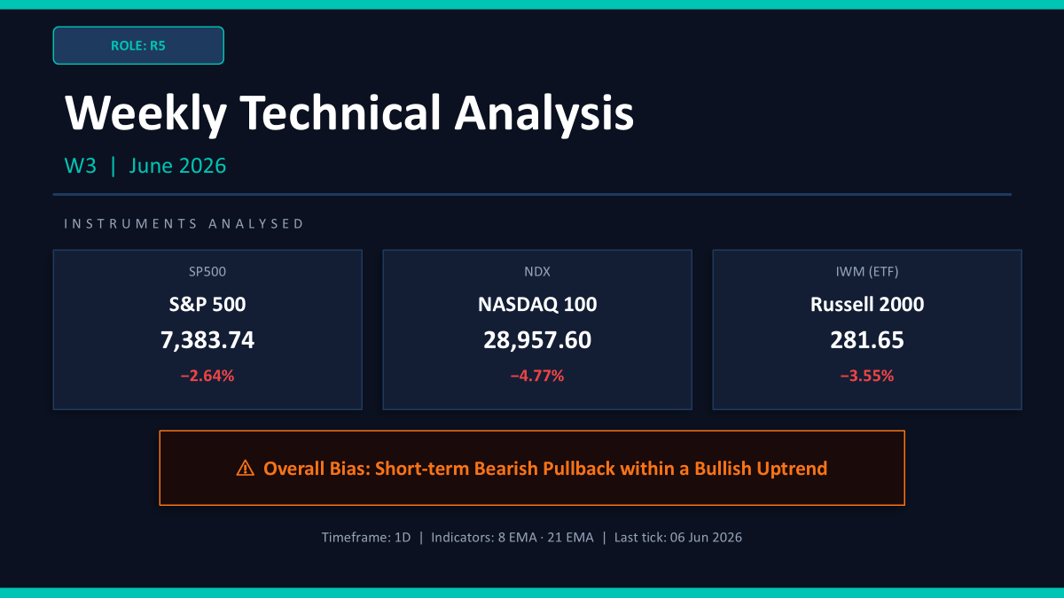

Slide 15
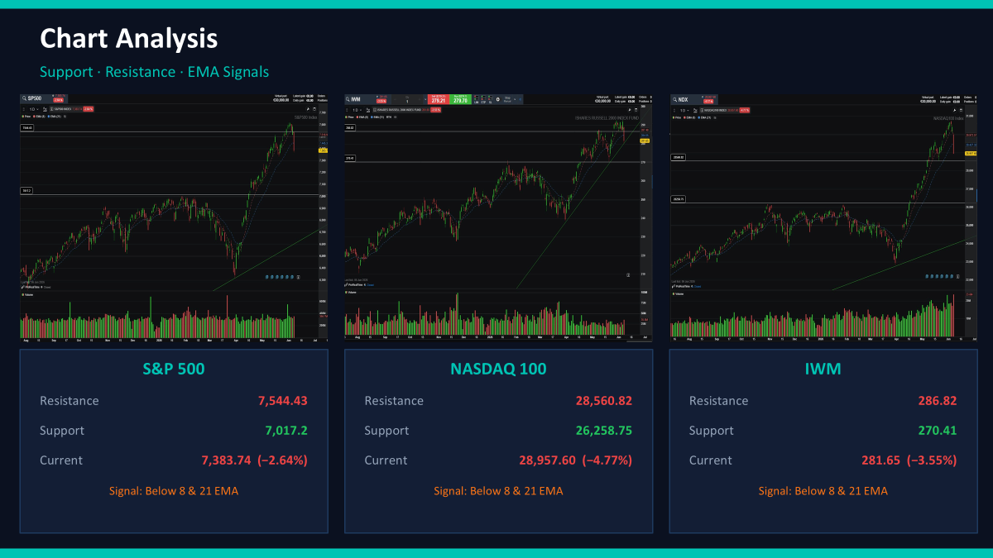

Slide 16

Week 3 Sprint Review: Market Intelligence Synthesis
CP3405 DT3 — R6 (LLM Synthesis) & R7 (Human Score) Report
SPRINT REVIEW
WEEK 3

Slide 17

R6 — LLM SYNTHESIS
The LLM Synthesis Process
Ensuring Fair and Rigorous AI Evaluation
The core objective of the R6 role this sprint was to aggregate, sanitize, and stress-test data across four distinct AI models — Claude, ChatGPT, Gemini, and DeepSeek — without introducing bias at any stage of the pipeline. Achieving comparability required strict procedural discipline: all models received the same locked input data, executed at the same time, under the same prompt structure.
The Goal
The Process
Build a rigorous "AI Stress Test" to evaluate model reasoning under conflicting macroeconomic, technical, and seasonal data — without contaminating any model's context prior to output extraction.
Data Extraction: Pulled locked evidence from R3 (Almanac), R4 (Macro), and R5 (Technical) — no new data sources introduced.
Simultaneous Execution: The identical Master Prompt was run across all four LLMs at the same time to prevent context contamination and ensure output independence.
Structured Output Capture: Extracted the 8-point required output structure from each model's raw response to form the Multi-LLM Comparison Table.
Four models evaluated in parallel: Claude, ChatGPT, Gemini, DeepSeek
Identical Master Prompt administered simultaneously to all models
No cross-model outputs shared prior to comparison
Speaker context: "My primary responsibility was to build a rigorous 'AI Stress Test.' The goal wasn't just to get an answer, but to force the AIs to deal with conflicting data so we could evaluate their reasoning quality under pressure."
🎙️ SPEAKER NOTES: "Good morning everyone. I am the R6 LLM Synthesis Operator for this week. My primary responsibility was to build a rigorous 'AI Stress Test.' To ensure absolute fairness and comparability, I gathered the locked data from R3, R4, and R5, and fed it into four different LLMs simultaneously. The goal wasn't just to get an answer, but to force the AIs to deal with conflicting data so we could evaluate their reasoning."

Slide 18


R6 — MASTER PROMPT DESIGN
The Master Prompt Design
Forcing Hard Choices with Strict Constraints
To achieve consistent, comparable outputs across all four LLMs, a strictly formatted Master Prompt was designed and executed. Rather than asking open-ended questions, the prompt injected raw locked data and mandated a precise 8-point output structure. Critically, the conflicts embedded in the data were left intentionally unresolved — forcing each model to synthesize across contradictions rather than avoid them.
Context Injection — Locked Evidence
Required Output Constraints — 8-Point Structure
R3 — Almanac
01
June midterm average return: -2.1%. Signal classification: Bearish. Historical seasonal weakness confirmed across multiple midterm June cycles.
Weekly Regime
Single-word classification (e.g., Bearish, Bullish, Neutral)
02
R4 — Macro
Confidence Score
10Y Treasury Yield: 4.534% (rising). WTI Crude: +3.64%. DXY Dollar Index: +1.21%. Combined signal: monetary tightening environment.
Qualitative confidence assessment: Low / Medium / High
03
R5 — Technical
Key Supporting Evidence & Contradictions
SPX, NDX, and IWM all trading below their 8 EMA. Across-the-board breakdown signal. No index holding support.
Primary bullish and bearish drivers identified by the model
04
Invalidation Conditions
Scenario that would negate the model's primary thesis
05
SPX, NDX & IWM % Predictions
Week-ahead directional percentage range estimates per index
Key design decision: Conflicts were deliberately left unresolved in the prompt (e.g., XLK seasonal long bias vs. 4.5% yield headwind) to expose each model's capacity to synthesize across contradictory signals rather than default to the dominant data stream.
🎙️ SPEAKER NOTES: "This is the exact Master Prompt framework I used. Notice that we didn't ask open-ended questions. We injected our raw data and forced the models to strictly output an 8-point structure. We deliberately left the conflicts in the prompt—like Tech being a seasonal 'Long' but facing a 4.5% yield headwind—to see which AI could connect the dots."

Slide 19

R6 — COMPARISON TABLE
Multi-LLM Comparison Table
Week 3 (June 8–12, 2026) — 4-Model Output Matrix
The following table captures the full structured output extracted from each of the four LLMs following execution of the identical Master Prompt. All outputs were captured independently and parsed into the 8-point required structure before comparison was performed.
Dimension
Claude
Opus 4.8 Max "Thinking"
ChatGPT
5.5 Instant
Gemini
3.1 Pro "Extended"
DeepSeek
V4 Flash "Expert Mode"
Weekly Regime
Bearish
Bearish
Bearish
Bearish
Confidence Score
Medium
High
Medium
Medium
SPX % Estimate
-3.5% to +1.5%
-0.8% to -3.0%
-1.0% to -3.0%
-3.0% to +1.5%
NDX % Estimate
-4.5% to +2.0%
-1.0% to -4.0%
-1.5% to -4.0%
-4.0% to +2.0%
Top Supporting Reason
Seasonality (midterm June), bearish macro (NFP), Tech breakdown
Midterm June weakest month, macro deterioration
Almanac midterm June data, widespread technical damage
Midterm June seasonality, macro tightening
Top Contradiction
CPI is 2-way wildcard, Tech bias only Neutral
Neutral Tech seasonality; geopolitical support for energy
XLK seasonal long, SPX technical bias still "Neutral"
XLK seasonal long window; CPI binary wildcard
Result: A rare 4/4 absolute consensus — all models independently classified the weekly regime as Bearish, converging on Midterm June Almanac weakness and NFP macro tightening as primary bearish drivers.
🎙️ SPEAKER NOTES: "Here is our Multi-LLM Comparison Table. As you can see, we achieved a rare 4 out of 4 absolute 'Bearish' consensus. All models correctly identified the midterm June Almanac weakness and the macroeconomic tightening from Friday's NFP data as the primary bearish drivers."

Slide 20
R6 — CONSENSUS & DIVERGENCES
AI Consensus & Divergences
4/4 Bearish Consensus, but Cracks in Confidence
The Consensus
Critical Divergences — Blind Spots Detected for R7
A rare 4/4 absolute agreement: Bearish. All four models independently identified the same two primary bearish drivers without cross-contamination:
Confidence Trap — ChatGPT
ChatGPT registered a "High" confidence score despite the massive binary risk posed by Wednesday's CPI report. A binary catalyst of this magnitude warrants, at minimum, a "Medium" confidence ceiling. This represents an overconfidence hallucination in the face of unresolved event risk.
Midterm June Almanac seasonal weakness (-2.1% historical avg)
Friday's NFP macro data confirming tightening conditions
Across-the-board sub-8 EMA technical breakdown in SPX, NDX, IWM
Range Variance — Claude & DeepSeek vs. ChatGPT & Gemini
Claude and DeepSeek widened their SPX estimates to include a positive tail (up to +1.5% to +2.0%) to account for a potential CPI relief rally. ChatGPT and Gemini remained entirely in negative territory, implicitly dismissing the upside CPI scenario.
Geopolitical Miss — All Four Models
All models fixated on inflation and technical signals but materially under-weighted the US-Iran geopolitical premium impacting Energy (XLE). This sector-level blind spot was flagged and escalated to the R7 Human Scorer for manual override consideration.
🎙️ SPEAKER NOTES: "However, as the Human-in-the-loop, I flagged critical divergences. ChatGPT hallucinated a 'High' confidence despite the upcoming CPI binary event. Claude and DeepSeek were smarter, widening their percentage estimates to account for a potential CPI relief rally. Furthermore, the models missed the defensive geopolitical premium on Energy. I passed these blind spots to R7."

Slide 21
R7 — HUMAN SCORE
Human Score & The Wild Card
Human Score Total: -2 (Neutral-Bearish)
The R7 Human Score evaluates the AI's multi-dimensional analysis and applies human-in-the-loop judgment to validate, adjust, or override where model reasoning is insufficient. The scoring rubric below reflects where the team agreed with the AI, and where the critical Wild Card divergence was applied.
The "Triple-Tightening" Wild Card — Score: -1
The decisive differentiator between the AI score and the Human Score is the identification of a triple-tightening environment — a compound macro condition the AI models discussed in isolation but failed to synthesize as a unified systemic risk.
All three of the following moved higher simultaneously:
Dimension
AI Said
Team Score
Macro Weight
-1
-1
Treasury Yields (10Y): Rising to 4.534%, tightening credit conditions
Crude Oil (WTI): +3.64%, increasing input cost pressure across the economy
US Dollar (DXY): +1.21%, compressing multinational earnings expectations
Technical Structure
-1
-1
Almanac Seasonal
-1
-1
AI Agreement Quality
+2 (4/4 Bearish)
+2
When all three tighten in unison, the compounded, synergistic restriction on equity markets is exponentially greater than the sum of individual headwinds. This emergent condition was not captured by any of the four LLMs and drove the Wild Card deduction of -1.
Wild Card
0
-1
Total
-1
-2
🎙️ SPEAKER NOTES: "Passing over to R7 for the Human Score. We scored a -2 overall. While we agreed with the AI's bearish macro and technical reads, our differentiator is the Wild Card score of -1. The AI failed to synthesize the 'Triple-Tightening' effect: Yields, Oil, and the Dollar rising simultaneously. This synergy creates exponential pressure on equities that the AI missed."

Slide 22
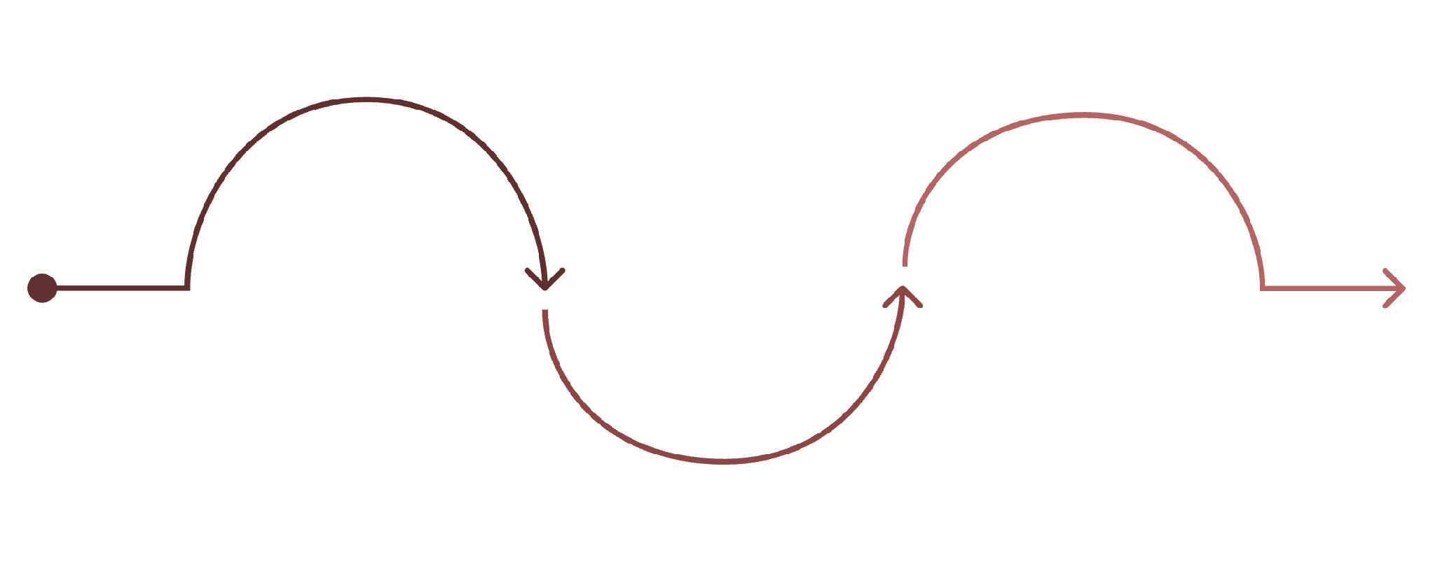
R7 — FINAL CONSENSUS
Final Consensus & Sector Strategy
Navigating CPI Binary Risk — Regime: Neutral-Bearish (Medium Confidence)
Regime
SPX Prediction
Invalidation Condition
Neutral-Bearish — Medium Confidence. The 4/4 AI Bearish consensus, combined with the Human Wild Card deduction, yields a final directional bias of Neutral-Bearish. Medium confidence reflects the unresolved binary nature of Wednesday's CPI report.
DOWN: -1.0% to -3.0%. This range aligns with the ChatGPT and Gemini estimates but widens slightly to preserve a tail buffer for CPI-driven volatility in either direction.
A significantly cooler-than-expected CPI print causing SPX to reclaim the 8 EMA on strong volume. This single catalyst has the capacity to neutralize every bearish signal in our model and trigger a broad relief rally.
🟢 LEADING Sector — Energy (XLE)
🔴 LAGGING Sector — Technology (XLK)
Manual Human Override: Despite the AI models flagging XLE as a seasonal short, the R7 team is overriding this classification. The US-Iran geopolitical tension is injecting a persistent risk premium into crude oil prices that the seasonal model does not account for. WTI's +3.64% weekly move corroborates this thesis. Energy is designated the Leading Sector as a geopolitical hedge and inflation-linked asset in a tightening environment.
The seasonal long window for Technology — typically a tailwind in early June — has been structurally negated by two compounding pressures:
Treasury Yield Headwind: The 10Y at 4.534% materially compresses growth-multiple valuations in rate-sensitive tech equities
Technical Breakdown: NDX's sharp Friday decline and sub-8 EMA positioning eliminates the seasonal long case on a technical basis
XLK is designated Lagging Sector for the week ahead. The seasonal long thesis is tabled pending CPI resolution and EMA reclaim.
R6 Stress Test
Final Allocation
LLM-driven regime stress scenarios
R7 Human Review
Regime decision and sector weights
Human scoring, adjustments, overrides
The R6 → R7 synthesis pipeline is the methodological backbone of the CP3405 Market Intelligence framework. R6 enforces procedural rigor and structural comparability across AI models; R7 applies domain expertise and human judgment to identify emergent risks that no single model captured independently.
🎙️ SPEAKER NOTES: "Our final prediction is Neutral-Bearish. We project SPX down 1 to 3 percent. We are manually overriding the AI to call Energy our Leading Sector as a geopolitical hedge, while Technology is our Lagging Sector due to yield pressure. Our thesis is invalidated only if a very cool CPI print sparks a massive relief rally."

Slide 23
R8
Week 03 Actuals — Indexes
S&P snapped 9-week winning streak · first losing week in 10
This is our Week 03 actuals for the three indexes we track every week.All three finished lower. The S&P closed at 7,383 — down 2.6%. That ended its 9-week winning streak; first red week in ten.The Nasdaq was the worst — down 4.5%, close 28,957. Tech got hit hardest.The Russell 2000 — smaller companies — down 3%, close 281.
Index | Ticker | Friday Close | Weekly Change
S&P 500 | SPX | 7,383.74 | Down 2.59%
Nasdaq 100 | NDX | 28,957.60 | Down 4.53%
Russell 2000 | IWM | 281.65 | Down 3.02%
Week 03 Actuals — Macro
Fear spiked · crypto crashed · oil reversed higher
Asset | Friday Close | Weekly Change
Gold | $4,337 / oz | Down 4.90%
Oil (WTI) | $90.54 / bbl | Up 3.64%
10-Year Yield | 4.54% | Up (+0.09 pts)
TLT (Bonds) | $85.06 | Down 0.43%
VIX | 21.51 | Up 40.40%
Bitcoin | $60,500 | Down 17.54%
On the macro side — gold, oil, bonds, fear, and crypto.
Fear spiked — the VIX jumped to 21.5, up 40% for the week. Traders got nervous fast.
Bitcoin had a brutal week — down 17.5%, close around 60,500. One of its worst weeks in years.
Gold fell almost 5% — down with a stronger dollar.
Oil reversed — up 3.6% to 90.54 a barrel. Opposite of Week 2.
Yields ticked up to 4.54%. Bonds slightly down.

Slide 24
R8
Week 03 — Sector Analysis
Complete flip from Week 2 · tech worst, defensives best
Rank | Sector | Weekly Change
1 | Energy | Up 2.45%
2 | Health care | Up 2.37%
3 | Real estate | Up 1.61%
4 | Financials | Up 1.40%
5 | Consumer staples | Up 0.64%
6 | Industrials | Up 0.61%
7 | Utilities | Down 0.16%
8 | Materials | Down 1.02%
9 | Communication | Down 3.47%
10 | Consumer disc. | Down 4.97%
11 | Technology | Down 5.61%
• Best: Energy (+2.5%), Health care (+2.4%), Real estate (+1.6%)
• Worst: Technology (−5.6%), Consumer disc. (−5.0%), Communication (−3.5%)
• Week 2: tech led the rally. Week 3: tech led the drop.
• Defensive rotation — money moved into energy, health care, staples
• Semis/AI (Nvidia, Broadcom) hammered after jobs report
Sectors flipped from Week 2.
Best: Energy, Health care, Real estate — defensive rotation. Worst: Technology down 5.6%, Consumer disc, Communication.
Tech carried Week 2; this week tech dragged the market.
Nvidia and Broadcom hit hard.

Slide 25
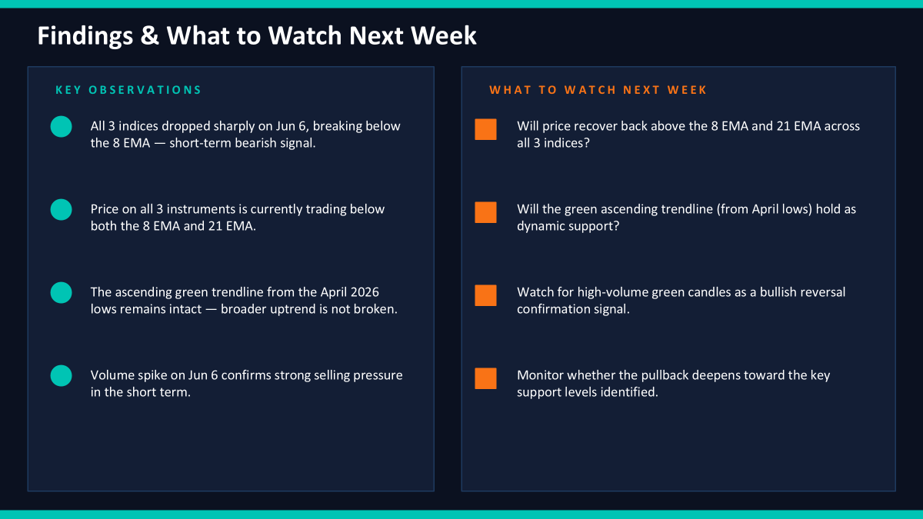

Slide 26
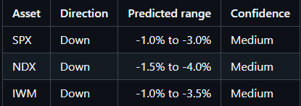
R10 QA & Learning Log Lead
Calibration status
• Latest completed calibration: Week 2 = +5 / +9
• Week 3 prediction has been QA checked
• W3 score is not calculated yet because the matching actual result has not happened
For my R10 part, I checked whether the team prediction has the required direction, range, confidence, and invalidation condition. The latest completed calibration score is still Week 2, which was +5 out of +9. For Week 3, I am not scoring it yet because this is the prediction we are filing before the market week happens.
W3 prediction checked
• SPX: Down, -1.0% to -3.0%, Medium
• NDX: Down, -1.5% to -4.0%, Medium
• IWM: Down, -1.0% to -3.5%, Medium

Slide 27
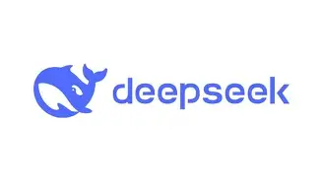
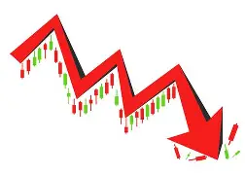

R10 QA & Learning Log Lead
LLM Horse Race
Week 2 winner
• DeepSeek was closest for SPX
Week 3 model comparison
• All four models are bearish
• Main shared risk: CPI could change the setup quickly
• W3 winner will be scored after the matching SPX actual result is available
One change next sprint
• R10 will do a pre-submission QA check before the release tag
• Final prediction must clearly show direction, range, confidence, prediction week, and invalidation condition
For the LLM horse race, the latest completed result is Week 2, where DeepSeek was closest to the actual SPX move. For Week 3, all four models agreed on a bearish view, but I cannot choose a winner yet because the actual SPX result is not available. My improvement for next sprint is to check the final prediction file earlier, before the release tag is created.

Slide 28
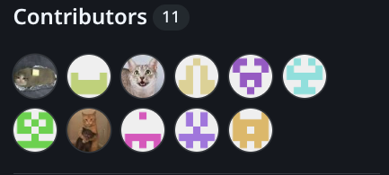
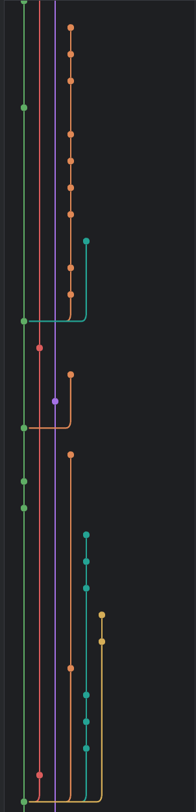
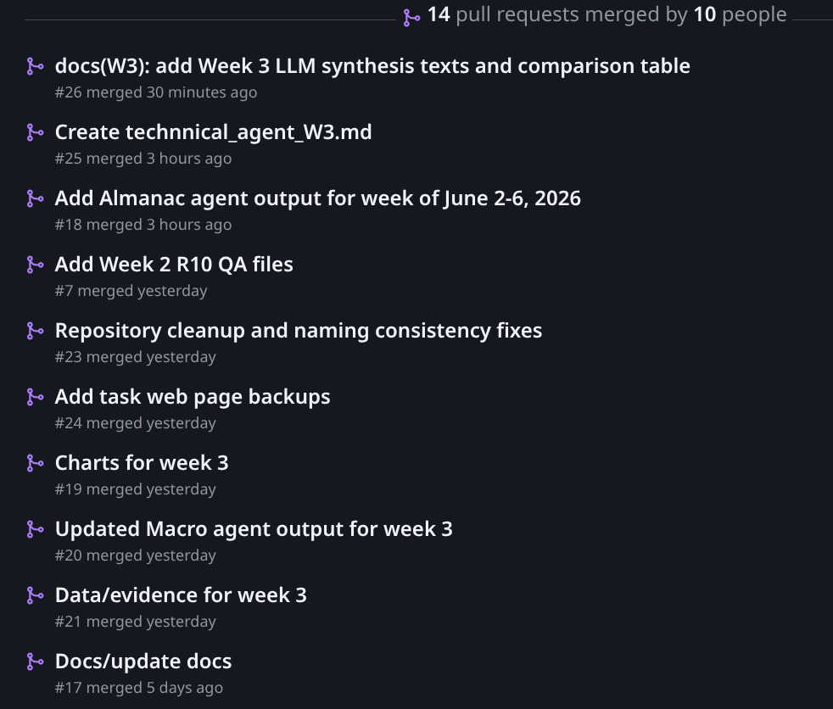
GitHub
Repository
Team members became more adapted to the workflow
All team members contributed
All planned PRs merged
README up to date
Formatting checkers had a successful integration into team’s workflow

Slide 29
Thank you!
Do you have any questions?

