Slide 1

Weekly
Goal Updates
TEAM 1- PRAC A - PROJECT

Slide 2
R1
25th MAY
+ Assigned to a team
+ Assigned roles to each members
+ Set up milestones
26th May – 1 June 2026
+collects data, runs the agents, queries four AI models, and commits a prediction to GitHub
Timeline
31st May
+ Summarizing Works
+ Check the criterias
+ Send the Final report to Dr.Tan
8th June
Welcome to Team 1's Market Intelligence synthesis. I am presenting as the Product Owner alongside my co-PO, Georgi.
As required for the Product Owner role, I will first address our team's performance tracking: our calibration score from last week's sprint was [Insert Score here, e.g., 85% / OR write "N/A for Sprint 1" if this is your first official prediction].
As outlined in our timeline, our sprint kicked off on May 25th with team formation and milestone planning. From May 26th up until today, May 31st, we executed a rigorous process of collecting data, running agents, and querying four distinct AI models.
Our Sprint Goal this week is to create a clear, evidence-based prediction workflow for the SPX, NDX, and IWM, supported by quantitative market data, AI model comparison, and ultimately, critical human judgement.
+ Presentation about team works and what team have accomplished

Slide 3


R1
Overview of Goals
1
2
3
Upgrade customer expansion program
IMPLEMENT NEW SYSTEM
ASSESS NEW SYSTEM AND PROGRAM
Comlete Sprint missions
Install system and train users
Identify areas for improvement
DONE
DONE
ONGOING

Slide 4
R1
1
Goal #1
WHERE WE'RE AT
Sprint goal and acceptance criteria completed.
Presentation template created.
Team coordination and task allocation ongoing.
Upgrade customer expansion program
BLOCKERS
Some members unclear about tasks.
Limited Discord engagement.
GitHub commits and PRs not consistent.
GENERAL STATUS: DONE
ACTION ITEMS
Finalise report.
Follow up with team members.
Check files and evidence.
Prepare final submission to Dr Tan.
TRACKING SHEET

Slide 5
R1
2
Goal #2
WHERE WE'RE AT
System architecture successfully deployed and verified in the live environment.
Comprehensive end-user training modules finalized and distributed to the team.
Initial onboarding and live training sessions completed for all core stakeholders.
IMPLEMENT NEW SYSTEM
BLOCKERS
Legacy data migration required unexpected mapping for older file formats.
Scheduling conflicts caused minor delays in live training attendance for two members.
Initial sandbox testing revealed minor UI latency (successfully resolved before launch).
GENERAL STATUS: DONE
ACTION ITEMS
Monitor system stability and performance metrics for the first 48 hours.
Send out post-training feedback surveys to measure user adoption.
Schedule a brief catch-up training session for the absent members.
Document the entire installation workflow in the team's GitHub repository/wiki.
TRACKING SHEET

Slide 6
3
Goal #3
WHERE WE'RE AT
Preparations are still being made for the implementation
Assessment guidelines need to be developed
Discussion sessions with all teams involved have already been scheduled
Assess new system and program
BLOCKERS
There is always a learning curve when adapting to a new system or program
GENERAL STATUS: ONGOING
ACTION ITEMS
Prepare notes and materials for the discussion sessions
Confirm schedule by end of the week
Draft initial assessment guidelines
TRACKING SHEET

Slide 7
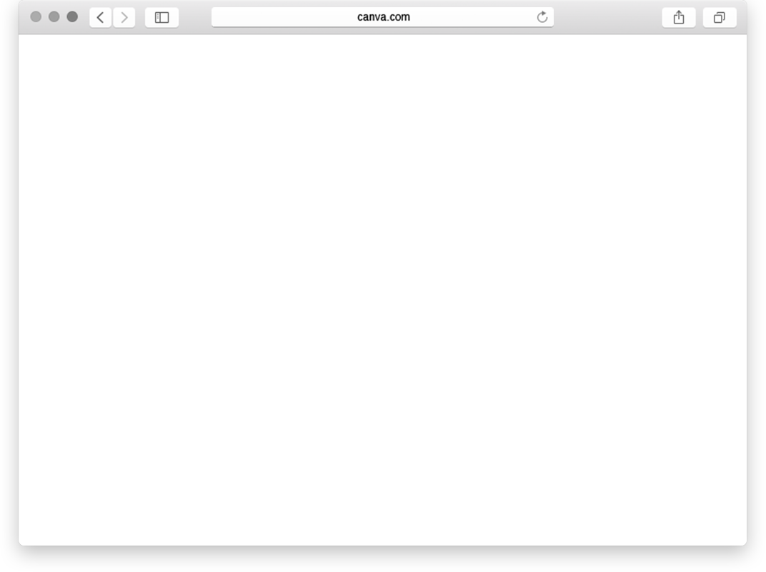
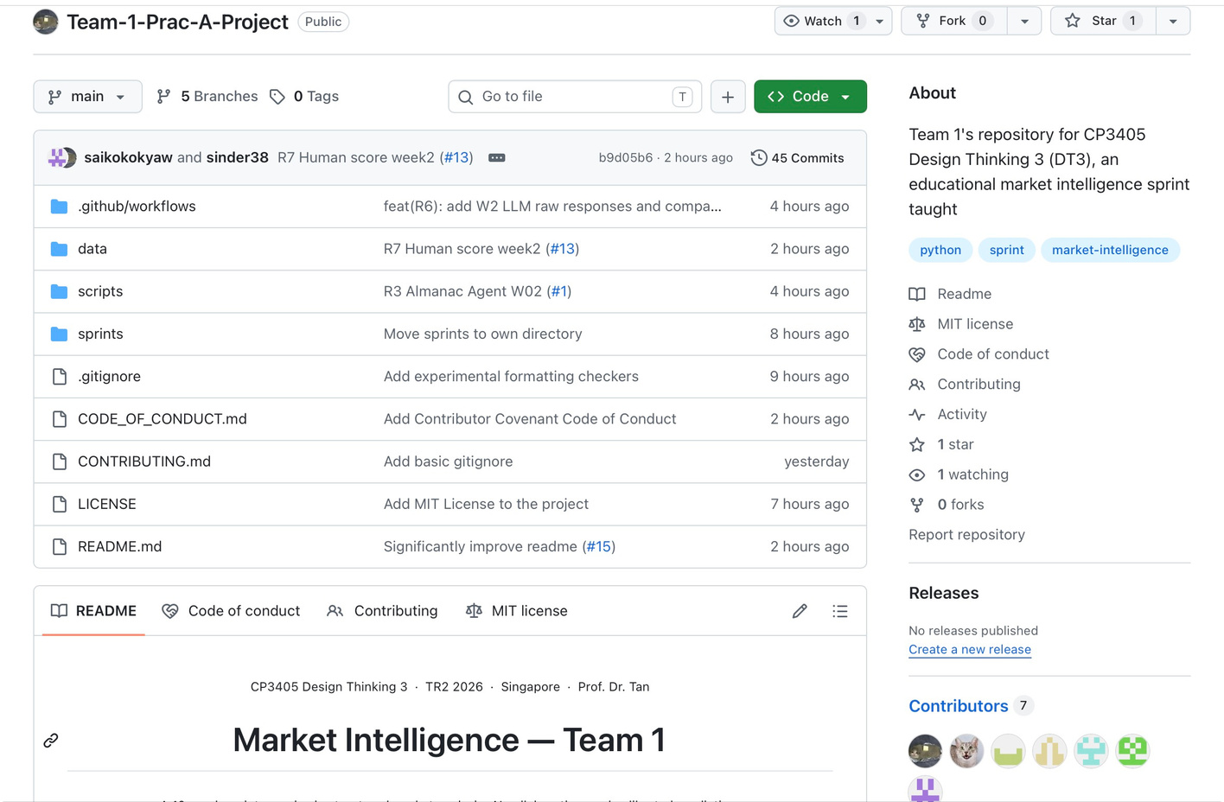
R1
I am presenting as one of the Product Owner alongside with my other P.O: Georgi and our team for our DT3 Market Intelligence team. Our sprint goal is to create a clear, evidence-based prediction workflow for SPX, NDX, and IWM, supported by market data, AI model comparison, and human judgement. For this sprint to be considered done, our prediction must be filed in GitHub with direction, percentage range, and confidence level. Our evidence folder must include the required data screenshots, LLM raw responses, Human Score, README update, and release tag. My focus as Product Owner is to make sure the team does not only complete tasks, but also improves the quality, clarity, and reliability of our prediction process each week.
What does "Done" look like for us this week? For this sprint to be considered completely done, our final prediction must be filed in GitHub specifying the market direction, percentage range, and our confidence level. Furthermore, our repository's evidence folder must be fully populated with the required data screenshots, raw LLM responses, our independent Human Score, the README update, and the official release tag.
My ultimate focus as Product Owner is to ensure the team does not merely complete tasks, but continuously improves the quality, clarity, and reliability of our prediction process as we prepare for our upcoming presentation on June 8th.

Slide 8
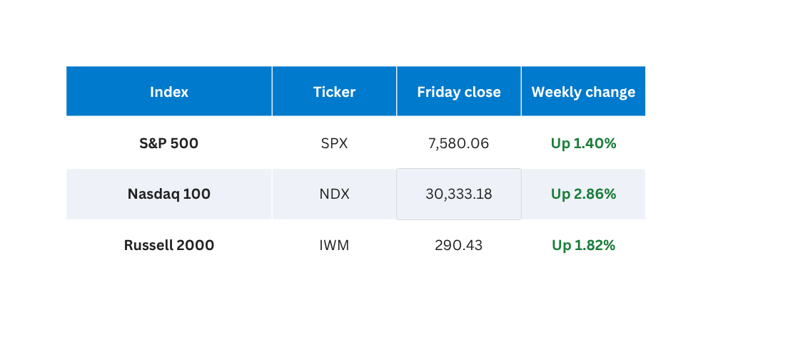
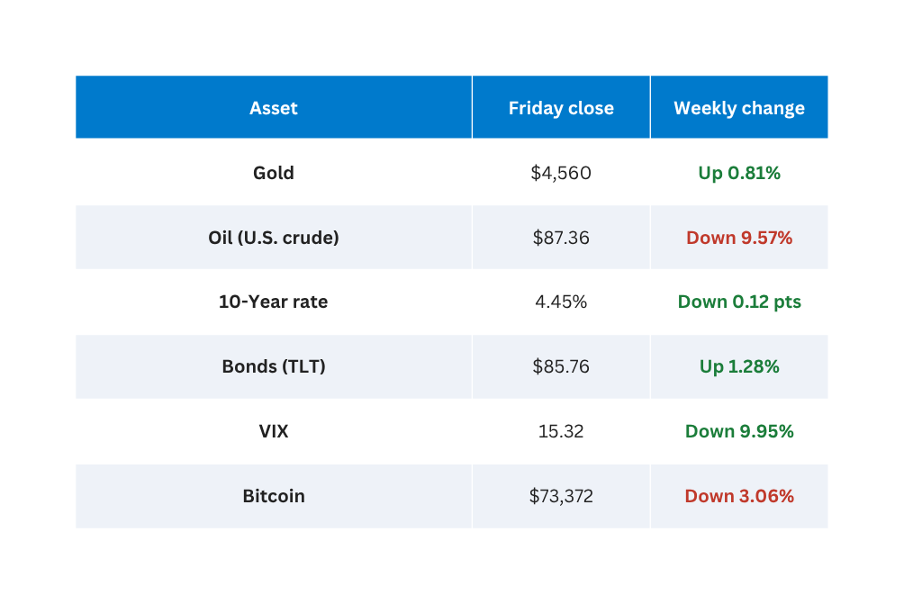
R8
Main Stock Indexes
All three up — Nasdaq led at +2.86%
S&P 500 hit a new high — 9th consecutive weekly gain.
Other Important Markets
Gold, oil, bonds, VIX, Bitcoin
VIX dropped sharply — traders less fearful. Oil fell on ceasefire headlines.
I will walk you through the definitive market actuals for Week 22 to establish our quantitative baseline. Crucially, to ensure data integrity, our official source: Finviz 1W screenshot, has been committed to our GitHub repository. Looking at the main indexes, the S&P 500 achieved its 9th consecutive weekly gain, closing up 1.4%. However, the Nasdaq 100 led the charge, surging 2.86%, while the Russell 2000 confirmed a broader breakout by gaining 1.82%. In the macro landscape, market fear rapidly evaporated—the VIX dropped nearly 10%, and WTI crude oil collapsed by 9.57% on ceasefire headlines, which helped drag the 10-year yield down.

Slide 9
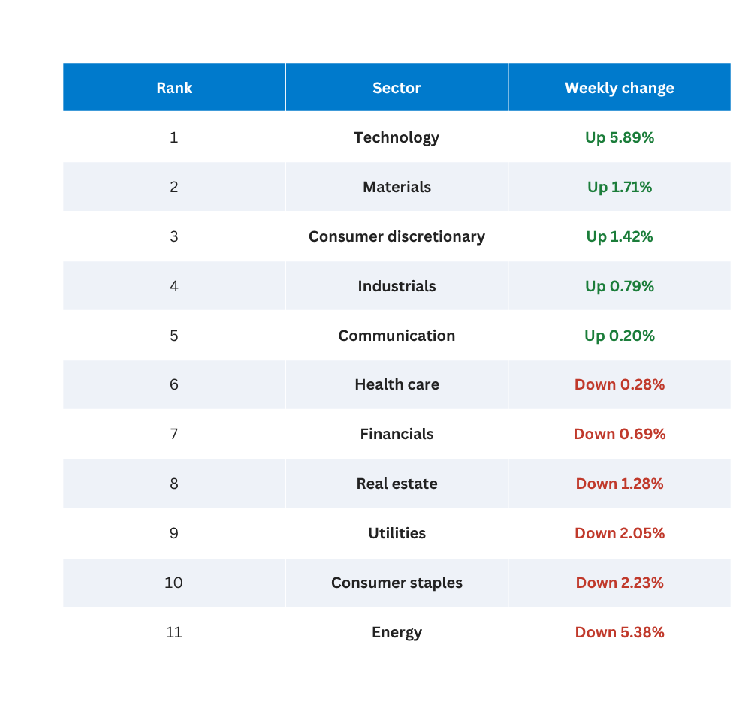
R8
Sector Highlights
S&P 500 Sectors — Ranked
Tech +5.89% led · 7 of 11 sectors were red
Best 3 -
• Technology — Up 5.89% (AI & tech earnings)
• Materials — Up 1.71%
• Consumer discretionary — Up 1.42%
Worst 3
• Energy — Down 5.38% (oil collapse)
• Consumer staples — Down 2.23%
• Utilities — Down 2.05%
Moving to the S&P 500 sectors, we observed a massive divergence beneath the surface. Despite the S&P hitting new highs, 7 out of 11 sectors actually closed in the red. The market rally was overwhelmingly carried by the Technology sector, which skyrocketed 5.89% driven by AI earnings momentum. Conversely, Energy was the absolute worst performer, plunging 5.38% in direct correlation with the collapse in crude oil.

Slide 10
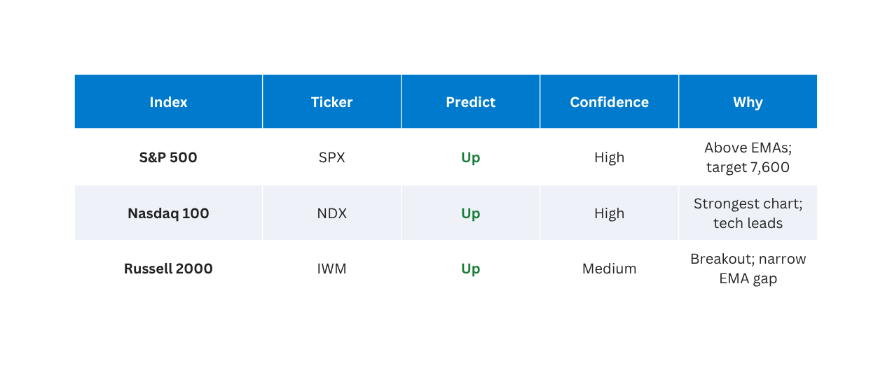
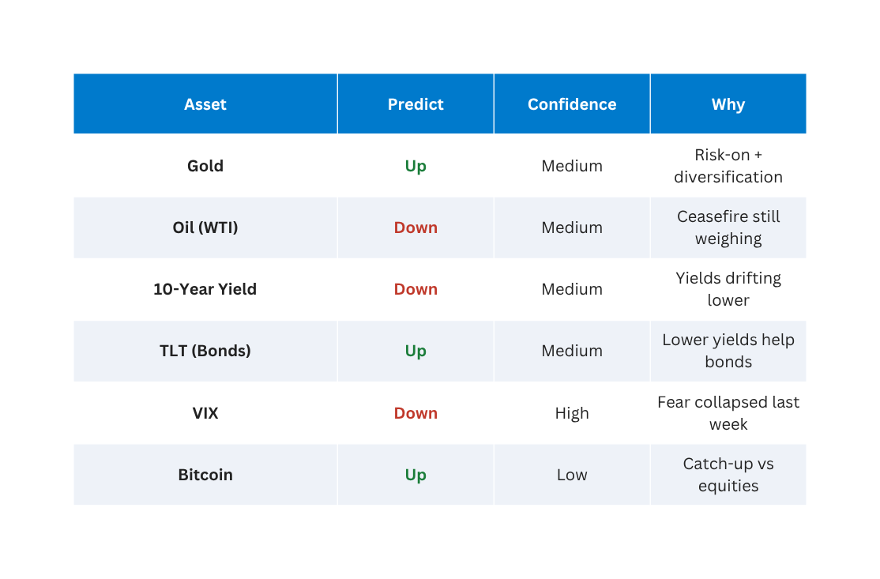
R8
Next Week: Our Predictions
Projecting these actuals into our preliminary, purely data-driven outlook for next week, the technical strength points to a high-confidence 'Up' prediction for the major equity indexes, supported by price action holding firmly above key EMAs. We also project continued downward pressure on Oil and the 10-Year Yield due to current momentum. I will now hand this data baseline over to our Almanac Lead to contextualize these trends with historical seasonality.

Slide 11
CP3405 DT3 · WEEK 2 · SPRINT REVIEW
ALMANAC BIAS
R3 — Almanac Agent
Bearish-Neutral
Seasonal Patterns · May–June 2026
CYCLE CONTEXT
MEMORIAL DAY WEEK PATTERN
SECTOR SIGNALS
2026 = Midterm Year
Q2–Q3 = The Weak Spot
S&P avg −2.5% across Q2–Q3 midterm years
Q4 2026 = Sweet Spot begins
Memorial Day Week
BEARISH
XLK
Technology
LONG
Dow ↓ 17 of 29
Mar–Jul window active
Day After (Tue 27 May)
BEARISH
XLF
Banking
SHORT
Dow ↓ 8 of last 10
May–Jul headwind
MAY VITAL STATS
Post-Expiration Week
BULLISH
XAU
Gold/Silver
SHORT
S&P ranks #8 of 12 months
Normal avg: +0.3%
Midterm year avg: −0.7% ← 2026 context
S&P ↑ 30 of 45
⚠ Contradicts ATH
NET: Mixed / Slight Bearish Lean
XLB
Materials
SHORT
May–Oct 6-month
My official Almanac bias for the upcoming Week 23 is strictly Bearish-Neutral, and I assign this a Medium confidence level. All historical probabilities presented on this slide are sourced directly from the Stock Trader's Almanac 2026.
Zooming out to the cycle context, we are currently navigating 'The Weak Spot' of the Q2 to Q3 Midterm Year cycle. While May is normally flat, the midterm context drags the S&P average down to negative 0.7%. More concerningly, as we enter our prediction window next week, June ranks as the absolute worst-performing month—number 12 out of 12—in a midterm year, with a historical average drop of 2.1%.
Looking at the micro-patterns for this specific week, the Memorial Day hangover leans heavily bearish. Historically, the Dow drops on the Tuesday after Memorial Day in 8 out of the last 10 years.
However, from a sector rotation standpoint, the Almanac gives a strong 'LONG' signal for Technology from March through July. This historical baseline perfectly validates the massive tech outperformance that our Data Lead, R8, just highlighted in the actuals. Conversely, Banking and Materials face severe seasonal headwinds and are flagged as 'SHORT'.
Finally, my Bearish-Neutral baseline will be invalidated and shifted higher only if we get a surprisingly cool PCE print or a confirmed Iran deal. I will now hand over to our Macro Lead to assess those exact real-time catalysts.
INVALIDATION:
Cool PCE print or confirmed Iran deal → bias shifts Neutral-Bullish
NEXT WEEK (June 2–5):
June ranks #12 in midterm year · S&P avg −2.1% · XLE seasonal SHORT begins
Source: Stock Trader's Almanac 2026, pp. 65–66, p. 94, pp. 10–11 · Accessed: 30 May 2026

Slide 12
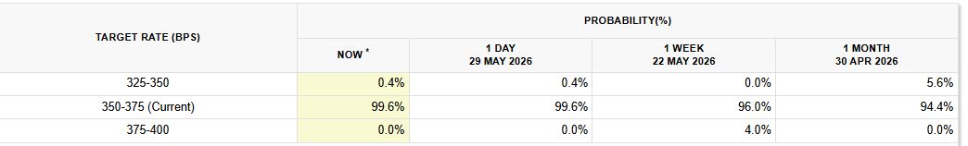
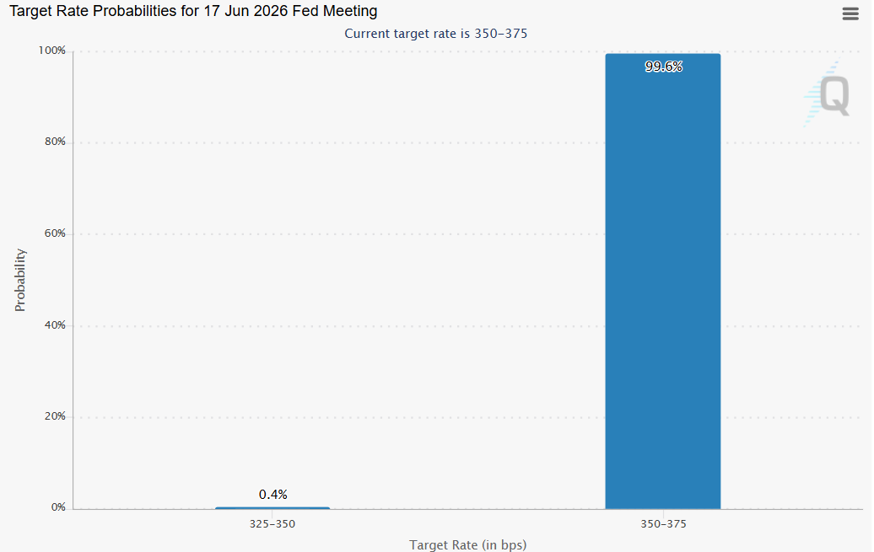
R4
FED & RATES (CME FedWatch + Treasury.gov)
Current Fed rate: 3.50%–3.75%
Next FOMC date: June 17, 2026. Hold probability: 99.6%. Cut probability: 0.4%. Direction vs last week: unchanged.
Presentation Note:
Starting with the Federal Reserve, the current Fed funds target range remains at 3.50% to 3.75%. According to CME FedWatch, markets are assigning a 99.6% probability that the Fed will leave rates unchanged at the June 17 FOMC meeting. This indicates that investors are largely expecting a wait-and-see approach from the Fed.
Image: Data Tables and charts from CME Fedwatch tool
First, looking at monetary policy, the market pricing in a Fed rate hold at 3.50%-3.75% is a "Confirmed" expectation, sitting at 99.6% probability. Similarly, the drop in the 10-year Treasury yield to 4.44% and the 9.5% collapse in WTI crude are "Confirmed" data points, providing significant inflation relief and tailwinds for risk assets.

Slide 13
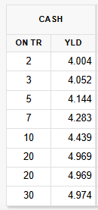
R4
FED & RATES (CME FedWatch + Treasury.gov)
2-year yield: 4.00% 10-year yield: 4.44% 30-year yield: 4.97%
Yield curve: normal. 10-year direction this week: falling.
Falling 10-year yield gives some relief to growth stocks and rate-sensitive sectors. Market still not pricing near-term Fed action.
Presentation Note:
Looking at Treasury yields, the 2-year, 10-year, and 30-year yields are approximately 4.00%, 4.44%, and 4.97% respectively. The yield curve remains normal, with longer-term yields above shorter-term yields. During the week, Treasury bond prices rose, implying that yields moved lower. Lower yields generally provide some support to growth and technology stocks.
Image: Data Table from CME Fedwatch tool
ExtraNote: Link provided for ustreasury is not working so I used CME Fedwatch tool to get the data for the treasury yield.

Slide 14
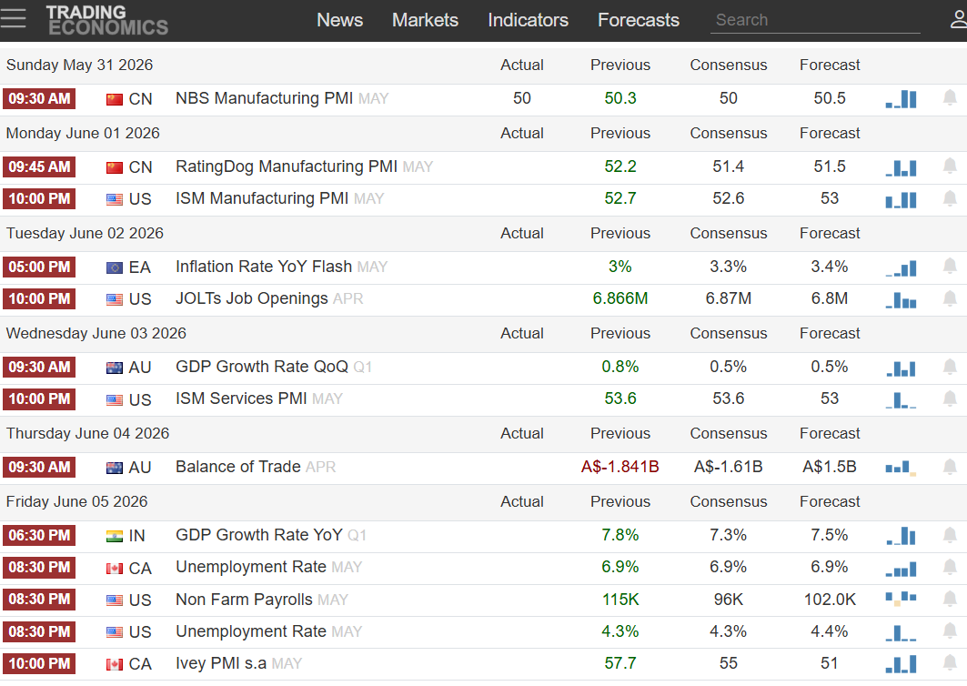
WEEK-AHEAD CALENDAR (TradingEconomics)
R4
Tuesday, June 2: US JOLTS Job Openings (Apr) — Expected: 6.8M, Previous: 6.866M — IMPORTANCE: Medium
Labor demand indicator. Market watching for signs of cooling employment conditions before payrolls report.
Tuesday, June 2: Euro Area Flash CPI YoY (May) — Expected: 3.3%, Previous: 3.0% — IMPORTANCE: Medium
Higher inflation reading could affect ECB policy expectations and global rate sentiment.
Wednesday, June 3: US ISM Services PMI (May) — Expected: 53.6, Previous: 53.6 — IMPORTANCE: Medium
Measures activity in the services sector, which remains the largest part of the US economy.
Friday, June 5: US Unemployment Rate (May) — Expected: 4.3%, Previous: 4.3% — IMPORTANCE: High
Stable unemployment would suggest labor market remains resilient despite slower hiring.
Friday, June 5: US Nonfarm Payrolls (May) — Expected: 96K, Previous: 115K — IMPORTANCE: High
Most market-moving event of the week. A large upside or downside surprise could materially shift Fed rate expectations.
Image: Event calendar next week from tradingeconomics.com filtered to highest priorities
Presentation Note:
Looking ahead, the key economic events this week are US JOLTS Job Openings, ISM Services PMI, the US Unemployment Rate, and most importantly, US Nonfarm Payrolls on June 5. The market expects payroll growth of 96,000 compared to the previous reading of 115,000. Since labor market conditions directly influence Federal Reserve policy expectations, this is likely to be the most market-moving event of the week.

Slide 15
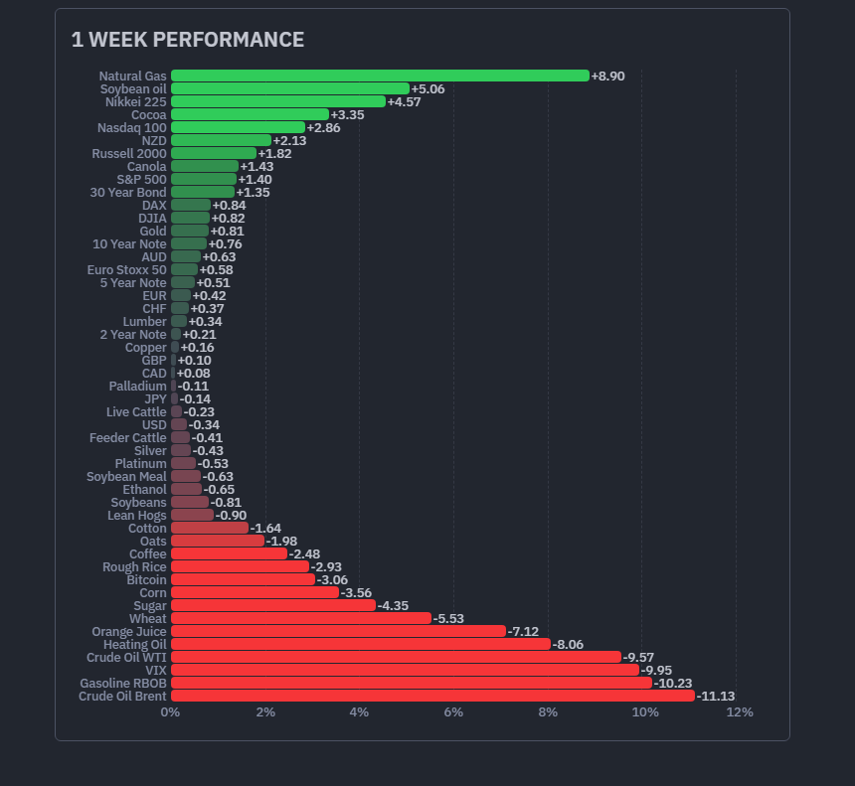
R4
COMMODITIES & DOLLAR (Finviz Futures 1W)
WTI Crude Oil: weekly change -9.57%, direction: falling
Gold: weekly change +0.81%, direction: rising
DXY (Dollar): weekly change -0.34%, direction: weakening
Cross-asset implication: Oil falling is inflation relief. Lower yields and weaker dollar are generally supportive for risk assets.
Gold (+0.8)
DXY(USD) (-0.34)
Presentation Notes:
For major macro assets, WTI crude oil recorded the largest move, falling 9.57% during the week. Gold increased by 0.81%, while the US Dollar Index weakened by 0.34%. The decline in oil prices may help ease inflation concerns, while lower yields and a weaker dollar are generally supportive for risk assets.
Crude Oil WTI(-9.57)
Image: 1 Week performance Bar Chart by finviz.com

Slide 16
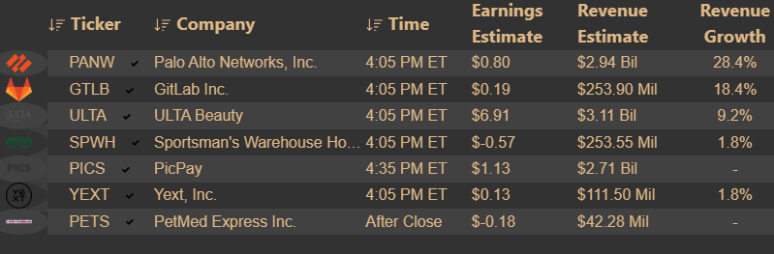
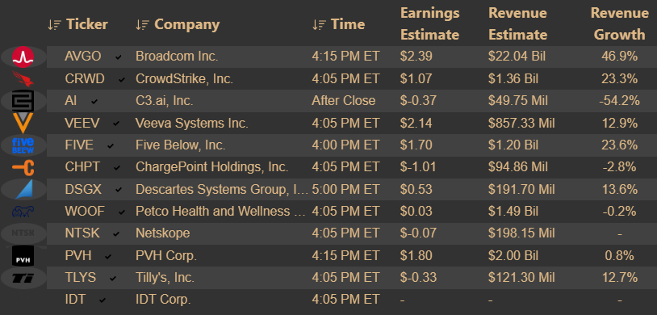
KEY EARNINGS (Earnings Whispers)
R4
Palo Alto Networks (PANW) — 2 June Tuesday (After Close) — Sector: XLK (Technology / Cybersecurity) — What to watch: Security platform growth, customer spending trends, and AI-related product demand.
Broadcom (AVGO) — 3 June Wednesday (After Close) — Sector: XLK (Technology/Semiconductors) — What to watch: AI infrastructure demand, semiconductor revenue growth, and management outlook for enterprise spending.
CrowdStrike (CRWD) — 3 June Wednesday (After Close) — Sector: XLK (Technology / Cybersecurity) — What to watch: Cybersecurity spending trends and forward guidance, which may affect sentiment across software and security stocks.
Image: Earning prediction calendar by earningwhispers.com for 2 June
Presentation Notes:
For the biggest earnings of the next week, the main sector-level catalysts are Palo Alto Networks (a company in cybersecurity field), Broadcom (semiconductor manufacturing company), and CrowdStrike (cybersecuity). These companies provide important signals on technology spending, cybersecurity demand, and AI-related investment trends.
Image: Earning prediction calendar by earningwhispers.com for 3 June
Looking ahead to our primary catalysts, while AI-related tech earnings from Broadcom and CrowdStrike are "Confirmed" scheduled events, our ultimate macro driver for Week 23 is Friday's Nonfarm Payrolls (NFP) report. The data outcome of the NFP remains completely "Unverified" and is a highly "Contested" debate among economists, forming the core risk to our prediction. I will now pass it to R5 to map out the technical charts.

Slide 17
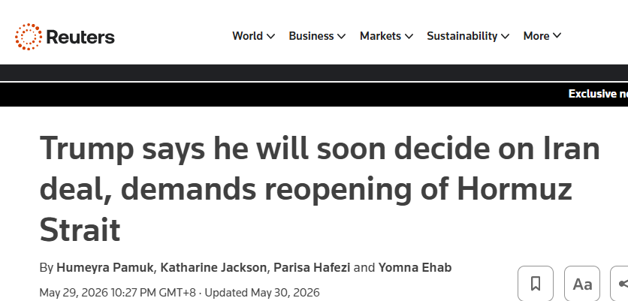
R4
CONFIRMED NEWS EVENTS (Reuters / AP)
Trump said he will soon decide on Iran deal and repeated demands for reopening of the Strait of Hormuz and removal of Iran nuclear capability. Source: Reuters — May 2026. Market implication: Any escalation could affect oil supply expectations and energy markets.
Presentation Notes:
On the geopolitical front, Reuters reported that President Trump is expected to make a decision regarding Iran and has reiterated demands concerning the Strait of Hormuz and Iran’s nuclear capabilities. Any escalation could affect oil supply expectations and energy markets.
Image: News about Iran war by Reuter.com
On the geopolitical front, Trump's statement regarding the Iran nuclear deal and the Strait of Hormuz is a "Confirmed" news event via Reuters. However, any actual escalation or supply disruption remains highly "Unverified" at this stage.

Slide 18
Final Slide For R4 Macro Agent Output in case only one slide per person
R4
FED & RATES (CME FedWatch + Treasury.gov)
WEEK-AHEAD CALENDAR (TradingEconomics)
KEY EARNINGS (Earnings Whispers)
Image: Earning prediction calendar by earningwhispers.com for 2 June
Image: Event calendar next week from tradingeconomics.com filtered to highest priorities
Image: Data Tables and charts from CME Fedwatch tool
FED & RATES (CME FedWatch + Treasury.gov) p2
COMMODITIES & DOLLAR (Finviz Futures 1W)
Image: Earning prediction calendar by earningwhispers.com for 3 June
CONFIRMED NEWS EVENTS (Reuters / AP)
Gold (+0.8)
DXY(USD) (-0.34)
Crude Oil WTI(-9.57)
Image: 1 Week performance Bar Chart by finviz.com
Image: News about Iran war by Reuter.com
Image: Data Table from CME Fedwatch tool
Notes:
This page is for only in case if one slide per person. Otherwise It can be deleted.
Presentation Note (Fed& Rate):
Starting with the Federal Reserve, the current Fed funds target range remains at 3.50% to 3.75%. According to CME FedWatch, markets are assigning a 99.6% probability that the Fed will leave rates unchanged at the June 17 FOMC meeting. This indicates that investors are largely expecting a wait-and-see approach from the Fed.
Presentation Note (Fed &Rate p2):
Looking at Treasury yields, the 2-year, 10-year, and 30-year yields are approximately 4.00%, 4.44%, and 4.97% respectively. The yield curve remains normal, with longer-term yields above shorter-term yields. During the week, Treasury bond prices rose, implying that yields moved lower. Lower yields generally provide some support to growth and technology stocks.
Presentation Note (Week-ahead section):
Looking ahead, the key economic events this week are US JOLTS Job Openings, ISM Services PMI, the US Unemployment Rate, and most importantly, US Nonfarm Payrolls on June 5. The market expects payroll growth of 96,000 compared to the previous reading of 115,000. Since labor market conditions directly influence Federal Reserve policy expectations, this is likely to be the most market-moving event of the week.
Presentation Notes (Commodities & dollar):
For major macro assets, WTI crude oil recorded the largest move, falling 9.57% during the week. Gold increased by 0.81%, while the US Dollar Index weakened by 0.34%. The decline in oil prices may help ease inflation concerns, while lower yields and a weaker dollar are generally supportive for risk assets.
Presentation Notes (Key earnings):
For the biggest earnings of the next week, the main sector-level catalysts are Palo Alto Networks (a company in cybersecurity field), Broadcom (semiconductor manufacturing company), and CrowdStrike (cybersecuity). These companies provide important signals on technology spending, cybersecurity demand, and AI-related investment trends.
Presentation Notes (Confirmed news event):
On the geopolitical front, Reuters reported that President Trump is expected to make a decision regarding Iran and has reiterated demands concerning the Strait of Hormuz and Iran’s nuclear capabilities. Any escalation could affect oil supply expectations and energy markets.

Slide 19
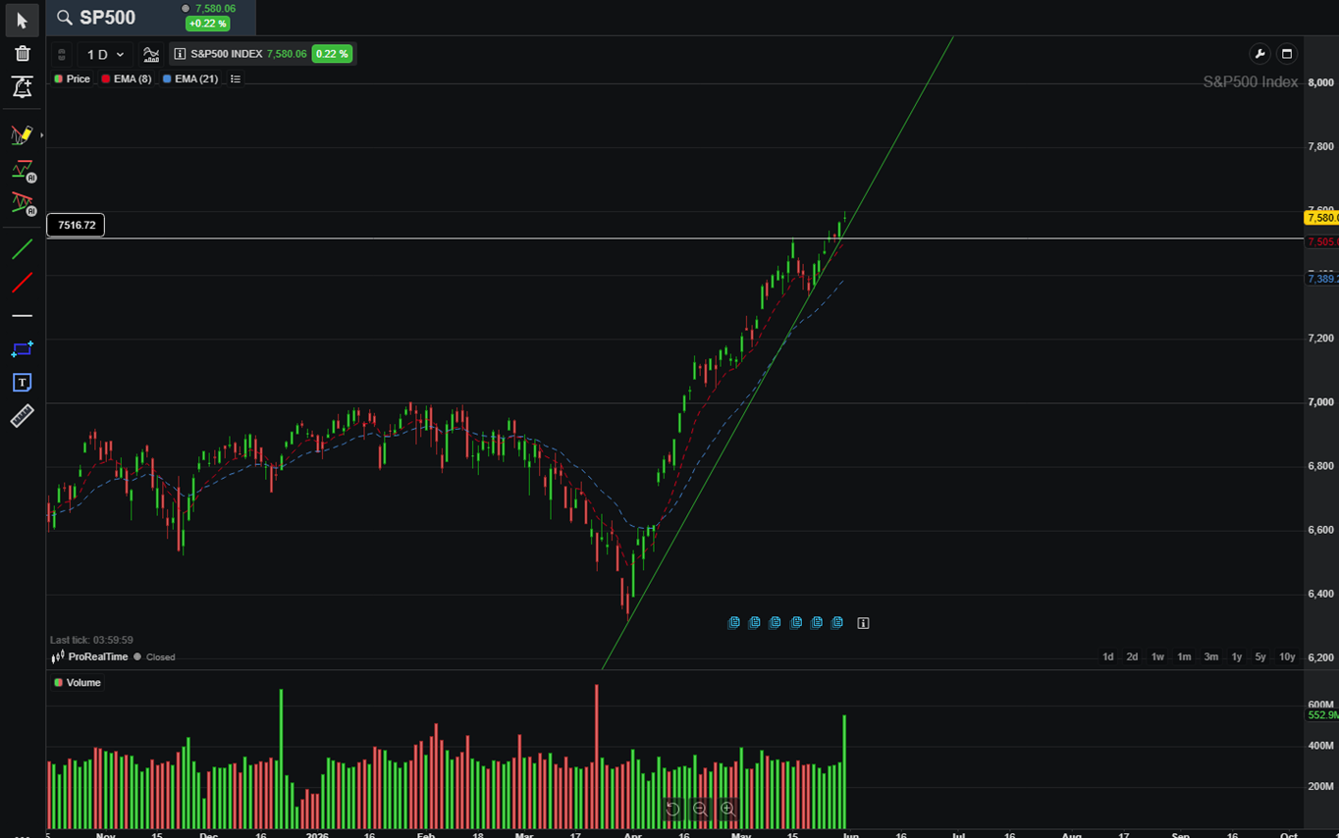
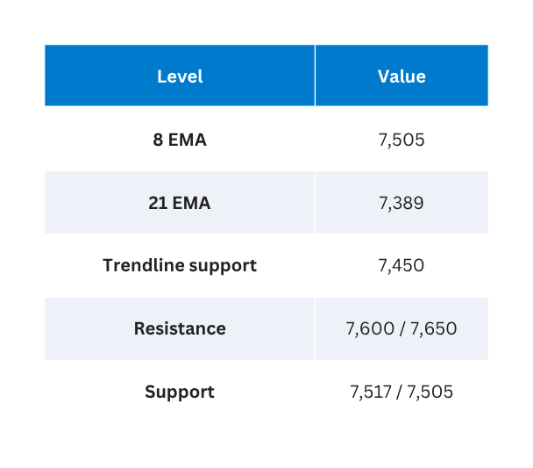
R5
S&P 500 (SPX)
S&P 500 (SPX) — Close 7,580.06
Close 7,580.06 · Week of May 30, 2026
Bias: Bullish
Confidence: High
Invalidation: Close below 7,500
Watch: Hold above 7,516? Reach 7,600?
Bullish (High) | 8 EMA 7,505 | 21 EMA 7,389 | Invalidate: close < 7,500
Price above both EMAs — Zone 1 bullish. Uptrend from April low intact.
I will map out the structural health of the market across all three major indices, starting with the S&P 500. Based on the Friday close at 7,580, the SPX is in a confirmed 'Zone 1 Bullish' state, holding firmly above its 8 and 21 EMAs with the April uptrend intact. Therefore, our bias is Bullish with High confidence. However, strict risk management is our core mandate. To satisfy this, I must state our specific invalidation level: our bullish thesis for the S&P 500 is strictly invalidated if the index registers a daily close below 7,500.

Slide 20
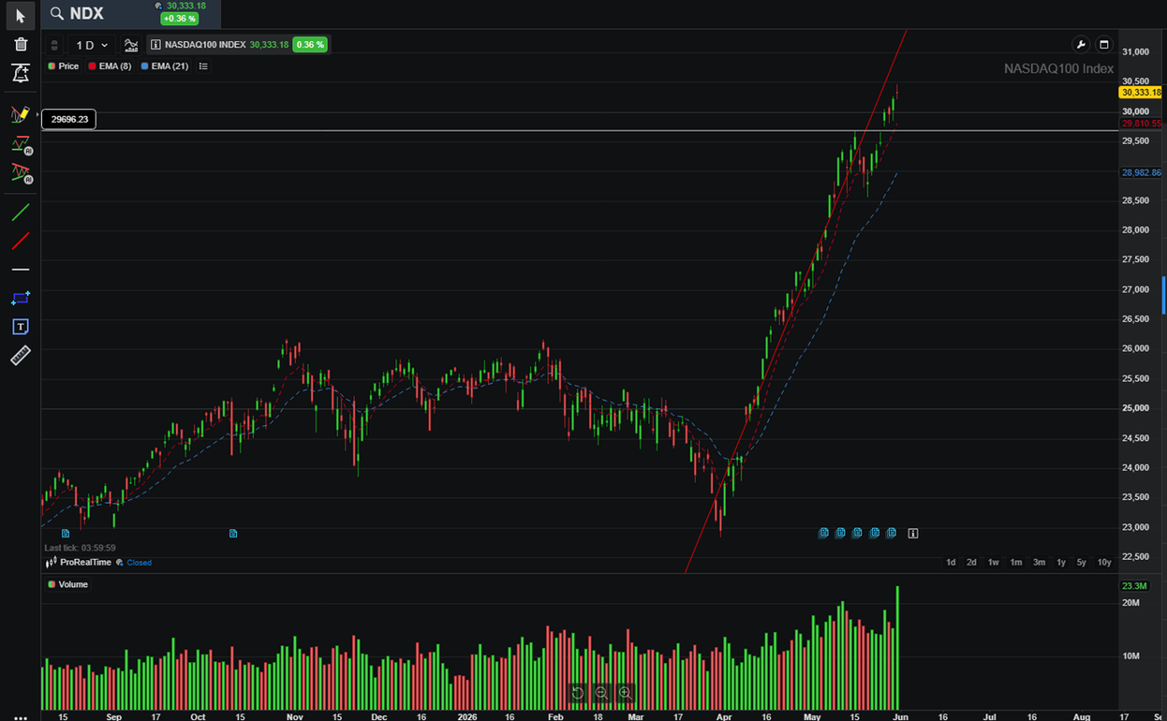
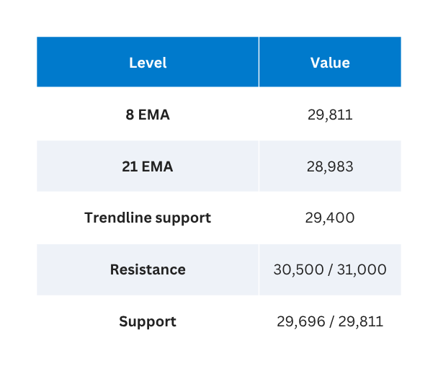
R5
Nasdaq 100 (NDX)
Nasdaq 100 (NDX) —Close 30,333.18
Close 30,333.18 · Week of May 30, 2026
Bias: Bullish
Confidence: High
Invalidation: Close below 29,600
Watch: Push to 30,500? 29,696 holds on dips?
Bullish (High) |8 EMA 29,811 | 21 EMA 28,983| Invalidate: close < 29,600
Strongest chart — widest EMA gap. Tech leading the market.
Moving to the Nasdaq 100, we see the absolute strongest chart in the market, perfectly aligning with our Data Lead's observation of Tech outperformance. Closing at 30,333, the NDX features the widest gap between the 8 and 21 EMAs, indicating intense, highly concentrated momentum. Our bias here is confidently Bullish. Again, maintaining our risk framework, I must state our specific invalidation level: this technology-led structural uptrend is invalidated only if we see a breakdown and a close below 29,600.

Slide 21
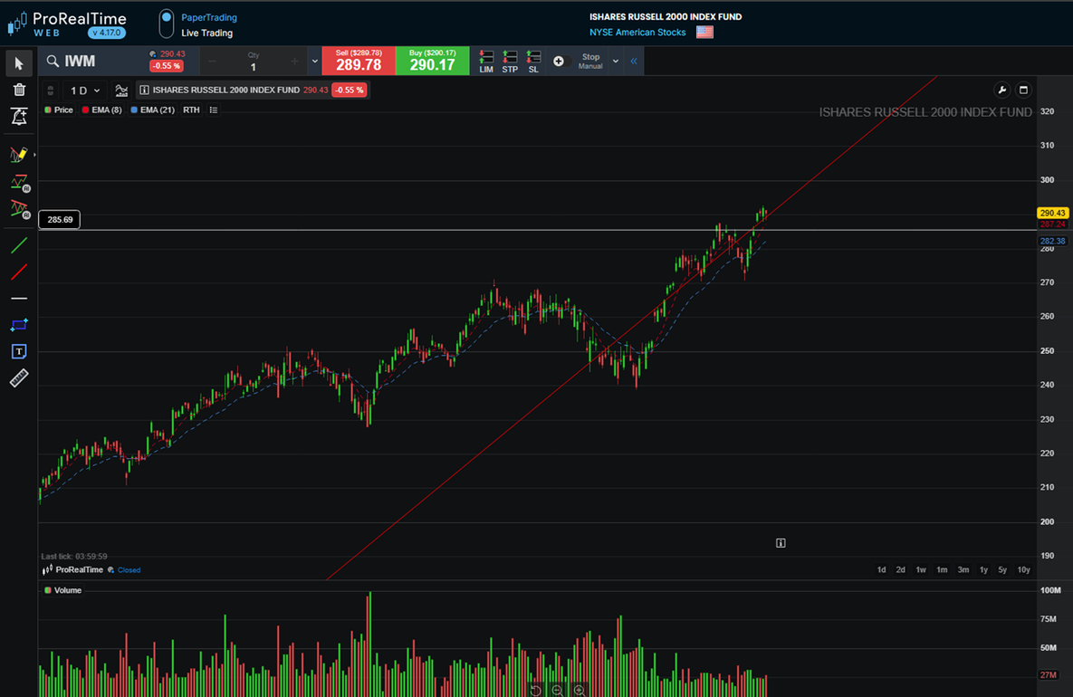
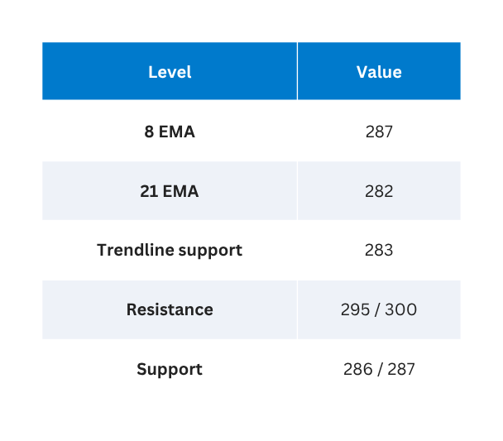
R5
Russell 2000 (IWM) —Close 290.43
Russell 2000 (IWM)
Close 290.43 · Week of May 30, 2026
Bias: Neutral-Bullish
Confidence: Medium
Invalidation: Close below 285
Watch: Stay above 286? Move toward 295?
Neutral-Bullish (Medium) | 8 EMA 287| 21 EMA 282 |Invalidate: close < 285
Breakout from sideways range. EMA gap still narrow — less certain.
Finally, looking at the Russell 2000 small caps, the technical picture reveals underlying hesitation. While the IWM closed at 290.43 and staged a breakout from a sideways range, the gap between the EMAs remains extremely narrow, signaling much less certainty than the mega-caps. Because of this fragility, our bias is downgraded to Neutral-Bullish with Medium confidence. For the small caps, I must state our specific invalidation level: this breakout fails, and our thesis is invalidated, if the price closes below 285. I will now hand over to R6 to reveal how the AI models interpreted these exact technical divergences.

Slide 22

R6
LLM Synthesis: The Shared Prompt Architecture
A rigorous, zero-bias stress-test methodology feeding an identical structured payload into four frontier language models simultaneously — Claude, ChatGPT, Gemini, and DeepSeek — to benchmark AI-driven market regime detection.
Prompt Architecture — System Payload
Methodology Principles
Identical Prompt Distribution
System: You are a market intelligence
synthesis assistant.
Input 1: ALMANAC EVIDENCE
(Seasonal Bias & Trends)
Input 2: MACRO EVIDENCE
(Fed Rates, Yields, NFP Risk)
Input 3: TECHNICAL EVIDENCE
(8/21 EMAs, Zones, Resistance)
─────────────────────────────────────────
Required Output Structure:
1. Weekly Regime
2. Confidence Score
3. Key Supporting Evidence (Max 3 pts)
4. Key Contradictions (Max 2 pts)
5. Invalidation Conditions
6. Predicted % Move (SPX, NDX, IWM)
7. Plain-English Brief
8. Disclaimer
─────────────────────────────────────────
The exact same structured prompt payload was fed simultaneously into Claude, ChatGPT, Gemini, and DeepSeek — no model received preferential or altered input.
Zero Manual Alterations
No human edits were made between model submissions, ensuring that any variation in regime calls derives strictly from each model's internal reasoning architecture.
Strict Constraint Mapping
Output structure constraints were hardcoded into the system prompt to enforce uniform, comparable responses — eliminating format-driven divergence from the analysis.
On this slide, we demonstrate our rigorous methodology for the LLM input layer. To ensure absolute data integrity and a fair benchmark, we engineered a static Prompt Architecture combining the raw outputs from our Almanac, Macro, and Technical agents. This identical payload was fed simultaneously into Claude, ChatGPT, Gemini, and DeepSeek with zero manual alterations, ensuring that any variation in the market regime call stems strictly from the models' internal reasoning rather than input bias.

Slide 23

R6
AI Consensus & Divergence Matrix
All four frontier models converged on a Bullish regime with Medium confidence, driven by the dominant Zone 1 technical breakout. Significant divergence emerged on magnitude — particularly regarding small-cap rotation via IWM — and on qualitative tone, reflecting each model's internal weighting of macro tail risk and NFP exposure.
Dimension
Claude 4.8 Max
ChatGPT 5.5
Gemini 3.1 Pro
DeepSeek V4
REGIME
BULLISH
BULLISH
BULLISH
BULLISH
CONFIDENCE
Medium
Medium
Medium
Medium
SPX RANGE
+0.3% to +1.2%
+0.3% to +1.5%
+0.5% to +1.2%
+0.5% to +1.5%
NDX RANGE
+0.5% to +1.8%
+0.5% to +2.0%
+0.8% to +2.0%
+0.8% to +2.0%
IWM RANGE
+0.2% to +1.6%
0.0% to +1.5%
+1.0% to +2.5%
+0.5% to +1.5%
TOP DRIVER
Tech + Easing Yields
Tech + Macro Tailwinds
Tech Momentum
Zone 1 + Macro
CORE RISK
Seasonality + NFP
Weak Spot + NFP
May Avg + NFP
Bearish Pattern + NFP
INVALIDATION
SPX<7500 / NFP / Iran
SPX<7500 + High Yields
SPX<7500 / NDX<29600
SPX<7500 + 10Y Spike
AI TONE
Defensive Bullish
Balanced
Highly Optimistic
Structured & Objective
Identified Cognitive Blind Spot — All Models: A systematic failure to account for the Volume Amplification Effect inherent in a post-holiday, low-liquidity week immediately preceding the high-stakes Nonfarm Payrolls report. All four frontier models linearize growth trajectories and underweight non-linear volatility risk under thin market conditions. Divergence insights have been escalated to R7 for human override formulation.
This matrix outlines the synthesis of our multi-LLM stress test. While all four frontier models reached a consensus of a 'Bullish' regime with 'Medium' confidence based on the dominant Zone 1 technical breakout, they diverged significantly on magnitude—especially regarding small-cap rotation via IWM. Crucially, our team identified a severe cognitive blind spot across all AIs: they linearize growth and fail to account for the 'Volume Amplification Effect' inherent in a post-holiday, low-liquidity week preceding the high-stakes Nonfarm Payrolls report. We have handed these divergence insights over to R7 to formulate our human override.

Slide 24
R7
The Human Score: Recalibrating AI Optimism
Our proprietary Human Override process applies five structured judgment factors to stress-test the raw AI consensus — surfacing risks that pattern-recognition models consistently miss. This week, the AI models returned a pure Bullish consensus. Our team downgraded that signal to Neutral-Bullish, driven by deteriorating market breadth and imminent macro event risk that no model flagged independently.
Dimension
Score
Team Reasoning
Macro / News
0
Supportive macro environment (falling yields) is fully neutralized by Friday's high-impact NFP event risk. Net effect: zero directional edge.
Technicals
+1
SPX remains constructively positioned above both the 8-day and 21-day EMAs. Conviction is tempered by narrow market participation — index strength is not broad-based.
Seasonality
-1
Active headwinds persist: Midterm-year May averages and Memorial Day week both carry a statistically bearish lean in historical backtests.
AI Agreement
+1
4 of 4 models independently converge on the same directional call, elevating baseline confidence in the consensus signal.
WILD CARD
-1
Breadth fragility — human-only insight. Only 57% of SPX constituents trade above their 200-day moving average. AI models treated index-level strength as broad participation; our team identified this as a structural warning no model surfaced.
Analyst Synthesis
0
The wild card score reflects a critical distinction between index-level performance and underlying market health. When fewer than 60% of index constituents trade above their long-term moving average, rallies become increasingly vulnerable to rapid reversals — particularly around binary macro events like NFP. This fragility was invisible to all four AI models, underscoring the irreplaceable role of human judgment in the override layer.
Total Human Score
Net of all five judgment dimensions
57%
SPX Above 200D MA
Breadth fragility — the AI blind spot
Human Call: Neutral-Bullish — Downgraded from AI's pure Bullish consensus. Score of zero signals constrained upside with elevated tail risk entering the week.
On this slide, we present the Human Score, which recalculates the AI's pure bullish consensus. While we agree with the technical and macro tailwinds, we downgraded the score to zero, resulting in a Neutral-Bullish call. Crucially, the wild card that our team saw that no AI raised is the deteriorating market breadth. Specifically, only 57 percent of S&P 500 stocks remain above their 200-day moving average. The AI models completely missed this fragility beneath the surface, treating index-level technicals as broad strength. This narrow participation, combined with the looming NFP event risk, forms the basis of our human override.

Slide 25
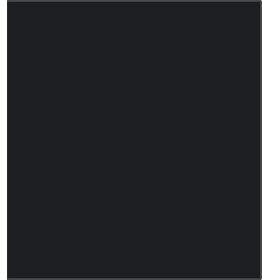
R7
Official Week 23 Prediction Dashboard
REGIME: NEUTRAL-BULLISH
CONFIDENCE: MEDIUM
This dashboard represents the team's final locked prediction for the upcoming week — a synthesis of AI signals, human override scoring, sector rotation intelligence, and clearly defined invalidation thresholds. Targets are deliberately conservative, reflecting the constrained risk/reward environment identified by our Human Score process.
Index Targets
Sector Watch
Instrument
Signal
Target Range
▲ LEADING: Technology (XLK)
▼ LAGGING: Financials (XLF)
S&P 500 (SPX)
UP
+0.2% to +1.0%
Nasdaq 100 (NDX)
UP
+0.5% to +1.5%
Seasonal strength aligns with AI earnings momentum. Structural bid from large-cap tech continues to dominate index-level performance and provides the primary upside driver for SPX and NDX targets this week.
Yield pressure compresses net interest margin expectations. May–July seasonal weakness adds a systematic headwind. Avoid overweighting until yield curve dynamics improve materially.
Russell 2000 (IWM)
UP
0.0% to +1.2%
10-Year Yield
FLAT
4.35% to 4.55%
WTI Crude Oil
FLAT
-3% to +3% (Iran Risk)
Equity index targets reflect a constrained but positive directional bias. The Nasdaq leads on structural AI earnings momentum; Russell upside is capped by yield sensitivity and small-cap breadth weakness. Crude oil carries elevated geopolitical optionality — the Iran risk premium makes a directional call unreliable.
Invalidation Red Lines
Red Line 1: SPX closes below 7,350 — triggers 21 EMA and primary trendline failure. Full thesis invalidation.
Red Line 2: NFP significantly beats consensus — violent Treasury yield spike reshapes Fed rate expectations, collapsing the macro tailwind underpinning all index targets.
The Neutral-Bullish thesis is strictly conditional on the two red lines holding. A breach of either threshold — particularly a hot NFP print on Friday — would invalidate the week's directional call entirely and signal an immediate reassessment of positioning across all listed instruments.
To conclude our Sprint, this dashboard represents our final locked prediction for the upcoming week. We are scaling back the AI's optimism, targeting a highly constrained gain of plus 0.2 to 1.0 percent for the S&P 500. We anticipate Technology to continue leading due to structural momentum, while Financials lag under yield pressures. Finally, our entire Neutral-Bullish thesis is strictly invalidated if the S&P closes below our 7,350 support confluence, or if a hot Nonfarm Payrolls print violently reshapes Fed expectations on Friday. This concludes our team's synthesis.

Slide 26
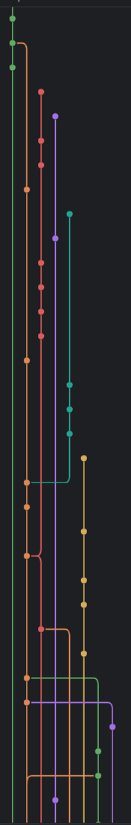
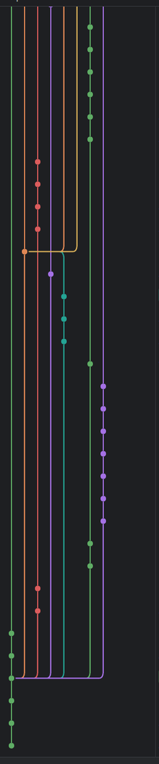
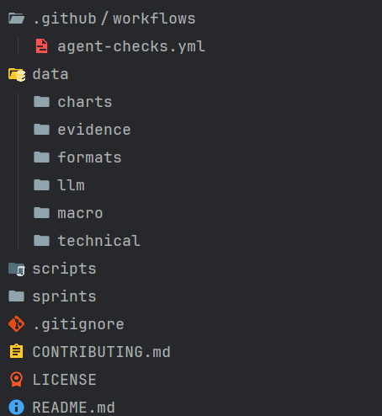
R9
GitHub Overview
BRANCH RULES
WORKFLOW
CLEAR STRUCTURE
Main branch is protected
Pull most recent main
Collaborators can create
their own branches and PRs
Create new branch with changes
Tags can be created only by the owner
Push PR and request review
GitHub actions provide automatic rule enforcement
Iteratete and improve
Merge backinto main
I will address our core definition of done: I can officially confirm that the release tag vW23 has been successfully created, and our repository's README has been fully updated with this week's locked prediction. To maintain absolute data integrity across our multi-agent workflow, we have enforced strict branch rules. As shown on the left, our 'main' branch is heavily protected. GitHub Actions are configured to provide automatic rule enforcement, ensuring no single member can overwrite our consensus data. Our required workflow dictates that every team member—whether uploading macro screenshots or LLM JSON outputs—must pull the most recent main, create their own specific branch, and push a Pull Request (PR) for peer review. Only after we iterate and approve the changes are they merged back into the main branch, as visualized in the commit graph above. This rigorous CI/CD pipeline guarantees a perfectly clear directory structure. As you can see on the right, all raw AI responses, market screenshots, and our final Human Score are safely siloed into their respective 'evidence' and 'data' folders. This provides a transparent, immutable audit trail for grading. I will now hand the presentation over to our QA Lead for the final sprint calibration and retrospective.

Slide 27
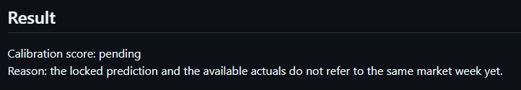
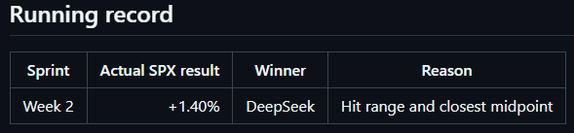
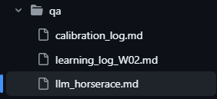
R10
Calibration Score
• Current status: Pending / not finalized
• Reason: prediction week and actuals week must clearly match before scoring
• QA decision: do not force a score from mismatched evidence
LLM Horse Race
• Actual SPX result: +1.40%
• Closest model: DeepSeek
• Reason: DeepSeek included the actual SPX result in its range and had the closest midpoint
Files Completed
• calibration_log.md
• llm_horserace.md
• learning_log_W02.md
For my R10 QA Lead role, I completed the calibration log, LLM horse race, and learning log.
For calibration, I kept the score pending instead of forcing a number. The reason is that QA should only score when the prediction week and actuals week clearly match.
For the LLM horse race, I used the merged R6 comparison table. The actual SPX result was +1.40%. DeepSeek was the closest model because its forecast range included the actual result and its midpoint was closest.
My primary responsibility is to objectively audit our process and evaluate our AI models. First, regarding our calibration score, I have officially marked it as 'Pending'. As a strict QA rule, we do not force a score from mismatched evidence; the locked prediction week and the available actuals must clearly align before a valid score can be finalized. Next, for our LLM Horse Race, benchmarking against the actual SPX result of plus 1.40%, DeepSeek emerged as the definitive winner. It was the most accurate model because its precise forecast range successfully captured the actual result, and its midpoint was the closest. All supporting logs have been committed to the QA folder.

Slide 28
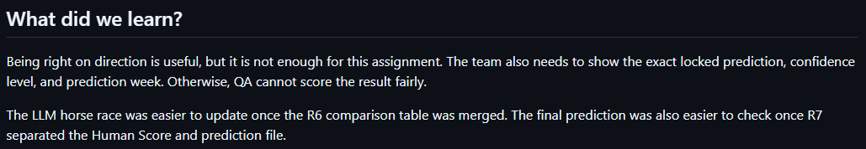
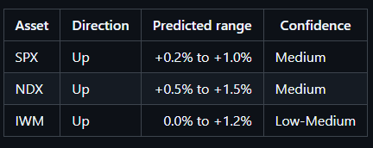
R10 Learning - What We Improve Next Sprint
Main Learning
• Direction alone is not enough for QA scoring
• We also need the locked prediction file, confidence level, range, and correct week
• Clean evidence makes calibration easier and more honest
One Change Next Sprint
• R10 will check the locked prediction file before final submission
• The file must show SPX / NDX / IWM direction, range, confidence, and prediction week
R10
The main thing I learned is that being right on direction is not enough. For QA, we need clear evidence showing what the team predicted, when it was locked, and what confidence level was used.
Next sprint, I will check the locked prediction file earlier. It should clearly show SPX, NDX, and IWM direction, percentage range, confidence level, and the prediction week.
I will also check that the raw LLM outputs, Human Score, actuals, screenshots, calibration log, and learning log are all available before final submission.
Moving to our retrospective, we recognized a critical gap in our evidentiary workflow. We realized that being right on market direction alone is simply not enough for rigorous QA scoring; we require clean, undeniable evidence to make calibration honest. Therefore, I must explicitly state our learning: what the team will do differently next sprint is implement a strict pre-submission QA gate. Specifically, I will audit the locked prediction file before any final submission is merged. I will verify that it explicitly dictates the SPX, NDX, and IWM directions, exact percentage ranges, confidence levels, and the precise prediction week. This operational change guarantees absolute transparency moving forward. Thank you, this concludes Team 1's sprint review.

Slide 29
Thank you!
Do you have any questions?

