Slide 1


Deforestation(Fire Classification)

Slide 2

Learning Objectives
Learn how forest fires impact deforestation.
Understand the use of AI to detect fire-prone areas.
Explore and clean the fire dataset.
Apply ML models like Decision Tree & Logistic Regression.
Check model performance using accuracy & confusion matrix.
Use Python libraries like Pandas, Sklearn, and Matplotlib.
GOAL
Source :
www.freepik.com/

Slide 3
Tools and Technology used
Python – Programming language
Jupyter Notebook / Google Colab – For coding and testing
Pandas – For data handling and preprocessing
NumPy – For numerical operations
Matplotlib & Seaborn – For data visualization
Scikit-learn – For machine learning models
Classification Algorithms – Logistic Regression, Decision Tree, Random Forest
CSV Dataset – Forest fire data

Slide 4
Methodology
In this project, we aim to predict forest fires using machine learning. We first understand the problem and collect the dataset with features like temperature, humidity, wind, and rainfall. Then, we clean the data by removing missing values and preparing it for training. We use graphs and charts to understand the data better. Next, we split the data into training and testing parts. We apply different ML models like Logistic Regression, Decision Tree, and Random Forest. After training, we test the model's performance using accuracy and confusion matrix. We compare which model gives the best results. We also check which features affect fire prediction the most. Finally, we conclude the best model and its use in real forest fire detection.

Slide 5
Problem Statement:
Forest fires are one of the major causes of deforestation and environmental damage. Detecting and predicting fire-prone areas in advance can help prevent large-scale forest loss and support early action. The goal of this project is to develop a machine learning model that can classify whether a specific area is at risk of a forest fire based on environmental data such as temperature, humidity, wind speed, and rainfall. By using historical fire data, we aim to build a reliable model that helps in early detection and supports forest protection efforts.

Slide 6
Solution:
To solve the problem of forest fire prediction, we use a machine learning-based classification model. We start by collecting and analyzing a dataset that contains environmental features like temperature, humidity, wind, and rainfall. After preprocessing the data, we apply ML algorithms such as Logistic Regression, Decision Tree, and Random Forest to classify whether an area is fire-prone or not. We evaluate the model’s performance using accuracy and other metrics. The best-performing model is selected to predict fire risk in new data. This solution helps in early warning and supports forest protection by identifying areas that are likely to catch fire.
Github link :https://github.com/sindhu-ops24/AICTE-INTERNSHIP.git

Slide 7
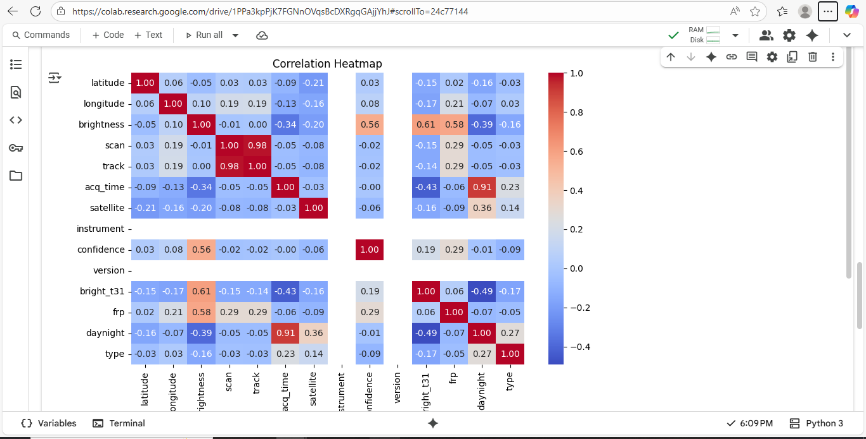
Screenshot of Output:

Slide 8
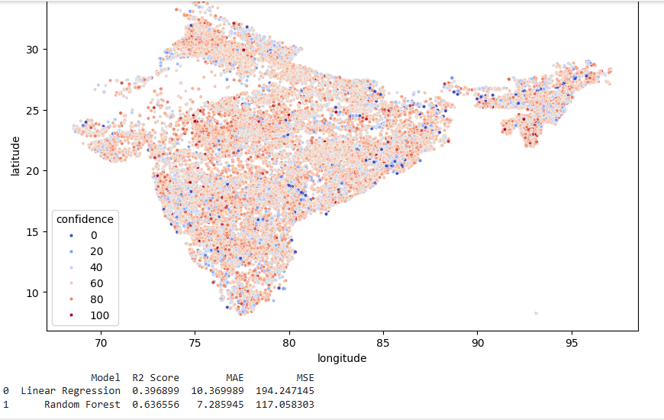

Slide 9
Conclusion:
In this project, we successfully built a machine learning model to classify fire-prone areas using environmental data. By applying classification algorithms like Logistic Regression, Decision Tree, and Random Forest, we were able to predict the chances of a forest fire based on key factors such as temperature, humidity, wind, and rainfall. The model helps in early detection and can assist forest departments in taking preventive measures. This project shows how AI can be effectively used to solve real-world environmental problems and support sustainable development by protecting forests from fire-related deforestation.

