Slide 1




Team-UXIFY
Unified Student Dashboard
A centralized platform to simplify student life
Submitted by: G.Sindhu 245323748096
G.Thanusree 245323748029

Slide 2
Problem Statement
Students rely on multiple platforms such as WhatsApp, portals, and Telegram to access academic information. This fragmented system creates confusion, wastes time, and often leads to missed deadlines and important updates. The lack of a centralized platform makes it difficult for students to manage their academic activities efficiently.

Slide 3
User Persona
Background:
A full-time engineering student managing multiple subjects
Depends on different platforms for academic updates
Often struggles to track deadlines and important notices
Wants a simpler and more organized system
Frustrations:
Too many platforms for different tasks
Misses important deadlines or updates
Confusion about where information is posted
Time wasted switching between apps
Name: Riya Sharma Age: 20 Occupation: Engineering Student Location:NGIT,Hyderabad, India
Personality: Organized, responsible

Slide 4
Goals:
Access all academic information in one place
Never miss deadlines or notices
Save time and reduce confusion
Improve productivity and planning
Key Behaviors:
Checks multiple apps frequently
Relies on reminders and notifications
Double-checks information to avoid missing updates
Prefers simple and clear interfaces
Hobbies & Interests:
Uses mobile apps daily for academic work
Prefers digital notes over handwritten
Regularly checks WhatsApp & college portals
Interested in productivity and time management
Preferred Tech & Tools:
WhatsApp (for notices)
College portal (for attendance)
Google Drive / PDFs (for materials)
Coding platforms (for assignments)

Slide 5
User Story
Riya is a college student who checks her phone daily for academic updates. She receives notices, assignments, and materials across multiple platforms like WhatsApp, portals, and Telegram. This makes it difficult for her to keep track of important information. She often switches between apps, feeling confused and worried about missing deadlines. At times, she forgets where a specific update was posted. Using the Unified Student Dashboard, she can access everything in one place. She quickly views assignments, notices, and attendance without confusion. This helps her save time, stay organized, and manage her academics efficiently.

Slide 6
Empathy Map
Think:
I need to keep track of assignments and notices properly
Where was this update posted?
I hope I didn’t miss any deadlines
Why is everything scattered across different platforms?
I wish everything was available in one place
Say:
“Where did they send this notice?”
“I think I missed something important.”
“There are too many apps to check.”
“This is so confusing!”
“I wish there was a single platform for everything.”
Key Pain Points:
Too many platforms to manage
Missed deadlines and updates
Time wasted switching apps
No centralized system
Information overload
Feel:
Frustrated due to scattered information
Stressed about missing deadlines
Confused about where to find updates
Relieved when everything is found
Annoyed by switching multiple apps
Do:
Checks WhatsApp groups frequently
Logs into different portals for attendance
Searches Telegram or Drive for materials
Switches between multiple apps repeatedly
Sets reminders to avoid missing deadlines
Key Learnings / Opportunities:
Need for a centralized dashboard
Highlight urgent tasks clearly
Provide all resources in one place
Reduce app switching
Improve student productivity

Slide 7
Pain points
Multiple platforms for different academic tasks
Difficulty tracking notices, assignments, and materials
Missed deadlines and important updates
Time wasted switching between applications
Lack of a centralized system
Information overload and confusion

Slide 8
Feature List
Centralized dashboard for all academic activities
Real-time notices and updates
Assignment tracking with deadlines
Study materials access and download
Attendance overview with percentage
Highlight urgent tasks and notifications

Slide 9
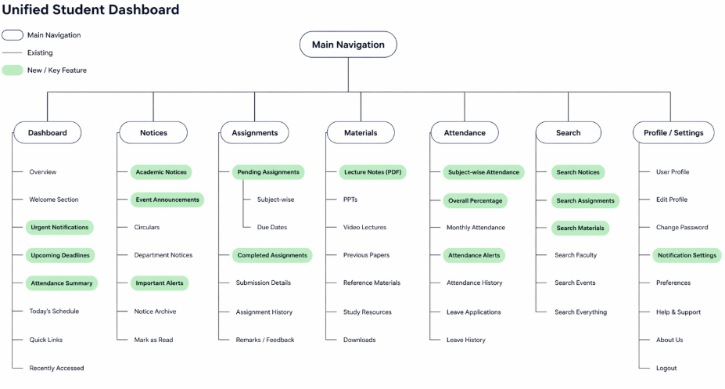
Information Architechture

Slide 10
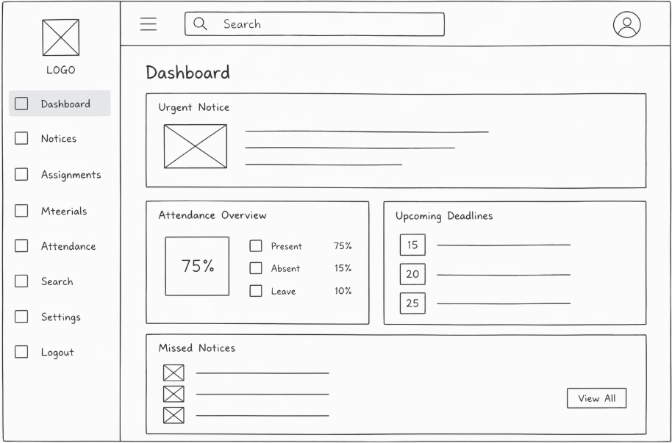
Wire Frame

Slide 11
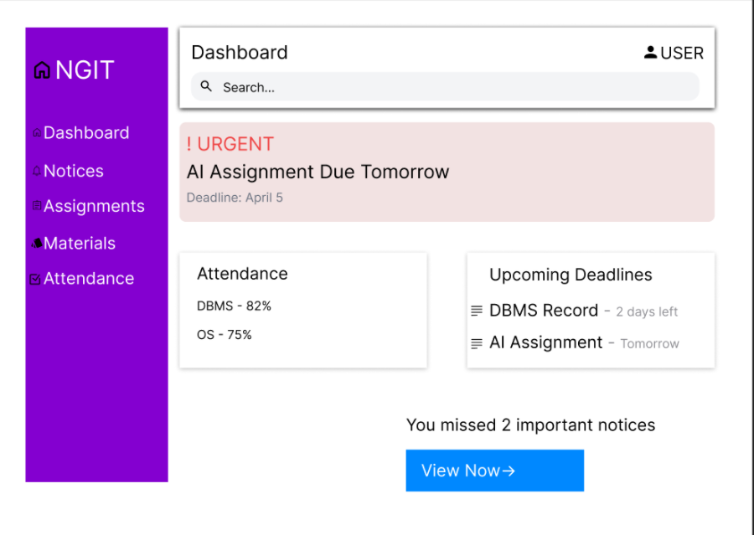
Final Design
Main Dashboard UI

Slide 12
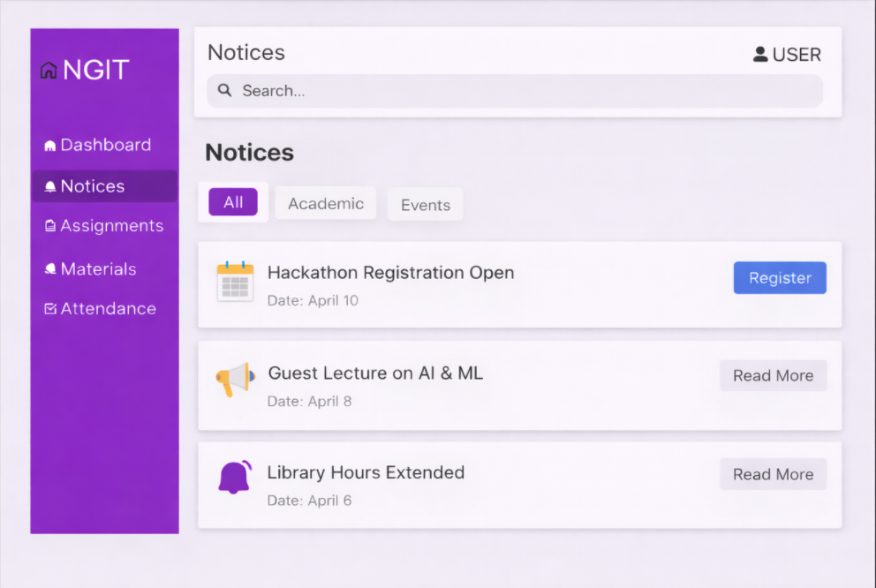
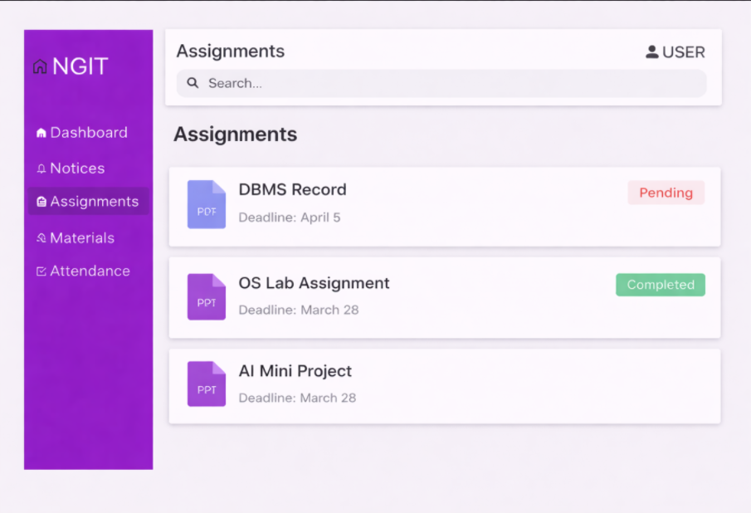
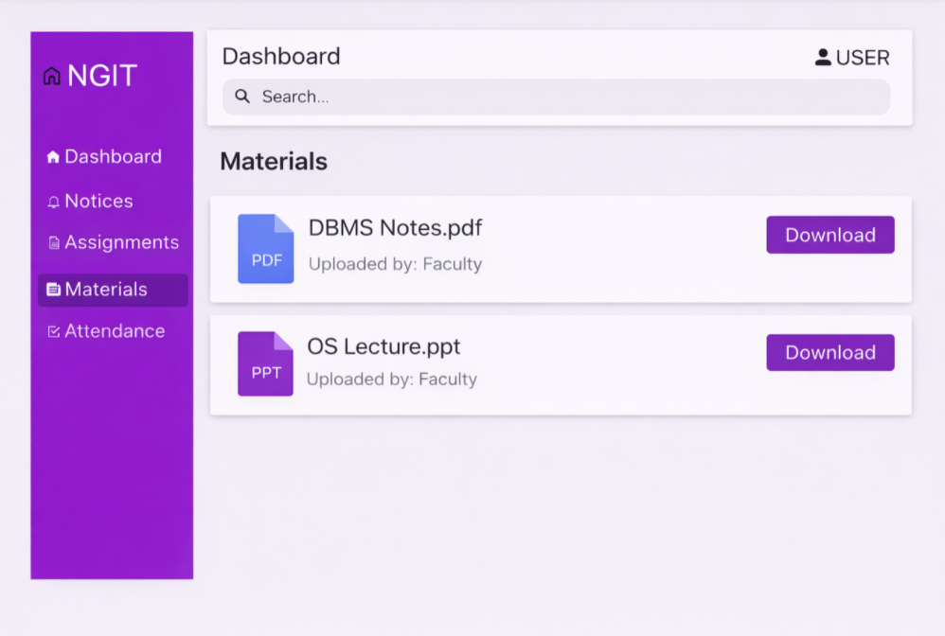
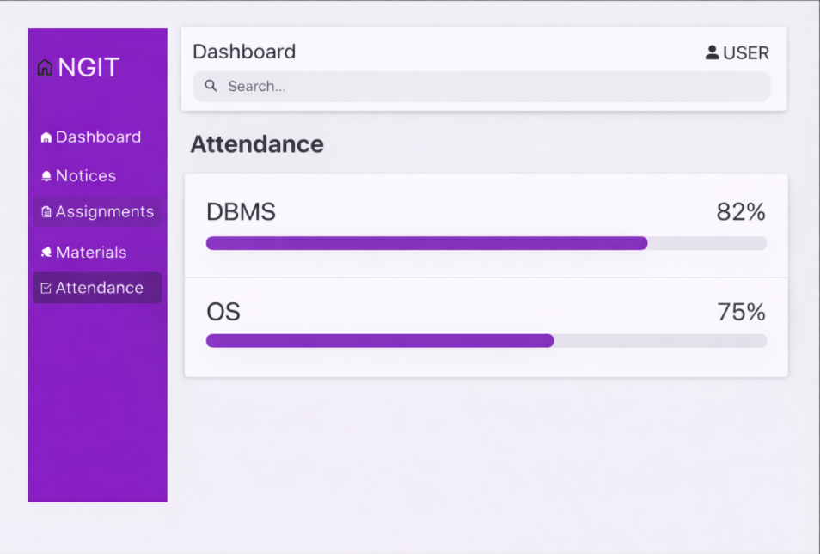

Slide 13
Live Demo Link
A fully functional prototype of the Unified Student Dashboard:
https://boisterous-paprenjak-fc3313.netlify.app/

Slide 14
THANK YOU

